Slide 1
Distributed systems
naming

Slide 2
Title and Content Layout with List
Objectives
Identifying names, identifiers and addresses
Differentiating flat naming, structure naming and attribute based naming
Introduction
Names, identifiers and addresses
Flat naming
Structured naming
Attribute-based naming

Slide 3
Introduction
Names in computer system plays an important role:
To share resources
To uniquely identify entities
To refer to location
Naming is that a name can be resoled to an entity it refers to.
Name resolution thus allows a process to access the named entity.
To resolve names, it is necessary to implement naming system
Naming in nondistributed and distributed system is the way naming systems are implemented.
In distributed systems naming system is distributed across multiple machines.
important types of names
Address, identifiers and human-friendly

Slide 4
Naming ways in DS
Three ways:
Flat-naming systems
→ Entity referred by identifier
→ no structure and need other special mechanism to trace the location of entity
Structure
→ Readable for human
→ Allow for a highly systematic way of finding the server responsible for the named entity
→ Example : DNS of Web pages are referred to
Attributed based
describe entities by their characteristics
which makes difficult naming system especially for searching.

Slide 5
Names, identifiers, and addresses
Name in DS is a string of bits or characters that is used to refer to an entity.
An entity can be anything
Example hosts, printers, disks, and files, users, mailboxes, newsgroups, Web pages, GUI, messages, network connections, and so on.
Entities can be operated on.
Examples
printer
Network service
To operate on an entity, it is necessary to access it, for which we need an access point.
Access point is special kind of an entity of DS.
Address is the name of an access point.

Slide 6
Names, identifiers, and addresses
An entity can offer more than an access point.
As a comparison
telephone ➔access point of a person
Telephone number ➔an address
In DS
host running a specific server ➔ access point
IP address : Port ➔ address
Address and access point can be reassigned or changed
When an entity is independent from its address will be much easier and more flexible to use.
This is called location independent. Example Web service across multiple servers referred by an address
Unique identifiers of an entity ➔ identifiers

Slide 7
Names, identifiers, and addresses
A true identifier is a name that has the following properties:
An identifier refers to at most one entity
Each entity referred to by at most one identifier
An identifier always refers to the same entity → never reused
Referring an entity by identifier makes much easier and unambiguous.
In computer system addresses and identifiers are represented in machine-readable form only, that is in form of bit of strings
Example
Ethernet address is essentially a random string of 48 bit
Memory addresses are represented by 32 bit or 64 bit strings

Slide 8
Flat naming
Flat name can be resolved, how can locate an entity when given only its identifier
Simple solutions
Broadcast applicable in LAN (wired or wireless)
Message containing the identifier of that entity is broadcast to each machine and each machine is requested to check whether it has that entity?
Only the machines that can offer an access point for the entity send a reply message containing the address of that access point.
This principle is used the Internet ARP
It becomes inefficient when network grows
As solution → multicast
Forwarding pointers applicable LAN of mobile entity naming
When an entity moves from A to B, it leaves behind in A a reference to its new location at B
The advantage of this approach is its simplicity
Drawbacks
Chain become so longer
Intermediate locations in a chain will have to maintain their part
Vulnerability to broken link

Slide 9
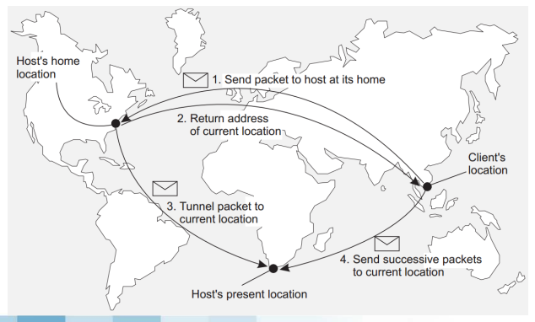
Flat naming
Home based approaches
Supporting mobile entities in large-scale network
Keeps track of current location of entity
It used as fall-back mechanism for location services based on forwarding pointers
Example
Mobile IP
Drawbacks
The entity first contact to home ,which increase communication latency
Use fixed home location

Slide 10
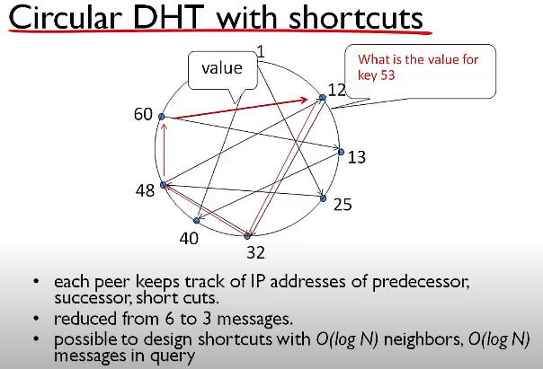
Flat naming
Distributed hash tables
Many DHT systems have been developed with Chord system
Chord uses an m-bit identifier space to assign randomly chosen identifiers to nodes as well as keys to specific entities.

Slide 11
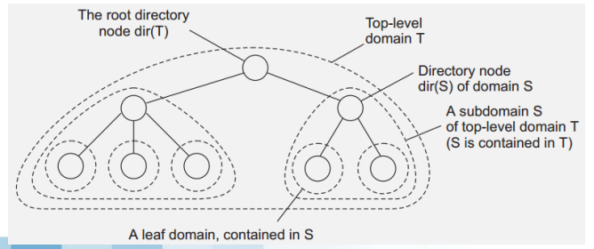
Flat naming
Hierarchical
Network is divided into a collection of domains
Single top-level domain
Lowes-level domain → leaf domain
Directory node

Slide 12
Structured naming
Name space → names package
Name space is represented as a labeled(sequential) , directed graph(hierarchical)
Typical two types of nodes :
Leaf node
→ name an entity that has no outgoing edges.
It store information of entity it is representing and alternatively store stat of that entity.
It will return contents of nodes below
Directory node
Name an entity that has outgoing edges
Store table which contain node identifier and edge

Slide 13
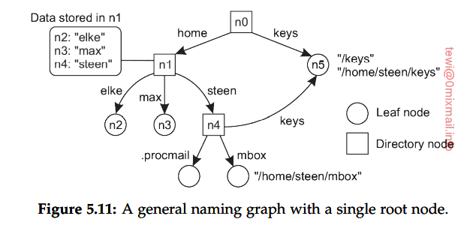
Structured naming
Path → sequence of label
Relative path name
Absolut path name

Slide 14
Structured naming
Name resolution is the process of looking up a name.
Name resolution can takes place only if we know how and where to start.
Example [label 1, label 2,…. Label n ] where the name label 1 is looked up in the directory table, which returns the identifier of the node to which label 1 refers. Then continue to label 2
Closure mechanism
It is know how and where to start name resolution
Example “003120058798” how to know what this string mean →told that it is phone number → call

Slide 15
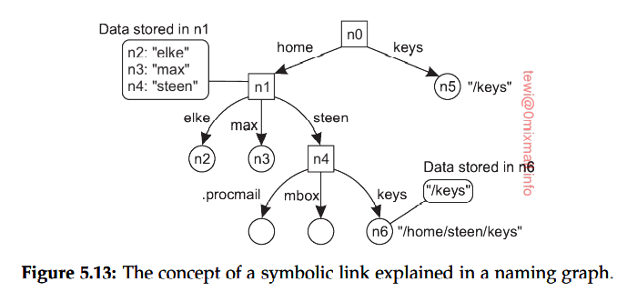
Structured naming
Hard links to refer to node n5 are
/keys and home/steen/keys
Hard link : multiple absolute path referred to an entity
Soft link: leaf node stores an absolute path name

Slide 16
Structured naming
Linking and mounting
Name resolution is possible by merge different name spaces in a transparent way
Foreign name space → directory node store the identifier of a directory node from a different name space
Mount point is the directory node storing the node identifier
Mounting point is directory node in the foreign name space and it is root of a name space

Slide 17
Implementation of name spece
Name space is the heart of naming service
Name service is implemented by name servers
LAN → single name server is enough
Large scale DS → multiple name servers
Name spaces are partitioned into logical layers and organized into hierarchy to implement them effectively

Slide 18
Implementation of name spece
Layers
Global
Represents a group of organizations which manage it jointly
Consist of highest level that are stable
Administrational
Midd-level directory nodes that are managed within a single organization
Represent group of entities that belongs to the same organization
Relatively stable
Managerial
Nodes change regularly
Example
Hosts in a network
Managed by system administrators and end users of a DS

Slide 19
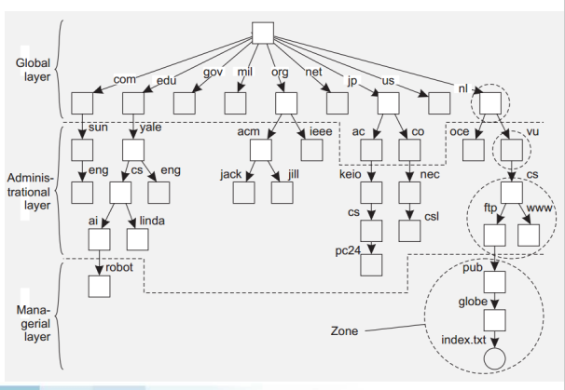
Implementation of name spece
Zone
A non-overlapping division of a name space
Implemented by separate name server

Slide 20
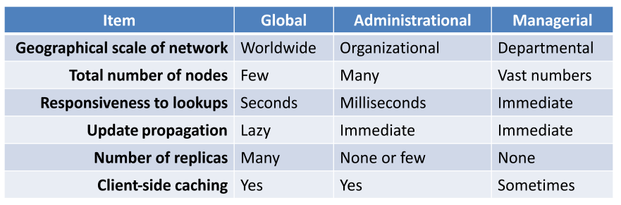
Implementation of name spece

Slide 21
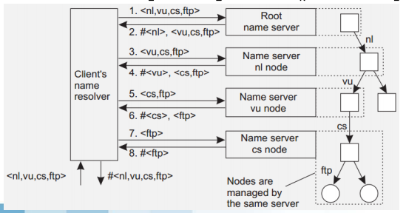
Implementation of name resolution
Iterative name resolution
Resolve(dir,[name₁, name₂,……name_{k}]) sent to Server₀ responsible for dir
Server₀ resolves name₁ using dir, and return the address of Server₁ which stores dir₁
Client send resolve(dir₁,[name₂,……name_{k}]) sent to Server₁

Slide 22
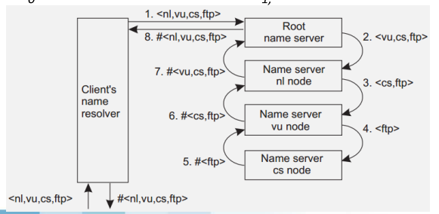
Implementation of name resolution
Recursive name resolution
Resolve(dir,[name₁, name₂,……name_{k}]) sent to Server₀ responsible for dir
Server₀ resolves name₁ using dir, and return the address of Server₁ which stores dir₁
Server₀ wait for result from Server₁ and returns result to client

Slide 23
Implementation of name resolution
Recursive name resolution
Drawbacks
Puts higher performance demand on each name server
Possible solution
Replication at the global and administrative level
Advantages
Caching results is more effective
For iterative name resolution caching is restricted to the client’s name resolver

Slide 24
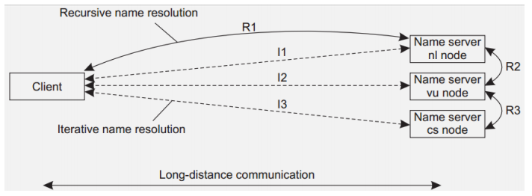
Implementation of name resolution
Recursive name resolution
Drawbacks
Puts higher performance demand on each name server
Possible solution
Replication at the global and administrative level
Advantages
Caching results is more effective
For iterative name resolution caching is restricted to the client’s name resolver
Reduce communication costs

Slide 25
Implementation of name resolution
Recursive name resolution
Drawbacks
Puts higher performance demand on each name server
Possible solution
Replication at the global and administrative level
Advantages
Caching results is more effective
For iterative name resolution caching is restricted to the client’s name resolver
Reduce communication costs

Slide 26
Attribute based naming
Also known as directory services

