Slide 1
Distributed systems
coordination

Slide 2
Title and Content Layout with List

Slide 3
Title and Content Layout with List
Introduction
Coordination and synchronization
Physical clock
Logical clock
Mutual exclusion
Election algorithm
Objectives
By the end of this lesson you will be able to
Define coordination and synchronization
Differentiate physical clock, logical clock and mutual exclusion
Know physical clock, logical clock, mutual exclusion and election algorithms

Slide 4
Synchronization
Synchronization : flow of a program
Task is going on
Example if there are three sensors and exchange date in every 30 second without interrupting each other
Coordination of actions between processes is synchronization (we use clock to achieve this) to send and receive data
Clock synchronization
It is a mechanism to synchronize the time of all nodes in the DS

Slide 5
Clock synchronization
Clock synchronization can be achieved by
Internal : your own clock
Is the one which each node share its time with other node and all nodes set and adjust accordingly.
External : external reference clock is present.
It is used as a reference and the node in the system can set and adjust their time accordingly.
Ethiopia (3:00)➔ USA(3:00) the same time

Slide 6
Clock synchronization
Algorisms
Centralized : a single time server used as a reference
The time server propagate its time to the node and all the nodes adjust their time accordingly.
If the time server filed the whole synchronization failed
Decentralized
No centralized time server here instead node their by sharing their and making average

Slide 7
Physical Clock
Physical clock/local clock
It is a physical process and also a method of measuring that process to record the passage of time. For example, the rotation of the Earth measured in solar days.
Most of the physical clocks are based on cyclic processes such as a celestial rotation.
Count Crystal Oscillator at particular frequency
each node share local system clock
T1 working at 3:00 T2 says working at 3:15 (who will work?)
The time difference between the two computers know as drift.

Slide 8
Physical clock synchronization algorithms
Coordinate Universal Time (UTC)
Christian algorithm
Berkley algorithm ➔ most important

Slide 9
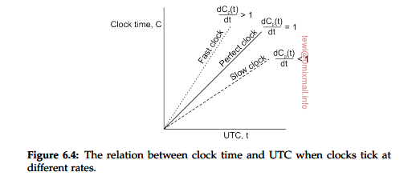
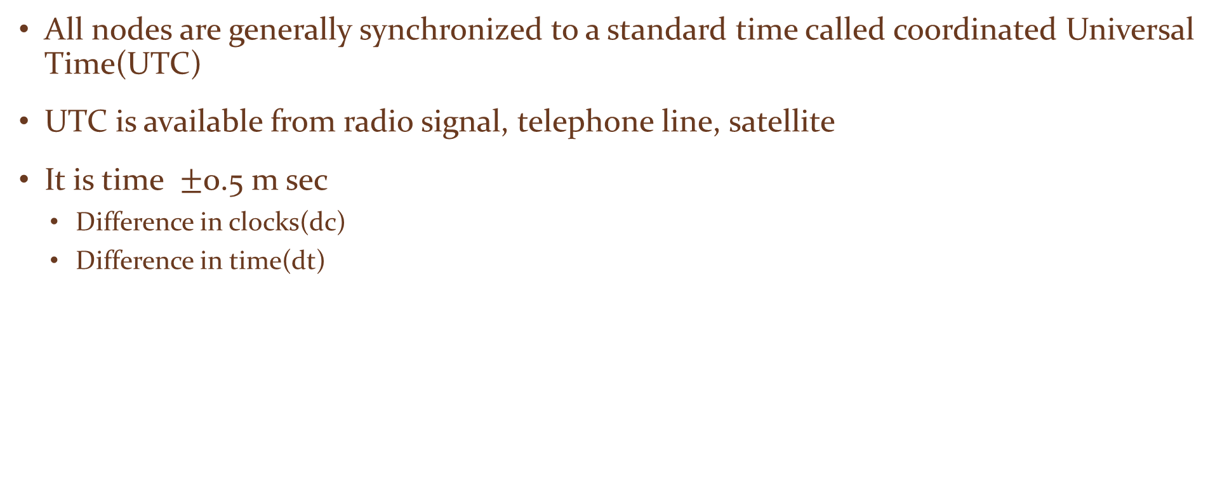
UTC
All nodes are generally synchronized to a standard time called coordinated Universal Time(UTC)
UTC is available from radio signal, telephone line, satellite
It is time $±$0.5 m sec
Difference in clocks(dc)
Difference in time(dt)

Slide 10
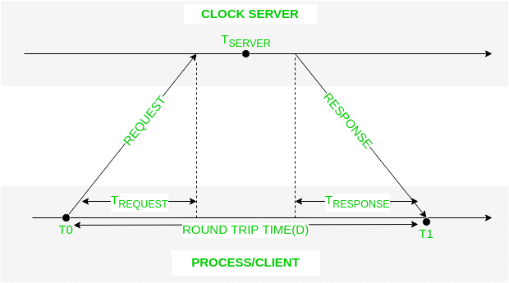
Christians
It is simple algorithm for setting a time
Issue a RPC to time server and obtain the time
A machine send a request to the time server in d/2 seconds
Where d is the max differ between a clock and UTC
The time server sends a reply with current UTC where receive the request
The machine measure the time delay between server sending the message and machine received it the adjust the clock

Slide 11
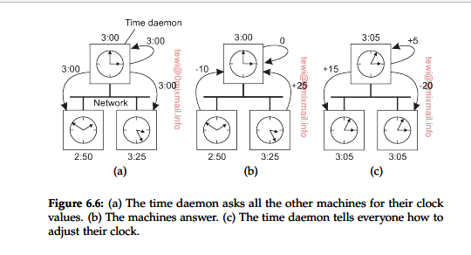
Berkley algorithm
The server polls each machine periodically asking it for the time

Slide 12
Logical clock
Mechanism for capturing chronological and causal relationships in a DS(event)
Then the nodes are able to maintain consistent ordering of events with some virtual time stamp
Ordering is important
Exact time is not important
Only forward no backward

Slide 13
Logical clock algorithm
Lamport timestamps : which are monotonically increasing software counters.
Vector clocks: that allow for partial ordering of events in a distributed system.
Version vectors: order replicas, according to updates, in an optimistic replicated system.
Matrix clocks: an extension of vector clocks that also contains information about other processes' views of the system.

Slide 14
Lamport algorithm
Process exchange message
Message must be sent before received
Sender/receiver used to order events and synchronize logical clock
Assign sequence number to message
No central time source
Only ordering
Uses happed before notation a → b ( the time a must be greater or equal to time b)

Slide 15
Mutual exclusion
When a process is accessing a shared variable, the process is said to be a critical section
No two processes in the same critical section at the same time this is called mutual exclusion
Algorithms
centralized
Token ring
Distributed
decentralized

Slide 16
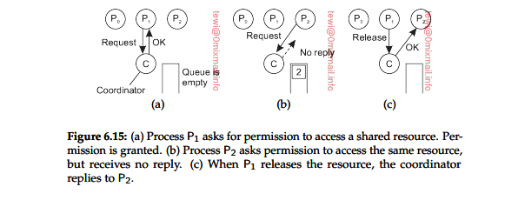
Centralized algorithm
Boss → elected leader
Other are requesting the boss and get permission
Queue is maintained to track the requests

Slide 17
Decentralized algorithm
Problems in centralized algorithm is that when a boss crashed the nodes cannot be communicate
Every node are equal
To access the shared resource process will require the majority to the vote coordinator( any voting process)
Based on the maximum vote resource can be allocated
If a process wants to access it needs to get m > n/2

Slide 18
Distributed algorithm
When a process wants to access a shared resource builds a message containing the name of resource, its process number, current local time
It sends the message to all others
Based on the process status with reply to the resource
1 if the receiver is not accessing the resource and does not want to access it, it sends back on Ok message to the sender
2 if the receiver already has access to the resource, it simply does not reply and queue instead
3 if the resource also want to access. The time stamps are compared and one will win.

Slide 19
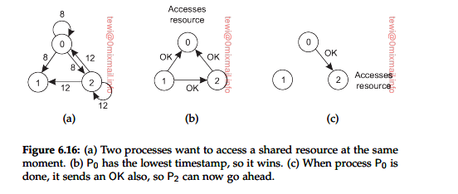
Distributed algorithm

Slide 20
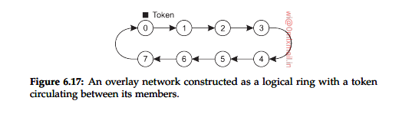
Token ring algorithm
A simple approach in which the token is used as a key
Whoever has the token can access the resource if needed and the token is passed one by one in any particular order
No starvation
Mutual exclusion

Slide 21
Token ring algorithm
Algorithm | Message per entry/exit | Delay before entry | problem
Centralized | 3 | 2 | Coordinator crashs
Decentralized | 3 mk( k = 1,2,3…) | 2m | Starvation, low efficient
Distributed | 2 (n-1) | 2(n-1) | Crash of any process
Token ring | 1 to infinity | 0 to n-1 | Loss of token, Process crash

Slide 22
Location system (GPS)
Global positioning nodes
When the number of nodes in DS grows it becomes increasingly difficult for on node to keep track of the others
So to keep the tack we position each process in an m dimension space such that the distance between any two nodes is measurable.
Distance can be in terms of time also time taken from one node to another is the distance between them.
Example if a server s1 is replicated into multiple servers s1, s2, s3,… sk when a client come and if know the distance the we can directly select the mine of distance between client and any replicated server.

Slide 23
Election algorithm
Many distributed algorithms need are process to act as coordinator
Is the technique to pic a unique coordinator (leader)
Bully algorithm
Ring algorithm

Slide 24
Bully algorithm
Each process has a unique number
Process know the id and address of every other processes
Communication is assumed as reliable
The key idea is selecting the highest ID (for a leader)
Process initiates election if it just recovered from failure or if coordinator failed
Several process can be initiated an election simultaneously
O(n²)

Slide 25
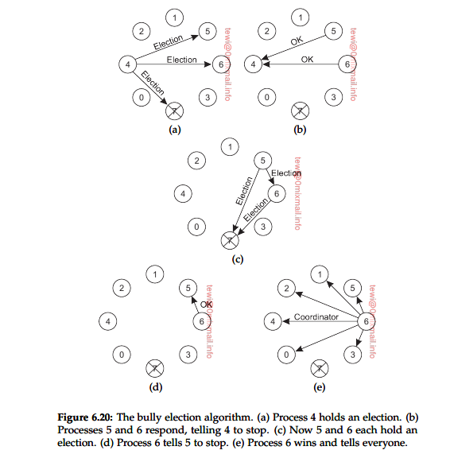
Bully algorithm

Slide 26
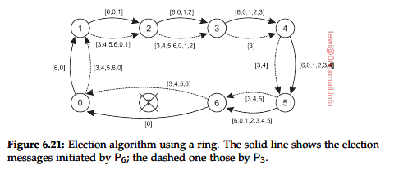
Ring algorithm
This algorithm applies to system organization as a ring(train) or chain (logically or physically)
P7 is failed and p6 and p3 are initiate to discover the leader then the highest number is 6 and it will be a leader

Slide 27
Ring algorithm
This algorithm applies to system organization as a ring(train) or chain (logically or physically)
P7 is failed and p6 and p3 are initiate to discover the leader then the highest number is 6 and it will be a leader

Slide 28
?

