Slide 1
Distributed System
MapReduce
Raft
k/v server
Shared k/v
Maarten van Steen
Andrew S. Tanenbaum
Third edition

Slide 2
Title and Content Layout
Introduction
Architectures
Architectural styles
Middleware organization
System architecture
Examples
Objectives
At the end of this course you will be able to:
Define what an architecture style mean in DSs
List different architectures of DSs
Compare and contrast architectural styles of DSs
List examples of architectural styles DSs

Slide 3
Introduction
DSs are often complex pieces of software of which the components are by definition dispersed across multiple machines.
To master their complexity, it is crucial that these systems are properly organized.
Logical organization ➔software architecture
Physical organization ➔system architecture
Software architectures : how various software components are to be organized and how they should organized.
An important goal of DSs is to separate applications from underlying platforms by providing a middleware layer.

Slide 4
Introduction
Middleware layer is an important architectural decision, and its main purpose is to provide distribution transparency.
However, trade-offs need to be made to achieve transparency, which has led to various techniques to adjust the middleware to the needs of the applications that make use of it.
Realization of a DS requires that we instantiate and place software component on real machines.
The final destination of a software architecture is referred to as a system architecture.
Centralized ➔traditional and single system
Decentralized ➔ peer to peer
Hybrid

Slide 5
Architectural styles
Software architecture is crucial for the successful development of large software.
Style is formulated in terms of:
components
the way components connected to each other
the data exchange between components
how these elements are jointly configured into a system
Layered architectures
Object based architectures
Resource centered architectures
Event based architectures
Some of DSs architectural styles

Slide 6
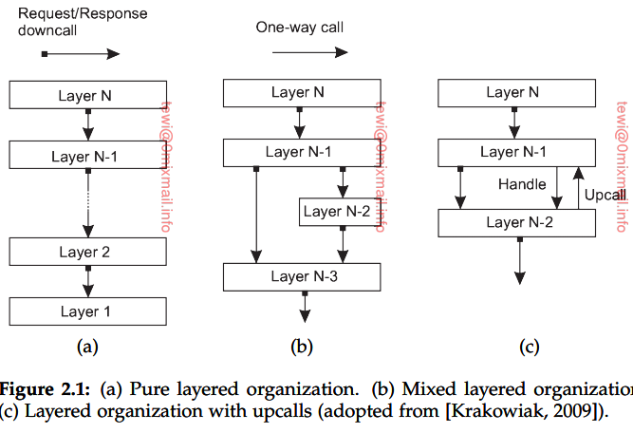
1. Layered Architectures
Components are organized in a layered fashion where a component at layer L_{j} can make a downcall to a component at a lower-level layer L_{i} (with i < j) and generally expect a response.
Only an exceptional cases will an upcall be made to a higher level component.

Slide 7
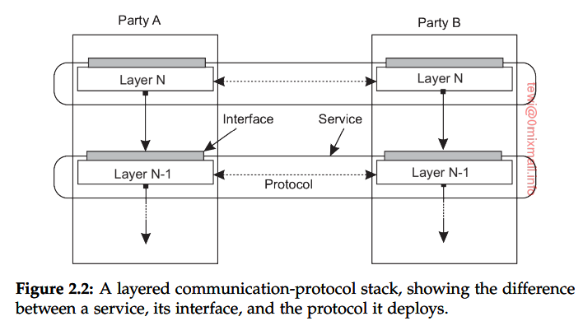
Layered Architectures communication protocol
Connection oriented (TCP)

Slide 8
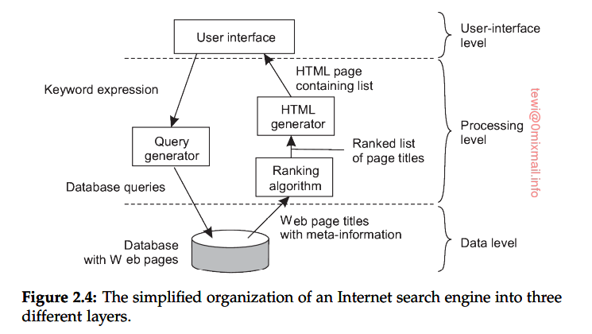
Application layering
The application-interface layering
The processing layering
The data level
Example search engine

Slide 9
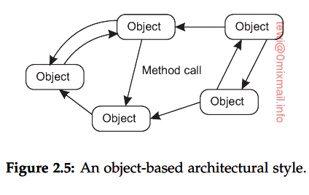
2. Object-based and service-oriented architectures
In DSs components are connected through a procedural call mechanism.
This object or a component not need to be on a machine instead it may be on a network.
Different components can interact directly with other components through a direct method call (RMI or RPC).
This style is attractive due to its data encapsulating nature
Object-based architecture form the foundation of
encapsulating services into independent units
This led to SOA
Example : online shopping

Slide 10
3. Resource based architectures
A DS as a huge collection of resources that are individually managed by components.
Resources may be added or removed by remote applications, likewise retrieved or modified.
This approach has now been widely adopted for the web and known as REST.

Slide 11
4. Event Based Architecture
The entire communication in this kind of a system happens through events.
When an event is generated, it will be sent to the bus system.
With this, everyone else will be notified telling that such an event has occurred.
So, if anyone is interested, that node can pull the event from the bus and use it.
Sometimes these events could be data, or even URLs to resources.
So the receiver can access whatever the information is given in the event and process accordingly.
processes communicate through the propagation of events.
Communication styles
Publisher-subscriber
Broadcast
Point-to-Point

Slide 12
System level architecture
Centralized
Decentralized
Hybrid

Slide 13
1. Centralized organizations
Simple client-server architecture
Connection-oriented
Connectionless
Multitiered architecture
A client machine containing only the programs implementing (part of) the user interface level
A server machine containing the rest, that is, the programs implementing the processing and data level

Slide 14
2. Decentralized organizations: peer to peer systems
All systems are equal
Structured peer-to peer
Topology and route is predefined
Unstructured peer-to-peer
Overlay resemble random graph and apply searching for data(flooding and random walk)
Hierarchically organized peer-to-peer

Slide 15
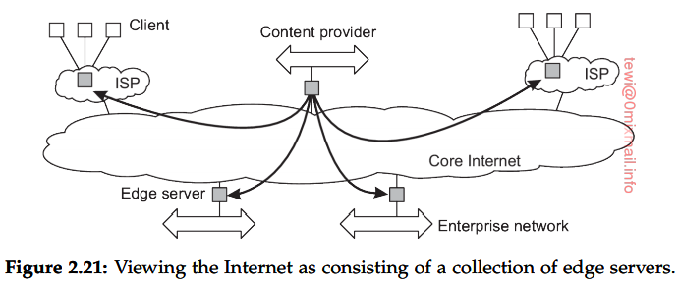
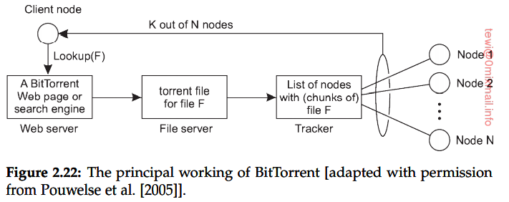
3. Hybrid architecture
Edge-server systems
Deployed on the Internet where servers are placed “at the edge” of the network.
This edge is formed by the boundary between enterprise networks and the actual Internet
Collaborative distributed systems
BitTorrent

Slide 16
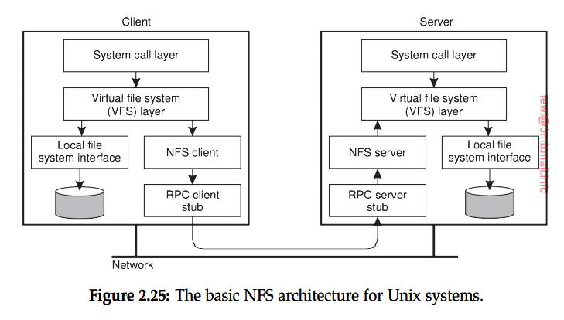
Examples of architectures
1. The network file system (NFS)
One of the most widely deployed ones for Unix systems

Slide 17
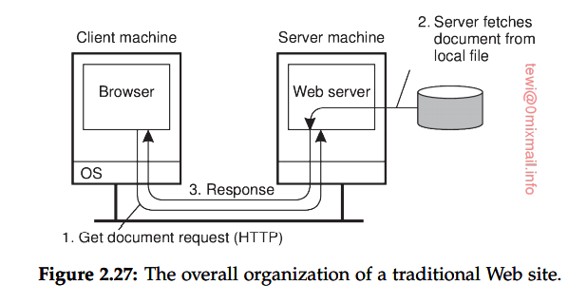
Examples of architectures
2. The Web
a. Simple client-server web architecture

Slide 18
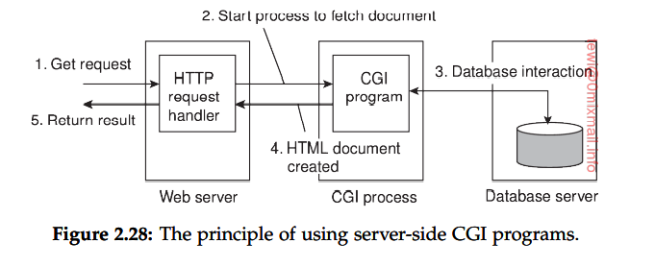
Examples of architectures
2. The Web
b. Multitiered architecture

Slide 19
?

Slide 20
Quiz
Web and network file systems are example of distributed system architecture. Identify the architecture style of Web and Network file system and draw its architectures.

Slide 21
Individual assignment 1
1. Write what you understand from architectures of DSs.
a. Why do you need to learn about distributed systems architecture?
2. Differentiate appropriate application area of different distributed system architectural styles.

