Slide 1
CSM6120 Introduction to Intelligent Systems
Defining the problem + Uninformed search

Slide 2
Groups!
Topics:
Philosophical issues
Neural Networks
Genetic Algorithms
Bayesian Networks
Knowledge Representation (semantic networks, fuzzy sets, rough sets, etc)
Search - evolutionary computation (ACO, PSO), A*, other search methods
Logic/Prolog (e.g. lambda-Prolog, non-monotonic reasoning, expert systems, rule-based systems)

Slide 3
Revision
What is AI??
What is the Turing test?
What AI is involved?
What is the Chinese Room thought experiment?

Slide 4
Search
Many of the tasks underlying AI can be phrased in terms of a search for the solution to the problem at hand
Need to be able to represent the task in a suitable manner
How we go about searching is determined by a search strategy
This can be either
Uninformed (blind search)
Informed (using heuristics – “rules of thumb”)

Slide 5
Introduction
Have a game of noughts and crosses – on your own or with a neighbour
Think/discuss:
How many possible starting moves are there?
How do you reason about where to put a O or X?
How would you represent this in a computer?

Slide 6
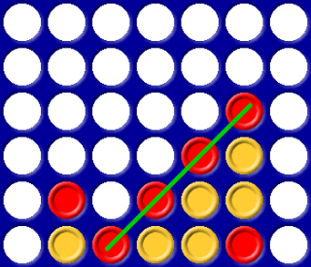
Introduction
How would you go about search in connect 4?
Notes:
So we need a way of representing the problem, and a way of reasoning about the problem

Slide 7
Search
Why do we need search techniques?
Finite but large search space (e.g. chess)
Infinite search space
What do we want from a search?
A solution to our problem
Usually require a good solution, not necessarily optimal
e.g. holidays - lots of choice

Slide 8
The problem of search
We need to:
Define the problem (also consider representation of the problem)
Represent the problem spaces - search trees or graphs
Find solutions - search algorithms

Slide 9
Search states
Search states summarise the state of search
A solution tells us everything we need to know
This is a (special) example of a search state
It contains complete information
It solves the problem
In general a search state may not do either of these
It may not specify everything about a possible solution
It may not solve the problem or extend to a solution
In Chess, a search state might represent a board position

Slide 10
Define the problem
Start state(s) (initial state)
Goal state(s) (goal formulation)
State space (search space)
Actions/Operators for moving in the state space (successor function)
A function to test if the goal state is reached
A function to measure the path cost

Slide 11
C4 problem definition
Start state -
Goal state -
State space -
Actions -
Goal function -
Path cost function -

Slide 12
C4 problem definition
Start state - initial board position (empty)
Goal state - 4-in-a-row
State space - set of all LEGAL board positions
Actions - valid moves (put piece in slot if not full)
Goal function - are there 4 pieces in a row?
Path cost function - number of moves so far

Slide 13
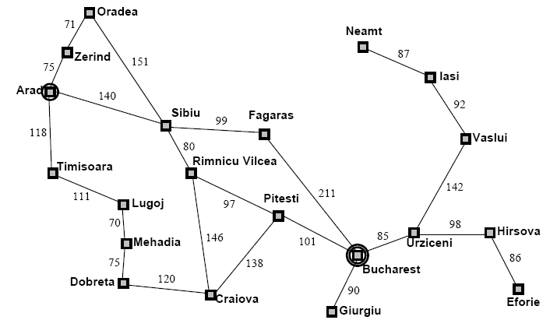
Example: Route planning
Notes:
We’re at Arad and want to get to Bucharest

Slide 14
Problem defintion
Start state - e.g. Arad
Goal state - e.g. Bucharest
State space - set of all possible journeys from Arad
Actions- valid traversals between any two cities (e.g. from Arad to Zerind, Arad to Sibiu, Pitesti to Bucharest, etc)
Goal function - at the destination?
Path cost function - sum of the distances travelled

Slide 15
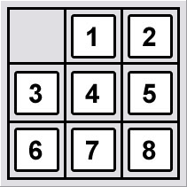
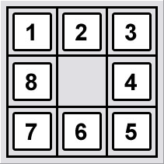
8 puzzle
Initial state
Goal state

Slide 16
8 puzzle problem definition
Start state – e.g. as shown
Goal state – e.g. as shown
State space - all tiles can be placed in any location in the grid (9!/2 = 181440 states)
Actions- ‘blank’ moves: left, right, up, down
Goal function - are the tiles in the goal state?
Path cost function - each move costs 1: length of path = cost total
Notes:
A heuristic here is: how many tiles are in the correct position? We’ll look at heuristics later.
Branching factor is about 3
Empty tile in the middle -> four moves
Empty tile on the edge -> three moves
Empty tile in corner -> two moves
8 puzzle has 9!/2 possible states = 181440 states

Slide 17
Generalising search
Generally, find a solution which extends search state
Initial search problem is to extend null state
Search in AI by structured exploration of search states
Search space is a logical space:
Nodes are search states
Links are all legal connections between search states
Always just an abstraction
Think of search algorithms trying to navigate this extremely complex space
Notes:
With search states we can generalise search
Not just finding a solution to a problem

Slide 18
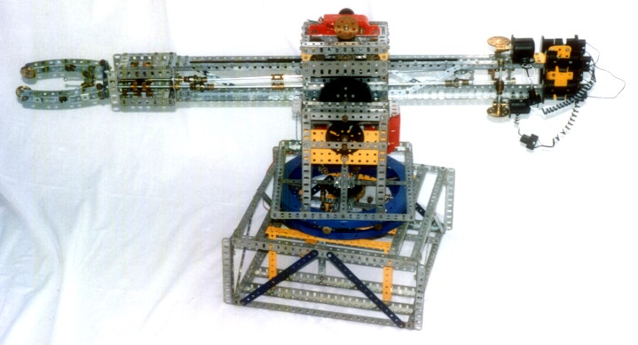
Planning
Control a robot arm that can pick up and stack blocks.
Arm can hold exactly one block
Blocks can either be on the table, or on top of exactly one other block
State = configuration of blocks
{ (on-table G), (on B G), (holding R) }
Actions = pick up or put down a block
(put-down R) put on table
(stack R B) put on another block
Notes:
State = configuration of blocks: ON(A,B), ON(B, TABLE), ON(C, TABLE)
Start state = starting configuration
Goal state test = does state satisfy some test, e.g. “ON(A,B)”?
Actions: MOVE x FROM y TO z
or PICKUP(x,y) and PUTDOWN(x,z)
Output: Sequence of actions that transform start state into goal.

Slide 19
State space
Planning = finding (shortest) paths in state space
put-down(R)
stack(R,B)
pick-up(R)
pick-up(G)
stack(G,R)

Slide 20
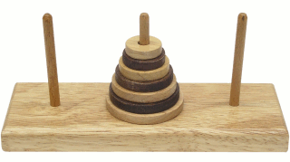
Exercise: Tower of Hanoi
Somewhere near Hanoi there is a monastery whose monks devote their lives to a very important task. In their courtyard are three tall posts. On these posts is a set of sixty-four disks, each with a hole in the centre and each of a different radius. When the monastery was established, all of the disks were on one of the posts, each disk resting on the one just larger than it. The monks’ task is to move all of the disks to one of the other pegs.
Only one disk may be moved at a time, and all the other disks must be on one of the other pegs. In addition, at no time during the process may a disk be placed on top of a smaller disk. The third peg can, of course, be used as a temporary resting place for the disks. What is the quickest way for the monks to accomplish their mission?
Provide a problem definition for the above (do not attempt to solve the problem!)
- Start state, goal state, state space, actions/operators, goal function, path cost

Slide 21
Solution
State space: set of all legal stacking positions which can be reached using the actions below
Initial state: all disks on the first peg, smallest on top, then increasing in size down to the base
Goal state: all disks transferred to a peg and ordered with the smallest on top, decreasing in size from the top
Actions: All valid moves where the disk is moved one at a time to any of the other pegs, with the constraint of no larger disks on top of smaller disks
Goal function: No disks on two pegs, and disks in order on one peg, no larger on top of smaller
Path cost function: Number of moves made

Slide 22

Exercise
The missionaries and cannibals problem is usually stated as follows. Three missionaries and three cannibals are on one side of a river, along with a boat that can hold one or two people. The boat cannot cross the river empty. Find a way to get everyone to the other side, without ever leaving a group of missionaries in one place outnumbered by the cannibals in that place.
This problem is famous in AI because it was the subject of the first paper that approached problem formulation from an analytical viewpoint.
a. Formulate the problem precisely, making only those distinctions necessary to ensure a valid solution. Draw a diagram of the complete state space.
b. Why do you think people have a hard time solving this puzzle given that the state space is so simple?

Slide 23
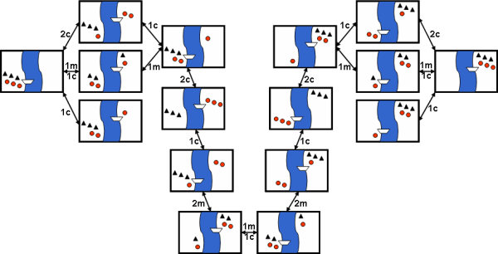
State space
Notes:
A state could be (CanLeft, MissLeft, BoatPos, CanRight, MissRight)
e.g. (2, 2, RIGHT, 1, 1) i.e. 2 cannibals and 2 missionaries on the left bank of the river, the boat is on the right side, together with 1 cannibal and 1 missionary.
Operators: A legal move is one which involves moving one or two people to the opposite bank, such that cannibals don't outnumber missionaries on either bank.
An initial state is: (3, 3, LEFT, 0, 0)
Possible moves are:
from (3, 3, LEFT, 0, 0) to (2, 2, RIGHT, 1, 1)
from (2, 2, RIGHT, 1, 1) to (2, 3, LEFT, 1, 0)
A goal state is: (0, 0, RIGHT, 3, 3)
An example action:
Assume the current state is: (cLeft, mLeft, boatPos, cRight, mRight)
Action: move 1 missionary and 1 cannibal from the left bank to the right bank.
Preconditions:
boatPos = LEFT
cLeft >= 1 AND mLeft >= 1
(mLeft-1 >= cLeft-1) OR mLeft = 0
(mRight+1 >= cRight+1) OR mRight = 0
New state would become: (cLeft-1, mLeft-1, RIGHT, cRight+1, mRight+1)
This action could be applied to the state: (3, 3, LEFT, 0, 0) and would give the new state: (2, 2, RIGHT, 1, 1). This action could not be applied to the state: (2, 2, RIGHT, 1, 1)

Slide 24
Search trees
Initial state
A
A
B
C
D
E
Goal state
Leaf node
G
H
N
K
L
L
M
Search trees do not summarise all possible searches, but are an abstraction of one possible search
Root is null state (or initial state)
Edges represent one choice, generated by actions
Child nodes represent extensions (children give all possible choices)
Leaf nodes are solutions/failures
Notes:
B,C,D and E are siblings (all share the same parent node)

Slide 25
Search trees
Search algorithms do not store whole search trees
Would require a lot of space
We can discard already explored nodes in search tree
Search algorithms store frontier of search
i.e. nodes in search tree with some unexplored children
Many search algorithms understandable in terms of search trees and how they explore the frontier

Slide 26
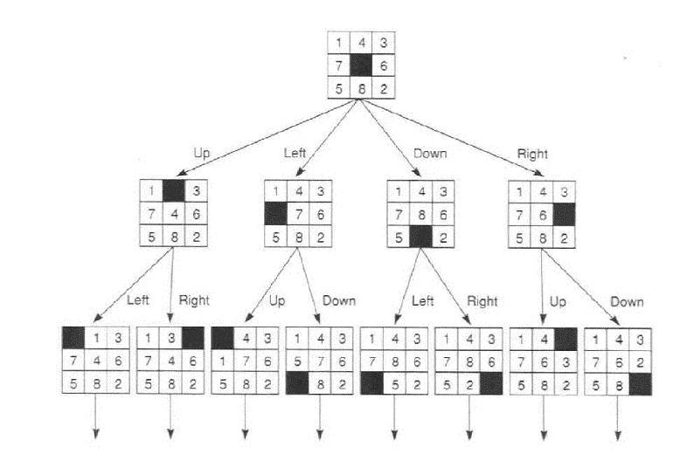
8 puzzle search tree
Notes:
Some possibilities can be eliminated, e.g.
If the blank is at the top, it can’t go further upwards, likewise for the other positions
There’s no point returning the blank to where it was the move before

Slide 27
Finding a solution
Search algorithms are used to find paths through state space from initial state to goal state
Find initial (or current) state
Check if GOAL found (HALT if found)
Use actions to expand all next nodes
Use search techniques to decide which one to pick next
Either use no information (uninformed/blind search)
or use information (informed/heuristic search)

Slide 28
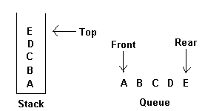
Representing the search
Data structures: iteration vs recursion
Partial - only store the frontier of search tree (most common approach)
Stack
Queue
(Also priority queue)
Full - the whole tree
Binary trees/n-ary trees
Notes:
In order to perform search, we need to be able to keep track of where we are and where we are going. The two most commonly used structures for this are stacks and queues.
A stack is an ordered list in which all insertions and deletions are made at one end, called the top.
A queue is an ordered list in which all insertions take place at one end, the rear, while all deletions take place at the other end, the front.
The restrictions on a stack imply that if the elements A,B,C,D,E are added to the stack in that order, then the first element to be removed/deleted must be E. Equivalently we say that the last element to be inserted into the stack will be the first to be removed, which is why stacks are sometimes referred to as Last In First Out (LIFO) lists.
The restrictions on a queue imply that the first element which is inserted into the queue will be the first one to be removed. Thus A is the first letter to be removed, and queues are known as First In First Out (FIFO) lists.

Slide 29
Search strategies - evaluation
Time complexity - number of nodes generated during a search (worst case)
Space complexity - maximum number of nodes stored in memory
Optimality - is it guaranteed that the optimal solution can be found?
Completeness - if there is a solution available, will it be found?

Slide 30
Search strategies - evaluation
Other aspects of search:
Branching factor, b, the maximum number of successors of any node (= actions/operators)
Depth of the shallowest goal, d
The maximum length of any path in the state space, m

Slide 31
Uninformed search
No information as to location of goal - not giving you “hotter” or “colder” hints
Uninformed search algorithms
Breadth-first
Depth-first
Uniform Cost
Depth-limited
Iterative Deepening
Bidirectional
Distinguished by the order in which the nodes are expanded

Slide 32
Breadth-first search
Breadth-first search (BFS)
Explore all nodes at one height in tree before any other nodes
Pick shallowest and leftmost element of frontier
Put the start node on your queue (FRONTIER/OPEN list)
Until you have no more nodes on your queue:
Examine the first node (call it NODE) on queue
If it is a solution, then SUCCEED. HALT.
Remove NODE from queue and place on EXPLORED/CLOSED
Add any CHILDREN of NODE to the back of queue
Notes:
The root node is expanded first
Next, all the nodes generated by the root
Then their successors
Pseudo-code:
Search( Start, Goal_test)
Open: fifo_queue;
Closed: hash_table; //or a list, but hashtables are faster
enqueue(Start, Open);
repeat
if (empty(Open)) return fail; //no more nodes to look at and we haven’t found a solution
Node = dequeue(Open); //get first element
if (Goal_test(Node)) return Node; //if it’s the solution, return it and stop searching
for each Child of node do
if (not find(Child, Closed)) //if we haven’t seen this node before, put it on to the ‘open’ list
enqueue(Child, Open)
insert(Child, Closed)//put child on the closed list

Slide 33
BFS example
Node B is expanded…
The search then moves to the first node
A
We begin with our initial state: the node labelled A
A
B
B
C
C
D
D
E
E
F
F
G
G
H
H
I
I
J
J
K
K
L
L
L
L
L
L
M
N
O
P
Node L is located and the search returns a solution
Q
R
S
T
U
Notes:
Put A on queue
Examine A - Not a Solution
Remove from queue and place on EXPLORED
Add B,C,D,E,F to the back of queue
Repeat until a solution is found
Black nodes are nodes that have been evaluated, white nodes are those that have been expanded (and so are in the memory) but are not yet evalauted. Evaluation = using the goal function to test if a given node/state is the goal state.

Slide 34
BFS time & space complexity
Consider a branching factor of b
BFS generates b¹ nodes at level 1, b² at level 2, etc
Suppose solution is at depth d
Worst case would expand all nodes up to and including level d
Total number of nodes generated:
b + b² + b³ + ... + b^{d} = O(b^{d})
For b = 10 and d = 5, nodes generated = 111,110
Notes:
For b = 10 and d = 5
10 + 100 + 1000 + 10,000 + 100,000 = 111,110

Slide 35
BFS evaluation
Is complete (provided branching factor b is finite)
Is optimal (if step costs are identical)
Has time and space complexity of O(b^{d}) (where d is the depth of the shallowest solution)
Will find the shallowest solution first
Requires a lot of memory! (lots of nodes on the frontier)
Notes:
Can be very efficient if there are many equally good solutions

Slide 36
Depth-first search
Depth-first search (DFS)
Explore all nodes in subtree of current node before any other nodes
Pick leftmost and deepest element of frontier
Put the start node on your stack
Until you have no more nodes on your stack:
Examine the first node (call it NODE) on stack
If it is a solution, then SUCCEED. HALT.
Remove NODE from stack and place on EXPLORED
Add any CHILDREN of NODE to the top of stack
Notes:
Always expands the node at the deepest level
When a dead end is reached, shallowest node is
expanded that still has unexplored successors
Pseudo-code:
Search( Start, Goal_test)
Open: stack;
Closed: hash_table;
push(Start, Open);
repeat
if (empty(Open)) return fail;
Node = pop(Open);
if (Goal_test(Node)) return Node;
for each Child of node do
if (not find(Child, Closed))
push(Child, Open)
insert(Child, Closed)

Slide 37
DFS example
The search then moves to the first node
Node B is expanded…
The process now continues until the goal state is achieved
We begin with our initial state: the node labelled A
A
A
B
B
C
C
D
D
E
F
G
G
H
H
I
I
J
J
K
K
L
L
L
L
L
L
L
L
Node L is located and the search returns a solution
Q
Q
R
R
S
S
T
T
U
U
Notes:
Put A on stack
Examine A - Not solution
Pop A from stack and place on EXPLORED list
Push B, C, D, E and F onto the stack
Repeat until solution found

Slide 38
DFS evaluation
Space requirement of O(bm)
m = maximum depth of the state space (may be infinite)
Stores only a single path from the root to a leaf node and remaining unexpanded sibling nodes for each node on the path
Time complexity of O(b^{m})
Terrible if m is much larger than d
If solutions are deep, may be much quicker than BFS

Slide 39
DFS evaluation
Issues
Can get stuck down the wrong path
Some problems have very deep search trees
Is not complete* or optimal
Should be avoided on problems with large or infinite maximum depths
Notes:
* Unless loop-avoidance is implemented (i.e. maintain a closed list)

Slide 40
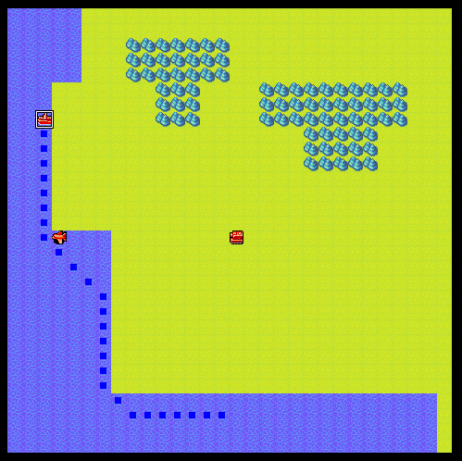
Practical 1
Implement data structure code for BFS and DFS for simple route planning
Notes:
The algorithms are exactly the same in the code, the only thing that differs is the data structures for open and closed lists

Slide 41
E.g., DFSPathFinder.java
public Path findPath(Mover mover, int sx, int sy, int tx, int ty) {
addToOpen(nodes[sx][sy]);
while (open.size() != 0) {
//get the next state to consider - the first in the stack
Node current = getFirstInOpen();
//if this is a solution, then halt
if (current == nodes[tx][ty]) break;
addToClosed(current);
// search through all the neighbours of the current node evaluating them as next steps
for (int x=-1;x<2;x++) {
for (int y=-1;y<2;y++) {
// not a neighbour, its the current tile
if ((x == 0) && (y == 0)) continue;
// if we're not allowing diagonal movement then only
// one of x or y can be set
if (!allowDiagMovement) {
if ((x != 0) && (y != 0)) continue;
}
// determine the location of the neighbour and evaluate it
int xp = x + current.x;
int yp = y + current.y;
if (isValidLocation(mover,sx,sy,xp,yp)) {
Node neighbour = nodes[xp][yp];
if (!inOpenList(neighbour) && !inClosedList(neighbour)) {
neighbour.setParent(current);
//keep track of the path
addToOpen(neighbour);
}
}
}
}
… //other stuff happens here – path construction
}

Slide 42
DFSPathFinder.java
/** The set of nodes that we do not yet consider fully searched */
private Stack<Node> open = new Stack<Node>();
...
/**
* Get the first element from the open list. This is the next
* one to be searched.
*
* @return The first element in the open list
*/
protected Node getFirstInOpen() {
}
/**
* Add a node to the open list
*
* @param node The node to be added to the open list
*/
protected void addToOpen(Node node) {
}

Slide 43
PathTest.java
//finder = new AStarPathFinder(map, 500, true);
//finder = new BFSPathFinder(map, 500, true);
finder = new DFSPathFinder(map, 500, true);
Notes:
// while we haven't found the goal
while ((open.size() != 0)) {
//get the next state to consider - the first in the stack
//no need for an explicit call to remove it, as pop() method does this automatically
Node current = getFirstInOpen();
//if this is a solution, then halt
if (current == nodes[tx][ty]) {
break;
}
addToClosed(current);
// search through all the neighbours of the current node evaluating
// them as next steps
for (int x=-1;x<2;x++) {
for (int y=-1;y<2;y++) {
// not a neighbour, its the current tile
if ((x == 0) && (y == 0)) {
continue;
}
// if we're not allowing diagonal movement then only
// one of x or y can be set
if (!allowDiagMovement) {
if ((x != 0) && (y != 0)) {
continue;
}
}
// determine the location of the neighbour and evaluate it
int xp = x + current.x;
int yp = y + current.y;
//if we can move to this node - i.e. it's not an obstacle
if (isValidLocation(mover,sx,sy,xp,yp)) {
Node neighbour = nodes[xp][yp];
// if the node hasn't already been processed and discarded add it as a next possible
// step (i.e. to the open list)
if (!inOpenList(neighbour) && !inClosedList(neighbour)) {
neighbour.setParent(current); //keep track of the path
addToOpen(neighbour);
}
}
}
}
}

Slide 44
Depth-limited search
Avoids pitfalls of DFS
Imposes a cut-off on the maximum depth
Not guaranteed to find the shortest solution first
Can’t follow infinitely-long paths
If depth limit is too small, search is not complete
Complete if l (depth limit) >= d (depth of solution)
Time complexity is O(b^{l})
Space complexity is O(bl)
Notes:
Depth-limited search cannot follow infinitely long paths, nor can it get stuck in cycles

Slide 45
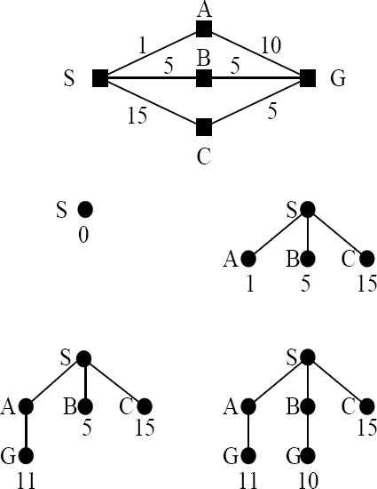
Uniform cost search
Modifies BFS
Expands the lowest path cost, rather than the shallowest unexpanded node
Not number of steps, but their total path cost (sum of edge weights), g(n)
Gets stuck in an infinite loop if zero-cost action leads back to same state
A priority queue is used for this
Notes:
Where BFS first visits the node with the shortest path length (number of nodes) from the root node, UCS first visits the node with the shortest path costs (sum of edge weights) from the root node.
A priority queue is used for this – so we expand first those nodes that have the smallest total cost.
You might wonder why node G is explored again in the search tree – surely this has been added to the EXPLORED list (after visiting node A) and not visited again? Actually, here the nodes would be the path visited up to that point, so the first time we reach G, the node is “S -> A -> G” and it is this that is put on EXPLORED. The next time we encounter G is for node “S -> B -> G”. As this is not the same as “S -> A -> G”, then we progress with search down this path.

Slide 46
Example: Route planning
Notes:
We’re at Arad and want to get to Bucharest
Using UCS, we would visit Zerind next as this has the least cost – which is not the best move ultimately. Call this move (A -> Z)
Expand nodes at Arad, with their associated total path costs: (A -> Z) = 75, (A -> T) = 118, (A -> S) = 140
Priority queue = (A -> Z) = 75, (A -> T) = 118, (A -> S) = 140
Choose (A -> Z) as this is nearer. Remove this from the queue and add its children (nodes expanded at Z)…
Expand nodes at Z: (A -> Z -> O) = 75 + 71 = 146
Add nodes to the priority queue:
Priority queue = (A -> T) = 118, (A -> S) = 140, (A -> Z -> O) = 146
Choose (A -> T) as this is now the best option. Remove this from the queue and add its children…
Expand nodes at T: (A -> T -> L) = 229
Add nodes to queue:
(A -> S) = 140, (A -> Z -> O) = 146, (A -> T -> L) = 229
Choose (A -> S) as this is now the nearest option. Remove this from the queue and add its children…
Expand nodes at S:
(A -> S -> F) = 239, (A -> S -> RV) = 220
Add nodes to the queue:
(A -> Z -> O) = 146, (A -> S -> RV) = 220, (A -> T -> L) = 229, (A -> S -> F) = 239
Choose (A -> Z -> O). Remove this from the queue and add its children…
Expand nodes at O:
(A -> Z -> O -> S) = 297
Add nodes to the queue:
(A -> S -> RV) = 220, (A -> T -> L) = 229, (A -> S -> F) = 239, (A -> Z -> O -> S) = 297
Choose (A -> S -> RV). Remove this from the queue and add its children…
Expand nodes at RV:
(A -> S -> RV -> P) = 317, (A -> S -> RV -> C) = 366
Add node to the queue:
(A -> T -> L) = 229, (A -> S -> F) = 239, (A -> Z -> O -> S) = 297, (A -> S -> RV -> P) = 317, (A -> S -> RV -> C) = 366
Etc etc…

Slide 47
Uniform cost search
Identical to BFS if cost of all steps is equal
Guaranteed complete and optimal if cost of every step (c) is positive
Finds the cheapest solution provided the cost of the path never decreases as we go along the path (non-negative actions)
If C* is the cost of the optimal solution and every action costs at least c, worst case time and space complexity is O(b^{1+[C*/c]} )
This can be much greater than b^{d}
When all step costs are equal, b^{1+[C*/c]} = b^{d+1}
Notes:
Notice that this is slightly worse than the b^{d} complexity for breadth-ﬁrst search when all step costs are equal, because the latter applies the goal test to each node as it is generated and so does not expand nodes at depth d. UCS expands the nodes at depth d as the first goal encountered might be sub-optimal – see the exercise later on!
E.g. if the optimal solution costs 20, and each action costs at least 2, then the worst case complexity is O(b¹¹)
This is more complex as we’re not only trying to find a goal node, but also minimise total cost
I’ve used square brackets to denote the floor function here.
For example, if C* (the optimal cost) is 10 and c (the minimum cost for an action) is 3, then [C*/c] = 3. So in the worst case, the depth of the solution could be 4 levels deep (1+[C*/c]).

Slide 48
Iterative deepening
Iterative deepening search (IDS)
Use depth-limited search but iteratively increase limit; first 0, then 1, then 2 etc., until a solution is found
IDS may seem wasteful as it is expanding nodes multiple times
But the overhead is small in comparison to the growth of an exponential search tree
For large search spaces where the depth of the solution is not known IDS is normally preferred
Notes:
Advantages:
Guarantees to find a solution if one exists
Finds shallow solutions first (cf BFS)
Always has small frontier (cf DFS)

Slide 49
IDS example
Node B is expanded…
Node A is expanded
We now backtrack to expand node C, and the process continues
The search now moves to level one of the node set
A
We again begin with our initial state: the node labelled A
A
B
B
C
C
D
D
E
E
F
F
As this is the 1st iteration of the search, we cannot search past any level greater than level one. This iteration now ends, and we begin a 2nd iteration
For depth = 1

Slide 50
IDS example
Node B is expanded…
The search then moves to level one of the node set
After expanding node G we backtrack to expand node H. The process then continues until goal state is reached
We again begin with our initial state: the node labelled A
We now move to level two of the node set
A
Again, we expand node A to reveal the level one nodes
A
B
B
C
C
D
D
E
F
G
G
H
H
I
I
J
J
K
K
L
L
L
L
L
L
Node L is located on the second level and the search returns a solution on its second iteration
For depth = 2
Notes:
Note that the nodes expanded and evaluated are different to both BFS and DFS
E.g., for BFS and DFS the children of G, H etc are expanded.

Slide 51
IDS evaluation
Advantages:
Is complete and finds optimal solutions
Finds shallow solutions first (cf BFS)
Always has small frontier (cf DFS)
Has time complexity O(b^{d})
Nodes on bottom level expanded once
Those on next to bottom expanded twice, etc
Root expanded d times
(d)b + (d − 1)b² + ... + 3b^{d − 2} + 2b^{d − 1} + b^{d}
For b = 10 and d = 5, nodes expanded = 123,450
Has space complexity O(db)
Notes:
An iterative deepening search from depth 1 to depth d expands only about 11% more nodes than a single breadth-first or depth-limited search to depth d, when b = 10.
The nodes on the bottom level are only expanded once – but there are b^{d} of them.

Slide 52
Bidirectional search (BDS)
Simultaneously search both forward from the initial state and backwards from the goal
Stop when two searches meet
b^{d/2} + b^{d/2} is much less than b^{d}
Issues
How do you work backwards from the goal?
What if there is more than one goal?
How do we know if they meet?
Notes:
runs two simultaneous searches: one forward from the initial state, and one backward from the goal, and stopping when the two meet in the middle

Slide 53
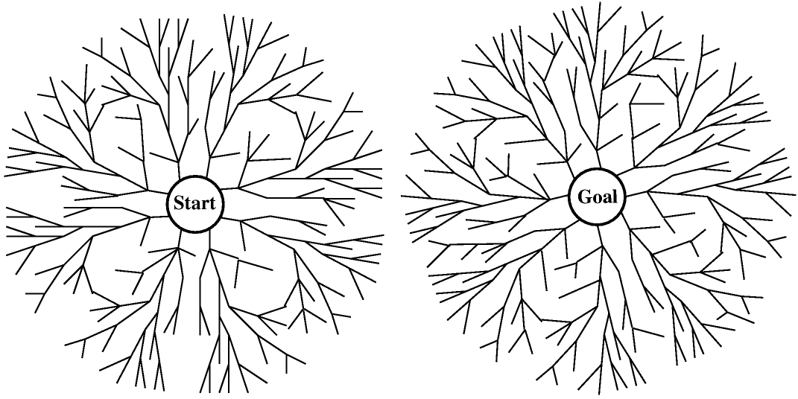
BDS

Slide 54
BDS evaluation
Reduces time complexity vs IDS: O(b^{d/2})
Only need to go halfway in each direction
Increases space complexity vs IDS: O(b^{d/2})
Need to store the whole tree for at least one direction
Each new node is compared with all those generated from the other tree in constant time using a hash table

Slide 55
Exercise in pairs/threes
Consider the search space below, where S is the start node and G1 and G2 satisfy the goal test. Arcs are labelled with the cost of traversing them.
For each of the following search strategies, indicate which goal state is reached (if any) and list, in order, all the states popped off the FRONTIER list (i.e. give the order in which the nodes are visited). When all else is equal, nodes should be removed from FRONTIER in alphabetical order.
BFS
Goal state reached: ___ States popped off FRONTIER:
Iterative Deepening
Goal state reached: ___ States popped off FRONTIER:
DFS
Goal state reached: ___ States popped off FRONTIER:
Uniform Cost
Goal state reached: ___ States popped off FRONTIER:
What would happen to DFS if S was always visited first?
S
2
A
3
1
2
B
1
C
G1
8
1
1
5
5
9
D
2
E
7
G2

Slide 56
Solution
Breadth-first
Goal state reached: G2 States popped off FRONTIER: SACBED G2
Path is S-C-G2
Iterative Deepening
Goal state reached: G2 States popped off FRONTIER: S SAC SABECD G2
Path is S-C-G2
Depth-first
Goal state reached: G1 States popped off FRONTIER: SABCD G1
Path is S-A-B-C-D-G1
Uniform Cost
Goal state reached: G2 States popped off FRONTIER: S ABCDCDS G2
Choose S
S-A = 2, S-C = 3
Choose A
S-A-B = 3, S-C = 3, S-A-E = 10
Choose B (arbitrary)
S-C = 3, S-A-B-C = 4, S-A-B-S = 5, S-A-E = 10
Choose C
S-C-D = 4, S-A-B-C = 4, S-A-B-S = 5, S-C-G2 = 8, S-A-E = 10
Choose D (arbitrary)
S-A-B-C = 4, S-A-B-S = 5, S-C-D-G2 = 6, S-C-G2 = 8, S-C-D-G1 = 9, S-A-E = 10
Choose C
S-A-B-C-D = 5, S-A-B-S = 5, S-C-D-G2 = 6, S-C-G2 = 8, S-A-B-C-G2 = 9, S-C-D-G1 = 9, S-A-E = 10
Choose D
S-A-B-S = 5, S-C-D-G2 = 6, S-A-B-C-D-G2 = 7, S-C-G2 = 8, S-A-B-C-G2 = 9, S-C-D-G1 = 9, S-A-B-C-D-G1 = 10, S-A-E = 10
Choose S
S-C-D-G2 = 6, S-A-B-S-A = 7, S-A-B-C-D-G2 = 7, S-A-B-S-C = 8, S-C-G2 = 8, S-A-B-C-G2 = 9, S-C-D-G1 = 9, S-A-B-C-D-G1 = 10, S-A-E = 10
Choose G2
Optimal path is S-C-D-G2, with cost 6

Slide 57
Uninformed search evaluation
Criterion | BFS | Uniform Cost | DFS | Depth-limited | IDS | BDS
Time | b^{d} | b^{1+[C*/c]} | b^{m} | b^{l} | b^{d} | b^{d/2}
Space | b^{d} | b^{1+[C*/c]} | bm | bl | bd | b^{d/2}
Optimal? | Yes | Yes | No | No | Yes | Yes
Complete? | Yes | Yes | No | Yes, if l >=d | Yes | Yes

Slide 58
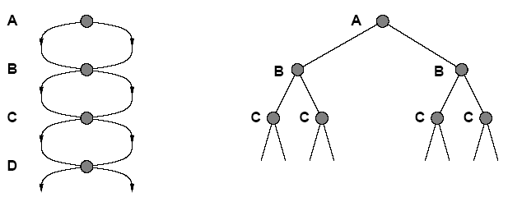
Note: Avoiding repeated states
State Space
Search Tree
Failure to detect repeated states can turn a linear problem into an exponential one!
Unavoidable where actions are reversible

Slide 59
For tomorrow...
Recap uninformed search strategies
Russell and Norvig, section 3.5
Chapters 3 and 4 are available here: http://www.pearsonhighered.com/assets/hip/us/hip_us_pearsonhighered/samplechapter/0136042597.pdf
Try the practical
If you are unfamiliar with Eclipse/Java pair up with someone who is familiar!

