Slide 1
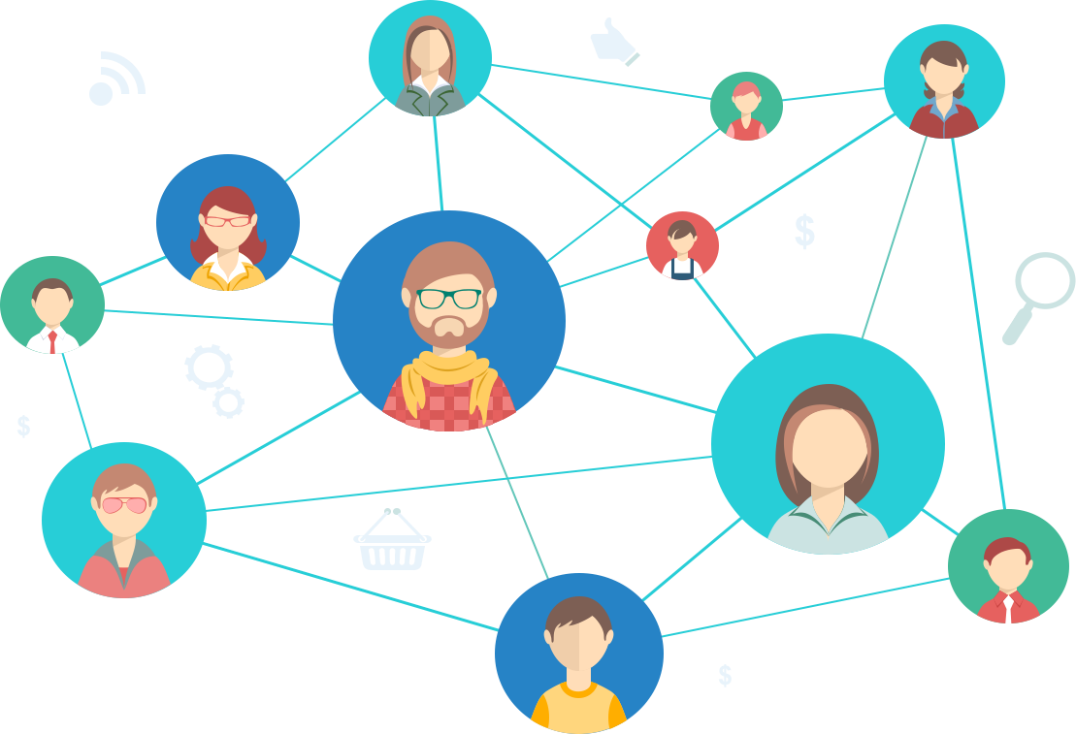


BABBLE
MESSENGER FOR EVERY STUDENT
SHAI BREMER
GIRON APTIK
AMIT GOLDSHTEIN
ALMOG AMSALEM

Slide 2

Hallo
Babble is a chat system designed for students in educational institutions to chat, ask questions and find information regarding to subjects they study via other students in chat rooms that are made for each subject specifically.
The chat system also allows for users to create chat rooms for usage in classes or study sessions to ask questions that the lecture could also see and respond to avoid interruption of class with questions and or allow more shy students to ask questions easily.
BABBLE
Notes:
גירון

Slide 3
BABBLE
WHY BABBLE?
-Allows consulting with other students and receiving answers for questions in specific subjects in specific rooms for each subject instead of having a lot of messages that can contain irrelevant information to the topic.
-Ability to share files and relevant information to a subject.
-Allows setting a specific time for lecturer to answer questions which allows avoiding interruptions during class.

Slide 4
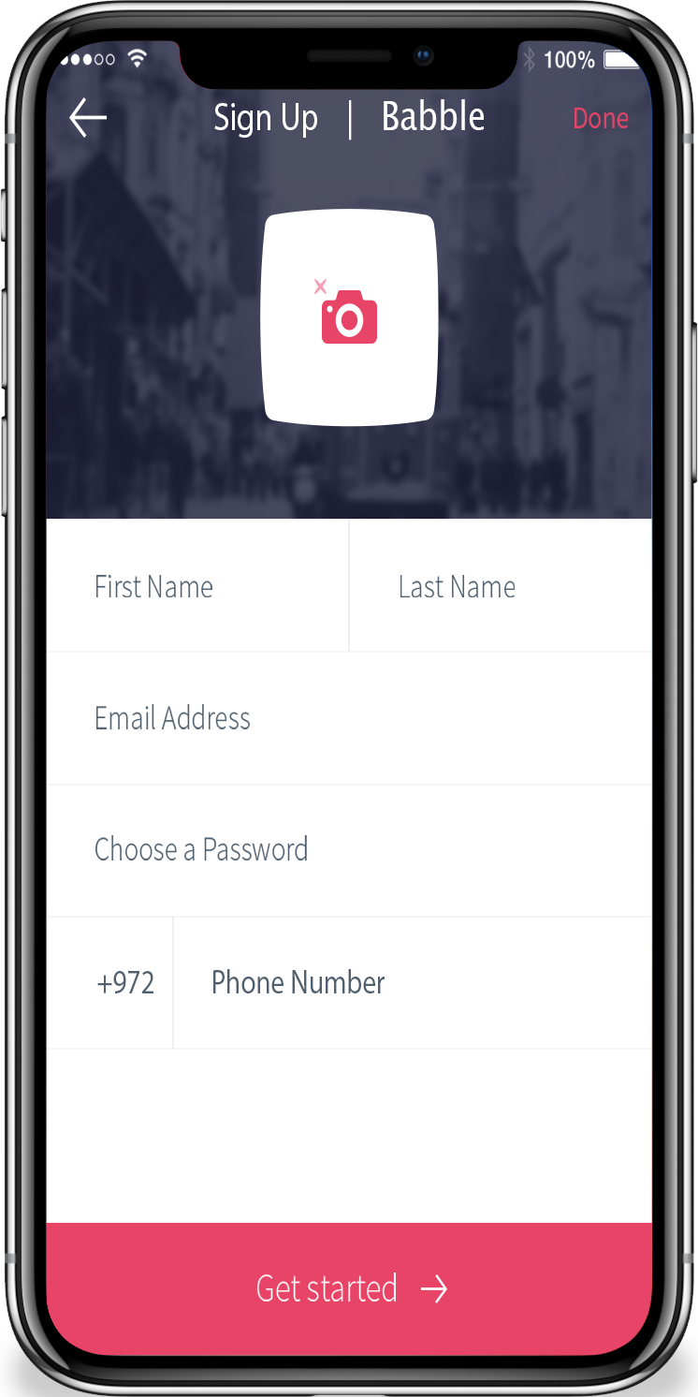
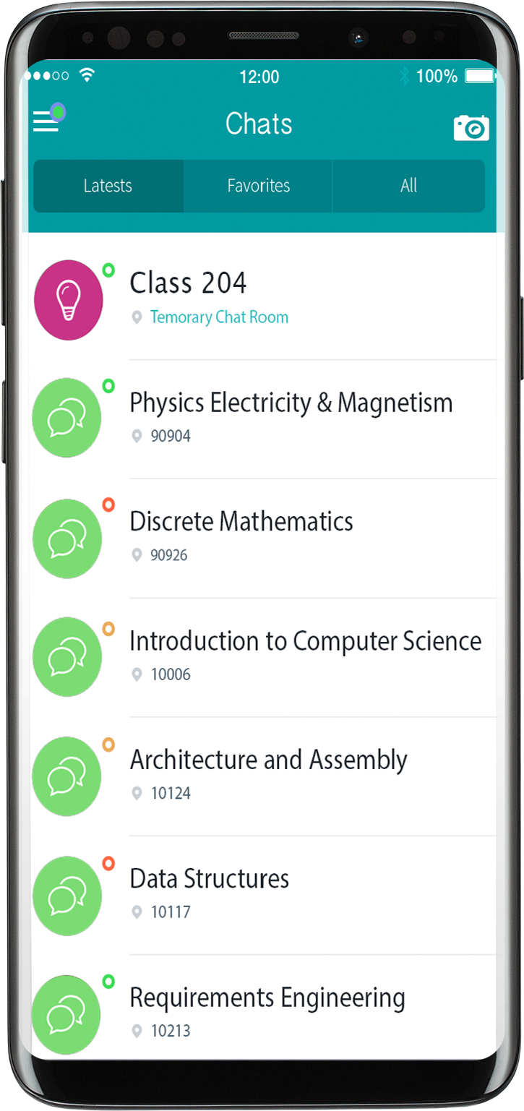

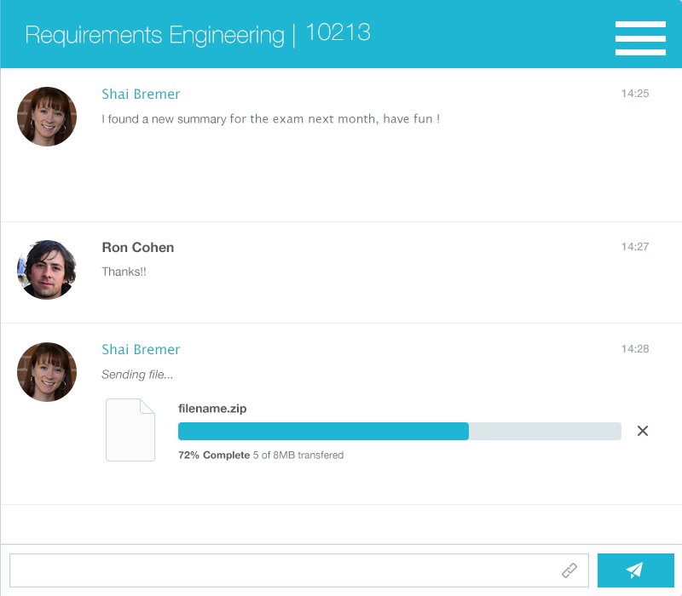
HOW BABBLE WORKS
BABBLE

Slide 5

BABBLE
SCOPE - IN
General rooms per course subject.
Temporary rooms for usage in classes and study
sessions
Features
Muting chats
File sharing
Searching (for groups / text)
User feedback
Reporting other users
Notes:
אלמוג

Slide 6
BABBLE
SCOPE - OUT
Getting information that requires afeka’s systems. (No integration with Afeka’s systems)
Recording / Sharing audio snippets

Slide 7
BABBLE
CURRENT STATE
Currently, students use different chat groups in different applications such as Whatsapp, facebook, telegram, but these chat groups aren’t specific for each subject, usually they contain a mix of subjects as people just ask questions that relate to them, meaning a student can be in such group and see questions related to topics they don’t study / will study in the future.
This makes it difficult to find and ask for information related to subjects they’re studying.

Slide 8
BABBLE
Actors & Goals
Actor name | Description | Goals | Role
Chat user | A user of the system | To use the chat system | Primary
Prospect | A potential future chat user | To register to the system and become a chat user | Primary
Time | An automated procedure set to run after a period of time |  | Support
Phone Verification System | An external service used to verify accounts with SMS |  | Support
Notes:
עמית

Slide 9
BABBLE
USE - CASES
Join chat Room
Leave chat Room
Send Message
Account Creation
Create chat Room
Close chat Room

Slide 10
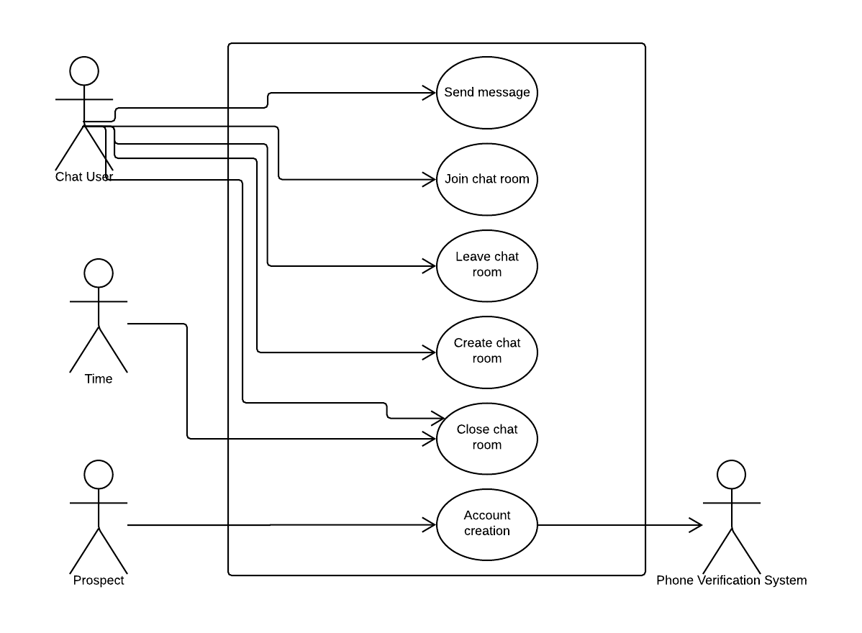
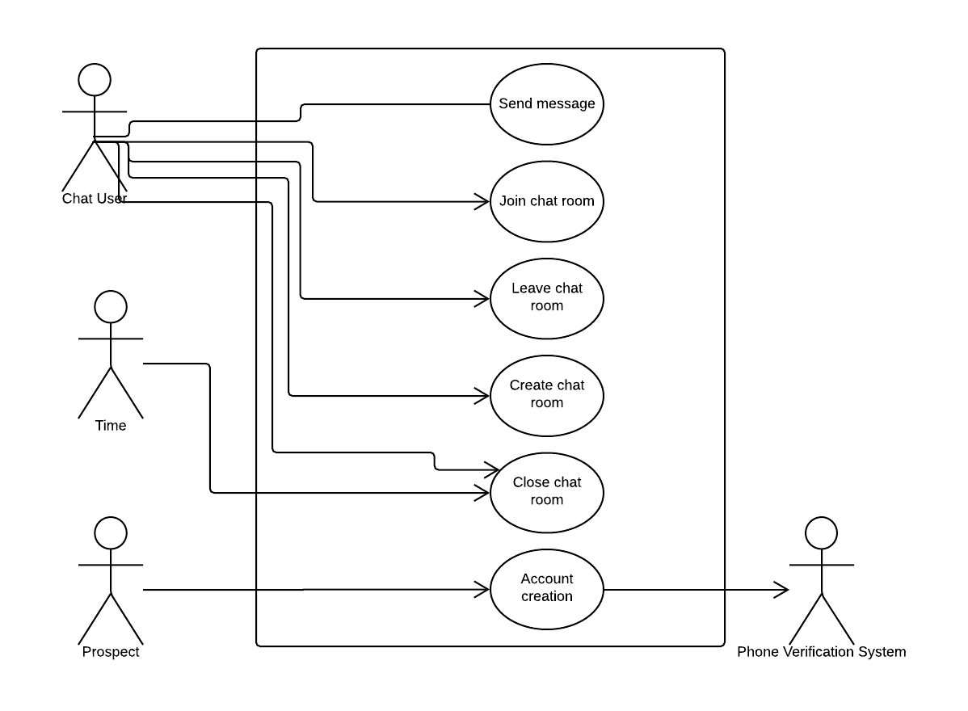
BABBLE
U.C.D - Use Case Diagram

Slide 11
BABBLE
SEND MESSAGE
DETAILS
Actor: Chat User (Primary, The user of the chat messaging system)
Goal: Sending a message in a chat.
Notes:
שי

Slide 12
BABBLE
SEND MESSAGE FLOW
(BASIC)
Chat User | System
Identify user (login) | Confirm identity
Choose room for the message (from list of rooms the chat user joined) | Set room for the message
Send message to set chat room | Send message to all other users who are currently registered (joined) the chat room Display message

Slide 13
BABBLE
SEND MESSAGE FLOW (ALTERNATIVE)
Alternative flow: Invalid credentials
Chat User | System
Identify user(login) | Failed to confirm identity (Invalid login) Displays error message

Slide 14
BABBLE
2. JOIN CHAT ROOM
DETAILS
Actor: Chat User (Primary, The user of the chat messaging system)
Goal: Join an existing chat room.

Slide 15
BABBLE
JOIN CHAT ROOM FLOW
(BASIC)
Chat user | System
Identify user (login) | Confirm identity
Submit a code to join a room | Check if the code is valid and if the room exists Code valid and room found Register the user to the temporary chat room

Slide 16
BABBLE
JOIN CHAT ROOM FLOW
(ALTERNATIVE)
Alternative flow: Chat user attempts to join a temporary chat room using an invalid invite code
Chat user | System
Identify user (login) | Confirm identity
Submit a code to join a room | Check if the code is valid and if the room exists Code is invalid Display error message saying “Invalid invite code, room not found”

Slide 17
BABBLE
3. LEAVE CHAT ROOM
DETAILS
Actor: Chat User (Primary, The user of the chat messaging system)
Goal: Deregister the chat user from a chosen chat room.

Slide 18
LEAVE CHAT ROOM FLOW
(ALTERNATIVE)
Alternative flow: Chat user attempts to use the leave chat room function without being registered to any room
Chat User | System
Identify (login) | Confirm identity
Leave chat room | Check if the user is registered to at least 1 room. User is not registered to any rooms Display error message “User is currently not registered to any rooms”
BABBLE

Slide 19
BABBLE
LEAVE CHAT ROOM FLOW
(BASIC)
Chat User | System
Identify (login) | Confirm identity
Leave chat room | Check if the user is registered to at least 1 room. Display list of chat room(s) user is currently registered to
Select which room to leave from list | Deregister user from selected room Display message “You’ve successfully left the chat room.”

Slide 20
BABBLE
4. CREATE CHAT ROOM DETAILS
Actor: Chat User (Primary, A user with room creation privileges)
Goal: Create a temporary chat room for class usage.
Notes:
גירון

Slide 21
BABBLE
CREATE CHAT ROOM FLOW
(BASIC)
Chat User | System
Identify user(login) | Confirm user identity
Request temporary chat room (requires to specify the chat room’s name and description) | Check user doesn’t have an existing temporary room. Create temporary chat room with the provided attributes (name, desc). and generate invitation code in the room details Add user to chat room Display temporary chat room
Notes:
code / qr

Slide 22
BABBLE
CREATE CHAT ROOM FLOW
(ALTERNATIVE)
Alternative flow:
User trying to create a second temporary room when they created one already
Chat User | System
Identify user (login) | Confirm user identity
Request temporary chat room (requires to specify the chat room’s name and description) | Check user doesn’t have an existing temporary room. Existing room found Display error message “This user has already opened a temporary chat room, only one temporary room is permitted per user.”

Slide 23
BABBLE
5. CLOSE CHAT ROOM DETAILS
Actor: Time (Primary, Automated chat closing mechanism), Chat User (Primary, a user of the chat system)
Goal: Automatically close temporarily opened rooms after a period of time, or manually close a room opened by a chat user.

Slide 24
BABBLE
CLOSE CHAT ROOM (BASIC)
Time | System
A set amount of time passes after a temporary room is created | Check if temporary room should be timed out (‘old enough’) Close chat room

Slide 25
BABBLE
CLOSE CHAT ROOM
(ALTERNATIVE)
Alternative flow:
Chat user attempting to manually close a temp room when they didn’t create one.
Chat user | System
Identify user (login) | Confirm user identity
Close temporary chat room | Check to see if chat user has an open temporary room No room found Display error message “No open temporary room created by this user was found.”

Slide 26
BABBLE
6. ACCOUNT CREATION
DETAILS
Actor: Prospect (Primary, A potential chat user)
Goal: Create a user for a potential new user of the system.
Notes:
אלמוג

Slide 27
BABBLE
ACCOUNT CREATION FLOW (BASIC)
Prospect | System | Phone verification system
Submit registration form With: First name, Last name Password Email address Phone number | Confirm form is valid Request phone verification system to confirm phone number | Confirm phone number is valid
 | Create account

Slide 28
BABBLE
ACCOUNT CREATION FLOW (ALTERNATIVE)
Alternative flow: Prospect submits an invalid form
Prospect | System
Submit registration form With: First name, Last name Password Email address Phone number | Form is invalid
 | Display error message saying “Submitted form is invalid”

Slide 29
BABBLE
NON - FUNCTIONAL REQUIREMENTS
Usability:
*On mobile devices, should be accessible on android from OS ver 6.0 and above
*On iOS from version 9.0 and above.
*I.E, Chrome or FireFox updated from 2016 and later
Performance:
*Require the chat service to withstand a peak of 5000 concurrent users.
(Afeka has approximately 2700 students, shouldn't go over 5000 for the next few years)
Reliability:
*Require that the service will return within a max of 6 hours from crashing
(The service does not use an extra stand-by chat servers, it’s a small service it's not a critical system)
Supportability:
Installation:
Web browser: Enter link -> Access chat room (No installation)
Mobile: install from App Store, -> Access chat room
Notes:
שי

Slide 30
USER STORIES
BABBLE
As a student I want to use the chat system to find relevant forums to ask questions so that I will be able to find answers more easily.
As a student I want to use the chat system in class to write down my questions so that I won’t forget them.
As a lecturer I want to concentrate the student’s questions during class to the chat so that there would be less interruptions during class.
Notes:
עמית

Slide 31
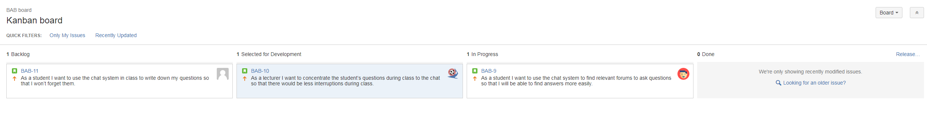
Requirements Agile Traceability
JIRA Kanban Board
BABBLE

Slide 32

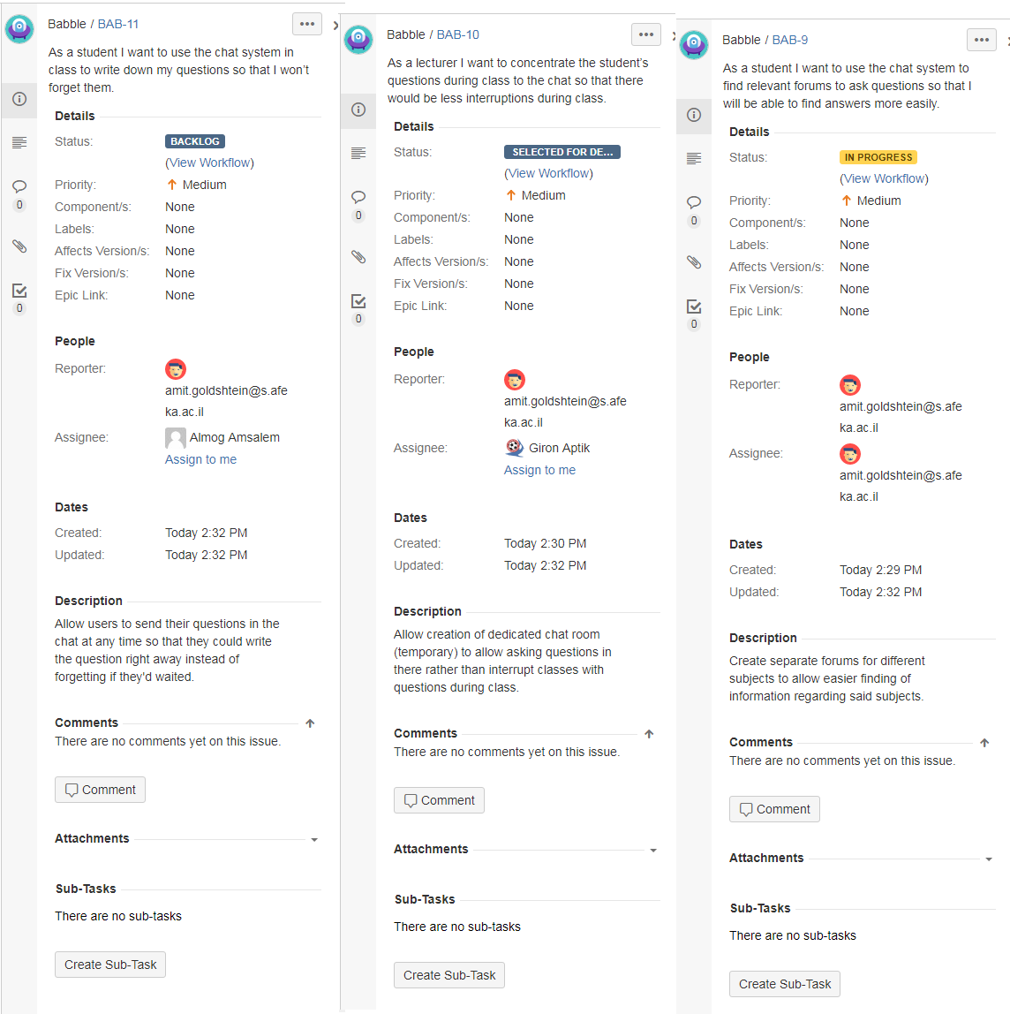
Requirements Agile Traceability
JIRA Kanban Board
BABBLE

Slide 33
THANKS
Question time!
ask if you have any questions
if you had babble, you could’ve sent the questions already :)
BABBLE

