Slide 1

How To Write a Scientific Paper – A General Guide
Notes:
Change logo, to add GOALI

Slide 2
Key Topics
Key elements of publishing
(structured abstract)
Article submission
Publisher/peer review process
Author and reader priorities
Hands on activities

Slide 3
Publish or Perish
‘Publishing is the chief currency in this universe, the main source of validation of one’s research, and often the key indicator of academic success. Promotion and tenure committees value peer-reviewed publications above all;... that is, regrettably, even above clinical performance or community service.’
Clark, Jacelyn. “Open Access Anxiety in the Publish or Perish World.” PLOS Blogs
3 Sept 2008. [Accessed 16 August 2015]
blogs.plos.org/plos/2008/09/open-access-anxiety-in-the-publish-or-perish-world/

Slide 4
Overview
Task of writing a research paper can be daunting
Even with groundbreaking research, unless the paper is correctly written:
at best, publication will be delayed
at worse, never published
Goal is to provide an overview of ‘how to write a well-structured research paper for publication’
Notes:
Replace the word “correctly” with a better word.

Slide 5
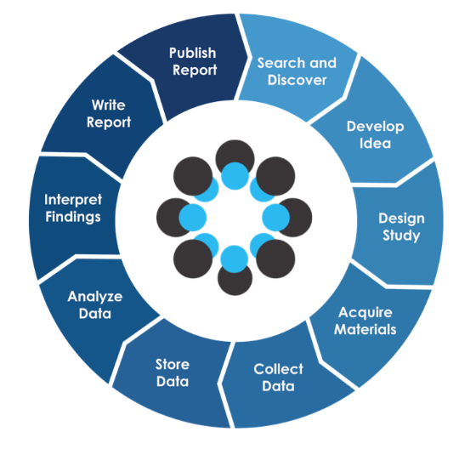

Research Life Cycle
www.slideshare.net/OSFair/osfair2017-workshop-increasing-research-transparency-using-the-open-science-framework 2018-12-30
Notes:
Changed “Information” to “Research”

Slide 6
Key Elements of Publishing
Ethical Issues
Style and language
Structure of paper
Components of paper
Article submission/journal selection
Publisher’s process/peer review

Slide 7
Ethical Issues
Disclosure of Conflict of Interest
Acknowledgment of funding sources
Image manipulation and fabrication of data
Online submission - supplemental information (datasets, videos)
For Health Sciences
Registering clinical trials to central
registries
Institutional Review Board approval
Best Practice Guidelines on Publishing Ethics: a publisher’s perspective. 2nd ed. John Wiley & Sons, Ltd; c2014. [Accessed 2018-09-20] Available from: https://authorservices.wiley.com/ethics-guidelines/index.html

Slide 8
Style and Language
Refer to the journal’s author guide for notes on style (see Publishing Skills Web-Bibliography for examples)
Some authors write their paper with a specific journal in mind
Others write the paper and then adapt it to fit the style of a journal they subsequently choose
Objective is to report your findings and conclusions as clearly and concisely as possible

Slide 9
Style and Language
Complex language not needed; poorly written manuscripts get rejected
If English is not your first language, find a native English speaker (if possible) to review the content and language of the paper before submitting it
Regardless of primary language, find a colleague/editor to review the content and language of the paper
Recommendations for the Conduct, Reporting, Editing, and Publication of Scholarly Work in Medical Journals. ICMJE; Updated December 2017. Manuscript preparation. [accessed 2018-0928] Available from www.icmje.org/recommendations/browse/manuscript-preparation/preparing-for-submission.html

Slide 10
Structure of a Paper
Scientific writing follows a rigid structure, a format developed over hundreds of years
A paper can be read at several levels:
Some people will just refer to the title
Others may read only the title and abstract
Others will read the paper for a deeper understanding
This format is also used for Structured Abstract - invaluable for abstracts and papers for workshops or conferences.

Slide 11
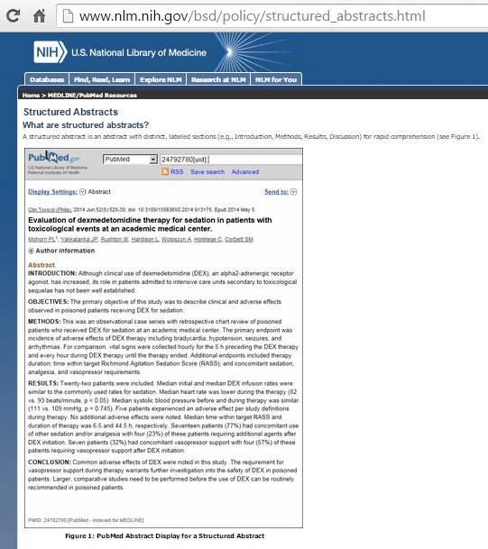
National Library of Medicine – Structured Abstract
www.nlm.nih.gov/bsd/policy/structured_abstracts.html [Accessed 2019-09-18]

Slide 12
Components of a Paper
Notes:
Where does this picture come from?

Slide 13
Order of Authors
ONLY include those who have made an intellectual contribution to the research
OR those who will publicly defend the data and conclusions, and who have approved the final version
Order of the names of the authors can vary from discipline to discipline
In some fields, the corresponding author’s name appears first

Slide 14
Title
Describes the paper’s content clearly and precisely including keywords
Is the advertisement for the article
Do not use abbreviations and jargon
Search engines/indexing databases depend on the accuracy of the title - since they use the keywords to identify relevant articles

Slide 15
Abstract
Briefly summarize (approximately 150 words) - the problem, the method, the results, and the conclusions so that
The reader can decide whether or not to read the whole article
Together, the title and the abstract should stand on their own
Most authors write the abstract last so that it accurately reflects the content of the paper
Use keywords that will attract the readers
The Structured Abstract: An Essential Tool for Research. [accessed 2018-09-18] Available from www.mlanet.org/p/cm/ld/fid=517
Gastel, Barbara. Writing Abstracts; Authoraid. [accessed 2018-09-18]. Available from www.authoraid.info/uploads/filer_public/86/c8/86c804e2-869b-45b1-a4d5-6fe46d766ed6/writing_abstracts_gastel_for_authoraid_posting.pdf

Slide 16
Introduction
Clearly state the:
Problem being investigated
Background that explains the problem
Reasons for conducting the research
Summarize relevant research to provide context
State how your work differs from published work
Identify the questions you are answering
Explain what other findings, if any, you are challenging or extending
Briefly describe the experiment, hypothesis(es), research question(s); general experimental design or method

Slide 17
Methods
Provide the reader enough details so they can understand and replicate your research
Explain how you studied the problem, identify the procedures you followed, and order these chronologically where possible
Explain new methodology in detail; otherwise name the method and cite the previously published work
Include the frequency of observations, what types of data were recorded, etc.
Be precise in describing measurements and include errors of measurement or research design limits

Slide 18
Results
Objectively present your findings, and explain what was found
Show that your new results are contributing to the body of scientific knowledge
Follow a logical sequence based on the tables and figures presenting the findings to answer the question or hypothesis
Figures should have a brief description (a legend), providing the reader sufficient information to know how the data were produced

Slide 19
Discussion/Conclusion
Describe what your results mean in context of what was already known about the subject
Indicate how the results relate to expectations and to the literature previously cited
Explain how the research has moved the body of scientific knowledge forward
Do not extend your conclusions beyond what is directly supported by your results - avoid undue speculation
Outline the next steps for further study

Slide 20
References
Whenever you draw upon previously published work, you must acknowledge the source
Any information not from your experiment and not ‘common knowledge’ should be recognized by a citation
How references are presented varies considerably - refer to notes for authors for the specific journal
Avoid references that are difficult to find
Avoid listing related references that were not important to the study
Components of a Research Paper. Center for Innovative Research and Teaching. Grand Canyon University. [Accessed 2018-09-18] available from cirt.gcu.edu/research/developmentresources/tutorials/researchpaper

Slide 21
Harvard Reference Style
Uses the author's name and date of publication in the body of the text, and the bibliography is given alphabetically by author
Adams, A.B. (1983a) Article title: subtitle. Journal Title 46 (Suppl. 2), 617-619
Adams, A.B. (1983b) Book Title. Publisher, New York.
Bennett, W.P., Hoskins, M.A., Brady, F.P. et al. (1993) Article title. Journal Title 334, 31-35.

Slide 22
Vancouver Reference Style
Uses a number series to indicate references; bibliographies list these in numerical order as they appear in the text
1. Adams, A.B. (1983) Article title: subtitle. Journal Title 46 (Suppl. 2), 617-619.
2. Lessells, D.E. (1989) Chapter title. In: Arnold, J.R. & Davies, G.H.B. (eds.) Book Title, 3rd edn. Blackwell Scientific Publications, Oxford, pp. 32-68.
3. Bennett, W.P., Hoskins, M.A., Brady, F.P. et al. (1993) Article title. Journal Title 334, 31-35.

Slide 23
Reference Management Software Tools
Tools such as Mendeley, Zotero or EndNote can be used to create the footnote and reference format required by a specific publisher
See the Reference Management Software Tools modules to learn how to access, download and use these options
www.research4life.org/training/reference-management-tools/

Slide 24
Article Submission
Select your journal carefully
Read the aims and scope of several journals – who reads them and what has been published
Think about your target audience and the level of your work – do you have a realistic chance of being accepted?
Follow the guidelines in the notes for authors and include everything they ask – it makes the editor’s job easier…
Articles should not be submitted to more than one journal at a time
See: Instructions to Authors in Health Sciences
mulford.utoledo.edu/instr/

Slide 25
Broad/generalist vs. Specialist Scope
Broad journal:
Considers a broad range of topics/thresholds
May recommend a transfer to a more suitable subject specific journal
Specialist journal:
Considers a narrow range of topics/thresholds
Rejection in pre-review for ‘out of scope’
May recommend transfer to another subject specific journal or to a broader scope journal

Slide 26
Open Access vs. Subscription
Similar quality and standards:
Peer review, editors, editorial boards, indexing, permanent/electronic access
Distribution is different:
For Open Access, no subscription barriers, universal access and openly licensed to allow reuse; authors pay publication fee
For Commercial Publications, subscription fee is paid, publisher owns the license agreement; authors do not pay publication fee
Notes:
Open access may not allow reuse, but just for reading
Funder may pay the APC

Slide 27
Online Submission
Many publishers now offer a completely electronic submission process
Article is submitted online and all of the review procedure also happens online
Speeds up the editorial process
Is invaluable for authors in low-income countries

Slide 28
After Submission
Most journal editors will make an initial decision on a paper - to review or to reject
Most editors appoint two referees
Refereeing speed varies tremendously between journals
Authors should receive a decision of Accept, Accept with Revision (Minor or Major), or Reject
If a paper is rejected, most editors will write to you explaining their decision
After rejection, authors have the option of submitting the paper to another journal - editor’s suggestions should be addressed

Slide 29
Overview of Peer Review Process
Paper Submitted
Notification to Author
Confirmation of Receipt
Revise
Accept
Initial Decision by Editor
Revision Received
Rejection
Decide to Review
Revision Checked
Assign Reviewers
Reviewers Accept Invite
Reviews Completed
Paper sent to Publisher
Revise
Accept
Reject

Slide 30
Keys for Editor
Does the work fit the journal’s scope?
The clarity of the English language used?
Is the science sound?
Targeted to the journal’s audience?
Is it new/interesting?
Is it a big enough advance for this field and this journal?

Slide 31
What Do Peer Reviewers Look For?
Quality
Soundness of research
Suitability of methods and analyses
Soundness of analysis/appropriateness of conclusions
Reporting/clarity of the message
Language/presentation
Contribution to the literature
Novelty
Importance/interest
May also comment on
Suitability to the journal‘s scope
Research and publication ethics

Slide 32
Models of Peer Review
Closed peer review
Single blind – the reviewers know who the authors are, but the authors don’t know who the reviewers are
Double blind – the reviewers don’t know who the authors are and the authors don’t know who the reviewers are
Open peer review
The reviewers know who the authors are, and the authors know who the reviewers are
Reviews published online if the manuscript is accepted

Slide 33
After Peer Review
Editor makes a decision
Peer reviewers often disagree with each other
Editors may seek further advice
Editors may overrule reviewers
Editors, not reviewers ultimately decide what is published

Slide 34
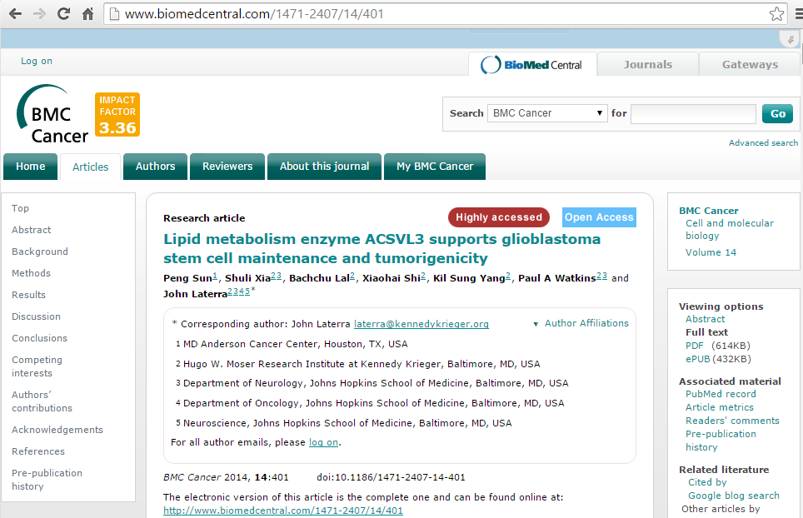
Link to “Pre-publication history”/ BMC Cancer Article
www.biomedcentral.com/1471-2407/14/401 (accessed 16 Aug. 2015)

Slide 35
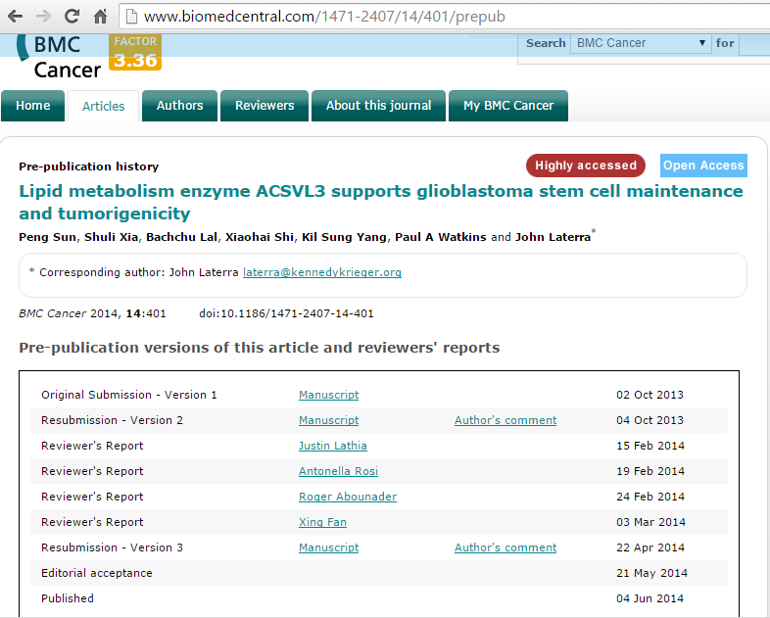
“Pre-publication history versions of article and reviewers’ reports”
www.biomedcentral.com/1471-2407/14/401/prepub (accessed 16 Aug 2015)

Slide 36
Publishing Tips
Editors and reviewers are looking for original and innovative research that will add to the field of study
For research-based papers, ensure that you have enough numbers to justify sound statistical conclusions
For a larger study, it may be better to produce one important research paper, rather than a number of average incremental papers:
See:
www.elsevier.com/connect/8-reasons-i-accepted-your-article
www.elsevier.com/connect/8-reasons-i-rejected-your-article

Slide 37
The Bottom Line: You Will Get Published if…
You picked an important research question.
You used the right method to answer it.
You wrote a short, clear account of the study that followed a tight structure and used effective writing to convey your message clearly.
“Promoting Scientific Workshops from Authors Overseas.” PLOS Neglected Tropical Diseases 10 Apr 2014. [Accessed 2018-09-23] available from
blogs.plos.org/speakingofmedicine/2014/04/10/writing-workshop/

Slide 38
Some Words of Caution – When Selecting a Journal
With the development of Open Access publishing, some unscrupulous publishers take advantage of authors
Examples are stand-alone (one title) publishers, the publisher is the editor, no formal editorial/review board, lack of transparency of publishing operations, no policy for digital preservation, name of journal is inflated or incongruent with journal’s mission, false claim of indexing, poor journal standards or practices, excessively broad titles, etc.

Slide 39
Useful resources
Think. Check. Submit. thinkchecksubmit.org
“Open Access, A2K & Scholarly Communication: Predatory Publishers” Libguide from University of the Witeatersrand, Johsnnesburg
libguides.wits.ac.za/openaccess_a2k_scholarly_communication/Predatory_Publishers
Or check if the journal is listed in the Open Access Scholarly Publishers Association oaspa.org/ or Directory of Open Access Journals https://doaj.org/

Slide 40
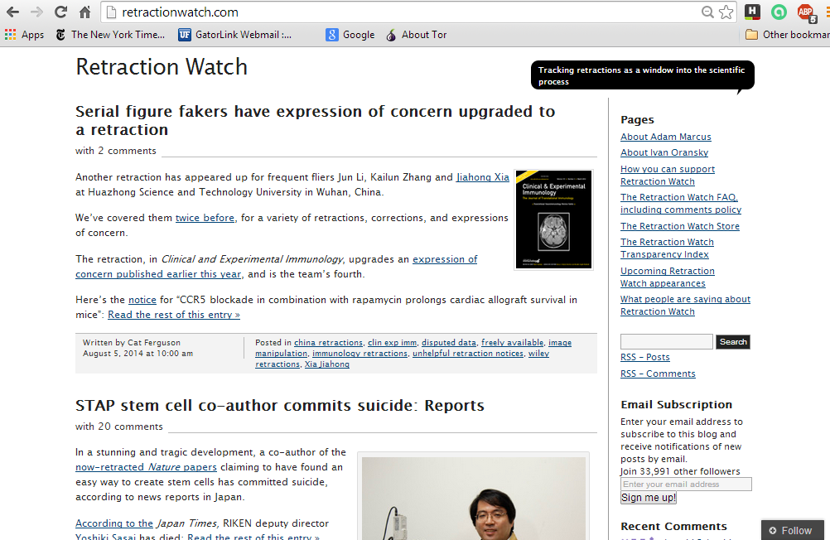
This is a cautionary note. Retraction Watch is a website that tracks the retraction of peer-reviewed papers due to fabrication, faulty research and/or statistics. All types of journal publishers (open access and commercial) must deal with these issues.

Slide 41
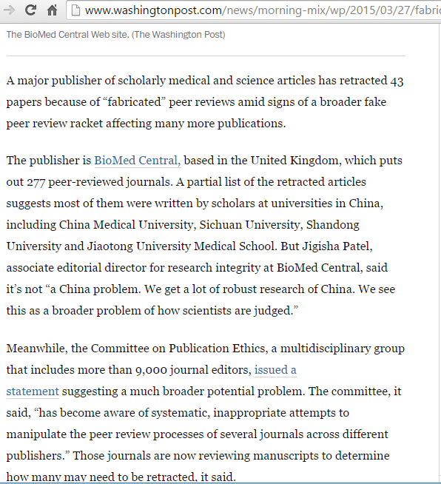
This is part of an article published by the Washington Post – 27 March 2015. It discusses the retraction of 43 papers by BioMed Central.

Slide 42
‘The national affiliations of authors and reasons for retraction of papers accessible through PubMed that were published from 2008 to 2012 and subsequently retracted were determined in order to identify countries with the largest numbers and highest rates of retraction due to plagiarism and duplicate publication. Authors from more than fifty countries retracted papers. While the United States retracted the most papers, China retracted the most papers for plagiarism and duplicate publication. Rates of plagiarism and duplicate publication were highest in Italy and Finland, respectively. Unethical publishing practices cut across nations.’
Amos, K. The ethics of scholarly publishing: exploring differences in plagiarism and duplicate publication across nation. J Med Library Association. Apr 2014 102(2) 87-91

Slide 43
Background: Author’s Perspective
Motivation to publish:
Dissemination (54% 1st choice)
Career prospects (20% 1st choice)
Improved funding (11% 1st choice)
Ego (8% 1st choice)
Patent protection (4% 1st choice)
Other (3% 1st choice)
Bryan Coles (ed.) The STM Information System in the UK, BL Report 6123, Royal Society, BL, ALPSP, 1993

Slide 44
Author Publishing Priorities
Quality and speed
Top items were
Refereeing speed
Refereeing standard
Journal reputation
Editor/board, physical quality and publication services

Slide 45
Reader’s Priorities
Authoritative quality articles
Ease of access
Rapid delivery
Convenient format
Linking of information - clustering
Low or no cost
Up-to-date information

Slide 46
Author versus Reader Behaviour
Author behaviour
Want to publish more
Peer review essential
Other journal functions crucial
Wider dissemination
Reader behaviour
Want integrated system
Browsing is crucial
Quality information important
Want to read less
Elsevier study of 36,000 authors (1999-2002) presented by Michael Mabe at ALPSP Seminar on “Learning from users” 2003; www.alpsp.org
Notes:
However, another extremely interesting study was undertaken by Elsevier
Taken from a presentation by Michael Mabe (then Director of Academic relations, Elsevier, and also visiting professor at the Dept of Information Science, City University, London) given at an ALPSP seminar on “Learning from Users” in 2003. The survey was undertaken from 1999-2002, and included data from >36,000 authors
The presentation is available on the ALPSP website - www.alpsp.org, “ALPSP previous events”

Slide 47
Differences: Authors and Readers
Authors are journal focused
Readers are article focused
Publish more/read less dichotomy

Slide 48
Priorities for Readers in Low-Income Countries (discussion)
Rank on a Scale of 5:1
5 (very useful), 4 (somewhat useful), 3 (average), 2 (somewhat not useful), 1 (not useful)
Authoritative quality articles
Ease of access
Rapid delivery
Convenient format
Linking of information - clustering
Low or no cost (Open Access or HINARI publisher)
Up-to-date information
Other

Slide 49
Additional Resources
Davis, Martha (2005) “Scientific Papers and Presentations”, 2nd Edition. Academic Press (ISBN 0-12-088424-0)
Grossman, Michael (2004) “Writing and Presenting Scientific Papers”, 2nd edition, Nottingham University Press, (ISBN 1-897676-12-3).
Clare, J & Hamilton, H (2003) “Writing research transforming Data into Text”, Churchill Livingstone (ISBN 0443071829).
Research4Life Authorship Skills Web-bibliography
www.research4life.org/training/authorship-skills/

Slide 50
Presentation Sources
Significant portions were adapted from a 2005 ‘How to Publish a Scientific Paper’ Elsevier Presentation
Additional material
adapted from ‘Journal Development’ – Authors’ workshop material: INASP June 2005
added from BioMed Central Author Workshop: Walking in the Editor’s Shoes; Liz Hoffman/Springer 2014an
Journal Development Editor

Slide 51
Hands On Activities
Any Questions?
We now will proceed to the ‘Hands On Activities’ for ‘How to Write a Scientific Paper’
Structured Abstract
Bibliographic citations
Updated 2018-12-14

