Slide 1

MEMENTO also known as: Snapshot
Essence:
Behavioral design pattern that lets you save and restore the previous state of an object without revealing the details of its implementation
Applicable usage:
Undo / Redo case,
Roll back a transaction, operation or error
Avoid violation of directly accessing object’s fields / getters / setters

Slide 2
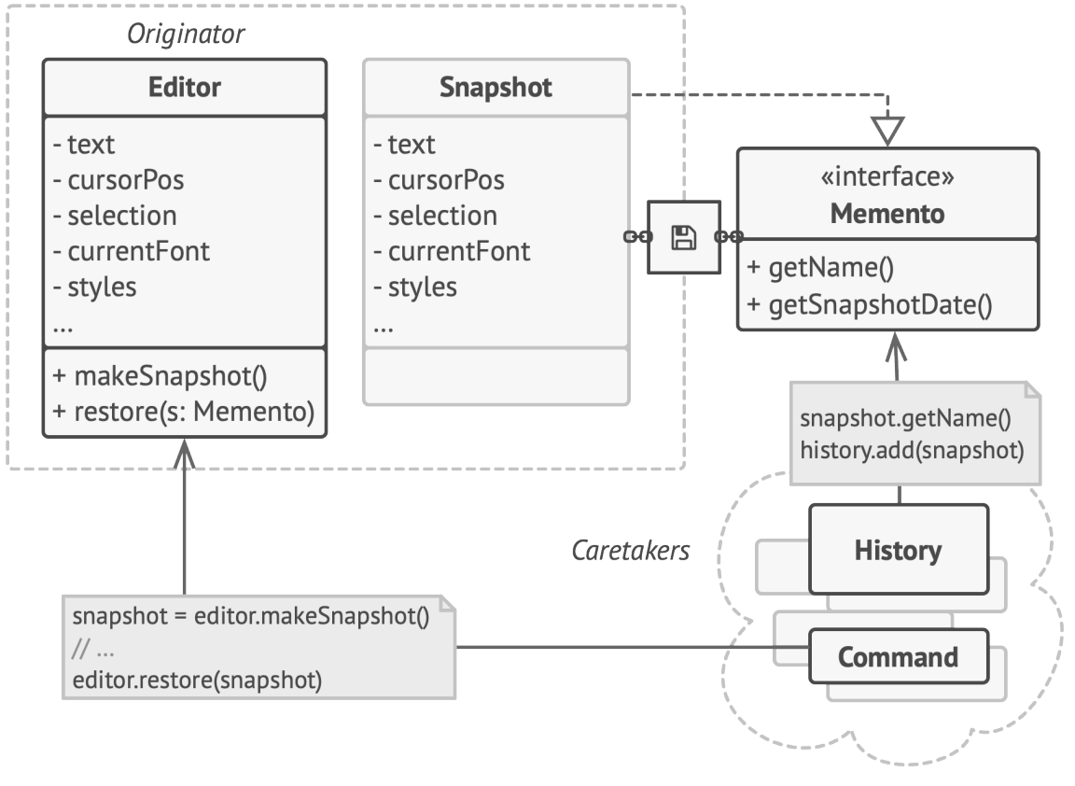
Typically consists of 3 objects:
Originator – can produce snapshots of its own state, as well as restore its state from snapshots,
Memento – acts as a snapshot of the originator’s state. Usually immutable, and receives data only once via constructor,
Caretaker – has the history of Mementos and knows when and why to capture the originator’s state and when the state should be restored

