Slide 1
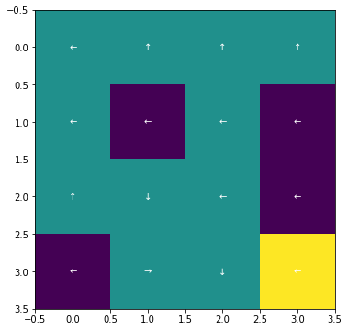
Value Iteration Policy
Policy Iteration Policy
4 x 4

Slide 2
Value Iteration
Policy Iteration
4 x 4

Slide 3
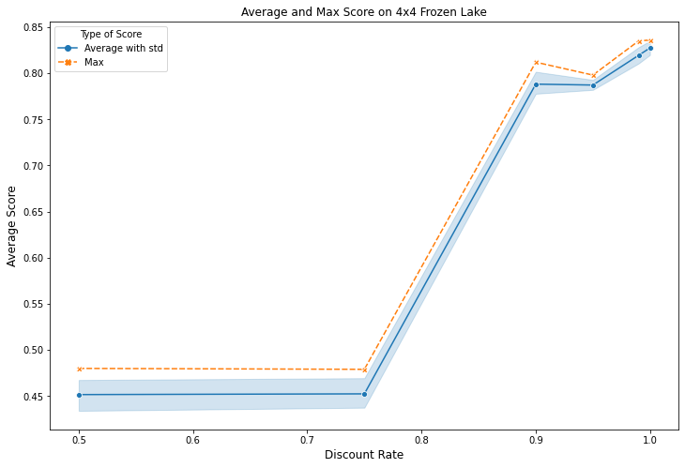
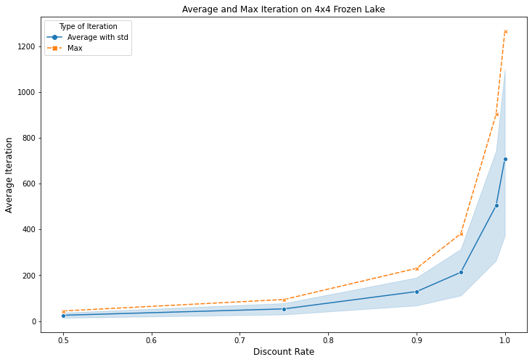
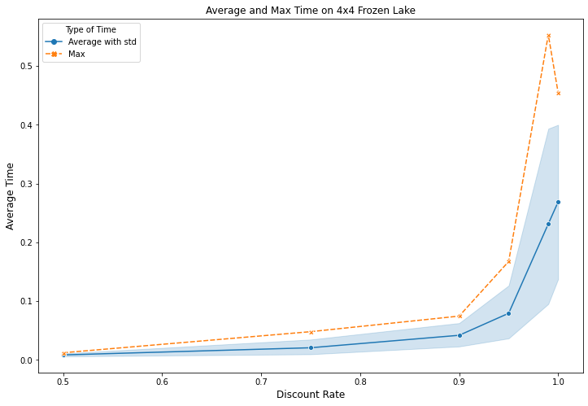
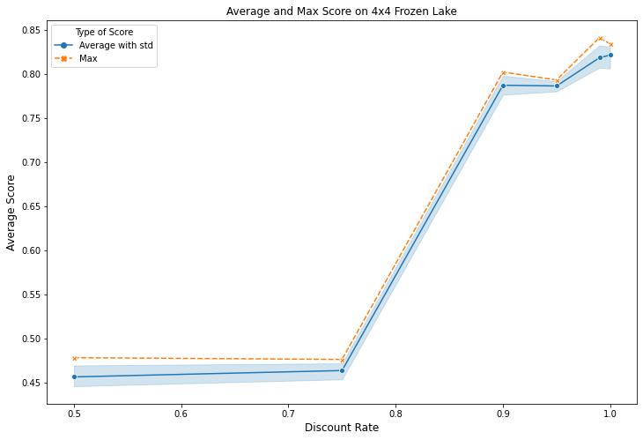
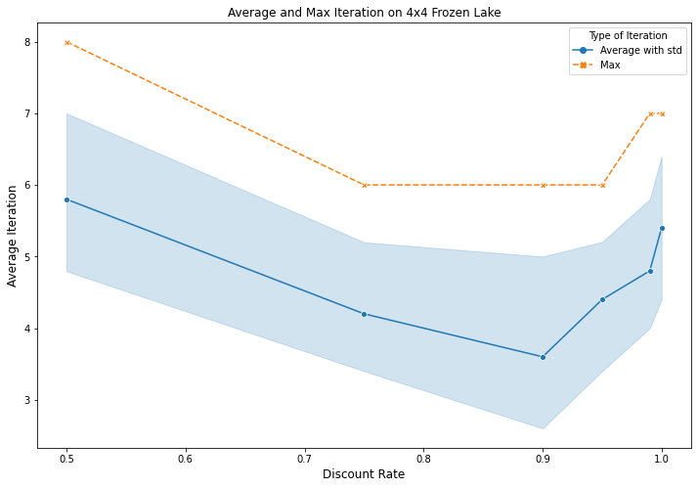
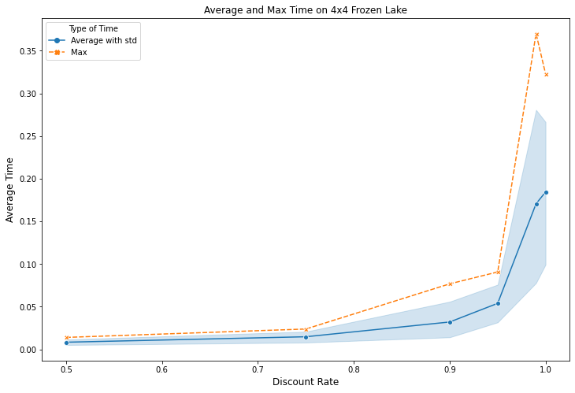
Value Iteration Discount vs. Reward
Value Iteration Discount vs. Iteration
Value Iteration Discount vs. Time
Policy Iteration Discount vs. Reward
Policy Iteration Discount vs. Iteration
Policy Iteration Discount vs. Time
4 x 4

Slide 4
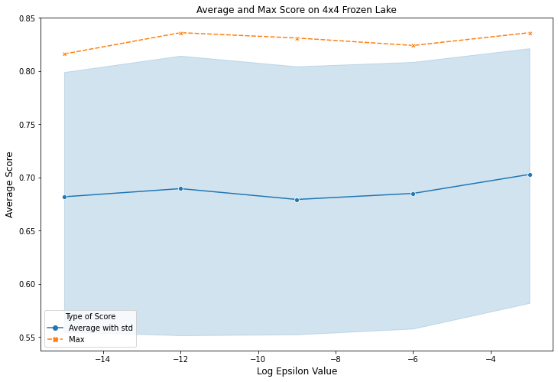
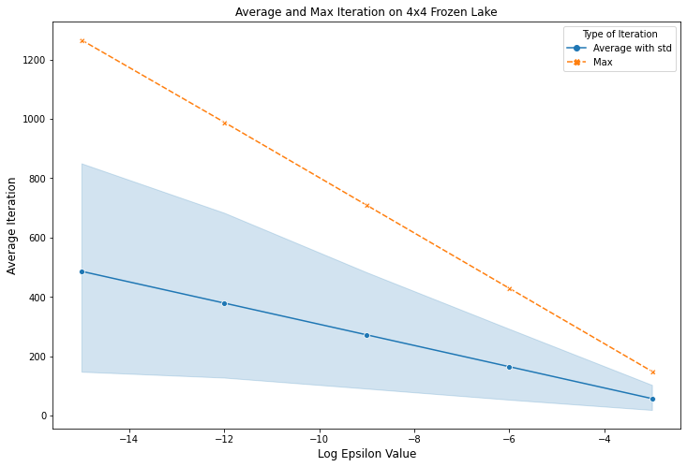
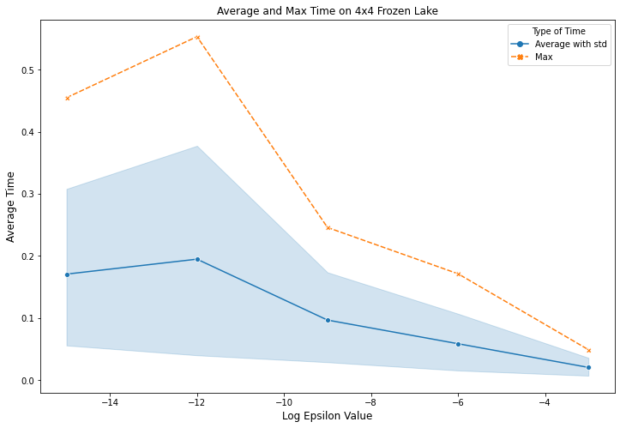
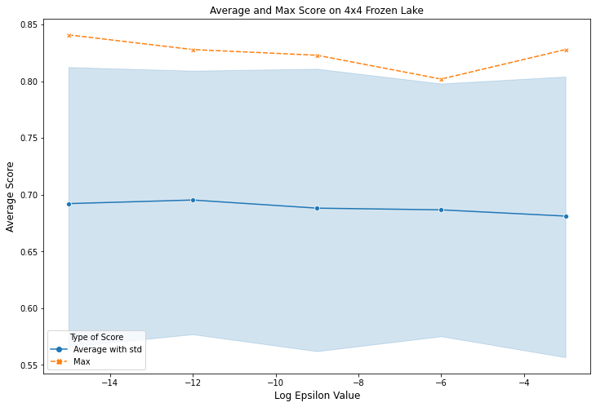
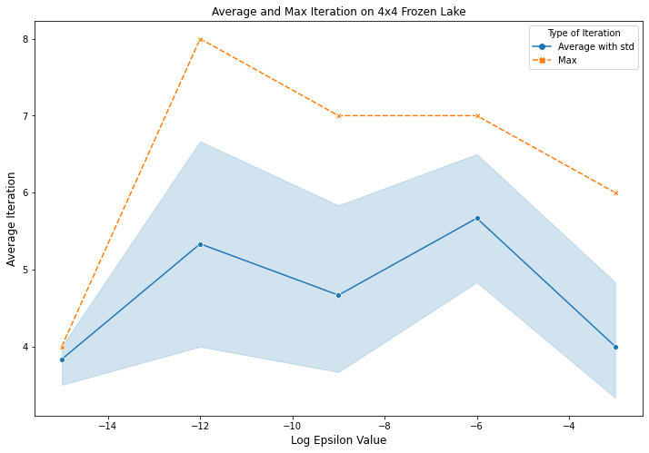
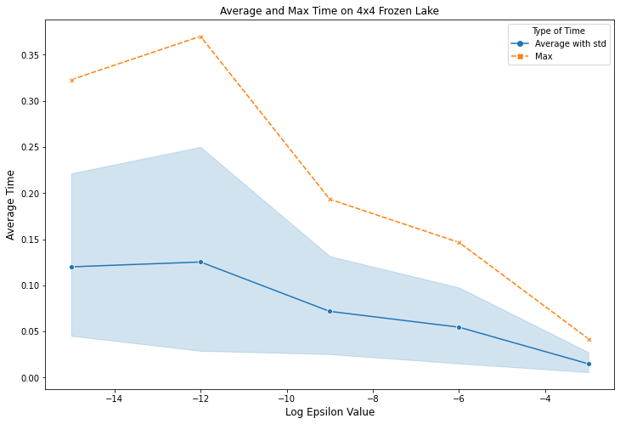
Value Iteration Ep vs. Reward
Value Iteration Ep vs. Iteration
Value Iteration Ep vs. Time
Policy Iteration Ep vs. Reward
Policy Iteration Ep vs. Iteration
Policy Iteration Ep vs. Time
4 x 4

Slide 5
Q Learner Policy
4 x 4

Slide 6
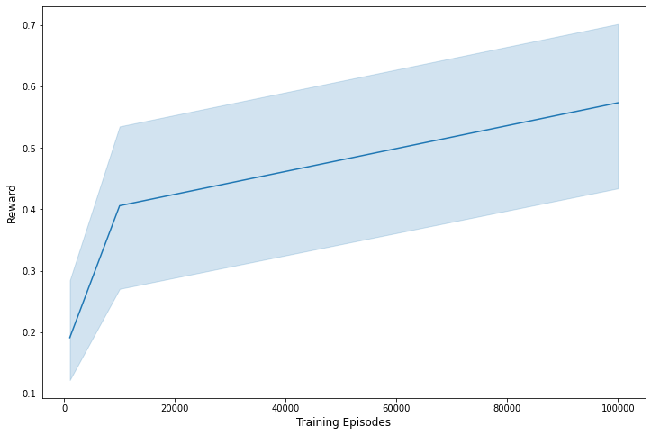
Q Learner – Reward vs. Iteration
4 x 4

Slide 7
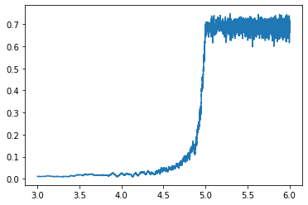
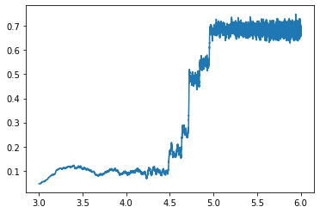
Q Learner
Discount 0.9999 Iteration 10^6 Alpha 0.01 Decay 1e-03
Discount 0.9999 Iteration 10^6 Alpha 0.01 Decay 1e-05
4 x 4

Slide 8
4 x 4

Slide 9
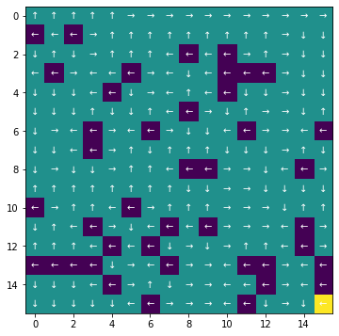

Value Iteration Policy
Policy Iteration Policy
Q-Learner Policy
16 x 16

Slide 11
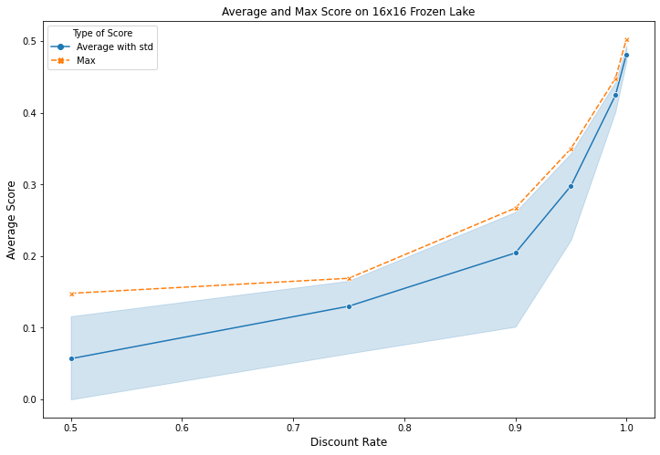
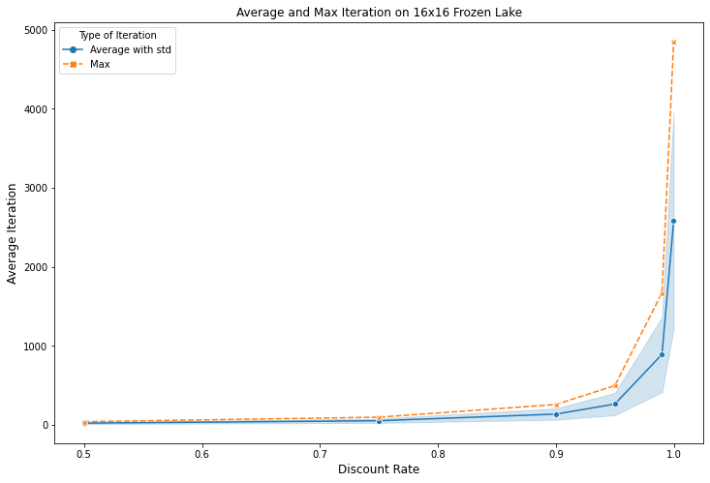
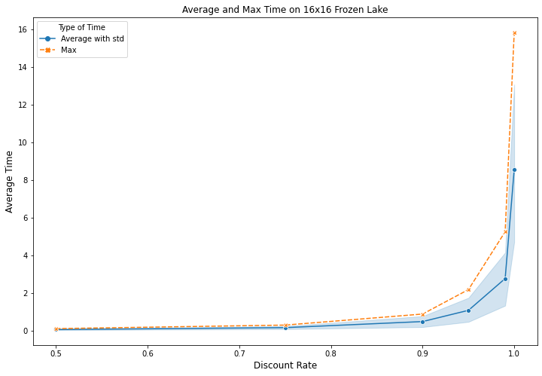
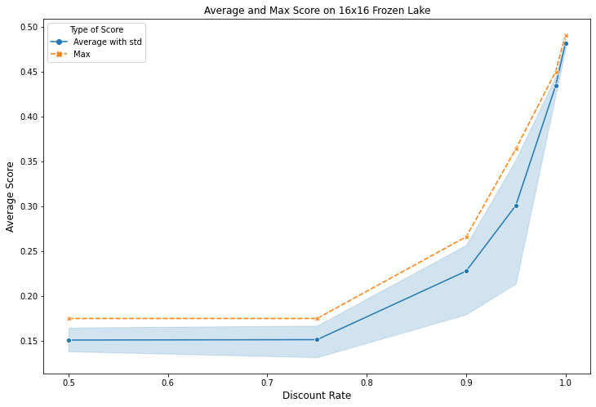
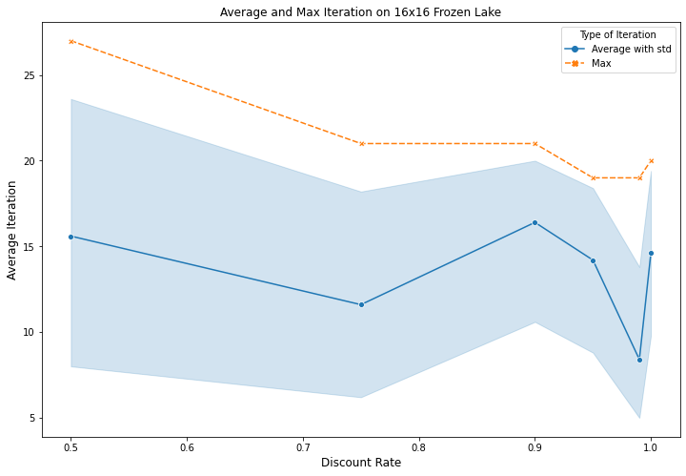
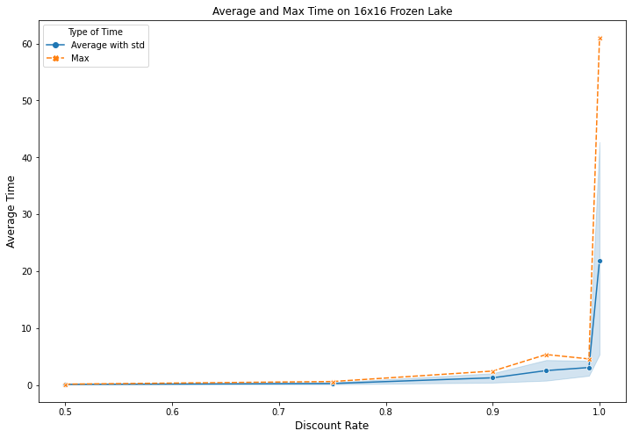
Value Iteration Discount vs. Reward
Value Iteration Discount vs. Iteration
Value Iteration Discount vs. Time
Policy Iteration Discount vs. Reward
Policy Iteration Discount vs. Iteration
Policy Iteration Discount vs. Time
16 x 16

Slide 12

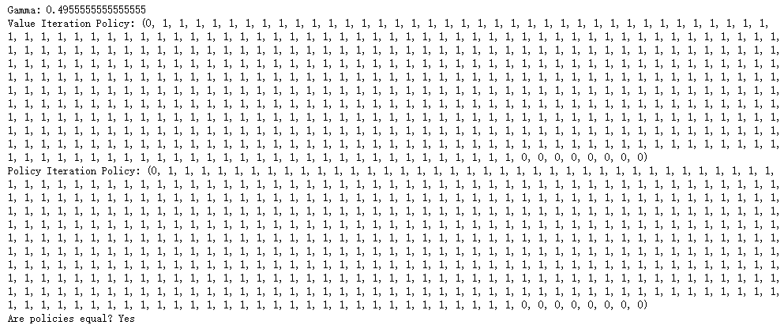


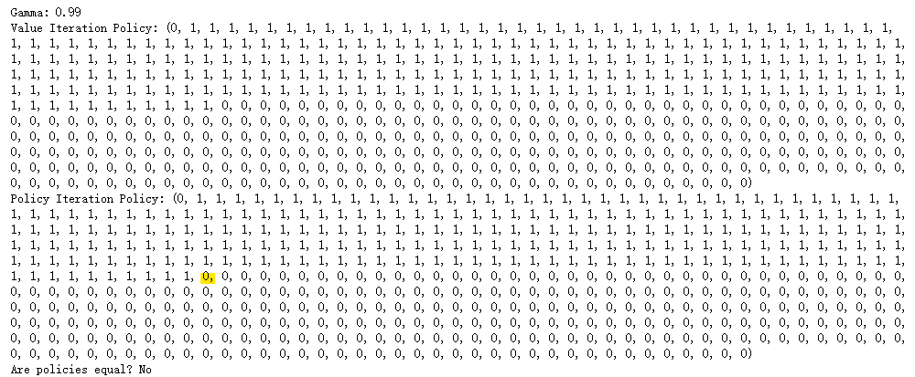

Forest 20 State
Forest 500 State
* Q-Learning Policy – Gamma 0.9

Slide 13
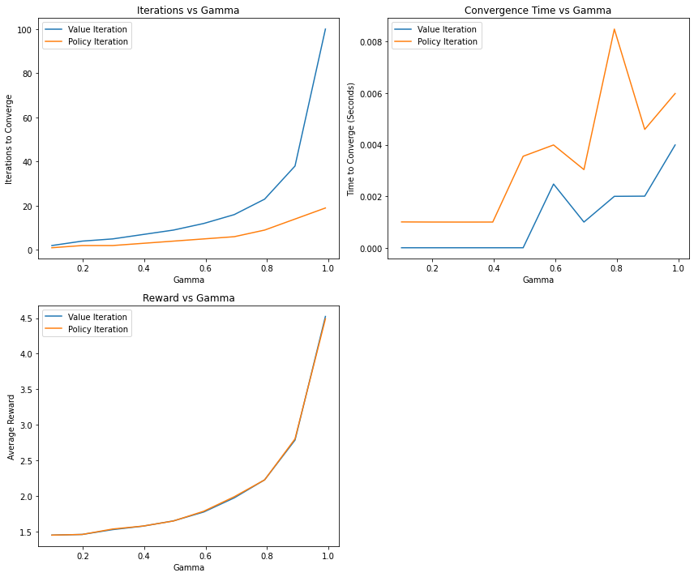
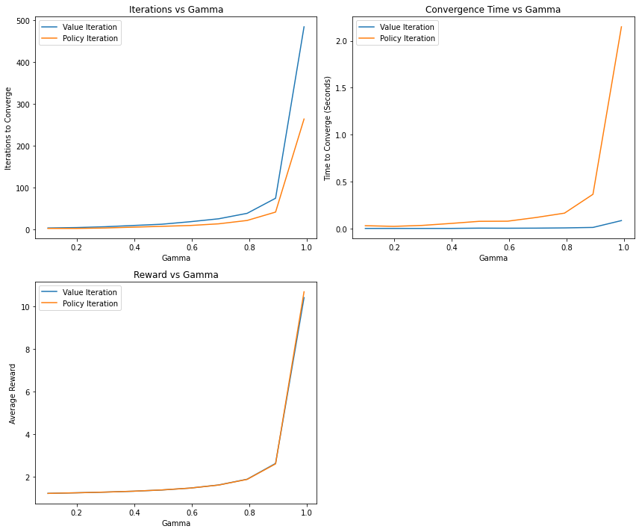
Forest 20 State
Forest 500 State

