Slide 1
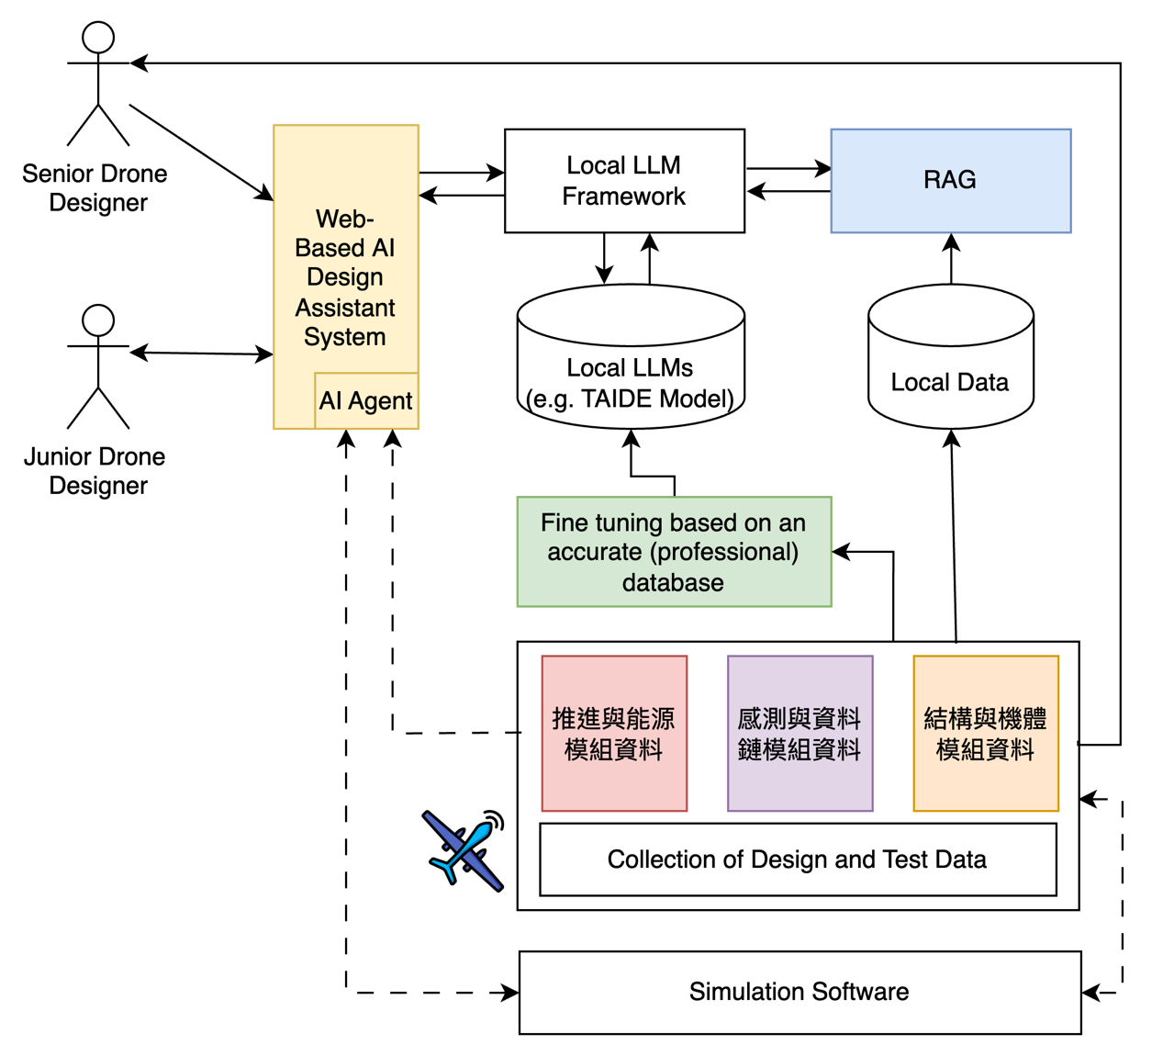
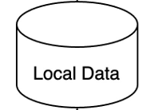
prompt
RAG
prompt
embedding
similarity
search
document
embedding
vector DB

