Slide 1
Forecasting Short-Term ICU Stress From State Hospital Data
Predicting ICU surges before they happen
Capstone 3 Final Presentation | Safari Gisa

Slide 2
Problem & Motivation
Unexpected ICU surges cause delayed admissions, staff burnout, and worse patient outcomes
ICU capacity strain is often recognized after it has materialized
No advance signal means missed opportunities for staffing adjustments, procedure rescheduling, and patient transfers
A 1–7 day early warning shifts response from reactive to proactive, enabling action early

Slide 3
Goal
Question: Will California's adult ICU system enter high stress within the next 1–7 days?
Data: HHS Protect, California state-level (June 2022 – 2024)
Time period: Post-Omicron regime (June 2023 – April 2024)
High stress: ICU utilization above the 85th percentile
1–7 day horizon: matches the lead time hospitals need to adjust staffing, reschedule procedures, and coordinate transfers

Slide 4
Scope
Geography: California (state-level, aggregated across all hospitals)
Data source: HHS Protect Public Data Hub
Stress definition: Adult ICU utilization exceeds the 85th percentile of its historical distribution

Slide 5
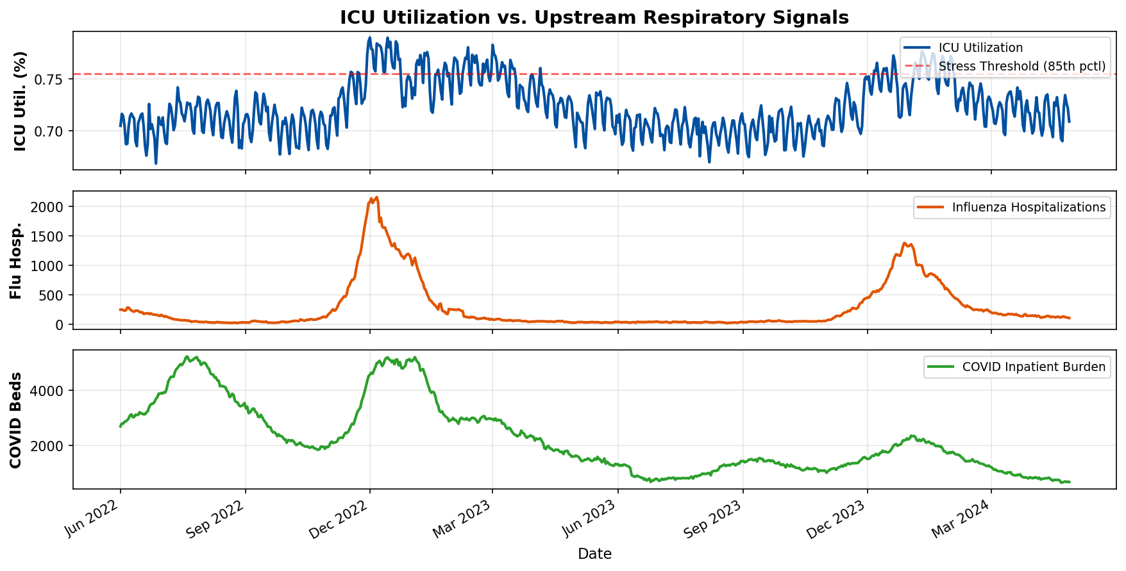
Data Overview
Respiratory signals peak before ICU utilization rises
This lead-lag pattern is what the model learns to detect

Slide 6
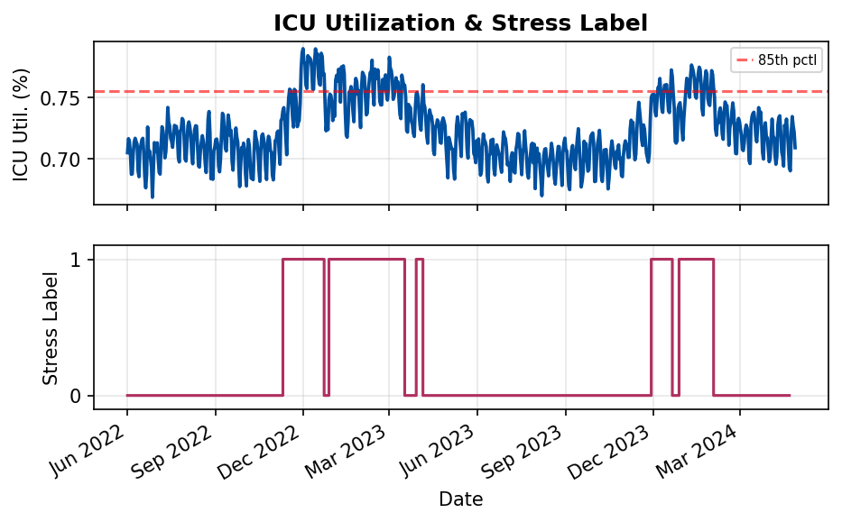
Target Label & Stress Definition
Target: Will ICU utilization exceed the 85th percentile in the next 1–7 days?
Label = 1 (stress ahead) or 0 (no stress)
27% of days preceded a stress event
Limitation: Only 2 stress episodes in the evaluation window(June 2023 - 2024)

Slide 7
Modeling Approach
Baseline: A simple rule that flags risk only after ICU utilization has already been elevated(the current reactive paradigm)
Model v1: Uses respiratory admission and hospitalization trends to anticipate ICU stress before it materializes
Model v2: Builds on v1 by incorporating trend momentum and smoothed demand patterns to capture compounding pressure

Slide 8
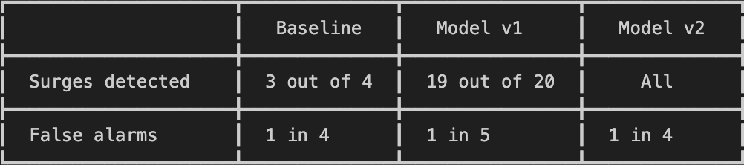
ICU Stress - Results
Baseline: reactive, misses 1 in 4 surges
Model v1: catches nearly all surges, fewest false alarms
Model v2: zero missed surges, slightly more false alarms than v1
Both models detect stress before it happens, not after

Slide 9
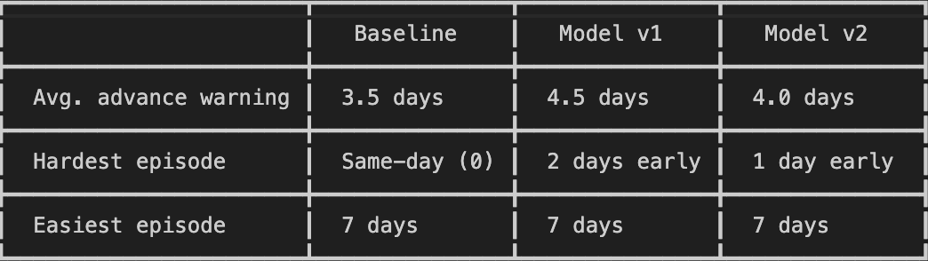
How Much Advance Notice?
Baseline detected one surge the same day it began, too late to act
Model v1 provided the most advance warning at 4.5 days on average
Both models raise alerts days before ICU utilization crosses the stress threshold

Slide 10
Limitations
Only two stress episodes in the evaluation window.
Results are based on a small number of events; performance may differ in future seasons
State-level data only
ICU stress is a facility-level problem; statewide averages may mask localized surges
Single seasonal cycle
The model has been tested over ~11 months; multi-year validation is needed before operational deployment
Fixed stress threshold, different thresholds would change results
Respiratory signals only
ICU stress driven by non-respiratory causes (trauma, surgical volume, heat events) would not be detected by this model

Slide 11
Recommendations
Adopt Model v1 (respiratory signals only) as the primary early-warning tool It It has the most reliable balance of detection and lead time
Run prospectively through at least one more winter season before operational reliance
Extend to regional or facility-level data to capture localized surges
Add interpretability so clinicians can see why an alert fired
Simulate intervention policies Does acting on an early alert actually improve outcomes?

Slide 12
Executive Summary
Respiratory admissions data, collected daily, can predict ICU stress 4–5 days before it materializes
That lead time turns a reactive scramble into a planned response: staffing, transfers, and equipment staged ahead of demand
The system has clear boundaries
Respiratory-driven stress only, tested on one state and one seasonal cycle

