Slide 1
An explanation sheet for iSAM multi-robot slam tutorial
    2019.11.28
    Giseop Kim, IRAP lab, KAIST
    paulgkim@kaist.ac.kr

Slide 2



For the multi-robot system,
Every robot (should) believes it starts at the origin.

Slide 3
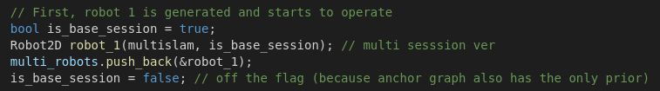
For the multi-robot system,
Every robot (should) believes it starts at the origin.
Because actually they do not know other’s existence before encounters
This example shows only the robot 1 exists at time 0.

Slide 4
For the multi-robot system,
Every robot (should) believes it starts at the origin.
Because actually they do not know other’s existence before encounters
This example shows only the robot 1 exists at time 0.
In this multi-robot example, we assume the first appeared robot’s frame is the global.

Slide 5
Ok. now the robot 1 is generated and it starts at the origin. (others have not appeared yet.)

Slide 6

The robot 1 moved 1 step in x. (others still have not appeared yet.)

Slide 7
The robot 1 moved again 1 step in x and 1 step in y.
(others still … have not appeared yet.)

Slide 8

Suddenly the robot 2 appeared.
But robot 2 does not know the robot 1 yet. (i.e., the robot 1 not seen by the robot 2)
Therefore the robot 2 should starts its own origin. (not know others frame yet)

Slide 9
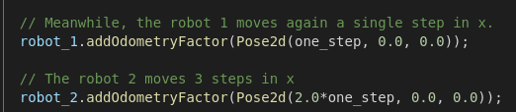
The robot 1 and 2 move independently.

Slide 10
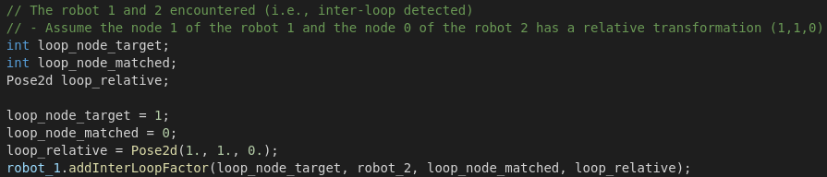
At that time, the robot 1 noticed (encountered) the robot 2!
And it realized also the relative between them is (1, 1, 0).
i.e., a node 0 of the robot 2
= a node 1 of the robot 1 ⊕ (1,1,0)
Inter-robot loop is added.
0
1
δ = (1, 1, 0)

Slide 11

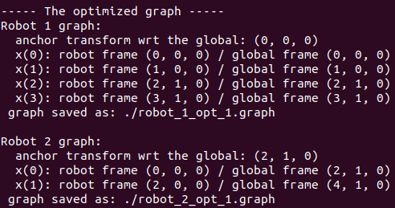
If we close the loop
The result is:
(i.e., anchor node pose is optimized)
== node 0 of the robot 2 to node o of the robot 1
0
1
Anchor Δ = (2, 1, 0)
for all nodes in the robot 2

Slide 12
If we close the loop
The result is:
(i.e., anchor node pose is optimized)
The robot 2’s poses
are transformed into the global frame (i.e., robot 1)
using the relative between anchor node 1 to 2.

Slide 13
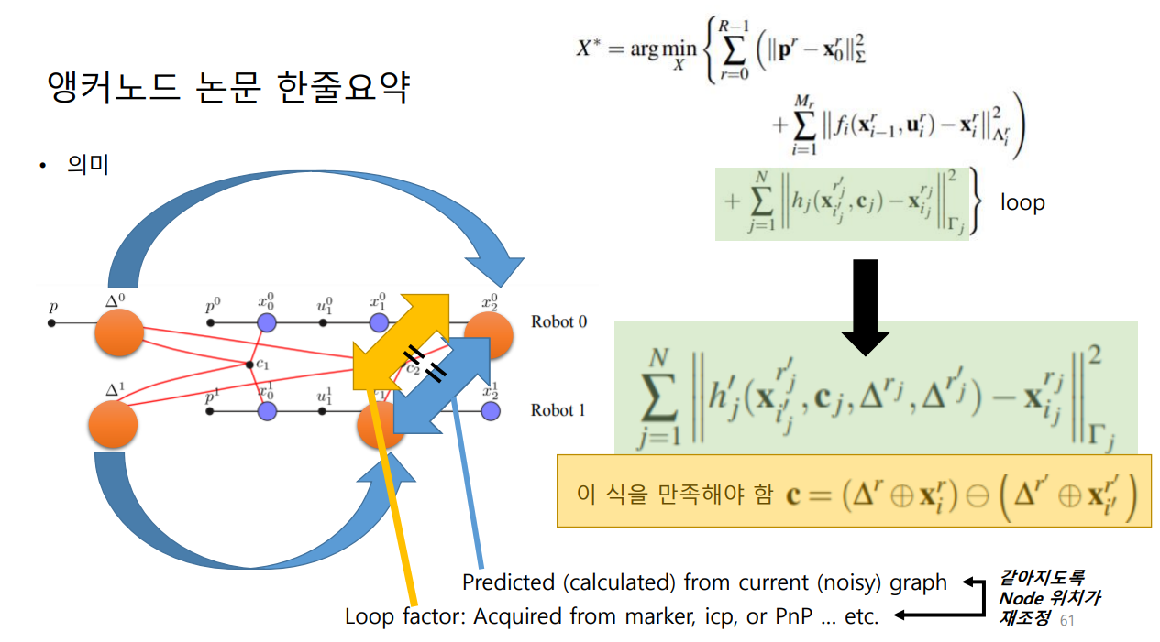

BTW, the detailed principle of anchor node optimization for multi-robot SLAM is here.
Refer the original paper for details,
10 ICRA, Been Kim, et al, multiple relative pose graphs for robust cooperative mapping
Loop factor
anchor node
version
Such that
Optimize Δ1, not
to make these to be equal

Slide 14
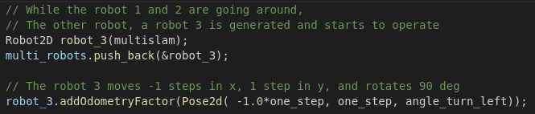
While the robot 1 and 2 being optimized,
Now a robot 3 is appeared.
And it moves
a negative step in x,
a step in y,
and turn left.

Slide 15
Meanwhile,
the robot 2 moves again a single step in x.

Slide 16
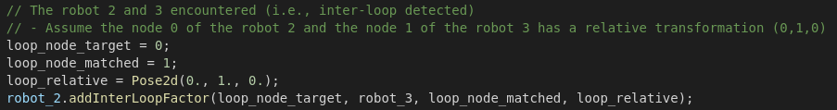
1
δ = (0, 1, 0)
0
Then,
The robot 2 and 3 encountered (i.e., inter-loop detected)
Assume the node 0 of the robot 2 and the node 1 of the robot 3 has a relative transformation (0,1,0)
i.e., a node 1 of the robot 3
= a node 0 of the robot 2 ⊕ (0, 1, 0)

Slide 17
That is, the node 1 of the robot 3 should be seen like this
1
δ = (0, 1, 0)
0

Slide 18
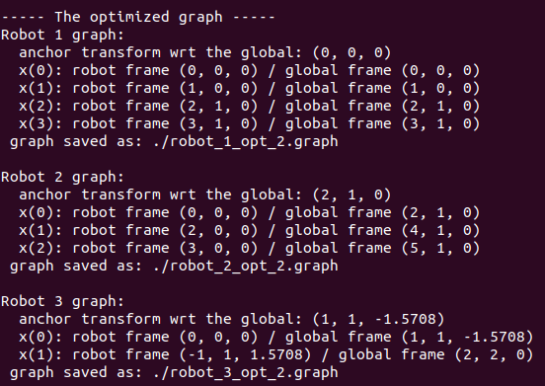
Optimize the overall slam graph again ...
1
0
Δ = (1, 1, - 90deg)
for all nodes in the robot 3
The result is:
(i.e., anchor node pose is optimized)
== node 0 of the robot 3 to node o of the robot 1

Slide 19
The robot 3’s poses
are transformed into the global frame (i.e., robot 1)
using the relative between anchor node 1 to 3.
Using this eq.
global node pose = anchor pose ⊕ own (local) node pose

Slide 20
This result is
equivalent to our expected result
at the slide 17
The robot 3’s poses
are transformed into the global frame (i.e., robot 1)
using the relative between anchor node 1 to 3.
Using this eq.
global node pose = anchor pose ⊕ own (local) node pose

Slide 21
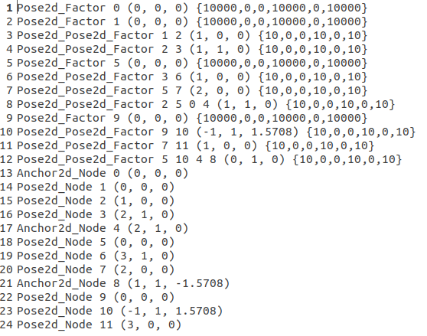
Final result
In this example, finally, the optimized robot pose is save as .graph file
  Overall graph
    Including anchor node pose
  Each robot’s own nodes’ pose

Slide 22
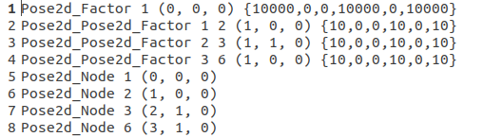
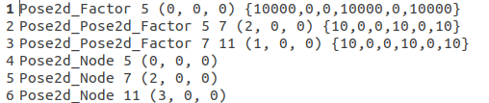

Final result
In this example, finally, the optimized robot pose is save as .graph file
  Overall graph
    Including anchor node pose
  Each robot’s own nodes’ pose (within each one’s frame)
Robot 1
Robot 2
Robot 3

Slide 23
Advantages of anchor node-based multi-robot SLAM
This submap-like technique reduces time for convergence
Each robot could be added at arbitrary time
Each robot can operate on its own frame
No gauge freedom problem (i.e., each robot has its own prior / if not, graph convergence is not stable)
Directly can be extend to the multi-session (or long-term) SLAM

Slide 24
Thank you!

