Slide 1
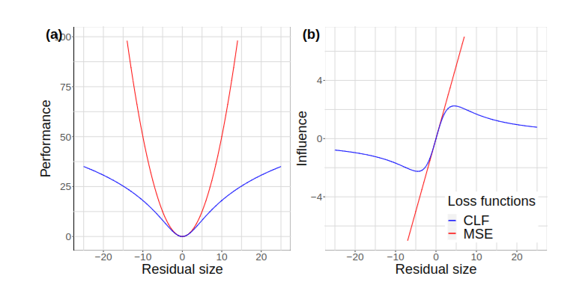



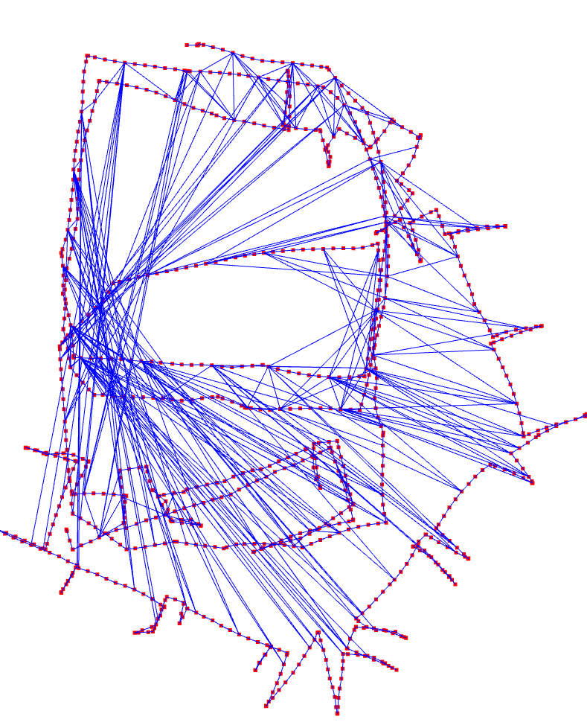
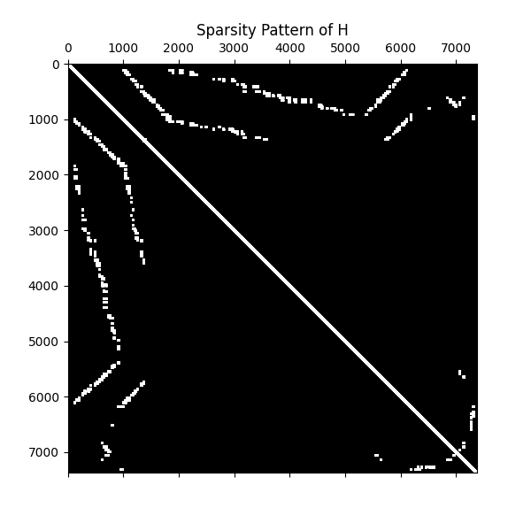
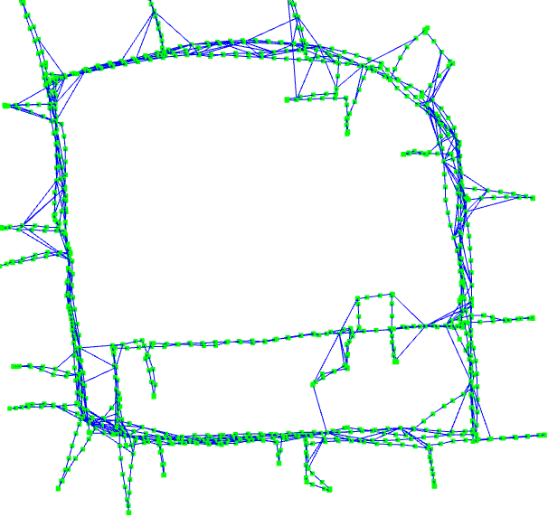
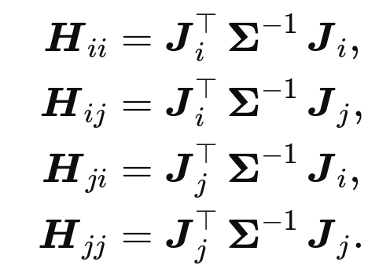
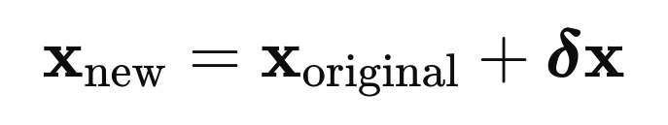


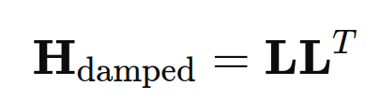

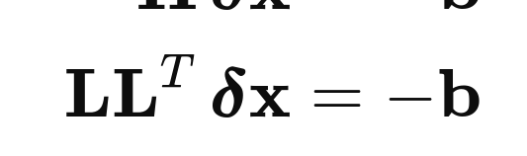
Codegen for Jacobian Auto-generation
and Code Optimization
De-weighting the block for outliers
(Cauchy Robust Loss)
For each constraint
and engaged variables:
Enhanced initial for the next iteration
SE(3) variables
Four 6 by 6 blocks
for a between factor
Levenberg
–Marquardt
scipy.sparse
colmod

