Slide 1
By: Gisele de Araújo Flor

Slide 2
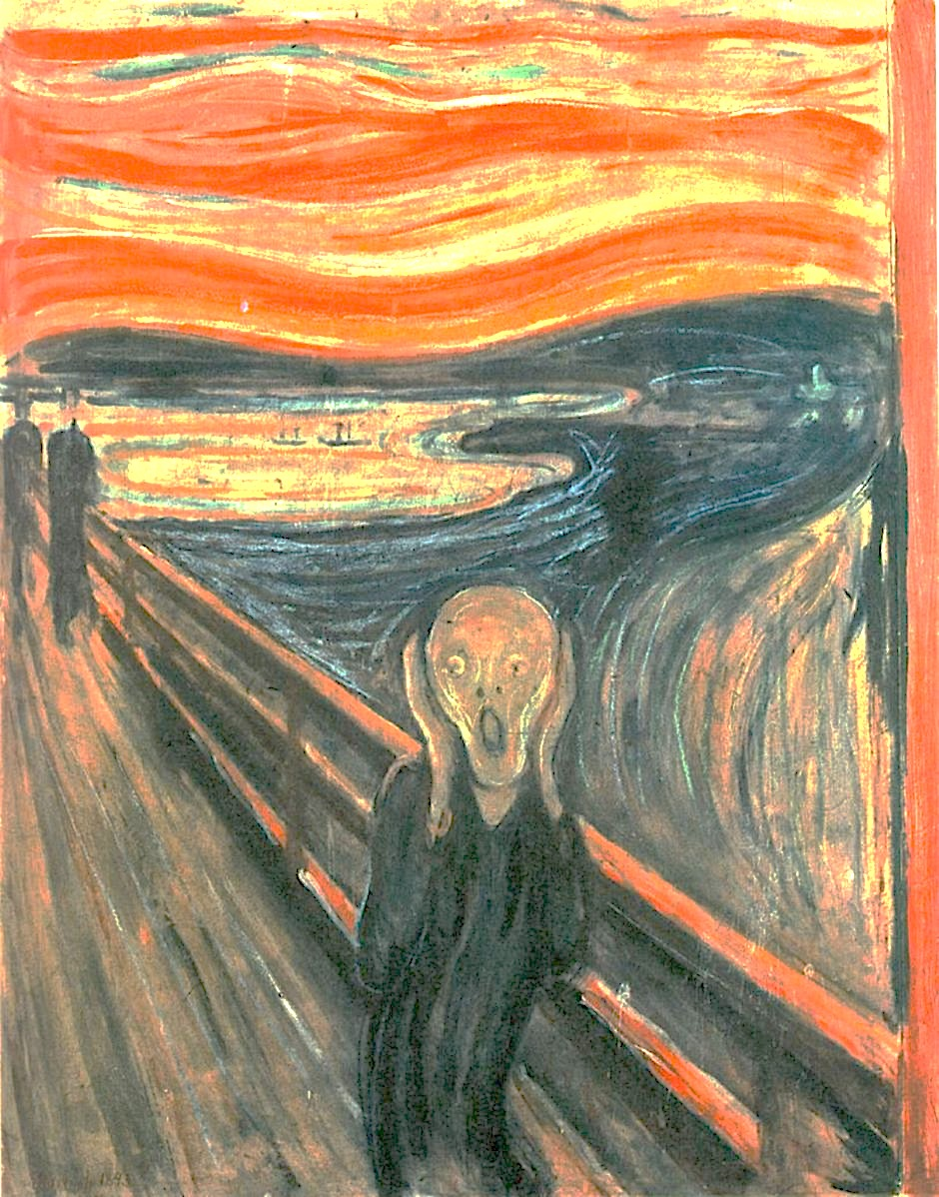

Slide 3
