Slide 1
Fake News Classifier Model Performance Comparison Study
Concordia University
COMP 432 – Fall 2020 Project
Giselle Martel ID#26352936
Firas Sawan ID# 26487815

Slide 2
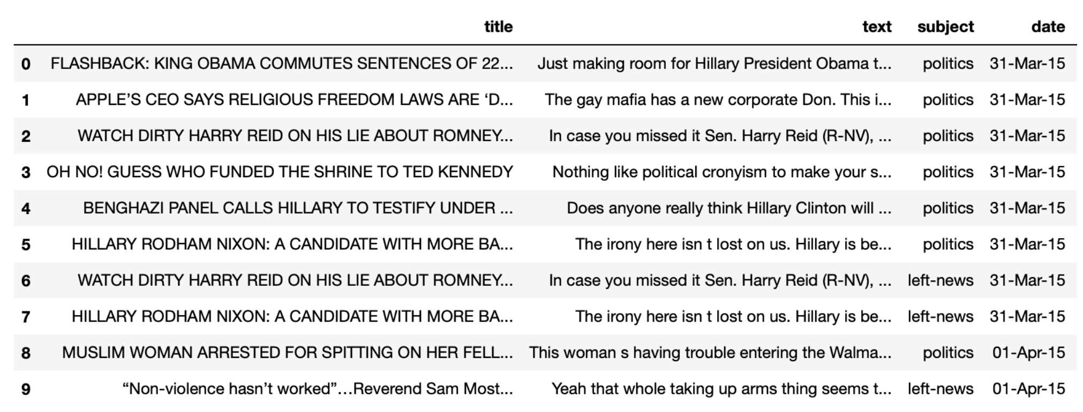
Dataset
Dataset contained a list of two csv files containing Fake and True news articles.
Datasets were preprocessed and joined together.
Additional data was scraped from internet for our CNN implementation.

Slide 3
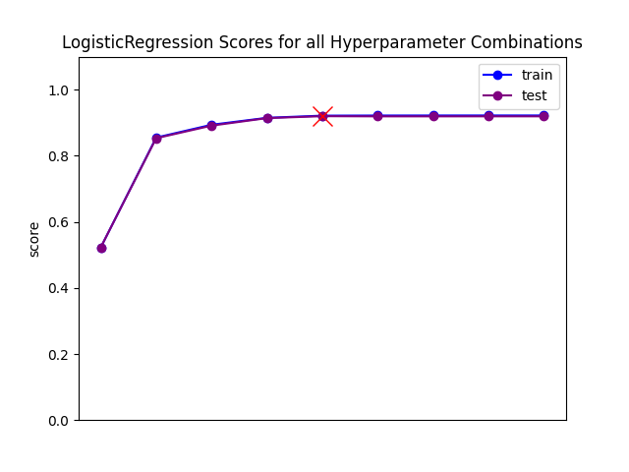
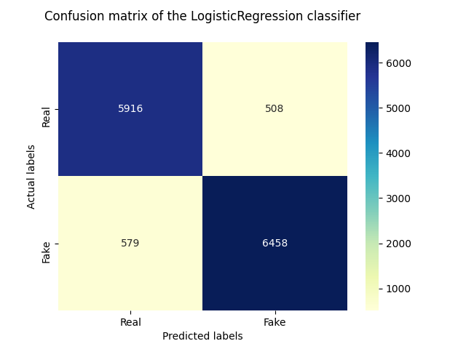
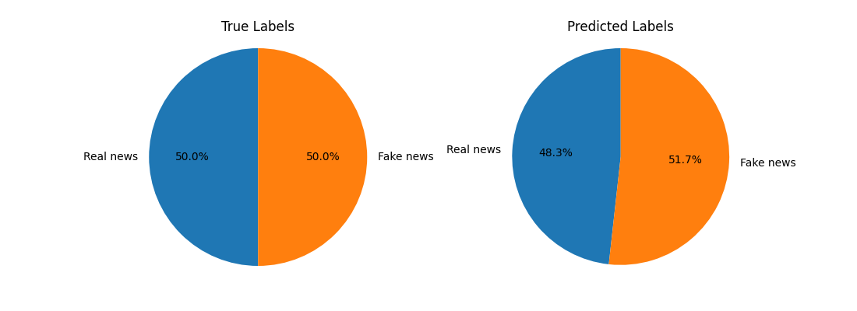
Logistic Regression
• Highest accuracy at 91.92%.
• Mean squared error at 8.07%.
• Lowest overfitting value of 0.018.

Slide 4
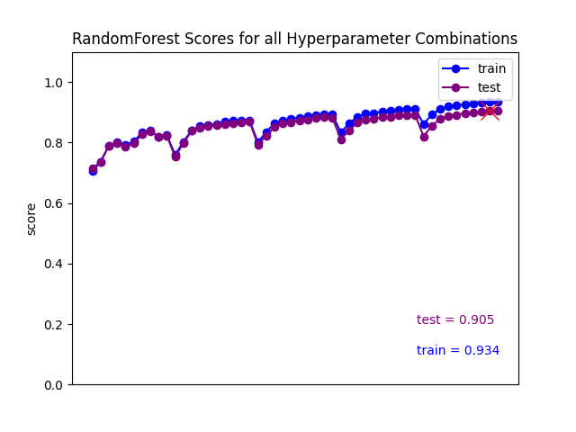
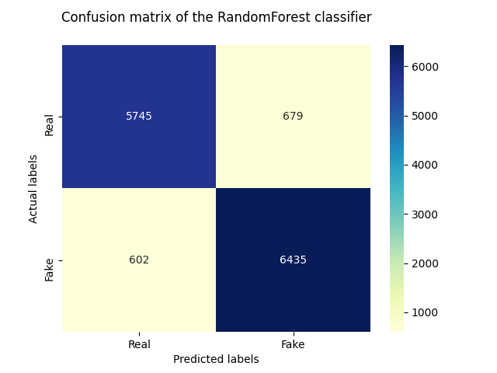
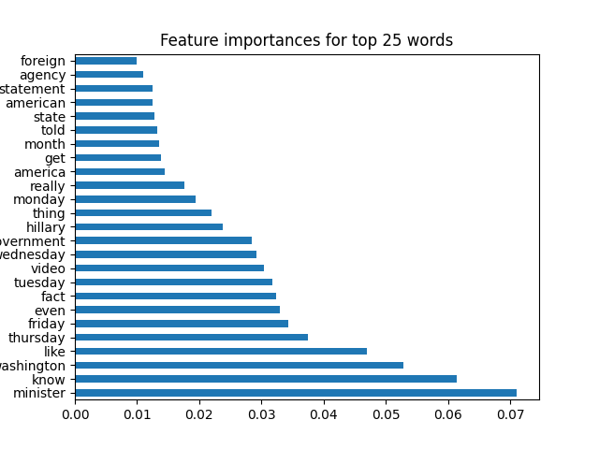
Random Forest Classifier
• Second highest accuracy at 90.48%.
• Mean squared error at 9.51%.
• Overfitting value of 0.705.

Slide 5
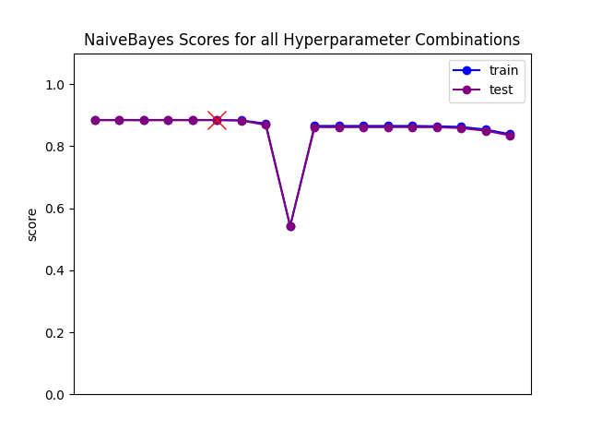
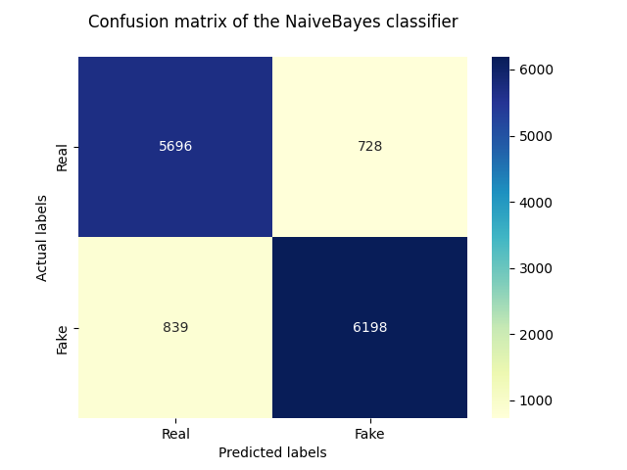

Multinomial Naïve Bayesian
• Third highest accuracy at 88.35%.
• Mean squared error at 11.64%.
• Overfitting value of 0.045.

Slide 6
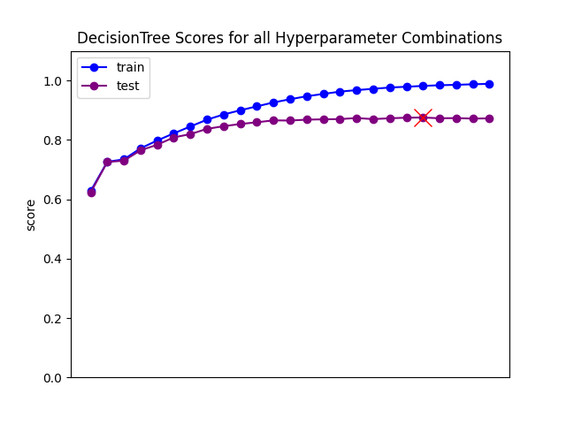
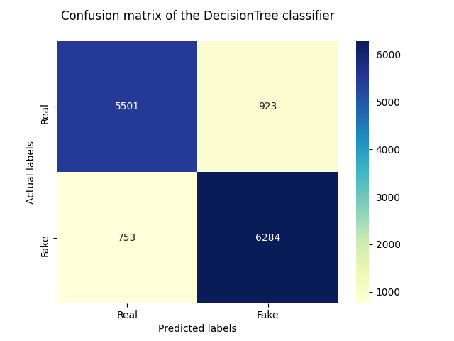
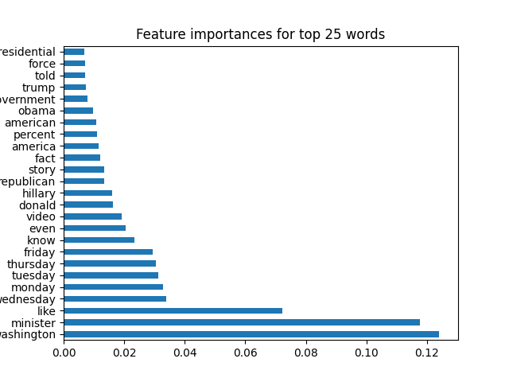
Decision Tree
• Fourth highest accuracy at 87.54%.
• Mean squared error at 12.45%.
• Overfitting value of 1.596.

Slide 7
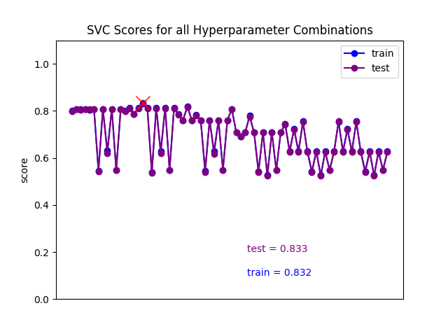
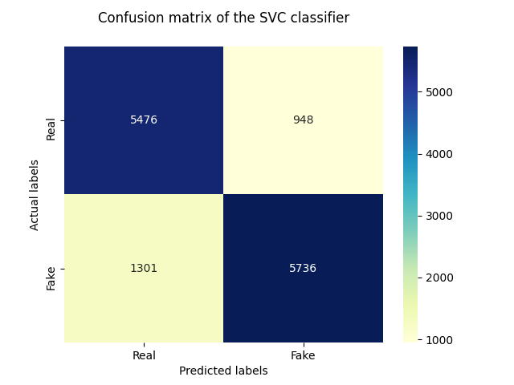
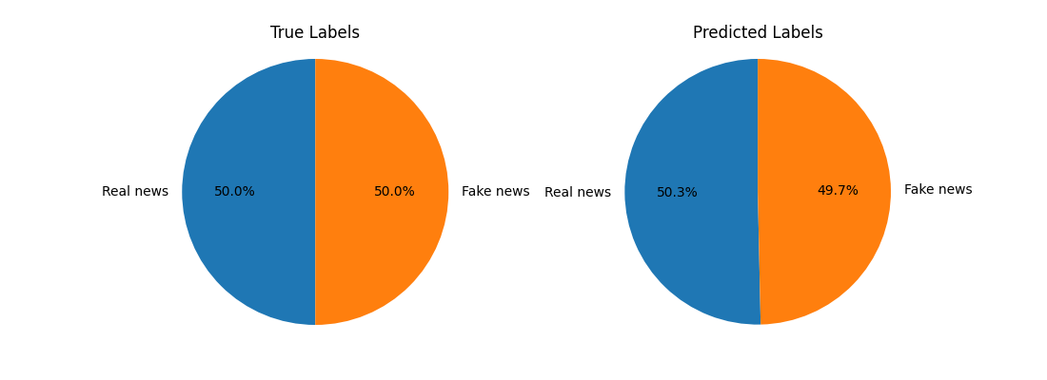
Support Vector Machine
• Fifth highest accuracy at 83.29%.
• Mean squared error at 16.70%.
• Overfitting value of 0.183.

Slide 8
Convolutional Central Neural Network

Slide 9
THANK YOU !

