Slide 1

VMware ESXi 4.0::
Overview
Version: 0.1
Last Update: 2009.10.05
Global Publishing Division / GiSeong Eom <GiSeong.Eom@nurien.com>

Slide 2

About me
IT System Engineer (Since 2000/10)
IT Blog - http://www.performance.kr
Like
Automated process and seam-less migration
Rule of K.I.S.S. (Keep IT Simple, Stupid !!!)
Dislike
Manual and laborious works

Slide 3
Why VMware ESXi 4.0?
VMware is market leader.
VMware remains the market leader in server virtualization with approximately 50% share among enterprise users; Microsoft follows with 26% share. (2009/08/26) ITIC 2009-2010 Global Virtualization Deployment Trends Survey
Easy migration from VMware (Free) Server
Official support for non-Windows Platform

Slide 4
Hardware Requirement
ESXi 4.0 Now supports SATA Storage !!!!
Processor Requirement:
x64 with Intel VT or AMD-V enabled.
But ☹
ESXi 4.0 does not support Realtek NIC.
“Intel Pro 1000 GT Desktop adapter” works well. (USD 29.99 / KRW 40,000)

Slide 5
Software Requirement
ISO: VMware-VMvisor-Installer-4.0.0-171294.x86_64.iso (340MB)
ESXi 4.0 installation method
CDROM
USB
PXE Server
ESXi 4.0 (Free) License key
1J23Q-0E394-48139-0C2R6-A17QM

Slide 6
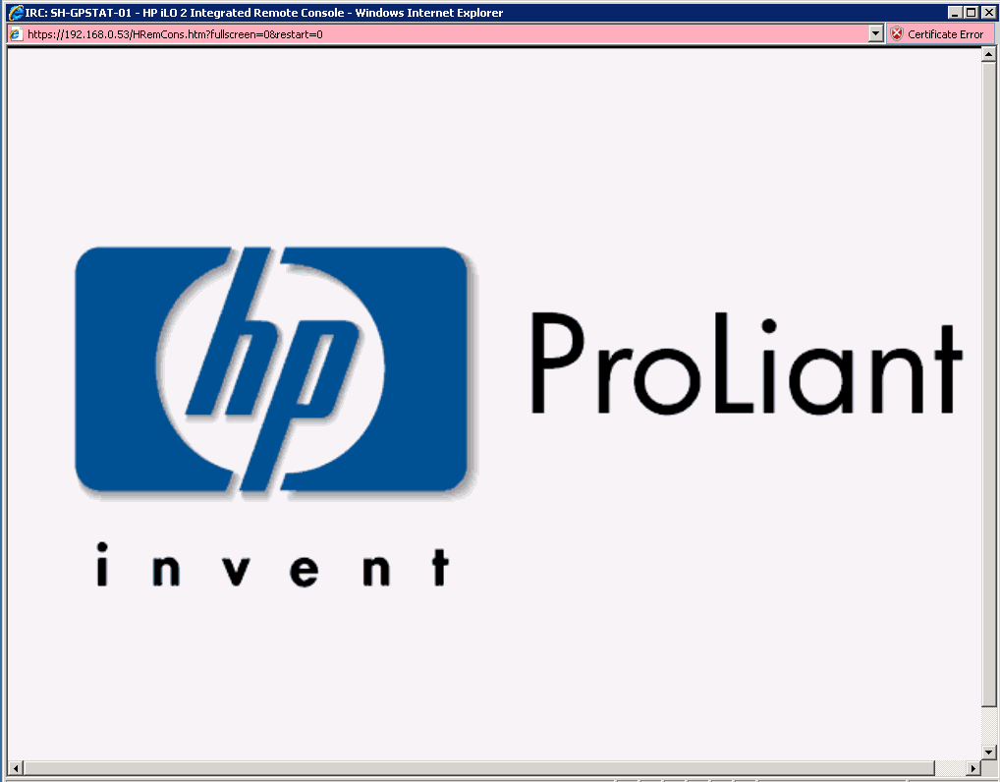
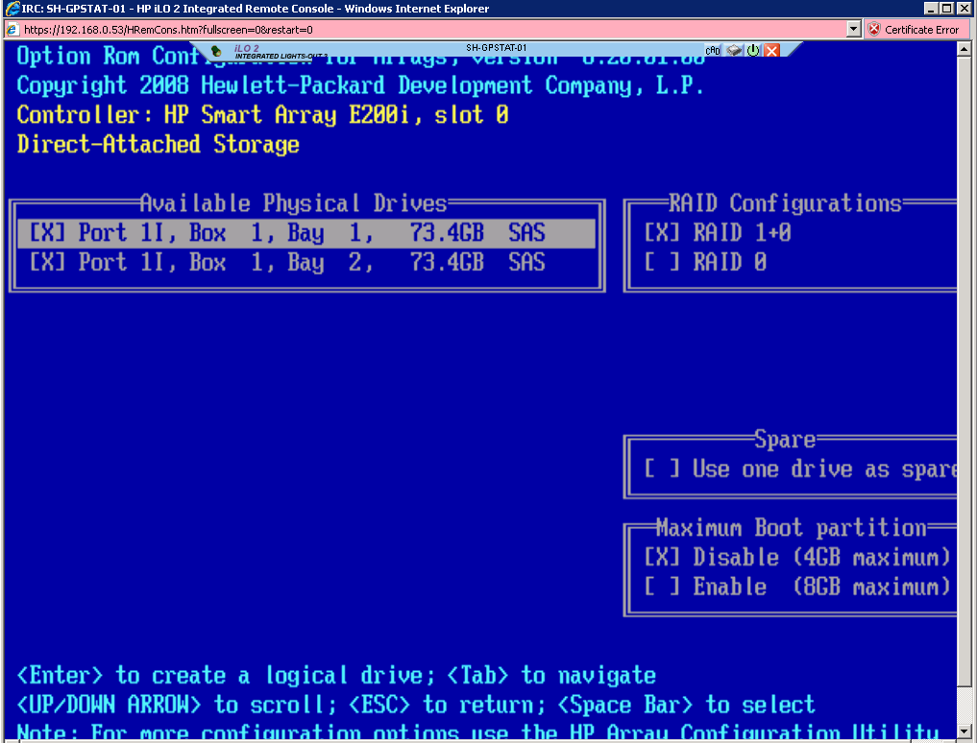
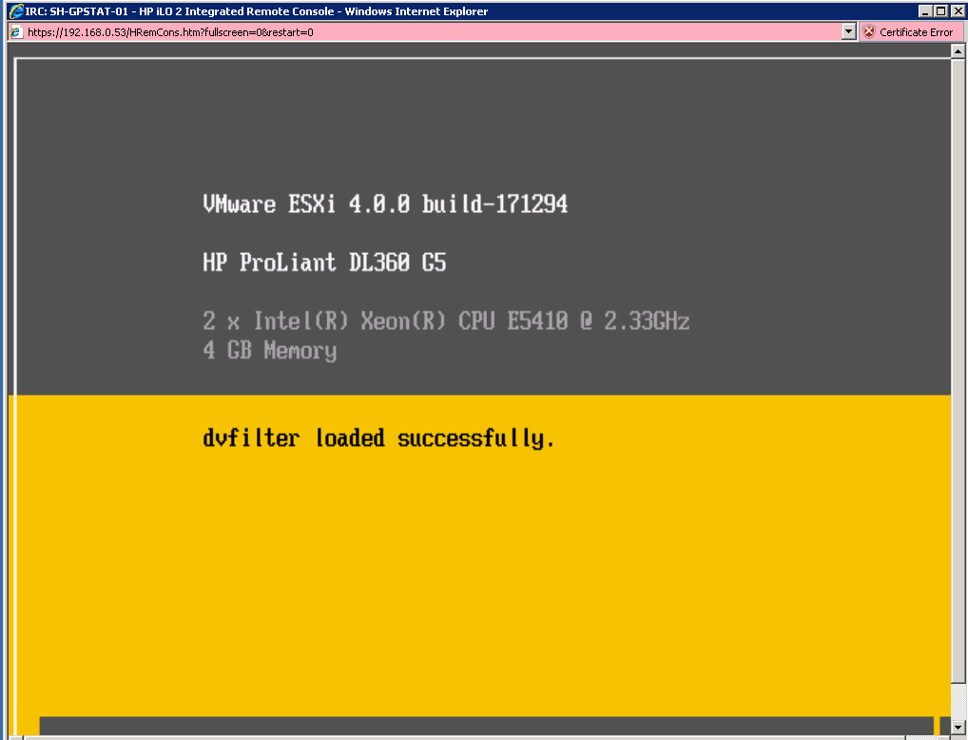
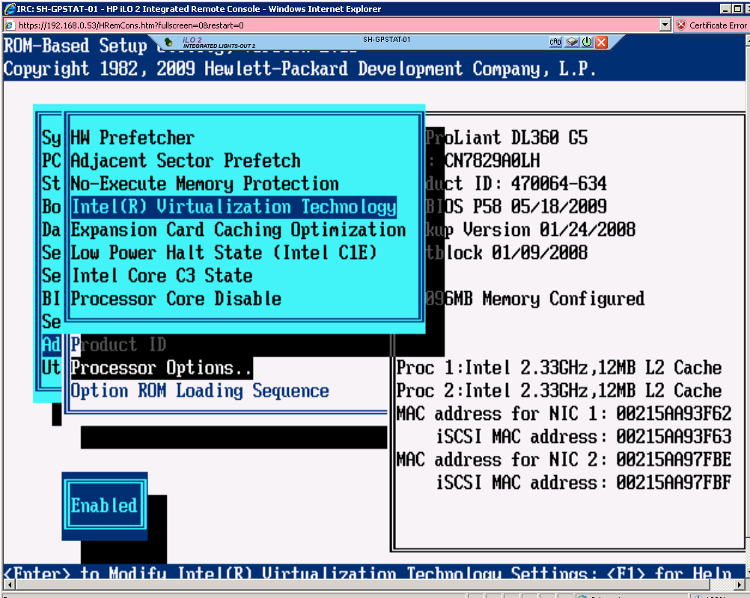
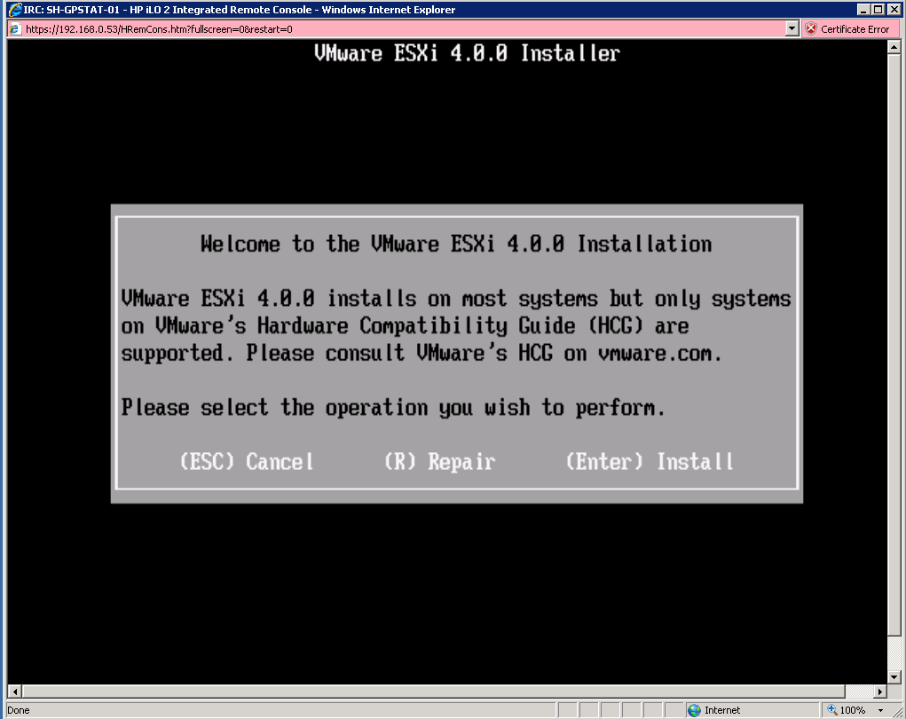
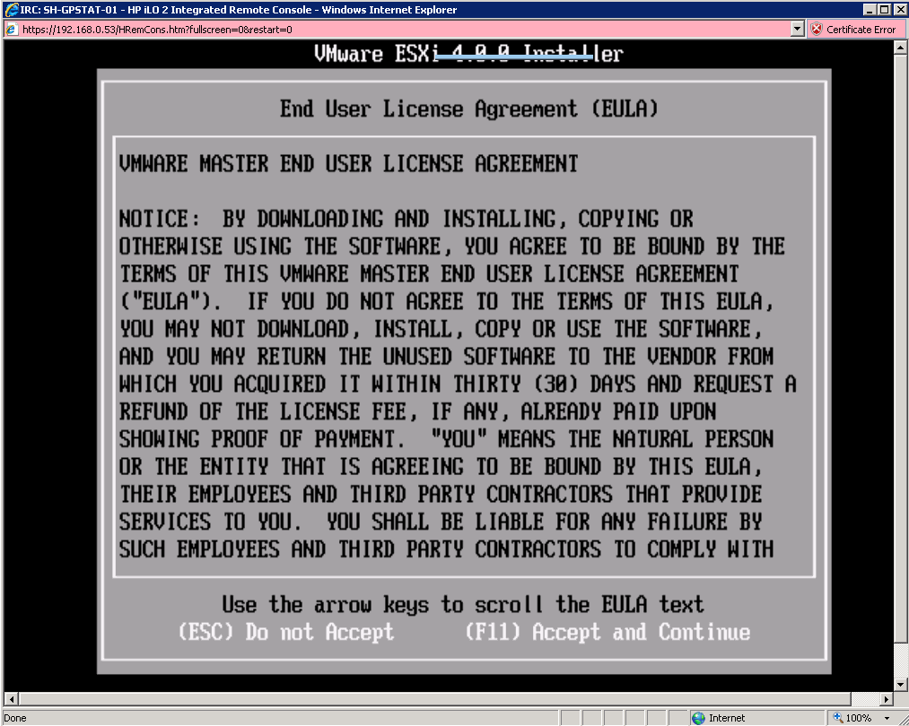
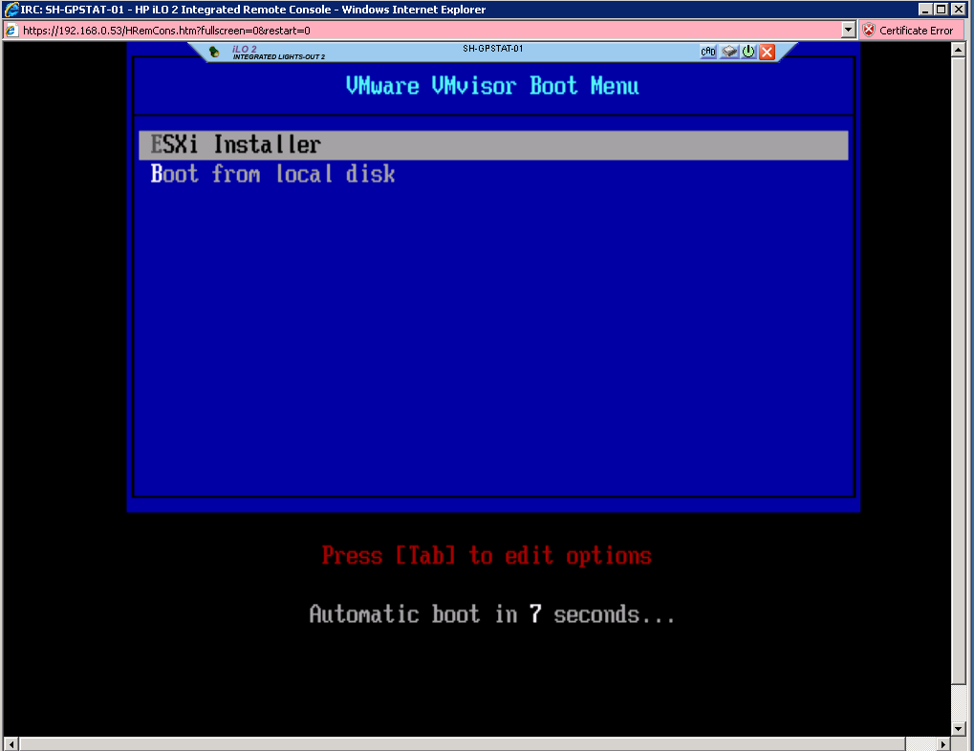
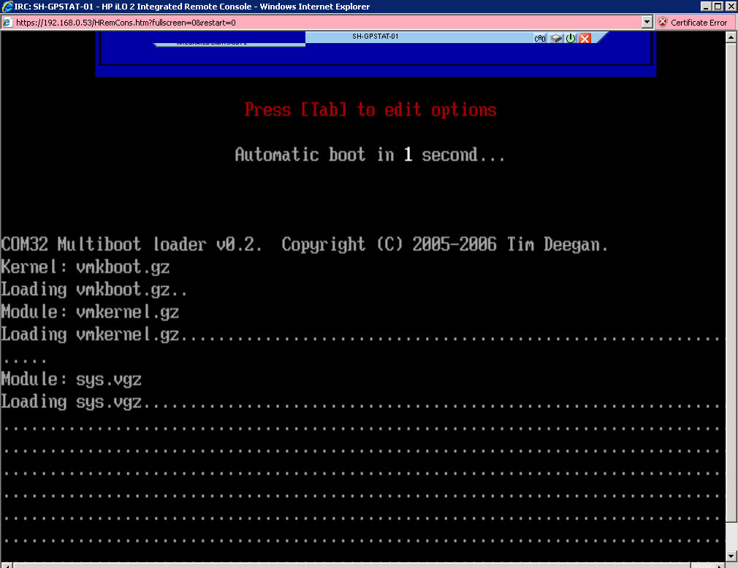
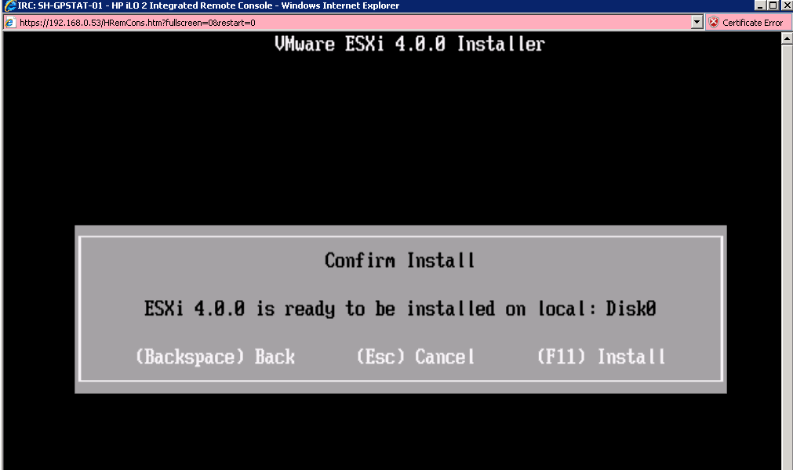
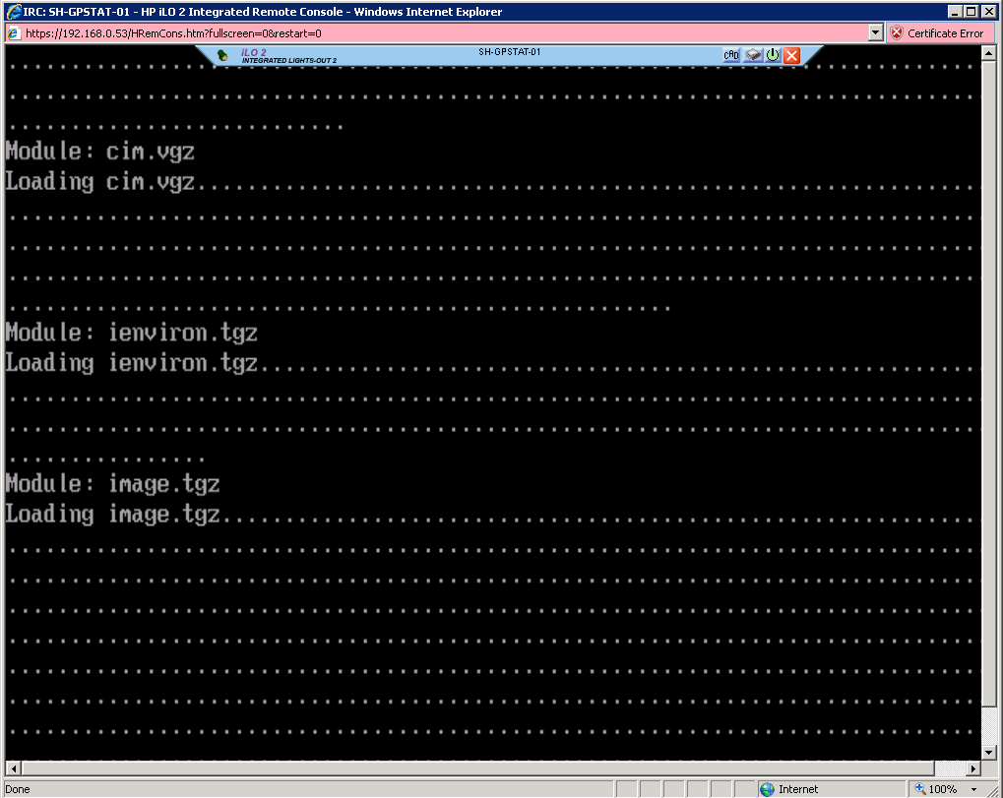
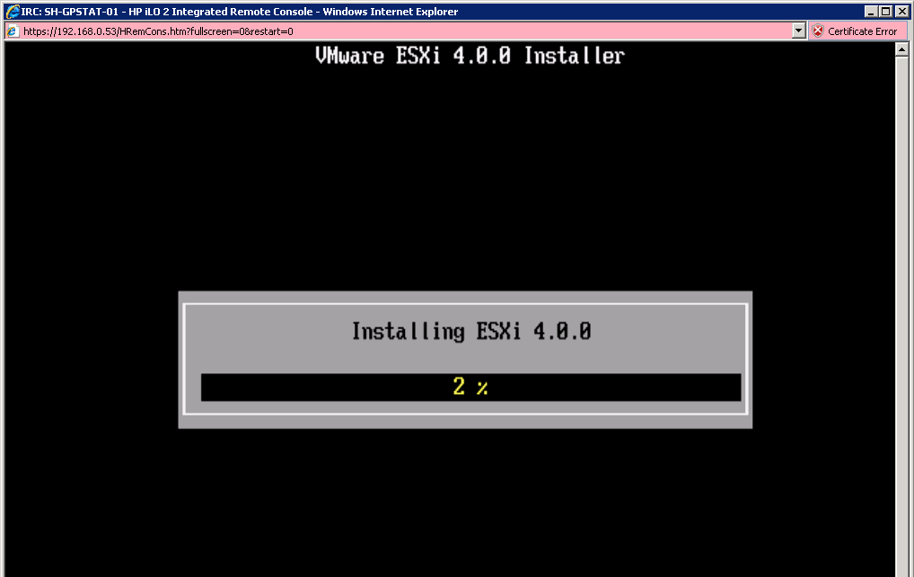
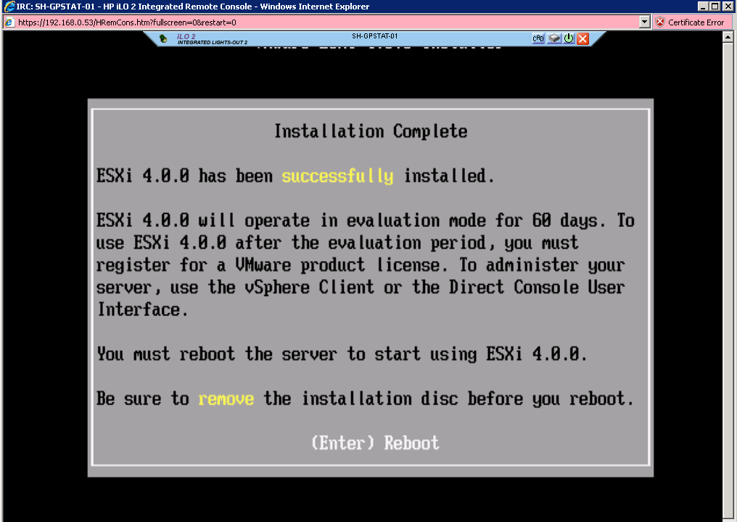
ESXi Installation

Slide 7
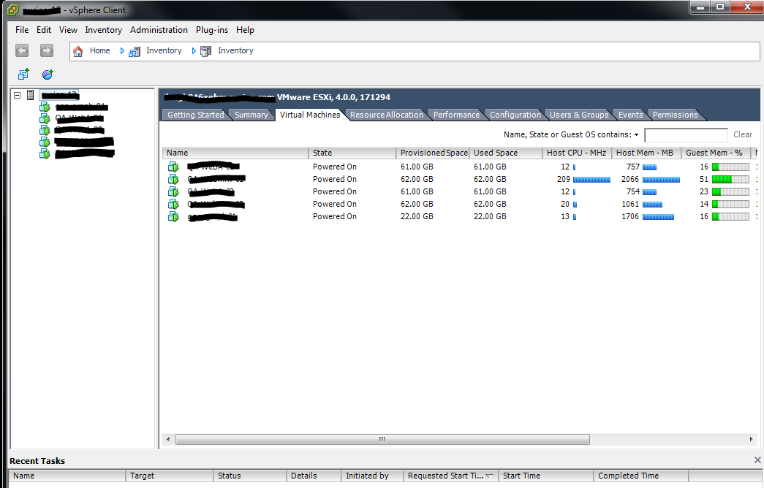
VMware vSphere Client

Slide 8
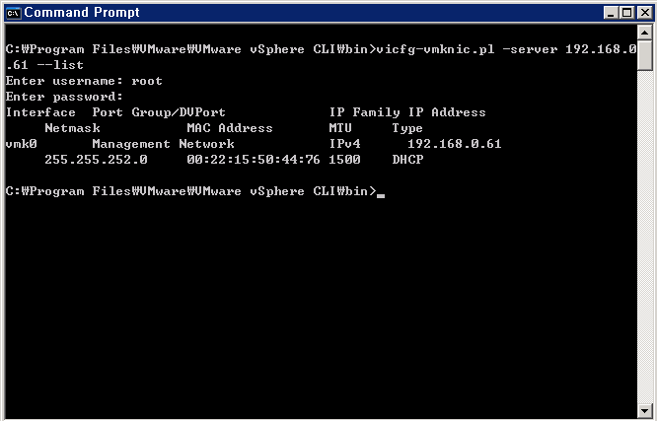
VMware vSphere CLI

Slide 9
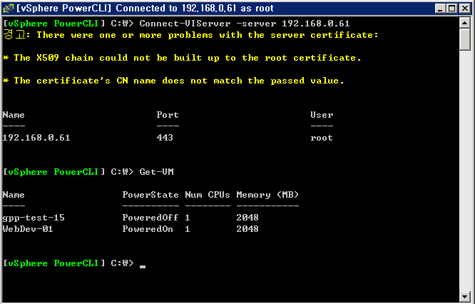
VMware vSphere PowerCLI

Slide 10
Demo
VMware vSphere Client
VMware vSphere CLI
VMware vSphere PowerCLI

Slide 11
For Your Information
ITIC 2009-2010 Global Virtualization Deployment Trends Survey http://itic-corp.com/blog/2009/08/itic-2009-2010-global-virtualization-deployment-trends-survey-results/
Free VMware ESXi: Bare Metal Hypervisor with Live Migration http://www.vmware.com/products/esxi/
Home of the Unofficial VMware ESX Server Whitebox HCL http://www.vm-help.com
VMware vSphere Client on Microsoft Windows 7! http://www.virtuallifestyle.nl/2009/05/vmware-vsphere-client-on-microsoft-windows-7/

Slide 12
Questions ?

Slide 13
System Administration is not a Job.
It’s Life Style.
from “Time Management for System Administrators”

