Slide 1
Power BI Dashboard Project
Sales • Customers • Payments • Delivery & Operations
Dataset Source: Kaggle
Presented using Power BI | Brazilian E-Commerce Analytics

Slide 2
Project Overview
Power BI Analytics
Project Focus
Technology Used
Analyze Brazilian e-commerce sales and operations using the Olist public dataset.
The dashboard converts raw transactional data into clear business insights.
Power BI Desktop
Power Query for data cleaning and transformation
DAX for calculated measures
Interactive dashboard visuals and slicers
Business Areas
Final Dashboard
Sales performance
Customer behavior
Payment patterns
Delivery performance
Regional analysis
3 report pages:
1. Executive Overview
2. Sales Analysis
3. Delivery & Operations Analysis
2

Slide 3
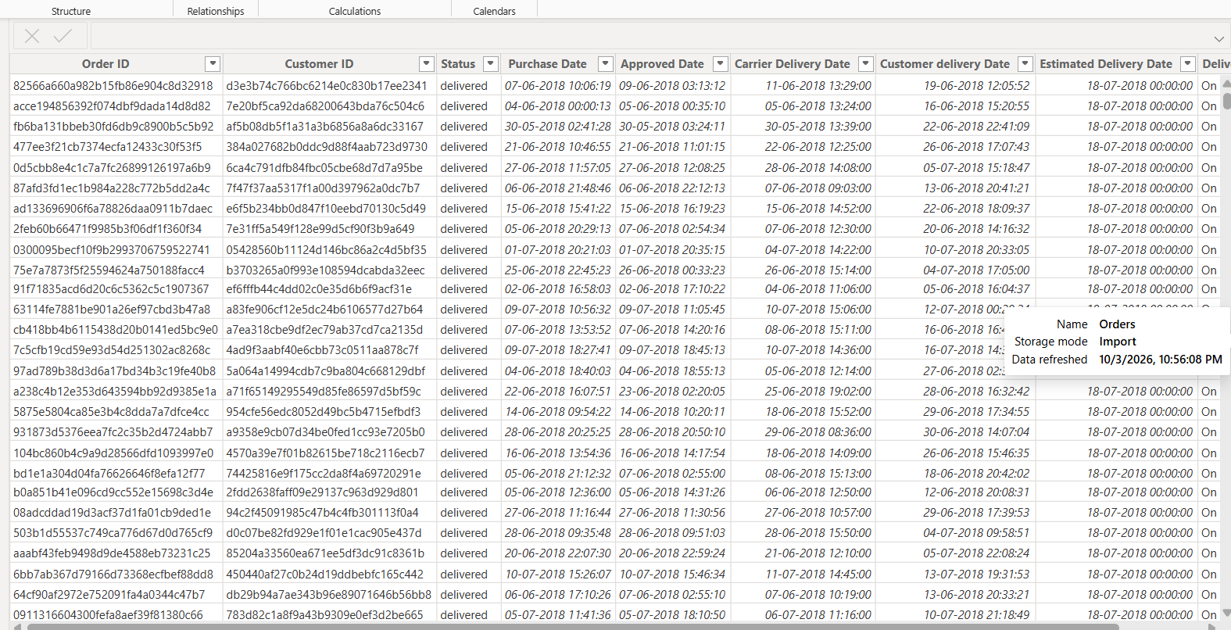
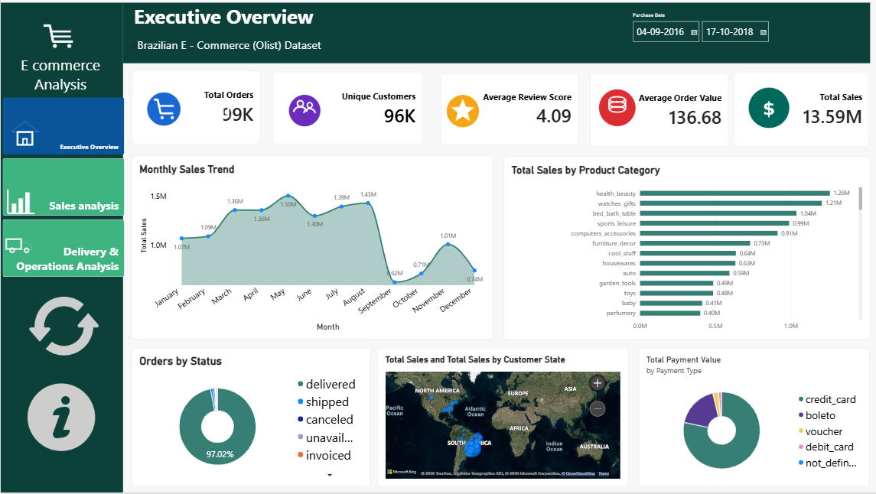
Dataset Overview
Olist Public Dataset
• Brazilian E-Commerce Public Dataset by Olist
• 9 related CSV tables covering orders, customers, products, sellers, payments and reviews
• Core transaction tables contain around 100K orders and 112K order-item records
• Used relationships and a star-schema-style model for analysis
Main Tables
Orders • Order Items • Payments • Reviews
Customers • Products • Sellers
Geolocation • Category Translation
Sample records from the Orders table in the Olist dataset
Dataset Source: Kaggle — Brazilian E-Commerce Public Dataset by Olist
3

Slide 4
Project Objectives
What the dashboard should answer
01
Measure overall sales and order performance
02
Understand customer and regional sales patterns
03
Analyze product-category and payment behavior
04
Evaluate delivery time and late-delivery performance
05
Build an interactive dashboard for decision-making
4

Slide 5
Data Preparation & Modeling
Power Query + DAX
Data Cleaning
Data Model
DAX Measures
• Corrected data types
• Standardized date fields
• Cleaned category values
• Removed unnecessary fields
• Related Orders, Customers, Products, Sellers
• Connected Payments and Reviews
• Kept supporting tables separate
• Total Sales
• Total Orders
• Average Order Value
• Delivery & review metrics
Customers
Customer ID
Orders
Order ID
Order Items
Order ID / Product ID
Products
Product ID
Payments
Order ID
Reviews
Order ID
5

Slide 6
Dashboard Structure
3 focused pages
01 Executive Overview
02 Sales Analysis
03 Delivery & Operations
High-level KPIs, monthly sales, categories, order status and payments.
Sales trends, product categories, customer states, AOV and payment values.
Delivery days, late delivery, freight and state-level operations.
Interactive Power BI page
Interactive Power BI page
Interactive Power BI page
6

Slide 7
Key Insights — Sales
Executive & Sales Analysis
Overall Performance
Sales Pattern
Top Categories
Total Sales: €13.59M
Total Orders: 99K
Unique Customers: 96K
Average Order Value: €136.68
Sales increase strongly from the early months and peak around May.
A sharp decline appears in September.
Health & Beauty and Watches & Gifts are among the strongest sales categories.
Regional Sales
Payments
Customer Reviews
São Paulo (SP) contributes the largest share of state-level sales.
Credit card is the dominant payment type by payment value.
Average review score is 4.09, indicating generally positive customer feedback.
7

Slide 8
Key Insights — Delivery & Operations
Operational Performance
Average Delivery
On-Time Delivery
Late Deliveries
Delivery time varies by month, with the highest observed monthly average around 16 days.
Around 89K orders were delivered on time in the dashboard analysis.
About 8K delivered orders were identified as late.
Late Delivery Rate
Freight
Regional Delivery
The dashboard shows a late-delivery rate of about 8%.
Freight value changes across months and should be monitored alongside sales.
Average delivery time differs across customer states, highlighting regional logistics variation.
8

Slide 9
Dashboard — Executive Overview
Page 1
9

Slide 10
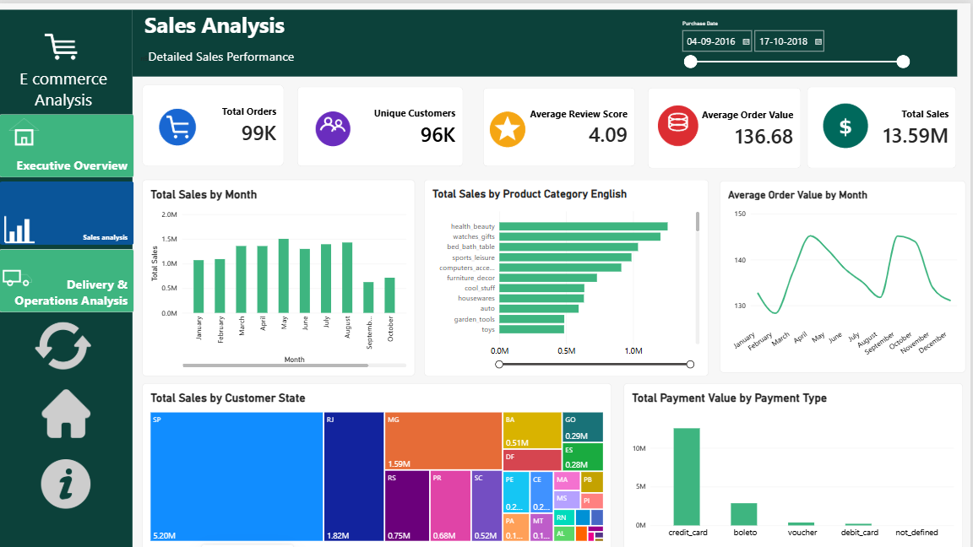
Dashboard — Sales Analysis
Page 2
10

Slide 11
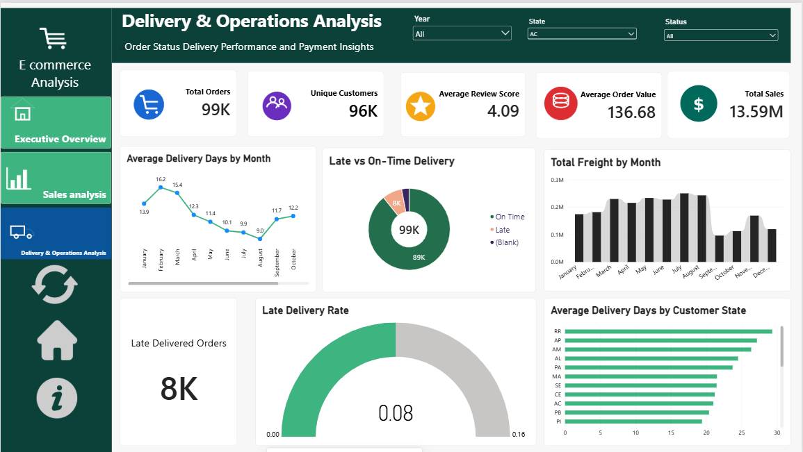
Dashboard — Delivery & Operations
Page 3
11

Slide 12
Conclusion
Project Outcome
What the project achieved
Business Value
• Converted multiple Olist CSV tables into an interactive Power BI model
• Created DAX measures for sales, customers, orders, reviews and delivery
• Built focused dashboards for executive, sales and operational analysis
• Identified useful patterns in sales, payments, customer regions and delivery
• Faster performance monitoring
• Easier comparison across categories and states
• Clear visibility into delivery issues
• Supports data-driven e-commerce decisions
12

Slide 13
Future Scope
Possible Enhancements
• Add sales forecasting using historical trends
• Develop customer segmentation and retention analysis
• Build product-level profitability and seller performance metrics
• Add predictive late-delivery risk analysis
• Publish to Power BI Service with scheduled refresh
• Create role-based access and mobile-friendly reporting
13

Slide 14
THANK YOU
E-Commerce Sales & Operations Analytics
Questions & Discussion

