Slide 1



DATA ANALYTICS PROJECT
DELHI AIR QUALITY & POLLUTION ANALYSIS
Excel-Based Air Quality & Pollution Analytics — 2025
Presented by: Gishal S

Slide 2







Air-quality analytics project
PROJECT OVERVIEW
Analyze Delhi’s 2025 air quality by time, location, weather, and pollutants.
ONE INTERACTIVE VIEW
FROM RAW DATA TO INSIGHT
PROJECT WORKFLOW
Compare • Filter • Analyze
01
02
03
Dashboard
Raw dataset
Power Query
2025 hourly AQI data
Cleaned & transformed
KPIs • charts • slicers
BUILT WITH
Excel + Power Query

Slide 3

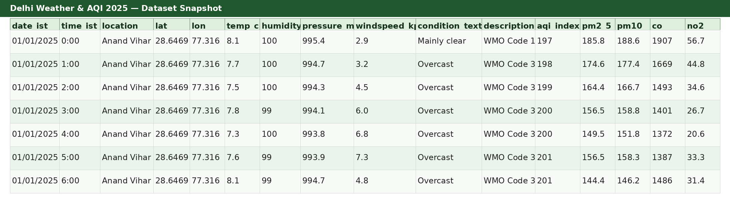



52,560 hourly observations
6 monitoring locations
January–December 2025
DATASET OVERVIEW
Delhi Weather & AQI 2025
Dataset snapshot
FIELD GROUPS
KEY FIELD GROUPS
Weather measurements
Temperature
Humidity
Pressure
Wind speed
Weather condition
Air-quality measurements
AQI
PM2.5
PM10
CO
NO₂
6 Delhi monitoring locations
52,560 rows • 16 original columns • 6 locations

Slide 4








EXCEL DATA WORKFLOW
DATA PREPARATION & ANALYTICS PROCESS
Analyze Delhi’s 2025 air quality using Excel-based data analytics.
01
02
03
Compare locations, months, and hours
Study weather and pollutants
Build an interactive dashboard
• Measure average AQI
• Compare locations
• Identify time trends
• Examine weather relationships
• Analyze PM2.5, PM10, CO & NO₂
• KPIs
• PivotCharts
• Excel slicers
• Use AQI categories
• Flag high pollution
Interactive decision support
Repeatable import
Result: clean, structured data ready for analysis.

Slide 5

RESEARCH FRAMEWORK
PROJECT OBJECTIVE
MAIN OBJECTIVE
Analyze Delhi’s 2025 air-quality patterns to identify when, where, and under which conditions pollution levels change.
01
Compare locations, months, and hours
Compare average AQI across monitoring locations, months, and hours.
02
Study weather and pollutant relationships
Examine AQI patterns under different weather conditions and pollutant levels.
03
Build an interactive decision-support dashboard
Build an interactive Excel dashboard using KPIs, PivotCharts, and slicers.

Slide 6

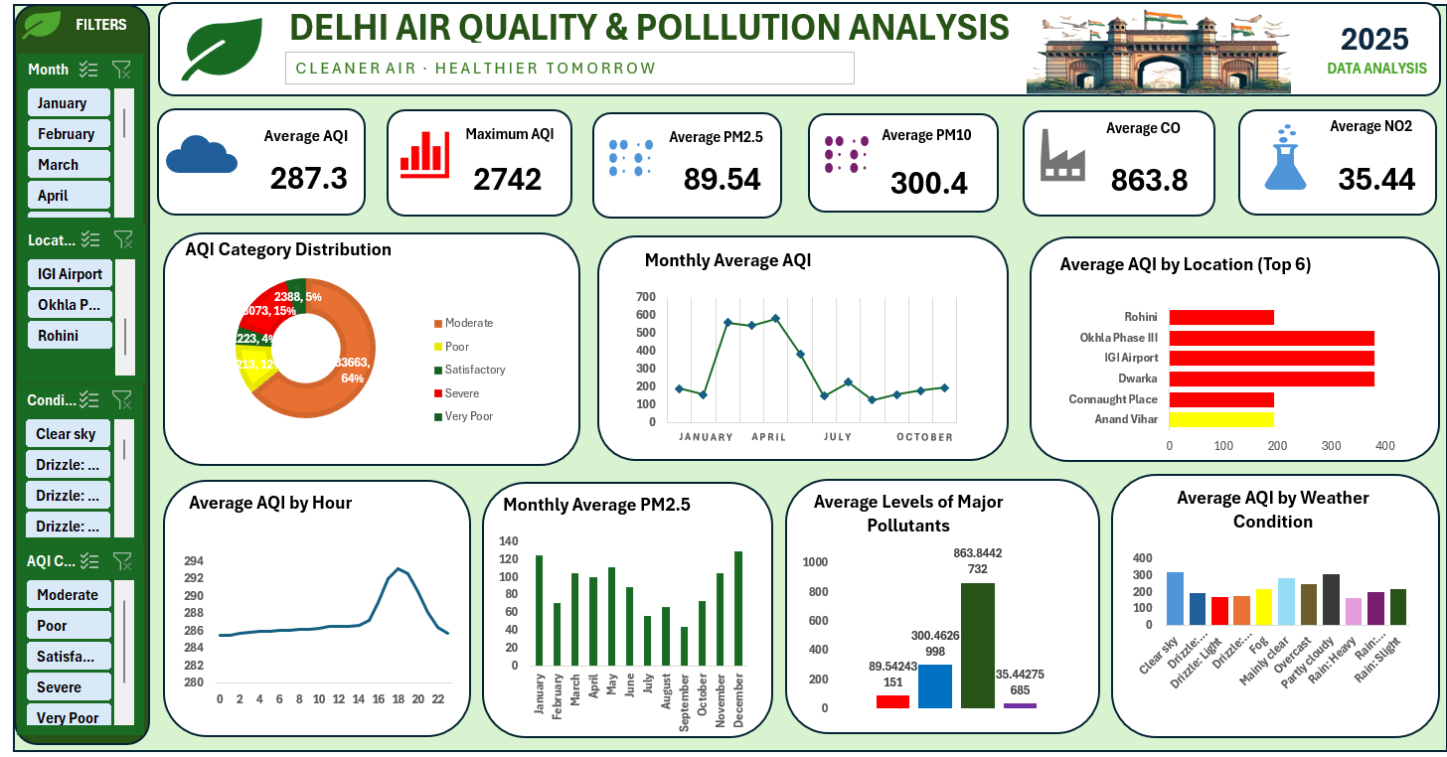
EXECUTIVE ANALYTICS SHOWCASE
INTERACTIVE AIR QUALITY DASHBOARD
Interactive Excel dashboard for AQI, pollutants, trends, locations, weather, and filters.
DASHBOARD SIGNALS
FINAL EXCEL DASHBOARD
Excel dashboard
Primary measure
AQI
AQI summary
Pollutant lens
PM2.5
Pollutant trend
Interactive control
SLICERS
Filter by month, location, weather, and AQI category.

Slide 7
AIR QUALITY MONITORING SYSTEM
KEY PERFORMANCE INDICATORS
A clear read on particulate exposure and city-wide air quality.
Six headline measures from the complete 2025 dataset
Average AQI
287.36
Mean air-quality index
Maximum AQI
2742
Highest recorded index
Average PM2.5
89.54
Fine particulate matter
Average PM10
300.46
Coarse particulate matter
Average CO
863.84
Carbon monoxide
Average NO₂
35.44
Nitrogen dioxide

Slide 8







AIR QUALITY ANALYSIS
KEY INSIGHTS
Key patterns identified from the final Excel analysis.
POLLUTION FLAG
AQI > 200
AQI CATEGORY
Moderate: 64.05%
Severe: 15.36%
Good: 0%
16,674 observations
31.72% flagged High Pollution
LOCATION
IGI Airport, Dwarka, Okhla Phase III
Average AQI: 380.28
TIME PATTERN
May: 582.76 AQI
September: 123.89 AQI
Hourly peak: ~18:00

Slide 9
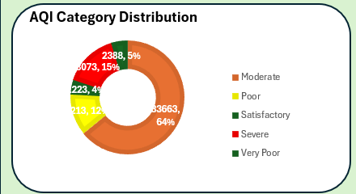
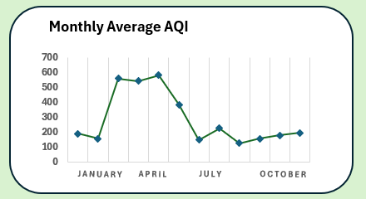
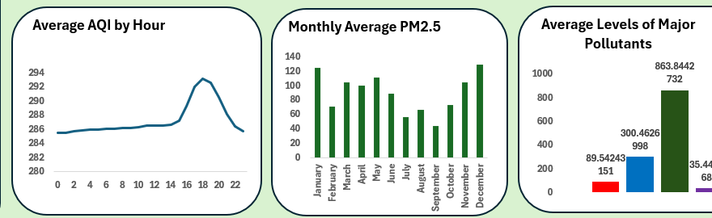
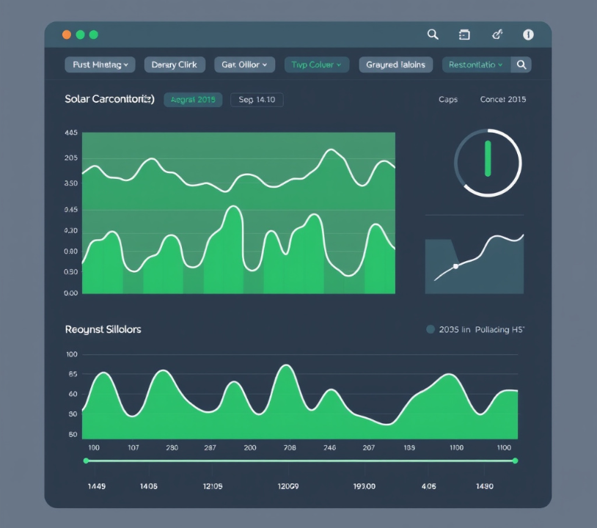





AIR QUALITY MONITORING SYSTEM
KEY ANALYTICAL VISUALIZATIONS
AQI severity
AQI by location
AQI trends
Major pollutants

Slide 10

CONCLUSION
The project transformed 52,560 hourly observations into a structured Excel analysis and an interactive dashboard for clearer air-quality interpretation.
Excel + Power Query dashboard workflow
Reveal patterns
Work repeatably
Build awareness
PivotTables and charts made time, location, weather, and pollutant patterns visible.
Power Query created a repeatable cleaning and transformation workflow.
KPIs and slicers made the results easier to explore and communicate.

Slide 11








NEXT HORIZON
FUTURE SCOPE
Live Data Flow
Predictive AQI
Broader Reach
Real-time AQI/weather feeds
Automated refresh
AQI forecasting with machine learning
Early warning
SO₂ & O₃
Maps • alerts • anomaly detection
Mobile/web access

Slide 12


THANK YOU
Questions & Discussion
AIR QUALITY • DATA • ACTION

