Slide 1
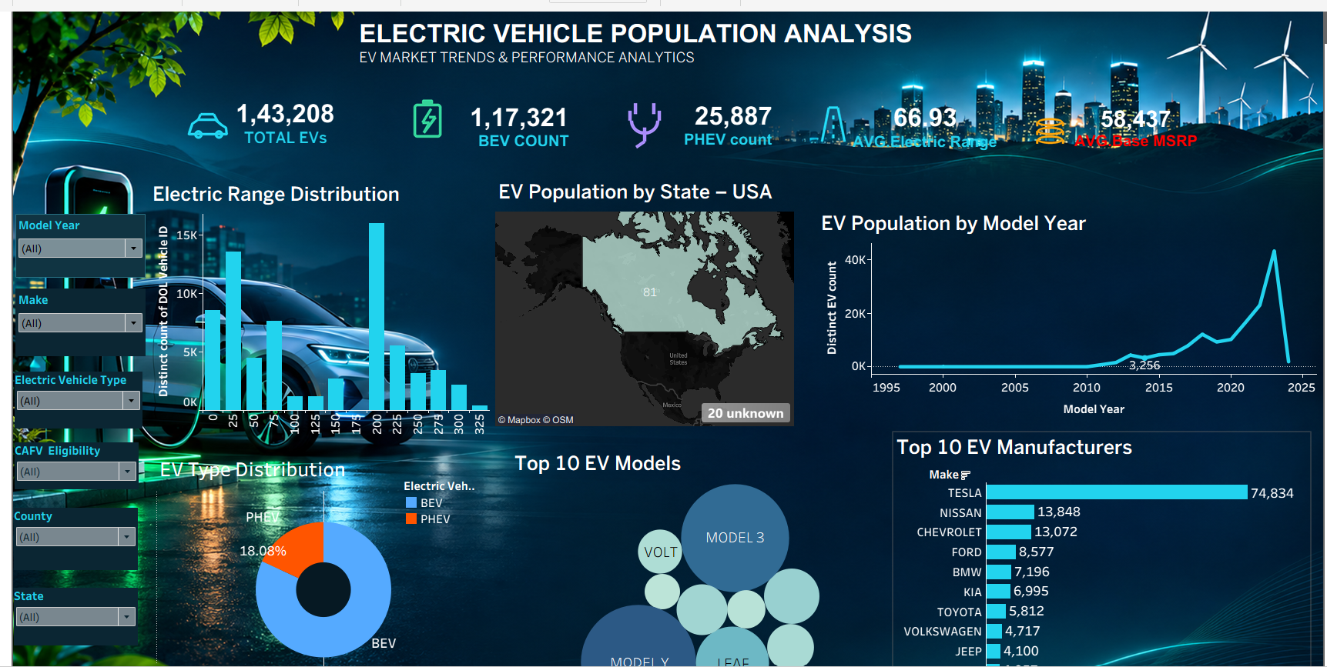
TABLEAU PROJECT
ELECTRIC VEHICLE
POPULATION ANALYSIS
Registration patterns • Vehicle types • Manufacturers • Model trends
PROJECT OVERVIEW
An interactive Tableau analysis of electric vehicle registration records, focused mainly on Washington State.
Prepared in Tableau

Slide 2
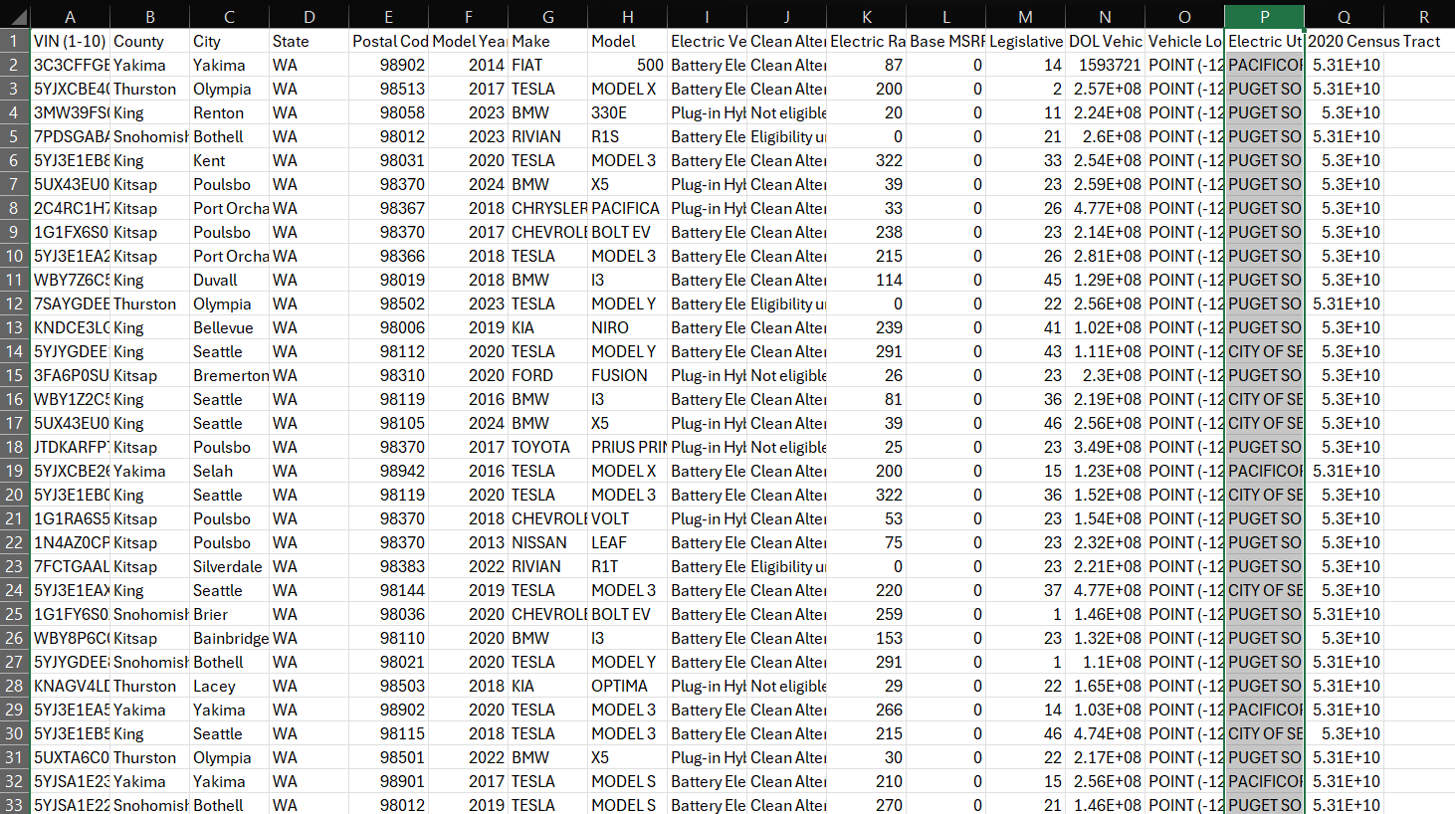
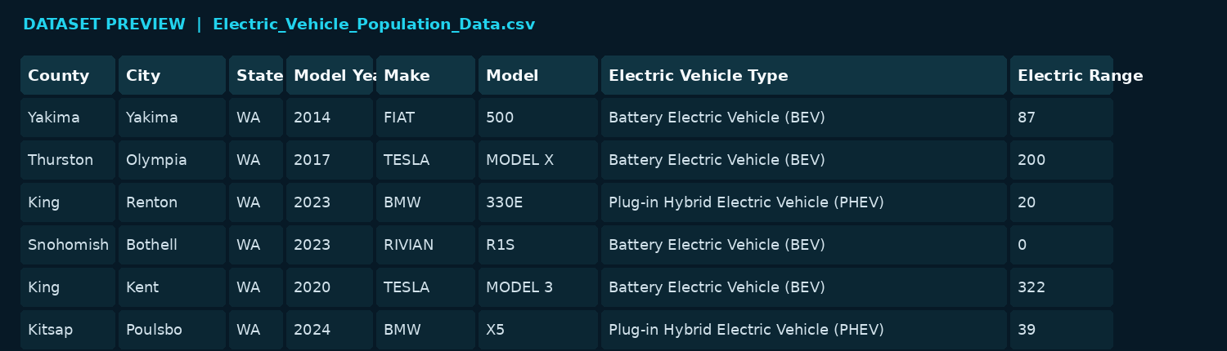
DATASET OVERVIEW
02 / 07
166,800
17
39
138
2002–2023
TOTAL RECORDS
COLUMNS
MANUFACTURERS
VEHICLE MODELS
MODEL YEARS
KEY DATA FIELDS
• County, City, State
• Model Year, Make, Model
• EV Type and CAFV Eligibility
• Electric Range and Base MSRP
• Vehicle ID and Location
Source: Electric Vehicle Population dataset (CSV) • Geographic coverage is primarily Washington State.

Slide 3
PROJECT OBJECTIVES
03 / 07
01
Measure EV population
Understand the number and composition of registered electric vehicles.
02
Compare vehicle types
Analyse Battery Electric Vehicles (BEV) and Plug-in Hybrid Electric Vehicles (PHEV).
03
Identify market leaders
Find leading manufacturers and the most common EV models.
04
Explore registration trends
Compare model years and geographic distribution.
05
Study vehicle attributes
Review electric range and CAFV eligibility patterns.

Slide 4
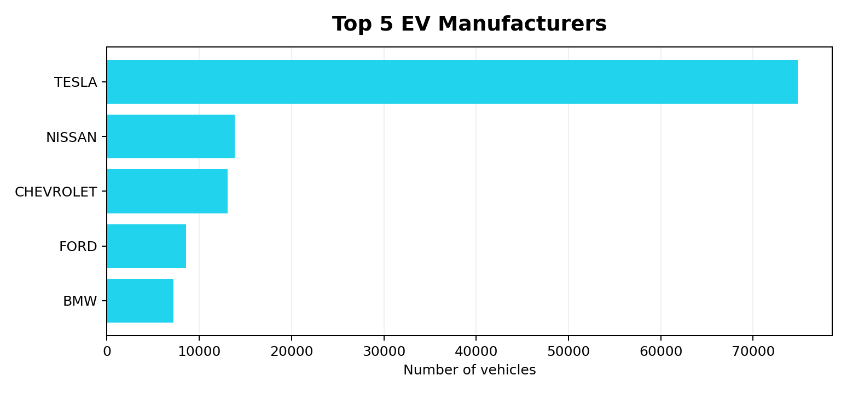
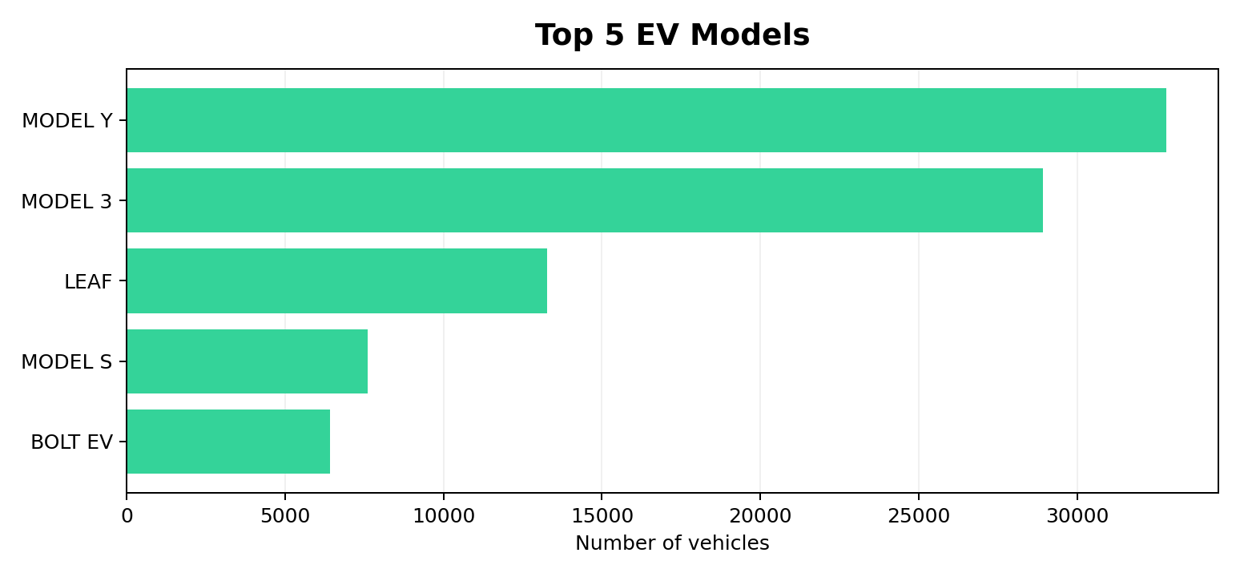
KEY INSIGHTS
04 / 07
130,293
36,507
TESLA
2023
BEV REGISTRATIONS
PHEV REGISTRATIONS
TOP MANUFACTURER
HIGHEST MODEL-YEAR COUNT
Dashboard screenshot: 143,208 EVs shown. Raw CSV: 166,800 records. Reconcile worksheet filters / data-source scope before final submission.

Slide 5
TABLEAU DASHBOARD
Interactive Tableau dashboard showing EV population, range distribution, vehicle types, model-year trends and manufacturers.

Slide 6
CONCLUSION
05 / 07
WHAT THE DATA SHOWS
DATA INTERPRETATION
• BEVs account for about 78% of the records.
• Tesla is the leading manufacturer in this dataset.
• Model Y and Model 3 are the most common models.
• Registrations are concentrated in Washington, especially King County.
• 83,517 records have zero Electric Range.
• 163,437 records have zero Base MSRP.
• These zero values may indicate unreported information.
• Range and MSRP averages should be interpreted cautiously.
The Tableau dashboard makes EV registration patterns easier to explore through interactive visualisations and filters.

Slide 7
FUTURE SCOPE
06 / 07
EV adoption forecasting
Charging infrastructure analysis
Use historical registration data to estimate future growth.
Combine registrations with charging-station locations.
Geographic drill-down
Data quality enhancement
Explore EV adoption by county, city and district.
Validate missing and zero-value range and MSRP fields.
Live data integration
Refresh the dashboard with regularly updated registration data.
THANK YOU

