Slide 1
Containerized Application Deployments on DC/OS
Jonathan Meyer
Applied Information Sciences

Slide 2
Agenda
Then – Now
Tech Overview
DC/OS Architecture
Demos
Best practices (containers / packaging)
References

Slide 3
Where We’ve Been
Unmanaged Dependencies
Large monolithic services, commonly a single-point-of-failure
Purpose built servers per application component / team
Dev to Ops handoff
High documentation and training burden

Slide 4
Where We Are
Containerized application components
Reproducible
Portable
Packaged Dependencies
Monolithic to Microservices approach brings new problems
How do we discover system components?
How do we manage persistence of many components?

Slide 5
Where We Want To Be
Fault-tolerant, discoverable and portable system
Declarative storage and networking requirements
Packaged to allow deployment by any Ops generalist

Slide 6
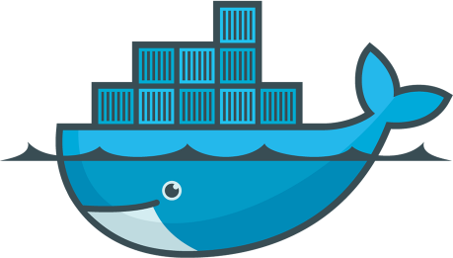



Enabling Tech
Docker
Apache Mesos
Marathon
Marathon-lb (L7)
Minuteman Load Balancer (L4)
DC/OS Universe

Slide 7
DCOS Architecture
DCOS Master (1…3)
DCOS Private Agent (0…n)
Your Service
Marathon
Admin User
DCOS Public Agent (0…n)
Admin Router
Public Internet
Marathon-lb

Slide 8
Demos
Public website
Private webservice or website
Universe packaging of full stack application

Slide 9
Public Website Demo
Build simple static content image
Run locally
Push to Docker Hub
Demonstrate marathon setup from a basic docker image
Add health check, demonstrate waiting state

Slide 10
Private Webservice (Eremetic)
Overview of service
Walkthrough marathon configuration
Deployment options
Admin Router (Service tokens required)
Tokens issuance is simplest via CLI (dcos auth login)
Supports single backend, no load balancing
Marathon-lb hosted on private agent
Fully featured load balancer built on HAProxy
Minuteman VIPs
Pure round robin load balancing
Can fill up route table for chatty services

Slide 11
Universe Packaging (Scale)
Overview of components
Scheduler
Web Service
UI
Persistence (Postgres)
Log Collector (Logstash)
Log Storage (Elasticsearch)
Walkthrough of deployment process
Demonstrate public exposure via Marathon-lb

Slide 12
Containerization Best Practices
Environment agnostic
Configuration injected via mounts or environment variables
Context agnostic
Reverse proxy (relative context: http://host/service/yourservice/)
Subdomain (absolute context: http://yourservice.host/)
Logging to STDOUT / STDERR
Single executable per container
There are justifiable cases to violate this guideline

Slide 13
Packaging Guidelines
Determine the right trade-off for multi-component systems
Bootstrap entire system, increased deployment fragility
More involved deployment instructions, reduced deployment fragility
Support multiple service access mechanisms
Marathon-lb internal/external
Minuteman Virtual IPs

Slide 14
Further Reading
Deploy Docker container within DC/OS: https://goo.gl/9DwCCb
Virtual IPs via Minuteman: https://goo.gl/6g4aeS
Marathon-lb: https://goo.gl/sqIUqa
Admin Router: https://goo.gl/AtmF3P
Universe Packaging: https://goo.gl/z2QW2h
Storage: https://goo.gl/O74YtY

Slide 15
References
Scale: https://github.com/ngageoint/scale
Universe: https://github.com/mesosphere/universe
Presentation: https://github.com/gisjedi/deployments-on-dcos

