Slide 1
Geographic Data Landscapes and Activity Patterns
Justin P. Peters
S637: Information Visualization

Slide 2
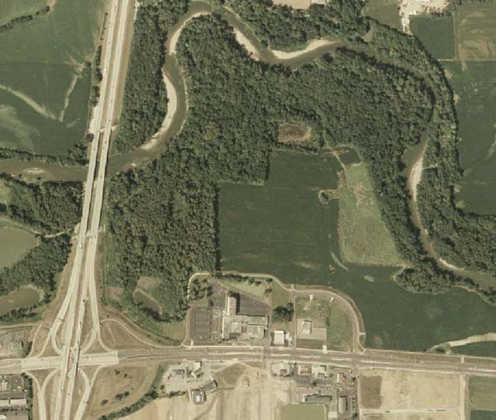
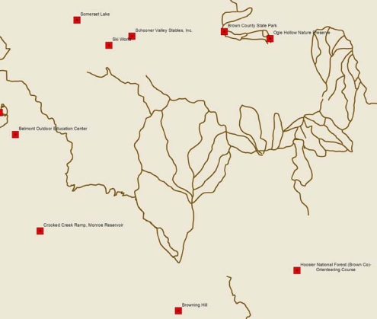
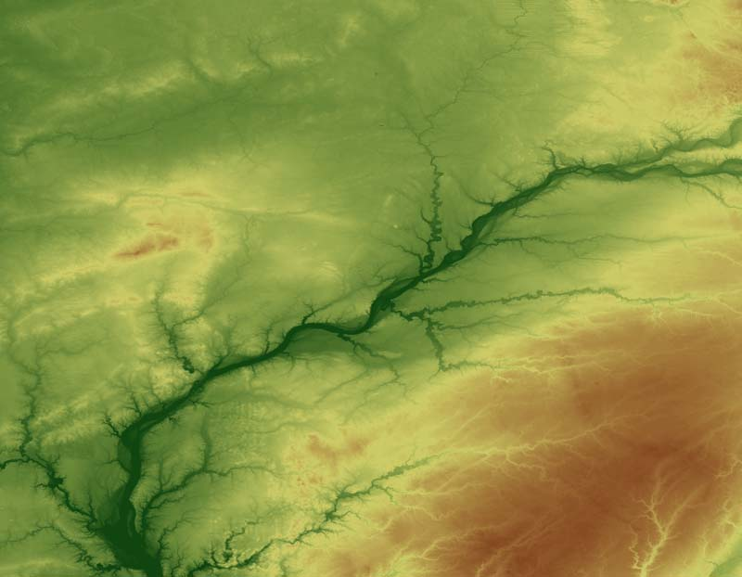
Spatial Data – Raster & Vector
Raster - Cells with values
Vector – Point, Line, Polygon

Slide 3
Geographic Data – File Based Semi-Static
Shapefile
KML, KMZ
Two most popular formats, but many others.
http://inmap.indiana.edu/download.html

Slide 4
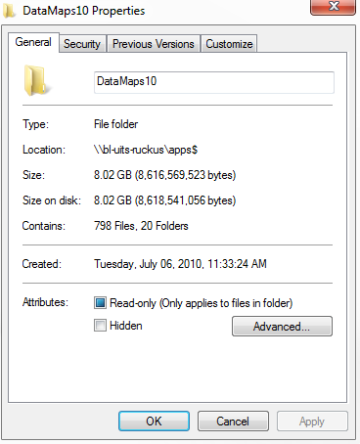
Shapefile (ESRI ArcGIS)
De facto file format
Many Gov’s/data creators use
ESRI Tutorials/software installed in all STCs
ESRI Virtual Campus Courses, IT Training
SLIS 603 workshop
Wide data availability
Conversion utilities

Slide 5
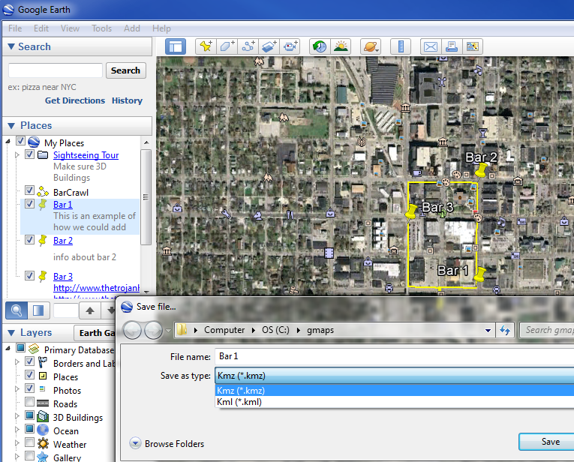
KML/KMZ
Google Maps/Earth
Free software
Easy Learning curve
Embed in Web pages via API

Slide 6


GeoRSS & GeoJSON
Gaining Popularity
XML/JSON based
Easily embed in Web pages via API
Several Flavors of each:
Sample using USGS RSS feed

Slide 7
Web Services:REST, SOAP, WSDL, etc.
Web Map Service (WMS) return map image NOAA
Web Feature Service (WFS) return features
Web Coverage Service (WCS) return raster data
Tile Map Service (TMS) Google maps & Earth, Bing maps, Indiana Imagery Basemap
Network/Routing Service
Geocode Service
Geometry services

Slide 8
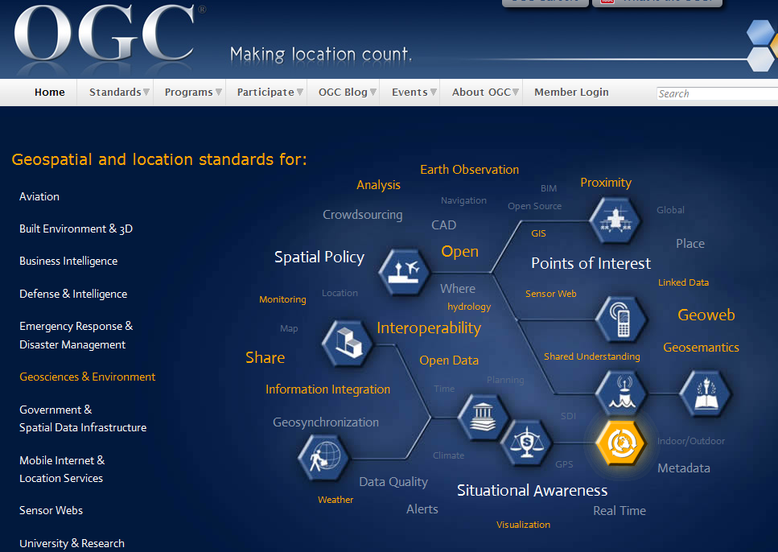
Who makes this stuff up?

