Slide 1
Indiana University – A Walkable Campus
Mapping the Pedestrian Realm of IU
Justin P. Peters and Paul Rohwer

Slide 2
Review of Position Paper
Bloomington Campus Master Plan
IU Campus Sustainability Report
90% of undergraduates and 75% of graduate students live within three miles of campus
Only 44% of students choose to walk
Of faculty, staff, and students, 48% drive alone and only 14% walk
IUSA Case Competition Justin P. Peters and Paul Rohwer

Slide 3
Making the walking option more visible
Mapping the pedestrian realm of IU to support possible applications such as:
Lighted walkways and paths
Recreational walking - Plan a walk
Student schedules - Building to Building
Meeting and schedule/time planning
Campus walking tours
IU Employee Health Engagement
Integration with bus scheduling/location application
IUSA Case Competition Justin P. Peters and Paul Rohwer

Slide 4
Interviews and planning discussions with
Bloomington GIS Coordinator
Monroe County GIS Coordinator
School of Health Physical Education and Recreation (HPER) staff
University Architect's office and IUB Department of Facilities Staff
IU Mobile Team
IUSA Case Competition Justin P. Peters and Paul Rohwer

Slide 5
Possible Sponsors/Stakeholders
IUSA
IU Office of Sustainability
UITS
IU Office of Health Engagement
IUSA Case Competition Justin P. Peters and Paul Rohwer

Slide 6
Other University Walking Route maps
University of Michigan
http://hr.umich.edu/mhealthy/programs/activity/walking.html
University of Maryland
http://terpnav.cs.umd.edu/map/#
Oregon State University
http://oregonstate.edu/campusmap/
IUSA Case Competition Justin P. Peters and Paul Rohwer

Slide 7
Started with Open Street Map and
City of Bloomington Data
http://www.openstreetmap.org/
Built initial dataset and hosted on maps.iu.edu
Demonstration and Prototype sites at:
http://maps.iu.edu/IUSA.html
http://maps.iu.edu/IUSA2.html
IUSA Case Competition Justin P. Peters and Paul Rohwer

Slide 8
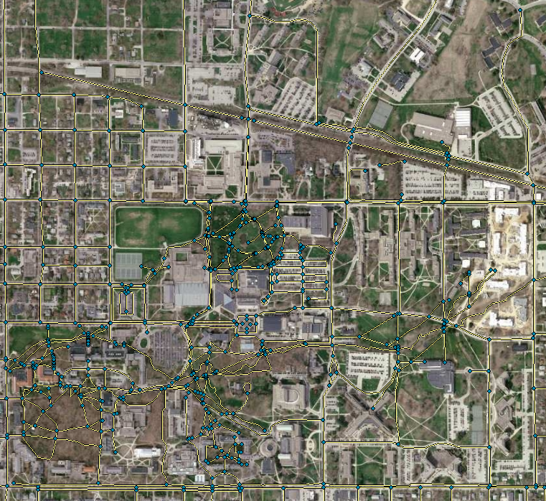
Cleanup and
Additional
Digitizing
Needed
Pathways missing
IUSA Case Competition Justin P. Peters and Paul Rohwer

Slide 9
Possible student opportunities:
GIS classes at HPER, SLIS, SPEA, GEOG, etc.
Student internship / hourly work
IUSA event similar to Google MapMaker event
IT Training workshop with GIS
IUSA Case Competition Justin P. Peters and Paul Rohwer

Slide 10
Hosting and Maintenance
University Architect’s Office has committed to maintenance of the GIS layer(s)
IU Mobile committed to using service for routing and directions/campus tours
UITS GIS staff will host on the IU Intelligent Infrastructure and include on http://maps.iu.edu
Open access for developers
Several different ways to use in mobile applications and web sites
IUSA Case Competition Justin P. Peters and Paul Rohwer

Slide 11
Questions?
jppeters@iu.edu
Justin P. Peters
812-855-7191
prohwer@indiana.edu
Paul Rohwer
812-855-5812
IUSA Case Competition Justin P. Peters and Paul Rohwer

