Slide 1
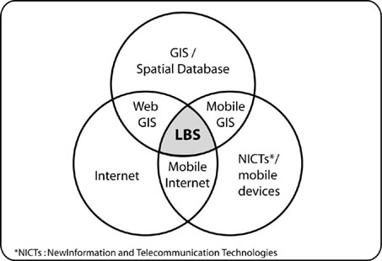
Location-Based Services
Justin P. Peters

Slide 2
Location-determination methods:
IP address, Wi-Fi and Bluetooth MAC address, radio-frequency identification (RFID), Wi-Fi connection location, Global Positioning System (GPS), GSM/CDMA cell IDs, User Input
The location is returned with a given accuracy depending on the best location information source available.

Slide 3

How does it work?
http://ella.slis.indiana.edu/~jppeters/S661/lbs.swf

Slide 4

LBS
indoor routing
directions
car park assistance
traffic management
people & vehicle tracking
emergency calls
Tracking
Navigation
product tracking
Emergency
automotive assistance
shopping guides
travel & tourist guides
Advertising
banners & alerts
Information
location-based services
mobile yellow pages
Billing
road tolls
travel planner
facility
Infrastructure
geocaching
Games
customer relationship
Leisure
Management
mobile games
Communications
fleet (scheduling)
location-aware call handling
buddy finder
security
environmental
Foundations of Location-based Services (Steinger, Neun, Edwardes), modified)

Slide 5
Privacy issues
Not all LBS are privacy-sensitive
  “where is the nearest coffee shop?”
  navigation with GPS
Problem: location + personal identity
  or derivable (home location, IP, WiFi)

Slide 6
Privacy threats
reveal device anonymously
(e.g., “nearest gas station”)
reveal identity + location to LBS
(friend finder service)
Privacy
reveal to individual
(friend, other)

Slide 7
Conclusion
Location as fundamental service
Improve user experience
  from navigation and locating services
  to automatic silent mode
Need protocols for
  describing privacy requirements

