Slide 1

Let’s share GIS much quicker
On behalf of Gisquick team Martin Landa and Jachym Cepicky
FOSS4G 2019

Slide 2
Overview
Idea
Architecture
Implementation
Product
Workflow
Try it out!

Slide 3
Idea

Slide 4
Idea
Easy to use and deploy
Accessible anywhere (browser, mobile)
Good performance
Extendable, customisable
Rely on OGC standards
Free and Open Source Software

Slide 5
Architecture

Slide 6
Architecture
Web App
OGC Mapserver
Project File
Desktop
Local Data
Remote Service

Slide 7
Implementation

Slide 8







Technologies behind
Python3
Django
AngularJS VueJS
OpenLayers
QGIS Server
QGIS Desktop Plugin
Docker

Slide 9
Implementation
Client
Angular VueJS
OpenLayers
Server
QGIS3 Server
Django
OGC OWS (WMS, WMTS and WFS) in between
WebApp
AngularJS / OpenLayers
QGIS Desktop
QGIS Server
Django

Slide 10
Product

Slide 11
Geospatial data publishing platform - “web map”
GNU GPL
QGIS friendly

Slide 12
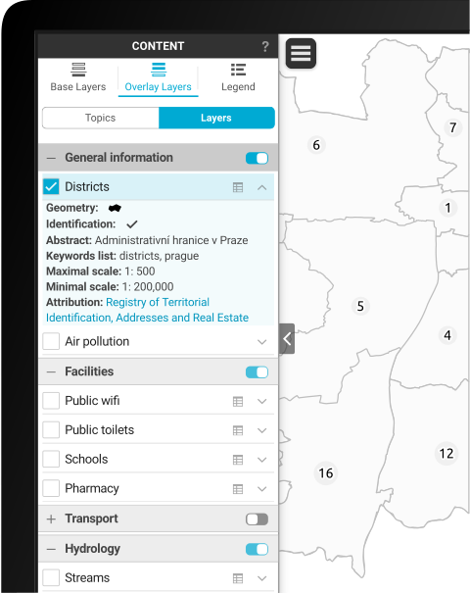
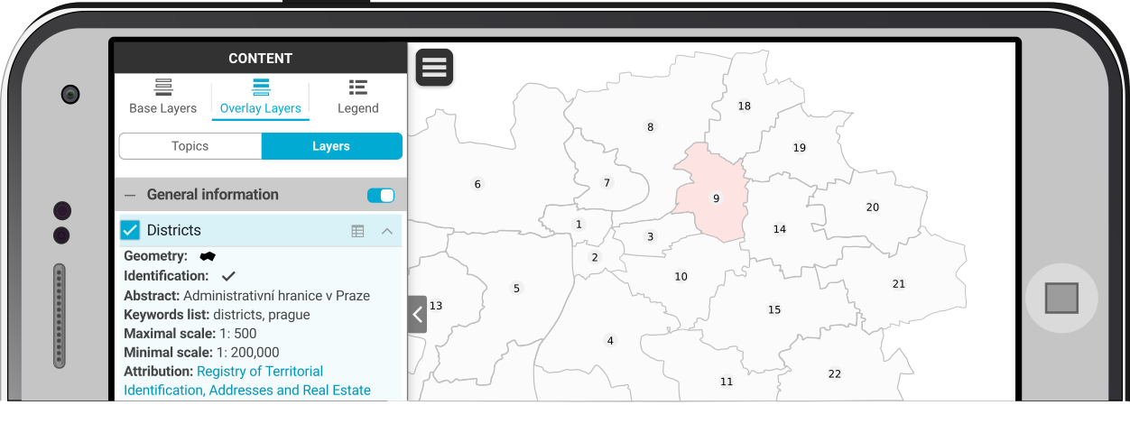
Consists of
QGIS Plugin
Web app
Mobile hybrid app

Slide 13
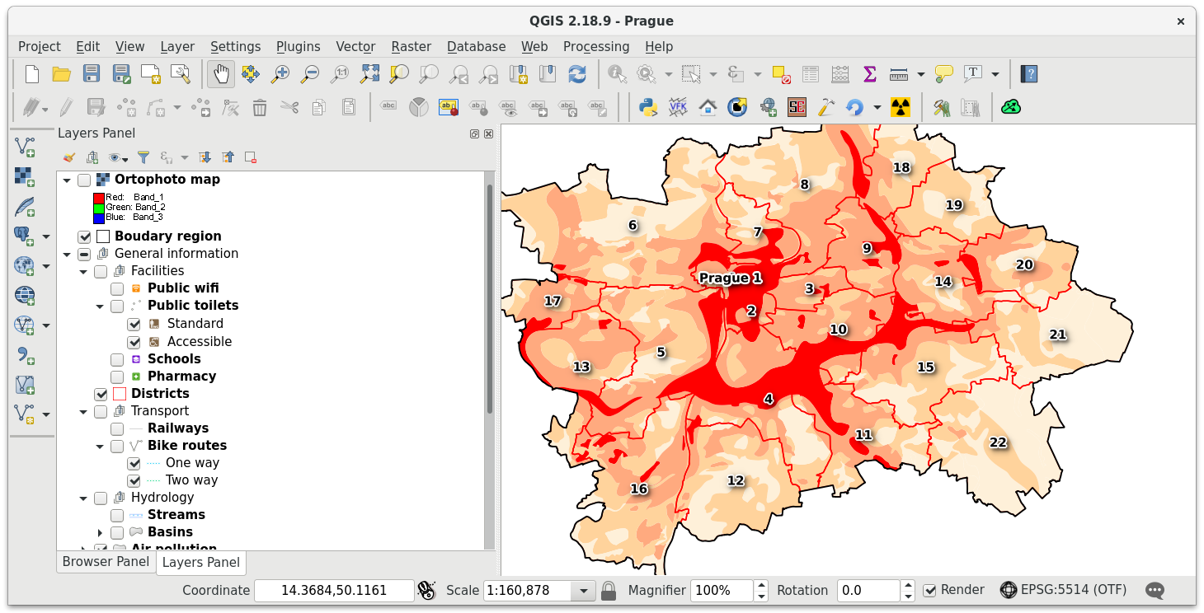

Slide 14
User Workflow

Slide 15
Workflow
1.
Prepare your QGIS project

Slide 16
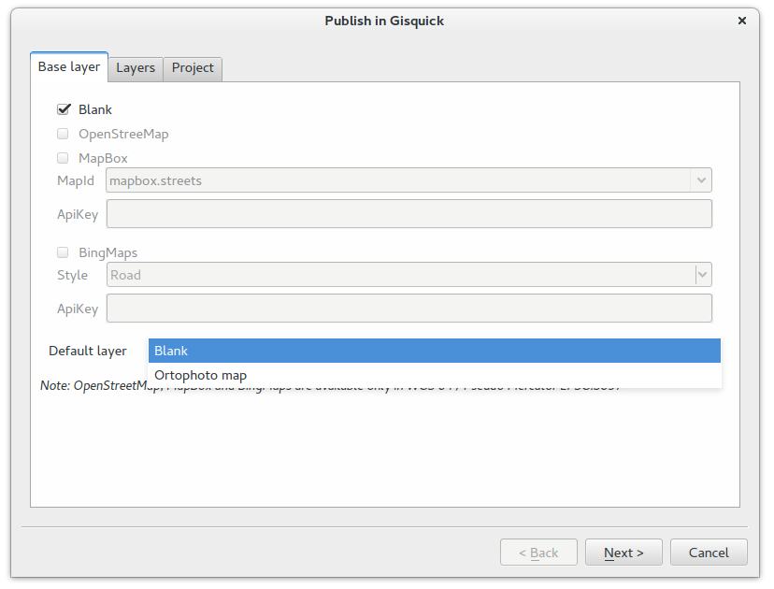
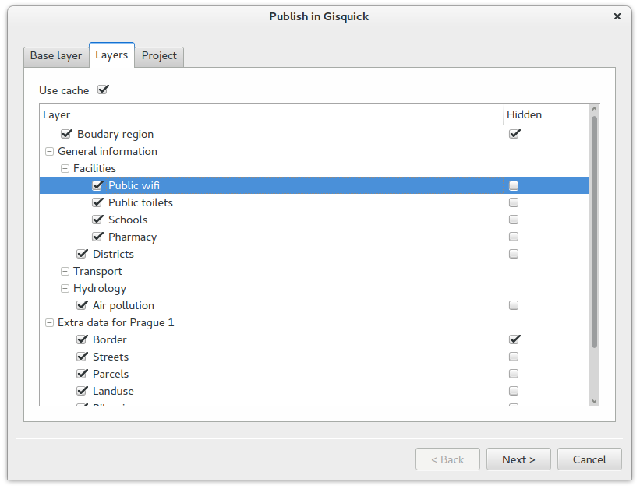
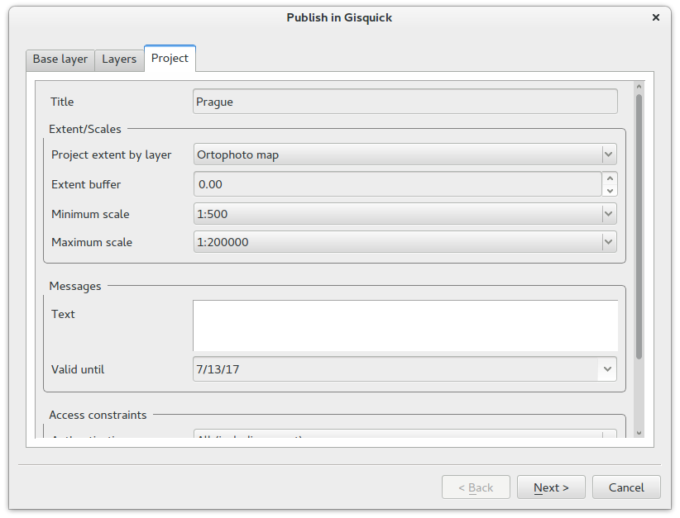
Workflow
2.
Publish using Gisquick plugin

Slide 17
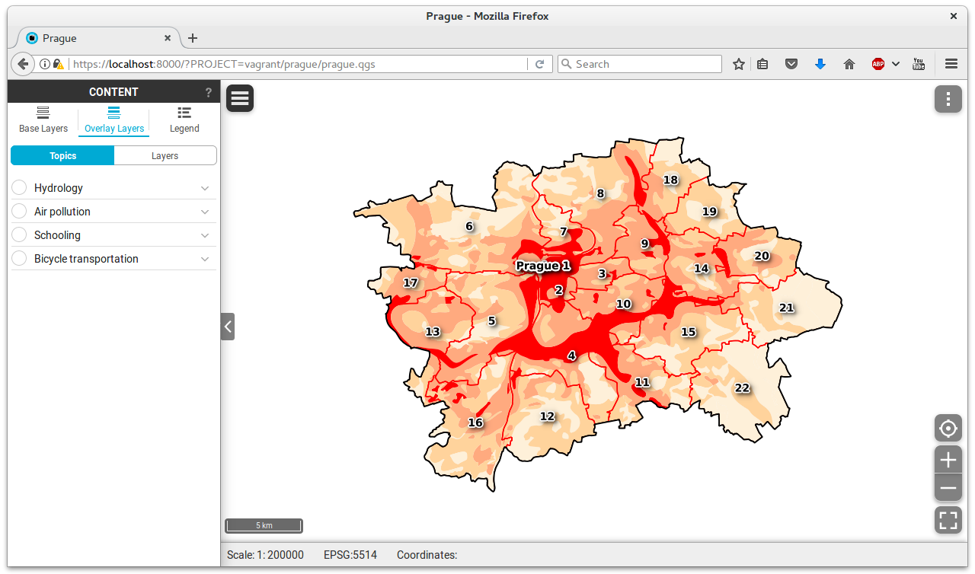
Workflow
3.
Enjoy Gisquick
Web/Mobile app

Slide 18
Try it out!

Slide 19
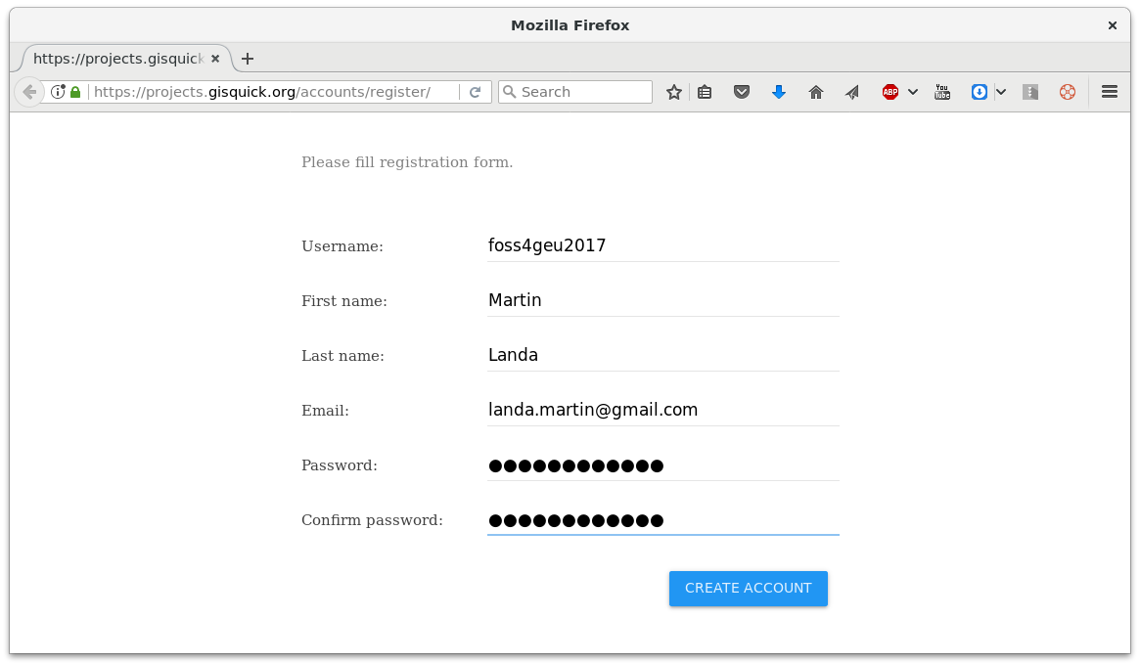
Try it out! How to...
Create an account https://projects.gisquick.org/accounts/register/

Slide 20
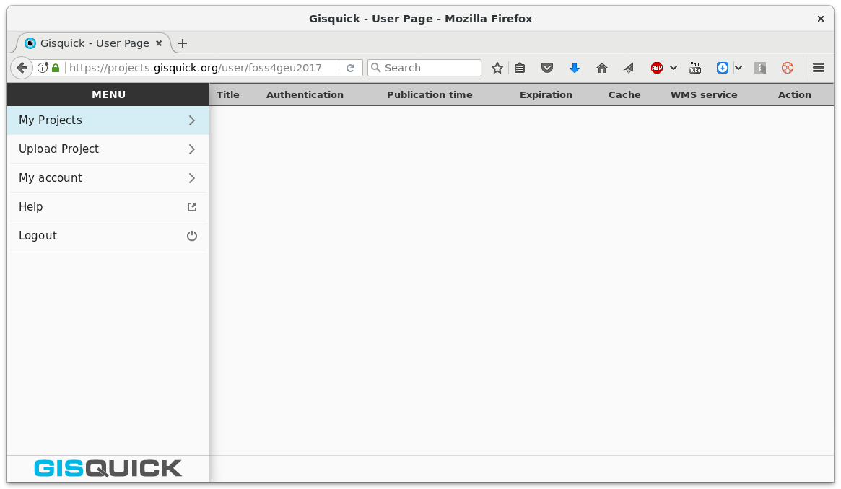
Try it out! How to...
Log in
https://projects.gisquick.org/user/<user-name>

Slide 21
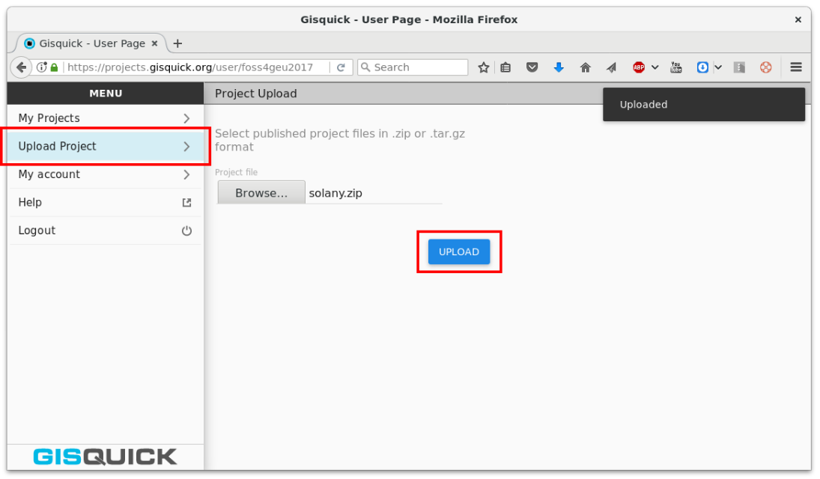
Try it out! How to...
Choose Upload project and upload zipped project directory published using Gisquick QGIS plugin

Slide 22
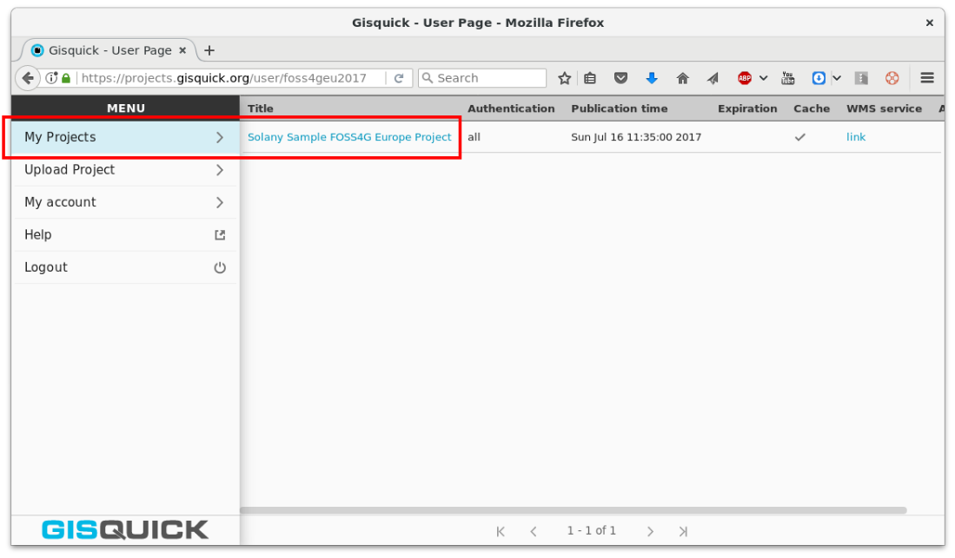
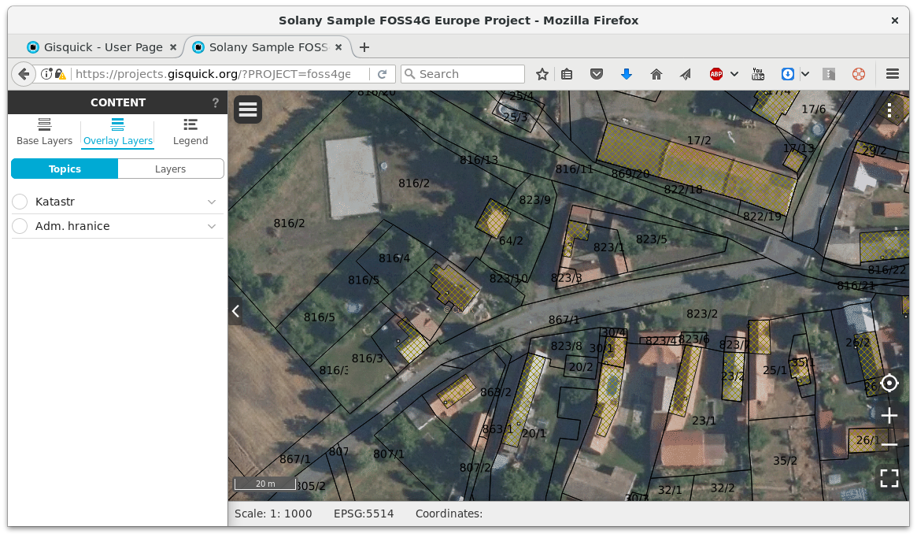
Try it out! How to...
Go to My Projects and enjoy!

Slide 23
Deploy on your own server
https://gisquick.readthedocs.io/en/latest/administrator-manual/installation/docker.html
git clone https://github.com/gislab-npo/gisquick.git
Update docker-compose.yml from template
docker-compose up
set ssl, PostGIS, ...

Slide 24
Latest work (2019)
QGIS2 → QGIS3
Angular → Vue JS (90%)

Slide 25
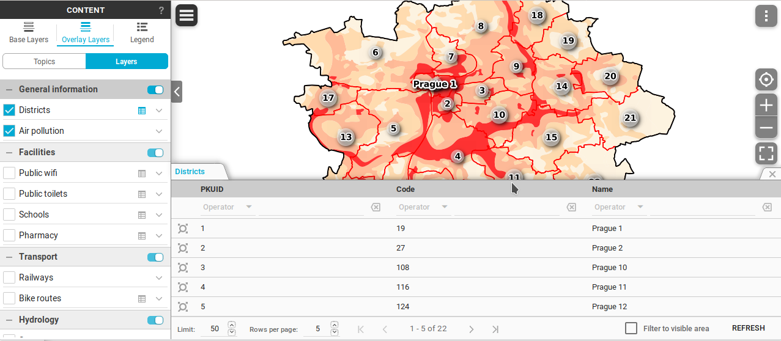
Angular (current stable)
QGIS2 → QGIS3
Angular → Vue JS (90%)

Slide 26
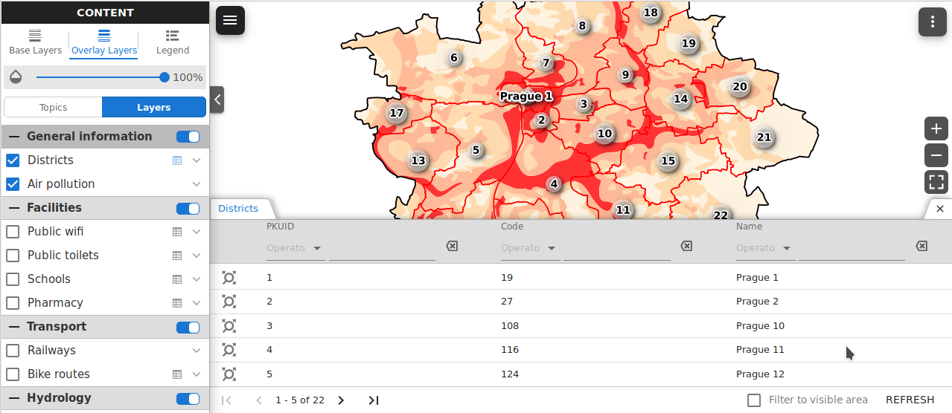
VueJS (/vue/)
QGIS2 → QGIS3
Angular → Vue JS (90%)

Slide 27
Future plans
Finish migration to VueJS
User management
Feature editing
Integration testing
...

Slide 28
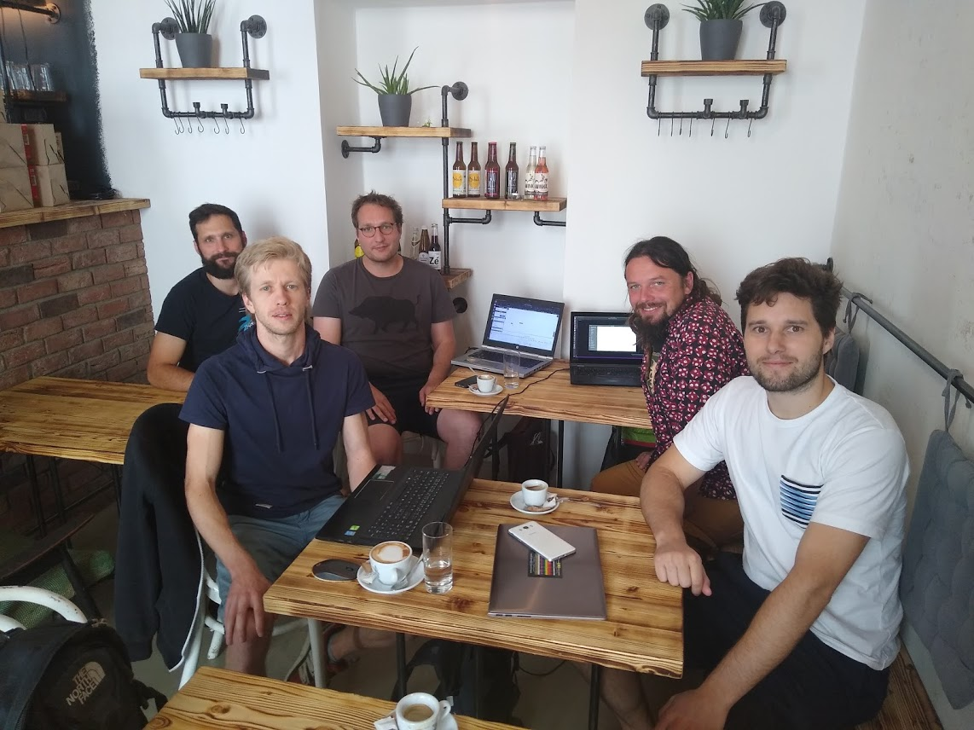
GISQuick developer meeting – Prague sprint 2019

Slide 29
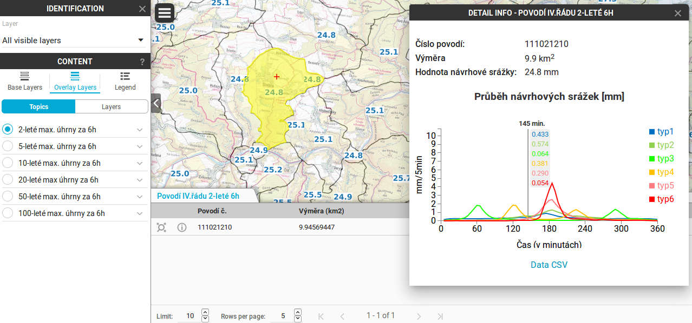
Links
Homepage
http://gisquick.org
Documentation
http://gisquick.readthedocs.io
Life demo
https://projects.gisquick.org
References
http://rain.fsv.cvut.cz/webapp/gisquick/
https://projects.mapotip.cz

Slide 30
gisquick@opengeolabs.cz https://lists.osgeo.org/mailman/listinfo/gisquick

