Slide 1
Let’s share GIS much quicker
On behalf of Gisquick team Martin Landa and Jachym Cepicky
FOSS4G Europe 2017

Slide 2
Overview
Idea
Architecture
Implementation
Product
Workflow
Try it out!

Slide 3
Idea

Slide 4
Idea
Easy to use and deploy
Accessible anywhere (browser, mobile)
Good performance
Extendable, customisable
Rely on OGC standards
Free and Open Source Software

Slide 5
Architecture

Slide 6
Architecture
Web App
OGC Mapserver
Project File
Desktop
Local Data
Remote Service

Slide 7
Implementation

Slide 8






Technologies behind
Python
Django
AngularJS
OpenLayers
QGIS Server
QGIS Desktop
Docker

Slide 9
Implementation
Client
AngularJS v1
OpenLayers v3
Server
QGIS Server
Django
OGC OWS (WMS, WMTS and WFS) in between
WebApp
AngularJS / OpenLayers
QGIS Desktop
QGIS Server
Django

Slide 10
Product

Slide 11
Geospatial data publishing platform - “web map”
GNU GPL
QGIS friendly

Slide 12
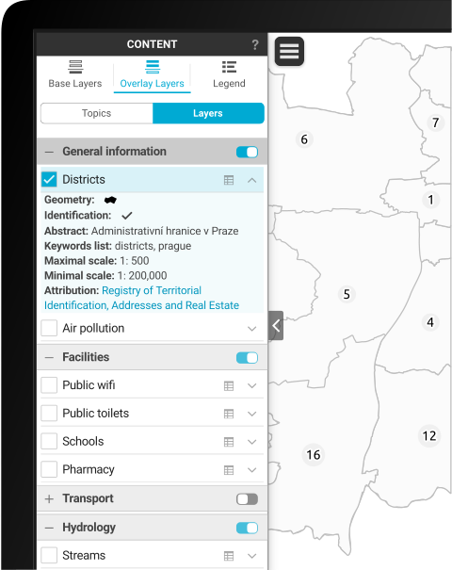
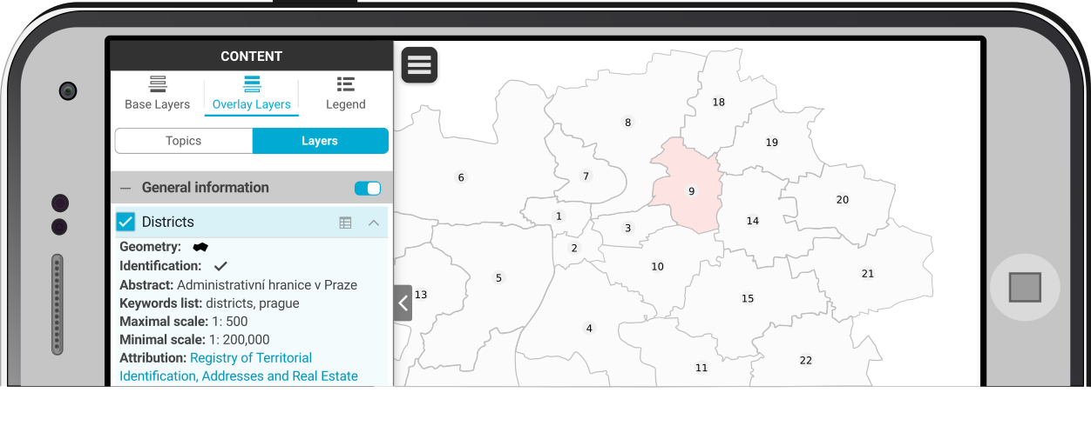
Consists of
QGIS Plugin
Web app
Mobile hybrid app

Slide 13
Workflow

Slide 14
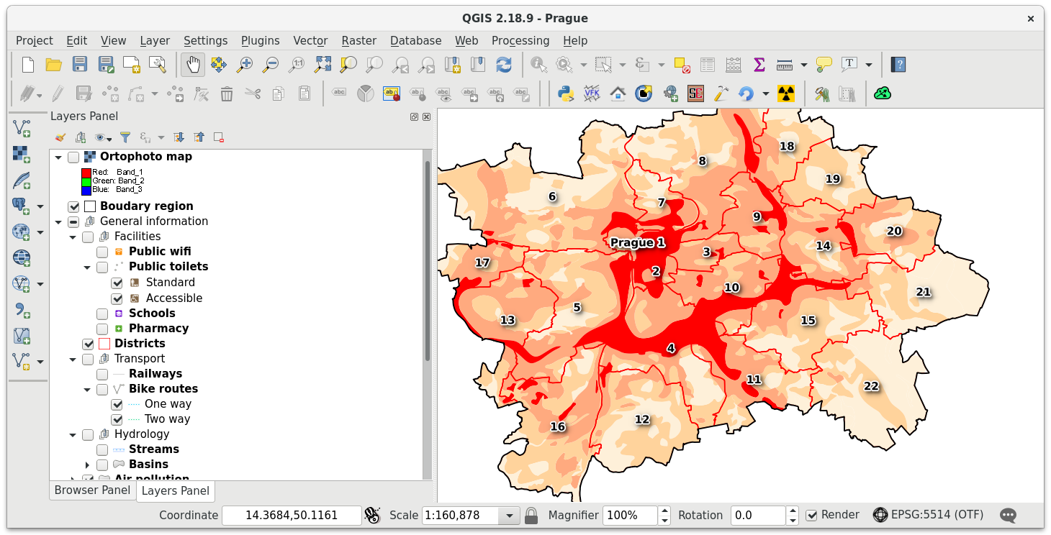
Workflow
1.
Prepare your QGIS project

Slide 15
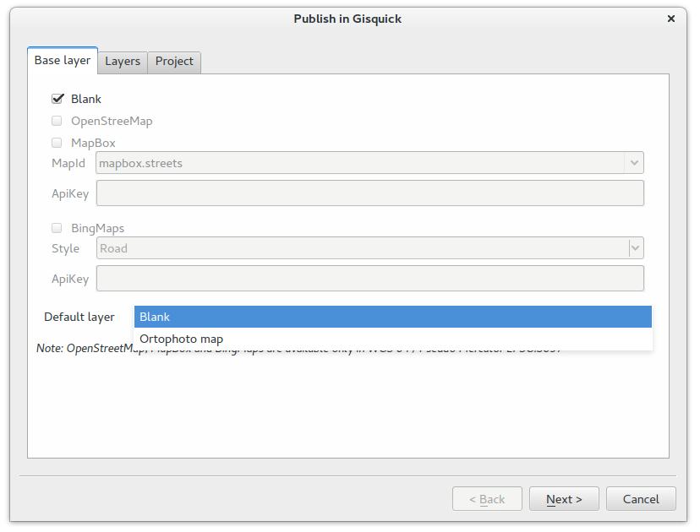
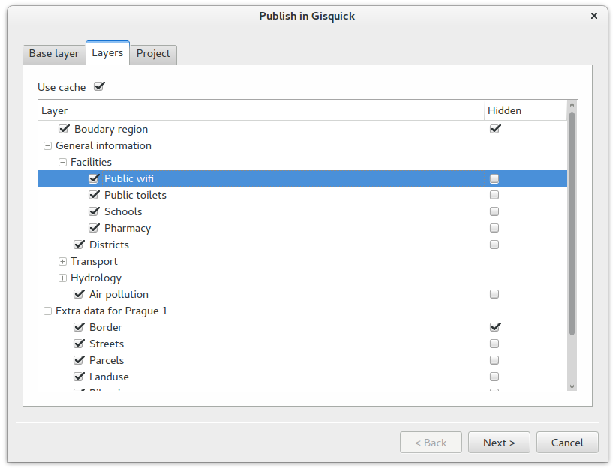
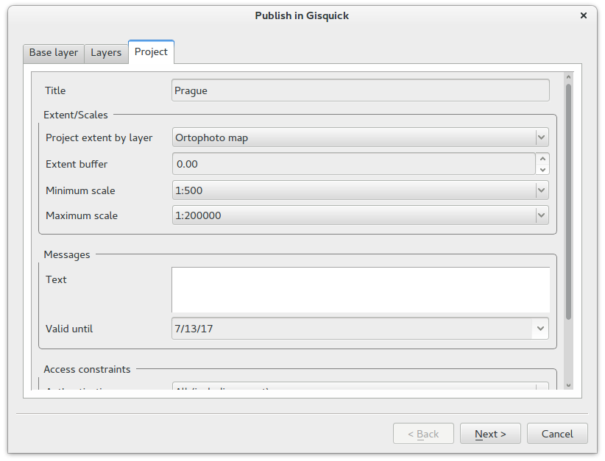
Workflow
2.
Publish using Gisquick plugin

Slide 16
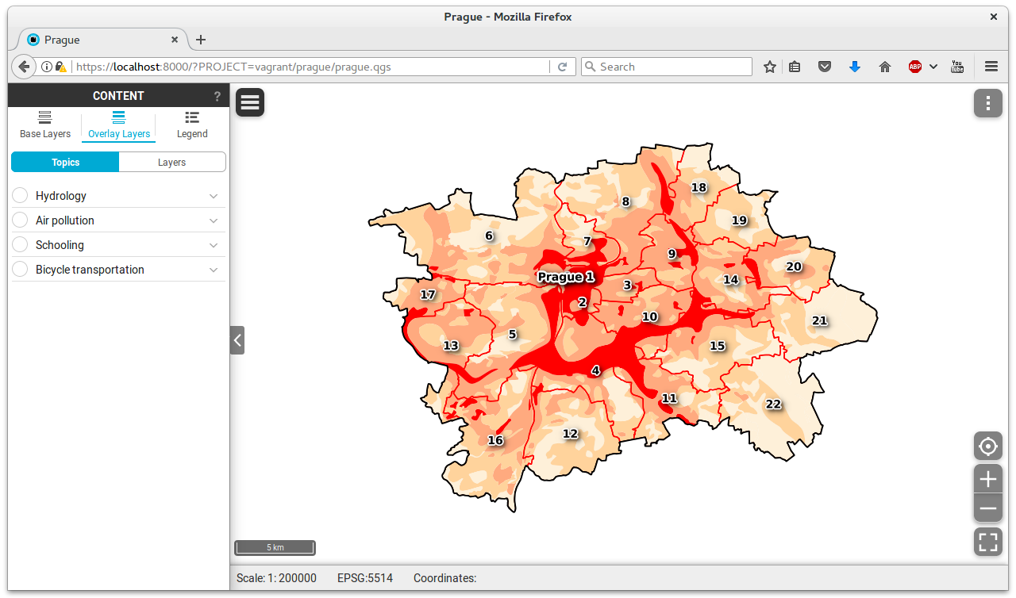
Workflow
3.
Enjoy Gisquick
Web/Mobile app

Slide 17
Try it out!

Slide 18
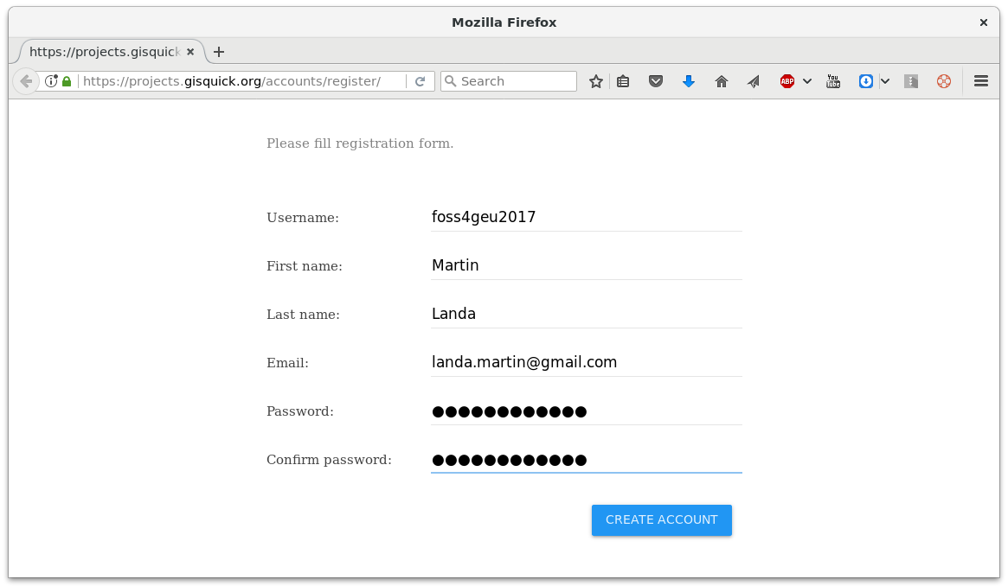
Try it out! How to...
Create an account https://projects.gisquick.org/accounts/register/

Slide 19
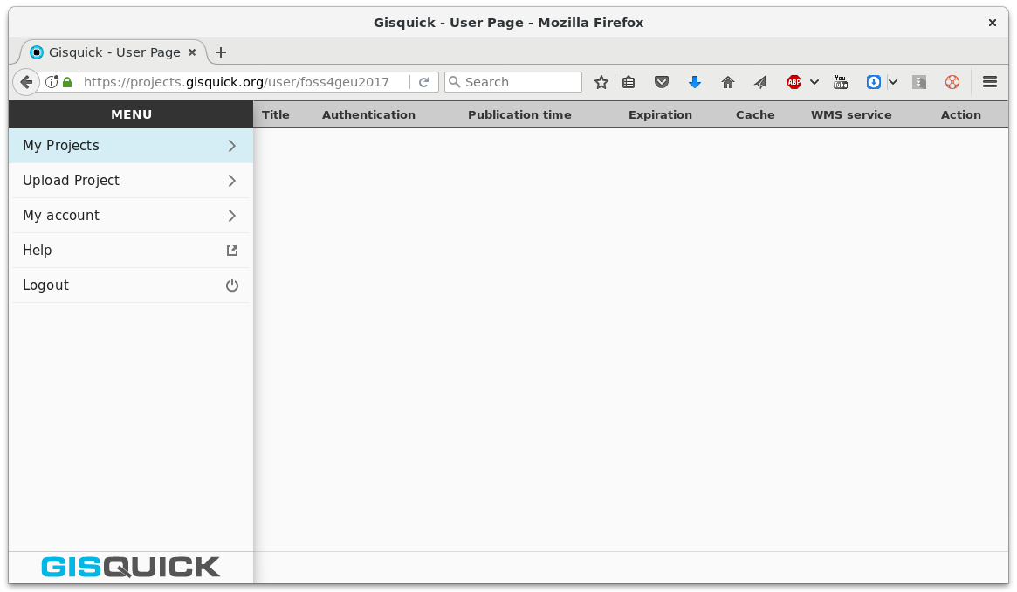
Try it out! How to...
Log in
https://projects.gisquick.org/user/<user-name>

Slide 20
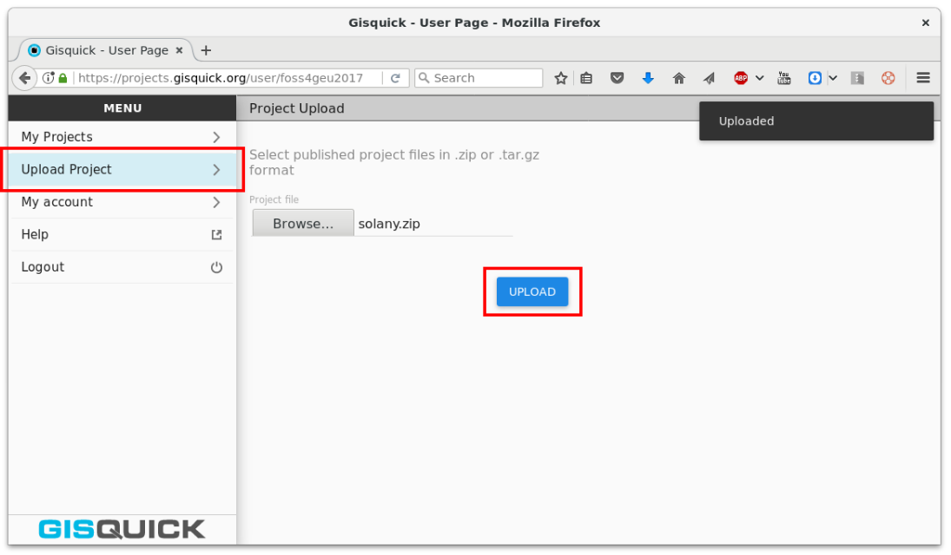
Try it out! How to...
Choose Upload project and upload zipped project directory published using Gisquick QGIS plugin

Slide 21
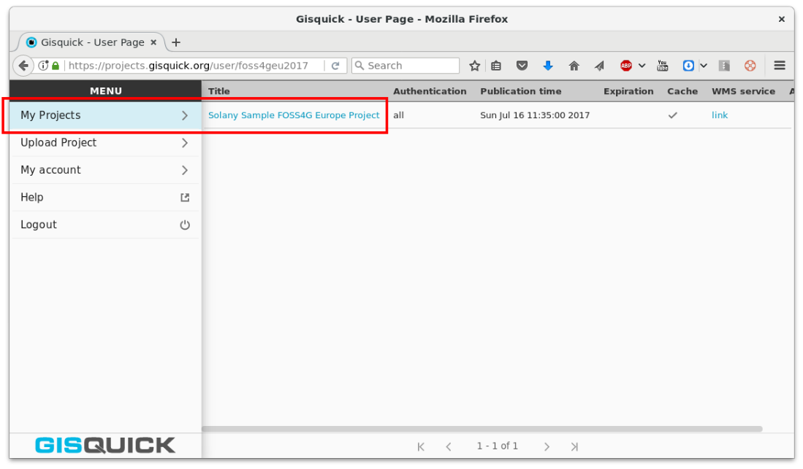
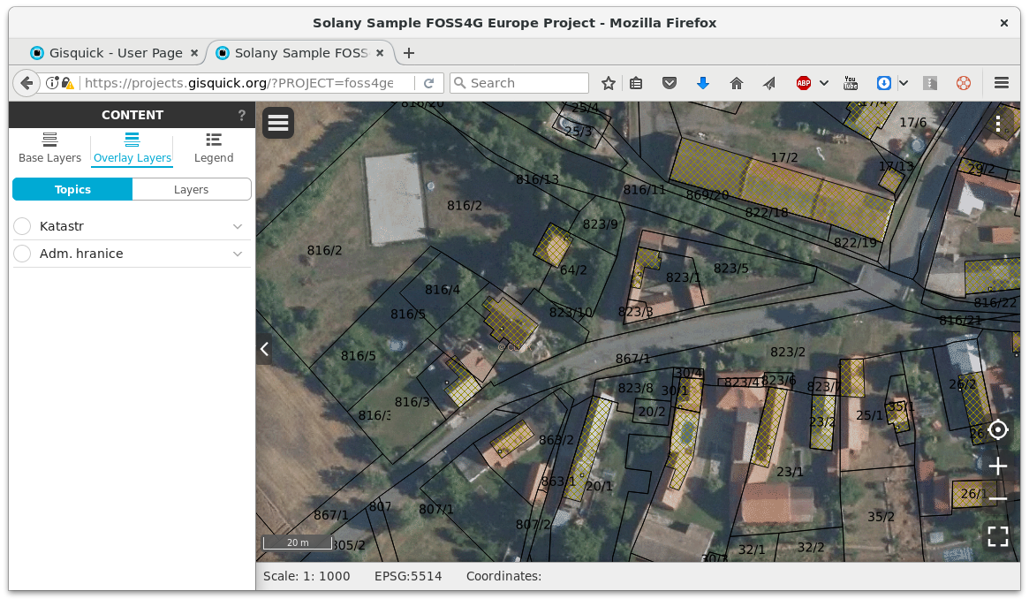
Try it out! How to...
Go to My Projects and enjoy!

Slide 22
Links
Website
http://gisquick.org
Documentation
http://gisquick.readthedocs.io
Live demos
https://projects.gisquick.org

Slide 23
info@gisquick.org

