Slide 1


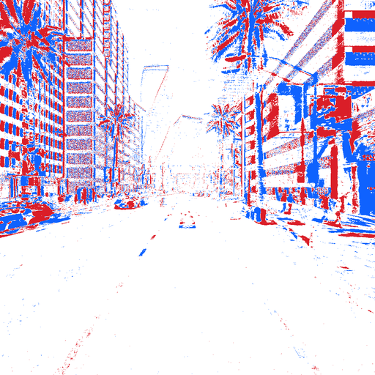
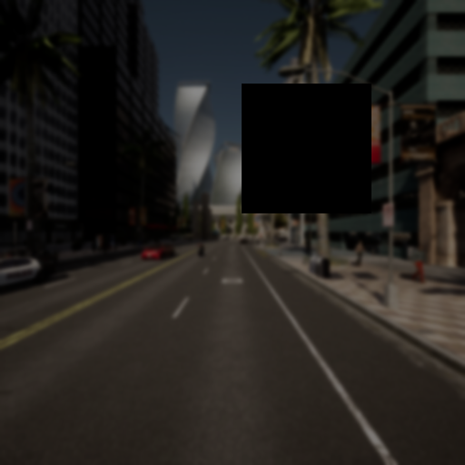
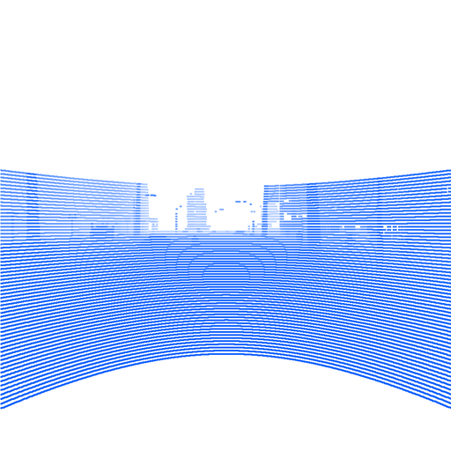
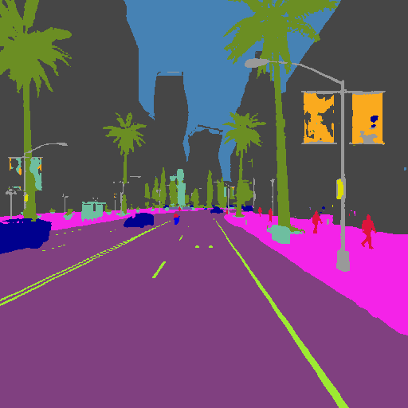
(a)
Inference: one frozen backbone, sensor-specific adapters, cross-modal fusion
(b)
Training: clean and degraded passes
DINOv3-L
frozen, shared
tokens
tap
6
12
18
24
SimpleFPN
RGB
LoRA
Cross-modal
attention
Dense head
L_{CE}
1/32
per-pixel
clean
1/16
Model (a)
Depth
LoRA
Query head
same
weights
1/8
arbiter
L_{CE}
100 queries
Event
LoRA
L_{KD}
each sensor attends
to the other sensors
2 layers
1/4
degraded
(blur, exposure,
sensor dropout)
LiDAR
LoRA
soft
targets
T=2
Teacher
sum per level
prediction
frozen,
clean-trained
samples tap tokens
conv stem
deformable extractors (×6)
high-resolution path
full-res. input

