Slide 1
Sections of solids
UNIT-IV

Slide 2
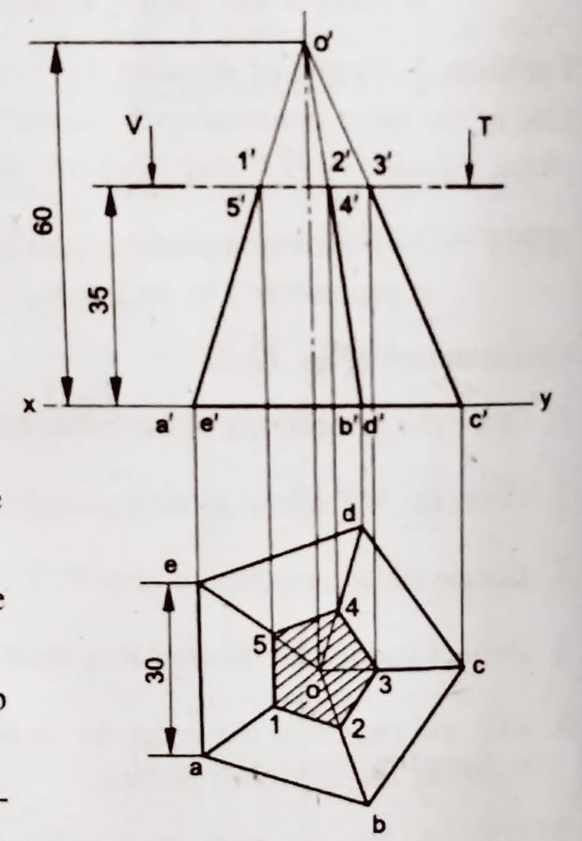
1. A pentagonal pyramid with side of base 30 and axis 60 long, is resting with its base on H.P and one of the edges of its base is perpendicular to V.P. It is cut by a section plane, parallel to H.P and passing through the axis at a point 35 above the base. Draw the projections of the remaining solid.

Slide 3
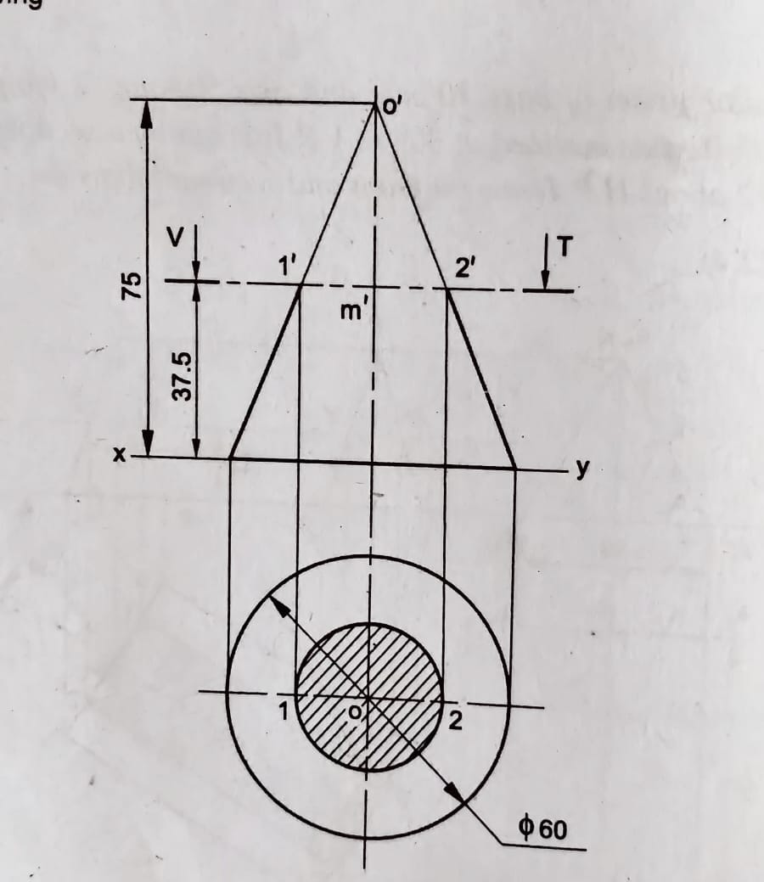
2. A cone with base 60 diameter and axis 75 long, is resting on its base on H.P. It is cut by a section plane parallel to H.P and passing through the mid-point of the axis. Draw the projections of the cut solid

Slide 4
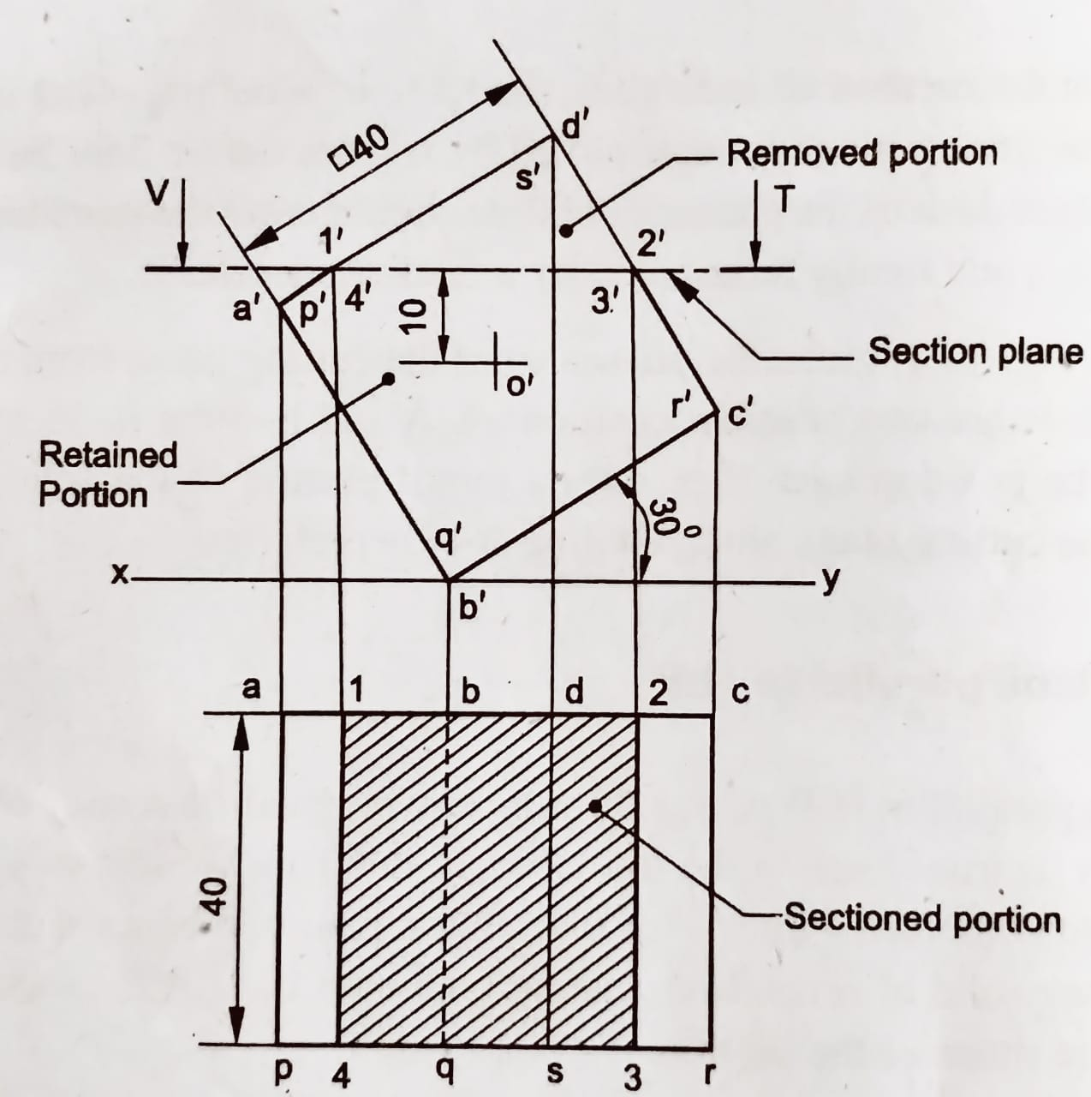
3. A cube of 40 edges, is resting on H.P on one of its edges, with a face parallel to V.P. One of the faces containing the resting edge is inclined at 30° to H.P. The solid is cut by a section plane, parallel to H.P and 10 above the axis. Draw the projections of the remaining solid.

Slide 5
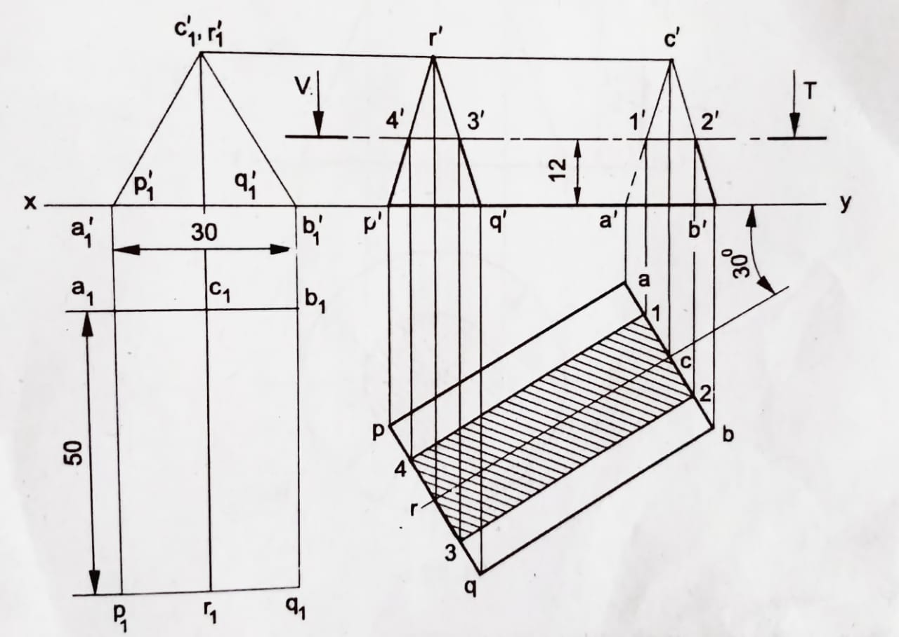
4. A triangular prism of base 30 side and axis 50 long, is lying on H.P on one of its rectangular faces, with its axis inclined at 30° to V.P. It is cut by a section plane, parallel to H.P and at a distance of 12 above H.P. Draw the front and sectional top view.

Slide 6
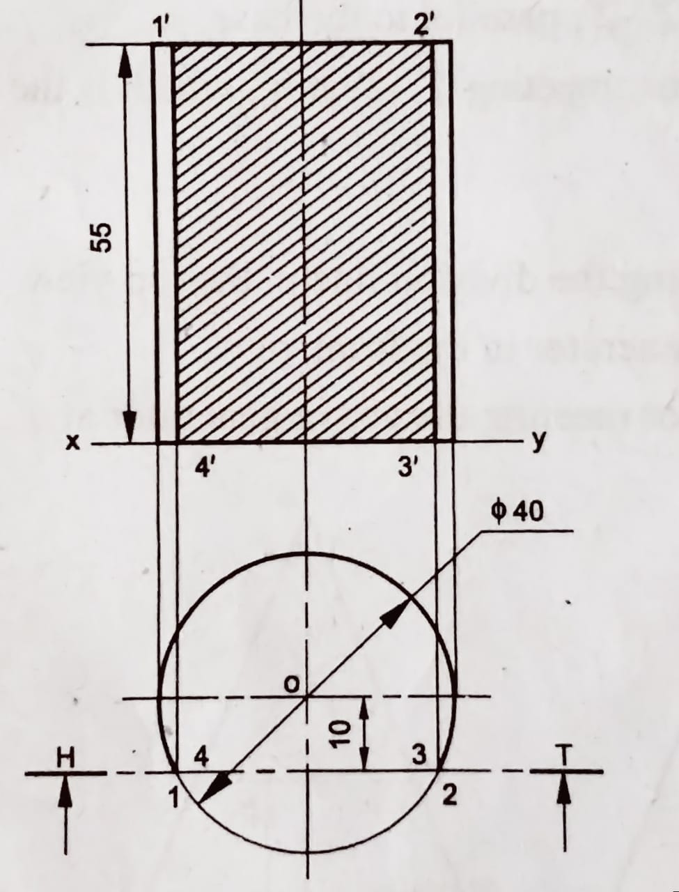
5. A cylinder of 40 diameter and axis 55 long, stands vertically with its base on HP. It is cut by a section plane, parallel to V.P and passes at a distance of 10 from the axis. Draw the projections of the retained solid.

Slide 7
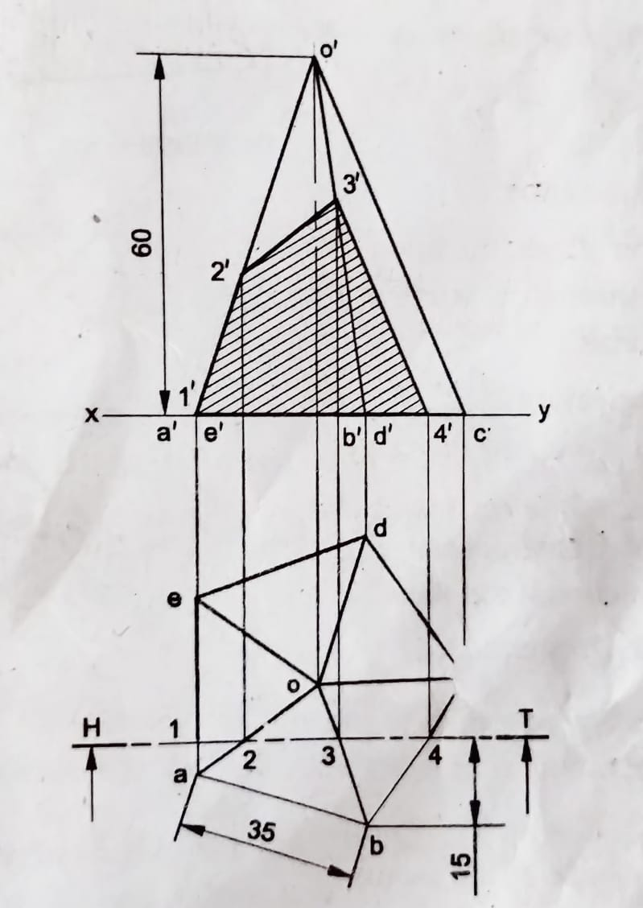
6. A pentagonal pyramid of side of base 35 and axis 60 long, stands with its base on H.P such that, one of the base edges is perpendicular to V.P. A section plane parallel to V.P, cuts the solid at a distance of 15 from the corner of the base which is nearer to the observer. Draw the top and sectional front views of the cut solid.

Slide 8
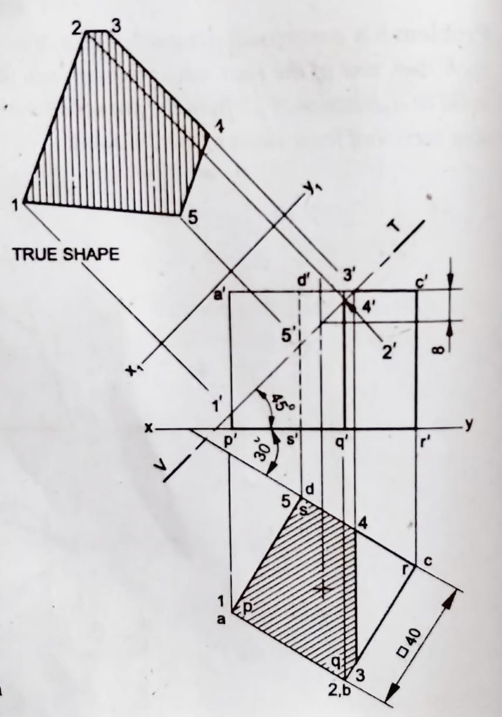
7. A cube of side 40 mm is resting on H.P on one of its faces with a vertical face inclined at 30⁰ to V.P. It is cut by a sectional plane inclined at 45⁰ to H.P and passing through the axis at 8 mm from the top surface. Draw its projection of solid and also show its true shape of the section.

Slide 9
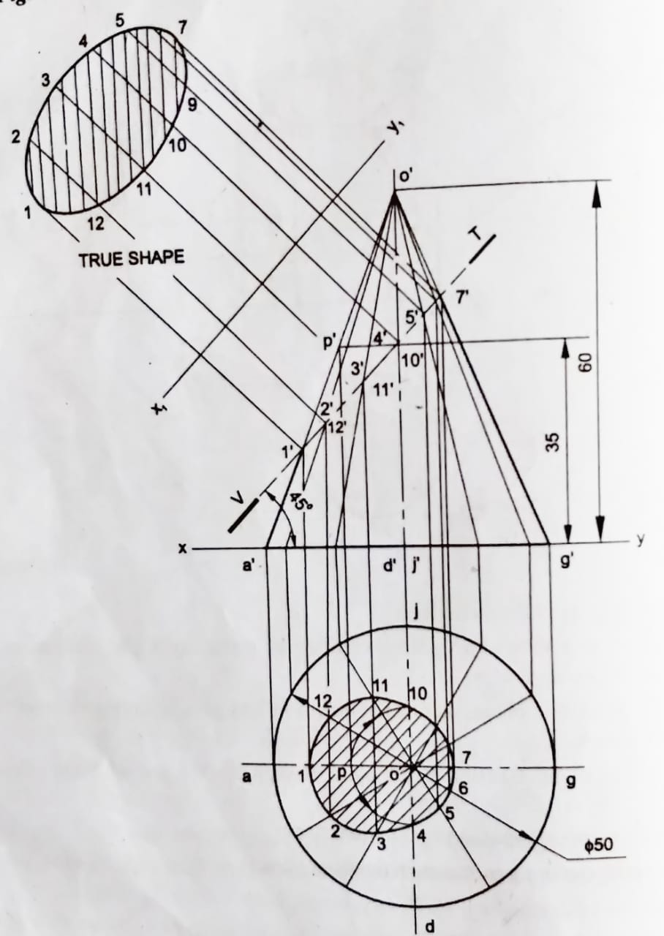
8. A cone with diameter of base 50 and axis 60 long, is resting on its base on H.P. It is cut by a section plane inclined at 45° to H.P and passing through the axis at a point 35 above H.P. Draw the projections of the cut solid.

Slide 10
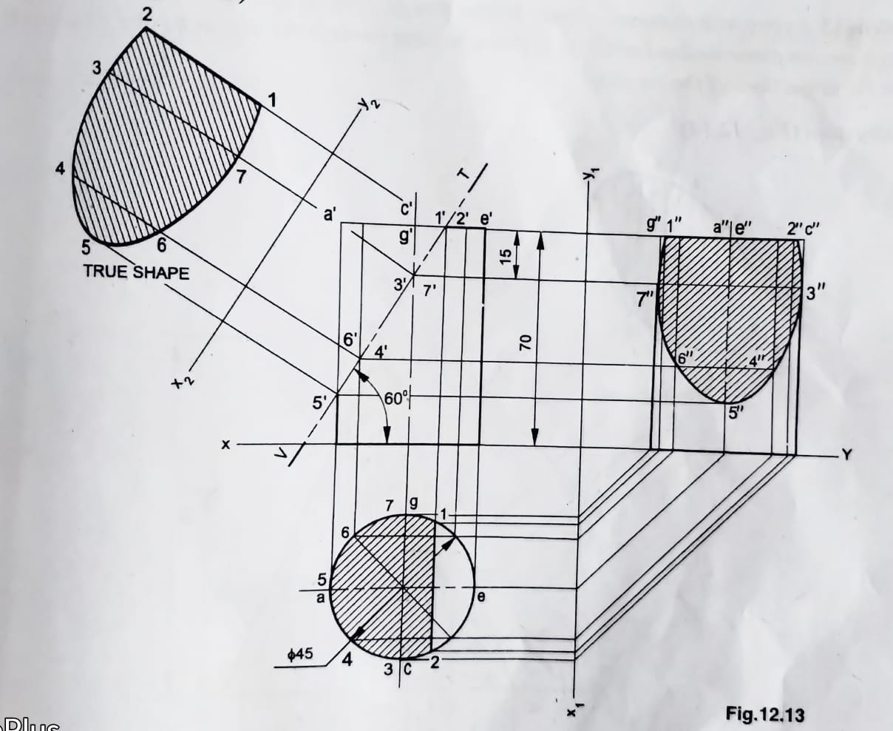
9. A cylinder of 45 diameter and 70 long, is resting on one of its bases on H.P. It is cut by a section plane, inclined at 60° with H.P and passing through a point on the axis at 15 from one end. Draw the three views of the solid and also obtain the true shape of the section.

Slide 11
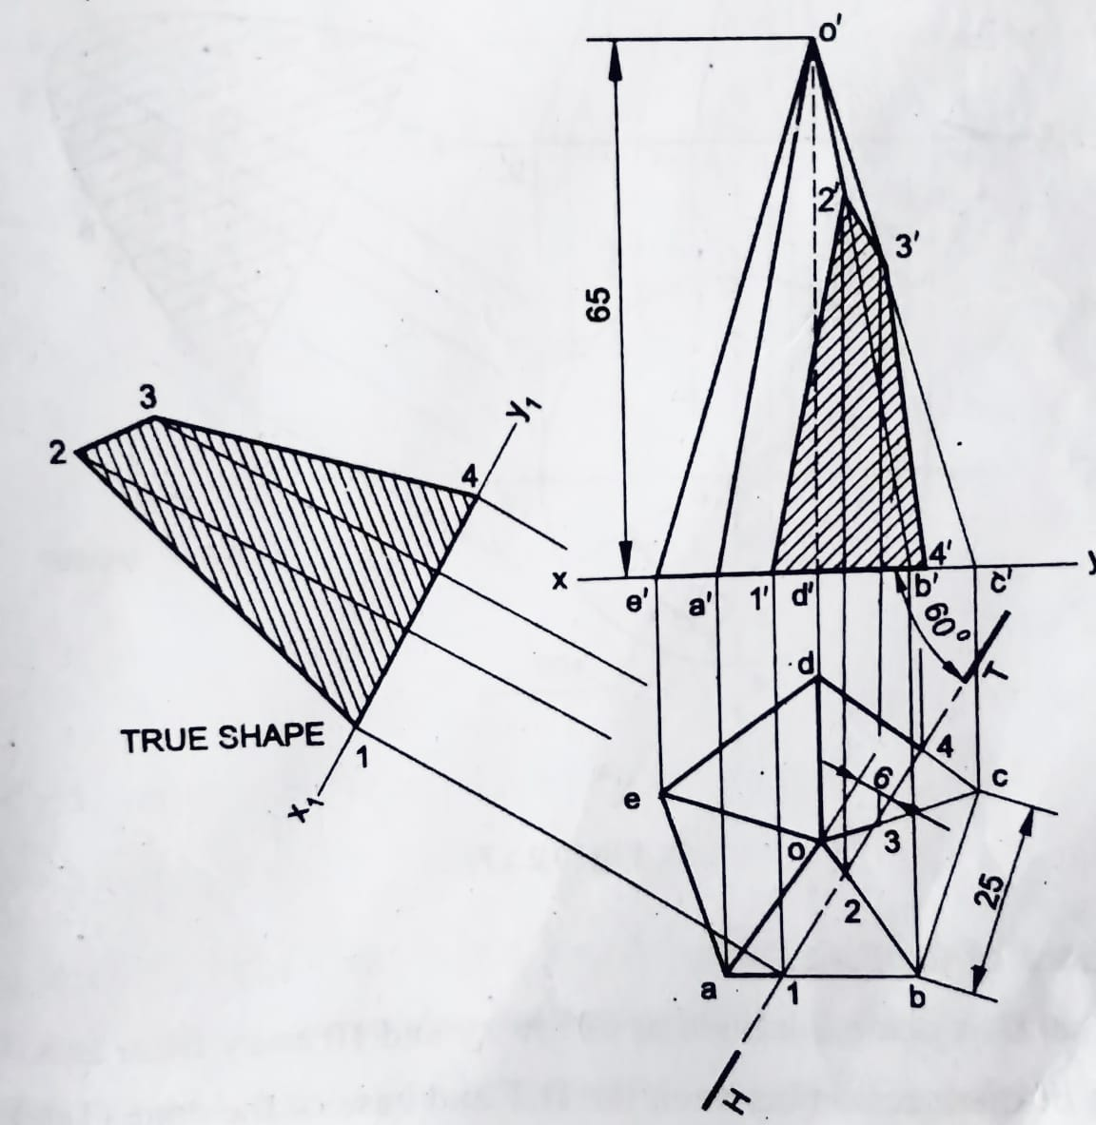
10. A pentagonal pyramid with edge of base 25 and axis 65 long, is resting on H.P on its base with an edge nearer to the observer, parallel to V.P. It is cut by a section plane, inclined at 60 to V.P and at a distance of 6 from the axis. Draw the projections and obtain the true shape of the section.

Slide 12
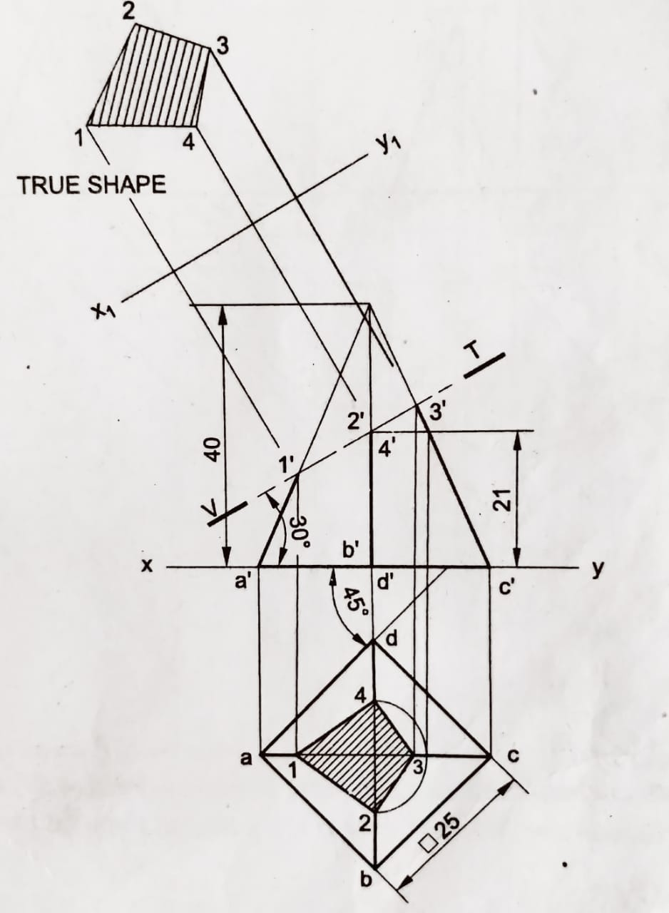
11. A square pyramid of base side 25 and height 40 rests on H.P with its base edges equally inclined to V.P. It is cut by a plane perpendicular to V.P and inclined at 30° to H.P. meeting the axis at 21 from the base. Draw the sectional top view and true shape of the section.

Slide 13
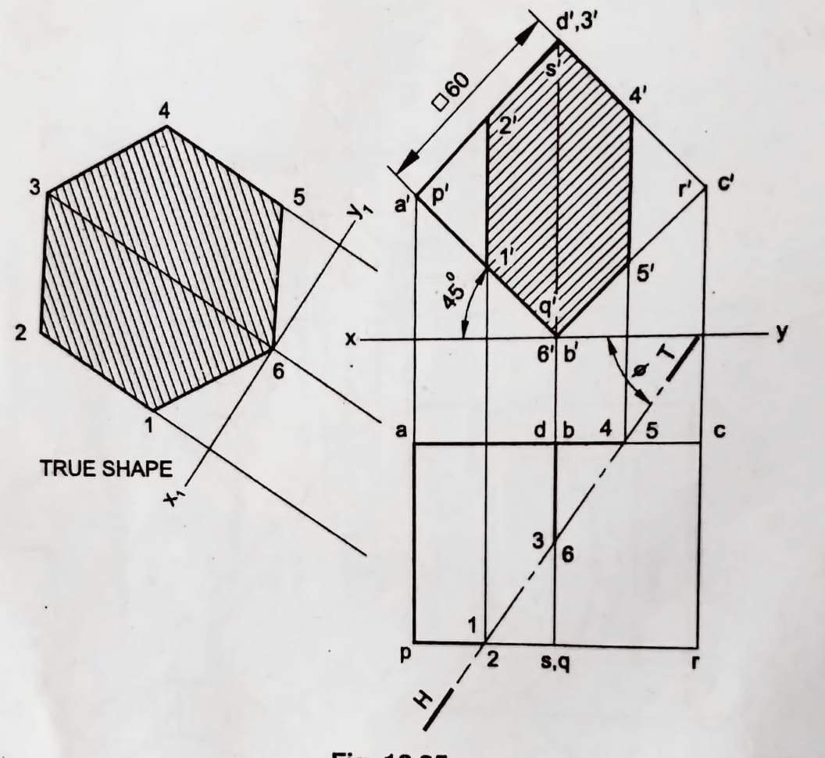
12. A cube of 60 long edges, is resting on one of its edges on H.P such that, a face containing that edge is inclined at 45° to H.P. It is cut by a section plane, perpendicular to H.P such that, the true shape of the section produced is a regular hexagon. Determine the inclination of the cutting plane with V.P and draw the projections of the solid and show the true shape of the section.

Slide 14
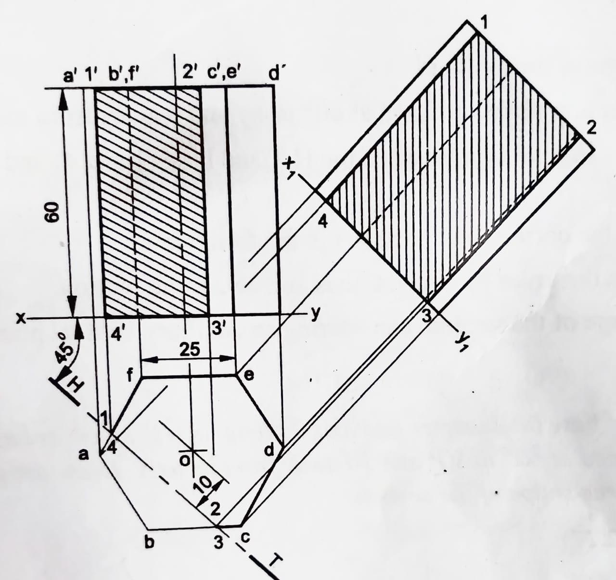
13. A hexagonal prism of side of base 25 and axis 60 long, is resting on its base on H.P such that, an edge of the base is parallel to V.P. It is cut by a section plane, inclined at 45° to V.P and 10 away from the axis. Draw the projections of the solid. Also obtain an auxiliary front view, showing the true shape of the section.

Slide 15
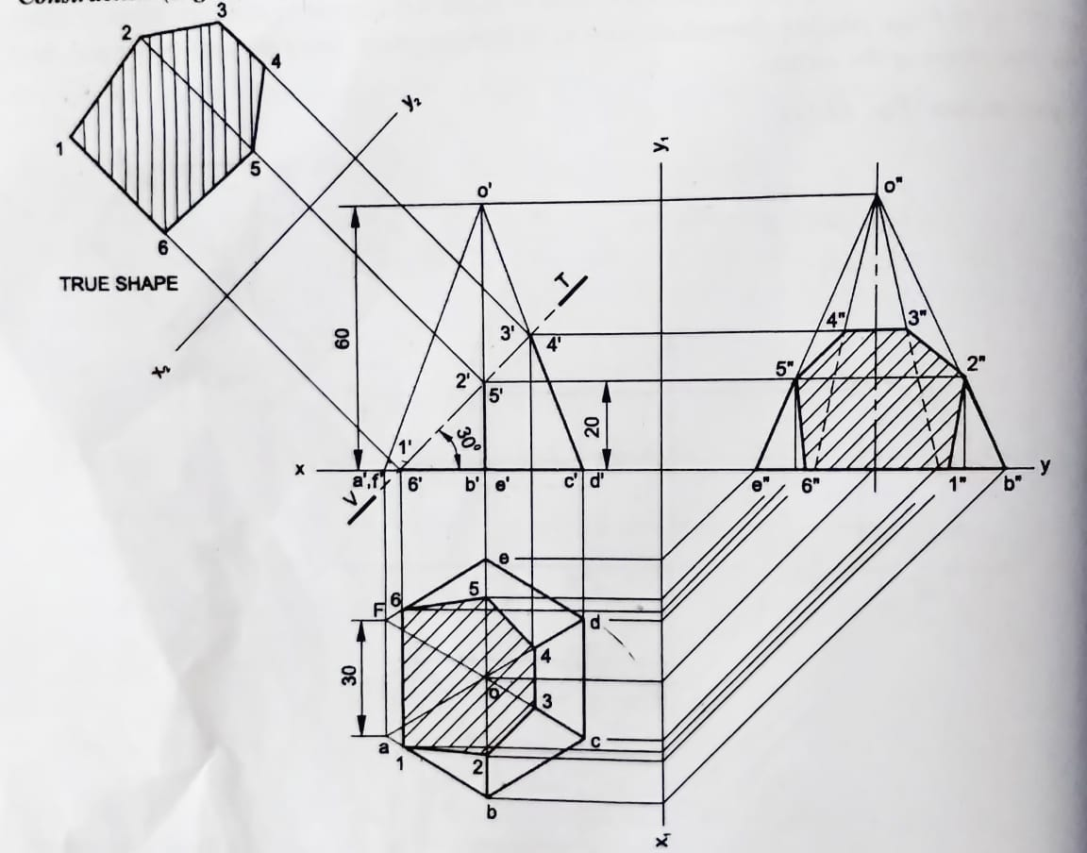
14. A hexagonal pyramid of side of base 30 and axis 60 long, is resting on its base on H.P, with an edge of the base perpendicular to V.P. It is cut by a section plane, inclined at 30° to H.P and passing through the axis at 20 from the base. Draw the three views of the solid and obtain the true shape of the section

Slide 16
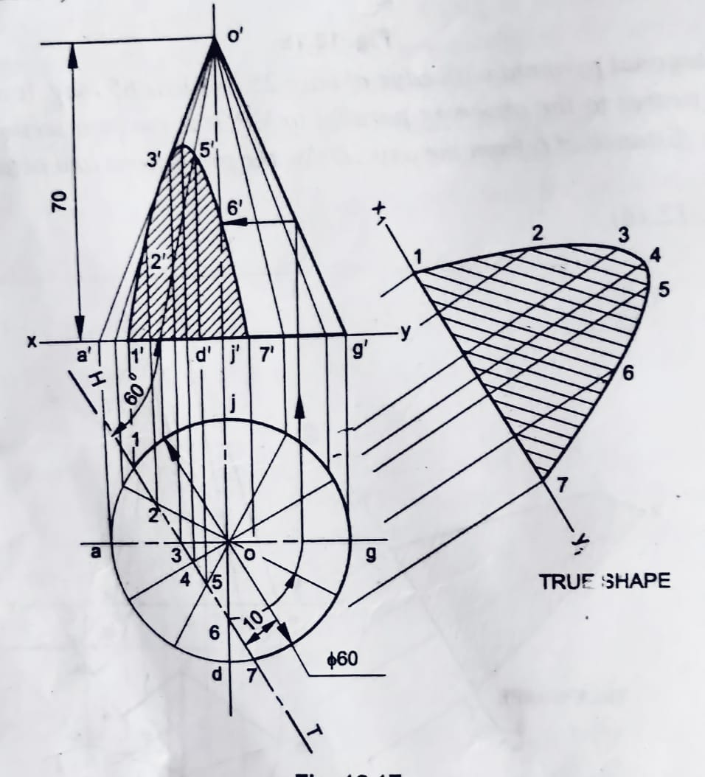
15. A cone of base 60 diameter and axis 70 long, is resting on its base on H.P. It is cut by a section plane, inclined at 60° to V.P and 10 away from its axis. Draw the projections of the cut solid and obtain the true shape of the section.

Slide 17
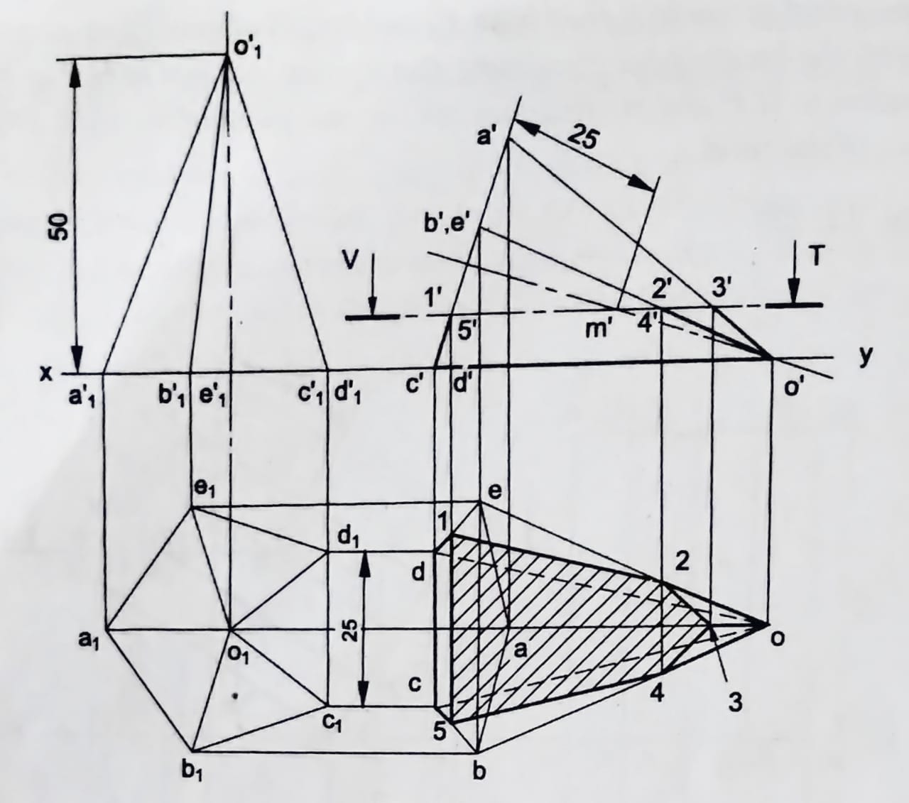
16. A pentagonal pyramid of side of base 25 and 50 height, rests on a triangular face on H.P, with its axis parallel to V.P. It is cut by a horizontal section plane, bisecting the axis. Draw the projections of the retained solid.

Slide 18
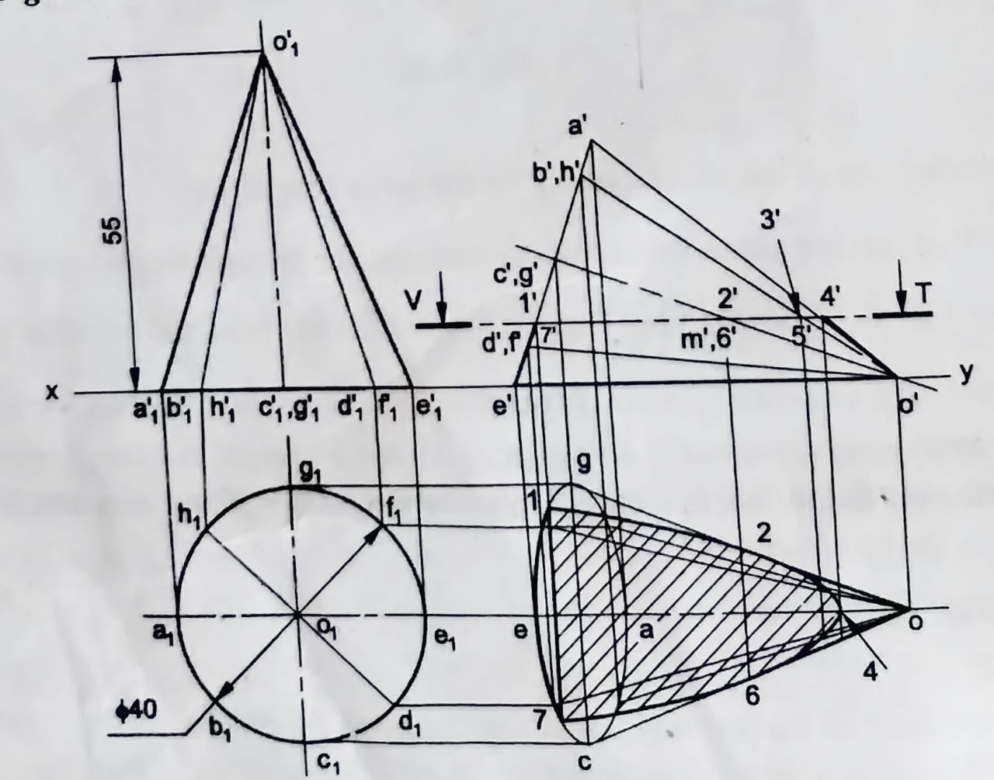
17. A cone of base 40 diameter and axis 55 long, lies on one of its generators on H.P. with its axis parallel to V.P. A horizontal section plane, bisects the axis of the cone. Draw the projections of the retained portion of the solid.

Slide 19
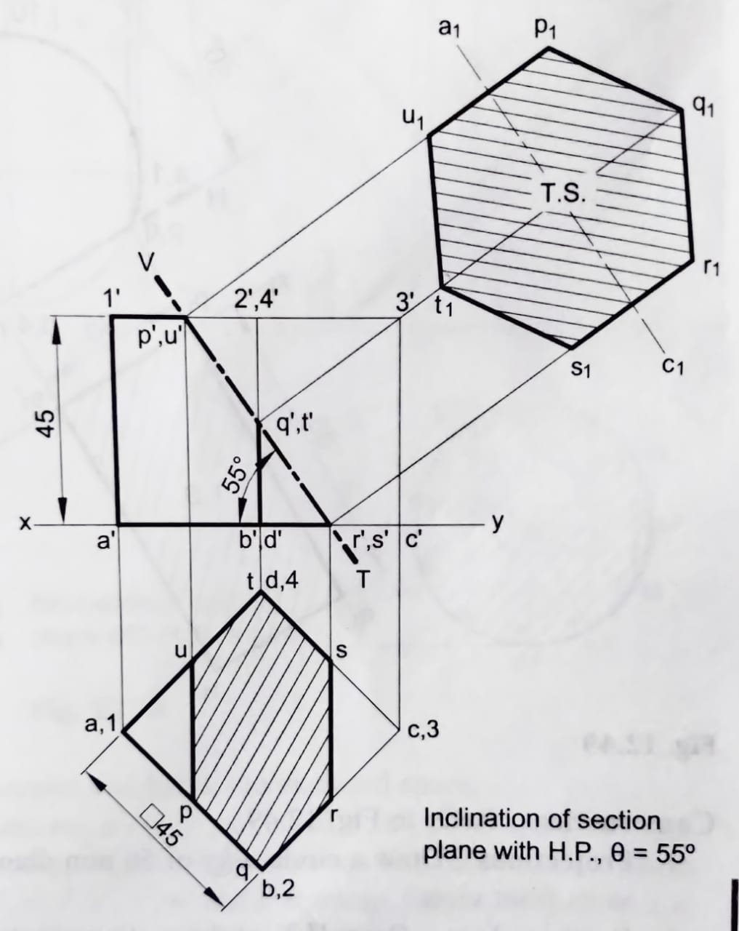
18. A cube of 45 mm long edges rests on the H.P. with vertical faces equally inclined to the V.P. It is cut by a section plane perpendicular to V.P. so that the true shape of the section is a regular hexagon. Draw the sectional top view and true shape of the section. Also, determine the inclination of the section plane with the H.P.

Slide 20
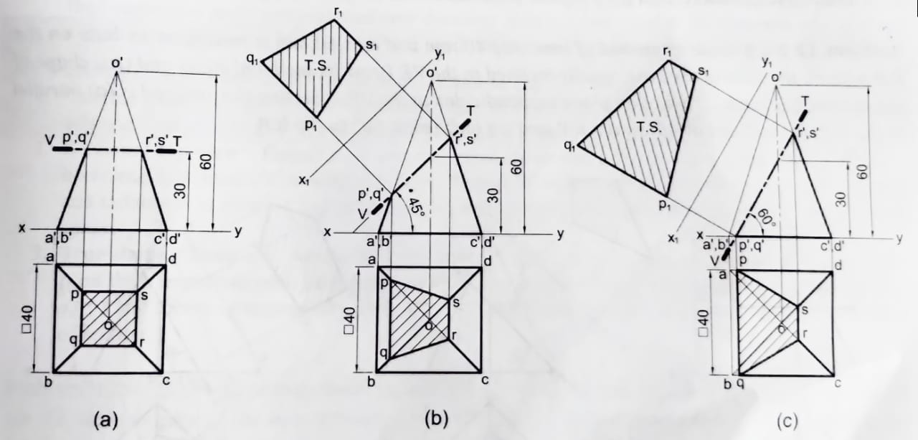
19. A square pyramid of base side 40 mm and axis 60 mm is resting on its base on the H.P. with all the sides of the base parallel to V.P. Draw its sectional views and true shape of the section, if it is cut by a section plane perpendicular to the V.P., bisecting the axis and is (a) parallel to the H.P., (b) inclined at 45° to the H.P. and (c) inclined at 60° to the H.P.

Slide 21
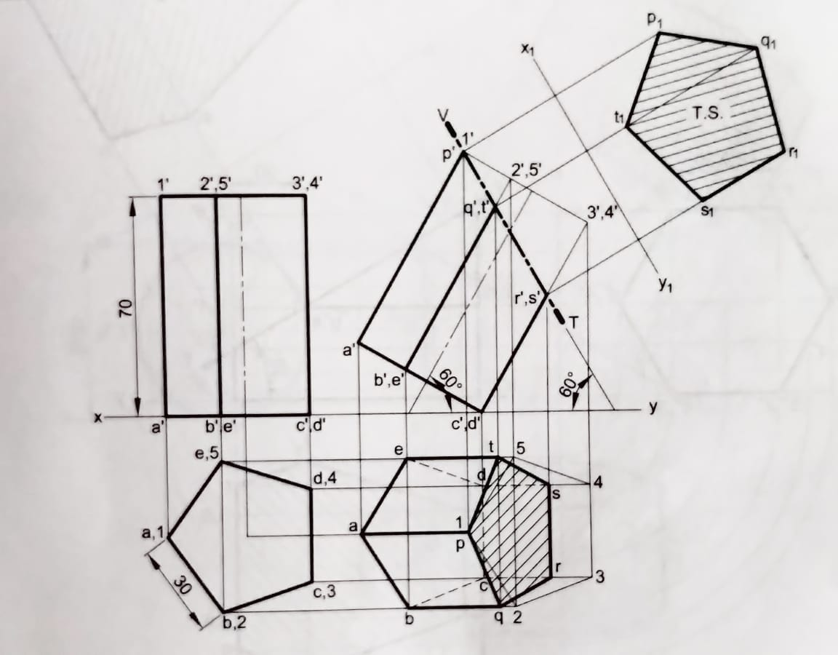
20. A pentagonal prism of base side 30 mm and axis 70 mm has an edge of its base on the H.P. The axis is parallel to the V.P. and inclined at 60° to the H.P. It is cut by an A.I.P. inclined at 60° to the H.P. and passing through the highest corner of the prism. Draw its sectional top view and true shape of the section.

