Slide 1
Development of surfaces
UNIT-V

Slide 2
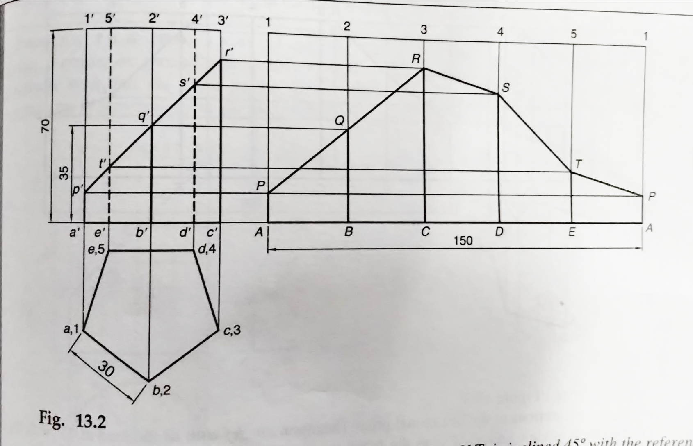
1. A pentagonal prism of base side 30 mm and axis 70 mm is resting on its base on the H.P. with a rectangular face parallel to the V.P. It is cut by an auxiliary inclined plane (A.I.P.) whose V.T. is inclined at 45° to the reference line and passes through the mid-point of the axis. Draw the development of the lateral surface of the truncated prism.

Slide 3
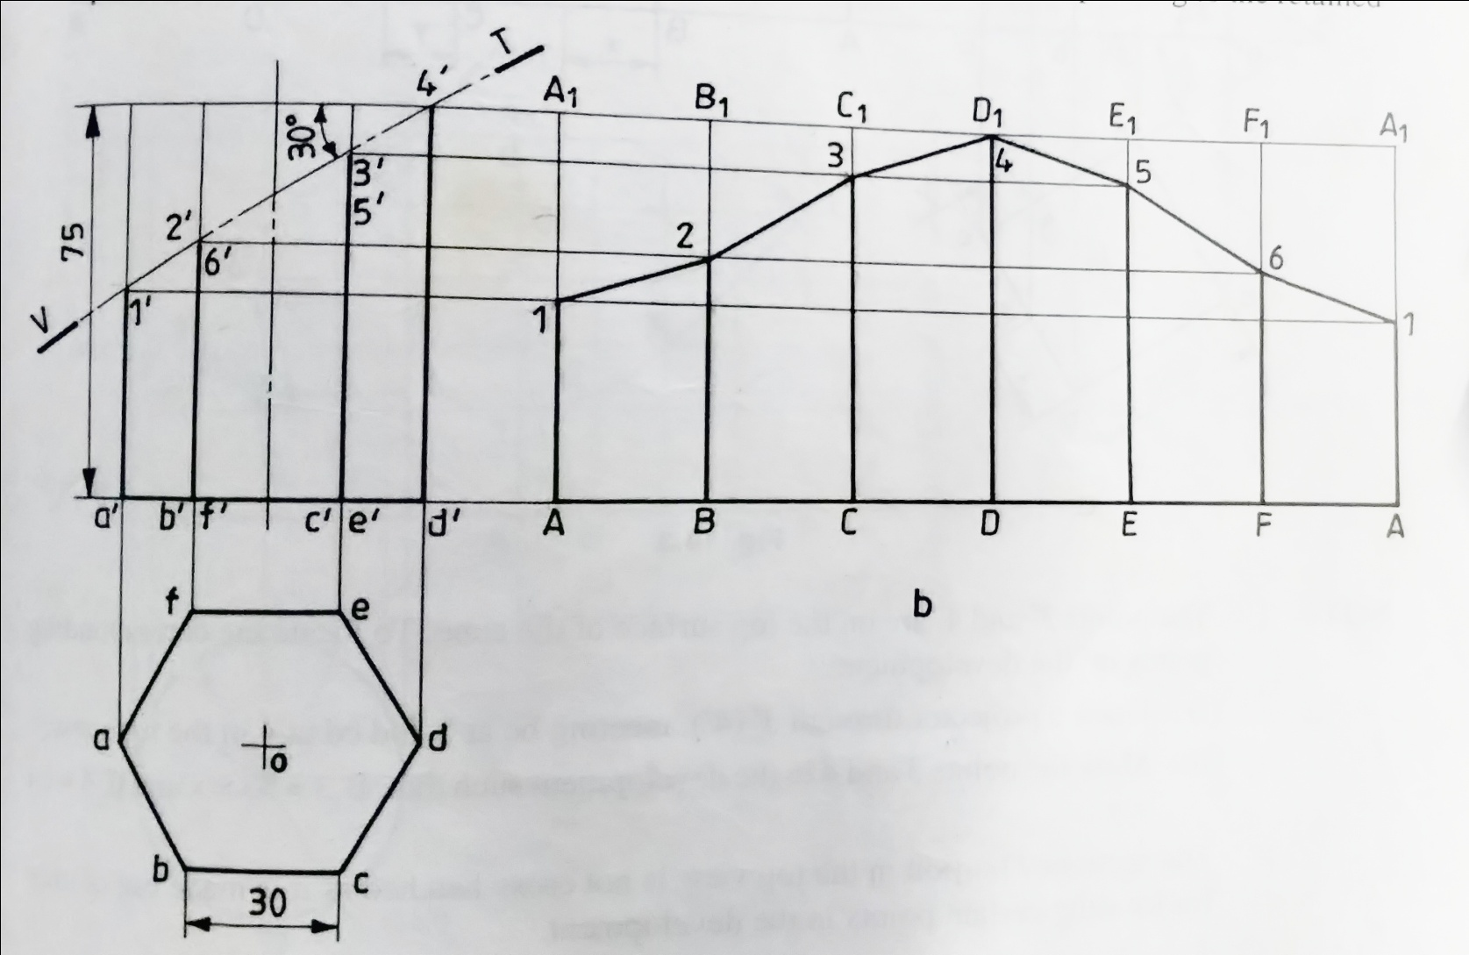
2. A hexagonal prism of side of base 30 and axis 75 long is resting on its base on H.P such that a rectangular face is parallel to V.P. It is cut by a section plane, perpendicular to V.P and inclined at 30° to H.P. The section plane is passing through the top end of an extreme lateral edge of the prism. Draw the development of the lateral surface of the cut prism

Slide 4
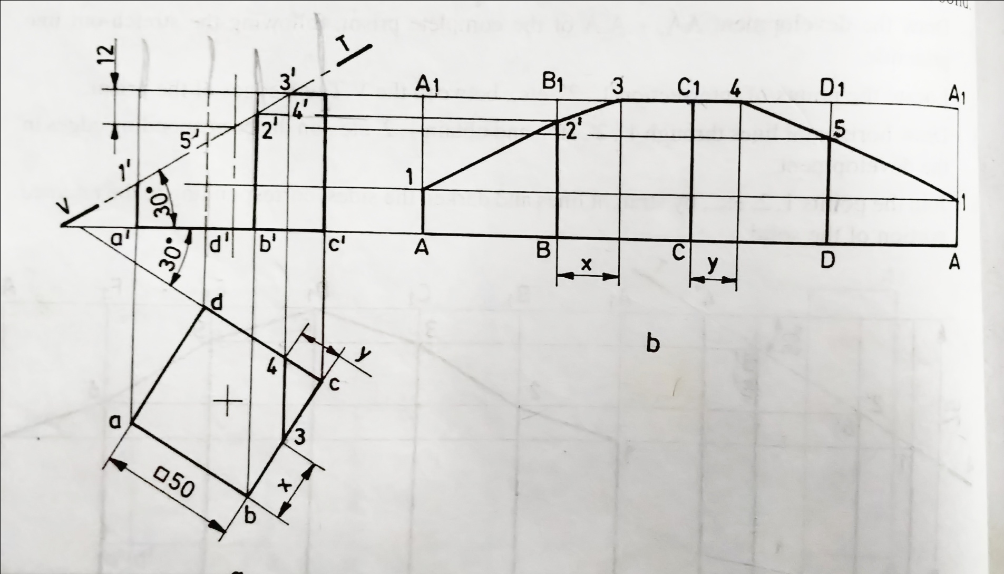
3. A cube of 50 edge, is resting on a face on H.P such that, a vertical face is inclined at 30° to V.P. It is cut by a section plane perpendicular to V.P and inclined to H.P at 30° and passing through a point at 12 from the top end of the axis. Develop the lateral surface of the lower portion of the cube

Slide 5
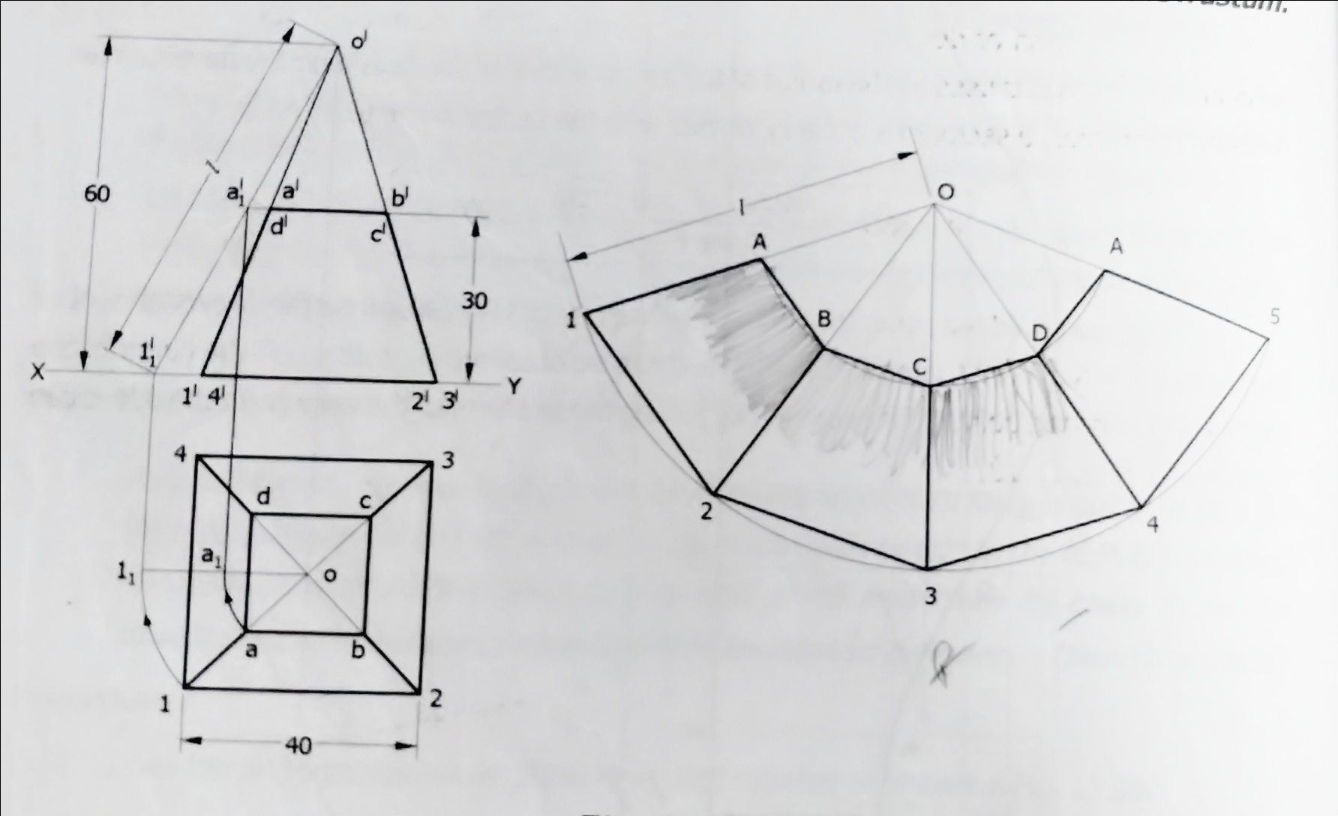
4. A square pyramid of side of base 40 mm and height 60 mm is standing vertically on its base with one of the base edges parallel to VP. It is cut by a horizontal place at a height of 30 mm from base. Develop the lateral surface of the frustum.

Slide 6
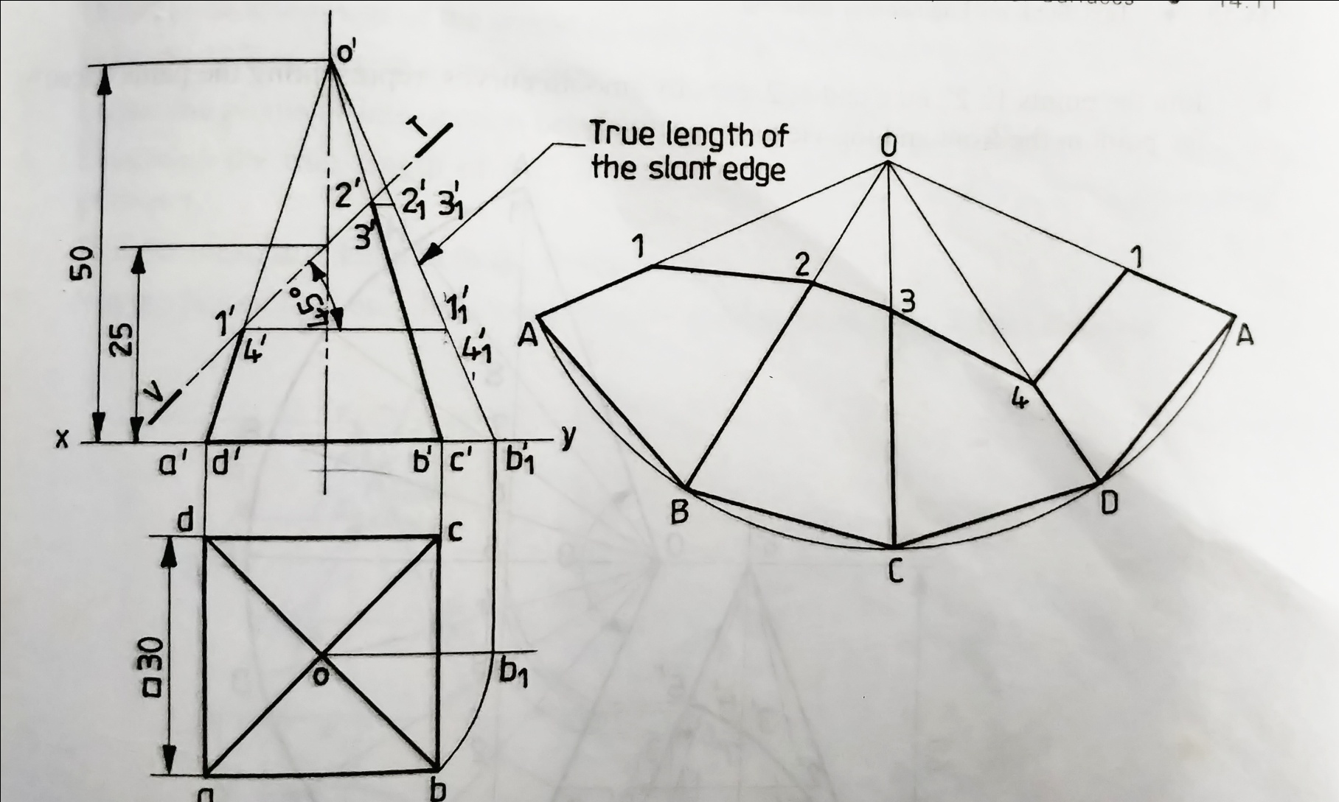
5. A square pyramid, with side of base 30 and axis 50 long, is resting on its base on H.P. with an edge of the base parallel to V.P. It is cut by a section plane, perpendicular to V.P and inclined at 45⁰ to H.P. The section plane is passing through the mid-point of the axis. Draw the development of the surface of the cut pyramid.

Slide 7
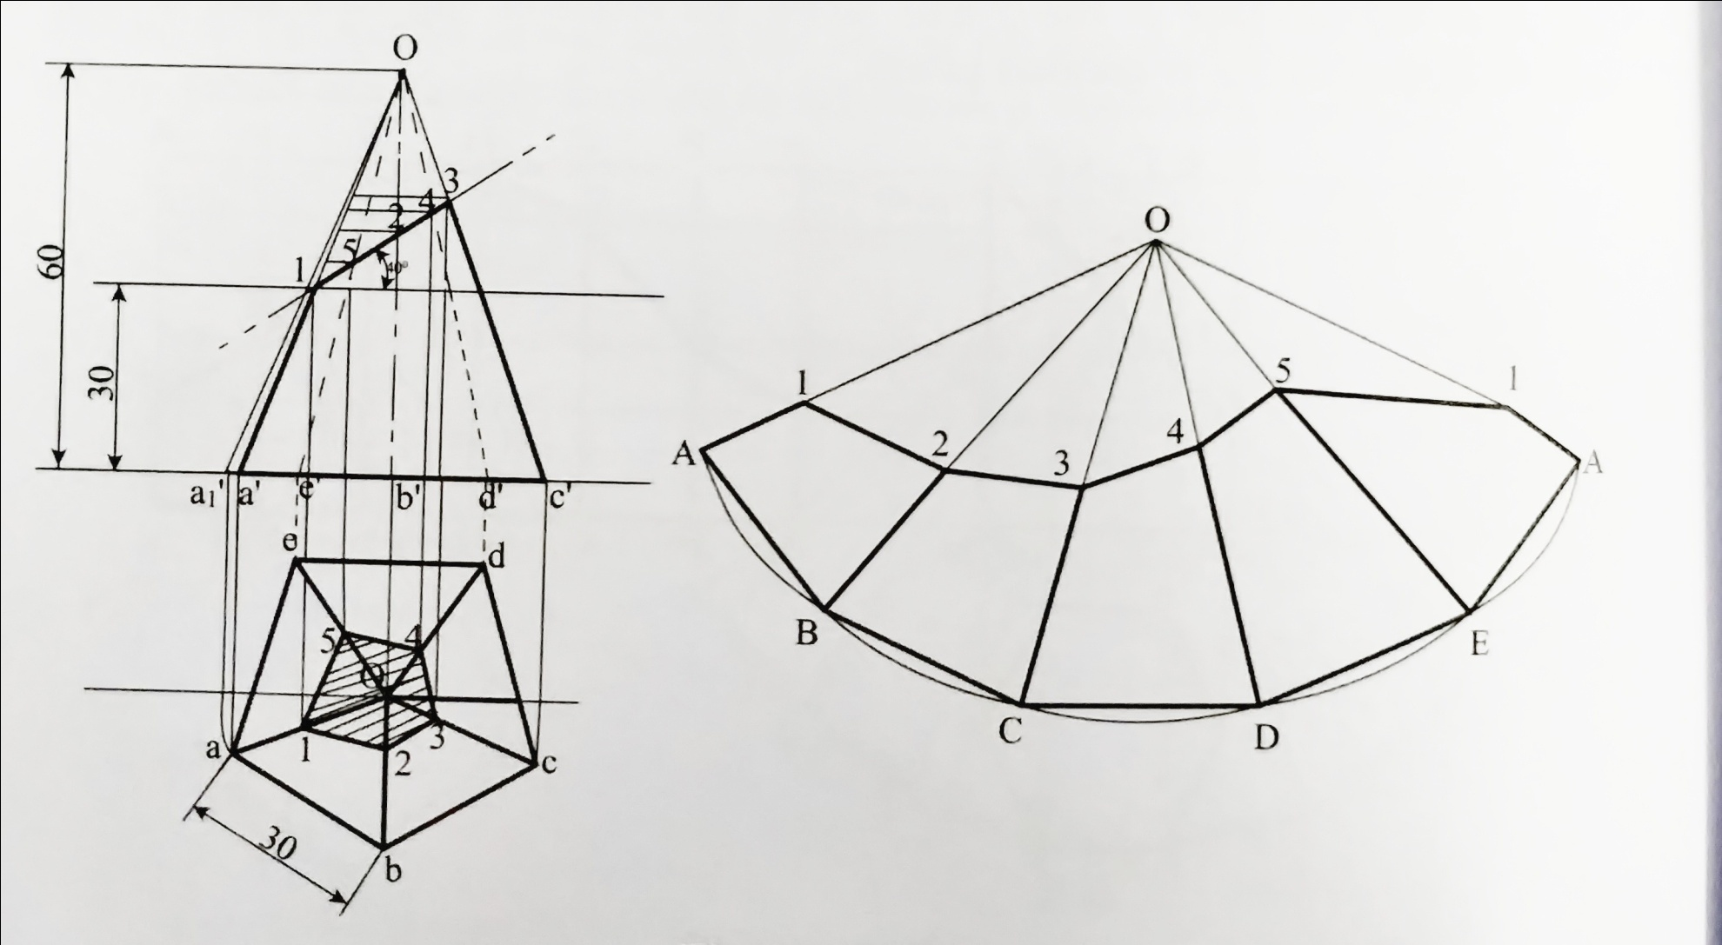
6. A pentagonal pyramid, side of base 30 mm and height 60 mm, stands with its base on HP and an edge of the base is parallel to VP and nearer to it. It is cut by a plane perpendicular to VP, inclined at 40° to HP and passing through a point on the axis, 32 mm above the base. Draw the sectional top view. Develop the lateral surfaces of the truncated pyramid.

Slide 8
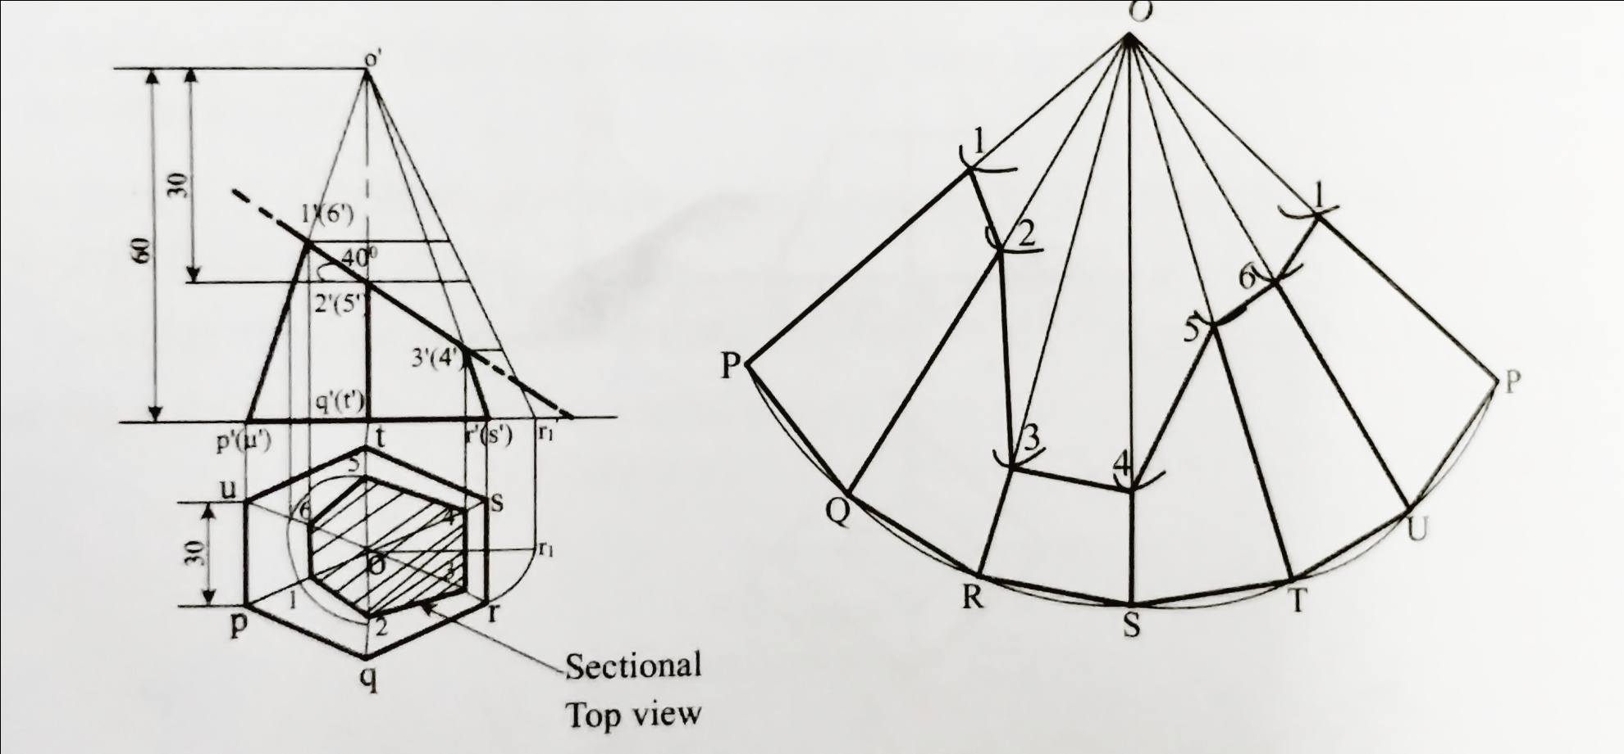
7. A regular hexagonal pyramid side of base 30 mm and height 60 mm is resting vertically on its base on HP. Such that two of its sides of the base are perpendicular to VP. It is cut by a plane inclined at 40° to HP and perpendicular to VP. The cutting plane bisects the axis of the pyramid. Obtain the development of the lateral surfaces of the truncated pyramid.

Slide 9
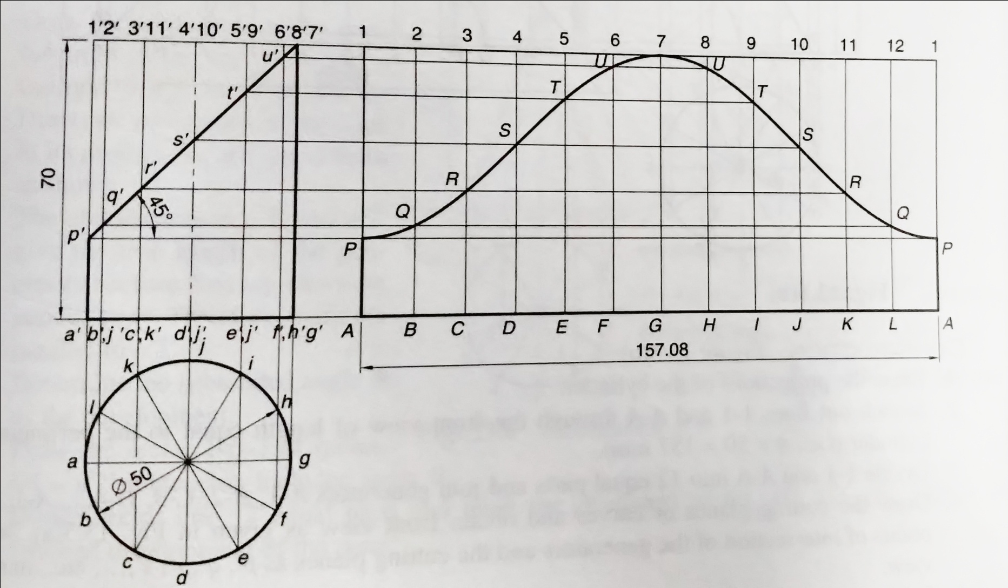
8. A cylinder of base diameter 50mm and axis 70mm is resting on ground with its axis vertical. It is cut by a sectional plane perpendicular to VP, inclined at 45⁰ to the HP, passing through the top of a generator and cuts all other generators. . Draw the development of its lateral surface.

Slide 10
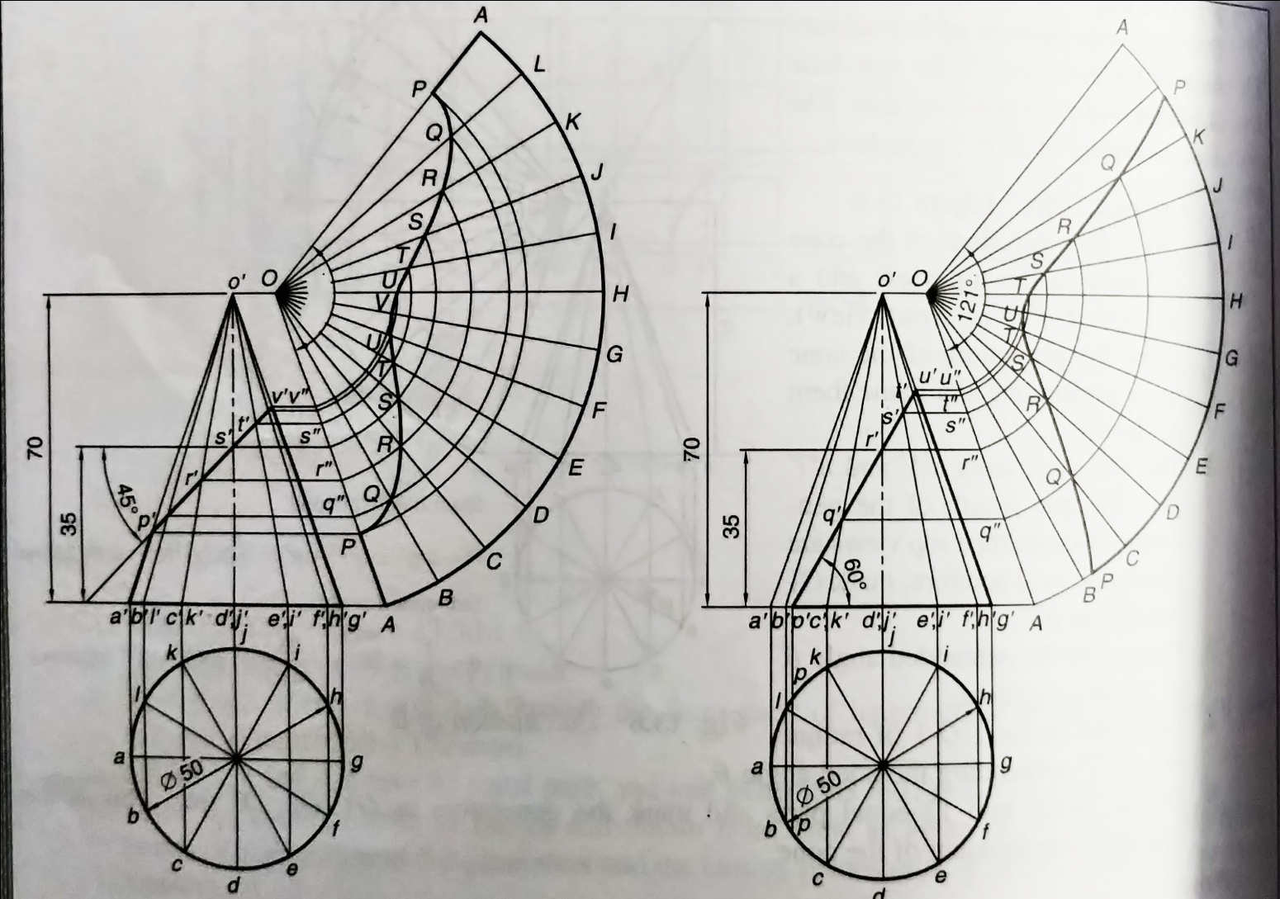
9. A cone with a 50 mm base diameter and a 70 mm long axis, rests on its base on the H.P. Draw the development of its lateral surface (A)when it is cut by an auxiliary inclined plane bisecting the axis and inclined at 45° to the H.P (B) when it is cut by an auxiliary inclined plane bisecting the axis and inclined at 60° to the H.P

Slide 11
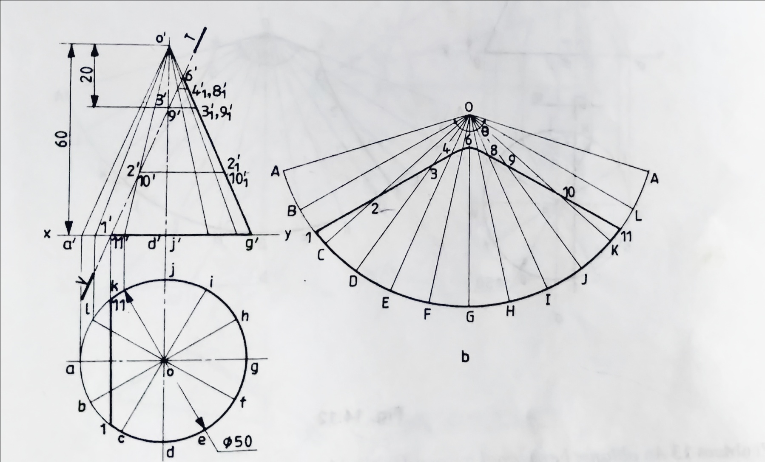
10. A cone of base 50 diameter and axis 60 long is resting on its base on H.P. It is cut by a section plane, perpendicular to V.P and parallel to an extreme generator and passing through a point on the axis at a distance of 20 from the apex. Draw the development of the retained solid.

Slide 12
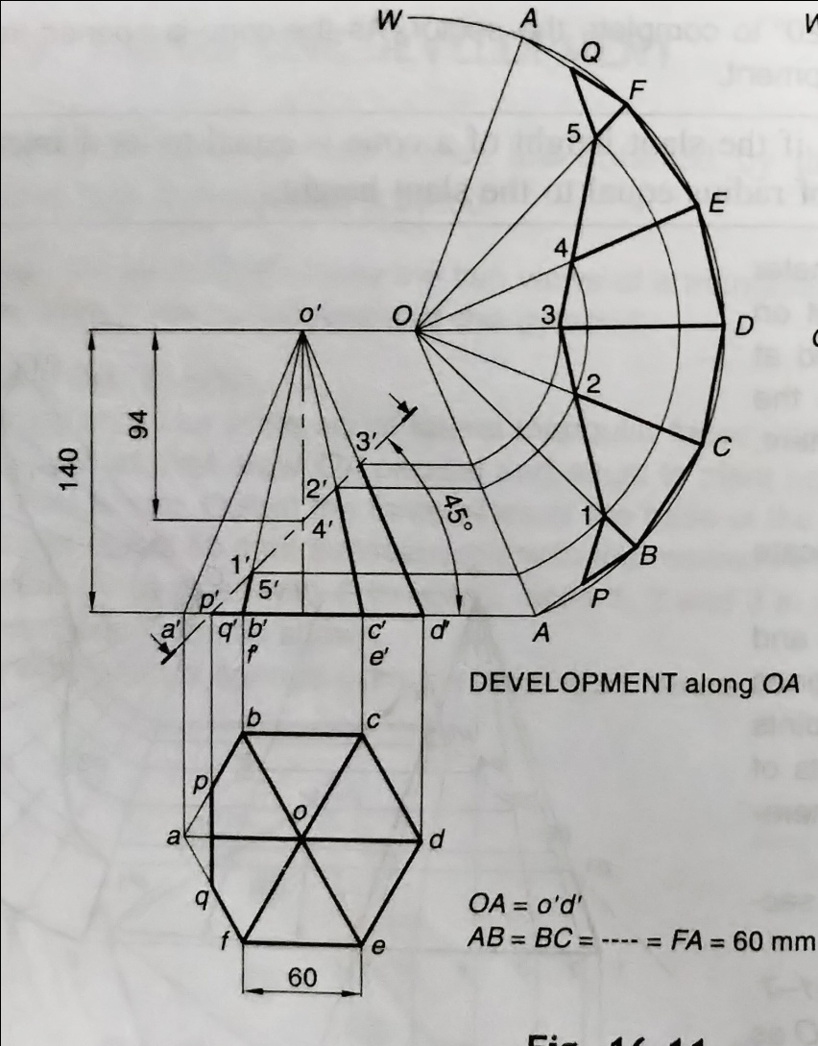
11. A hexagonal pyramid of side of base 60 mm and length of axis 140 mm is kept on the ground on its base. It is cut by an AIP inclined at 45° to the base and cutting the axis at 94 mm from the apex. Draw the development of lateral surfaces of the pyramid.

Slide 13
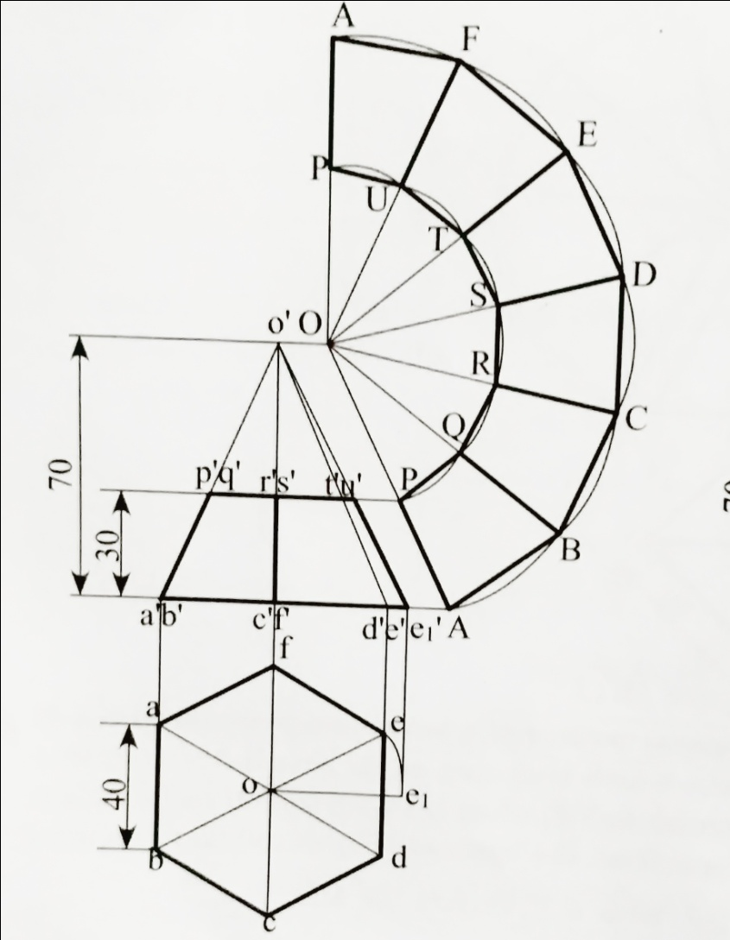
12. Draw the development of lateral surface of a hexagonal pyramid with a 40 mm base side and a 70 mm long axis, which is resting on its base in the H.P. such that an edge of the base is perpendicular to V.P. when a horizontal section plane cuts the pyramid at a height of 30 mm from the base.

Slide 14
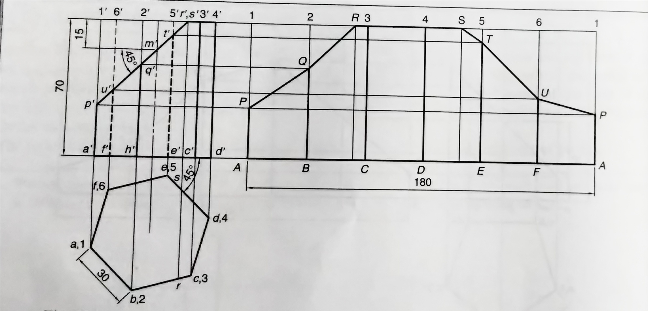
15. A hexagonal prism, having base with a 30 mm side and a 70 mm axis, is resting on its base on the ground with a side of base inclined at 45° to the V.P. It is cut by an auxiliary inclined plane making an angle of 45° with the H.P. and passing through a point 15 mm below the top end of the axis. Obtain the development of the lateral surface of the truncated prism.

