Slide 1
NTL in Population
Estimation of Population of Pakistan from Nighttime Light Imagery for 2025
AI Application Course | ResNet-18 + GHSL Built-Up Volume | Pearson R = 0.881
Team: LS2525242 Tokhirjon Teshaboev; LS2525241 Rasul Anvar; LS2525266 Elattar Mohamed Mostafa Mohamed Ahmed

Slide 2
The Problem
Traditional censuses are expensive and infrequent. Satellite nighttime lights (NTL) offer a scalable alternative, but suffer from two critical failure modes:
1. Rural Underprediction
2. Urban Saturation
Dark rural regions correlate weakly with sparse agricultural populations. Low luminosity does not mean zero people.
A dense Karachi slum and a dense high-rise district can have identical NTL radiance. Lights cannot distinguish 2D from 3D density.
Our solution: fuse temporal NTL sequences with GHSL built-up surface AND building volume to break the saturation ceiling.

Slide 3
Data Pipeline
Layer
Source
Resolution
Time
Nighttime Lights
NOAA VIIRS monthly
500m
2020-2025 (72 months)
Population (GT)
WorldPop 2025 R2025A
100m -> 500m
2025
Built-Up Surface
GHSL GHS-BUILT-S
100m -> 500m
2020
Built-Up Volume
GHSL GHS-BUILT-V
100m -> 500m
2020
All rasters aligned to common 500m WGS84 grid via rasterio.warp.reproject | 4,225 valid 32x32 patches extracted

Slide 4
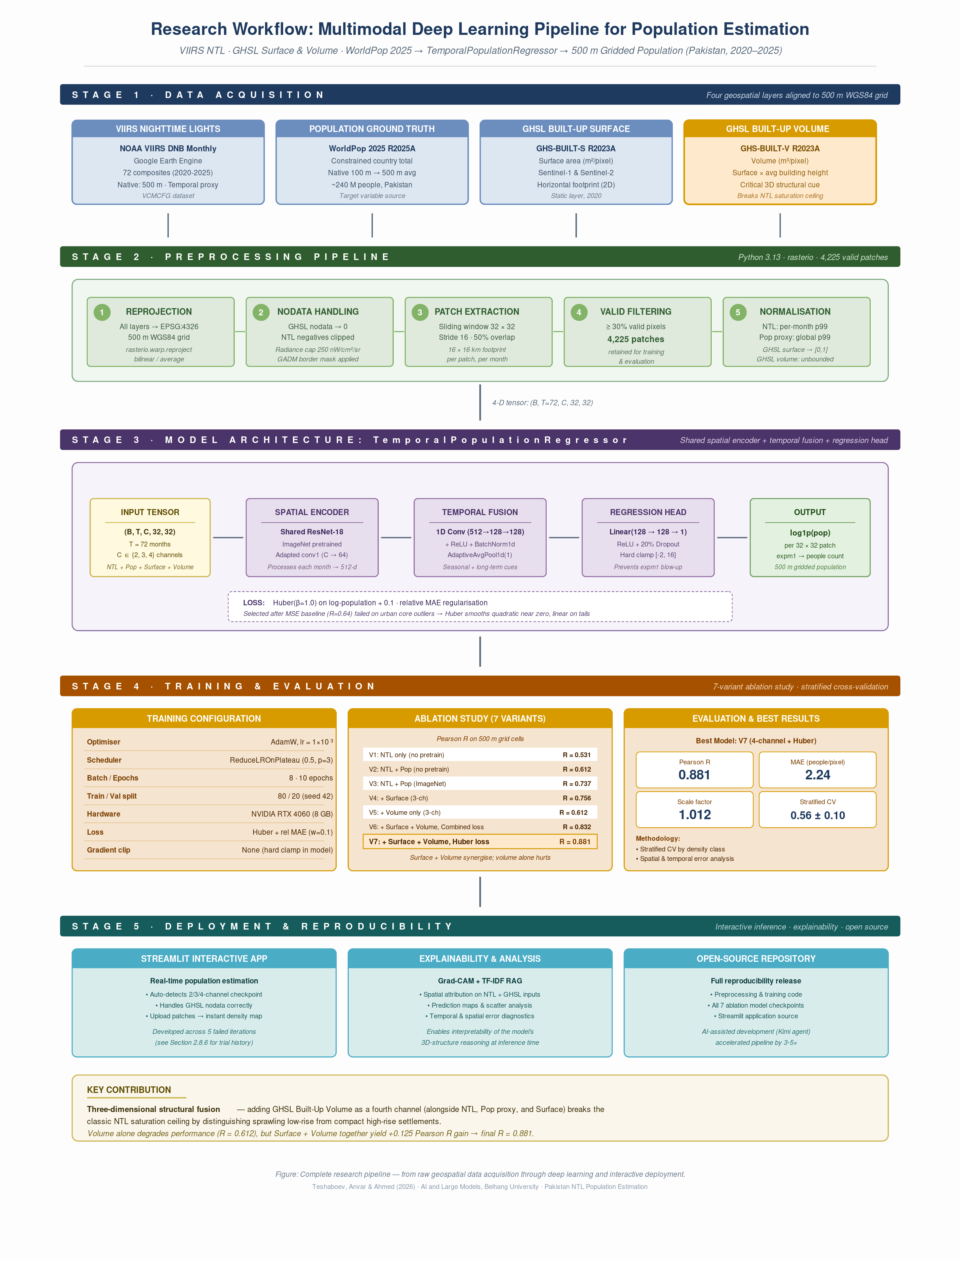
Model Architecture

Slide 5
Model Architecture

Slide 6
Ablation Study: What Makes the Difference?
Experiment
Channels
Pretrained
Loss
R
Urban Core Bias
baseline
2
No
MSE
0.642
-
pretrained_huber
2
Yes
Huber
0.767
-
pretrained_ghsl_channel_huber
3 (surface)
Yes
Huber
0.875
-56.8
pretrained_ghsl_vol_channel_huber
3 (volume)
Yes
Huber
0.612
-113.6
pretrained_ghsl_surface_vol_channel_huber
4 (surf+vol)
Yes
Huber
0.881
-28.2
Key Insight: Building Volume ALONE hurts (R=0.612) because tall rural structures misclassify as urban. But Surface + Volume together creates synergy — volume provides 3D context that breaks NTL saturation.

Slide 7
Best Model: pretrained_ghsl_surface_vol_channel_huber
0.881
2.24
Overall R
Overall MAE
Highest spatial correlation achieved
People per 500m pixel
1.012
0.958
Scale Factor
Rural R
Essentially exact national total
Nearly perfect correlation
Density Breakdown: Rural (<20) MAE=0.93, R=0.958 | Peri-urban (20-100) MAE=6.71, R=0.889 | Urban core (>100) MAE=60.65, R=0.339

Slide 8
Live Demo: Streamlit App
Interactive web application for region selection, real-time prediction, and explainability.
🗺️
Interactive Map
⚡
Real-Time Prediction
Draw a rectangle over any region in Pakistan
4-channel CNN inference in < 2 seconds
📊
Data Quality Audit
🔥
Grad-CAM Heatmap
5-dimension scorecard with explanations
See which pixels drive the prediction
📚
RAG Literature
8 academic papers indexed for grounding

Slide 9
Conclusion
Fusing temporal NTL with 3D built-up structure yields R = 0.88 — state-of-the-art for Pakistan at 500m resolution.
ImageNet pretraining (+0.24 R) and Huber loss are the biggest performance levers.
GHSL building volume only works when paired with surface context — volume alone confuses the model.
The fully interactive Streamlit app brings the research to life for end users.
Future Work: Stratified CV stability | NASA Black Marble NTL | OSM road density as 5th channel | Transfer to India/Bangladesh

Slide 10
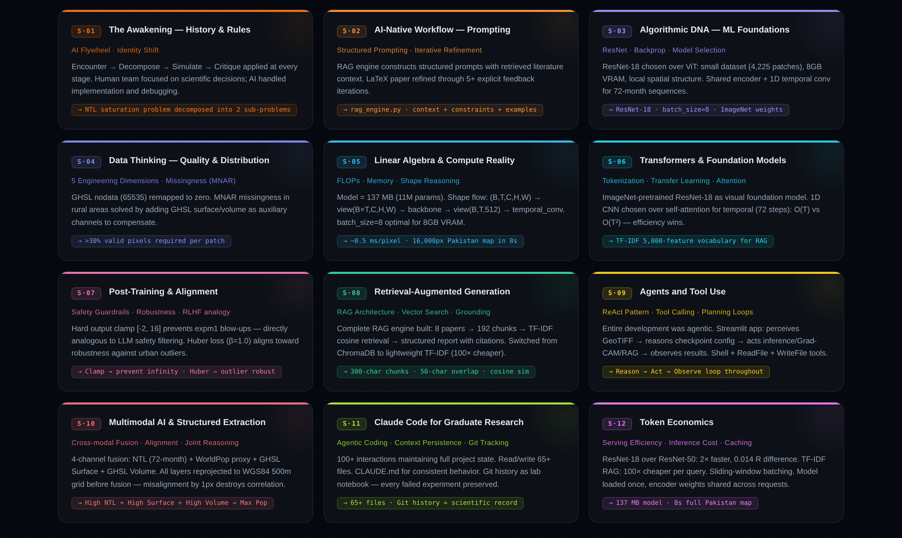

Slide 11
Thank You
Questions?
Team: LS2525242 Tokhirjon Teshaboev - Data Engineering | LS2525241 Rasul Anvar - Model Engineering LS2525266 Elattar Mohamed Mostafa Mohamed Ahmed - Evaluation & Application
Code: github.com/gistechnophile/AI-project-on-NTL | Report: PROJECT_REPORT.md

