Slide 1
Mental Health Predictor
in the Scope of Race and Economic Crisis in America
Chris Coble
7/30/2024

Slide 2
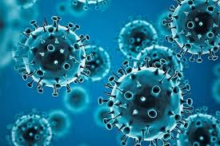
Why is mental health important?
What does Race and Economic Crisis have to do with mental health?
Mental health is costly: suffering, medication, hospitalization, violence, accidents, etc.
COVID 19 wreaked havoc on the economy, society, and mental health as well
Disproportionate effects across racial groups
https://www.who.int/health-topics/coronavirus#tab=tab_1
https://www.cdc.gov/mentalhealth/learn/index.htm

Slide 3

Why did I make this model?
Visualize and predict different mental health patterns in different racial groups in the US
Use this tool to make predictions about the mental health score of different groups in the future
Estimate the impact and incentivise government to prepare resources, create prevention methods
https://www.aarp.org/health/conditions-treatments/info-2020/find-mental-health-therapist.html

Slide 4
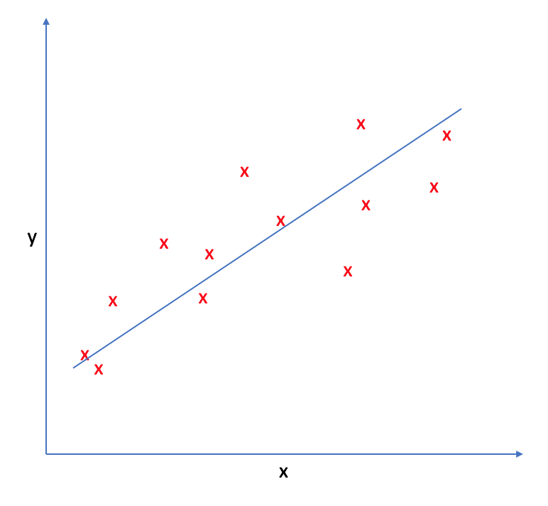
How does the model work?
Use data from two sources: NCHS and BLS
Provides data on mental health scores, employment statistics, test indication, date of test, and racial identity
Linear regression modeling to get a continuous output akin to a mental health survey score (0-48)
Prediction with Regression
https://www.jeremyjordan.me/linear-regression/

Slide 5
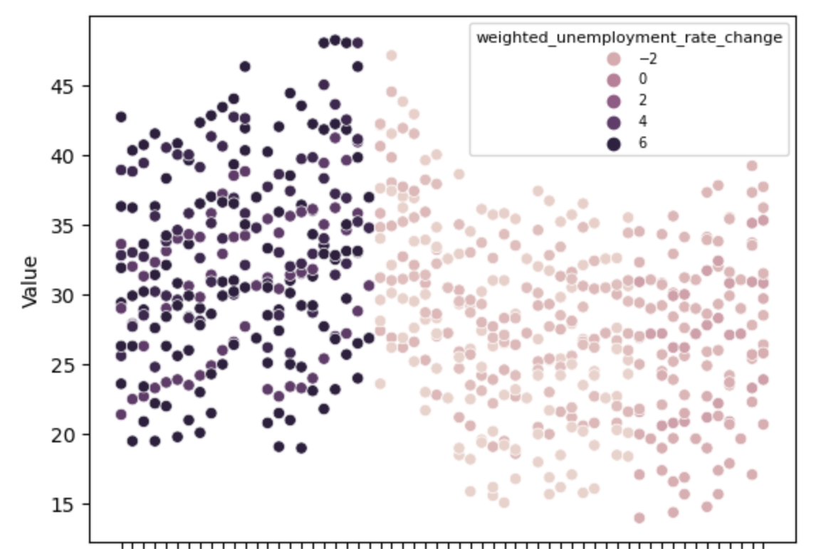
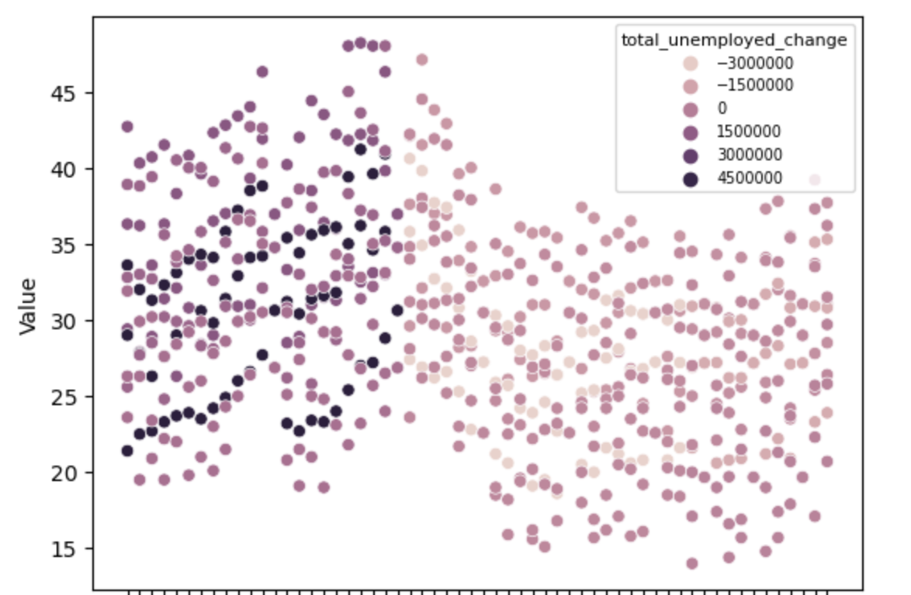
Mental Health Suffers as the Economy Worsens and Vice Versa
The higher the value (y-axis), the worse the mental health
Mental Health Survey Scores in Correlation with Unemployment Stats from 2020 - 2022
2020 : 2022

Slide 6
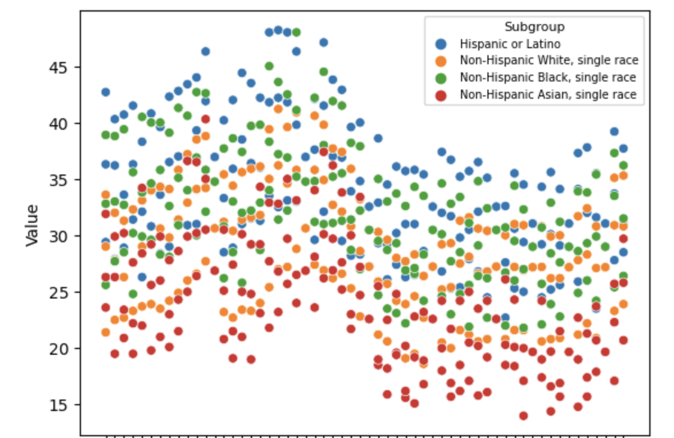
Hispanic/Latino and Black Americans are worst affected groups
Mental Health Survey Scores in Correlation with Racial Groupings from 2020 - 2022
2020 : 2022

Slide 7



Models deployed:
Ordinary Least Squares
Ridge Regression
Lasso Regression
Random Forest Regression
K Neighbors Regression
Support Vector Machine Regression
Gradient Boosting Regression
Deep Neural Network
https://www.statsmodels.org/stable/about.html
https://scikit-learn.org/stable/
https://www.tensorflow.org/

Slide 8
Model Training Results
Model | R_Squared | Root_Mean_Squared_Error
Ordinary_Least_Squares | 0.07267146928 | 6.034206296
Ridge | 0.7311340333 | 3.285131356
Lasso | 0.7621064319 | 3.344189157
Random_Forest | 0.7223852013 | 3.418525669
K_Neighbors | 0.7991674969 | 3.383203504
Gradient_Boosting | 0.7573394553 | 3.136241371
Support_Vector_Machine | 0.7517927508 | 3.442532139
Deep_Neural_Network | 0.7567943633 | 3.260544893
Best Performers: K Neighbors, Lasso, Gradient Boosting
Worst Performers: Random Forest, OLS
Moving on to predictions: K Neighbors, Lasso, Random Forest

Slide 9
Random Forest has lowest RMSE
Input (race, unemployment rate change, unemployment change) | k_neigh_pred | k_neigh_rmse | lasso_pred | lasso_rmse | random_forest_pred | random_forest_rmse
('Non-Hispanic Asian, single race', -8, -1600000) | 28.14675926 | 3.991439772 | 19.18704742 | 3.350900703 | 22.02397279 | 3.151577098
('Non-Hispanic White, single race', 6, 1200000) | 32.57837302 | 3.991439772 | 27.29705261 | 3.350900703 | 28.09523783 | 3.150674245
('Non-Hispanic Black, single race', -10, -2000000) | 30.00601852 | 3.991439772 | 30.67171914 | 3.350900703 | 32.48163954 | 3.151489829
('Hispanic or Latino', -4, -800000) | 35.13611111 | 3.991439772 | 35.97558854 | 3.350900703 | 36.56877692 | 3.150958577
('Non-Hispanic Asian, single race', -8, -1600000) | 31.20601852 | 3.991439772 | 23.59062168 | 3.350900703 | 27.11449451 | 3.151574778
('Non-Hispanic Black, single race', -2, -400000) | 25.91020833 | 3.991439772 | 30.50641028 | 3.350900703 | 29.00319931 | 3.151458517
('Hispanic or Latino', -6, -1200000) | 30.280625 | 3.991439772 | 26.22100861 | 3.350900703 | 28.08337061 | 3.15093888
('Non-Hispanic White, single race', -4, -800000) | 35.13611111 | 3.991439772 | 30.69423444 | 3.350900703 | 36.02932606 | 3.15109599
('Non-Hispanic Asian, single race', 0, 0) | 22.475 | 3.991439772 | 27.82888709 | 3.350900703 | 22.15838443 | 3.15068413
Positive takeaway: unemployment rate decrease will greatly aid Latino/Hispanic scores

Slide 10
Analysis and commentary
This data seems is vital to general US social wellbeing
Not only did EDA show how unemployment rate increase negatively impact mental health score, but also random inputs for models show the reverse for Latino/Black groups (moving away from high 30s- to low 30s/20s)
Government can use this to aid racial minority groups with mental health resources

Slide 11
Future work
More data, specifically, try to gather information from 2008 housing crisis and H1N1 2009 pandemic
Try to run the model without the indicator one hot encoded as see how model runs
Add information on mental health costs: hospitalizations, medications, etc. and use this info to predict costs based off of mental health score

