Slide 1
GI Neuroendocrine Tumors

Slide 2
Gastric Neuroendocrine Tumors
Category | Differentiation | Grade | Mitotic Rate | Ki-67 Index
NET - Grade 1 | Well-diff | Low | <2 | <3%
NET - Grade 2 | Well-diff | Intermed | 2-20 | 3-20%
NET - Grade 3 | Well-diff | High | >20 | >20%
NEC - Large Cell | Poorly | High | >20 | >20%
NEC - Small Cell | Poorly | High | >20 | >20%
MiNEN | Variable | Variable | Variable | Variable

Slide 3
Mixed Neuroendocrine - Nonneuroendocrine Neoplasms
Reference Here

Slide 4
Somatostatin Receptor (SSTR) PET for Staging
Frequently performed with ⁶⁸Ga-DOTATATE Most useful for poorly-differentiated or high-grade tumors Less helpful for small tumors

Slide 5
Gastric Neuroendocrine Tumors
Type 1 Multifocal Tumors - Driven by atrophic gastritis (70–80% of gastric NETs):
Atrophic gastritis $→$ $↓$ gastric acid ($↑$pH) $→$ $↑$ gastrin from G cells
Gastrin is trophic for enterchromaffin-like (ECL) cells $→$ Neuroendocrine tumors
Small (<1 cm), multifocal, well-differentiated, indolent
Type 2 Multifocal Tumors - Driven by Zollinger-Ellison Syndrome (rare)
Gastrinoma produces high levels of gastrin and low gastric pH
Generally have accompanying ulcer disease
Type 3 Sporadic Tumors - Autonomous growth (normal pH and normal gastrin)
Highest metastatic potential; most aggressive subtype

Slide 6
Gastric Neuroendocrine Tumors
Type 1 Multifocal Tumors - Driven by atrophic gastritis (70–80% of gastric NETs):
Atrophic gastritis $→$ $↓$ gastric acid ($↑$pH) $→$ $↑$ gastrin from G cells
Gastrin is trophic for enterchromaffin-like (ECL) cells $→$ Neuroendocrine tumors
Small (<1 cm), multifocal, well-differentiated, indolent
Small tumors <1cm: Endoscopic resection
Tumors 1-2cm: Endoscopic mucosal resection (EMR) or Endoscopic Submucosal Disssection (ESD)
High risk tumors (>2cm, Node⁺, Grade 3, muscle invasion): Surgical resection

Slide 7
Gastric Neuroendocrine Tumors
Type 2 Multifocal Tumors - Driven by Zollinger-Ellison Syndrome (rare)
Gastrinoma produces high levels of gastrin and low gastric pH
Generally have accompanying ulcer disease
Localization of gastrinoma (and resection) critical to treatment

Slide 8
Gastric Neuroendocrine Tumors
Type 3 Sporadic Tumors - Autonomous growth (normal pH and normal gastrin)
Highest metastatic potential; most aggressive subtype
Small tumors <1cm: Endoscopic resection
High risk tumors: Surgical resection with node dissection

Slide 9
Mixed Neuroendocrine / Nonneuroendocrine Neoplasms
Tumors showing neuroendocrine and nonneuroendocrine differentiation
Tend to be aggressive with liver and nodal metastasis
Origin from a single stem cell that then gives rise to two differentaition paths
Small tumors treated with surgery
Larger tumors treated with chemotherapy
Also known as Mixed Adenoneuroendocrine Carcinoma (MANEC)
(jacob721?)

Slide 10
Lutathera Lu¹⁷⁷-dotatate
Radioactive-tagged dotatate (artificial somatostatin analogue)
Indicated for treatment of somatostatin recpetor (SSTR)-positive tumors
Gastroenterohepatic neuroendocrine tumors of foregut, midgut, and hindgut
Dosed IV every 8 weeks x 4 doses, folloed by long-acting octreoride every 4 weeks

Slide 11
NETTER-1 clinical trial
 | ¹⁷⁷Lu-dotatate | Control
Progression-free survival @ 20mo | 65% | 11%
Median PFS | (not reached) | 8.4mo
Objective Response Rate | 18% | 3%
Overall Survival Median | 48mo | 33mo
Eligibility criteria:
Neuroendocrine tumors
Ki-67 index $$20%
OctreoScan positive in all lesions
Disease progression on standard-dose octroetide
Randomized:
¹⁷⁷Lu-dotatate q8 weeks x4 + octreotide LAR 30mg IM OR
Octreotide LAR 60mg IM every4 weeks

Slide 12
Survival difference was likely diluted by crossovers at progression
More pronounced survival benefit for patients with KPS 60-80

Slide 13
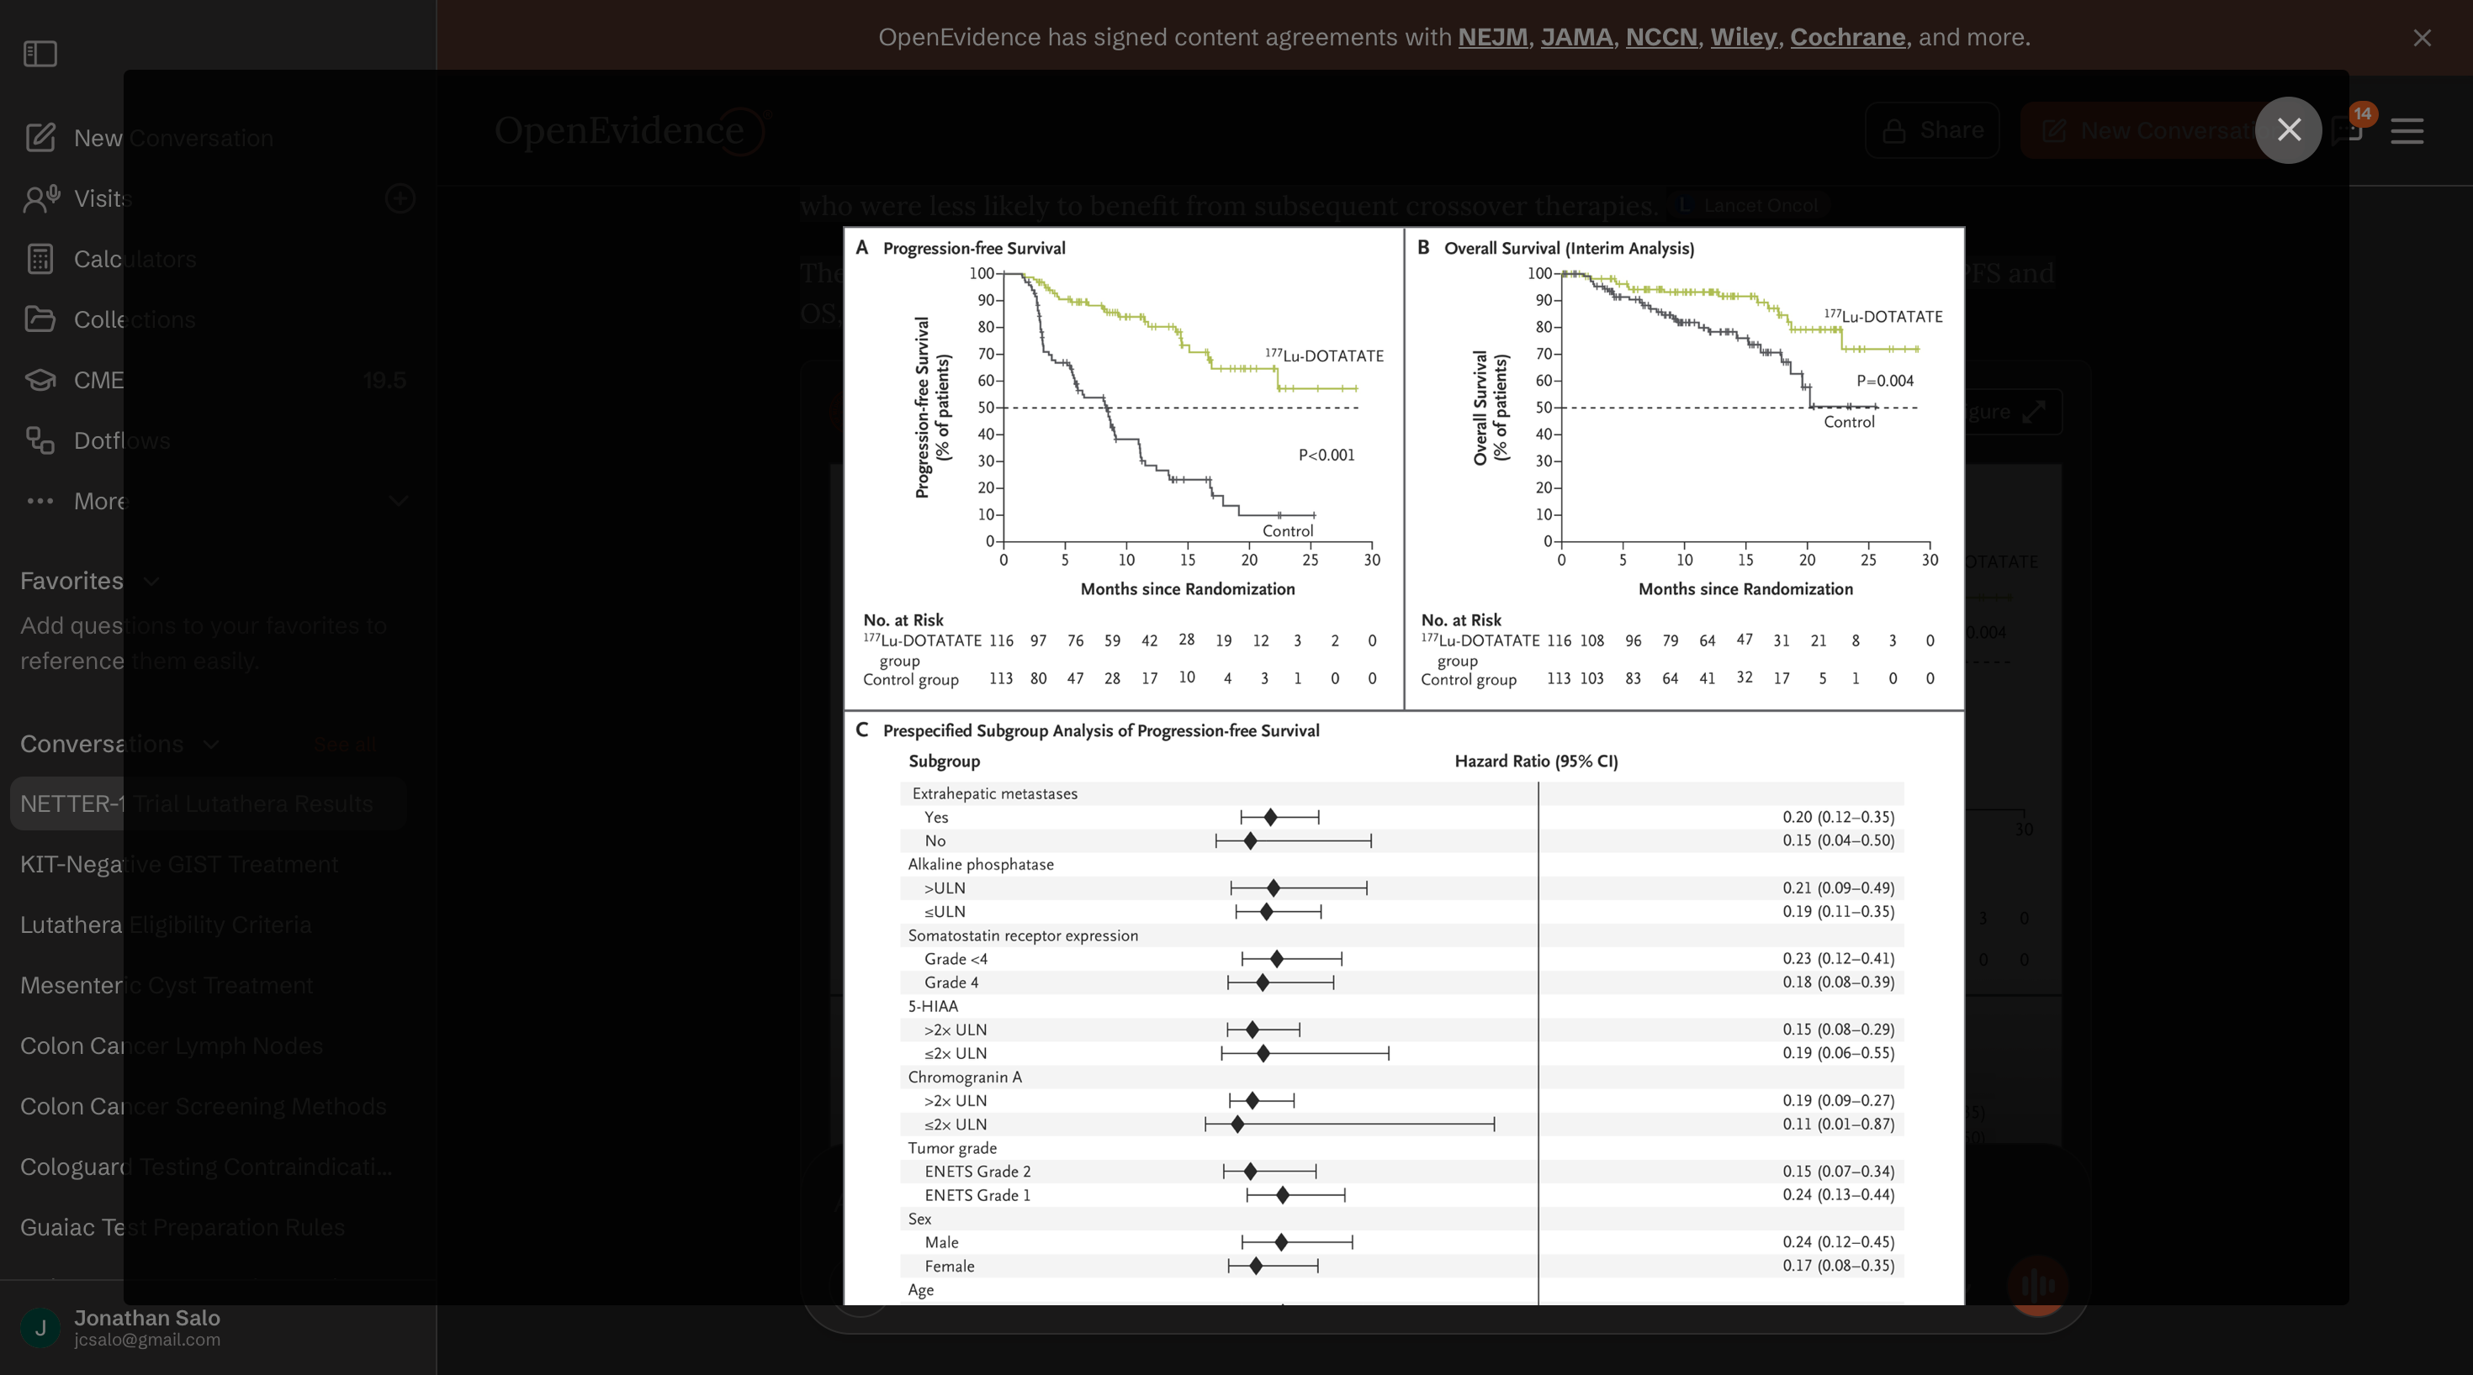
NETTER-1

Slide 14
Lutathera indications for GI/Pancreatic tumors
Well differentiated (Grade 1/2) tumors
Progression on octreodide LAR or lanreotide
Significant tumor burden and Ki-67 index $$10% (first line)
Well differentiated Grade 3 tumors
Favorable biology (Ki-67 10%-55%) - supported by NETTER-2 clinical trial
Impact of Liver Tumour Burden, Alkaline Phosphatase Elevation, and Target Lesion Size on Treatment Outcomes With Lu-Dotatate: An Analysis of the NETTER-1 Study. European Journal of Nuclear Medicine and Molecular Imaging. 2020. Strosberg J, Kunz PL, Hendifar A, et al.’
Cost-Effectiveness of [177Lu]Lu-Dotatate for the Treatment of Newly Diagnosed Advanced Gastroenteropancreatic Neuroendocrine Tumors: An Analysis Based on Results of the NETTER-2 Trial. Journal of Nuclear Medicine : Official Publication, Society of Nuclear Medicine. 2025. Holzgreve A, Unterrainer LM, Tiling M, et al.

Slide 15
Netter-2 Trial - Grade 2/3 Neuroendocrine tumors
226 Patients with higher grade 2 (Ki67 ≥10% and ≤20%) and grade 3 (Ki67 >20% and ≤55%), somatostatin receptor-positive gastroenteropancreatic neuroendocrine tumours
Treated with 4 cycles of Lutathera $→$ Octreotide 30mg IM q4 wk
vs
Octreotide 60mg IM q4wk
Progression-free survival with Lutathera was 22.8mo (vs 8.5mo)
$⇒$ Lutathera is indicated for first-line therapy of higer grade neuroendocrine tumors
(singh2807?)

