Slide 1
Colon Cancer

Slide 2
Category | Stage | Treatment
[Dyplasia] | Tis | Radiofrequency Ablation
[Superficial Tumors] | T1a | Endoscopic Therapy
[Localized Tumors] | T1b T2 | Surgery
Locally-advanced | T3 or N⁺ | ChemoRT → Surgery
Metastatic | M1 | Chemotherapy +/- Radiation
Gastrograffin Challange for malignant small bowel obstruction
(Wan Bahrum et al. 2024)
GI Stromal Tumors
Pathophysiology

Slide 3
(Schaefer, DeMatteo, and Serrano 2022)
Pathophysiology

Slide 4
Origin with bowel wall stomach- small intestine - colon - esophagus
Tyrosine kinase gain of function mutations - KIT2 - PDGRFA3 Genetic inactivation - NF14 - succinate dehydrogenase (SDH)

Slide 5
(Shaheen et al. 2009)
Rapido Trial

Slide 6
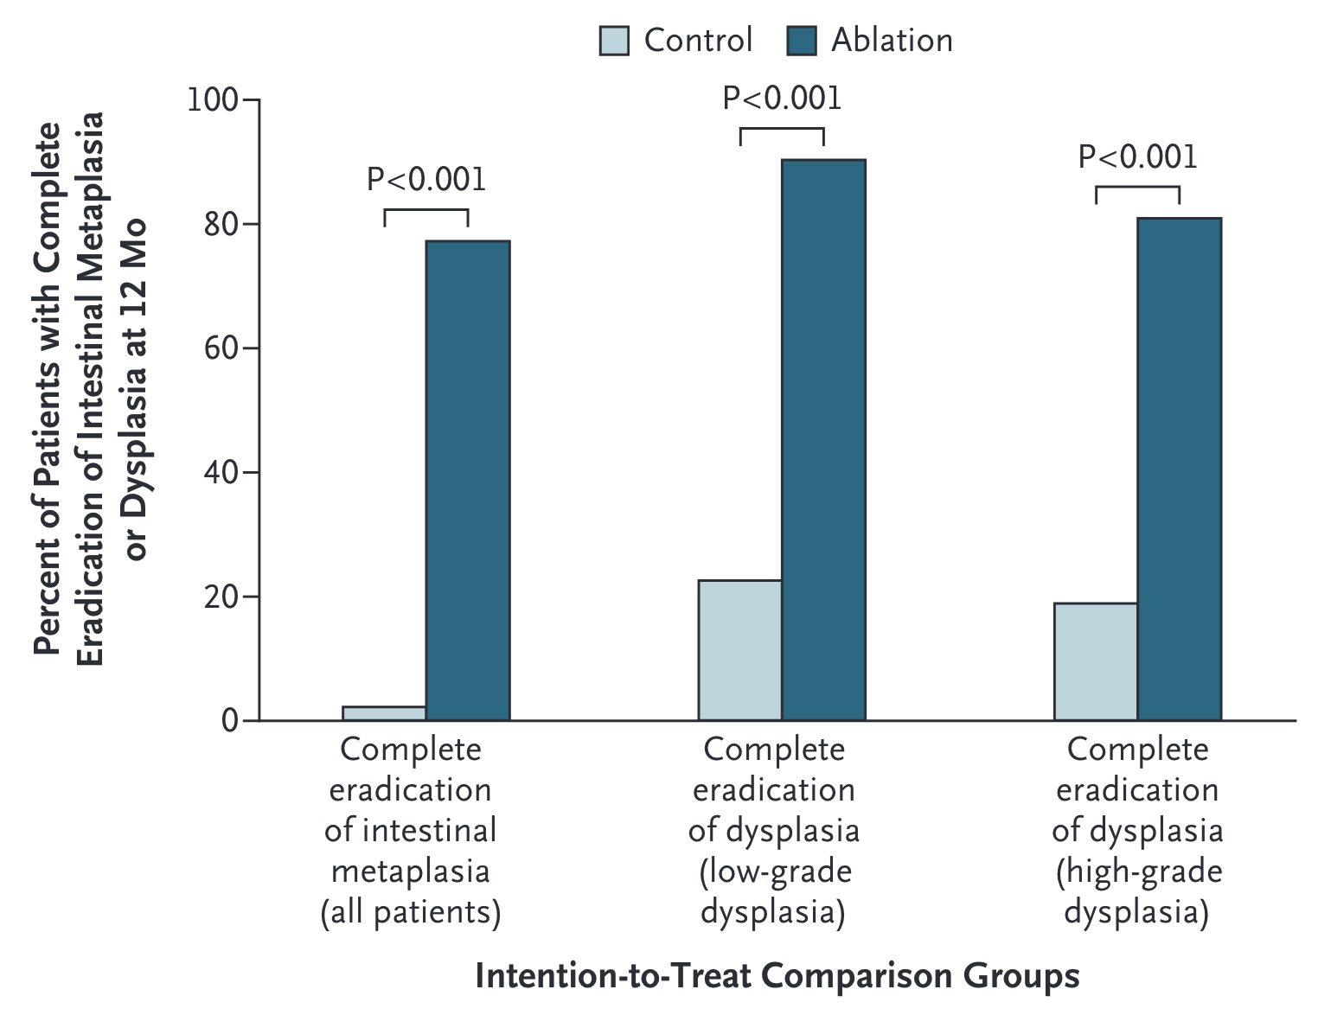
Short-course RT $→$ Chemo $→$ Surgery vs ChemoRT $→$ TME +/- Chemo

Slide 7
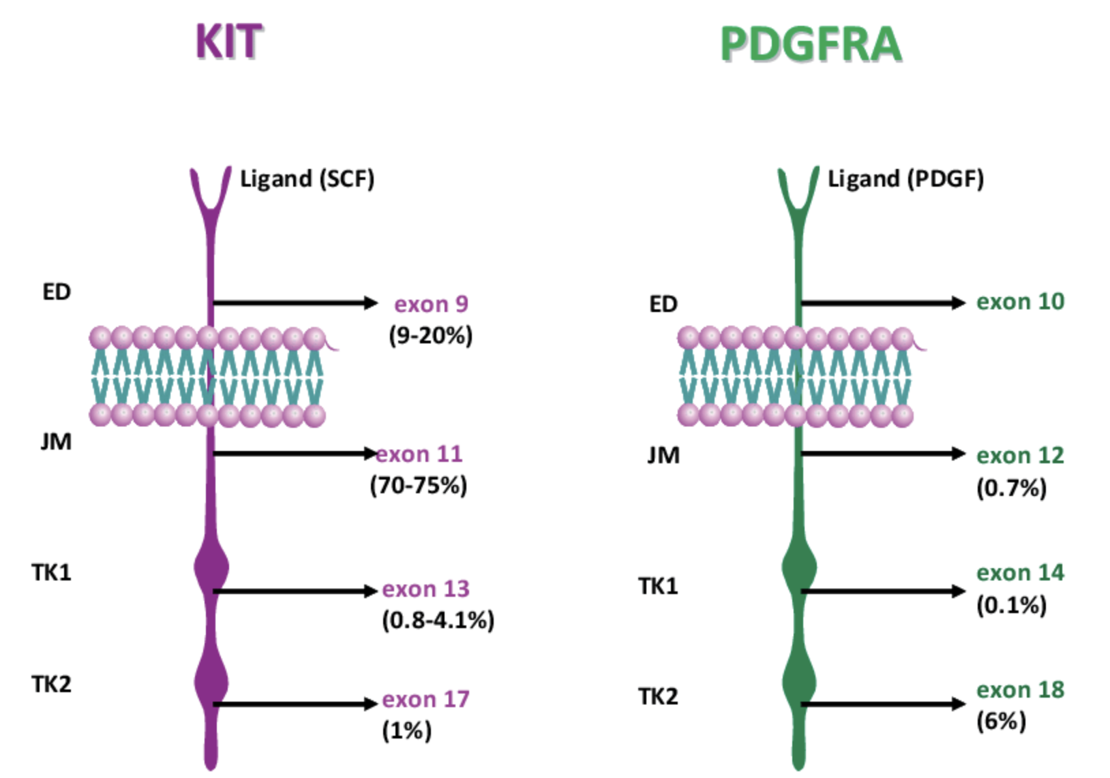
Lancet Oncol December 7, 2020
Total Neoadjuvant Therapy
Induction Chemotherapy
Consolidation Chemotherapy
KIT and PDGFR Mutations

Slide 8
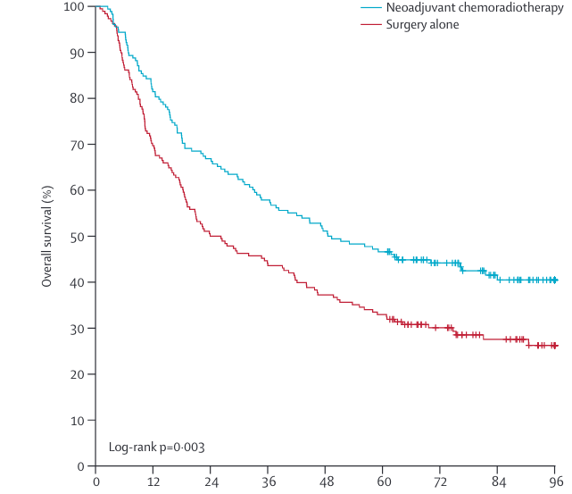
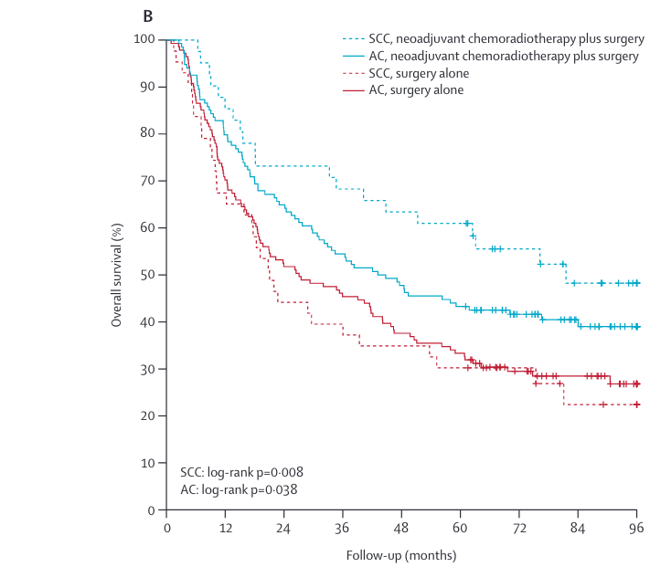
Joensuu Lancet March 2012
CROSS - Survival by Histology
Miettinen Lasota Seminars in Diagnostic Pathology 2006:23:70-83
CROSS - Pathologic Response
pCR seen in 23% of patients with adenocarcinoma
pCR seen in 40% of patients with squamous cell carcinoma
(Shapiro et al. 2015)
CROSS - Sites of Failure
EORTC 22921
Bossset Lancet Oncol p 184 2014
Prodige 23
PHase 3 RCT n=461
mFOLFIRINOX -> CRT -> Surgery -> Adjuvant Chemo
Patients with dysphagia almost always are T3 tumors (and don’t need EUS)
Symptomatic Tumors (Dysphagia)
Patients with dysphagia to solids or weight loss or tumor length >3cm are unlikely to have T1-2 tumors and can be initially evaluated with [PET Scan]
Disease confined to the esophagus and regional nodes $→$ Locally-advanced
Metastatic disease $→$ Metastatic
N3 $→$ induction chemotherapy followed by chemoradiation and surgical evaluation.
ACOSOG ZZ9001
GIST Tumors >3cm randomized: - 1 year of imatinib 40mg - Observation
Recurrence-free survival 98% vs 83% No significant difference at 6 years
Imatinib may simply delay recurrences
Ref
SSG SVII
High-risk GIST randomized: - 1 year of imatinib 400mg - 3 year of imatinib 400mg
5-year Recurrence-free survival 48% vs 66% 5-year Overall Survival 82% vs 92%
Ref
Mutational Testing
Genetic mutations can predict respoinse to imatinib ¹
Locally-advanced
For patients with locally-advanced esophageal cancer, improved survival with adjunctive therapy. There are two options:
ChemoRT $→$ Surgery ([CROSS Trial])
Chemo $→$ Surgery $→$ Chemo (EsoPEC Trial)
Positive Margins
368 esophageal cancer patients randomized:
Surgery alone
Chemo+RT $→$ Surgery
75% adenocarcinoma
T3: 80%. T2: 17%
median age=60
longer survival with Chemo+RT $→$ Surgery
Gronchi JAMA Surg 2020
Imatinib 1yr vs 3 yr
368 esophageal cancer patients randomized:
Surgery alone
Chemo+RT $→$ Surgery
75% adenocarcinoma
T3: 80%. T2: 17%
median age=60
longer survival with Chemo+RT $→$ Surgery
Joensuu JAMA Oncology 2020
Wild-Type GIST
SDH-Deficient
SDHx mutation
SDH wild-type
Associated with Carney-Stratakis syndrome
No SDH Deficiency
NF1-GIST
Sporadic Wild-Type GIST
Weldon JCS 2017
NF1-associated GIST
Multicentric (33%)
Median age 46
Small bowel >> Duodenum >> Stomach
Weldon JCS 2017
Recurrence Risk
Surgery vs ChemoRT $→$ Surgery
Surgery vs ChemoRT $→$ Surgery

Slide 9
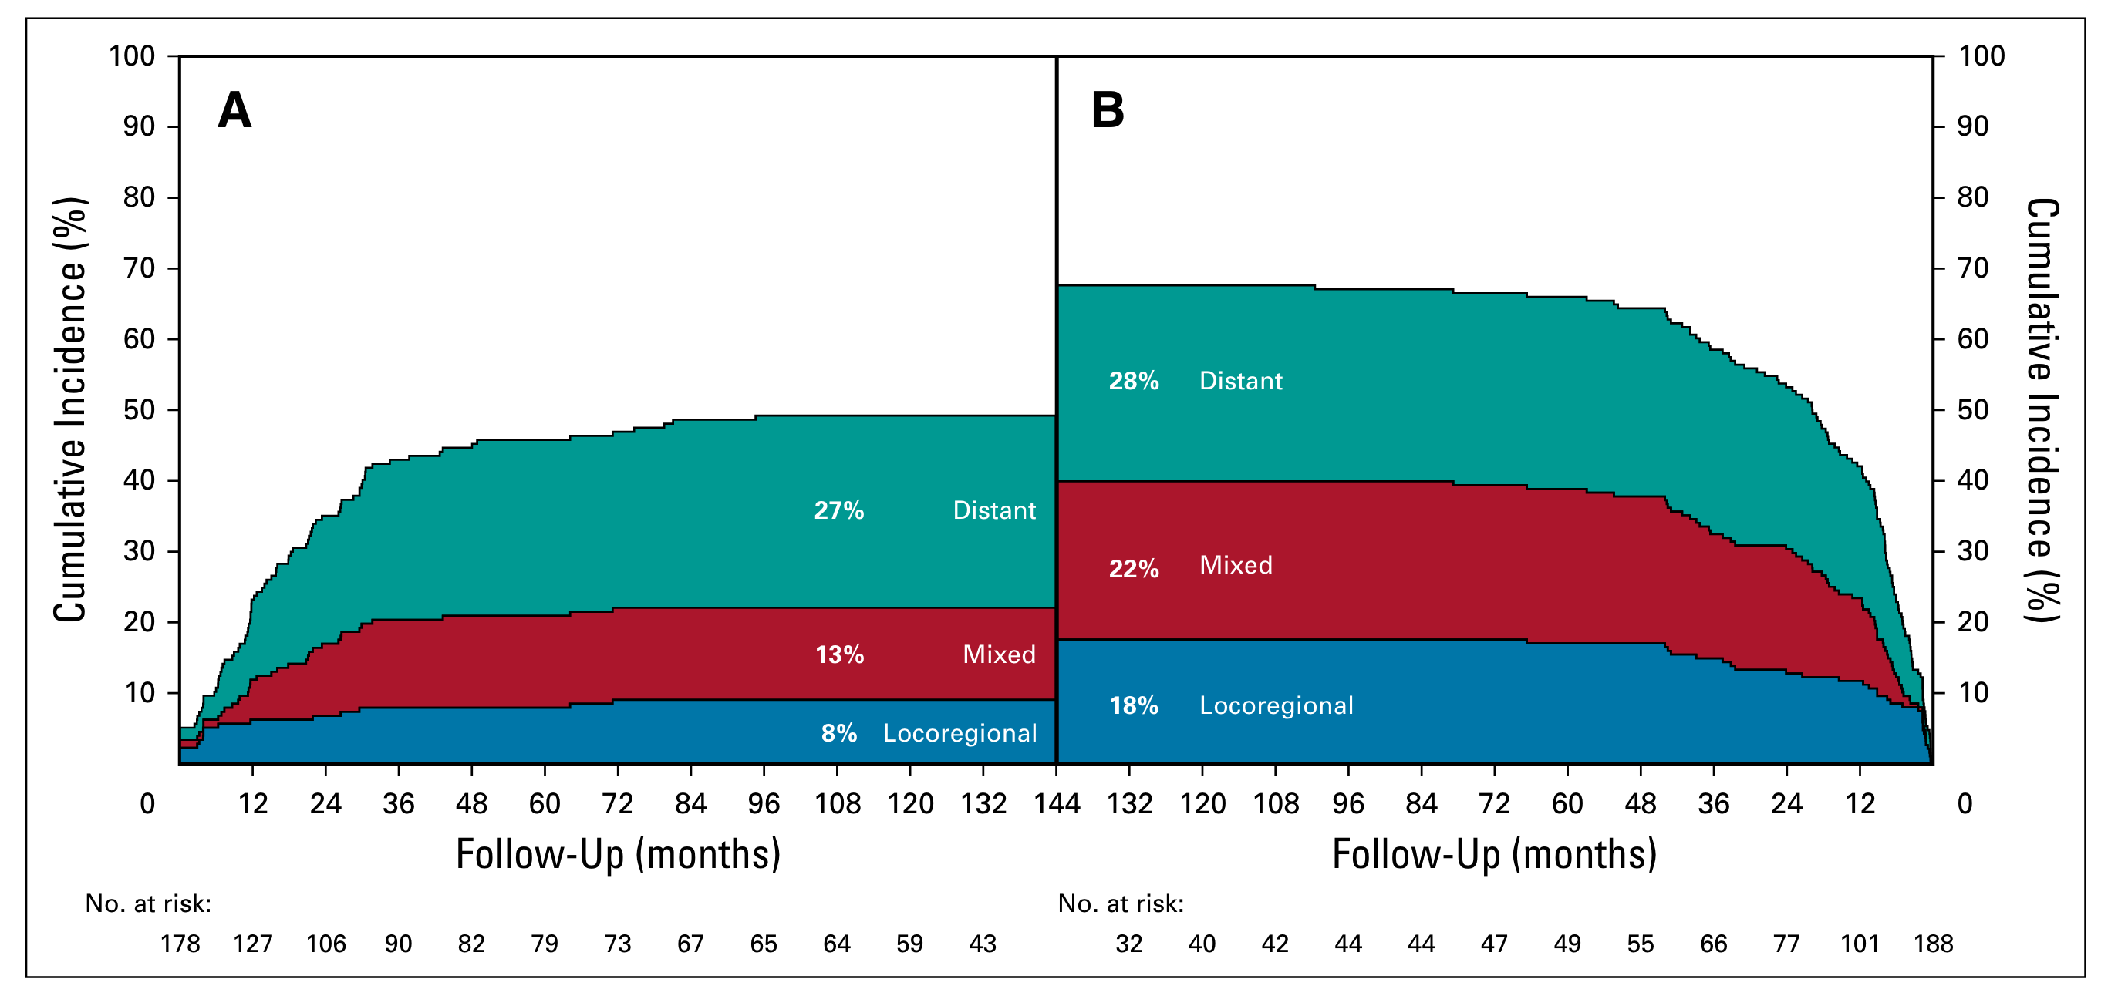
Sites of failure over time
ChemoRT + Surgery vs Surgery
ChemoRT appears to reduce risk of local or local+distant failure, but not isolated distant failure

Slide 10
(Shapiro et al. 2015)
Checkmate 577 Trial
Immunotherapy with nivolumab as adjuvant therapy after CROSS regimen for patients with residual disease
(Kelly et al. 2021)
Nivolumab

Slide 11
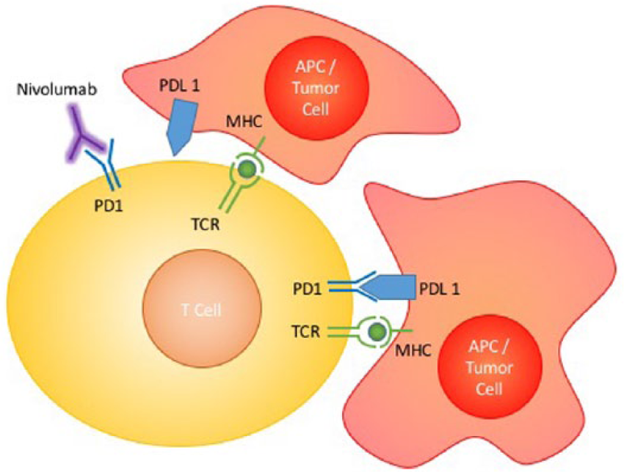
PD-L1 agonist ligand
Interferes with tumor cell down-regulation of T cells
Active against stage IV esophageal cancer
Nivolumab mechanism of action

Slide 12
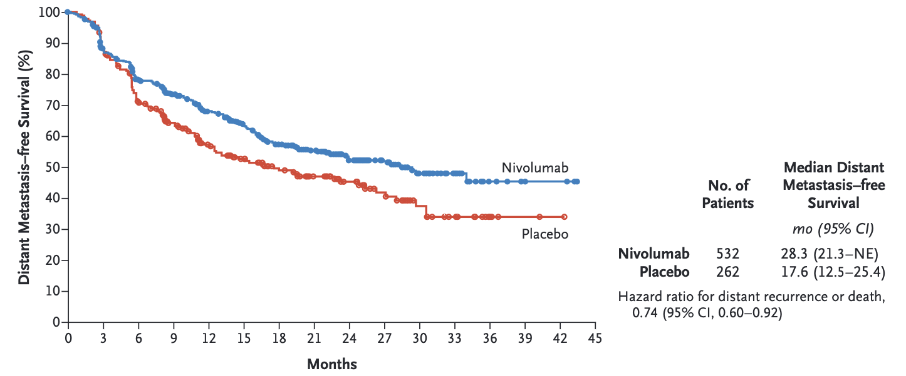
(Kelly et al. 2021)
Neoadjuvant Chemo for EsoCA
MAGIC trial (gastric): ECF²$→$Surgery$→$ECF vs Surgery
OEO2 Trial: (esophageal) Chemo$→$Surgery$→$ Chemo vs Surgery
FLOT (gastric): FLOT³$→$Surgery$→$ FLOT vs ECF$→$Surgery$→$ECF
EsoPEC: (esophageal):FLOT$→$Surgery$→$FLOT vs ChemoRT$→$Surgery (CROSS)
OEO2 Clinical Trial
802 Esophageal adenocarcinoma and squamous cell
Randomized to Chemo $→$ Surgery $→$ Chemo vs Surgery alone
Chemotherapy with ECF (Epirubicin, Cisplatin, 5FU)
5-year survival 23% for chemo+surgery vs 17% for surgery (HR 0.84 p=0.03)
(Allum et al. 2009)
EsoPEC Trial
Esophageal cancer
Randomized to CROSS vs FLOT
Better survival with FLOT
Metastatic
FOLFOX is first-line systemic therapy for metastatic GI cancers
Dose-limiting toxicity is frequently peripheral neuropathy
Chekmate 577 Trial
EsoCA patients who received ChemoRT$→$ Surgery with residual disease (not pCR)
Randomized to one year of immunotherapy (nivolumab) vs Observation
Adjuvant nivolumab group had better survival
(Kelly et al. 2021)
Checkmate 577 Trial
Adjuvant Nivolumab vs Observation

Slide 13

Orientation Manual

Slide 14
References
Allum, William H., Sally P. Stenning, John Bancewicz, Peter I. Clark, and Ruth E. Langley. 2009. “Long-Term Results of a Randomized Trial of Surgery with or Without Preoperative Chemotherapy in Esophageal Cancer.” Journal of Clinical Oncology: Official Journal of the American Society of Clinical Oncology 27 (30): 5062–67. https://doi.org/10.1200/JCO.2009.22.2083.
Kelly, Ronan J., Jaffer A. Ajani, Jaroslaw Kuzdzal, Thomas Zander, Eric Van Cutsem, Guillaume Piessen, Guillermo Mendez, et al. 2021. “Adjuvant Nivolumab in Resected Esophageal or Gastroesophageal Junction Cancer.” The New England Journal of Medicine 384 (13): 1191–1203. https://doi.org/10.1056/NEJMoa2032125.
Schaefer, Inga-Marie, Ronald P. DeMatteo, and César Serrano. 2022. “The GIST of Advances in Treatment of Advanced Gastrointestinal Stromal Tumor.” American Society of Clinical Oncology Educational Book. American Society of Clinical Oncology. Annual Meeting 42 (April): 1–15. https://doi.org/10.1200/EDBK_351231.
Shaheen, Nicholas J., Prateek Sharma, Bergein F. Overholt, Herbert C. Wolfsen, Richard E. Sampliner, Kenneth K. Wang, Joseph A. Galanko, et al. 2009. “Radiofrequency Ablation in Barrett’s Esophagus with Dysplasia.” The New England Journal of Medicine 360 (22): 2277–88. https://doi.org/10.1056/NEJMoa0808145.
Shapiro, Joel, J. Jan B. van Lanschot, Maarten C. C. M. Hulshof, Pieter van Hagen, Mark I. van Berge Henegouwen, Bas P. L. Wijnhoven, Hanneke W. M. van Laarhoven, et al. 2015. “Neoadjuvant Chemoradiotherapy Plus Surgery Versus Surgery Alone for Oesophageal or Junctional Cancer (CROSS): Long-Term Results of a Randomised Controlled Trial.” The Lancet. Oncology 16 (9): 1090–98. https://doi.org/10.1016/S1470-2045(15)00040-6.
Wan Bahrum, Wan Fadzrul Izuan Bin, Janet Hardy, Karyn Foster, and Phillip Good. 2024. “Oral Water-Soluble Contrast for Malignant Bowel Obstruction: Open Label Pilot Study.” BMJ Supportive & Palliative Care 13 (e3): e794–97. https://doi.org/10.1136/bmjspcare-2021-003444.

Slide 15
Notes
1. Meheran JCO 2017
2. Epirubicin, Cisplatin, 5FU
3. 5FU, Leuvocorin, Oxaliplatin, Decetaxol

