Slide 1
Risk Calculation in Minimally-invasive Esophagectomy
Van Christian Sanderfer, Alexis Holland, Erin E Donahue, Reilly Shea, Ella Schwartzen, Kunal Kadakia, Jonathan C Salo
Levine Cancer Institute Carolinas Medical Center
Notes:
Risk Calculation in Minimally-Invasive Esophagectomy
From the Levine Cancer Institute at Carolinas Medical Center

Slide 2
Esophagectomy
Despite advanced in minimally-invasive techniques, esophagectomy carries a risk of perioperative morbidity and mortality, particularly in frail patients.
Accurate risk prediction is critical in surgical decision-making, particularly in patients with locally-advanced cancers treated initially with chemoradiation

Slide 3
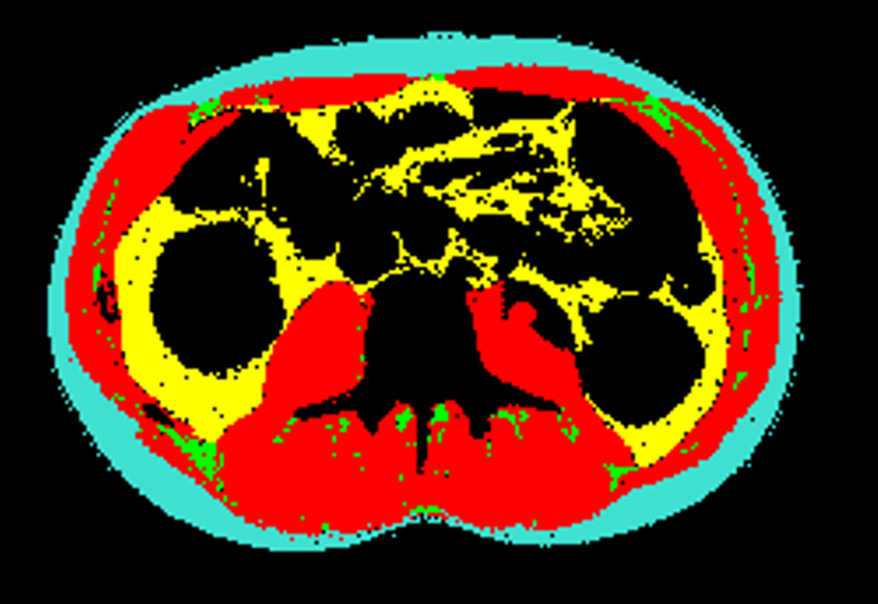
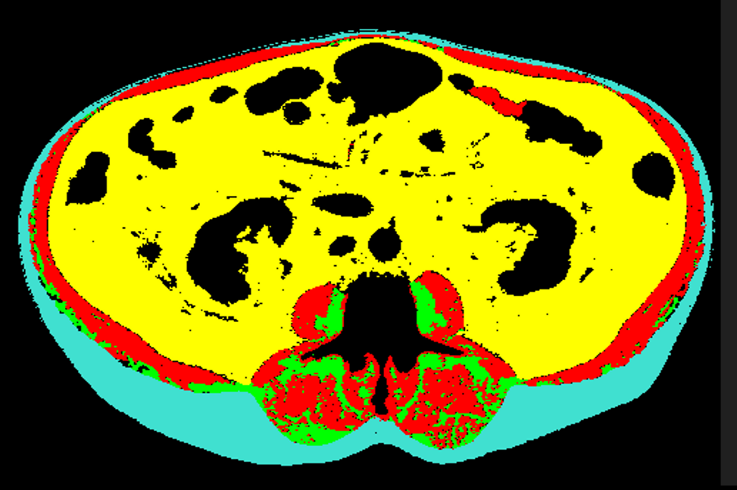
CT-Derived Muscle Measures
Muscle mass and quality can be measured from staging CT scans and have been shown to accurately predict surgical outcomes
Notes:
Patient on the left is a 44M who is an avid bicyclist. Muscle is identified in red. Patient on the right is an 82M. Notice the fatty infiltration of the paraspinus muscles, as indicated by the emerald green color

Slide 4
Methods
399 Minimally-invasive esophagectomy
Skeletal Muscle Gauge: abdominal wall muscle area × muscle density from CT
“Low Muscle”: Bottom quartile SMG
Age categorized as <75 vs 75+
Operative mortality at 90 days compared based upon age and skeletal muscle gauge
Notes:
We studied 399 patients who underwent minimally-invasive esophagetomy at our institution.
Skeletal Muscle Gauge was calculated from CT scans as the product of the abdominal wall muscle area and the muscle density
Low muscle was defined as the bottom quartile of skeletal Muscle gauge
Age was categorized as less than or greater than 75 years
We when analyzed the relationship between 90-day operative mortality and a combination of age and skeletal muscle gauge

Slide 5
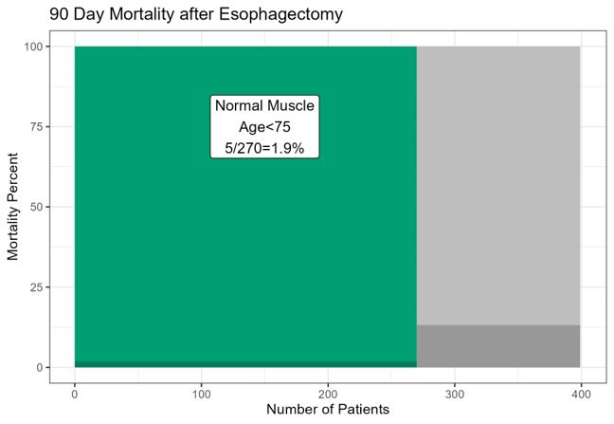
Notes:
Within the total cohort of 399 patients, 270 were under age 75 and had normal muscle based upon CT . Within this group, operative mortality was less than 2%

Slide 6
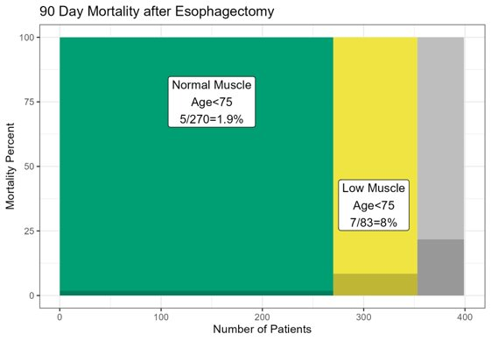
Notes:
83 patients under age 75 were in the bottom quartile for muscle measures and were considered to have low muscle. Within this group, operative mortality was 8%, confirming the ability of muscle measures to predict operative outcomes.

Slide 7
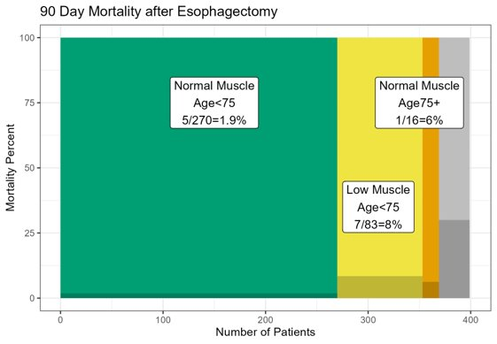
Notes:
16 patients over age 75 had normal muscle measures. Within this relatively small group, operative mortality was 6%

Slide 8
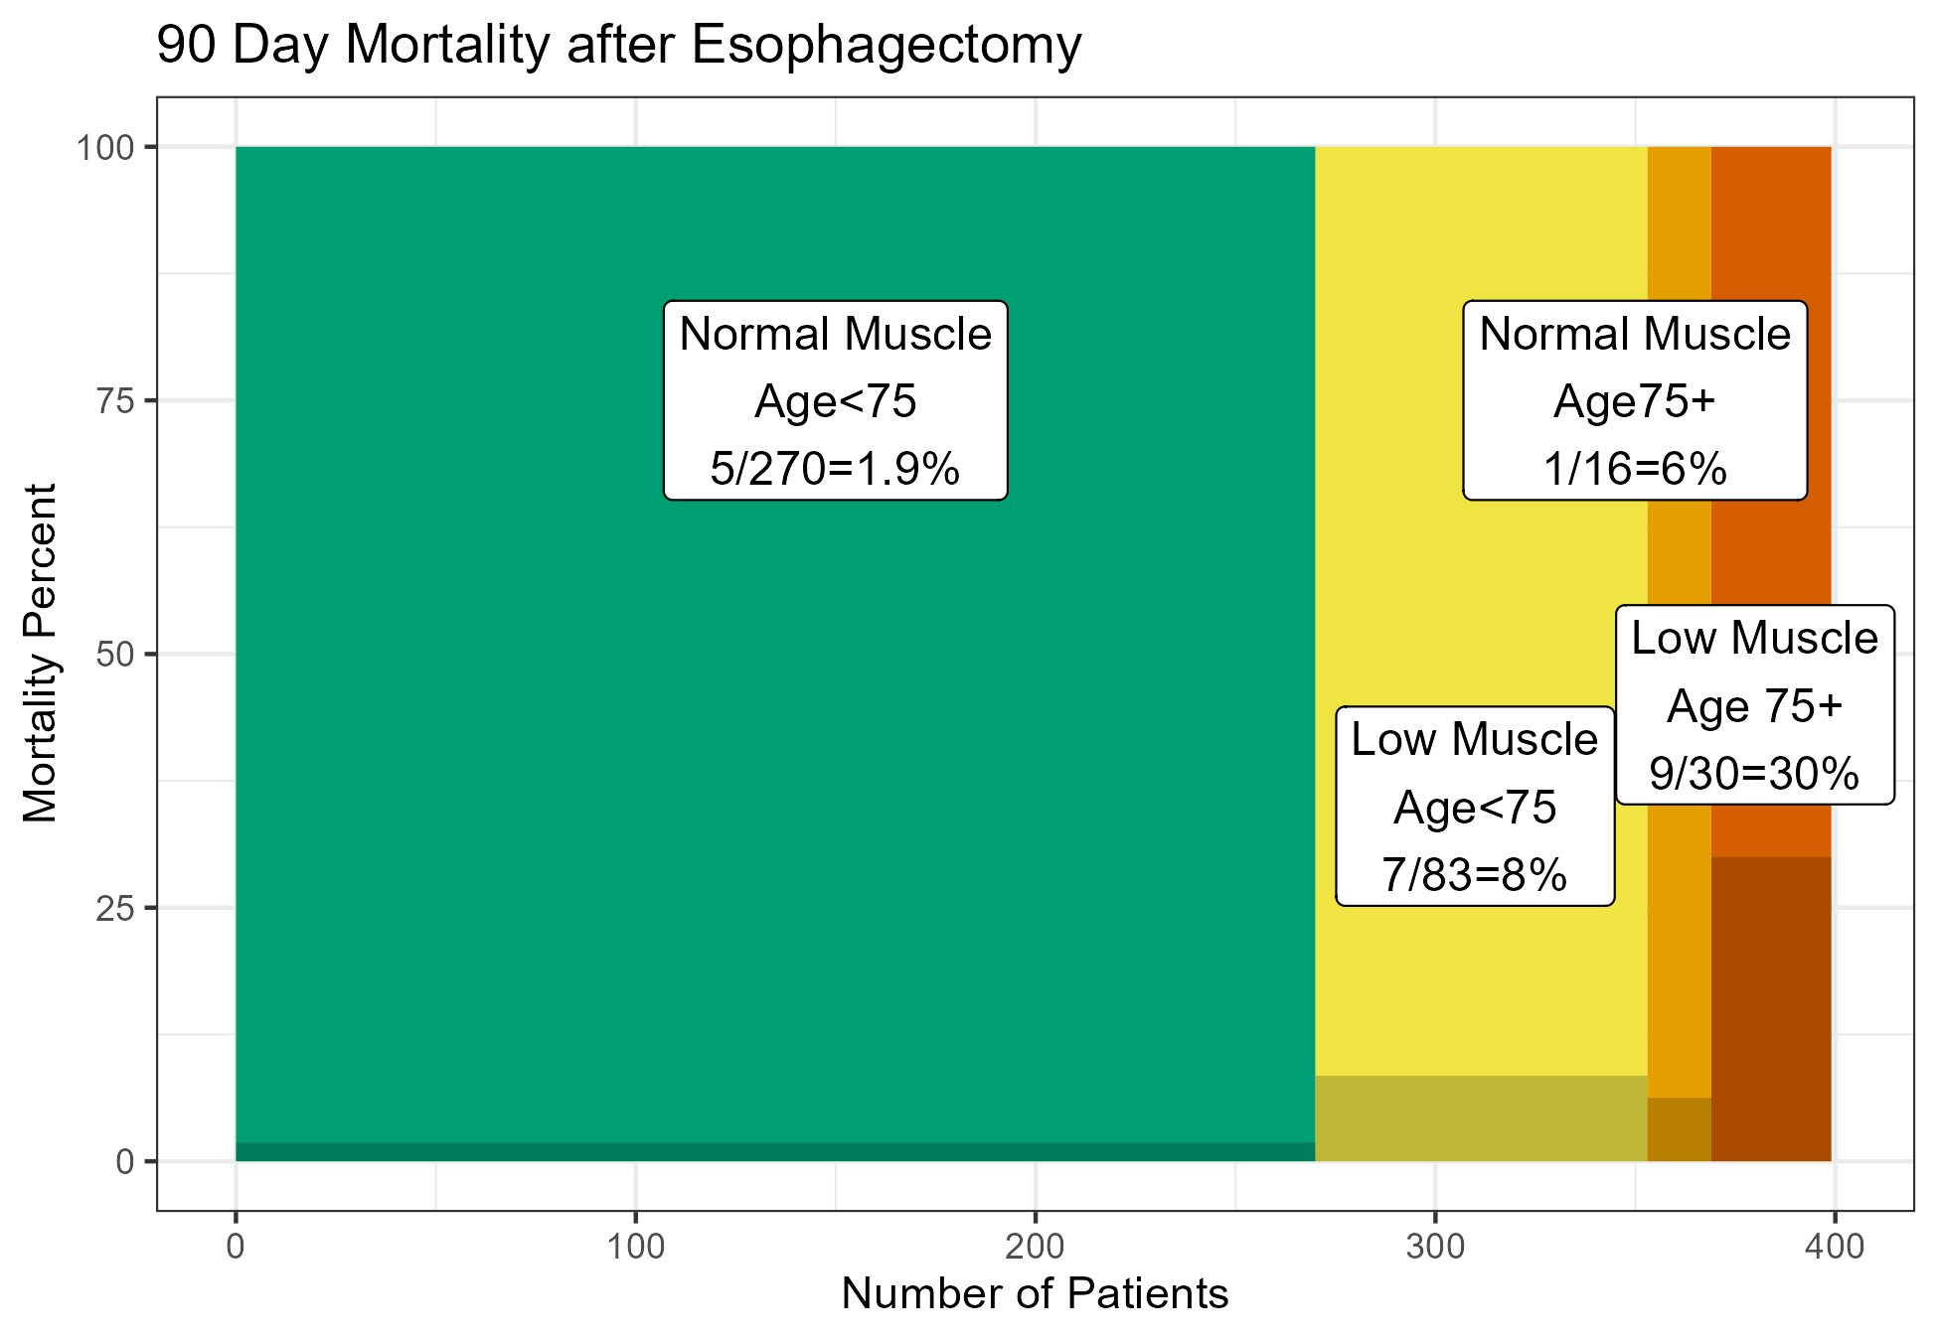
Notes:
By contrast, among 30 patients over age 75 with low muscle measures, operative mortality was 30%, again emphasizing the contribution of muscle measures for risk calculation. Among patients over age 75, those with normal had a 6% operative mortality, while it was 30% in the group with low muscle.

Slide 9
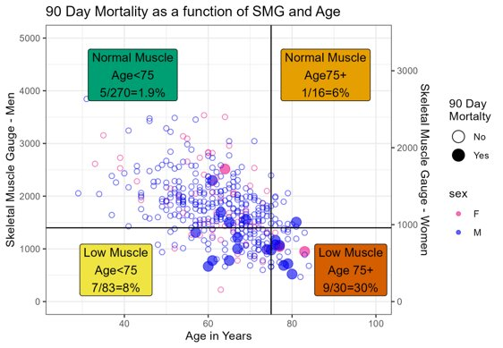
Notes:
The same data is presented here as a scatter plot of age and skeletal muscle gauge. Filled circles represent patients experiencing mortality within the 90 days after surgery.

Slide 10
Conclusions
CT-derived muscle measurements accurately risk-stratify patients undergoing minimally-invasive esophagectomy:
Normal Muscle and Age <75: 1.9% mortality (n=270)
Low Muscle and Age 75+: 30% mortality (n=30)
Notes:
We have shown that CT-derived muscle measurements accurately risk stratify patients undergoing minimally-invasive esophagectomy.
Among 270 patients under age 75 with normal muscle measures on CT, operative mortality was less than 2%
By contrast, among 30 patients over age 75 with low muscle measurements, operative morality was 30%
Our hope is that these methods will assist providers and patients in surgical decision-making

Slide 11
So What? What is the novelty?
Sarcopenia has been well investigated as a predicter of outcomes for surgical outcomes with mixed results
Almost all studies have investigated sarcopenia as a binary measure of muscle mass
Muscle density, as a marker of fatty infiltration of muscle, appears to be an independent biologic process
Skeletal Muscle Gauge is defined as the product of muscle mass x muscle density
Outcomes are analyzed relative to SMG as a continuous variable

Slide 12
Application to Other Clinical Scenarios
Risk prediction for urgent/emergent colectomy in the elderly
Christian Sanderfer, MD
Analysis of loss of muscle during chemoRT for esophageal CA
Can this help us understand who needs a feeding tube?
Can loss of muscle mass predict early death or complications among patients with metastatic GI cancers undergoing systemic chemotherapy?

