Slide 1

Feature & Target Engineering
Yalin Yang
Doctoral student
Geographic information science
Notes:
Before starting it, I just want to emphasis underestimate the importance of Data-PreProcessing. There is saying in Ml filed, gabage in, garbage out.

Slide 2
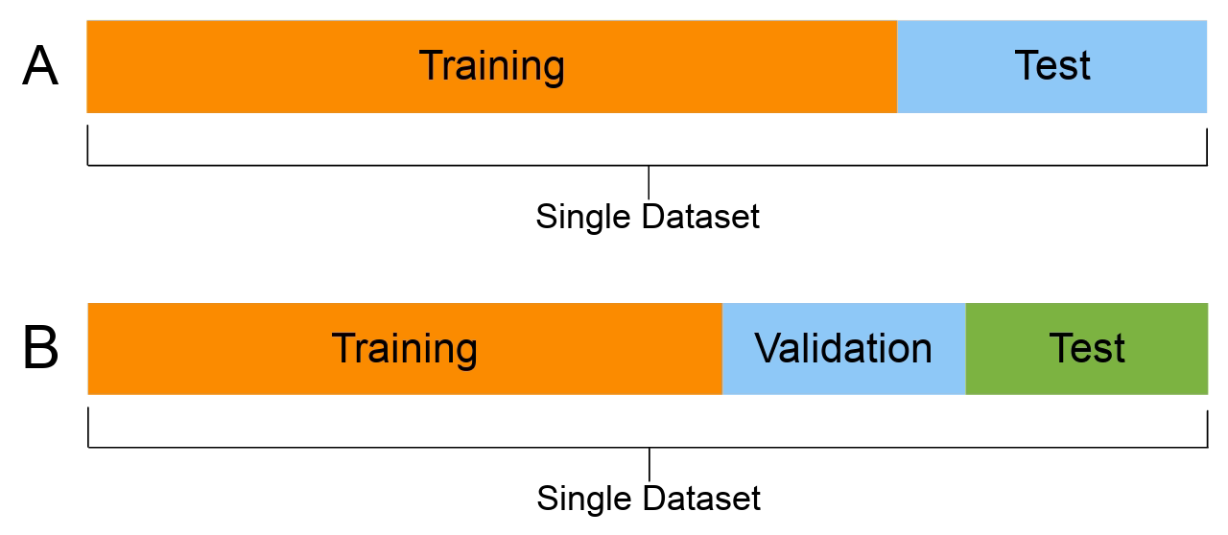
Population, Sampling distribution and unbiased estimator
In applied statistics we are dealing with sampled data from the population and aim at estimating properties of the underlying population from which the random sample has been drawn
In statistics, the bias of an estimator is the difference between this estimator's expected value and the true value of the parameter being estimated. An estimator or decision rule with zero bias is called unbiased.
Notes:
Let’s do some quick reviewing. T also covered this topic. So here I just want to show you how to implement it using r script.
From week3 and today’s content, you also know, if we want to apply the ML algorithm to the dataset, we need to divide our dataset into training and testing datasets. For some more complex ones, we may also need an additional one for validating. So here, basically, we do the re-sampling from the whole dataset to get training and testing part, we do not want to lose any features or information from the big picture, in other words, we want the training dataset is an unbiased sampling of, the whole dataset

Slide 3
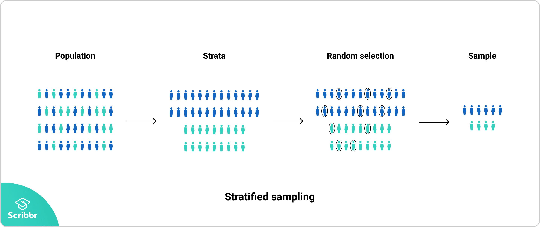
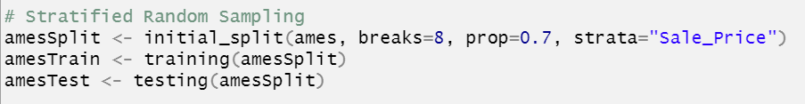
Stratified Sampling
Stratified sampling is a type of sampling method in which the total population is divided into smaller groups or strata to complete the sampling process.
The strata is formed based on some common characteristics in the population data.
After dividing the population into strata, the researcher randomly selects the sample proportionally.
Notes:
Go back to R script, Using hist() function to check T also covered this topic. So here I just want to show you how to implement it using r script.

Slide 4
Box-Cox Transformation, log Transformation
Why we assume errors are normally distributed?
The normal distribution often describes the actual distribution of the random errors in real-world processes reasonably well
Due to the Central Limit Theorem, we may assume that there are lots of underlying facts affecting the process and the sum of these individual errors will tend to behave like in a zero mean normal distribution
Notes:
After having data, we need to exam the distribution of our variables. Before talking about transformation methods, I want to emphasize why we want the error been normally distributed. There are two reasons given here.
We certainly do not want our model to capture the random process, because it varies from sample to sample

Slide 5
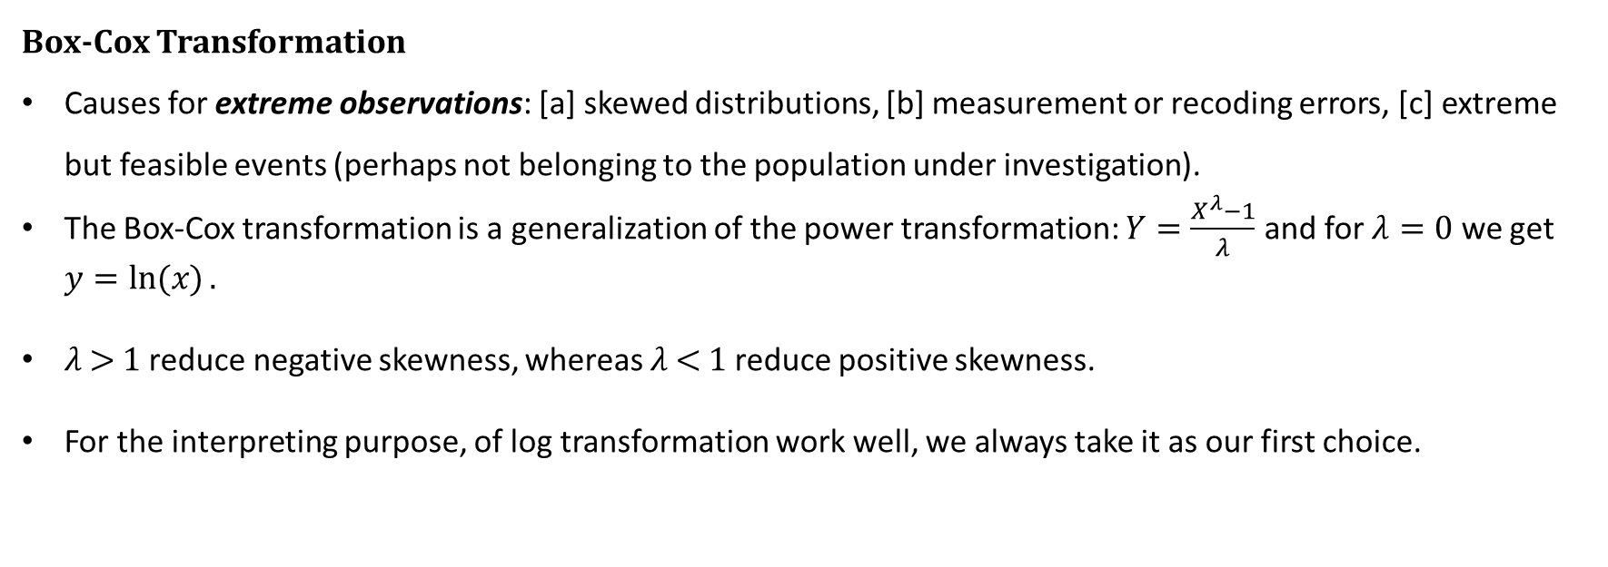
Box-Cox Transformation, log Transformation
Box-Cox Transformation
Causes for extreme observations: [a] skewed distributions, [b] measurement or recoding errors, [c] extreme but feasible events (perhaps not belonging to the population under investigation).
The Box-Cox transformation is a generalization of the power transformation: $Y=\frac{X^{λ}−1}{λ}$ and for $λ=0$ we get $y=\ln{(x)}.$
𝜆 > 1 reduce negative skewness, whereas 𝜆 < 1 reduce positive skewness.
For the interpreting purpose, of log transformation work well, we always take it as our first choice.
Notes:
Back to R

Slide 6
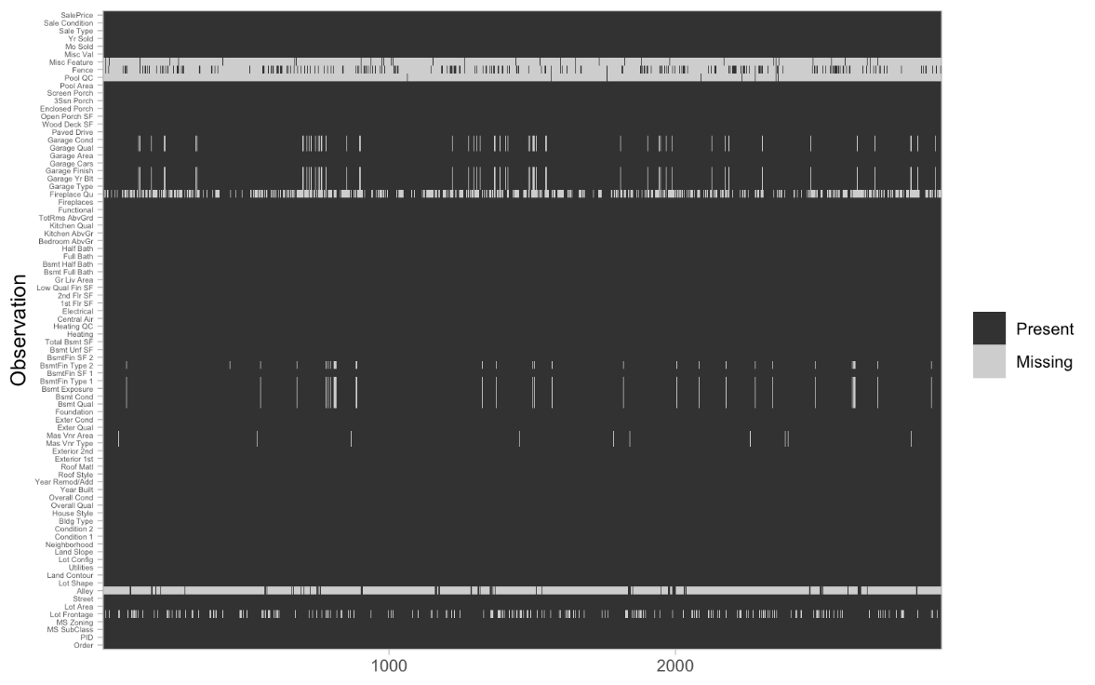
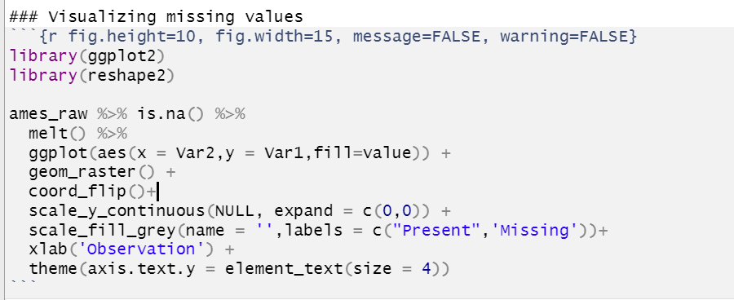
Missing data
The reasons are usually lumped into two categories:
Informative missingness: a structural cause for the missing value; whether this be deficiencies in how the data was collected or abnormalities in the observational environment
Missingness at random: The missing values’ occurrence is independent of the data collection process.
Visualizing missing values:
Notes:
Back to R

Slide 7
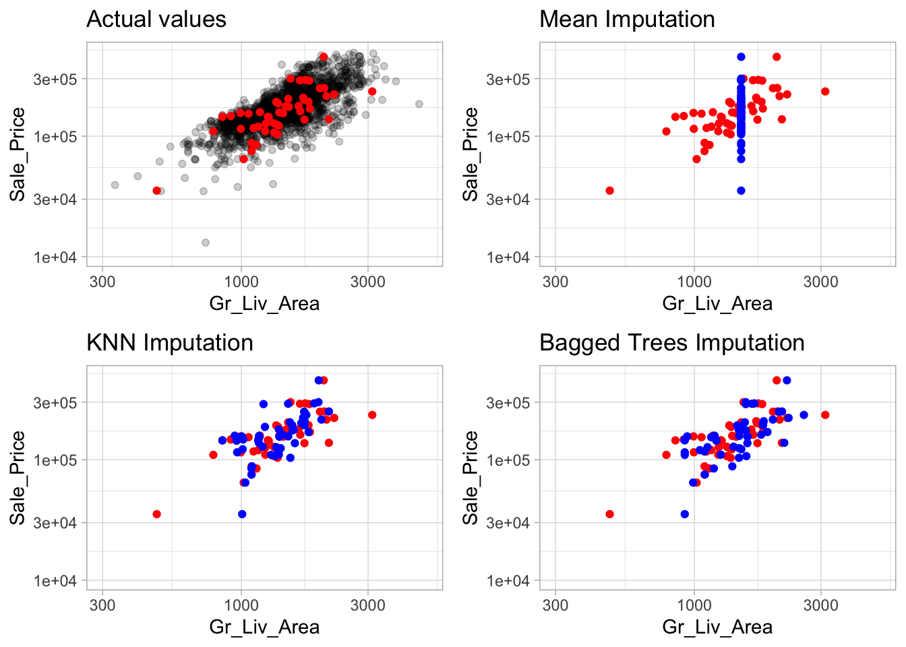
Imputation
imputation is the process replacing missing data with a "best guess" value.
Sometimes we use mean, median, or other statistics to fill the missing data , but this kind of process do not consider any other attributes for a given observation. An alternative is to use grouped statistics to capture expected values for observations that fall into similar groups.(infeasible for larger datasets)
Notes:
Back to R

Slide 8
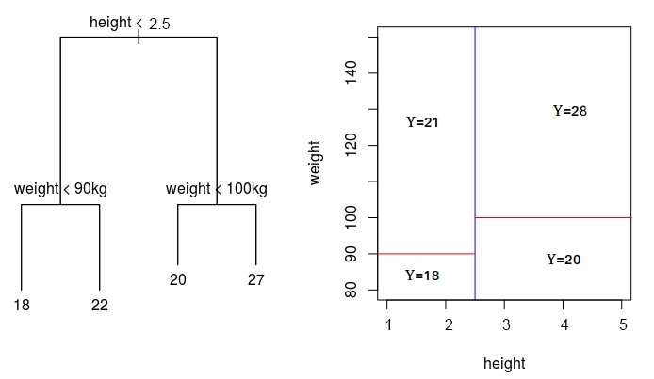
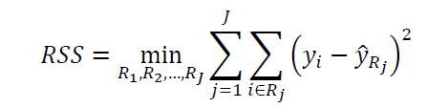
K-nearest neighbor and Tree-based method (Brief)
Tree based model
Tree-based models use a series of if-then rules to generate predictions from one or more decision trees.
Works for either regression or classification
Classification tree analysis is when the predicted outcome is the class (discrete) to which the data belongs.
Regression tree analysis is when the predicted outcome can be considered a real number (e.g. the price of a house, or a patient's length of stay in a hospital).
The objective is to find the regions (𝑅1,𝑅2,…,𝑅𝐽) for which the RSS is at its minimum:
Notes:
I believe both of you are very familiar with KNN methods now after week3 lecture, and I would briefly talk about what is tree-based model and what it could do, I think this figure illustrates how to make a simple decision tree in detail. Set the height and weight as our independent variables and Y here, maybe age as our dependent variable.

Slide 9
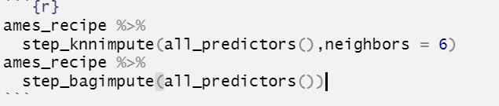
Bagging Trees and Random Forest models (Brief)
Bagging Tree(Bootstrap aggregating)
building many decision trees at a time by randomly sampling with replacement, or bootstrapping, from the original dataset.
This ensures variety in the trees, which helps to reduce the amount of overfitting.
Random Forest
Random forest models take this concept one step further. On top of building many trees from sampled datasets, each node is only allowed to split on a random selection of the model’s features.
Notes:
T also covered what is bootstrap in today’s lecture, What I told you here is a very general concepts about tree-based model, just want to give an idea what it is. As the trade-off between accuracy and training time, We applied the bagging tree algorithm in the sample script Go back to R.

Slide 10
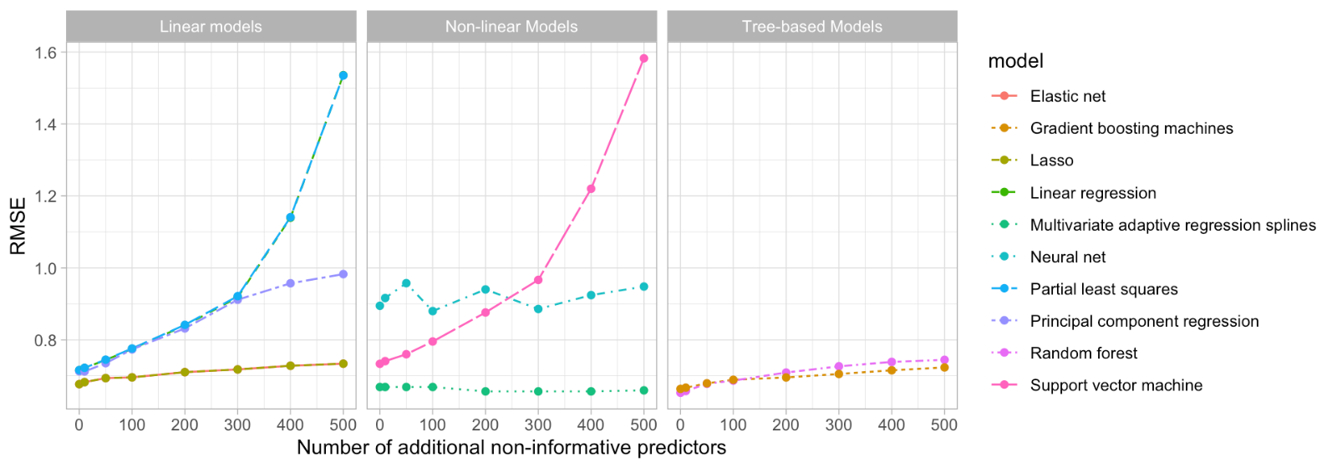
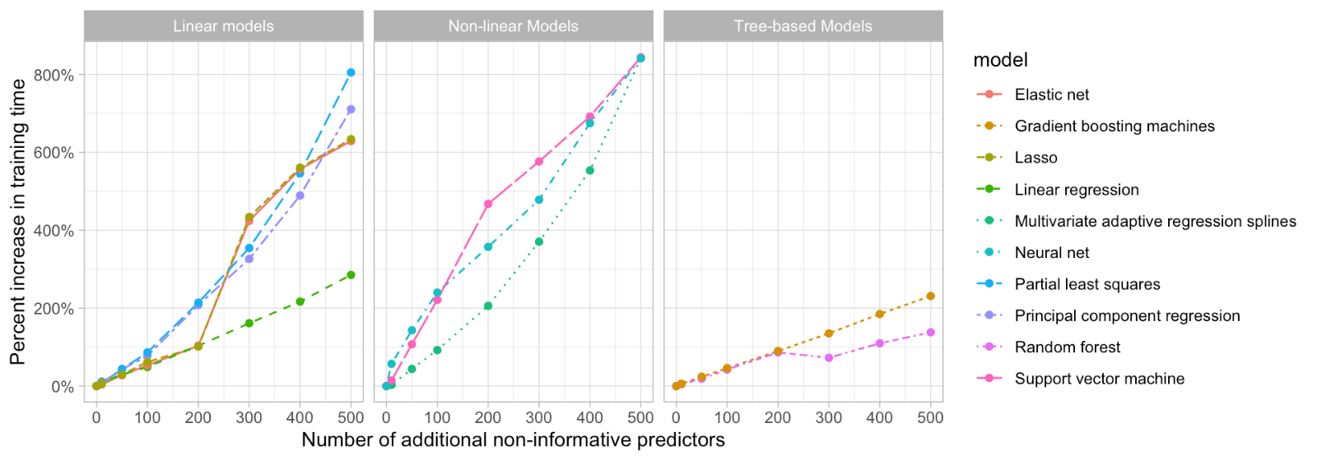
Feature Filtering
Reduce the number of features (input variables)
Model becomes harder to interpret
Costly to compute
What kind of features should be eliminated
Zero and near-zero variance variables
The fraction of unique values over the sample size is low (say ≤10%).
The ratio of the frequency of the most prevalent value to the frequency of the second most prevalent value is large (say ≥20%).
Notes:
From the right corner figure, basically, it tells, in general, the non-informative predictors make our model bad. As for training time, it even worse. Keeps those irrelevant features would let you cost more than twice

Slide 11
Numeric feature engineering (Feature scaling)
Why we need Normalization and Standardization?
Distance-Based Algorithms
Distance algorithms like KNN, K-means, and SVM are most affected by the range of features. This is because behind the scenes they are using distances between data points to determine their similarity.
If all features have different scales, there is a chance that higher weightage is given to features with higher magnitude. This will impact the performance of the machine learning algorithm and obviously, we do not want our algorithm to be biased towards one feature.
Tree-Based Algorithms
Tree-based algorithms, on the other hand, are fairly insensitive to the scale of the features.

Slide 12
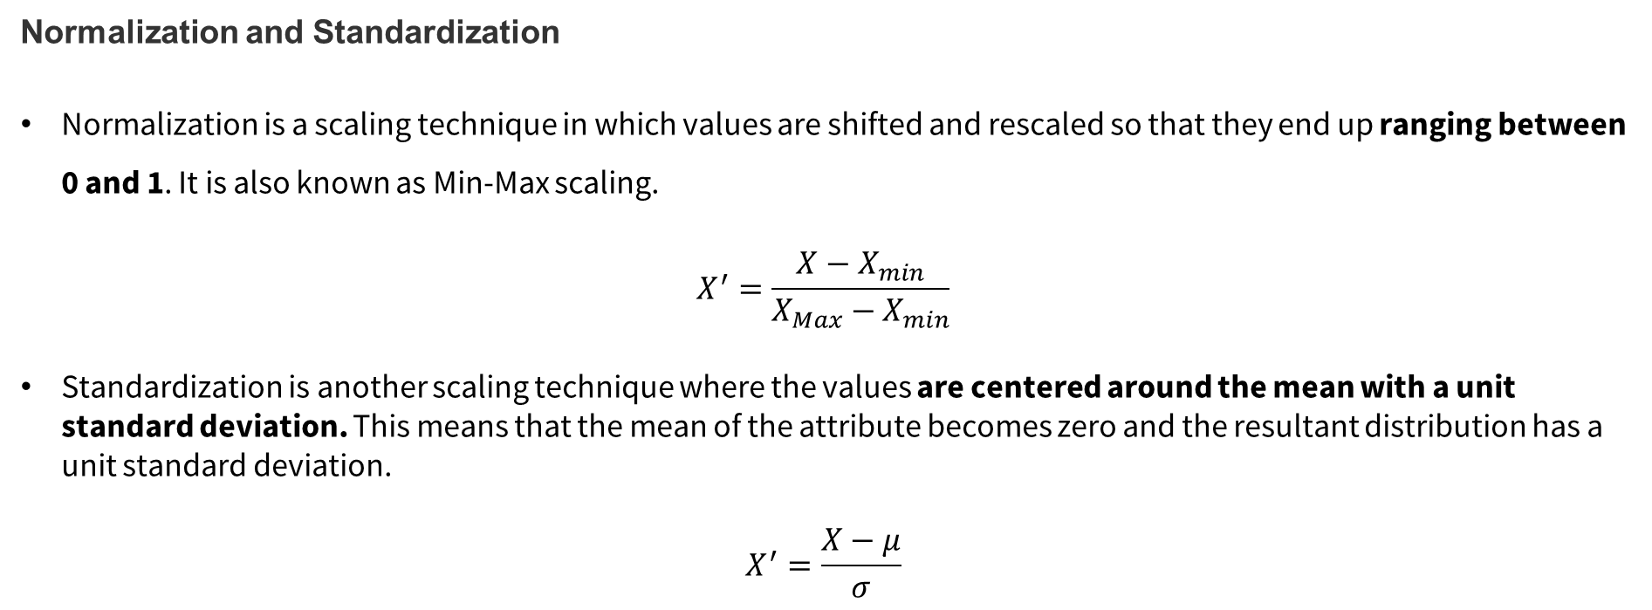
Numeric feature engineering (Feature scaling)
Normalization and Standardization
Normalization is a scaling technique in which values are shifted and rescaled so that they end up ranging between 0 and 1. It is also known as Min-Max scaling.
$$X^{′}=\frac{X−X_{min}}{X_{Max}−X_{min}}$$
Standardization is another scaling technique where the values are centered around the mean with a unit standard deviation. This means that the mean of the attribute becomes zero and the resultant distribution has a unit standard deviation.
$$X^{′}=\frac{X−μ}{σ}$$
Notes:
Back to R

Slide 13
Categorical feature engineering
Most models require that the predictors take numeric form. There are exceptions; for example, tree-based models naturally handle numeric or categorical features. However, even tree-based models can benefit from preprocessing categorical features.
Lumping
Similar to feature filtering, we want to find whether there is a dominant value (says >= 90%) in our variables.
Sometimes we can benefit from collapsing, or “lumping” these into a lesser number of categories.Usually, we may want to collapse all levels that are observed in less than 10% of the training sample into another category. We can use step_other() to do so.
However, lumping should be used sparingly as there is often a loss in model performance (Kuhn and Johnson 2013).

Slide 14
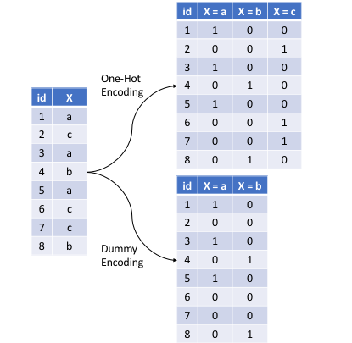
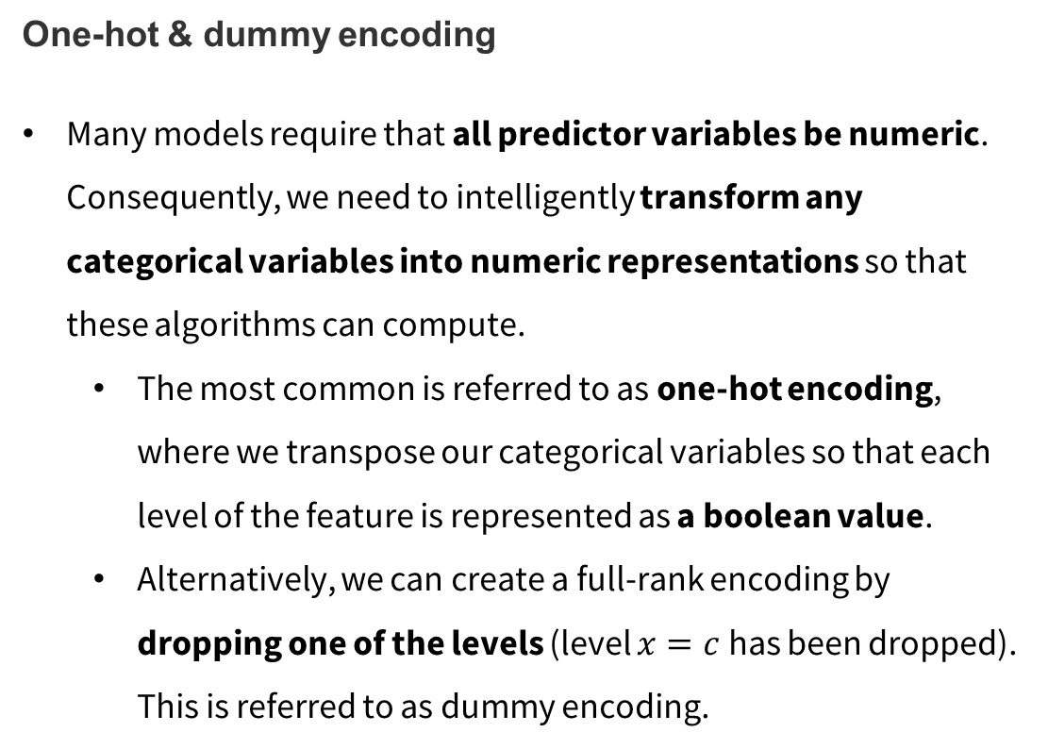
Categorical feature engineering
One-hot & dummy encoding
Many models require that all predictor variables be numeric. Consequently, we need to intelligently transform any categorical variables into numeric representations so that these algorithms can compute.
The most common is referred to as one-hot encoding, where we transpose our categorical variables so that each level of the feature is represented as a boolean value.
Alternatively, we can create a full-rank encoding by dropping one of the levels (level $x=c$ has been dropped). This is referred to as dummy encoding.

Slide 15
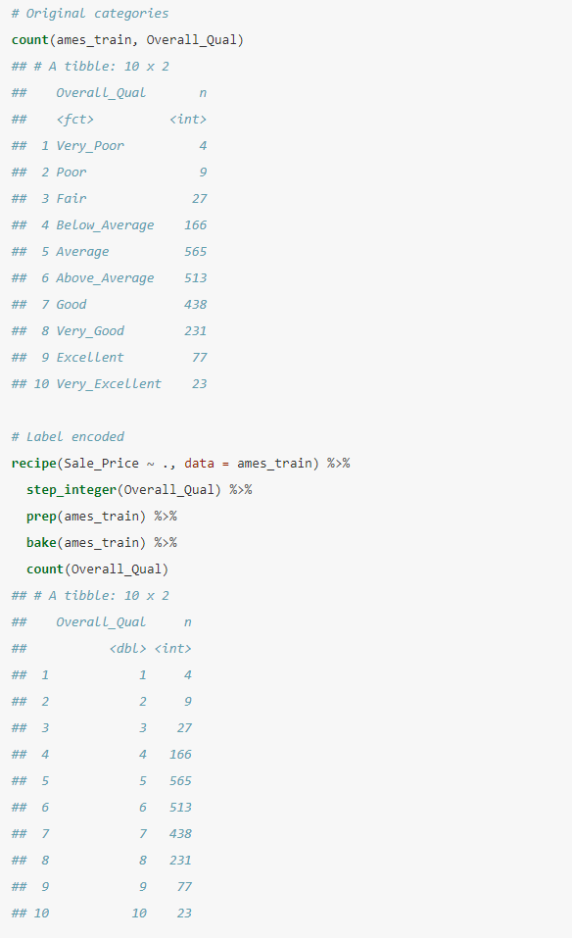
Categorical feature engineering
Label encoding / Ordinal encoding
Label encoding is a pure numeric conversion of the levels of a categorical variable.
Notice that this result would be treated as ordered number, So usually we rank the feature before Label encoding

Slide 16
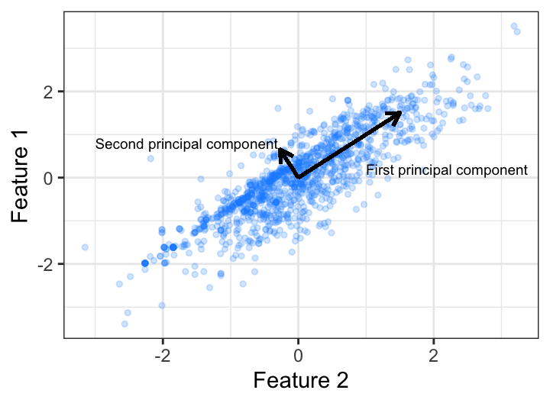
Dimension reduction
Dimension reduction is an alternative approach to filter out non-informative features without manually removing them. For example, we may wish to reduce the dimension of our features with principal components analysis.
Prerequisites
Any missing values in the data must be removed or imputed;
Typically, the data must all be numeric values
Numeric data should be standardized

Slide 17
Data Preprocessing
Remove Near-zero variance features that are nominal
Ordinal encode our quality-based features
Center and scale all numeric features
Perform dimension reduction by using principal component analysis
one-hot encode remainning categorical features
Notes:
Here is the proper sequential steps for data preprocessing, before dig into it. I just want to emphasize underestimate the importance of Data-PreProcessing. There is a saying in Ml fields, "garbage in, garbage out".
While your project’s needs may vary, here is a suggested order of potential steps that should work for most problems:

Slide 18
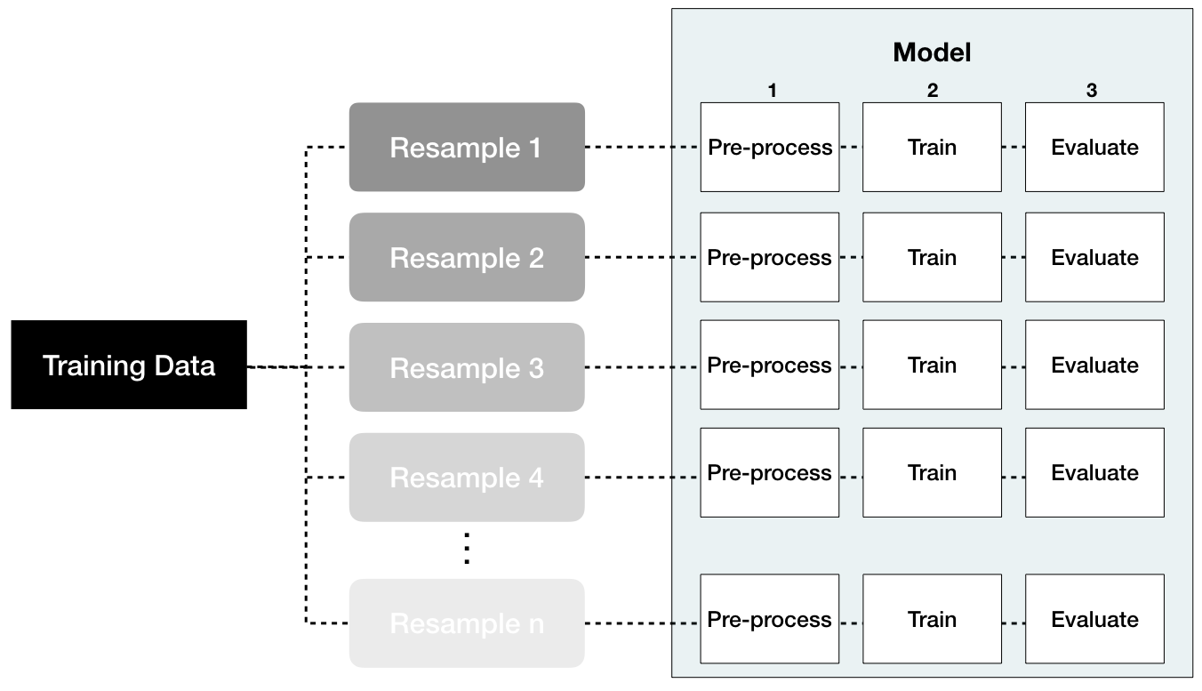
Data leakage
Data leakage is when information from outside the training data set is used to create the model. Data leakage often occurs during the data preprocessing period. To minimize this, feature engineering should be done in isolation of each resampling iteration.
Notes:
T also introduce this workflow, in his lecture，he emphasize we should test multiple algorithm to find which one is best, Here, we focus on features from whole dataset.

