Slide 1
Installing Django on PythonAnywhere
Go to your pythonanywhere account, open a bash
Create Python virtual environment
mkvirtualenv django3 --python=/usr/bin/python3.6
Install Django
pip install Django
Activate the virtual environment
workon django3
Copy Samplecode to local drive
cd ~
git clone https://github.com/csev/dj4e-samples
cd dj4e-samples
ls (check files)
Install required libraries
pip install –r requirements.txt
Use the manage.py to check installed library
python manage.py check
python manage.py makemigrations (connect to Django server files)
python manage.py migrate (deploy)

Slide 2
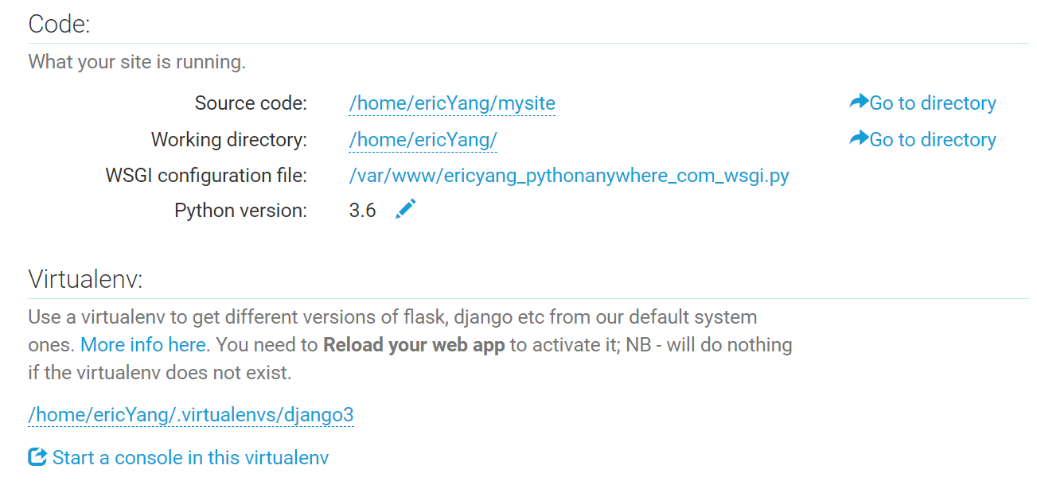
Build your application
Back to home directory and build a folder as your application folder
cd ~
mkdir django_projects
cd django_projects
Django-admin startproject mysite (use Django to start a new project)
Change the allowed_hosts tag in the setting file to [ “*” ] (Defines what sites can talk to this Server)
Cd ~/Django_projects/mysite/mysite/
Nano settings.py (save the file by pressing CTRL-X , Y, and Enter)
Run your application
Check the status of the application
Python3 manage.py check
Add Virtual environment of Web application in pythonanywhere

Slide 3
Adding Your Polls Application
Check the status of the application
Python3 manage.py check
Add Virtual environment of Web application in pythonanywhere

