Slide 1
Address Bus
RAM
CPU
EDB (External Data Bus)
MCC(memory control chip)
Cash
Clock
Register
3.4 ghz,
Overclocking

Slide 2
User Space
Applications
Kernel Space
Process Manager
Memory Manager
File Manager
I/O Manager
Hardware
Time Slice
Process 1
Page
Process 2
Process 2
Hard Drive
Page
Process 3
Process 3
RAM
CPU
Page
Virtual Memory

Slide 3
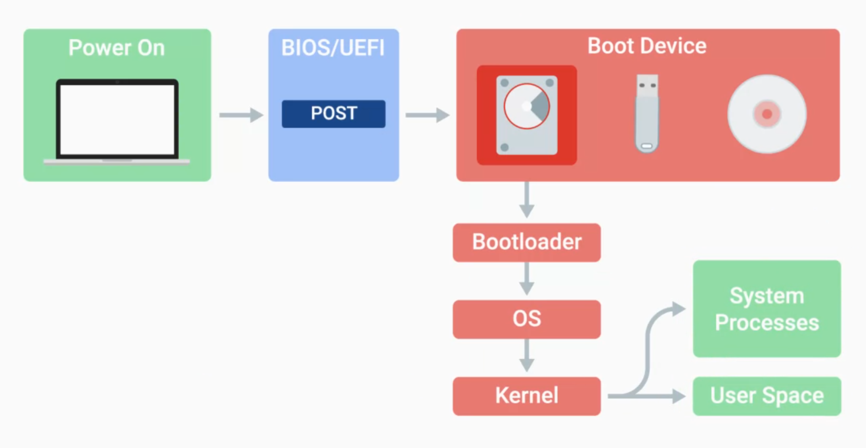
Boot Process
Power on
Self-test

