Slide 1
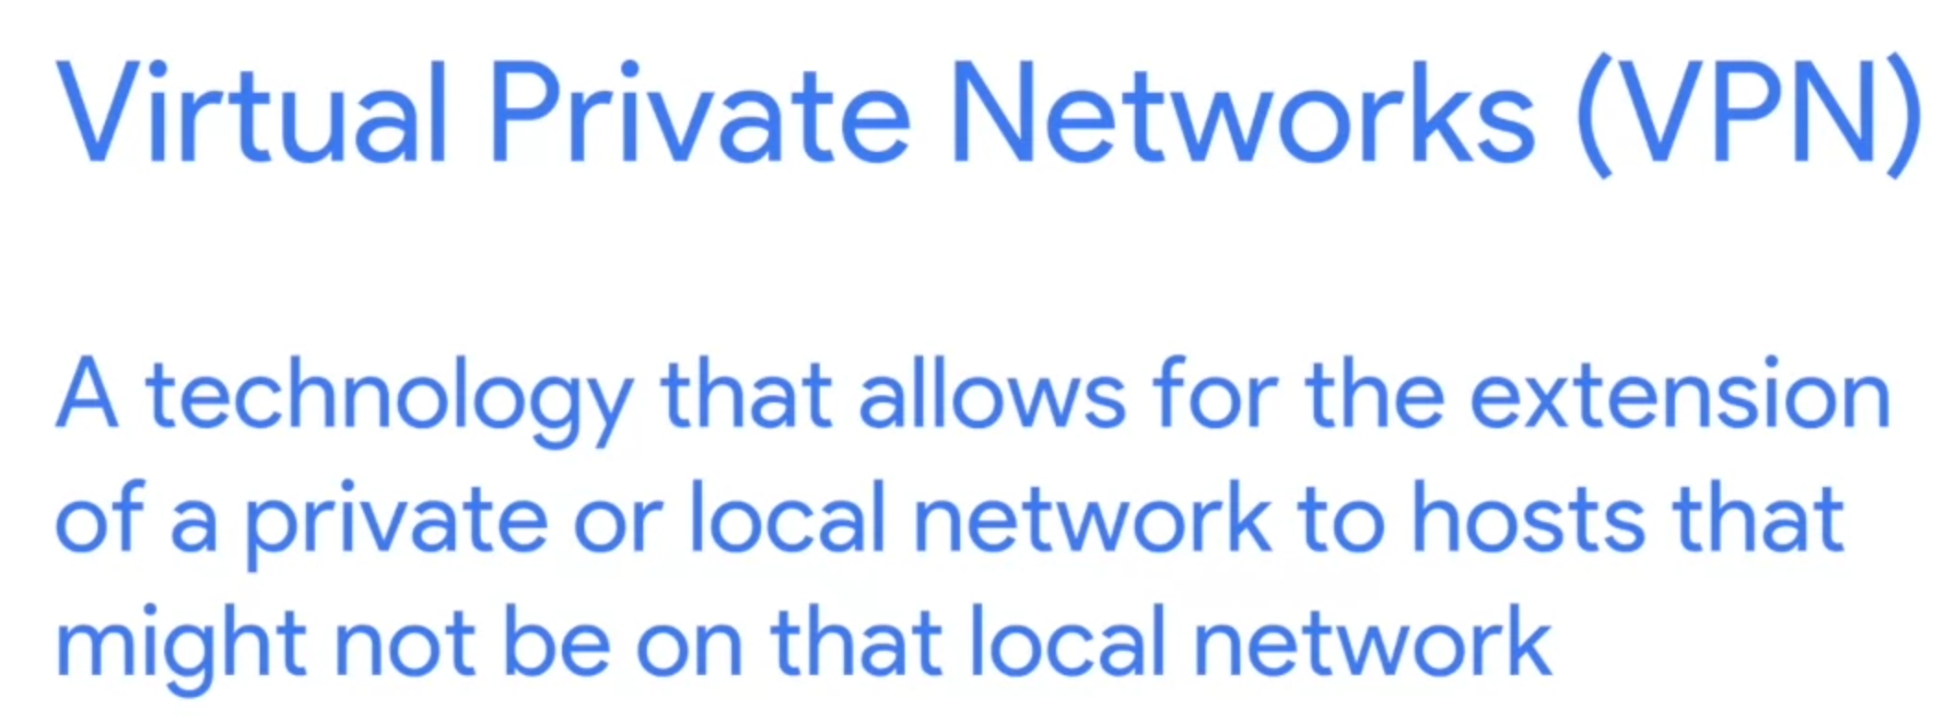


Slide 2
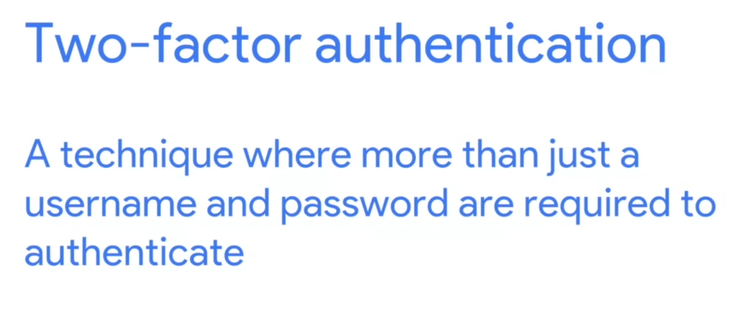


Slide 3

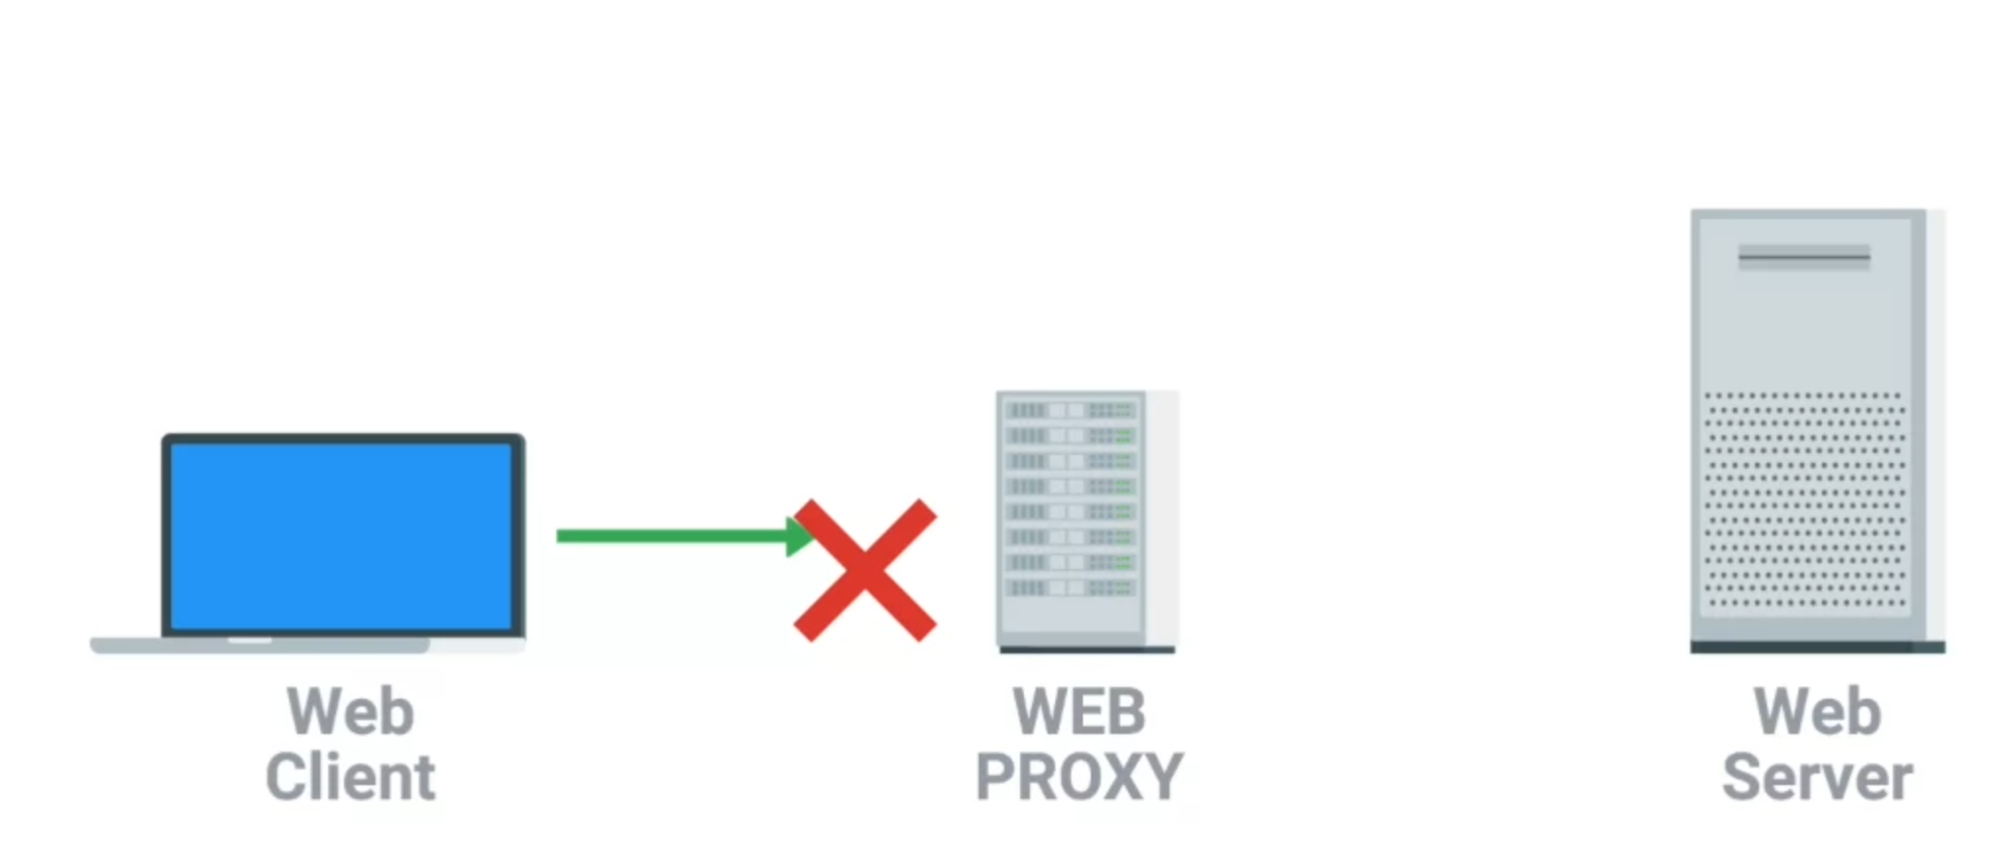
It’s implemented for four purposes
Anonymity
Security
Content filtering
Increased performance
Deny the request

Slide 4
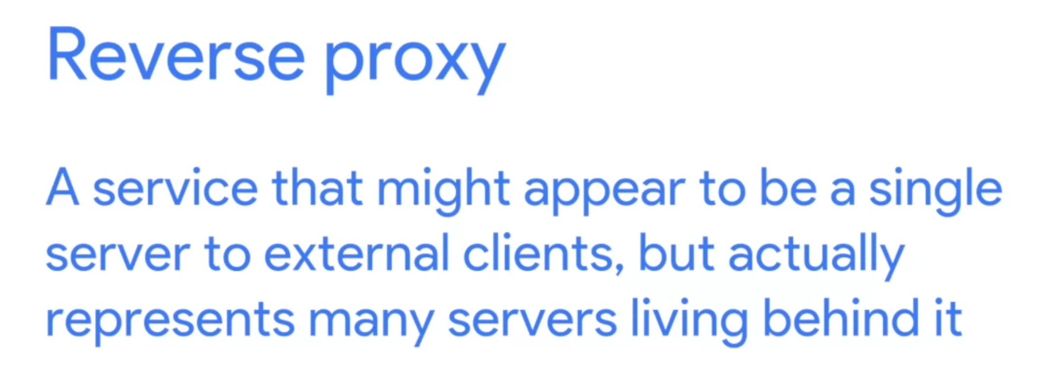
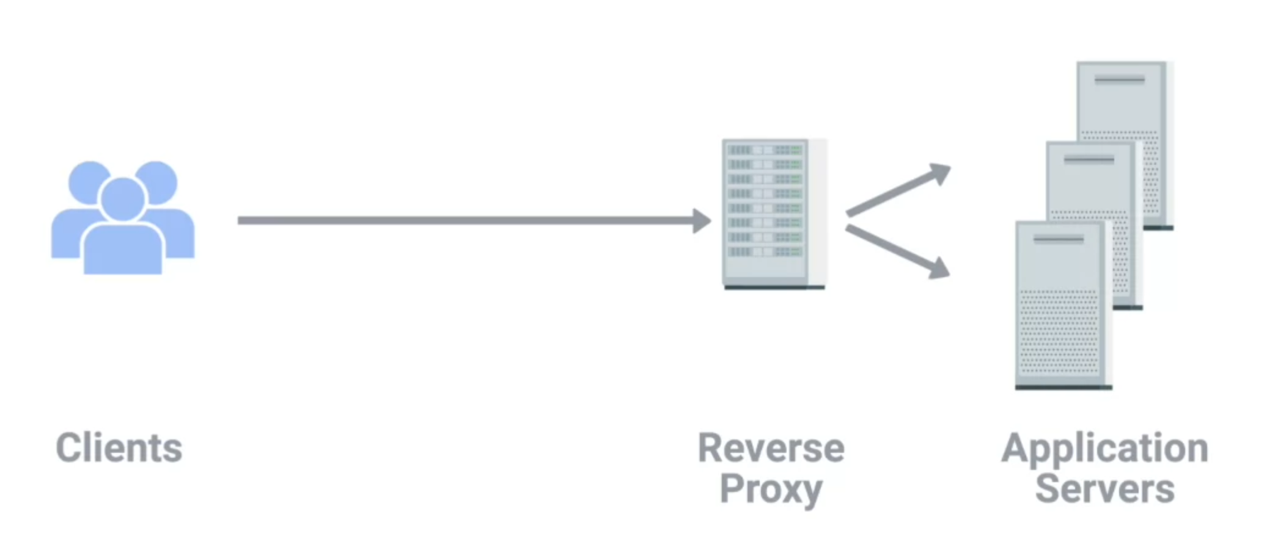
Similar to the DNS Round Robin

