Slide 1

WEEK 02
Field techniques lecture
Instructor: Yanan Wu
fALL 2025

Slide 2
2.1
Introduction to field techniques

Slide 3

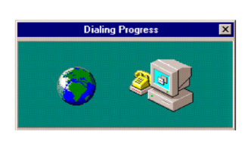
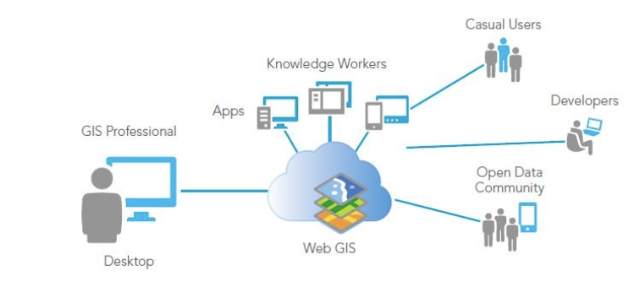
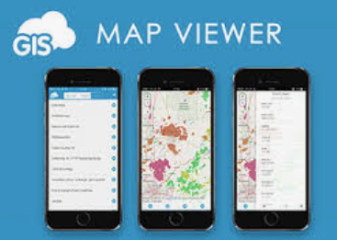

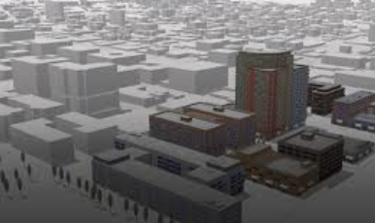
History
Web GIS 1.0
Arc/info, MapInfo
1960s
Dr. Roger Tomlinson
Canada GIS
1980s
Desktop GIS
2000S
Mobile GIS& Cloud
Real-Time, 3D & Integrated GIS
https://www.esri.com/en-us/what-is-gis/history-of-gis
2010S
2020s
Notes:
Next, let us go to the history of modern GIS.
During the early 1960s, GIS started as computers and early concepts of quantitative and computational geography emerged. Dr. Roger Tomlinson has been acknowledged as the "father of GIS.“ His work on creating a manageable inventory of Canadian natural resources during 1960s is the first computerized GIS in the world. He also gave GIS its name.
1965: Mr. Howard Fisher, a Chicago architect, established the Harvard Laboratory for Computer Graphics. Some of the first computer map-making software was created and refined at the Lab, such as one of the first mapping software SYMAP. Many of the early concepts of GIS and applications were also conceived at the lab.
1969: Jack Dangermond, a member of the Harvard Lab and his wife Laura founded ESRI (Environmental Systems Research Institute). This consulting firm applied this computer mapping and spatial analysis to help land use planners and land resource managers make informed decisions. Now it develops and cover almost entire sectors. ERSI also developed toolboxes and work-flows, which are now standard of GIS. The ArcGIS created by ESRI are the most popular GIS software.
1970s: During the era of satellite, starting around early 1970s, National agencies, such as NOAA and NASA developed very quickly to capture data from space.
1980s: Commercial GIS emerged, such as the Arc/Info, the first commercial GIS software and Mapping Display and Analysis System (the first desktop GIS product) developed by Manpinfo cooperation.
Begin 1990s: Users started to explore GIS data through internet and mobile phone. And some open source software, such as QGIS is developing.
In the future: Web and cloud computing GIS will continue developing. Integration with real-time information via the Internet of Things, GIS will become more dynamics.

Slide 4
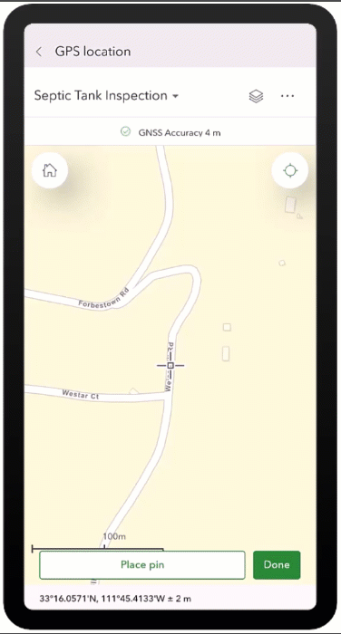

Geographic field techniques
Why Mobile & Web GIS Matter
Accessibility: Anyone with a phone can collect data.
Location awareness: Technologies enable precise location tracking of mobile devices

Slide 5
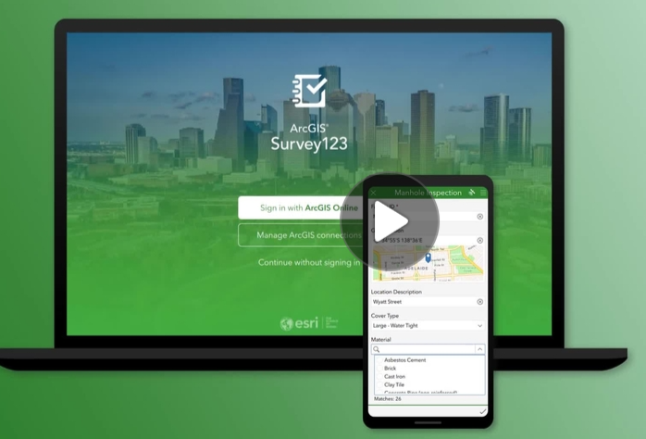
Geographic field techniques
Why Mobile & Web GIS Matter
Versatile communication tools: Mobile devices integrate with various communication methods to facilitate effective collaboration and communication among professionals and the public.

Slide 6


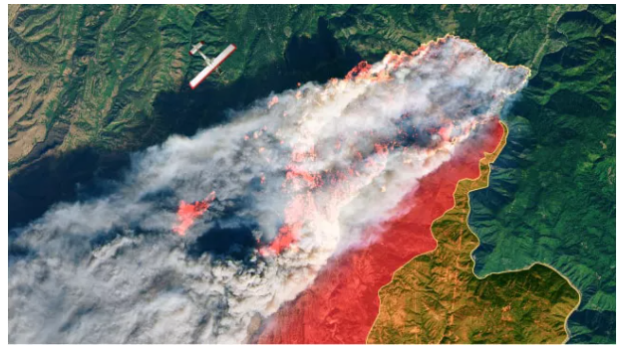

Geographic field techniques
Why Mobile & Web GIS Matter
Widespread accessibility: The ubiquity of smartphones, tablets, and smartwatches has made GIS accessible to billions, significantly expanding the user base and applications of GIS.
More than 680,000 organizations use GIS to understand, plan for, and solve the world’s complex problems.
Conservation
Disaster response program
Education
Non-profit

Slide 7
2.2 mobile gis

Slide 8
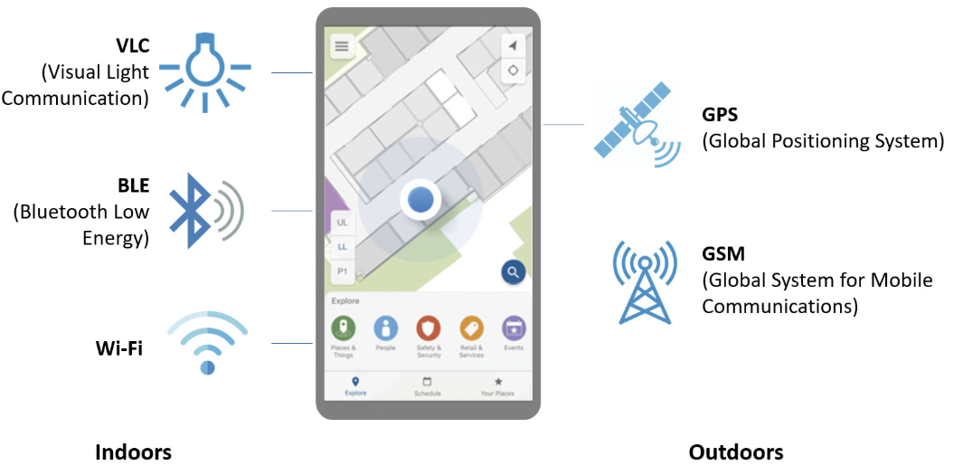
Mobile positioning technologies
Before 2000, GPS technology was not commonly integrated into mobile phones
Global Navigation Satellite System (GNSS): Uses satellite signals to pinpoint precise geographic locations (longitude, latitude, altitude).
Cellular network-based positioning: Relies on cellular network infrastructure to locate devices.
Bluetooth Low Energy (BLE): BLE is used in tracking technologies such as Apple’s AirTags

Slide 9
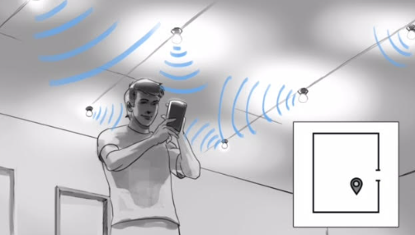
Mobile positioning technologies
Visible Light Communication
VLC

Slide 10
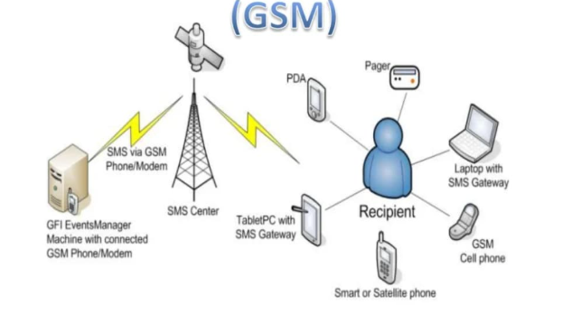
Mobile positioning technologies
Global System for mobile Communication
Cell tower track phone’s location

Slide 11
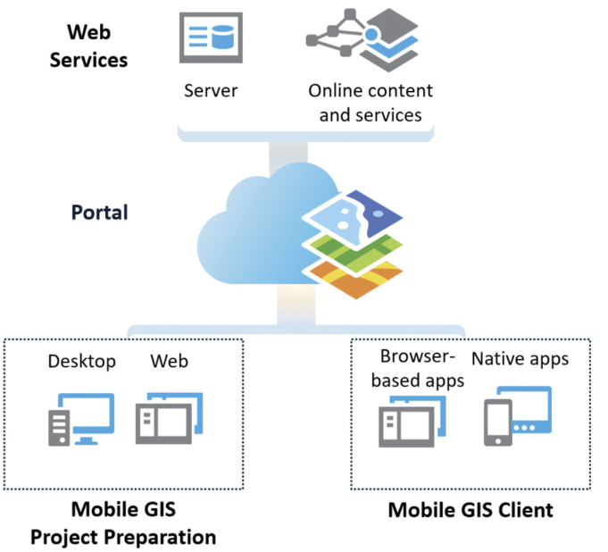



Mobile GIS architecture

Slide 12
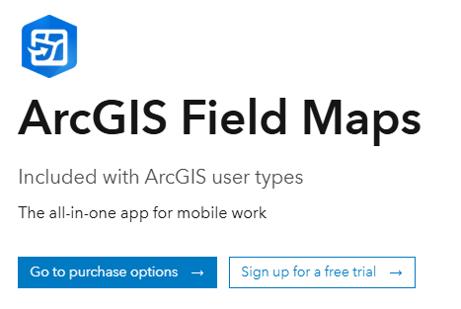
ArcGIS suite of web and native apps for Mobile GIS
Field Maps: Integrates several earlier products, including ArcGIS Collector, ArcGIS Explorer, ArcGIS Tracker, and ArcGIS Workforce. Serves as an all-in-one solution that supports planning, recording and sharing location, understanding, and map centric data capture.

Slide 13
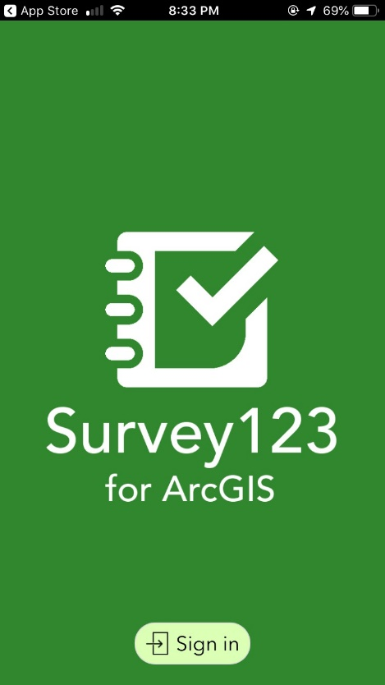
ArcGIS suite of web and native apps for Mobile GIS
ArcGIS Survey123: This formcentric app allows users to create, share, and analyze surveys. It features smart forms with skip logic, defaults, flexible formulas, and powerful data-pulling capabilities.
The app facilitates easy data collection through the web or mobile devices in any environment, requiring minimal training.

Slide 14
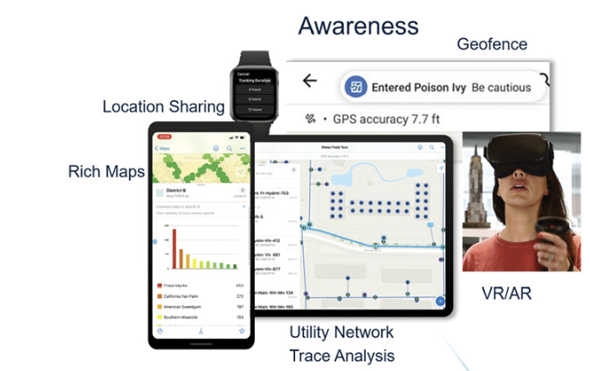
Four pillars of Mobile GIS capabilities
Notes:
Geofencing alerts mobile workers when they enter or leave designated areas. Integrated routing, navigation, and wayfinding capabilities efficiently locate assets, whereas location sharing allows workers to view, record, and share their locations. Field Maps also supports advanced capabilities, including viewing and tracing utility networks, measuring distances, and placing points by distance along linear referenced features.

Slide 15
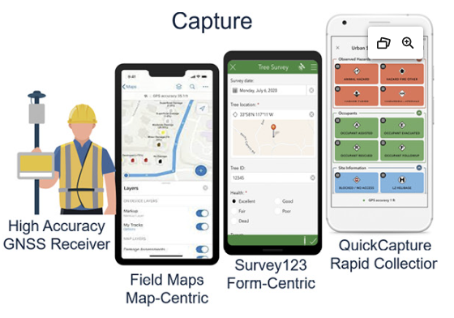
Four pillars of Mobile GIS capabilities

Slide 16
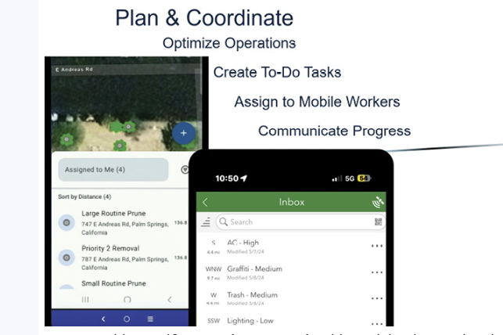
Four pillars of Mobile GIS capabilities

Slide 17
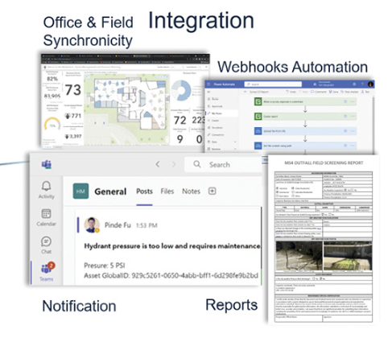
Four pillars of Mobile GIS capabilities

Slide 18

Real-world applications:
  Emergency management: Survey123 help in Emergency response and Recovery

Slide 19
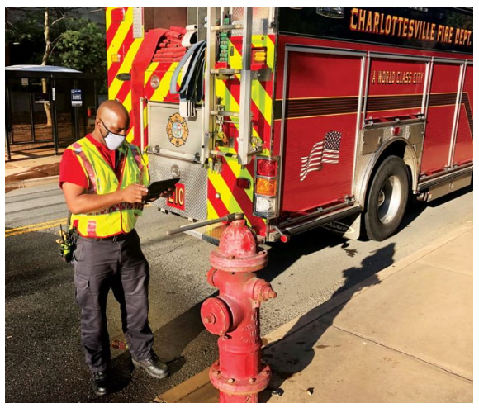
Real-world applications:
  Fire Department : Field Maps help in Hydrant Inspection

Slide 20
2.3 desktop gis

Slide 21
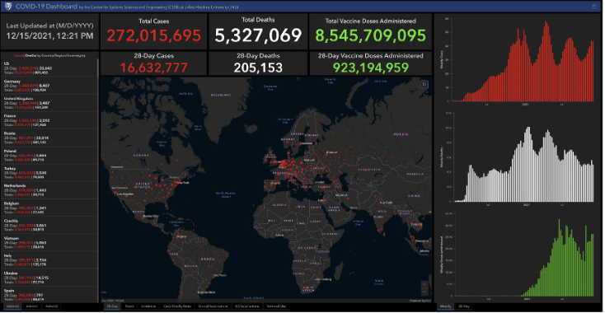
dashboard
The COVID-19 Dashboard by the Center for Systems Science and Engineering (CSSE) at Johns Hopkins University (JHU).

Slide 22
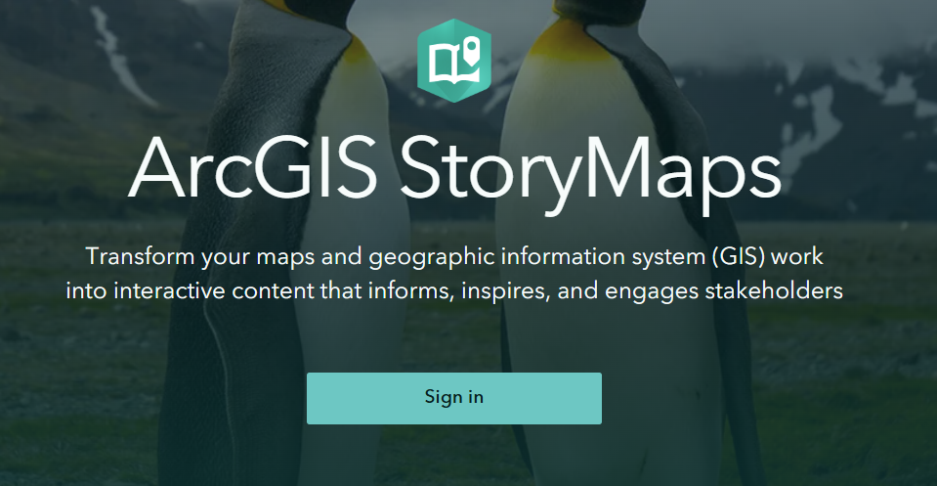
Storymap
2025 ArcGIS StoryMaps Competition

Slide 23
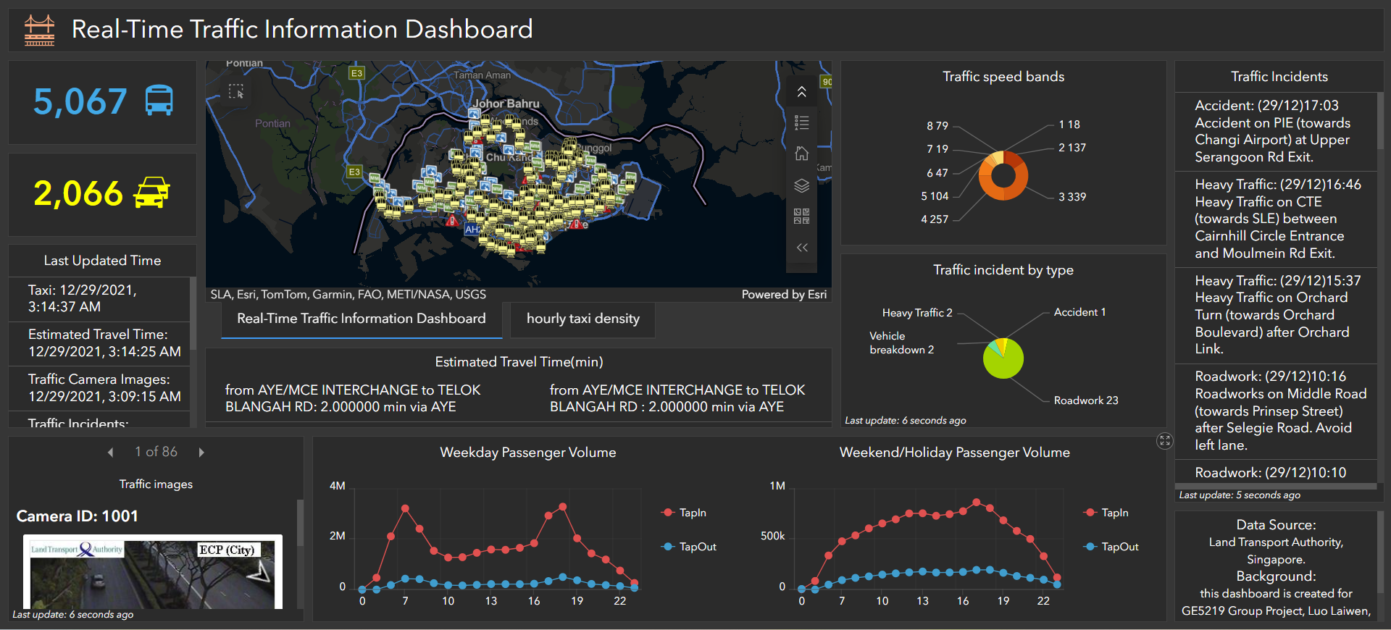
Spatial-temporal and real-time gis

Slide 24
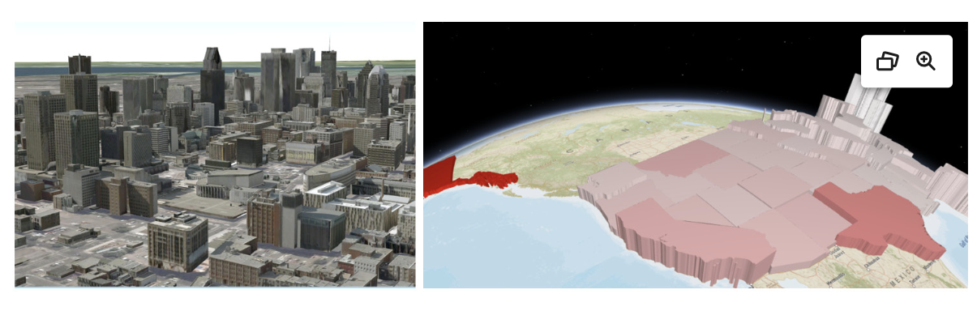
3d web scenes

Slide 25
2.4 drone and gps

Slide 26

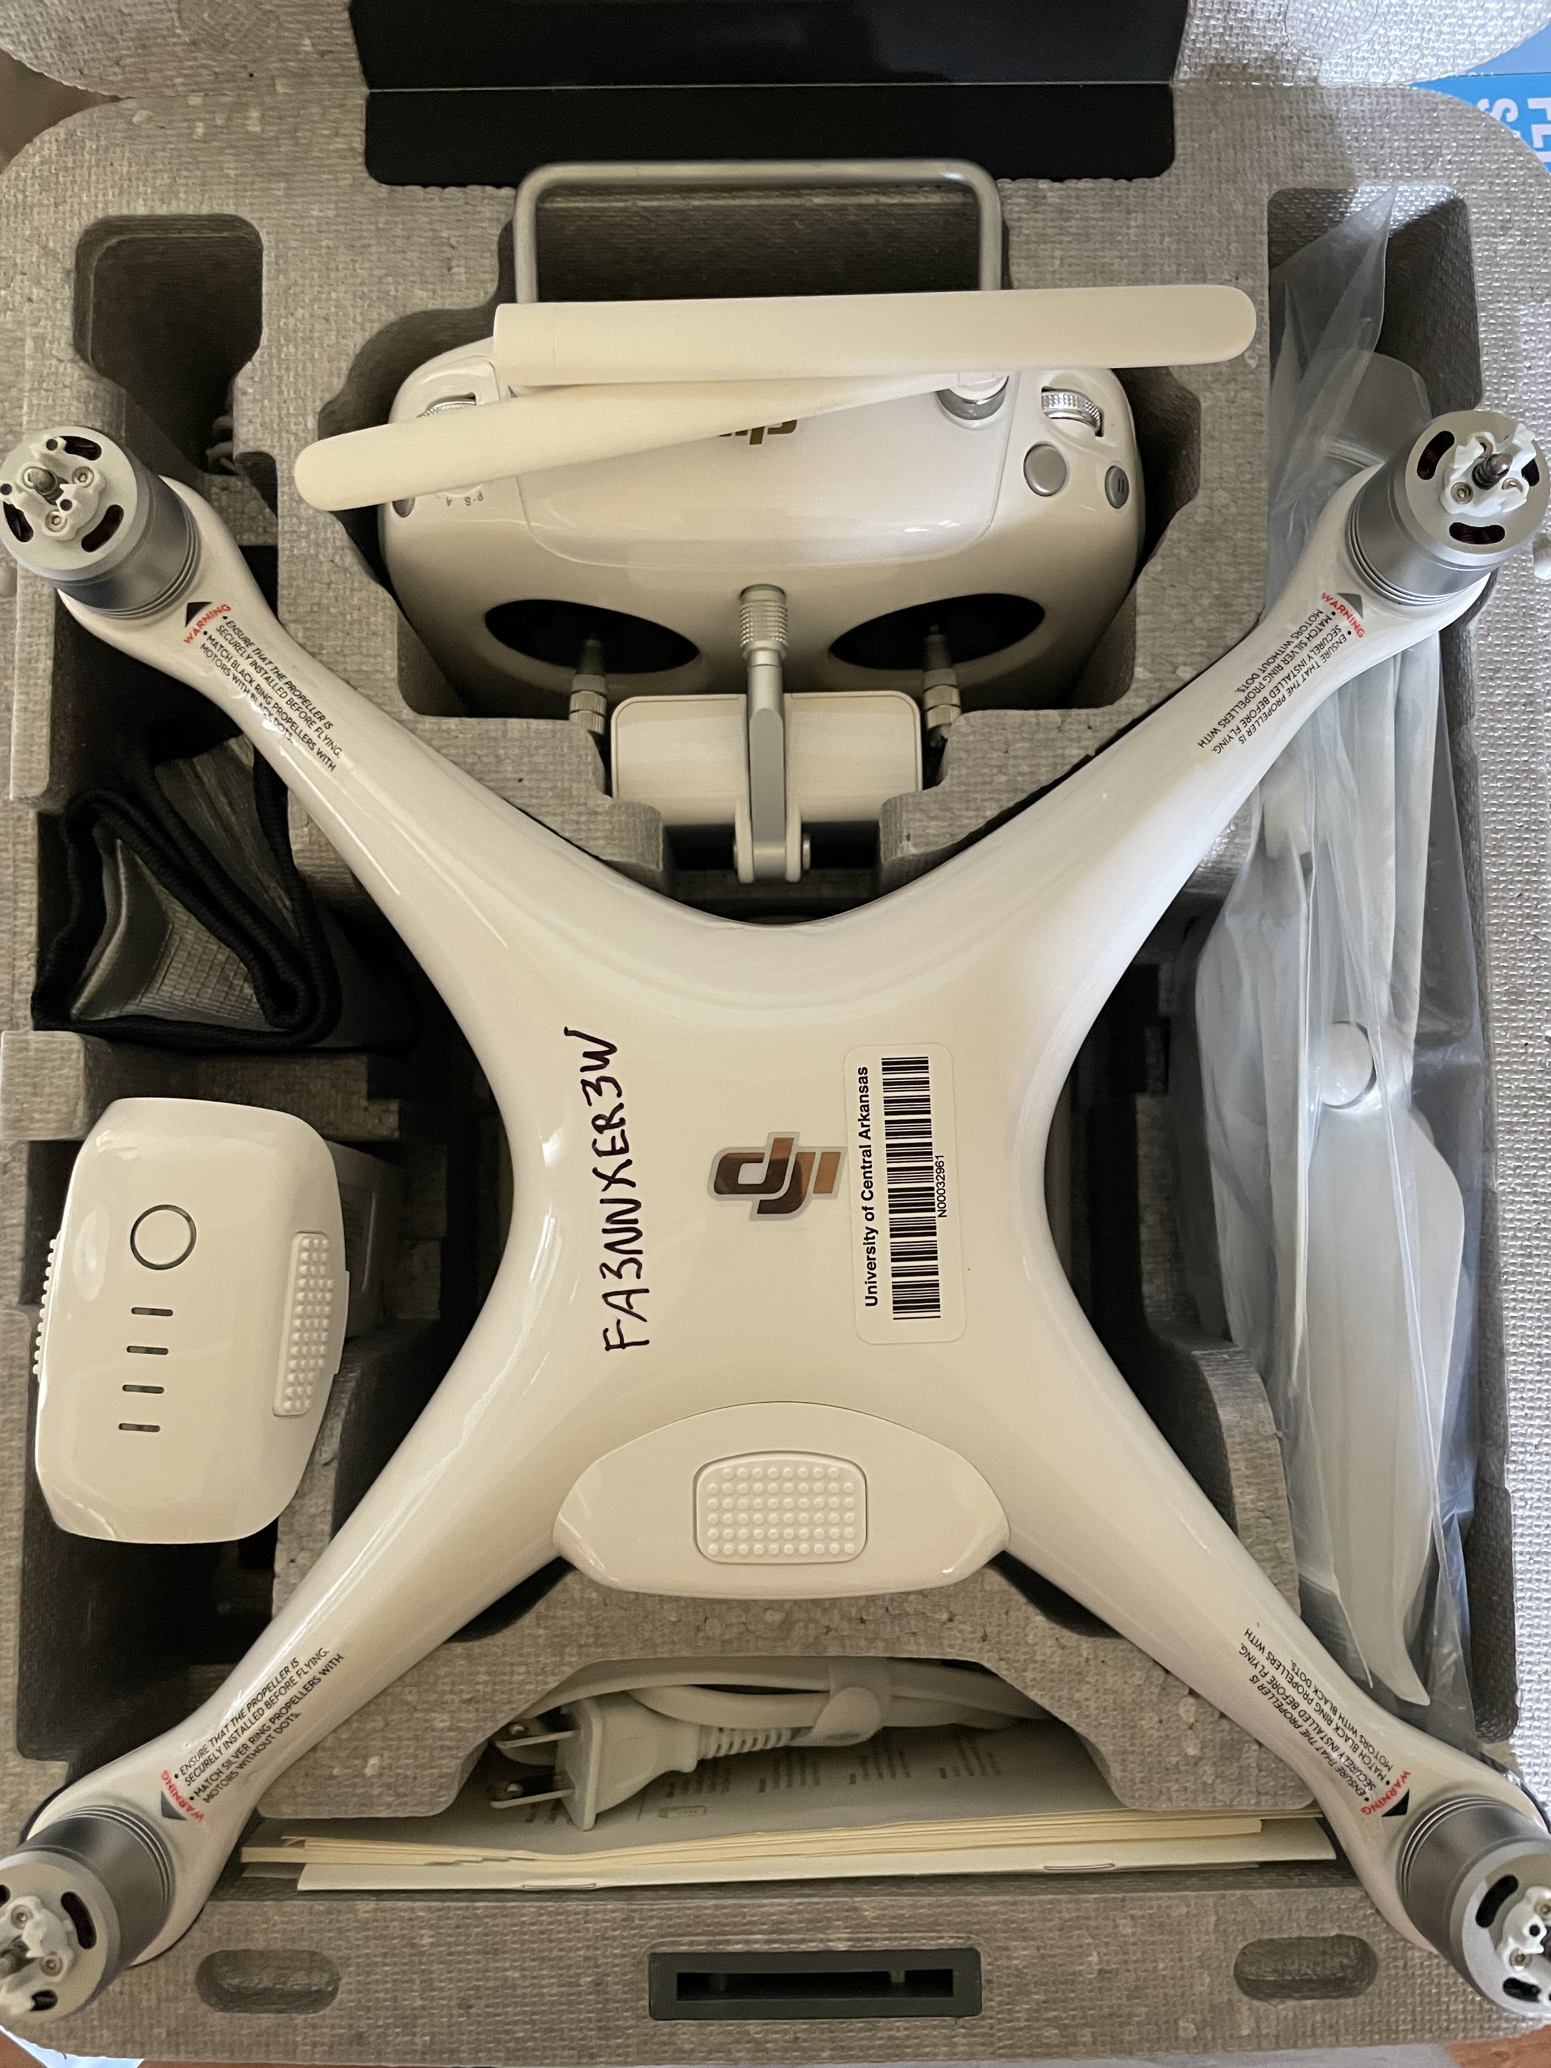

Survey tools
DJI Phantom IV
DJI Ground Station Pro (only iPad)
DJI GO 4
https://www.dji.com/downloads/djiapp/dji-go-4

Slide 27


Drone flight

Slide 28
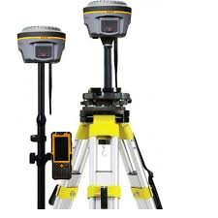
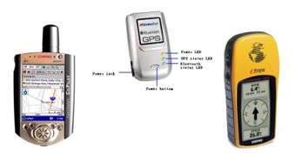
GNSS segment
User segment
  Comprises of Hundreds of thousands of civil, commercial, and scientific users
  In general, GPS receivers are composed of an antenna, receiver-processors, controller, and a highly stable clock.
https://unstats.un.org/unsd/geoinfo/UNGEGN/docs/_data_ICAcourses/_HtmlModules/_Selfstudy/S06/S06_05a.html
https://unstats.un.org/unsd/geoinfo/UNGEGN/docs/_data_ICAcourses/_HtmlModules/_Selfstudy/S06/S06_05a.html

Slide 29
2.5
ARCGIS ONLINE

Slide 30
ARCGIS ONLINE: CLOUD-BASED WEB GIS
Create, analyze, and share web maps in a browser.
Work with hosted layers, Living Atlas data, pop-ups, filters, and sharing settings.
Connect field data, dashboards, StoryMaps, and mobile apps in one Web GIS ecosystem.
Think of an app you use every day. What geographic data does it probably use?
Key idea: ArcGIS Online turns GIS from a desktop-only tool into a shared web platform.

Slide 31
TODAY’S LAB WORKFLOW
1
Begin
a web map
2
Add Living
Atlas layer
3
Style +
basemap
4
Filter +
table
5
Save +
share
→
→
→
→
The lab uses a hurricane evacuation scenario in Houston.
You map households with no vehicle access using ACS data.
The final product is a saved and shared web map.

Slide 32
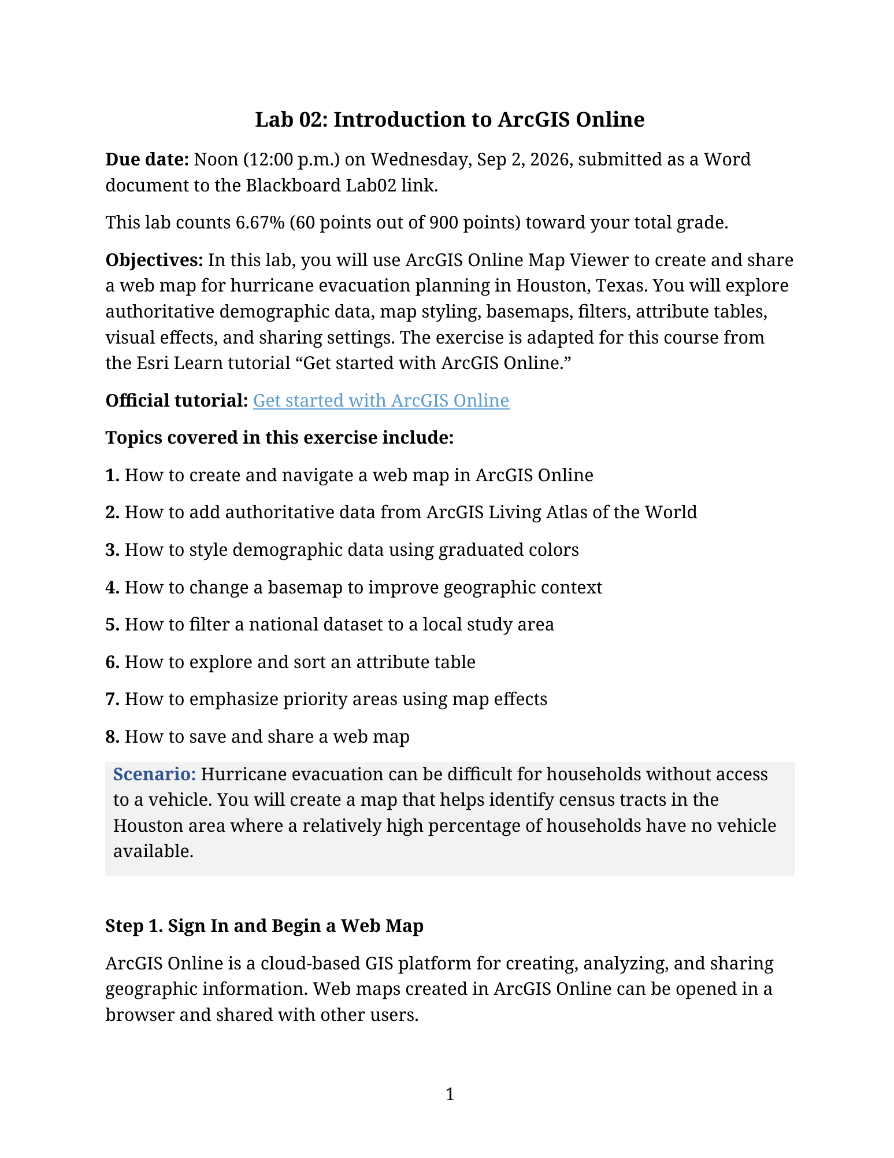
SCENARIO: HURRICANE EVACUATION ASSISTANCE
Problem: Some households may not have access to a vehicle during an evacuation.
GIS task: Identify census tracts with high percentages of households without vehicles.
Decision: Where should public transportation or emergency support be prioritized?
Lab connection: You will complete a web map and submit answers in a Word document.
Group discussion
In a real hurricane evacuation, what other datasets would improve the map?

Slide 33
WHAT MAKES A WEB MAP?
Basemap
Geographic context: roads, labels, water, boundaries
Attributes
The table values behind each feature
Operational layer
The main data students analyze and symbolize
Pop-ups & legend
How users read and interpret the map
Quick check
Which component is “background context,” and which component contains the analysis data?

Slide 34
ARCGIS LIVING ATLAS: READY-TO-USE DATA
A curated collection of geographic layers shared by Esri and other authoritative organizations.
In the lab, you search for ACS Vehicle Availability data instead of downloading data manually.
This helps you learn that data discovery is a core GIS skill.
Question for students
Browse data in Living Atlas using the keyword ‘Little Rock’
Why is it important to know who created a layer before using it in a project?
Interesting knowledge: A web map may combine data from many organizations, but the map author is still responsible for interpretation.

Slide 35
STYLE + BASEMAP: THE MAP COMMUNICATES A MESSAGE
Styling answers: Which values should stand out?
Basemap answers: What geographic context helps the reader?
Color ramps can change what students notice first.
Labels can either clarify or clutter the map.
Example of web GIS communication: maps, charts, labels, and design choices work together.

Slide 36
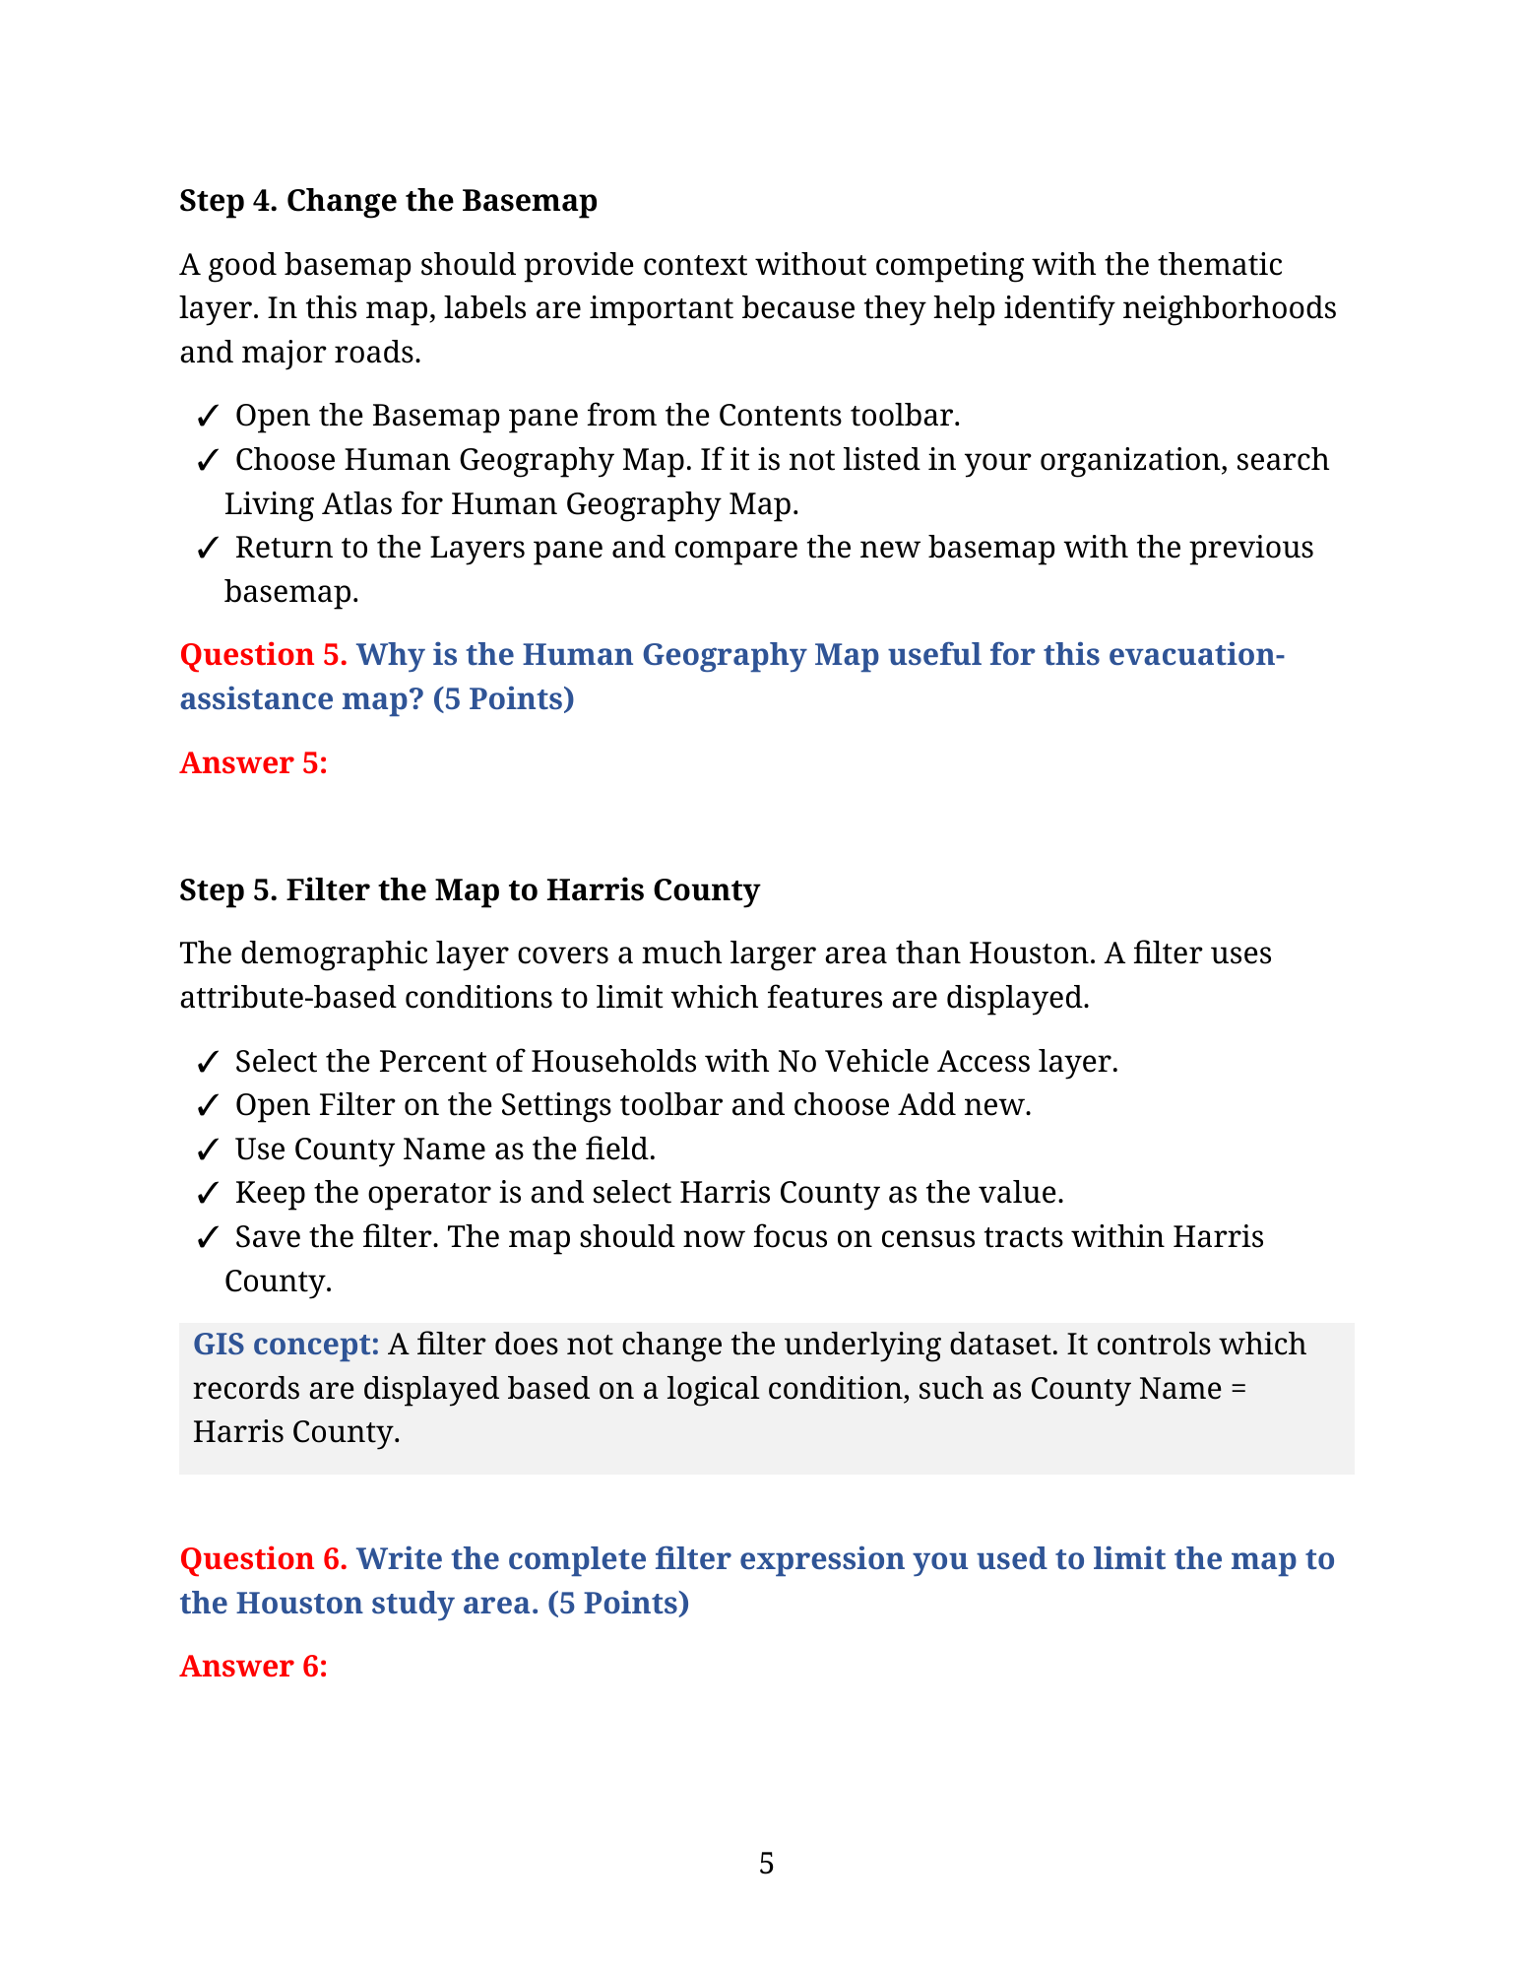
FILTER + ATTRIBUTE TABLE + EFFECTS
Filter: limit the map to a relevant study area or attribute condition.
Attribute table: inspect, sort, and compare values behind the map.
Effects: emphasize priority features while keeping geographic context visible.

Slide 37
SAVE, SHARE, AND THINK ABOUT AUDIENCE
A web map becomes useful when others can access and understand it.
Sharing settings control whether the map is private, shared with a group, or public.
Metadata, title, tags, and summary help others find and trust your map.
Not every map should be public: sensitive locations and personal data require caution.
Ethics question
What could go wrong if a map with sensitive field data is shared publicly?

Slide 38
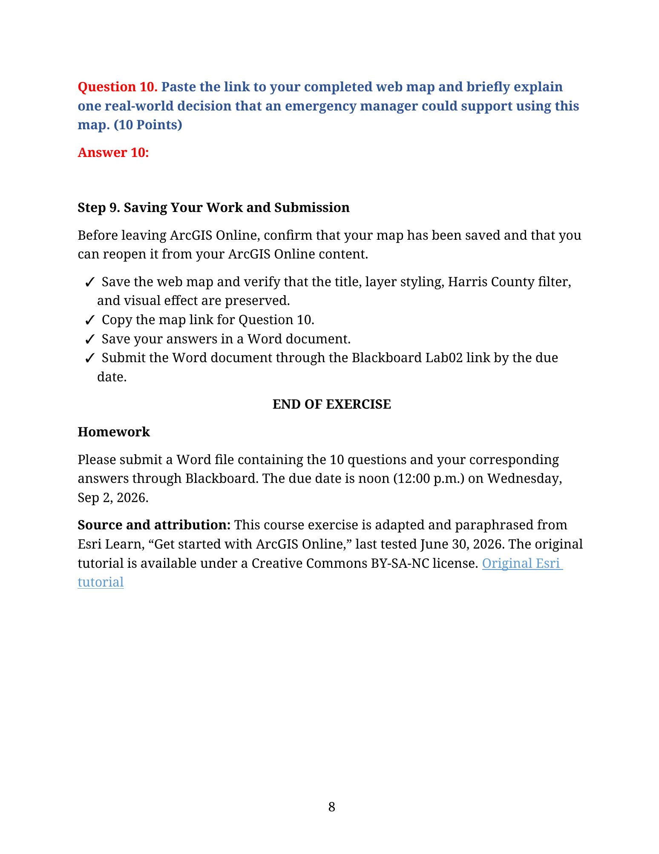
CLASS ACTIVITY: MAP TO ACTION
Open the lab handout and identify the final map product.
Identify one map design choice that could improve emergency decision-making.
Be ready to share one answer with the class.
Wrap-up
One-minute share-out: What action should an emergency manager take after seeing the map?

Slide 39
Lab 01: Introduction to ArcGIS ONLINE
Due by noon (11:59 pm) on WEDNESDAY, Sep 9, 2025
Submit a word document only include question and answer

