Slide 1

WEEK 06
GPS Receiver gps augmentation lecture
Instructor: Yanan Wu
fALL 2025

Slide 2
6.1
Attribute table

Slide 3
Overview
GPS receiver
  Antenna
  Controller
  Receiver Hardware
  GPS Receiver types
    Code Receivers
    Frequency Receivers
  GPS receiver limitation
Assisted GPS
  Information send to cellular device
  A-GPS mode
    UE-assisted
    UE-based
    Differential GPS
    WAAS
    RTK

Slide 4
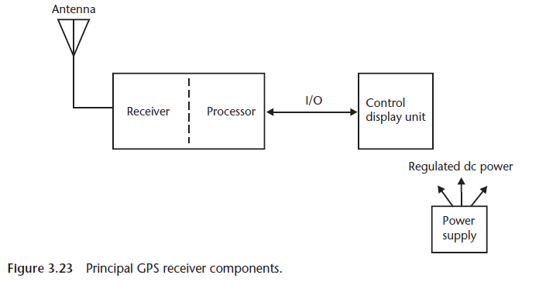
GPS receiver
  An electronic instrument
  Consists: an antenna, a hardware receiver, and a controller
  GPS signals are extremely low in power and get masked with interference
Kaplan & Hegarty, 2006

Slide 5
Antenna
Gathers GNSS/GPS signals from satellite and transform into guided wave
Quality of GNSS/GPS observation primarily depends on the antenna
Antenna remains integrated with the receiver electronics and all are kept in a single rugged case
Antenna can also present as an independent unit.

Slide 6
Global Navigation Satellite Systems (GNSS)
GPS (Global Positioning System – USA)
  Developed and operated by the United States Department of Defense.
  First fully operational GNSS (since the 1990s).
  Constellation: about 31 active satellites.
  Provides global coverage with ~5–10 m accuracy (better with augmentation).

Slide 7
Global Navigation Satellite Systems (GNSS)
GLONASS (Globalnaya Navigatsionnaya Sputnikovaya Sistema – Russia)
  Operated by the Russian Federation.
  Constellation: about 24 satellites.
  Provides global coverage similar to GPS.
  Often used together with GPS for better accuracy and reliability, especially in northern latitudes.

Slide 8
Global Navigation Satellite Systems (GNSS)
Galileo (European Union)
  Developed by the European Union & European Space Agency.
  Fully operational since 2016.
  Constellation: about 30 satellites.
  Known for high accuracy — open service aims for 1 meter, with encrypted services for safety-critical use.

Slide 9
Global Navigation Satellite Systems (GNSS)
BeiDou ( China)
  Built and operated by China.
  Third generation (BeiDou-3) became fully global in 2020.
  Constellation: about 35 satellites.
  Provides regional and global services, with navigation, timing, and even short message communication.

Slide 10
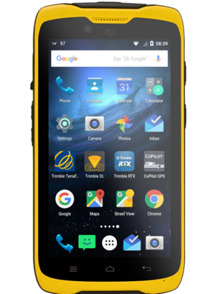
Antenna
The TDC100 has a built-in GNSS antenna inside the rugged handheld body (at the top left of the device, near the speaker).
It receives satellite signals (GPS, GLONASS, Galileo, BeiDou) directly without needing an external antenna.
Designed to work outdoors, it minimizes multipath errors and interference.
TDC 100
Trimble website
Notes:
Trimble TDC100 and Trimble TSC3

Slide 11
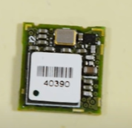
Receiver hardware

Slide 12
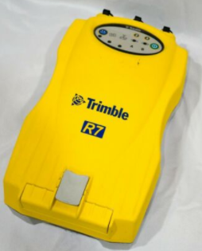
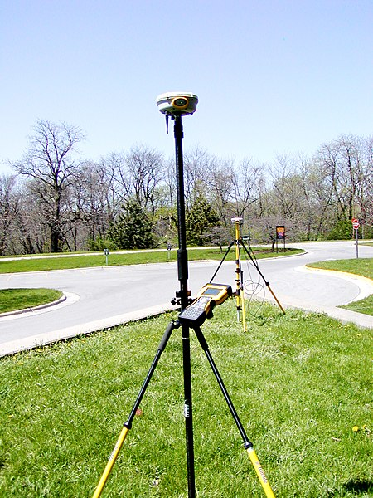
Receiver
Trimble R7
https://commons.wikimedia.org/wiki/File:Station_GPS_receiver.jpg

Slide 13
Processor
The device runs on Android OS.
This processor not only handles GNSS signal processing but also runs field apps like Trimble TerraFlex, Esri Field Maps, or Collector.
It integrates GNSS calculations with mapping, data entry, and communication functions.

Slide 14
I/O (Input/Output)
On the TDC100, I/O is through:
  Touchscreen (main user input/output).
  USB-C and Bluetooth/Wi-Fi (data transfer, connectivity with PCs, sensors, or cloud).
  Cellular 4G LTE (real-time sync to ArcGIS Online, Trimble Connect, etc.).
These allow data collected in the field to move seamlessly into enterprise GIS systems.

Slide 15
Control Display Unit
The rugged touchscreen display is the control and display unit.
Users can:
  View GNSS status (satellite strength, accuracy, corrections).
  Interact with GIS apps, maps, forms, and data layers.
  Control system settings and monitor battery/power.
Brightness and ruggedness are optimized for field visibility and durability.

Slide 16
Trimble tdc 100 series handheld overview
https://www.youtube.com/watch?v=fimWxYMRiF8

Slide 17
In-Class Activity: Exploring GNSS with SatLook
What do you think affects GPS accuracy?
Open SatLook on your TDC100.
Show the 3 tabs:
  Sky Plot → Satellites in the sky (constellation + geometry).
  NMEA → Raw GNSS data (for advanced logging).
  SNR → Signal strength for each satellite.
  Highlight: “Tracked vs Used satellites”, SNR levels, and constellations (GPS, GLONASS, BeiDou, Galileo).

Slide 18
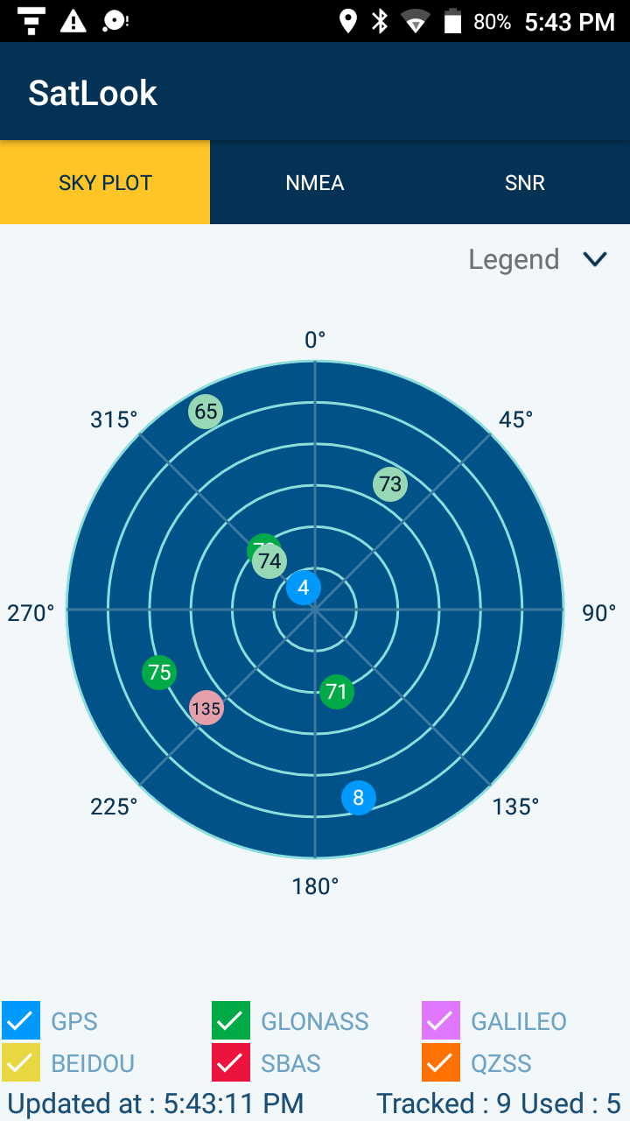
In-Class Activity: Exploring GNSS with SatLook
The polar plot shows the sky overhead, with your device in the center.
Each dot = a satellite being tracked.
Numbers inside the circles = satellite PRN numbers (identifiers).
Position of the dot = where the satellite is in the sky (azimuth & elevation).
“Tracked: 9 Used: 5” at the bottom means:
  9 satellites are visible
  5 are actually being used in your position calculation
👉 This tells you how well the antenna is seeing the sky. If many satellites are visible and used, your accuracy improves.

Slide 19
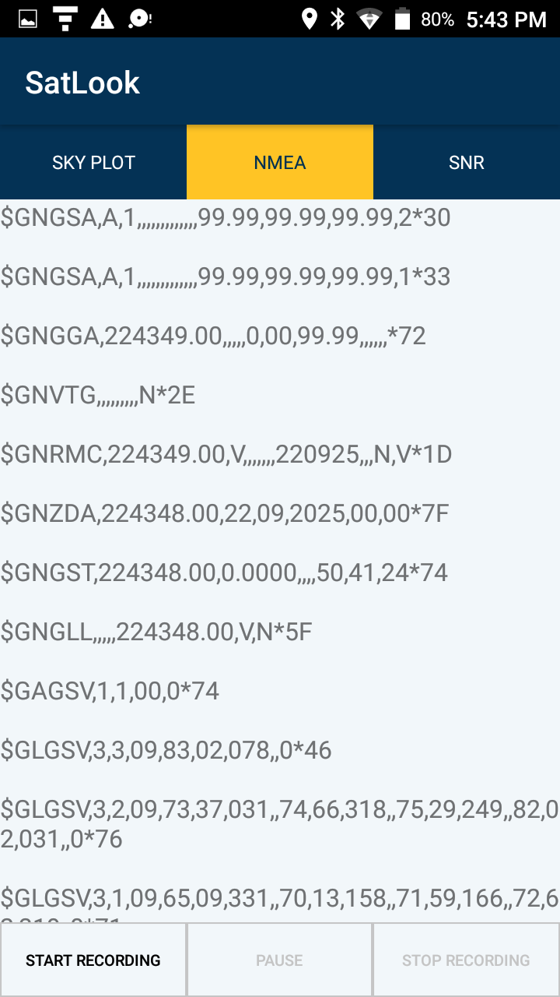
In-Class Activity: Exploring GNSS with SatLook
NMEA Data (NMEA tab)
NMEA = a standard GPS message format.
Each line starts with $ and a code that tells you what the sentence means. For example:
  $GNGSA → GNSS DOP and active satellites (Dilution of Precision info).
  $GNGGA → Fix data (time, latitude, longitude, altitude, fix quality).
  $GNRMC → Recommended Minimum GPS Data (time, date, position, speed).
  $GLGSV → Satellites in view (from GLONASS).
Explore Start Recording

Slide 20
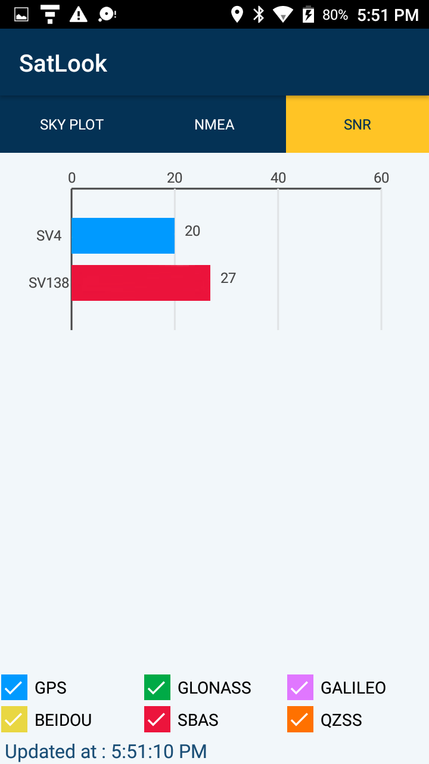
In-Class Activity: Exploring GNSS with SatLook
SNR = Signal-to-Noise Ratio
SNR measures how strong and clean the satellite’s signal is compared to background noise.
Units: dB-Hz (decibels relative to 1 Hz).
Higher = better (stronger, clearer signal).

Slide 21
In class activity
For optimal GNSS reception, hold the handheld at 15° from horizontal allowing it visibility of the sky.
When collecting point data with a TDC100 handheld, it is recommended that you remain stationary at the point for at least 10 seconds before beginning to log GNSS positions.
This allows the GNSS receiver’s internal algorithms to stabilize, and ensures the best possible point feature accuracy

Slide 22
To use the GNSS receiver: 1. In the Apps screen, tap Settings then tap Location. 2. Slide the Location slider to On. 3. Tap Mode then select the mode you want the device to use to determine your location: l High accuracy. Uses GNSS satellites, WLAN, and cellular networks to determine your location. l Battery saving. Uses WLAN and cellular networks to determine your location. l Device only. Uses GNSS only to determine your location. 4. Tap NMEA output to turn it on or off. 5. Tap SBAS mode to turn it on or off. 6. Tap Location mode then select the Location mode you want the device to use (GPS + BDS; GPS + GLONASS; GPS only). 7. Tap Update rate to modify the update rate of the GNSS solution. Two settings are available; 1s and 2s. By default the receiver is set to 2s but it is recommended that you use 1s to maximize reactivity of any GNSS applications.

Slide 23
The TDC100 handheld achieves optimal GNSS results when used with the Trimble TerraFlex™ software (available mid-August 2016).

Slide 24
How to access the photo gallery
Connect TDC100 to your computer with a USB cable.
On the TDC100 screen, swipe down from the top → you’ll see a notification like “USB charging this device.”
Tap the notification → select File Transfer (MTP) or Media Transfer.
Now, on your computer, open This PC → TDC100 → Internal Storage → pictures.
  Your photos and screenshots should be there.

Slide 25
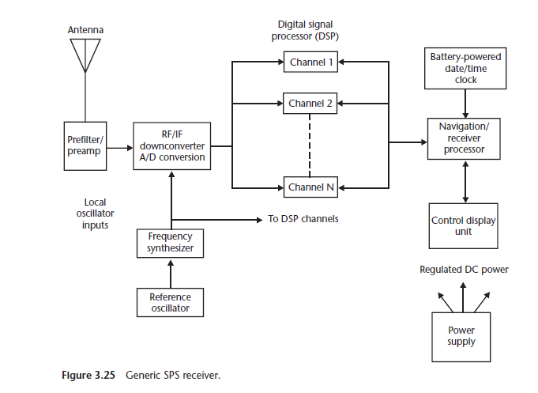
Receiver hardware
Many functional elements present within a GPS receiver hardware
  Filters, Amplifier, Frequency unit, Process unit
Kaplan & Hegarty, 2006
Notes:
GPS signals are very low in power, as well as it get merged with interference from the higher powerful signals. So we need to improve the power or in the signal as well as we need to filter the interference as well as we need to for the process the signal to get our desire parameters. In order to get those things the GPS receiver hardware contains filters, amplifiers, frequency unity, digital signal, processing unit.
We wanted at an intermediate frequency a lower frequency than one and a half gighertz so we can sample and digitally store the signal.
IF: intermediate frequency, in which incoming signal is shifted to an IF for amplification.
Converted it to intermediate frequency signal, that means the signal will be possible to be processed through digital signal processor.

Slide 26

Thank you!

