Slide 1

WEEK 05 attribute and geodatabase lecture
Instructor: Yanan Wu
fALL 2025

Slide 2
5.1 Attribute table

Slide 3
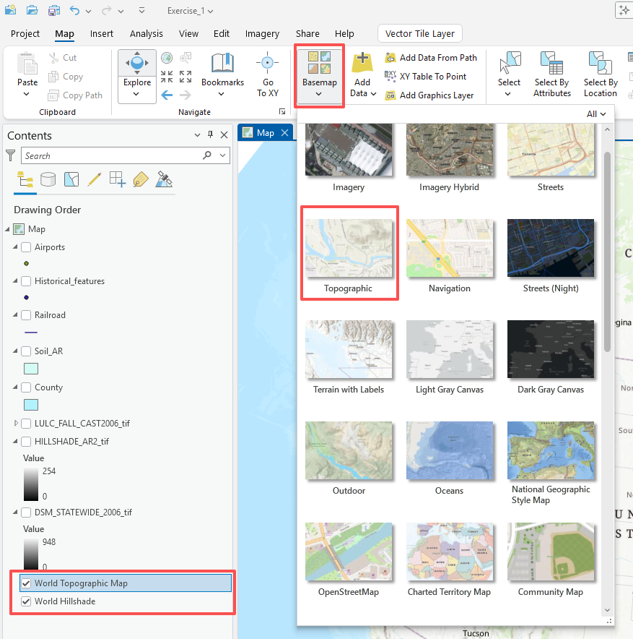
Lab 01
Question 1. How many layers are included on this map excepting the background layers of World Topographic Map and World Hillshade? (5 Points)
Answer 1: 8

Slide 4
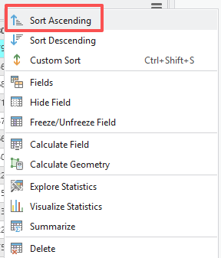
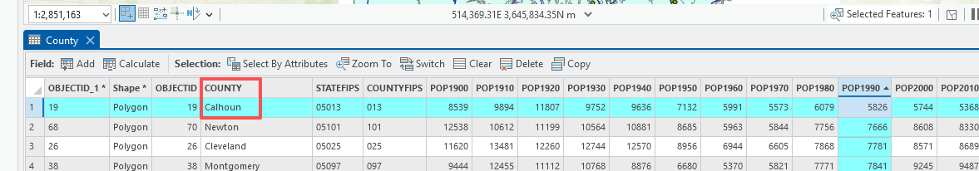
Lab 01
Question 8. What county had the smallest population in 1990?
(Hint: use the “POP1990” field)? (5 Points)
Answer Q8: Calhoun

Slide 5
Lab 01
Question 9. Which county experienced the greatest population increase between these years? (Hint, you can sort the field by right-clicking on the field name (i.e., change) and select Sort Descending or Ascending) (10 Points)
Answer 09: Benton

Slide 6
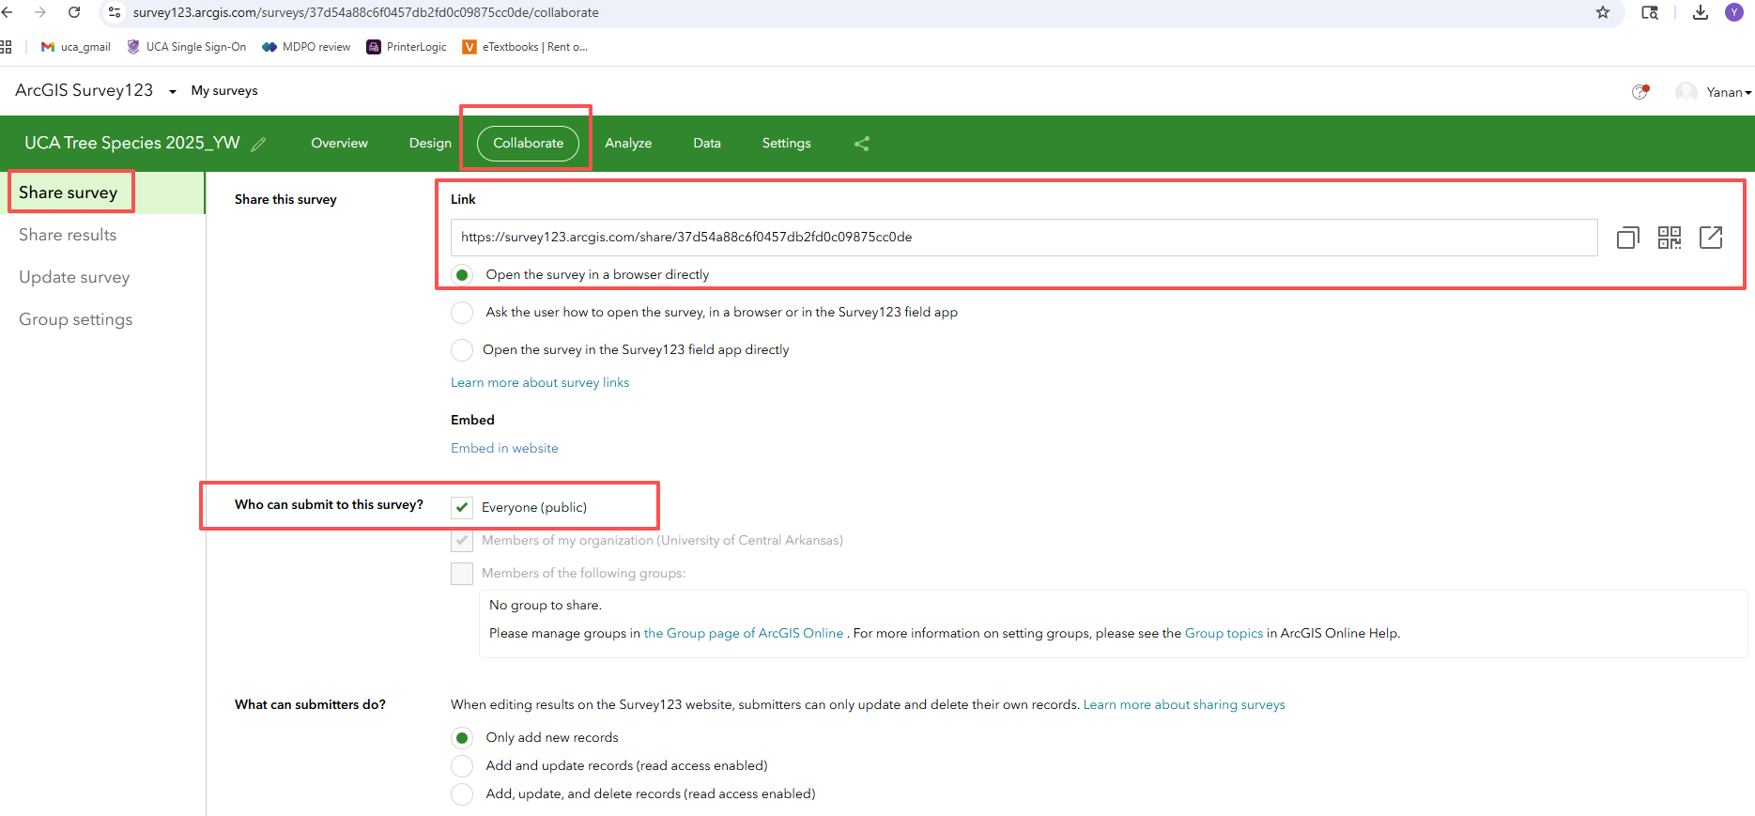
Lab 02
Deliverable 1: Please paste the URL of your survey123. Make sure to share everyone, so that I can see it (20 points)

