Slide 1

GEOG 3319: Geographic Field Techniques
Lecture 01 Introduction
Yaqian He, PhD
Assistant Professor
Department of Geography

Slide 2
Overview
Introduction
Who am I?
Who you are?
Course overview and Expectations
Syllabus
Software
Survey Tools
What is GNSS?
What is UAV?

Slide 3
Who am I?
Yaqian He
Assistant Professor, Geography Department @ UCA
Education
Postdoc, Climate Modeling & Impacts @Dartmouth
PhD, Department of Geology and Geography @West Virginia University
M.S. Cartography and GIS @ Beijing Normal University, China
B.S. Surveying Engineering @ China University of Mining and Technology

Slide 4
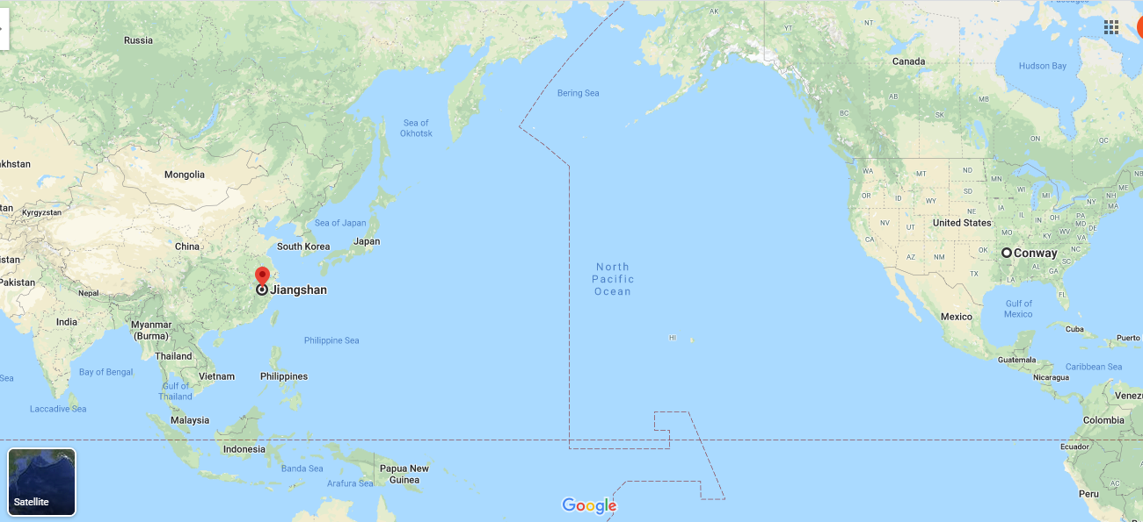

Who am I?

Slide 5
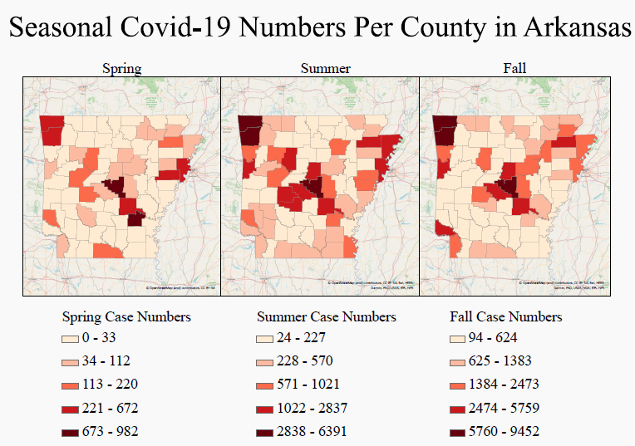
Who am I?
Climate and socioeconomic impacts on Covid-19 spread in Arkansas
Paul Seminara, funded by UCA AURS, UCA and INBRE. Got first prize in student paper competition at SWAAG
Notes:
Advancement of undergraduate research in the Science (AURS)

Slide 6
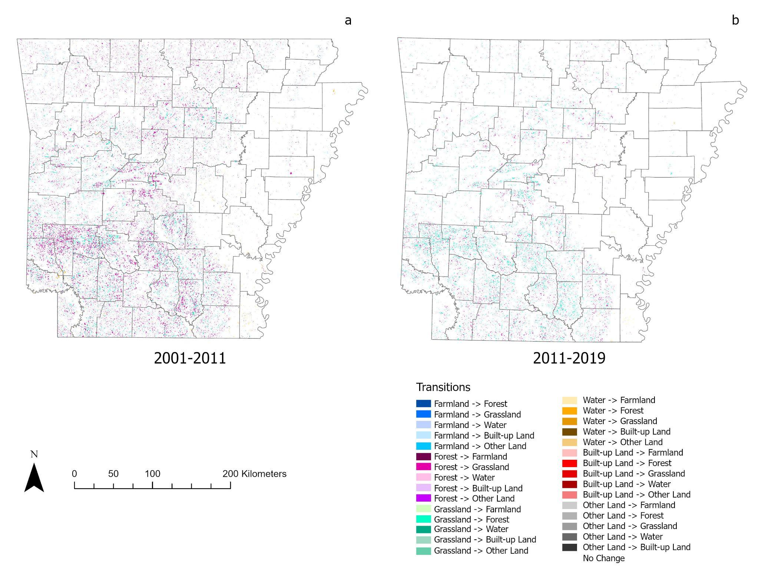
Who am I?
Land cover/ land use change-carbon emission in Arkansas
Wei Tay, funded by SERF
Notes:
Southwestern Energy Research Fellow

Slide 7
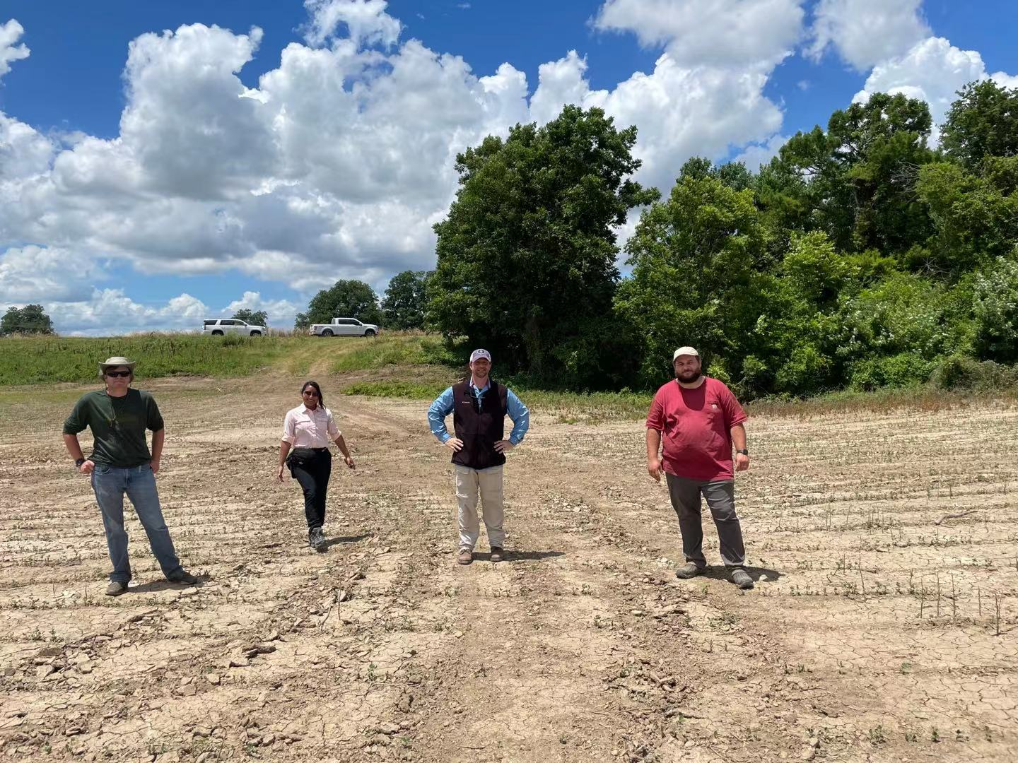
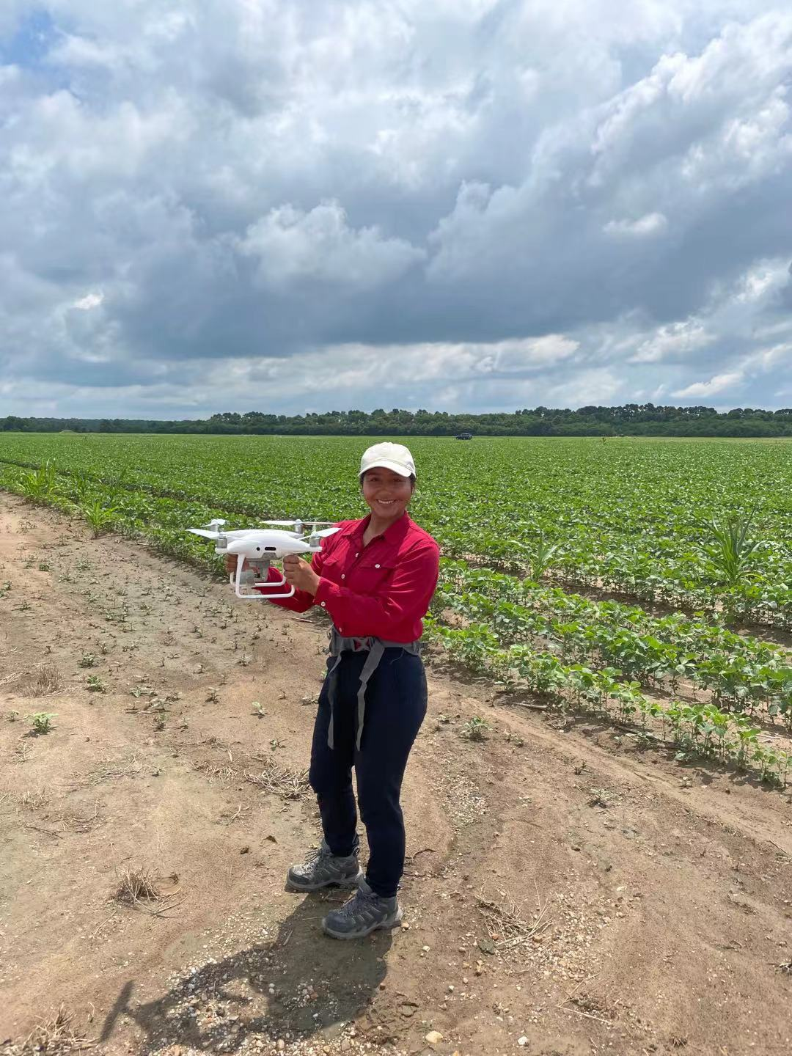
Who am I?
Climate-irrigation-Crop yields interaction in Arkansas using UAV and statistical model
Caden Rhodes , Marisol Filares Arreguin, Dr. Connolly, Matthew Davis
Funded by NASA EPSCoR

Slide 8

Who am I?
https://uca.edu/news/nasa-irrigation/

Slide 9
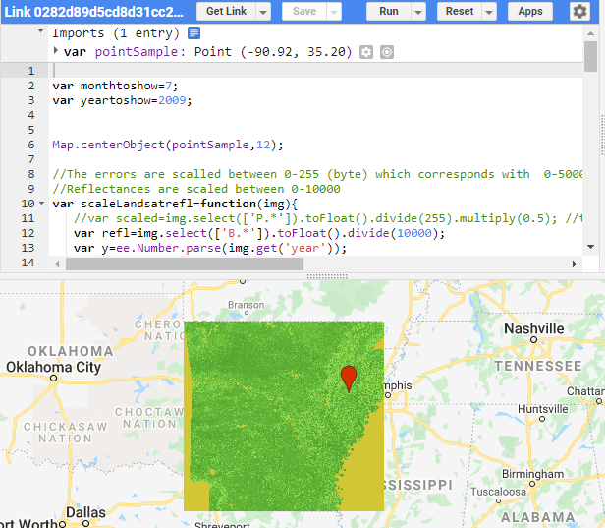
Who am I?
Tree species identification using remote sensing data
Willow Hoper, funded by ASGC with Dr. William Flatley

Slide 10
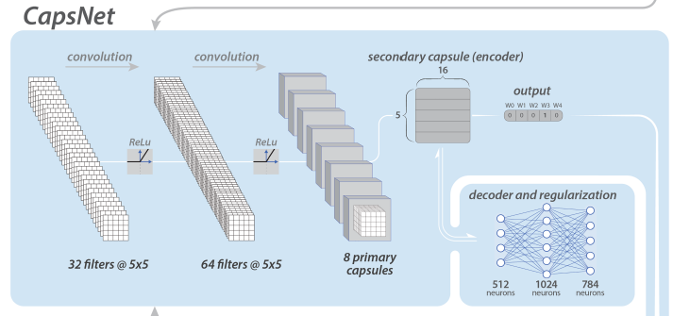
Who am I?
Machine learning in predicting climate extremes
Chattopadhyay et al., 2020

Slide 11
Who am I?
Geospatial and Climate Modeling Group @UCA
https://yaqianhe.github.io/research/

Slide 12

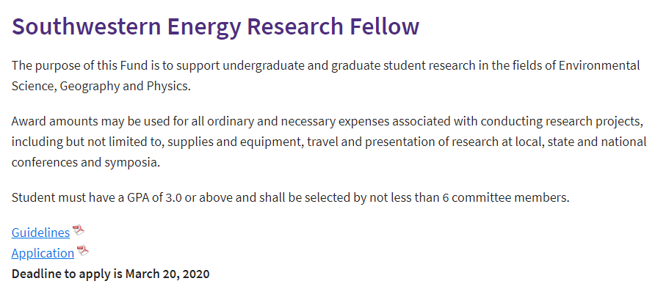
Who am I?
https://uca.edu/cnsm/research-awards/

Slide 13
About you
Your name and degree program
Your study interests
Which year you are?
GNSS/GPS knowledge?
GIS mapping knowledge?
Drone flying knowledge?
What do you expect from this class?

Slide 14
Course overview and expectations
Course Structure
Lecture
Interactive and inclusive environment
Feel free at any time during lecture to ask a question and make a comment
Lecture will be recorded and delivered on Blackboard if necessary
In-class lab exercise
Work individually on the in-class exercise
Guidance will be provided; demonstration will be provided if necessary
When submit exercise, copy questions in the guidance and provide answers in a word file
Feel free at any time to ask a question
Field work
On campus data collection and off-campus your group data collection
Drone flying practice on campus, may fly off-campus

Slide 15
Course overview and expectations
Final Group Project (based on GNSS/GPS)
Design research question (guidance will be introduced in lecture time)
Collection you own data
Map and analyze your data
Present your project on the final
Submit your report
Quiz
Quiz based on lecture note
Multiple choice
Quiz will be delivered on Blackboard
One page and one side of A4 cheat sheet is allowed

Slide 16
Course overview and expectations
Book
Understanding GPS: Principles and Applications edited by Elliott D. Kaplan and Christopher J. Hegarty (ISBN-10: 1580538940; ISBN-13: 9781580538947) (https://d1.amobbs.com/bbs_upload782111/files_33/ourdev_584835O21W59.pdf)
Fundamentals of Capturing and Processing Drone Imagery and Data edited by Amy E. Frazier and Kunwar K. Singh (ISBN 9780367245726)

Slide 17
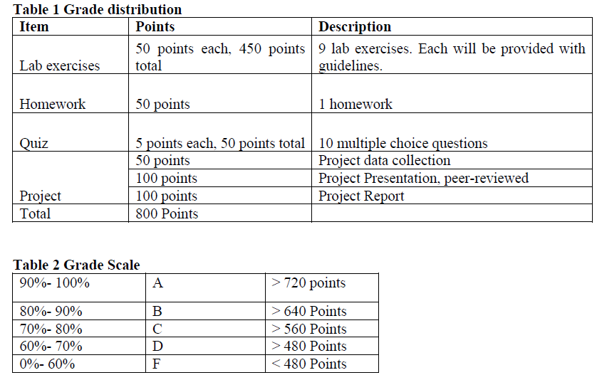
Course overview and expectations
Grading

Slide 18
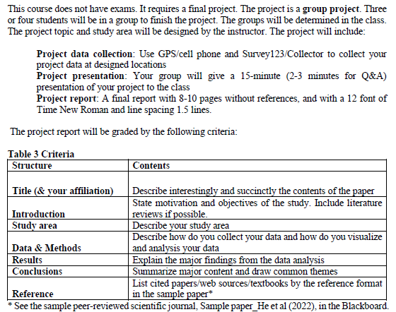
Course overview and expectations
Grading

Slide 19
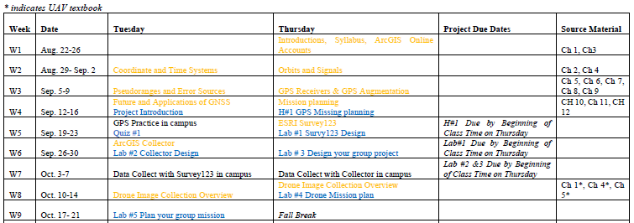
Course overview and expectations
Schedule

Slide 20
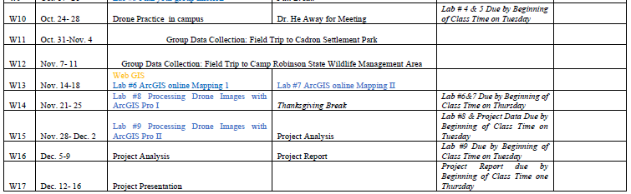
Course overview and expectations
Schedule

Slide 21
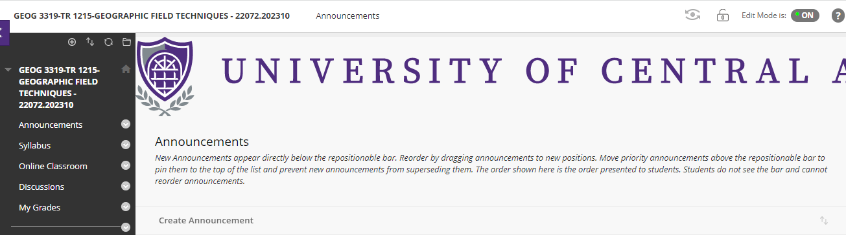
Course overview and expectations
Place for slides, video, and submitting lab exercise

Slide 22
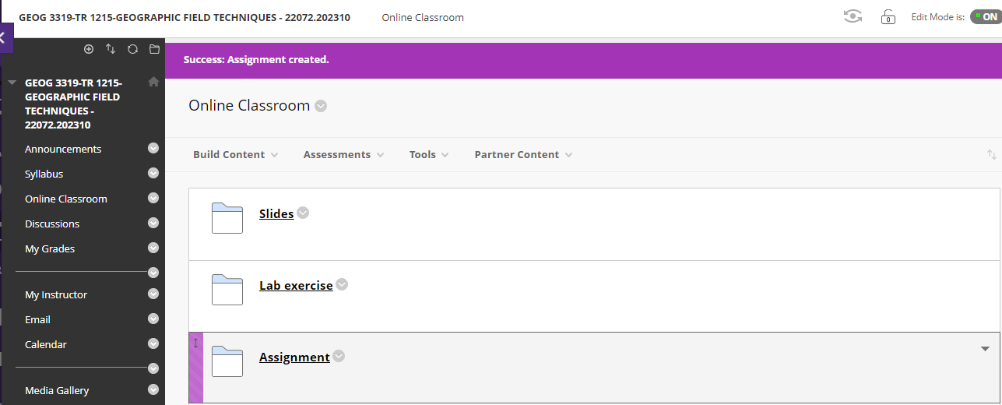
Course overview and expectations
Place for slides, video, and submitting lab exercise

Slide 23
Course overview and expectations
Attendance
Prolonged absence from class will inhibit your understanding of the lecture material and prevent you from receiving help on assignments
Up to 3 times of absence may result in moving out from this class
If you cannot attend class, please contact me before class
Covid-19 related absences are acceptable, please contact me for re-arranging lab exercise etc

Slide 24
Course overview and expectations
After this course
Explain GNSS principles and concepts
Collect spatial data using GPS and cell phone through Esri Collector and Suvey123
Implement field data into GIS software (Esri ArcGIS)
Produce maps using ArcGIS online mapping technique
Explain UAV concepts and regulations
Fly UAV
Process UAV images using GIS software (Esri ArcGIS)
Address a spatial problem using collected data

Slide 25
Course overview and expectations
Structure
In-person
Lecture
Lab
Field work
Online
Office hour through Zoom (TR 10:00 am to 11:50 am)
Zoom link has been posted on Blackboard and emailed to you
Please email me to make an appointment
Record
Lecture if necessary
The recorded video will only send the student who requested
May Change!
Please regularly check your Blackboard or email

Slide 26
Course overview and expectations
Contact Info
Lewis 036
Office Hour:
TR 10:00-11:50 am
Through Zoom
Email: yhe@uca.edu

Slide 27
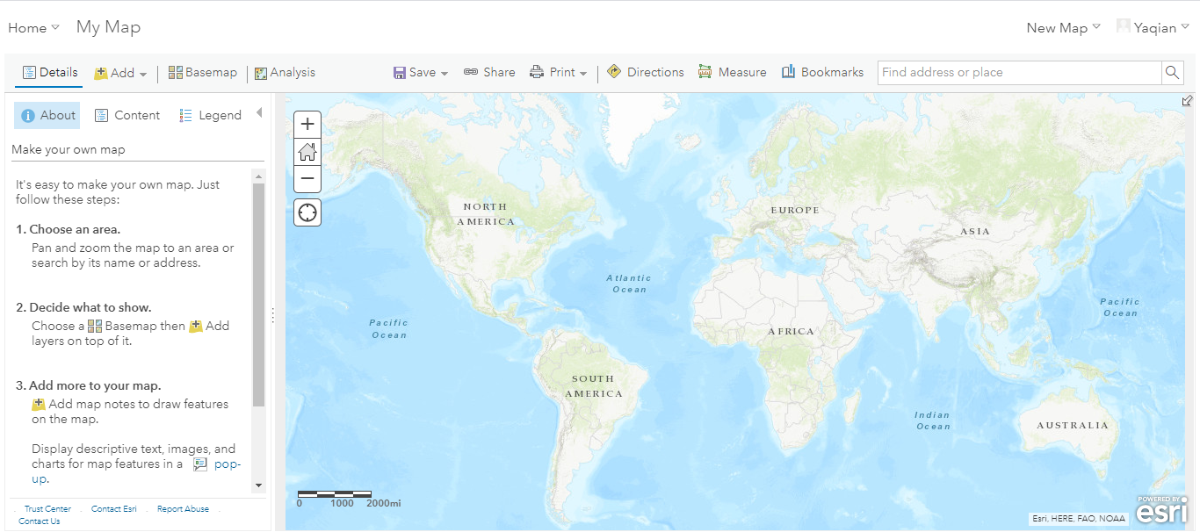
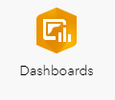
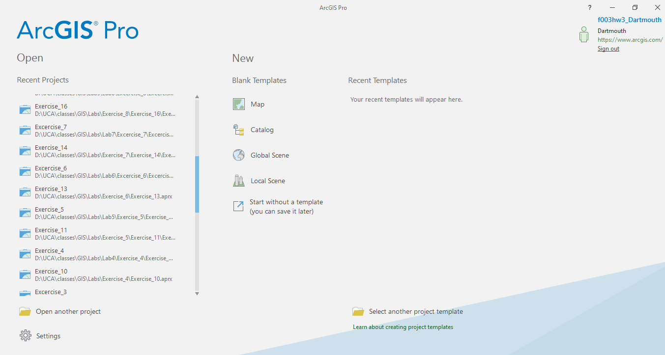
Mapping software
Mapping Techniques
ArcGIS online
Mapping
Analyze
Dashboard
ArcGIS Pro

Slide 28
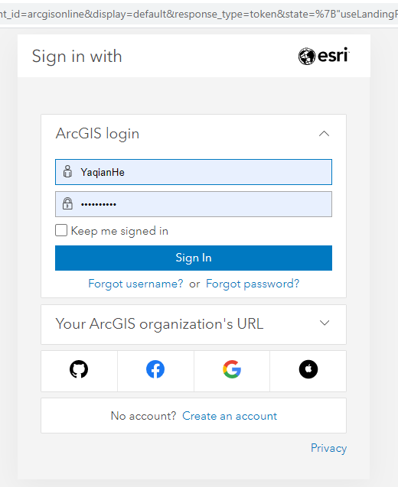
Mapping software
ArcGIS Pro installed in your own PC
Please check your email, an invitation to set up your ArcGIS online account has been sent to you!

Slide 29

Mapping software
ArcGIS Pro installed in your own PC

Slide 30
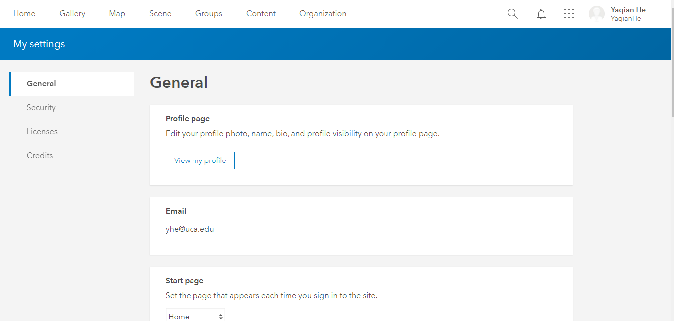
Mapping software
ArcGIS Pro installed in your own PC

Slide 31
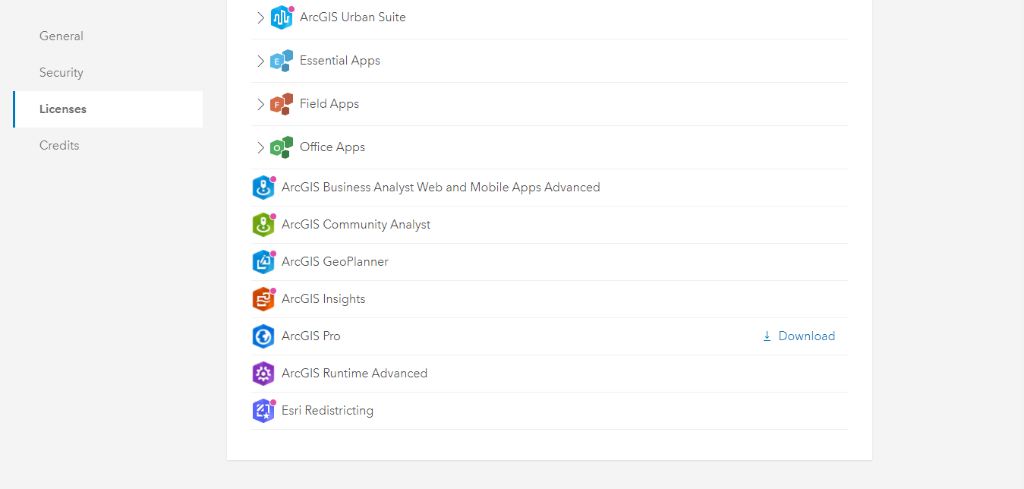
Mapping software
ArcGIS Pro installed in your own PC

Slide 32
Software
Windows system
Software requirement: Microsoft .NET
Hardware requirement: https://pro.arcgis.com/en/pro-app/latest/get-started/arcgis-pro-system-requirements.htm

Slide 33
ESRI https://pro.arcgis.com/en/pro-app/latest/get-started/run-pro-on-a-mac.htm Harvard https://gis.harvard.edu/faq/how-installing-arcgis-desktop-or-pro-mac-computer
Mapping software
ArcGIS Pro installed on Mac/other computer
Mac
Other PCs (e.g., Chromebook, Microsoft surface)
Please talk with/email to me

Slide 34

Survey tools
Survey123
Survey app
Create smart forms
Collect anytime, anywhere
Analyze & share results

Slide 35
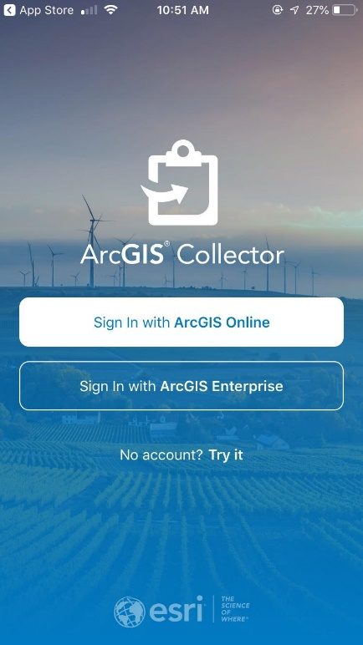
Survey tools
Collector
Survey app
Create a smart feature layer
Collect anytime, anywhere
Analyze & share results

Slide 36

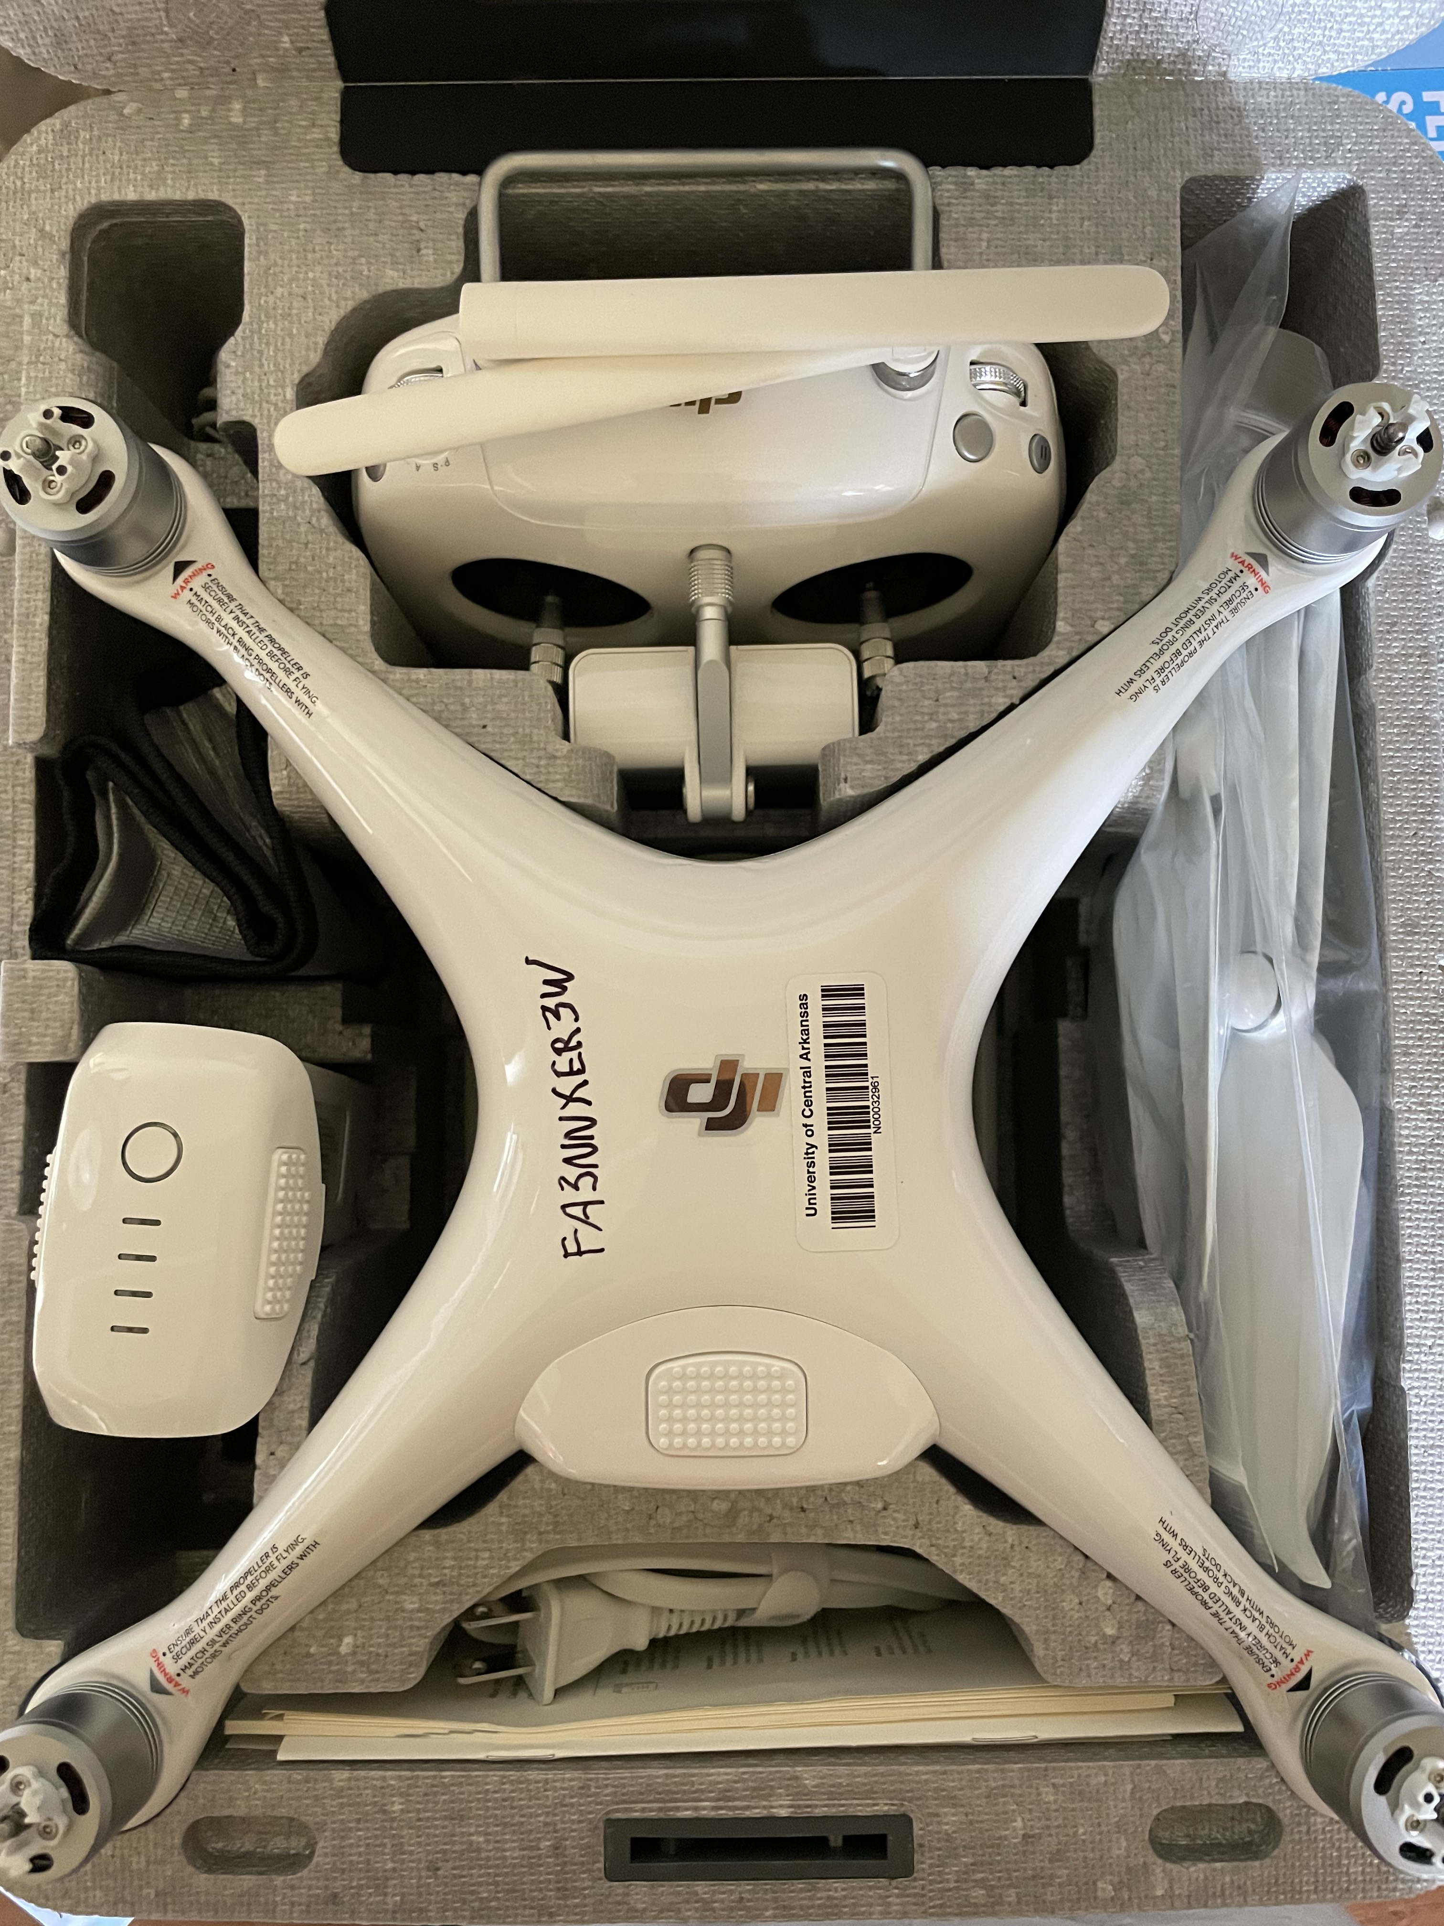

Survey tools
DJF Phantom IV
DJF Ground Station Pro (only iPad)
DJF GO 4
John
https://www.dji.com/downloads/djiapp/dji-go-4

Slide 37
Check ArcGIS Online Account

Slide 38
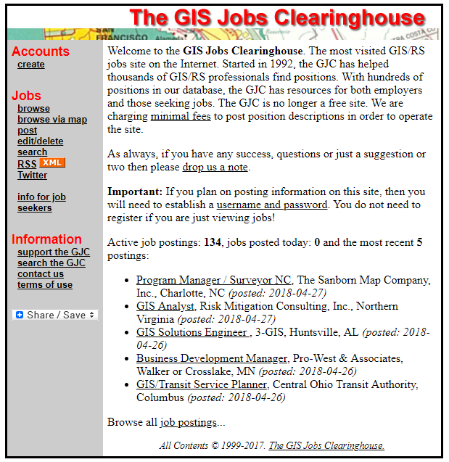

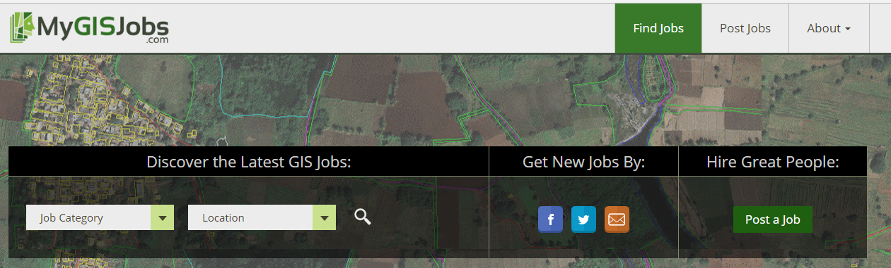
Professional development
Geospatial Job Market
Job titles include:
GIS Technician
GIS Analyst
Remote Sensing Analyst
GIS Programmer
GIS Web Developer
Aerial Survey Technician
Survey Technician
Image Analyst
Etc.
https://www.gisjobs.com/
https://www.mygisjobs.com/
http://www.gjc.org/
Notes:
Here are some examples of geospatial job titles.
I would recommend the GIS Jobs Clearinghouse, MyGISJobs, or GISJobs.com if you are job hunting.

Slide 39
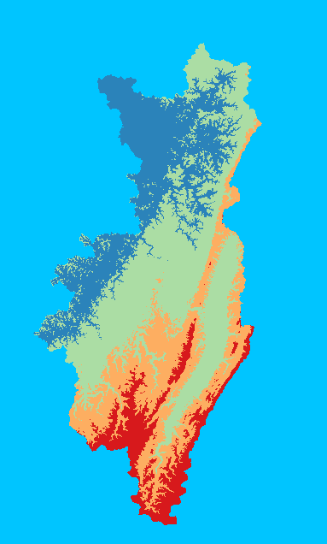
Important Geospatial Skillsets
Professional development
Spatial problem solving
Spatial analysis
Software troubleshooting
Statistics
Spatial predictive modeling
Database management
Web GIS
Python scripting
Cartography/Map design
Graphic design
Remote sensing/Image interpretation
GPS technology
Notes:
Here are a list of some key, marketable job skills in the geospatial sciences.
No one can do all of these things. If you are hoping to work in this field, I would recommend focusing on some key skills to develop and market.
Specifically, if you are interested in data analysis, it would be worth learning Python scripting.
If you are interested in data management, I would try to learn some Structured Query Language or SQL.
If you are interested in web development and web mapping, learn some HTML, CSS, and JavaScript.
As you advance through your career you will continue to develop skills. Also, new technologies and methods will require you to learn new skillsets.
Although this can be frustrating, it is exciting to be involved in a rapidly growing and developing discipline.

Slide 40

Professional development
Department of Geography @UCA

Slide 41
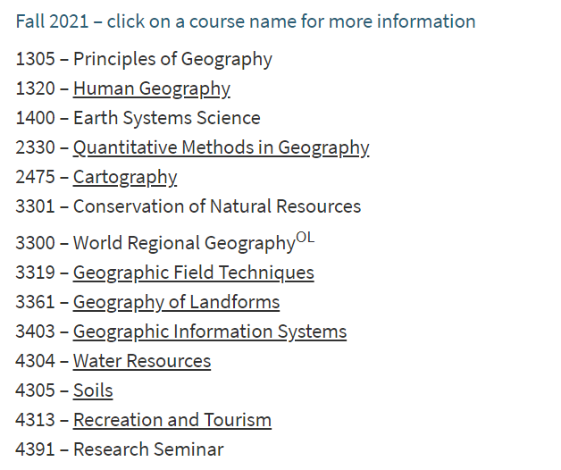
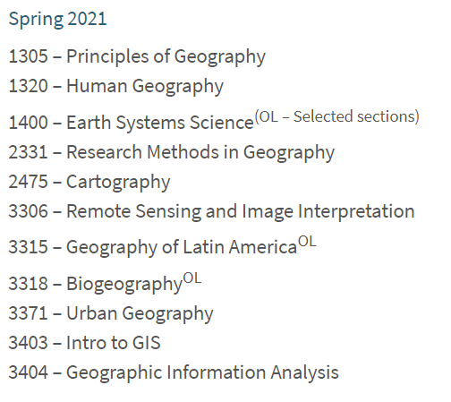
Professional development
Department of Geography @UCA

Slide 42

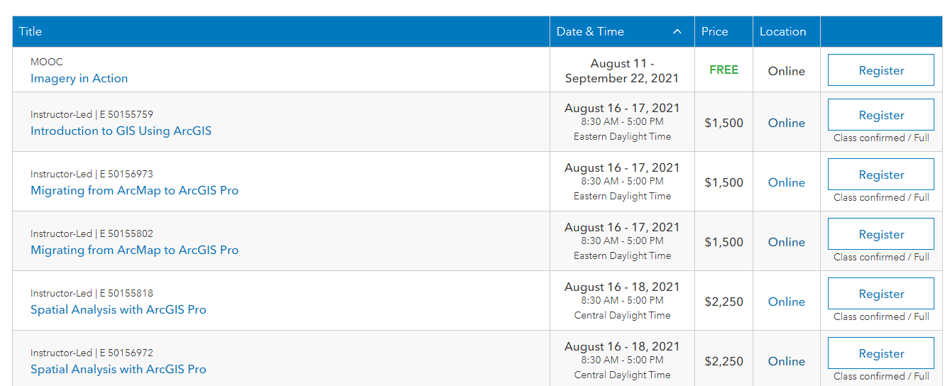
Professional development
ESRI Academy

Slide 43
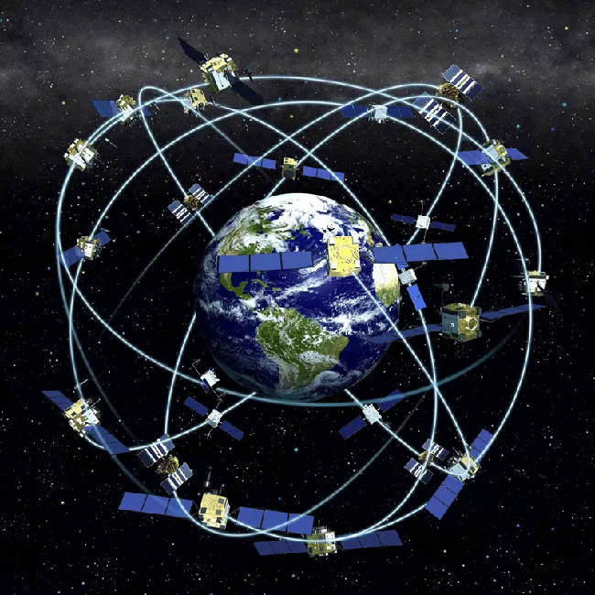
What is GNSS?
Global Navigation Satellite Systems
A space-based satellite navigation system that provides autonomous positioning information with a global coverage.
Encompasses all existing and planned satellite navigation systems such as GPS, GLONASS, Gaileo, Beidou, etc.
NOAA: https://celebrating200years.noaa.gov/transformations/gps/Figure_1.html

Slide 44
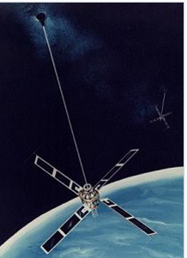
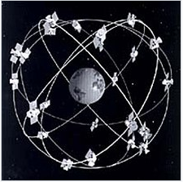
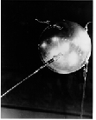
History of GNSS?
History
Sputnik
1957
Transit
1960
GPS
1978
https://history.nasa.gov/sputnik/gallerysput.html
https://en.wikipedia.org/wiki/Transit_(satellite)
https://en.wikipedia.org/wiki/GPS_satellite_blocks
Notes:
1964 transit become operational and 1967 transit release for commercial use
GPS (NAVSTAR GPS) launched in 1978, the full constellation of 24 satellites operational in 1993. Now total is 31 satellites in operation (https://www.gps.gov/systems/gps/space/#:~:text=The%20satellites%20in%20the%20GPS,any%20point%20on%20the%20planet.).
Transit position fix rate range from every 30 minutes to 110 minutes. Low-dynamic platform, first satellite-based geopositioning system

Slide 45
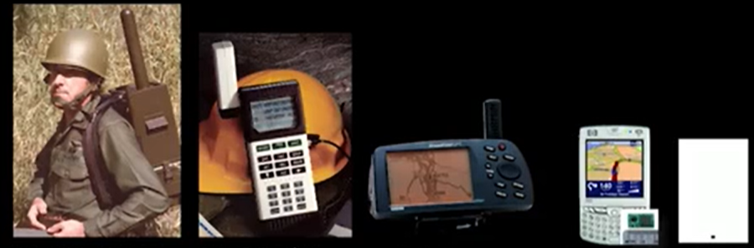
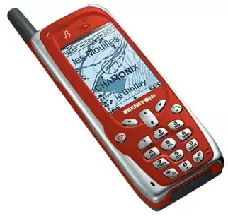
History of GNSS?
First portable GPS, 25 lb
1978
First handheld GPS
1989: Magellan navigation
In-car GPS
1998: Mazda
First GPS
Phone
1999: Benefon
GPS chip, 2mm
2013
MOOC, Sandford University
Notes:
1989, Magellan navigation Inc. Magellan NAV 1000
1990, Mazda introduced the first ever GPS system for automotive navigational use.
1999 Mobile phone manufacturer Benefon launched the first commercially-available GPS phone, a safety phone called the Benefon Esc

Slide 46
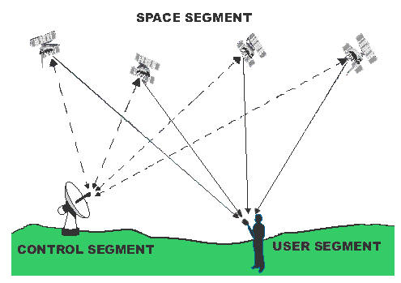
GNSS segment
GNSS segment
Space segment
Control segment
User segment
https://www.pdhonline.com/courses/l116/l116content.htm

Slide 47
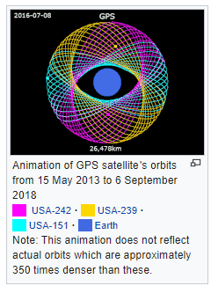
GNSS segment
Space segment
Comprises of the constellation of satellites
Each satellite broadcasts to the user an accurate time reference and a navigation message with ephemeris information
Example: GPS
Consists of 31 satellites on 6 orbits (~ 22,000 km from the center of the Earth)
Each satellite carries a clock
https://en.wikipedia.org/wiki/GPS_satellite_blocks
Notes:
Each plane contains four "slots" occupied by baseline satellites. This 24-slot arrangement ensures users can view at least four satellites from virtually any point on the planet (https://www.gps.gov/systems/gps/space/#:~:text=The%20satellites%20in%20the%20GPS,any%20point%20on%20the%20planet)

Slide 48
GNSS segment
Control segment
Consists of worldwide monitor and control stations
Maintain the satellites in their proper orbits through occasional command maneuvers
Adjust the satellite clocks
Example: GPS
A master control station
An alternate master control station
Four dedicated ground antennas
Six dedicated monitor stations

Slide 49
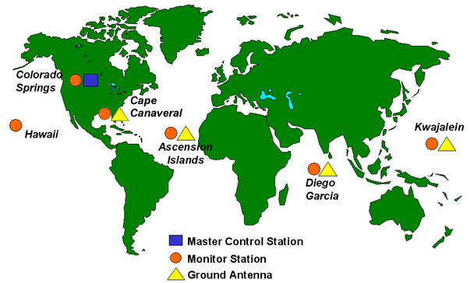
GNSS segment
Control segment
https://unstats.un.org/unsd/geoinfo/UNGEGN/docs/_data_ICAcourses/_HtmlModules/_Selfstudy/S06/S06_05a.html
Notes:
Alternate master control station in California

Slide 50
GNSS segment
Control segment
Master Control station
Collect and process the monitor station measurements
Generate satellite ephemeris and clock estimates and predictions
Monitor Station
Monitor range and carrier measurement
Collect atmospheric data
Ground Antenna
Upload the navigation data to Satellite
Notes:
https://www.vectornav.com/resources/inertial-navigation-primer/theory-of-operation/theory-gnss

Slide 51
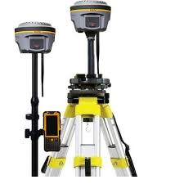
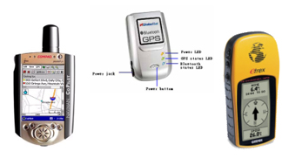
GNSS segment
User segment
Comprises of Hundreds of thousands of civil, commercial, and scientific users
In general, GPS receivers are composed of an antenna, receiver-processors, controller, and a highly stable clock.
https://unstats.un.org/unsd/geoinfo/UNGEGN/docs/_data_ICAcourses/_HtmlModules/_Selfstudy/S06/S06_05a.html
https://unstats.un.org/unsd/geoinfo/UNGEGN/docs/_data_ICAcourses/_HtmlModules/_Selfstudy/S06/S06_05a.html

Slide 52
GNSS application
Land
Survey, hiking, E-911, Vehicle ‘s GPS
Aviation
Flight, Unmanned Arial Vehicle or drone
Maritime
Ship navigation
Space
Spacecraft orbit determination, atmospheric research

Slide 53
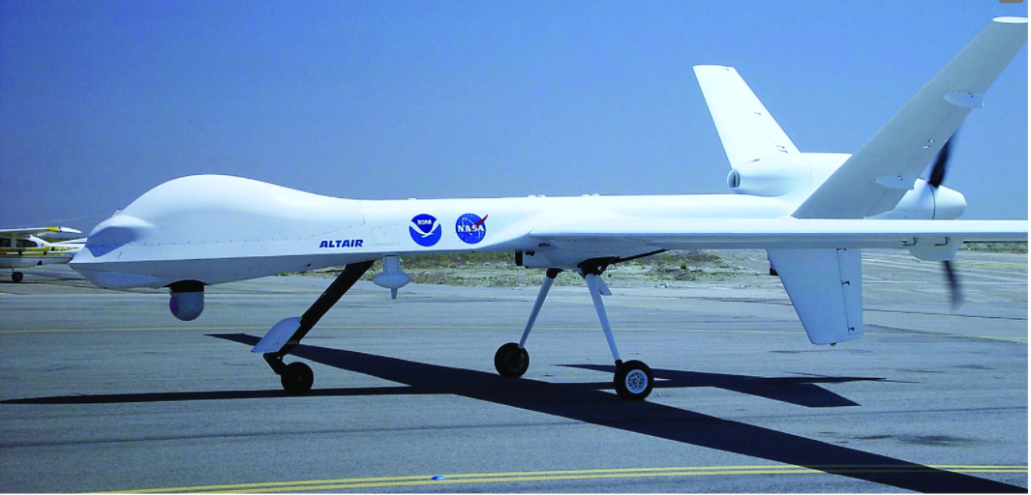
What is UAV?
UAV
Unmanned Aerial Vehicle or System or drone
It is simply a pilot-less aircraft.
Frazier and Singh, 2021

Slide 54
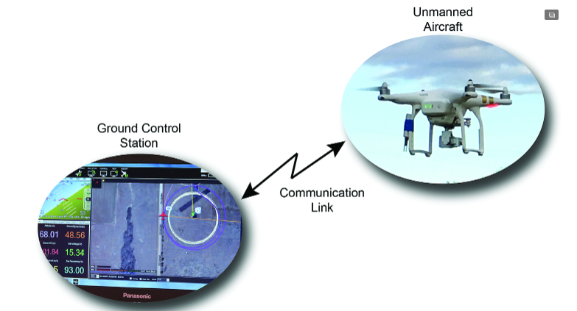
UAV component
Unmanned aircraft platform
Ground control station
Data communication link
Frazier and Singh, 2021
Notes:
A drone controller works by sending a radio signal from the remote control to the drone, which tells the drone what to do.
Radio signals are sent from the radio transmitter in the drone controller and received by the drone’s receiver.
High-end drones like DJI drones use an advanced communication system known as OcuSync that allows them to fly up to 10 KM (6.2) Miles.

Slide 55
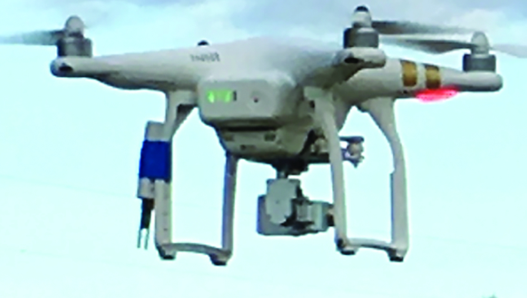
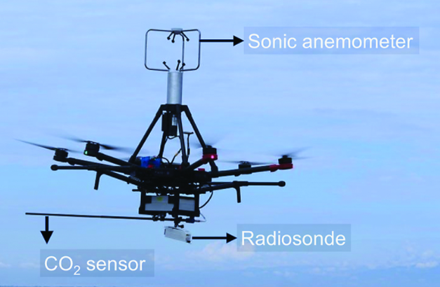
UAV sensor
Camera
Atmospheric sensor
Frazier and Singh, 2021
Notes:
An anemometer measures wind speed by sending sound pulses back and forth between its sensors and measuring the speed of sound as it is changed slightly by the wind.
Radiosonde can measure altitude, pressure, temperature, relative humidity, wind (both speed and direction), and cosmic ray readings at high altitudes.

Slide 56
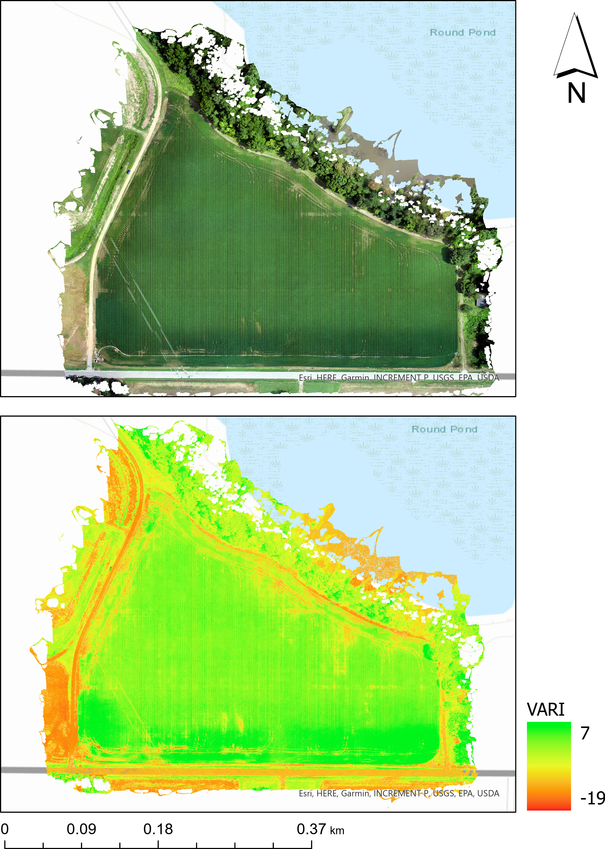
UAV application
Agriculture
Geomorphology
Wildlife survey
Surveilling volcanic eruptions
Inspecting power lines and other infrastructure
Monitoring gas leaks from pipelines
Etc.

Slide 57
Thank you!

