Slide 1

WEEK 02 Field techniques lecture
Instructor: Yanan Wu
fALL 2025

Slide 2
2.1 Introduction to field techniques

Slide 3

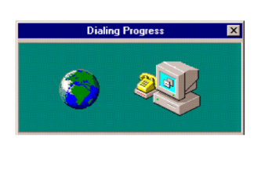
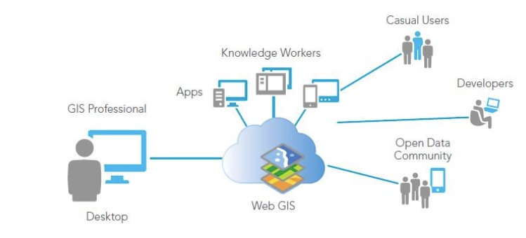
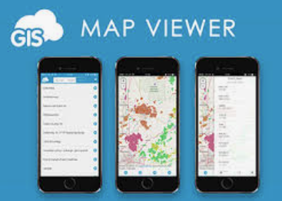

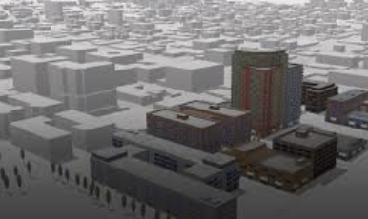
History
Web GIS 1.0
Arc/info, MapInfo
1960s
Dr. Roger Tomlinson
Canada GIS
1980s
Desktop GIS
2000S
Mobile GIS& Cloud
Real-Time, 3D & Integrated GIS
2010S
2020s
Notes:
Next, let us go to the history of modern GIS.
During the early 1960s, GIS started as computers and early concepts of quantitative and computational geography emerged. Dr. Roger Tomlinson has been acknowledged as the "father of GIS.“ His work on creating a manageable inventory of Canadian natural resources during 1960s is the first computerized GIS in the world. He also gave GIS its name.
1965: Mr. Howard Fisher, a Chicago architect, established the Harvard Laboratory for Computer Graphics. Some of the first computer map-making software was created and refined at the Lab, such as one of the first mapping software SYMAP. Many of the early concepts of GIS and applications were also conceived at the lab.
1969: Jack Dangermond, a member of the Harvard Lab and his wife Laura founded ESRI (Environmental Systems Research Institute). This consulting firm applied this computer mapping and spatial analysis to help land use planners and land resource managers make informed decisions. Now it develops and cover almost entire sectors. ERSI also developed toolboxes and work-flows, which are now standard of GIS. The ArcGIS created by ESRI are the most popular GIS software.
1970s: During the era of satellite, starting around early 1970s, National agencies, such as NOAA and NASA developed very quickly to capture data from space.
1980s: Commercial GIS emerged, such as the Arc/Info, the first commercial GIS software and Mapping Display and Analysis System (the first desktop GIS product) developed by Manpinfo cooperation.
Begin 1990s: Users started to explore GIS data through internet and mobile phone. And some open source software, such as QGIS is developing.
In the future: Web and cloud computing GIS will continue developing. Integration with real-time information via the Internet of Things, GIS will become more dynamics.

Slide 4

Geographic field techniques
Why Mobile & Web GIS Matter
Accessibility: Anyone with a phone can collect data.
Location awareness: Technologies enable precise location tracking of mobile devices

Slide 5
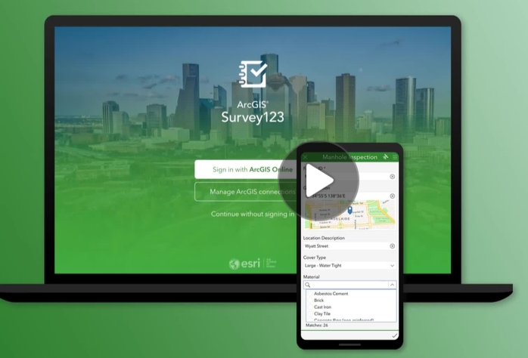
Geographic field techniques
Why Mobile & Web GIS Matter
Versatile communication tools: Mobile devices integrate with various communication methods to facilitate effective collaboration and communication among professionals and the public.

Slide 6


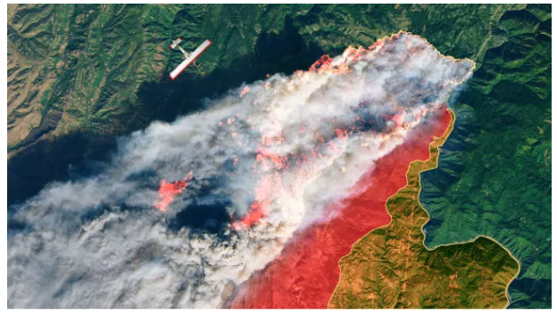

Geographic field techniques
Why Mobile & Web GIS Matter
Widespread accessibility: The ubiquity of smartphones, tablets, and smartwatches has made GIS accessible to billions, significantly expanding the user base and applications of GIS.
More than 680,000 organizations use GIS to understand, plan for, and solve the world’s complex problems.
Conservation
Disaster response program
Education
Non-profit

Slide 7
2.2 mobile gis

Slide 8
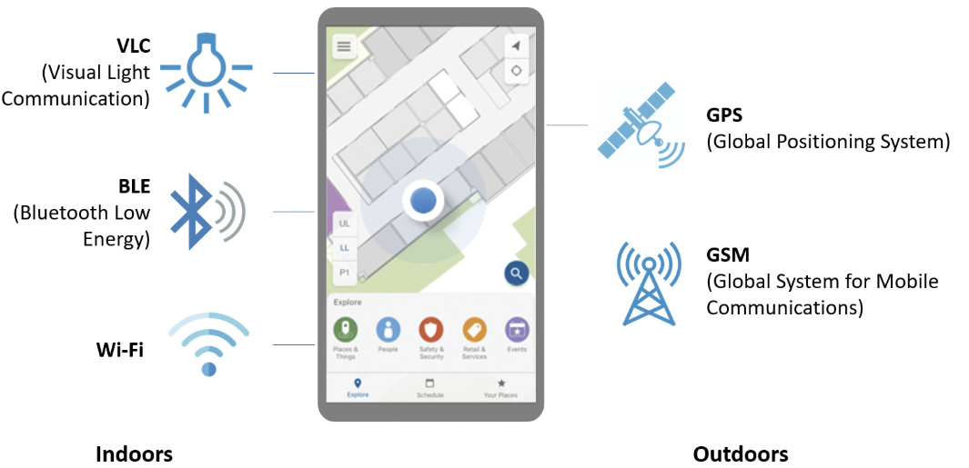
Mobile positioning technologies
Before 2000, GPS technology was not commonly integrated into mobile phones
Global Navigation Satellite System (GNSS): Uses satellite signals to pinpoint precise geographic locations (longitude, latitude, altitude).
Cellular network-based positioning: Relies on cellular network infrastructure to locate devices.
Bluetooth Low Energy (BLE): BLE is used in tracking technologies such as Apple’s AirTags

Slide 9
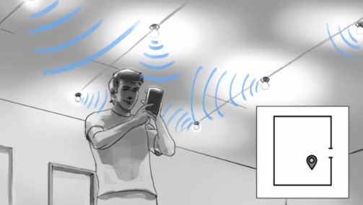
Mobile positioning technologies
Visual Light Communication
VLC

Slide 10
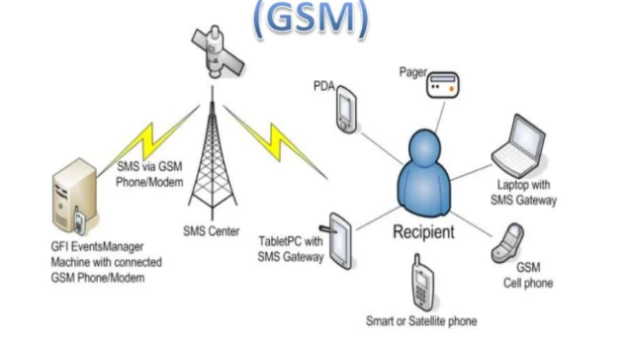
Mobile positioning technologies
Global System for mobile Communication
Cell tower track phone’s location

Slide 11
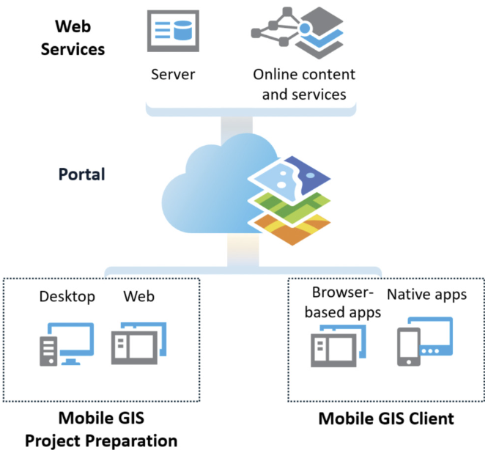



Mobile GIS architecture

Slide 12
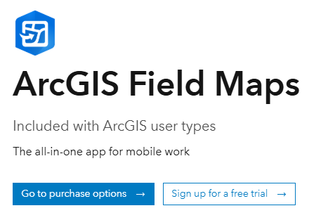
ArcGIS suite of web and native apps for Mobile GIS
Field Maps: Integrates several earlier products, including ArcGIS Collector, ArcGIS Explorer, ArcGIS Tracker, and ArcGIS Workforce. Serves as an all-in-one solution that supports planning, recording and sharing location, understanding, and map centric data capture.

Slide 13

ArcGIS suite of web and native apps for Mobile GIS
ArcGIS Survey123: This formcentric app allows users to create, share, and analyze surveys. It features smart forms with skip logic, defaults, flexible formulas, and powerful data-pulling capabilities.
The app facilitates easy data collection through the web or mobile devices in any environment, requiring minimal training.

Slide 14
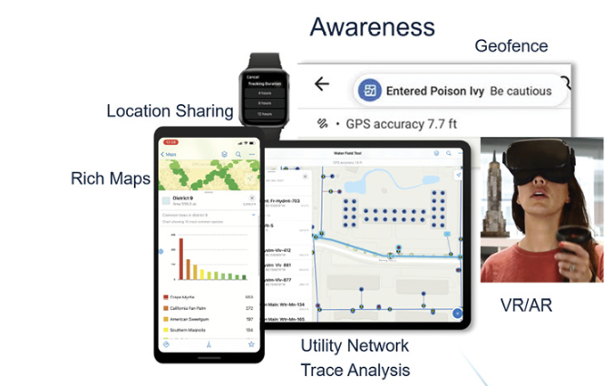
Four pillars of Mobile GIS capabilities
Notes:
Geofencing alerts mobile workers when they enter or leave designated areas. Integrated routing, navigation, and wayfinding capabilities efficiently locate assets, whereas location sharing allows workers to view, record, and share their locations. Field Maps also supports advanced capabilities, including viewing and tracing utility networks, measuring distances, and placing points by distance along linear referenced features.

Slide 15
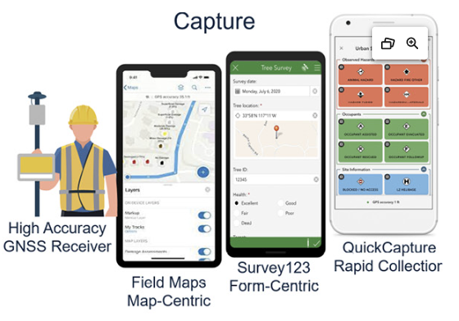
Four pillars of Mobile GIS capabilities

Slide 16
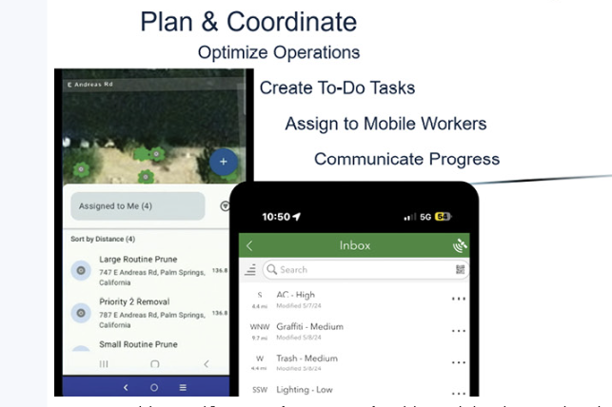
Four pillars of Mobile GIS capabilities

Slide 17
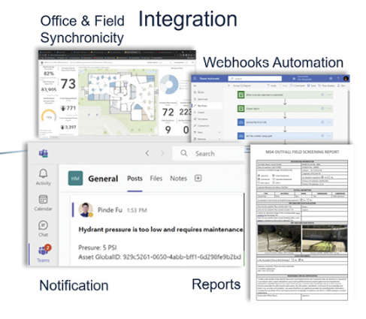
Four pillars of Mobile GIS capabilities

Slide 18
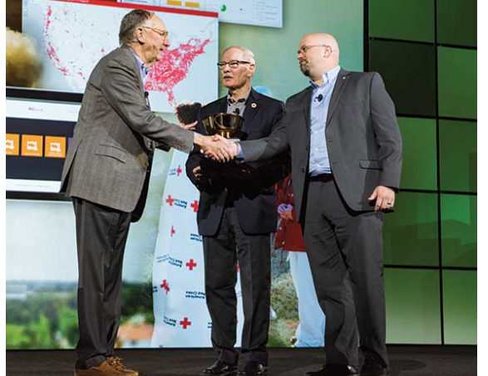
Real-world applications:
Emergency management: Survey123 help in Emergency response and Recovery

Slide 19
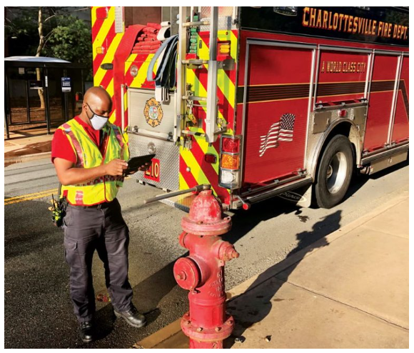
Real-world applications:
Fire Department : Field Maps help in Hydrant Inspection

Slide 20
2.3 desktop gis

Slide 21
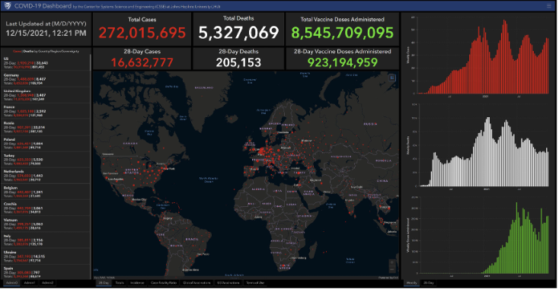
dashboard
The COVID-19 Dashboard by the Center for Systems Science and Engineering (CSSE) at Johns Hopkins University (JHU).

Slide 22

Storymap
2025 ArcGIS StoryMaps Competition

Slide 23
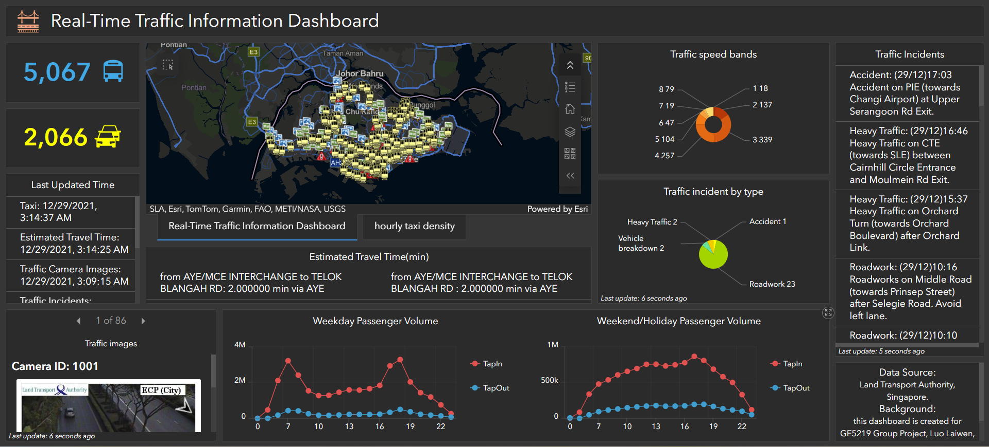
Spatial-temporal and real-time gis

Slide 24
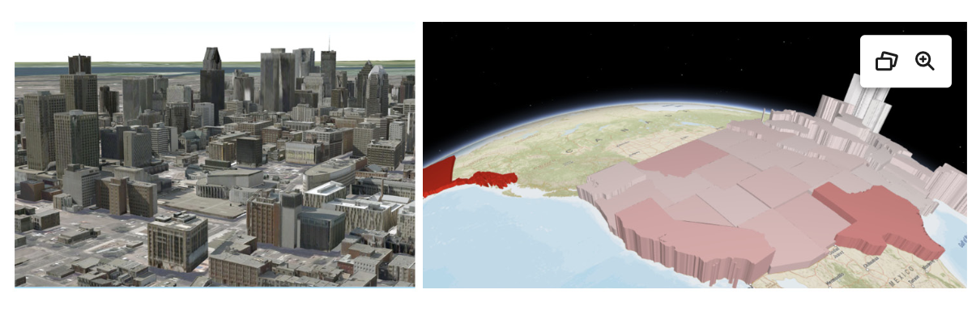
3d web scenes

Slide 25
2.4 drone and gps

Slide 26

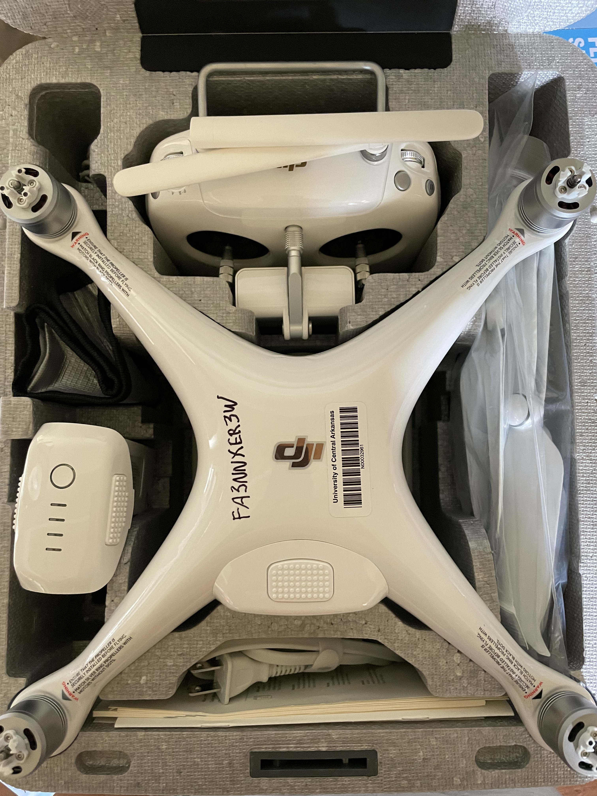

Survey tools
DJF Phantom IV
DJF Ground Station Pro (only iPad)
DJF GO 4
John
https://www.dji.com/downloads/djiapp/dji-go-4

Slide 27
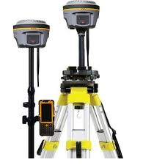
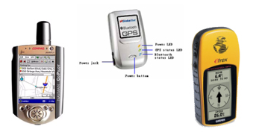
GNSS segment
User segment
Comprises of Hundreds of thousands of civil, commercial, and scientific users
In general, GPS receivers are composed of an antenna, receiver-processors, controller, and a highly stable clock.
https://unstats.un.org/unsd/geoinfo/UNGEGN/docs/_data_ICAcourses/_HtmlModules/_Selfstudy/S06/S06_05a.html
https://unstats.un.org/unsd/geoinfo/UNGEGN/docs/_data_ICAcourses/_HtmlModules/_Selfstudy/S06/S06_05a.html

Slide 28
Lab 01: Introduction to ArcGIS Pro
Due by Midnight (11:59 pm) on Monday, Sep 1, 2025
Submit a word document only include questions and answers

