Slide 1

WEEK 03 survey 123 lecture
Instructor: Yanan Wu
fALL 2025

Slide 2
2.1 introduction

Slide 3
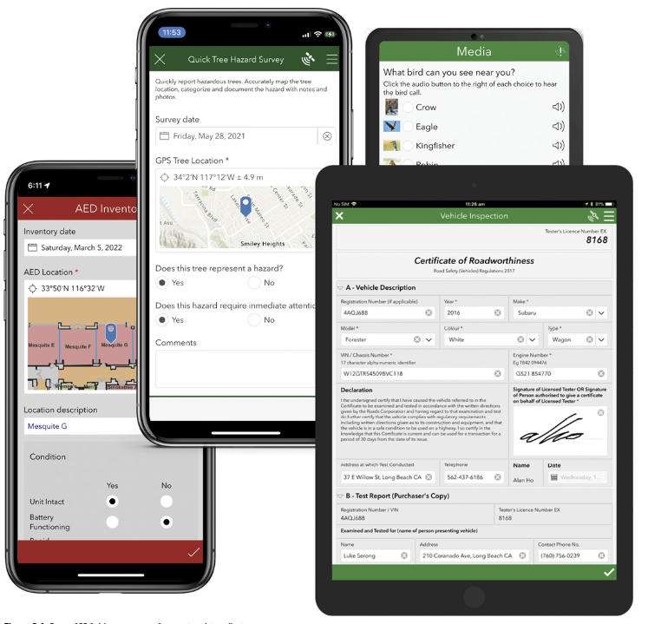
The need of formcentric data collection
Formcentric data collection
Location intelligence capabilities
🤔
Does other online forms (e.g., google form, Microsoft form) has location intelligence capabilities?

Slide 4
The need of formcentric data collection
Web browser-based solution
Also supports mobile devices
Integrated with ArcGIS online
Available with ArcGIS Enterprise
Smart form
Support decision-making

Slide 5
Suvery123
The “1-2-3” in the product name reflects the philosophy of the product and workflow. Survey123 provides components to
(1) Create surveys
(2) Gather responses
(3) Analyze the results. and capabilities.

Slide 6

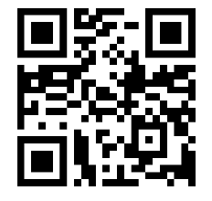
Why Smart Forms in ArcGIS
Improve data quality
Minimize mistakes at the point of entry
No more manual retyping from paper
Example: Survey123
Notes:
Lat/lon easily write wrong, list choice
Formula can be written as response. Radius and height of tree, can calculate the volume of tree in the field.

Slide 7
Why Smart Forms in ArcGIS
Increase efficiency in the field
Automate calculations
Link photos, sketches, and other records
Class Activity:
Please input 2 to ‘Tree Height’ and 0.7 to ‘Tree Perimeter’
Check the result of ‘Tree Volume’

Slide 8
Why Smart Forms in ArcGIS
Increase efficiency in the field
Link photos, sketches, and other records
Class Activity:
Please take a photo and provide a recording in the survey

Slide 9
Why Smart Forms in ArcGIS
Location intelligence built-in
Every submission includes a geographic reference
Easy integration with maps and spatial analysis
Class Activity:
Mark where you are on the map

Slide 10
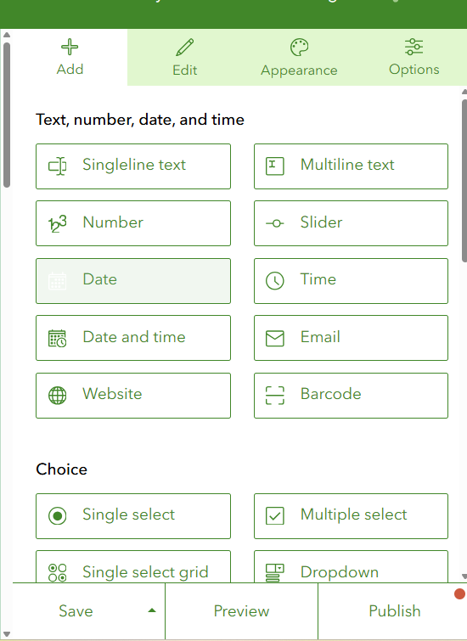
What makes a form ‘Smart’?
Flexible question formats
Capture text, numbers, dates, times, photos, barcodes
Support both multiple-choice and single-choice options
Notes:
Groups, Multiple pages, Notes, Media

Slide 11
What makes a form ‘Smart’?
Built-in intelligence
Conditional skips and cascading choices
Auto-fill values, enforce required fields, and suggest preferred answers
Pull from external reference datasets for consistency
User-friendly design
Customizable look with themes, hints, and multilingual support
Clear layout improves usability in the field

Slide 12
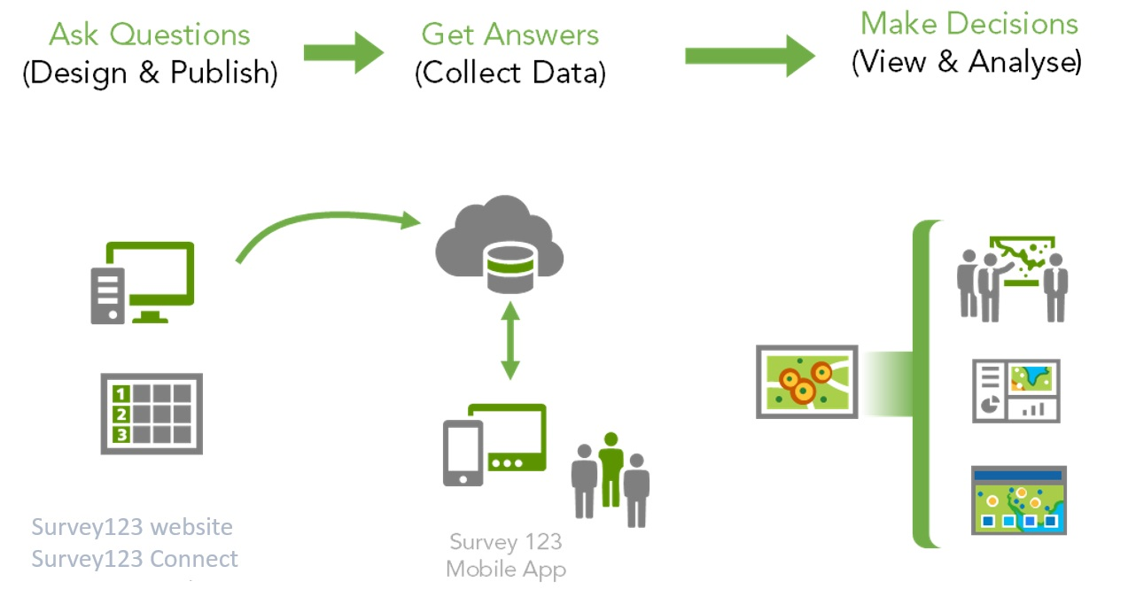
Suvery123
1
2
3
https://www.esri.com/arcgis-blog/products/survey123/announcements/smarter-forms-smarter-field-work-5-reasons-to-use-survey123-for-arcgis/

Slide 13
Type of Survey123
Survey123 Web Designer
Build smart forms graphically in a web browser
Very easy to get started
Ideal for simple forms
Survey123 Connect
Desktop tool, works in combination with Microsoft Excel
Requires learning and familiarity with XLSForms specification
Notes:
Complete smart form capabilities

Slide 14
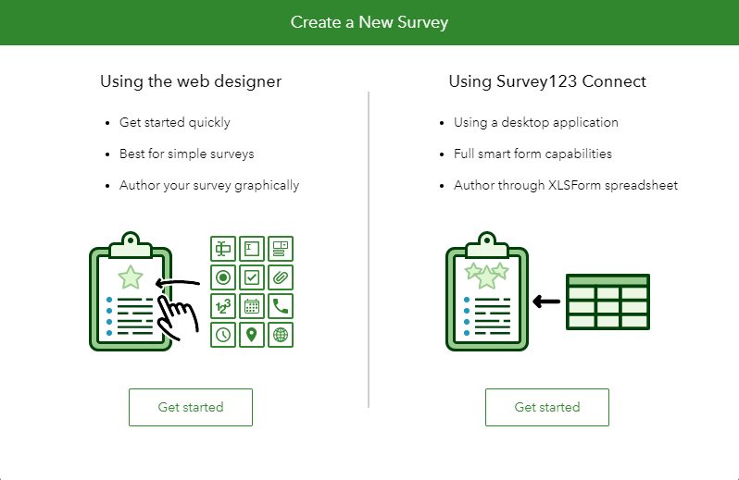
Type of Survey123

Slide 15
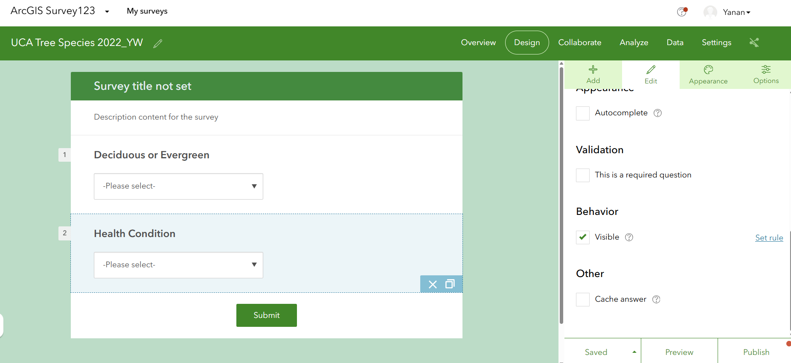
Create Survey
Preview in left panel, set parameters in the right panel

Slide 16
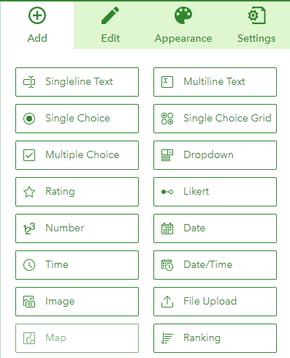
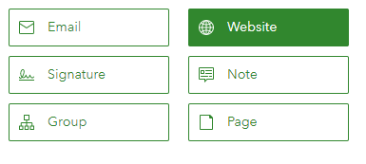
Survey Option
Survey Question Types in Web Designer
Most common questions
Addresses many workflows
Simple forms

Slide 17

Creating Surveys
Setting Rules
Simple conditional statements can control visibility of questions
Applicable for Single choice, Dropdown, and Rating…
Notes:
Likert

Slide 18
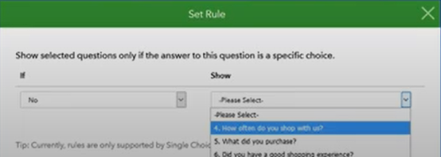
Creating Surveys
Setting Rules
Simple conditional statements can control visibility of questions
Applicable for Single choice, Dropdown, Likert, and Rating

Slide 19
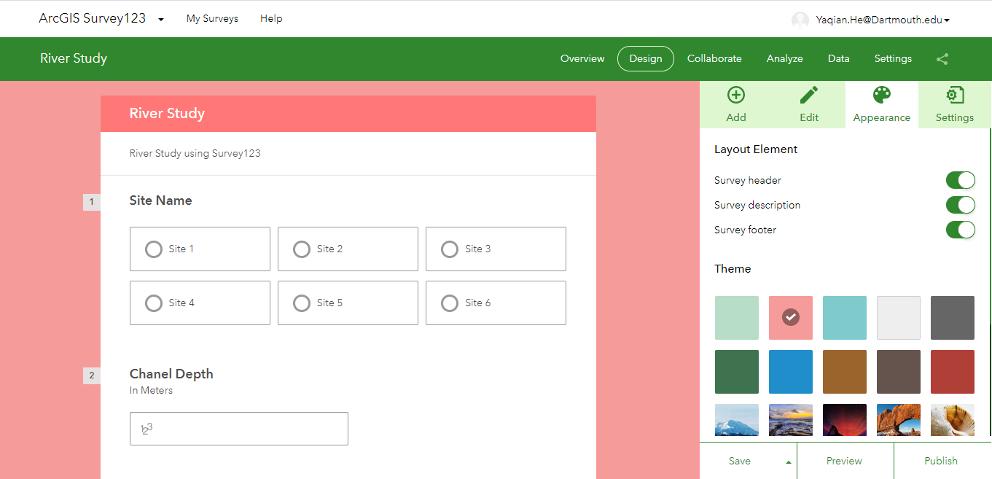
Creating Surveys
Style Your Form

Slide 20
Creating Surveys
Updating Surveys
Published surveys can be edited in Web Designer
Supported changes
Add new questions
Reorder questions
Delete questions
Update labels in questions
Add, update, delete choices in lists
Update constraints, default values, hints, and required status

Slide 21
Creating Surveys
Private Surveys
Shared with a well-known group of users (secured access)
Requires use of one ArcGIS accounts per every filed user
Enables Editor Tracking capabilities
Ideal for sensitive data or when you want to understand who is doing what
Public Surveys
Shared with everyone
No need for ArcGIS accounts; anyone can submit data
Ideal for crowd-sourcing initiatives

Slide 22
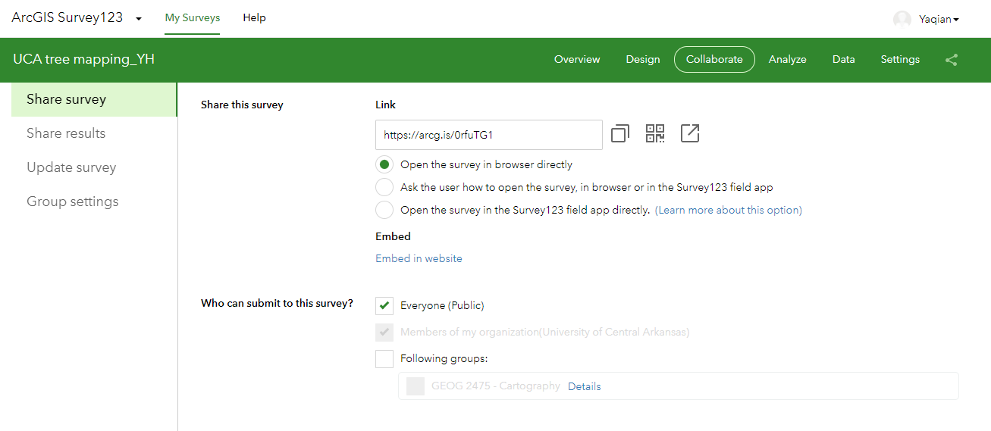
Creating Surveys
Collaborate Tab
After publishing survey, you can control access
Data submission → submitter (share survey)
Review results → Viewer (share results)

Slide 23
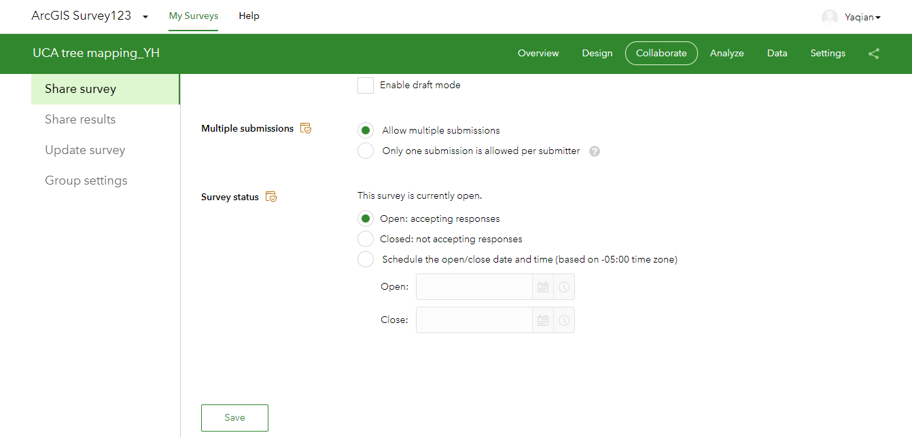
Control submission
Collaborate Tab
After publishing survey, you can control access
Survey Status: open/close

Slide 24
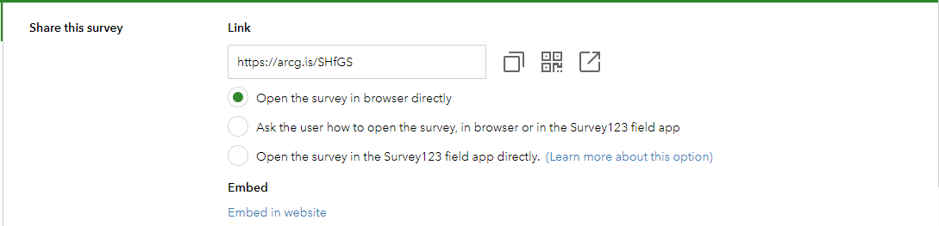
Accessing the Survey
Control how the survey is accessed
Link to share the survey

Slide 25
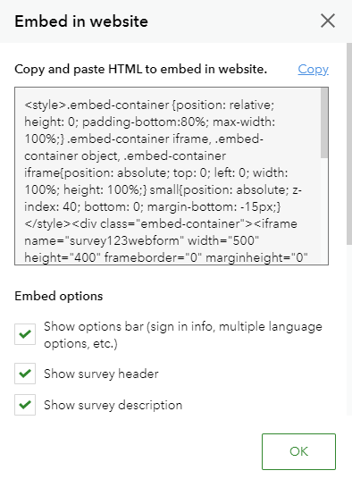
Accessing the Survey
Control how the survey is accessed
Link to share the survey
Embed in a web page

Slide 26
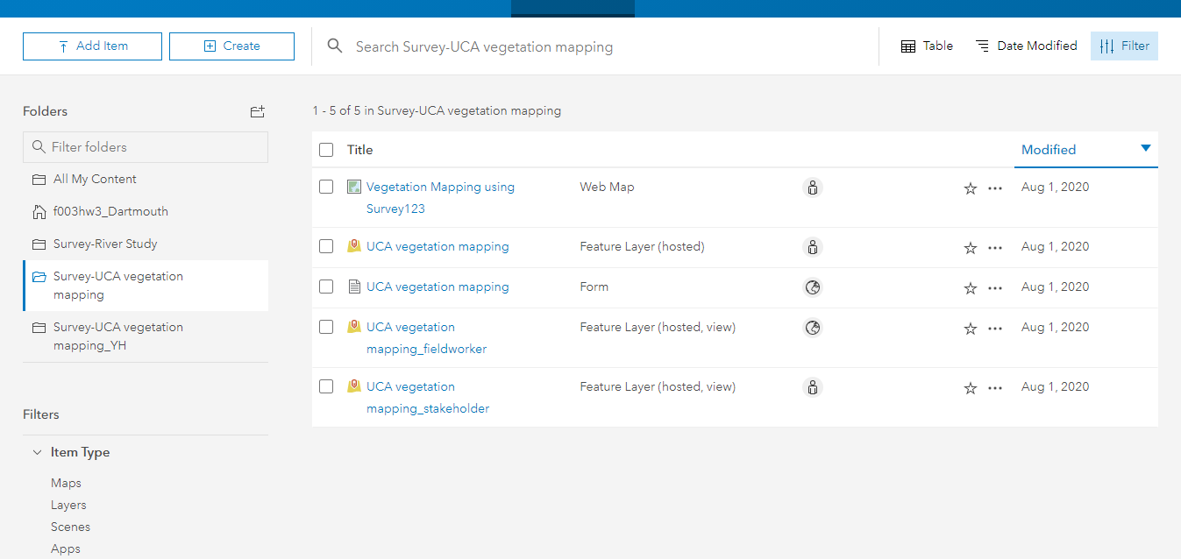
Surveys in ArcGIS online
A survey is stored as a folder
May have 4 components
Form
Feature layer
Feature layer view (Fieldworker)
Feature layer view (stakeholder)
Notes:
Survey- name of the survey. Three, fieldworker is used to sharing your survey to users to collect your data.
Share the survey to the viewers, such as the manager of your organization.
Edit this through survey123, not ArcGIS online.

Slide 27
Surveys in ArcGIS online
Form (green icon)
This is the actual Survey123 form.
It defines the questions, layout, logic, and appearance of the survey.
Feature Layer (hosted)
This is the main database that stores all responses.
Every submission from the form is saved here as a record (geometry + attributes)

Slide 28
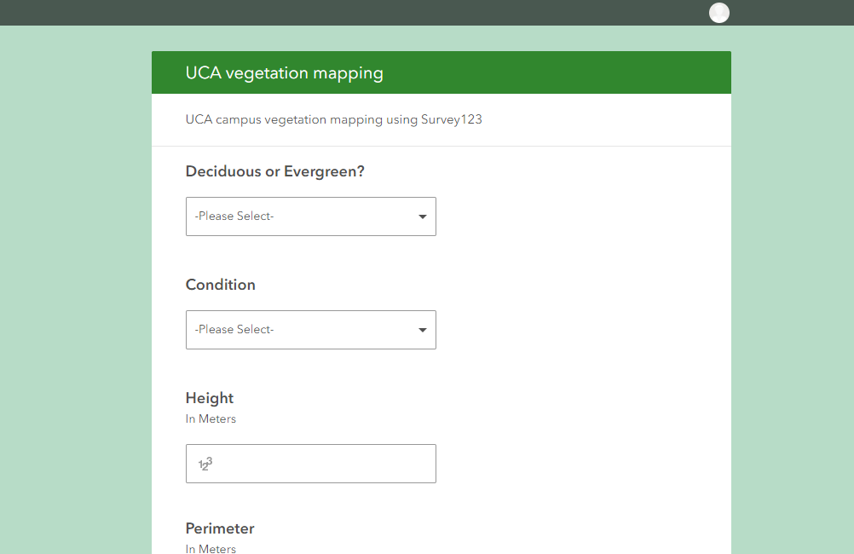
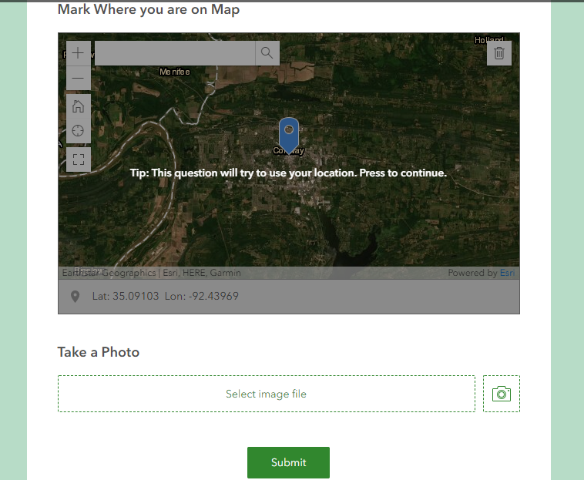
Collect data
Web forms
Capture data from a web browser
Can be embedded within a website
Add and edit data

Slide 29
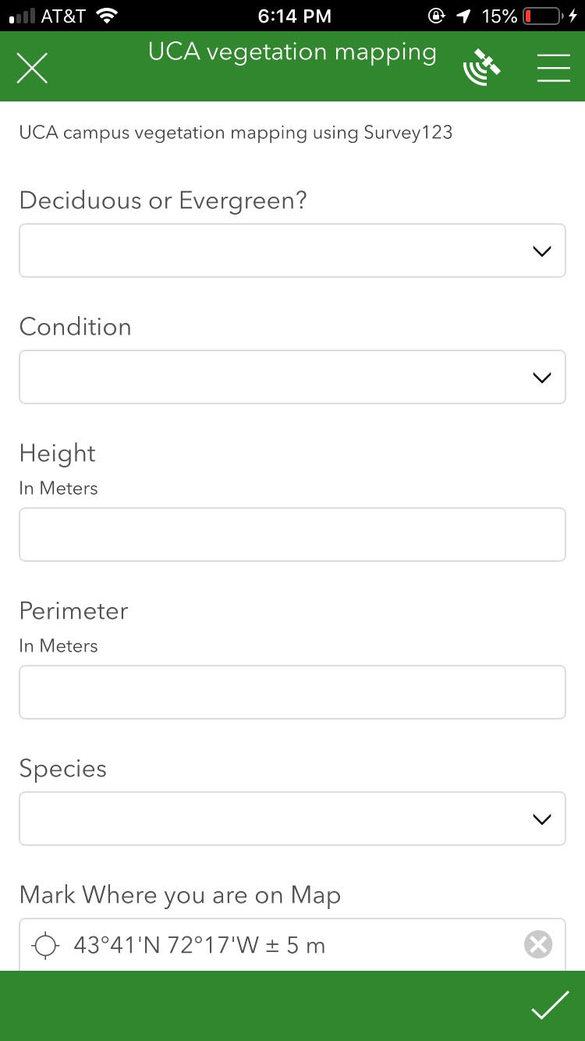
Collect data
Mobile App
Use for data collection in the field
Can capture new data, edit existing data
Supports offline workflows
Cross platform
Notes:
Windows, android, os

Slide 30
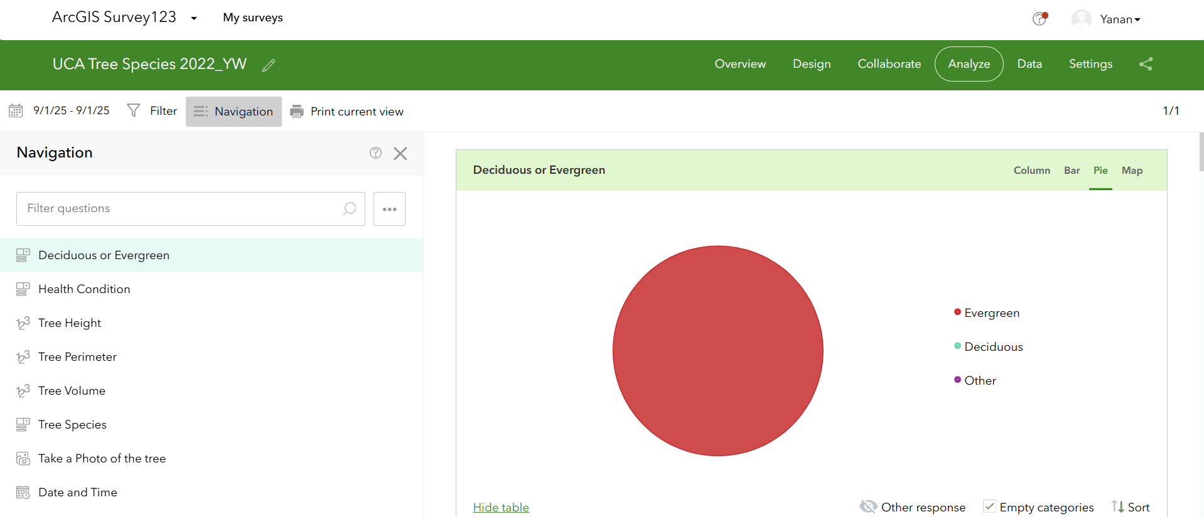
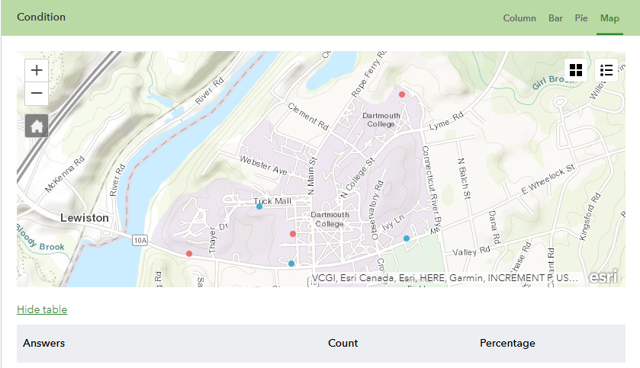
Make decision
Ready to use reporting tools
Understand data submission patterns
Create detailed reports
Aggregate survey data
Download data
Notes:
Spike, ike GPS

Slide 31
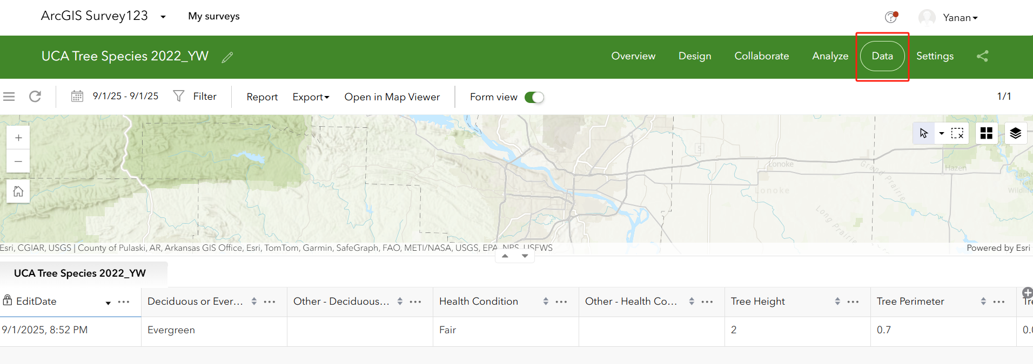
Make decision
Feature reports
Create printable documents with your survey data (e.g., word file)
Notes:
Spike, ike GPS

Slide 32
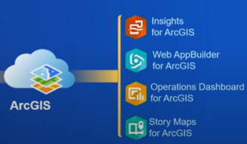
Make decision
Bring your data into ArcGIS
Real-time data collection
Survey123 submitted data is immediately available for visualization and analysis
All data stored in ArcGIS feature services
Use with other ArcGIS Apps
Multiple Uses of data
Notes:
Spike, ike GPS

Slide 33
Survy123 Examples
https://survey123.arcgis.com/surveys
Notes:
Spike, ike GPS

Slide 34

Thank you!

