Slide 1

WEEK 04 arcgis field map lecture
Instructor: Yanan Wu
fALL 2025

Slide 2
4.1 introduction

Slide 3
Overview
Field Maps is an all-in-one app that is widely used for mapcentric data collection
functioning with or without network connectivity.
It also supports utility network editing and tracing, location sharing, Geofences, task assignments, workforce coordination, webhook automation, and more

Slide 4
Why Field Data Collection Matters
Field data = foundation of GIS projects: roads, trees, utility poles, signs, benches, trails.
Traditional methods: Paper maps and manual entry → error-prone, time-consuming.
Digital GIS workflows: Real-time updates, GPS integration, attachments like photos.
Benefit: Faster, more accurate, supports decision-making in city planning, campus management, and environmental monitoring.

Slide 5
What is ArcGIS Field Maps?
Mobile application: Used on phones and tablets to collect data in the field.
Designer tool: Web-based builder to set up maps, layers, and smart forms before fieldwork.
Key capabilities:
Collect points (like benches), lines (like fences), polygons (like lawns).
Attach photos or documents to features.
Download offline basemaps when internet is unavailable.
Automate rules with Arcade expressions.
Notes:
Instructor note: Highlight that this integrates directly with ArcGIS Online.

Slide 6
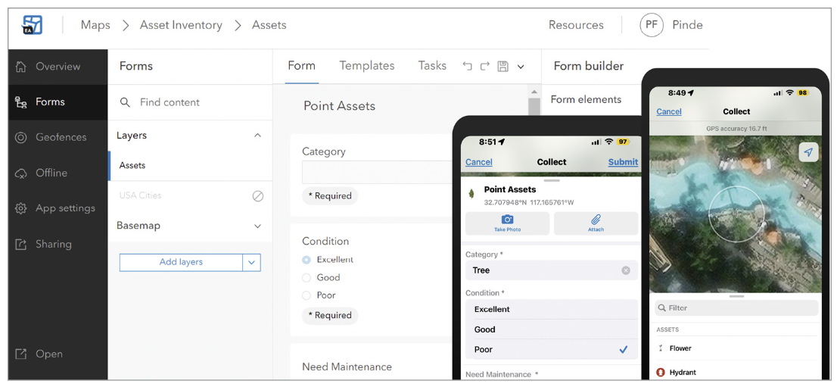
TWO COMPONENTS
Field Maps Designer: This component is for solution creators or map authors to use.
Field Maps mobile app: This component is for mobile workers to use. Using this app, mobile workers can open the maps, forms, data, and tools necessary to complete their field tasks. Field Maps is designed to function online and offline, as well as in outdoor and indoor environments.

Slide 7
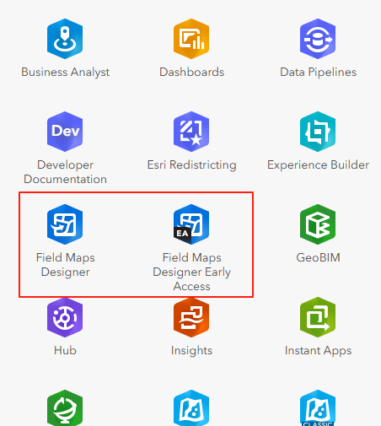
Field Maps Designer Overview
Where it lives: Inside ArcGIS Online → App launcher → Field Maps Designer.

Slide 8
Field Maps Designer Overview
Main functions:
Create new feature layers for points/lines/polygons.
Build forms with widgets like combo boxes and switches.
Configure security settings (e.g., only see your own data).
Manage templates and styles.
Why it matters: This is the “blueprint” mobile workers use in the field.

Slide 9
Feature Layers & Web Maps
Feature layers = digital storage for field assets (trees, signs, fences).
Each feature layer = data table + geometry (point/line/polygon).
Coordinate system: Use WGS 1984 Web Mercator for web mapping.
Web Map: Container where all layers are combined, styled, and shared.
Instructor note: Explain the hierarchy: Layers → Web Map → Field Maps app.

Slide 10
Form Design Basics
Forms = the digital “survey sheet” field workers fill out.
Widgets:
Combo box: dropdown menu for categories (Bench, Fence).
Radio buttons: single-choice conditions (Excellent/Fair/Poor).
Switches: yes/no fields (Need Maintenance: Yes/No).
Text fields: for notes, city names, inspector names.
Smart forms improve data consistency: fewer typos, fewer blank fields.

Slide 11
Arcade Expressions in Field Maps
Arcade = scripting language in ArcGIS for rules and calculations.
Examples:
Conditional visibility: Show “Need Maintenance” switch only if Condition = Fair or Poor.
Conditional requirement: Require maintenance notes only if Condition = Poor.
Calculated expression: Autofill inspector name with GetUser().
Spatial calculation: Autofill city name by intersecting with USA Cities layer.
Benefit: Saves time, prevents mistakes, makes forms “smart.”

Slide 12
Styling & Feature Templates
Styling layers: Assign colors, icons, transparency so different categories are easy to see.
Templates: Preconfigured entries — e.g., choosing “Bench” automatically sets Category = Bench and symbol.
Why important: Makes field collection faster and ensures uniform data entry.

Slide 13
Security & Access Settings
Editor tracking: Tracks who created/edited features and when.
Attachments enabled: Allow photos, videos, PDFs linked to features.
Restrict editing: Workers can only view/edit their own features.
Offline support: Enable sync & GlobalIDs → allows data collection without internet.
Instructor note: Stress that data integrity and security are just as important as data collection.

Slide 14
Learning source
ArcGIS Field Map Documentation

Slide 15

Thank you!

