Slide 1

WEEK 05 response web map lecture
Instructor: Yanan Wu
fALL 2025

Slide 2
5.1 introduction

Slide 3
Response web-map
Browser-based web apps generally require an internet connection to function adequately, but when connected with sufficient bandwidth, they can effectively deliver and collect data from the field.
Designed to adjust their layouts to accommodate the smaller screen sizes of mobile devices, ensuring a smooth user experience for field operations.
They are commonly used for data review in office settings using desktop browsers.
This versatility makes web apps a crucial component of the Mobile GIS workflow and an important option for field use.

Slide 4
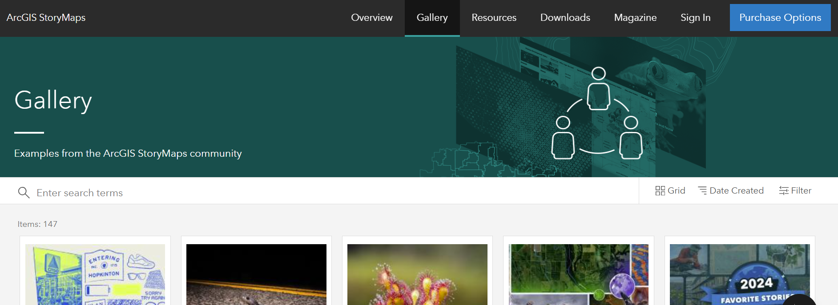
Configurable web app template
ArcGIS StoryMaps:
Allows users to craft interactive stories by combining maps with narrative text, images, and multimedia content.
This tool is designed to engage and inspire audiences with geographically enriched storytelling, making it perfect for educational purposes, advocacy, and public engagement.
ArcGIS StoryMaps provides a user-friendly interface that helps you connect with your audience through compelling geographic narratives.

Slide 5
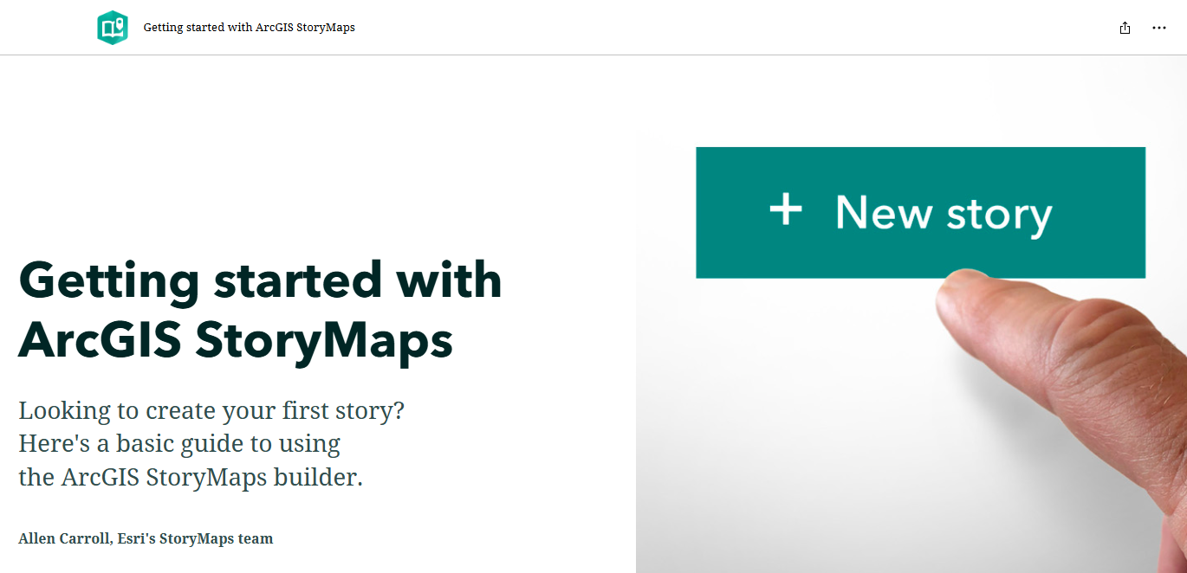
Getting started with Esri storymap

Slide 6
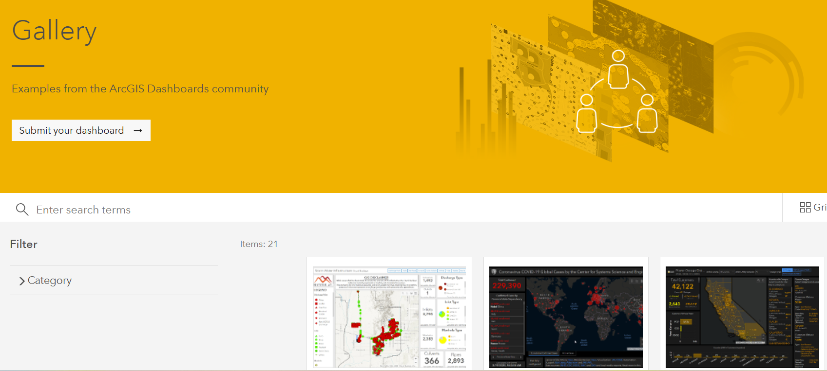
Configurable web app template
Dashboards
Displays geographic information as interactive maps, charts, gauges, and more, allowing for real-time data visualization and awareness at a glance.
Dashboards are widely used in emergency management, public services, and business operations to provide insights.

Slide 7
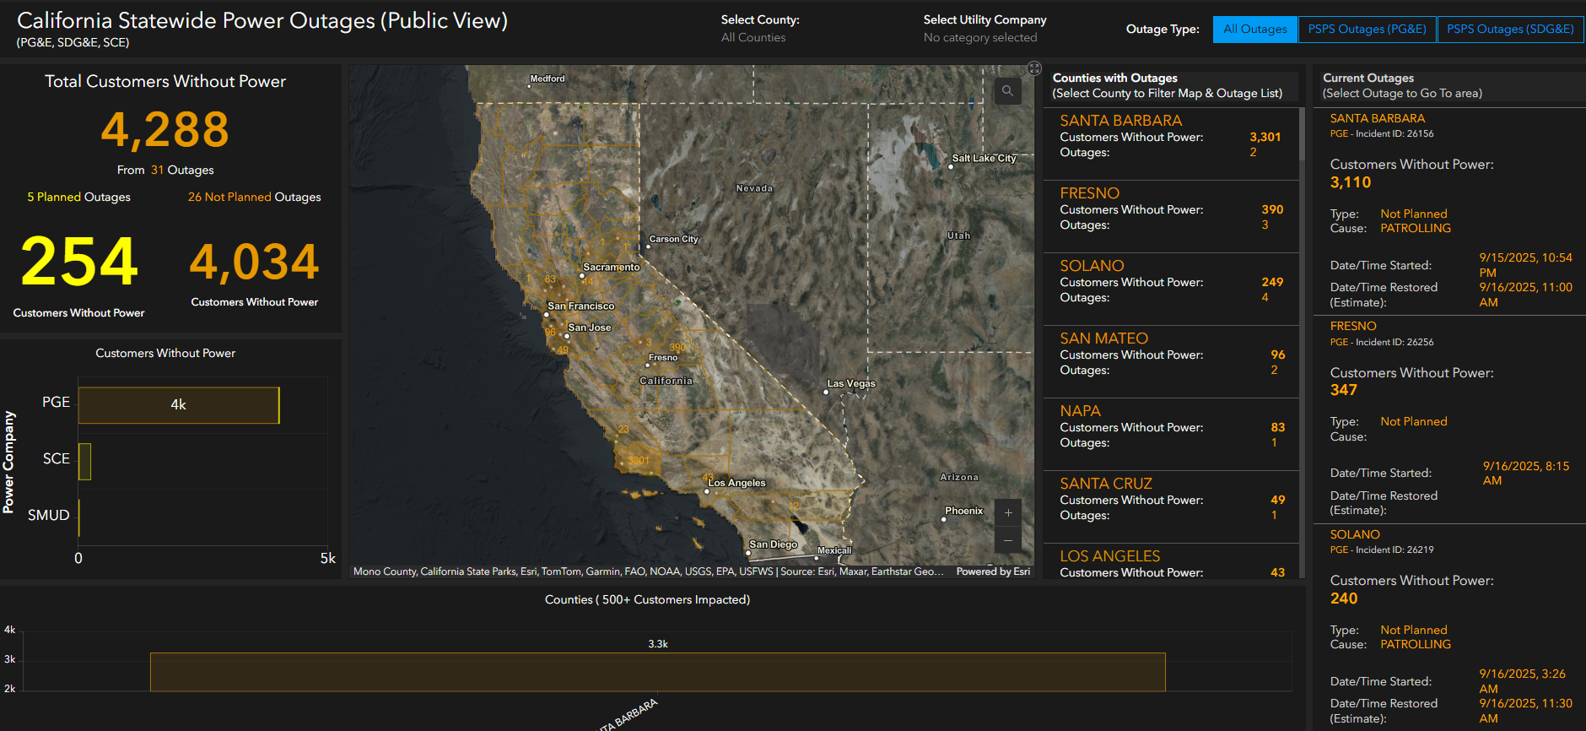
Basic workflow to create dashboards
Dashboards are composed of configurable widgets, such as maps, lists, charts, gauges, indicators, and tables. these widgets are called elements or components.
Most of these elements are data-driven, representing the information you want to present to your intended audience.
Dashboard apps are commonly designed to display multiple visualizations that work together on a single screen.

Slide 8
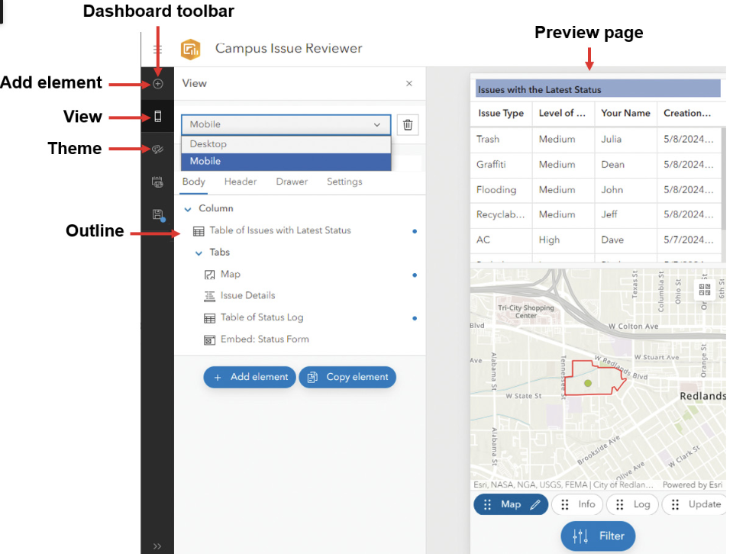
Dashboards configuration
A dashboard can be configured with both desktop and mobile views.

Slide 9
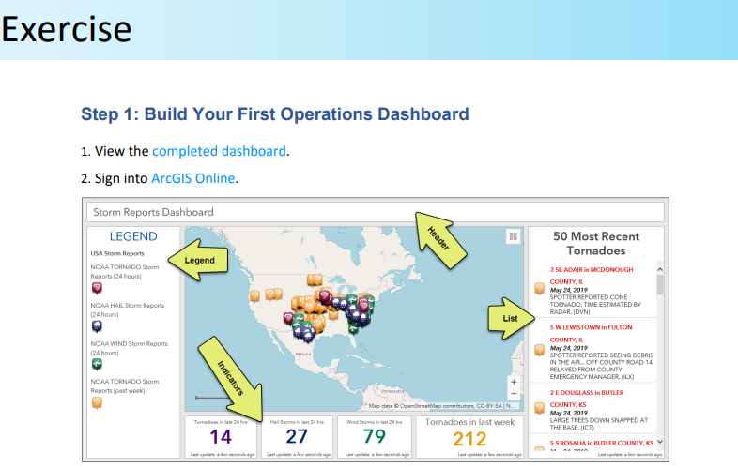
Basic workflow to create dashboards
Prepare data layers and web maps or scenes.
Create a dashboard and add elements.
For each element, configure its data source, style, and layout.
Set up interactivity between the elements by configuring actions and targets.
Refine the layout.

Slide 10
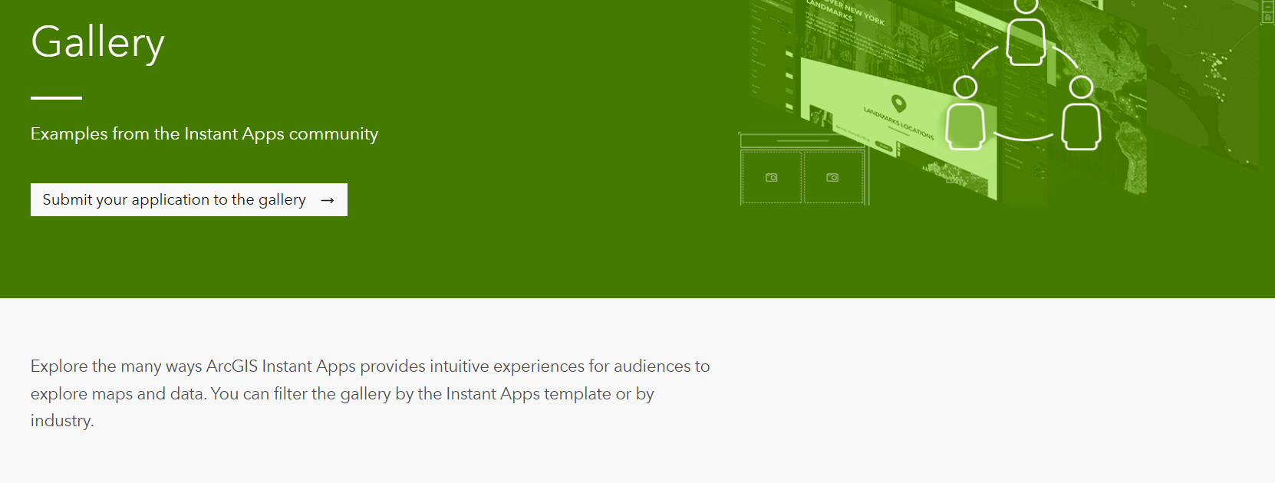
Configurable web app template
Instant Apps:
Enables users to quickly design and deploy web apps tailored to specific tasks and audiences.
The template-driven tools require minimal configuration, making it easier for users to visualize, present, and share geographic information.
Instant Apps are ideal for projects requiring simple functions, rapid deployment, and straightforward user interfaces.

Slide 11
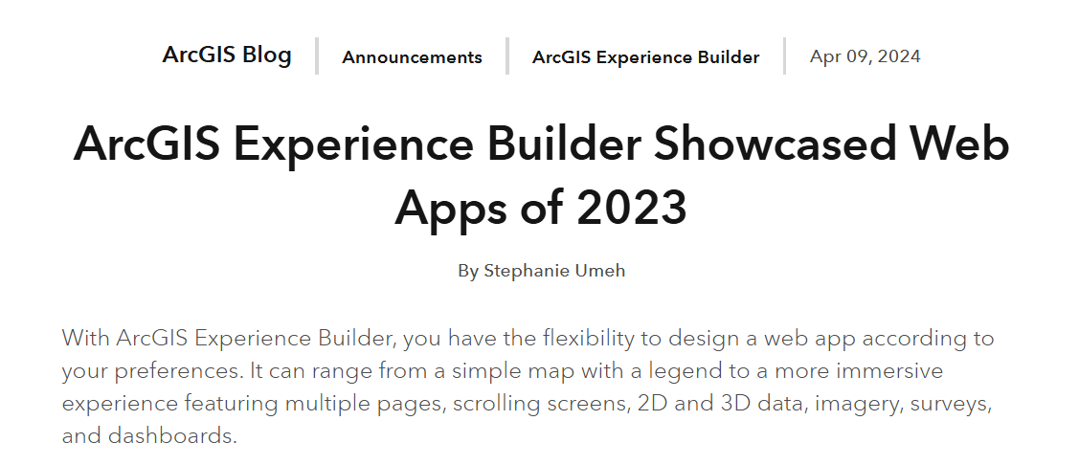
Configurable web app template
Experience Builder:
Offers a flexible and advanced approach to creating web apps with rich data and rich user experiences.
With drag-and-drop functionality, users can integrate maps, text, images, and other widgets into fully responsive layouts that work across all devices.
Experience Builder is designed for those who want to customize and extend their web applications beyond standard templates.

Slide 12
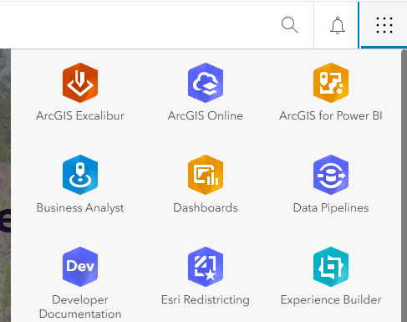

ArcGIS Experience Builder editions
ArcGIS Online and ArcGIS Enterprise
URL: experience.arcgis.com
ArcGIS Enterprise version 10.8.1 and higher
Developer Edition
Download from the Developers website and install locally
Sign in to ArcGIS Online or ArcGIS Enterprise

Slide 13
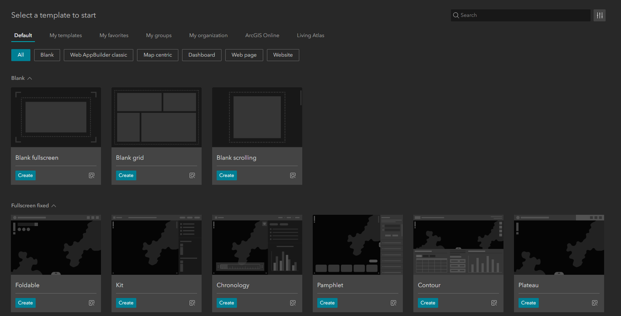
Default Templates
Scrolling Page
Blank
Monitor (New)
Quick Navigation (New)
Indicator (multi-page) (New)
Exhibition (multi-page)
Full Screen
Blank
Foldable
Launchpad

Slide 14
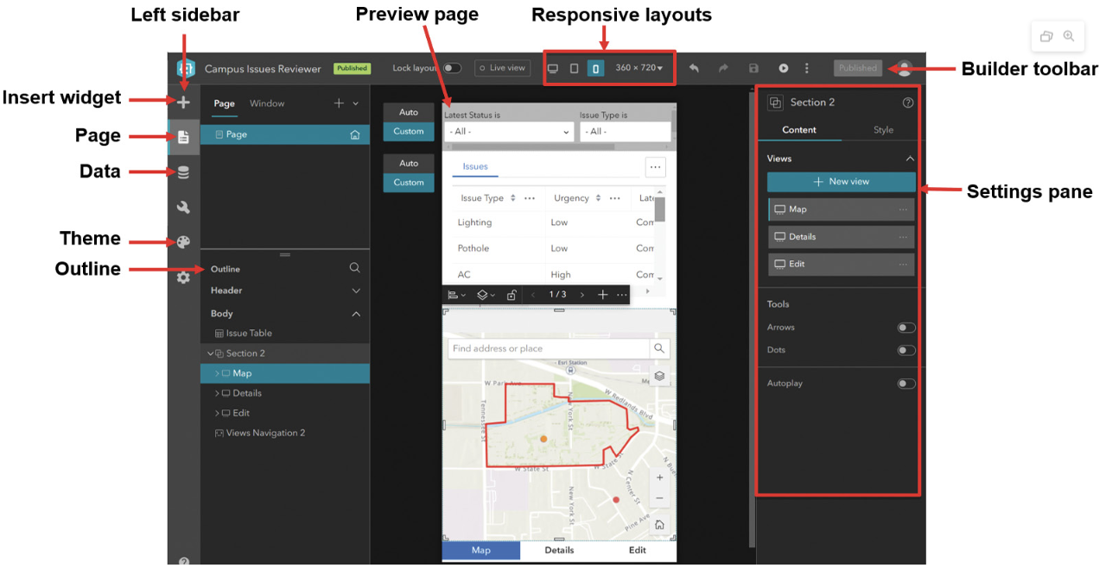
Basic workflow to create web experiences
In ArcGIS technology, the web apps created using Experience Builder are called web experiences. Experience Builder has the following workflow to create web experiences.

Slide 15
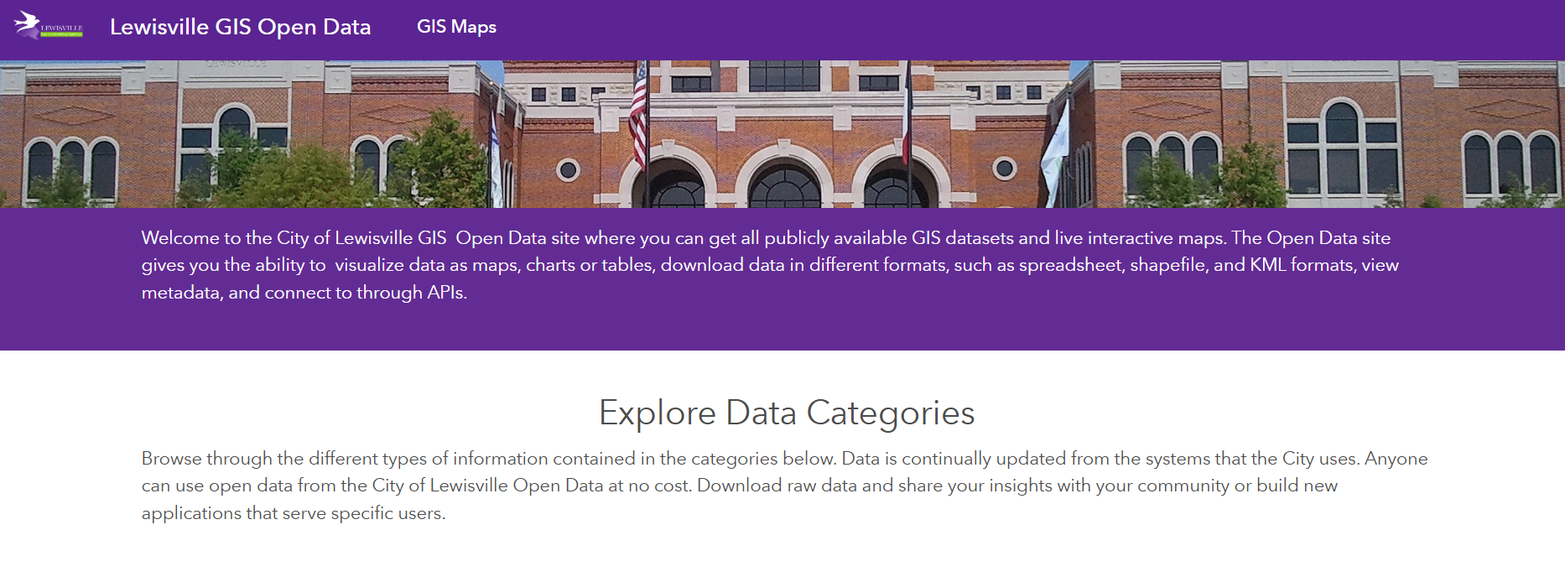

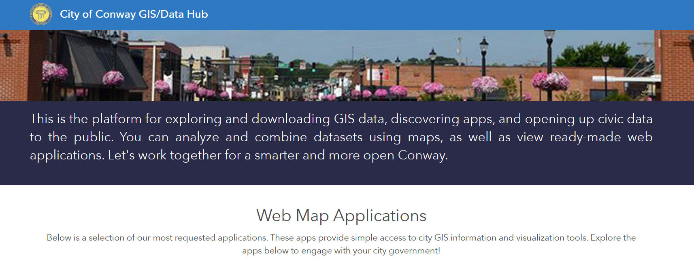
Configurable web app template
Hub:
An engagement platform that enables organizations to connect with their communities through open data, web apps, and interactive initiatives.
It supports collaboration between government, the private sector, and the public to tackle community challenges effectively.
By facilitating easier access to data and tools, Hub helps foster a more informed and involved community, advancing public awareness and participation.

Slide 16
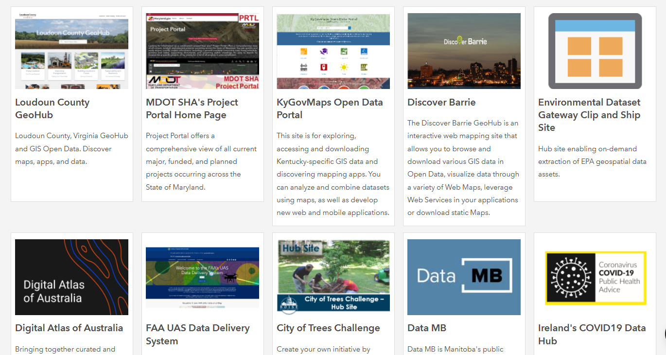
Arcgis hub basic
You can do the following with ArcGIS Hub Basic:
Create unlimited websites and pages using the site editor.
Build a catalog of searchable content for each of your sites using the site's content catalog.
Work with other collaborators with an ArcGIS Online account by adding them to edit groups that are connected to your site, pages, and content.
Access select templates to deploy a set of configurable sites and apps focused on specific topics and solutions.
Control who can access your site’s content (including specific items) using sharing controls.

Slide 17
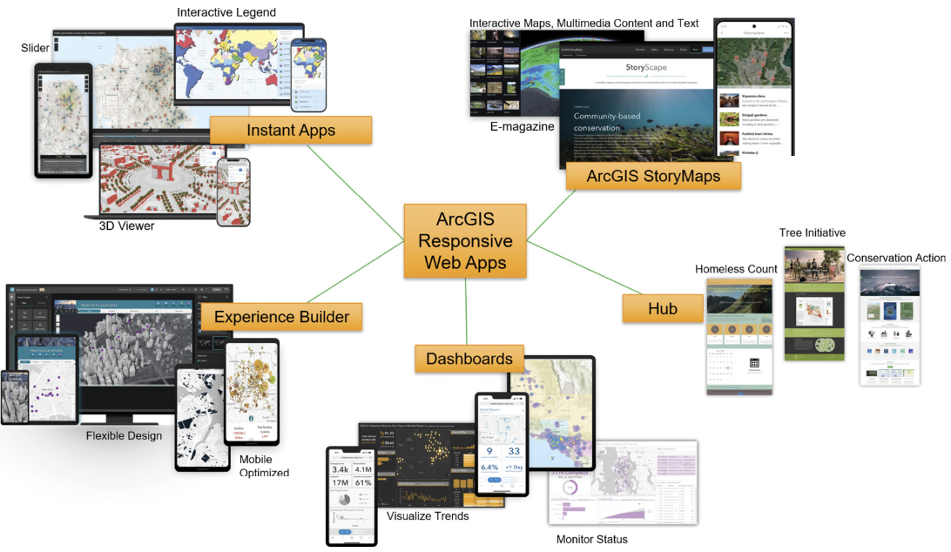
web app templates

Slide 18
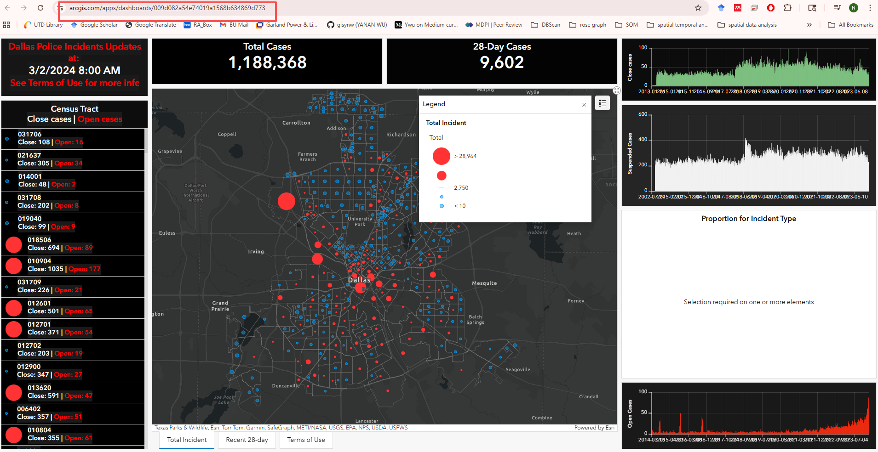
Map id in esri
Every map, layer, or app in ArcGIS Online / Enterprise has a unique Item ID
The Item ID is a 32-character code (letters & numbers)
Found in the URL of maps, dashboards, apps
Example:
URL: https://www.arcgis.com/home/item.html?id=abc123xyz456...
Map ID = abc123xyz456...
Purpose: Identifies and links directly to that specific map or laye

Slide 19
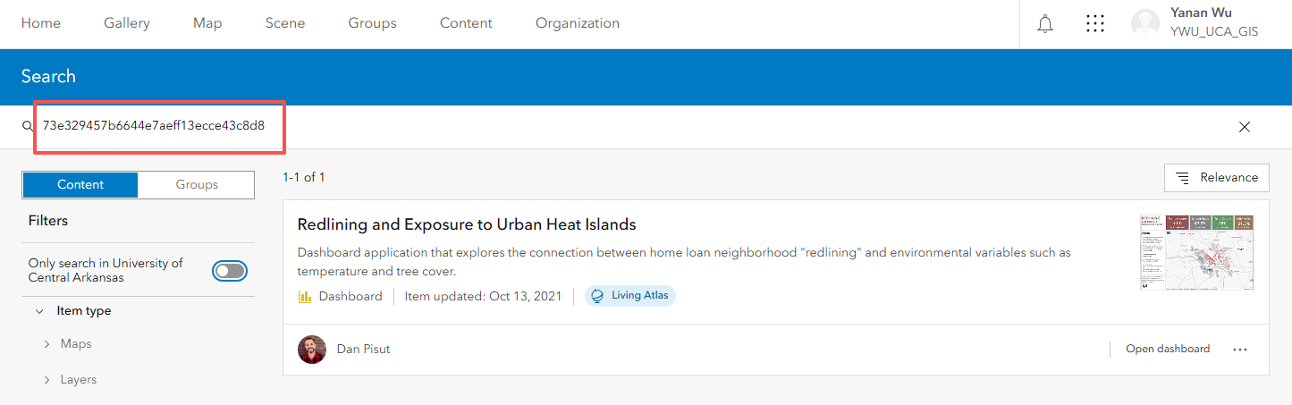
How to use map id
Open a map by ID
Paste the Item ID into ArcGIS Online search

Slide 20
How to use map id
Take the ID and paste it into the Web Map Viewer URL:
https://www.arcgis.com/home/webmap/viewer.html?webmap=IDHERE
ID: f02f90242e3b4eff8c8ac0ea4ffe1cfa
Replace IDHERE with ID

Slide 21
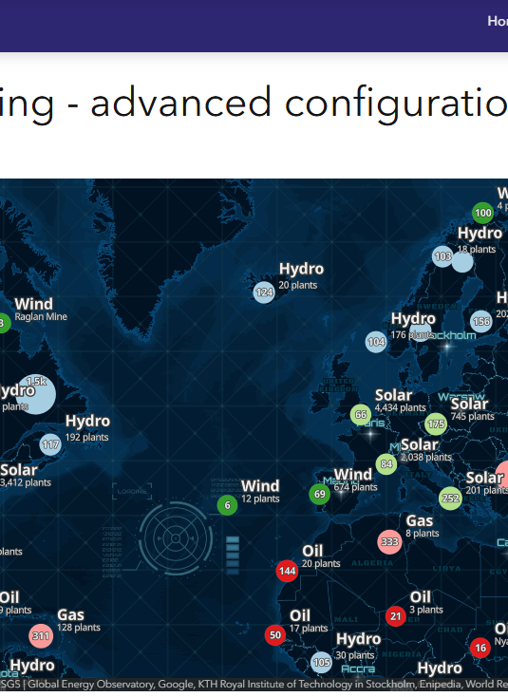
Using Map ID in Web Maps
Conceptual flow
Create a WebMap object
In code, developers create a WebMap by specifying the Item ID.
Example:
var webmap = new WebMap({
portalItem: { id: "abc123xyz456..." }
});
Display the map in a View
A MapView or SceneView is created to display the web map in the browser.
The webmap variable (with the ID) is passed into the view.
Result
The map automatically loads, with all its layers, symbology, and settings—because the Item ID links back to ArcGIS Online or Enterprise where everything is stored.

Slide 22
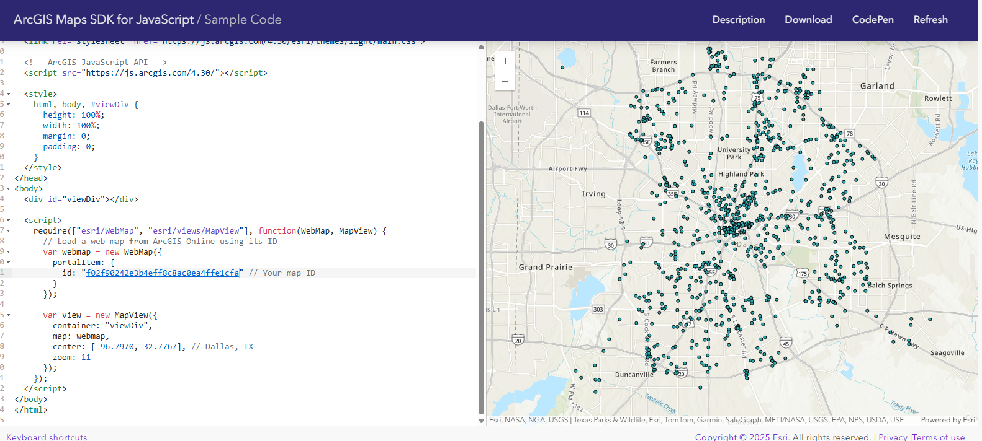
CLASS ERERCISE: ArcGIS Maps SDK for JavaScript

Slide 23
In-class activity
On your smartphone or tablet, navigate to the ArcGIS StoryMaps Gallery at https://arcg.is/1Lmyq50.
Browse the gallery and test at least three stories.
Change the screen orientation to see how the stories respond.
While reviewing the story maps, reflect on how their elements, capabilities, and interactive features can be incorporated into your Mobile GIS workflows or projects.

Slide 24

Thank you!

