Slide 1

WEEK 06 GPS Receiver lecture
Instructor: Yanan Wu
fALL 2025

Slide 2
6.1 GPS

Slide 3
Overview
GNSS Systems
GPS receiver
Antenna
Controller
Receiver Hardware
How GPS Work
Explore function of TDC 100

Slide 4
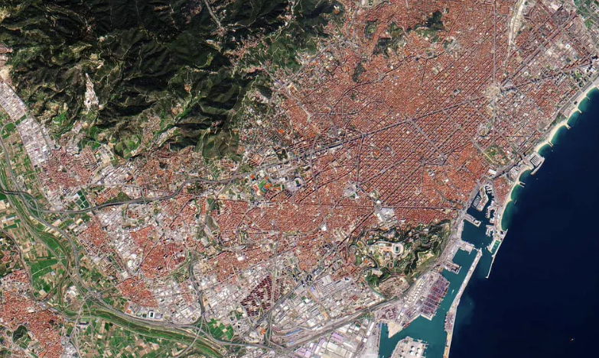

Overview
Where am I?
How to know my location precisely ?
At anytime
In any condition
Anywhere
How to navigate to the destination?
Guidance or Navigation
How to synchronize time globally?
Mobile phones Financial Institutes

Slide 5
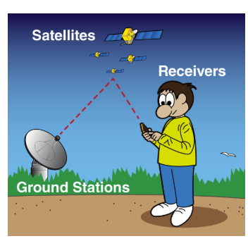
Overview
What is Global Positioning System (GPS)?
GPS is a system. It’s made up of three parts: satellites, ground stations, and receivers.
Satellites act like the stars in constellations—we know where they are supposed to be at any given time.
The ground stations use radar to make sure they are actually where we think they are.
A receiver, like you might find in your phone or in your parents car, is constantly listening for a signal from these satellites. The receiver figures out how far away they are from some of them.

Slide 6
Global Navigation Satellite Systems (GNSS)
GPS (Global Positioning System – USA)
Developed and operated by the United States Department of Defense.
First fully operational GNSS (since the 1990s).
Constellation: about 24 active satellites.
Provides global coverage with ~5–10 m accuracy (better with augmentation).

Slide 7
Global Navigation Satellite Systems (GNSS)
GLONASS (Globalnaya Navigatsionnaya Sputnikovaya Sistema – Russia)
Operated by the Russian Federation.
Constellation: about 21 satellites.
Provides global coverage similar to GPS.
Often used together with GPS for better accuracy and reliability, especially in northern latitudes.

Slide 8
Global Navigation Satellite Systems (GNSS)
Galileo (European Union)
Developed by the European Union & European Space Agency.
Fully operational since 2016.
Constellation: about 27 satellites.
Known for high accuracy — open service aims for 1 meter, with encrypted services for safety-critical use.

Slide 9
Global Navigation Satellite Systems (GNSS)
BeiDou ( China)
Built and operated by China.
Third generation (BeiDou-3) became fully global in 2020.
Constellation: about 35 satellites.
Provides regional and global services, with navigation, timing, and even short message communication.

Slide 10
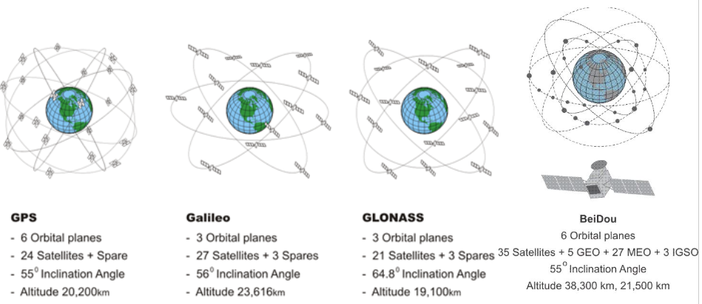
4 GNSS Constellations

Slide 11
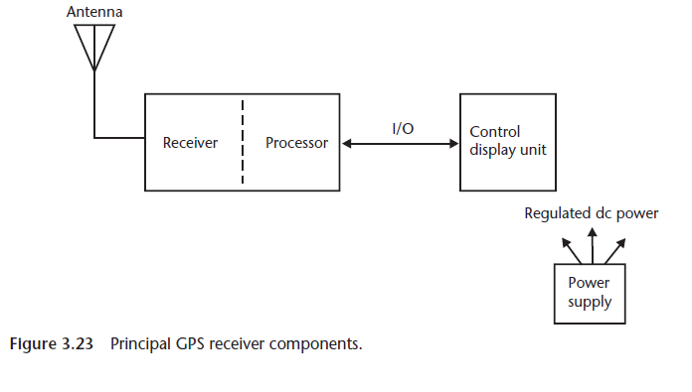
GPS receiver
An electronic instrument
Consists: an antenna, a hardware receiver, and a controller
Kaplan & Hegarty, 2006

Slide 12
Antenna
Gathers GNSS/GPS signals from satellite and transform into guided wave
Quality of GNSS/GPS observation primarily depends on the antenna
Antenna remains integrated with the receiver electronics and all are kept in a single rugged case
Antenna can also present as an independent unit.

Slide 13
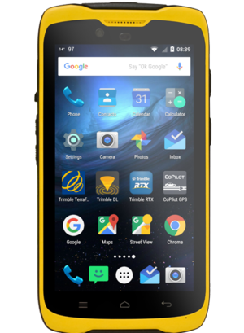
Antenna
The TDC100 has a built-in GNSS antenna inside the rugged handheld body (at the top left of the device, near the speaker).
It receives satellite signals (GPS, GLONASS, Galileo, BeiDou) directly without needing an external antenna.
Designed to work outdoors, it minimizes multipath errors and interference.
TDC 100
Trimble website
Notes:
Trimble TDC100 and Trimble TSC3

Slide 14
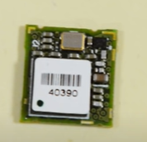
Receiver hardware
It is the electronic hardware that takes the very weak satellite radio signals captured by the antenna.
It amplifies those signals (since GPS signals are extremely weak by the time they reach Earth).
It filters them (so only the GPS frequencies are kept, ignoring other noise).
It converts the signals into a form that the Processor can understand and use to calculate position.

Slide 15
Processor
The device runs on Android OS.
This processor not only handles GNSS signal processing but also runs field apps like Trimble TerraFlex, Esri Field Maps, or Collector.
It integrates GNSS calculations with mapping, data entry, and communication functions.

Slide 16
I/O (Input/Output)
On the TDC100, I/O is through:
Touchscreen (main user input/output).
USB-C and Bluetooth/Wi-Fi (data transfer, connectivity with PCs, sensors, or cloud).
Cellular 4G LTE (real-time sync to ArcGIS Online, Trimble Connect, etc.).
These allow data collected in the field to move seamlessly into enterprise GIS systems.

Slide 17
Control Display Unit
The rugged touchscreen display is the control and display unit.
Users can:
View GNSS status (satellite strength, accuracy, corrections).
Interact with GIS apps, maps, forms, and data layers.
Control system settings and monitor battery/power.
Brightness and ruggedness are optimized for field visibility and durability.

Slide 18
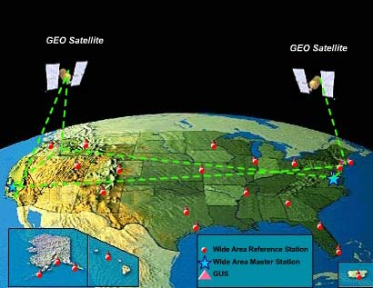
Wide Area Augmentation System
Wide Area Augmentation System (WAAS)
Satellite-Based Augmentation System (SBAS)
U.S. Federal Aviation Administration
Real-time accuracies for single fixes within 4-7 meters
Can average multiple fixes for increased accuracy
Broadcasted correction data from ground stations
Only for NAVSTAR GPS (US System)
Most handheld units are WAAS enabled
For real-time needs
Others: European: EGNOS , Japan: MSAS and QZSS, India: GAGAN, Russia: SDCM
https://www.faa.gov/about/office_org/headquarters_offices/ato/service_units/techops/navservices/gnss/waas/howitworks/
Notes:
WAAS, or the Wide Area Augmentation System, is a type of SBAS, or Satellite-Based Augmentation System.
It was originally developed by the US Federal Aviation Administration for aviation and air traffic control purposes and provides real-time corrections, which is very important for air traffic control.
Precision can be increased to 4 to 7 meters using this method. Note that some sources will suggest less than 4 meters.
It works by collecting error information at ground control stations. This error information is then transmitted to satellites that then re-broadcast the correction information.
WAAS-enable receivers can collect this information and use it to correct GNSS measurements in real time.
Currently, WAAS is only designed to work with the NAVSTAR system. However, other SBAS systems are available.
Most handheld units, especially those designed for use with NAVSTAR, are WAAS-enabled, Satellite-Based Augmentation System (SBAS)
WAAS is generally used if there is a need for real-time correction; however, post-processing can provide better results.
Measurements from the reference stations are routed to master stations, which queue the received Deviation Correction (DC) and send the correction messages to geostationary WAAS satellites in a timely manner (every 5 seconds or better). Those satellites broadcast the correction messages back to Earth, where WAAS-enabled GPS receivers use the corrections while computing their positions to improve accuracy.
European Geostationary Navigation Overlay Service (EGNOS). Currently, EGNOS supplements the GPS by reporting on the reliability and accuracy of their positioning data and sending out corrections. The system will supplement Galileo in a future version.
The MTSAT (Multi-functional Transport Satellites) Satellite Augmentation System (MSAS) is the Japanese Satellite Based Augmentation System (SBAS) System:^{[1]} a GPS Augmentation system with the goal of improving its accuracy, integrity, and availability.
The Quasi-Zenith Satellite System (QZSS), also known as Michibiki (みちびき), is a four-satellite regional time transfer system and a satellite-based augmentation system development by the Japanese government to enhance the United States-operated Global Positioning System (GPS) in the Asia-Oceania regions, with a focus on Japan.^{[1]}
The System for Differential Corrections and Monitoring (SDCM) is the SBAS currently being developed in the Russian Federation^{[1][2]} as a component of GLONASS
GAGAN is an acronym for GPS Aided GEO Augmented Navigation. It is a Space Based Augmentation System (SBAS) jointly developed by ISRO and AAI to provide the best possible navigational services over Indian FIR (Flight Information Region) with the capability of expanding to neighbouring FIRs.

Slide 19
Trimble tdc 100 series handheld overview
https://www.youtube.com/watch?v=fimWxYMRiF8

Slide 20
In-Class Activity: Exploring GNSS with SatLook
What do you think affects GPS accuracy?
Open SatLook on your TDC100.
Show the 3 tabs:
Sky Plot → Satellites in the sky (constellation + geometry).
NMEA → Raw GNSS data (for advanced logging).
SNR → Signal strength for each satellite.
Highlight: “Tracked vs Used satellites”, SNR levels, and constellations (GPS, GLONASS, BeiDou, Galileo).

Slide 21
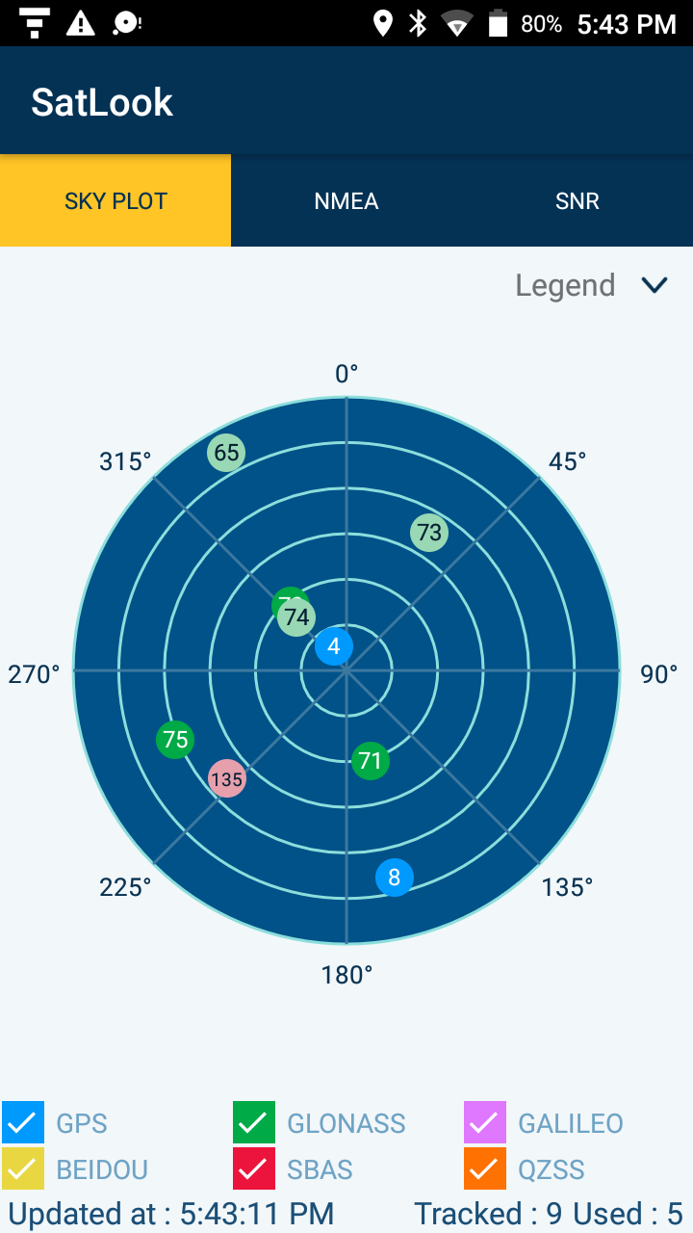
In-Class Activity: Exploring GNSS with SatLook
The polar plot shows the sky overhead, with your device in the center.
Each dot = a satellite being tracked.
Numbers inside the circles = satellite PRN numbers (identifiers).
Position of the dot = where the satellite is in the sky (azimuth & elevation).
“Tracked: 9 Used: 5” at the bottom means:
9 satellites are visible
5 are actually being used in your position calculation
👉 This tells you how well the antenna is seeing the sky. If many satellites are visible and used, your accuracy improves.

Slide 22
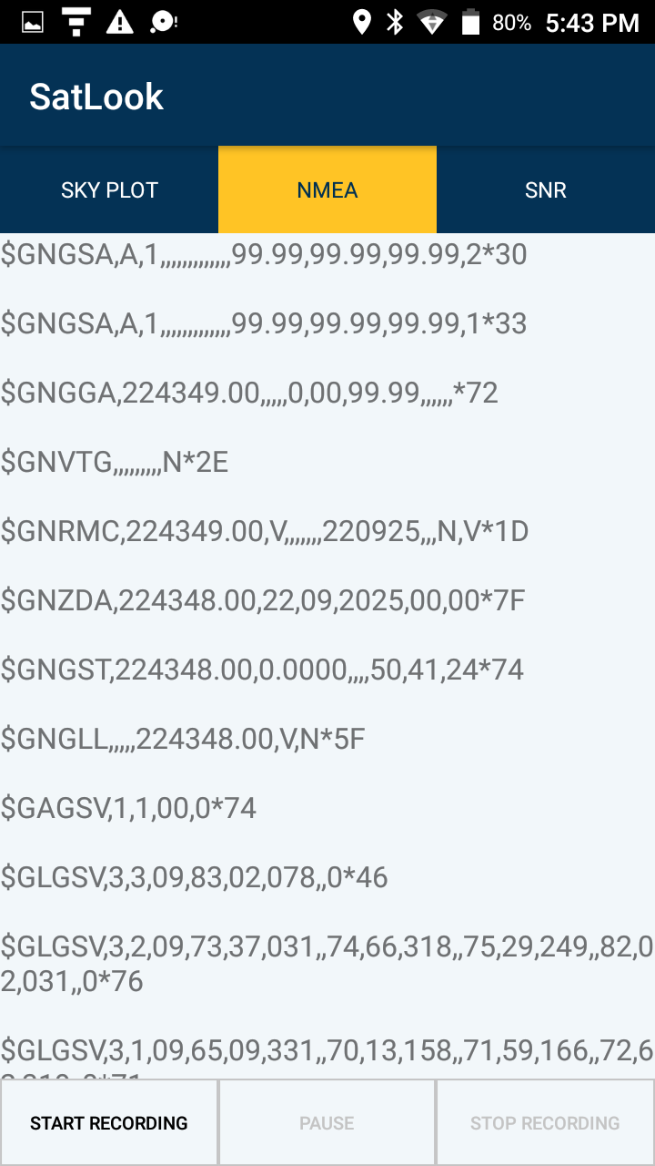
In-Class Activity: Exploring GNSS with SatLook
NMEA Data (NMEA tab)
NMEA = a standard GPS message format.
Each line starts with $ and a code that tells you what the sentence means. For example:
$GNGSA → GNSS DOP and active satellites (Dilution of Precision info).
$GNGGA → Fix data (time, latitude, longitude, altitude, fix quality).
$GNRMC → Recommended Minimum GPS Data (time, date, position, speed).
$GLGSV → Satellites in view (from GLONASS).
Explore Start Recording

Slide 23
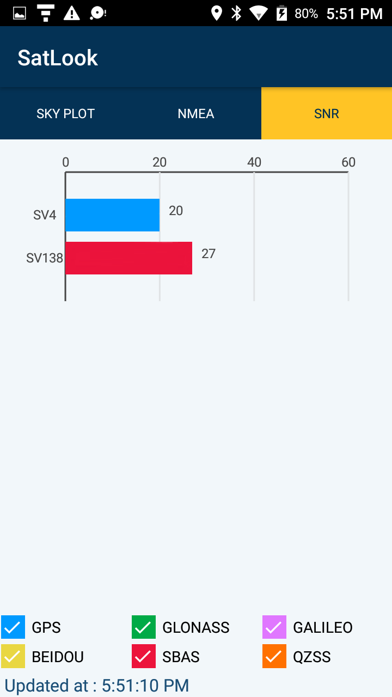
In-Class Activity: Exploring GNSS with SatLook
SNR = Signal-to-Noise Ratio
SNR measures how strong and clean the satellite’s signal is compared to background noise.
Units: dB-Hz (decibels relative to 1 Hz).
Higher = better (stronger, clearer signal).

Slide 24
GNSS receiver
1. In the Apps screen, tap Settings, then tap Location.
2. Slide the Location slider to On.
3. Tap Mode and select the mode you want the device to use to determine your location:
4. Tap Location mode, then select the Location mode you want the device to use (GPS + BDS; GPS + GLONASS; GPS only).
7. Tap Update rate to modify the update rate of the GNSS solution. Two settings are available: 1s and 2s. By default, the receiver is set to 2s, but it is recommended that you use 1s to maximize the reactivity of any GNSS applications.

Slide 25

Thank you!

