Slide 1

GEOG 3319: Geographic Field Techniques
Lecture 01 Introduction
Yanan Wu, PhD
Assistant Professor
Department of Geography

Slide 2
Overview
Introduction
Who am I?
Who you are?
Course overview and expectations
Syllabus
Software
ArcGIS Pro

Slide 3
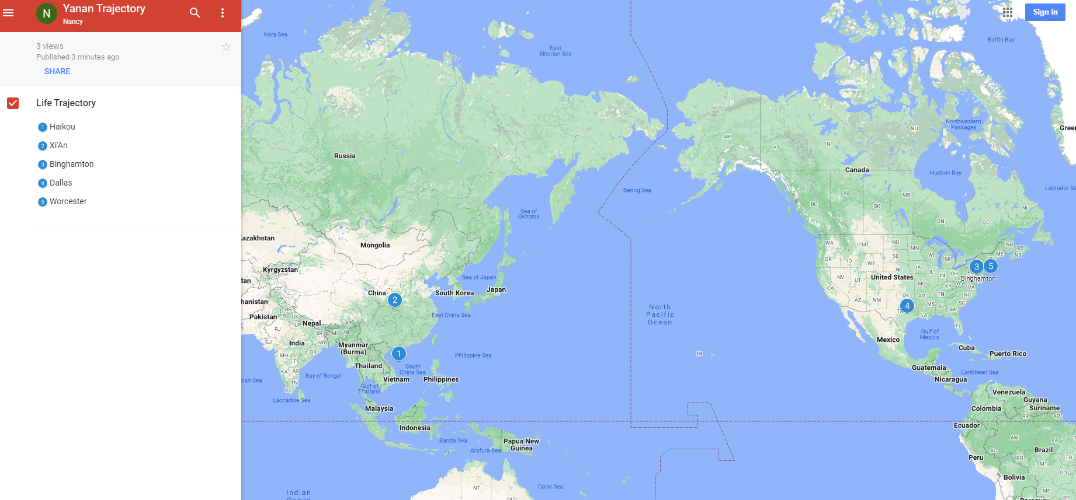
Who am I?

Slide 4


Past Teaching Experience
Python Programming
Spatial Database
Manipulating Spatial Data
Web Mapping
Processing Raster
Data Analysis
Creating Custom Tool
Data Visualization
…
Geodatabase
SQL
Proximity Analysis
Geometry processing
Raster processing
PostSQL with python
…

Slide 5

Past Teaching Experience
Web Mapping
Intermediate Statistics
Bivariate regression
Logistics regression
PCA
GWR
Spatial Autocorrelation
…
HTML
CSS
JS
Python Web Mapping
R Web Mapping
ArcGIS Maps for JavaScript
…

Slide 6

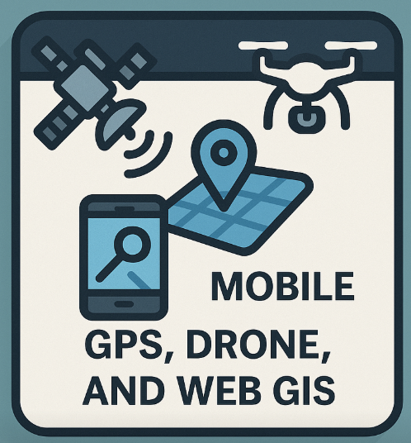
Teaching in UCA
GIS I
Geographic Field Techniques
Spatial Data
GIS software
Geodatabase
Cartography
Raster
Programming in GIS
…
GPS
Drone
Esri Mobile App
Field Map
Survey 123
ArcGIS Dashboard
…

Slide 7
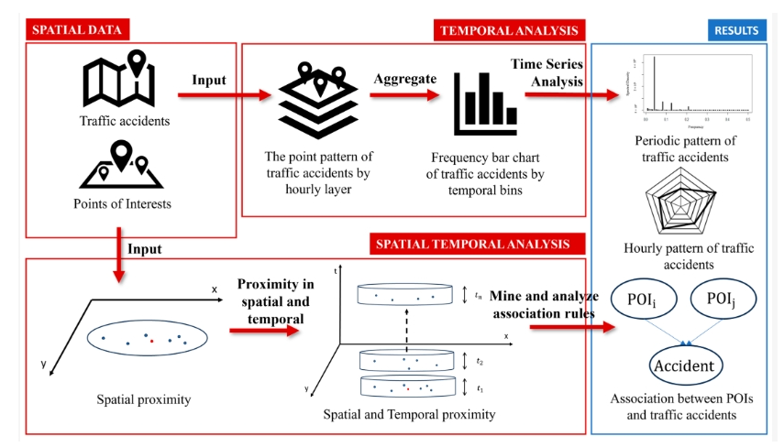
Research
Repetitive Pattern of Traffic Accidents in City of Dallas, TX
Notes:
Southwestern Energy Research Fellow

Slide 8
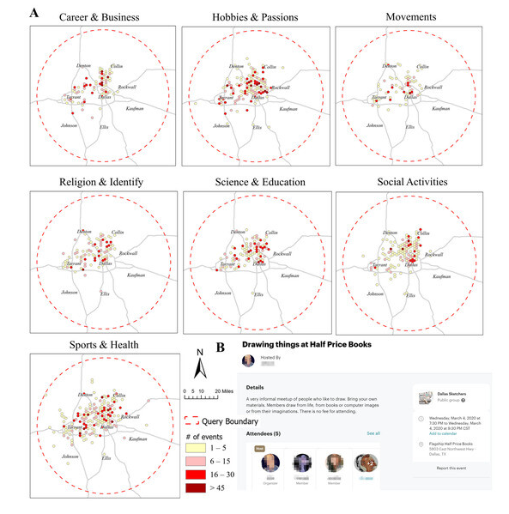
Research
What Local Environments Drive Opportunities for Social Events?
Funded by NASA EPSCoR

Slide 9
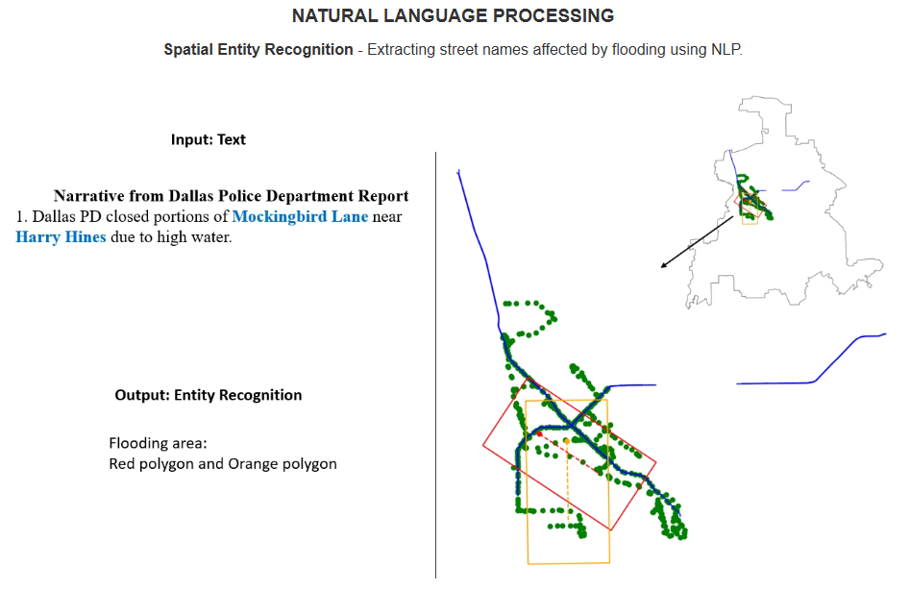
Research

Slide 10
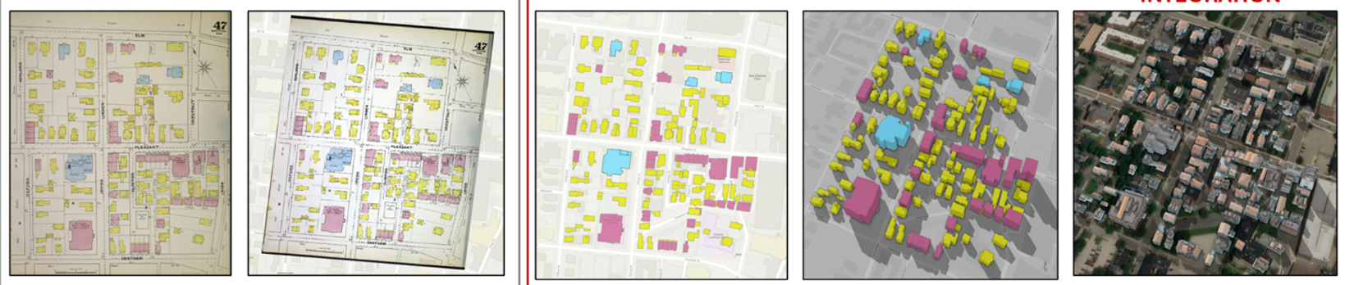
Research
Sanborn Historical Map

Slide 11
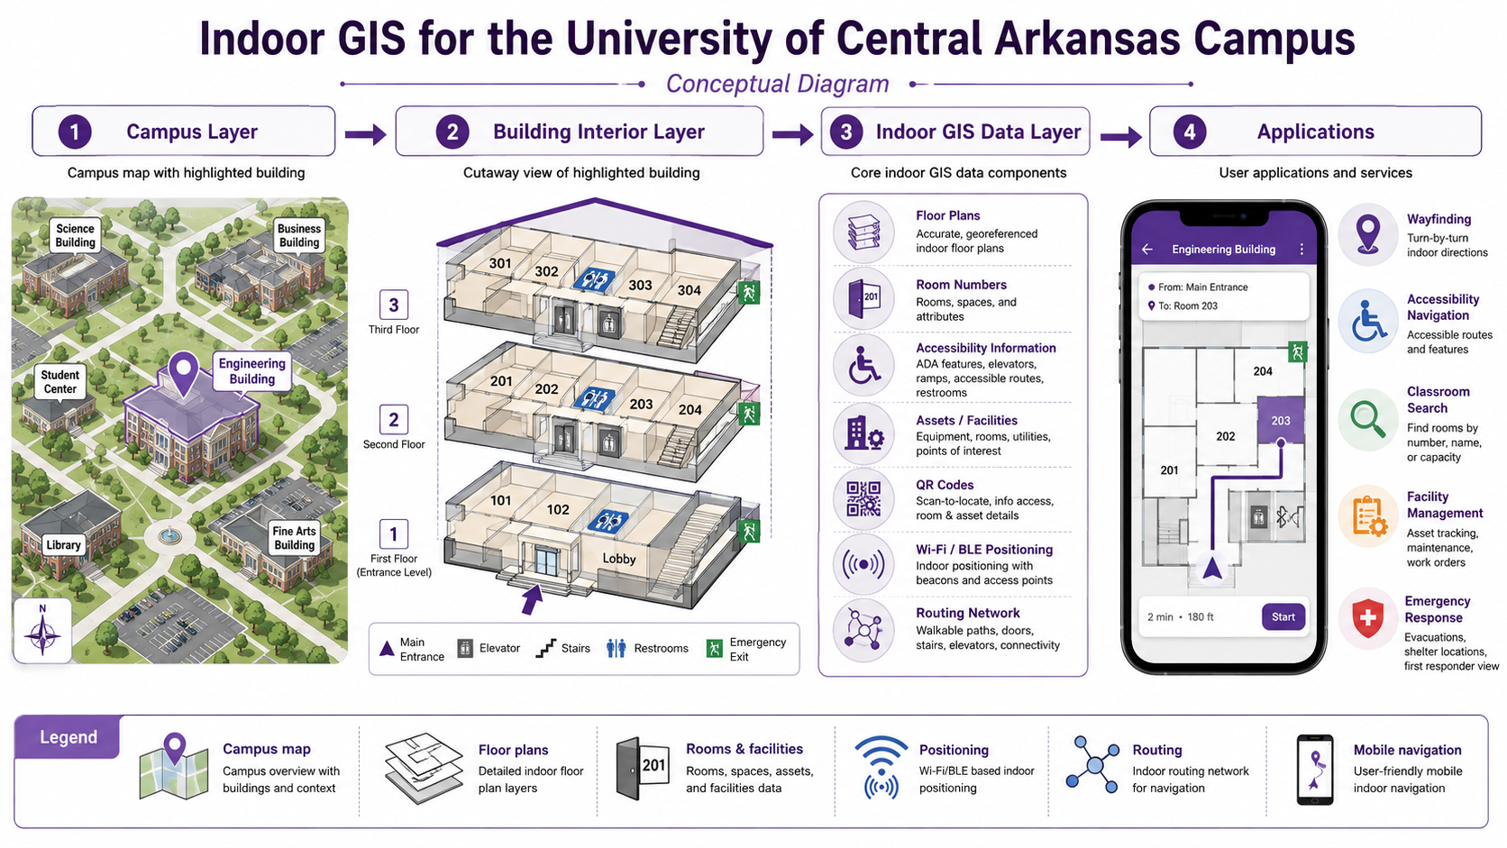
Indoor GIS

Slide 12
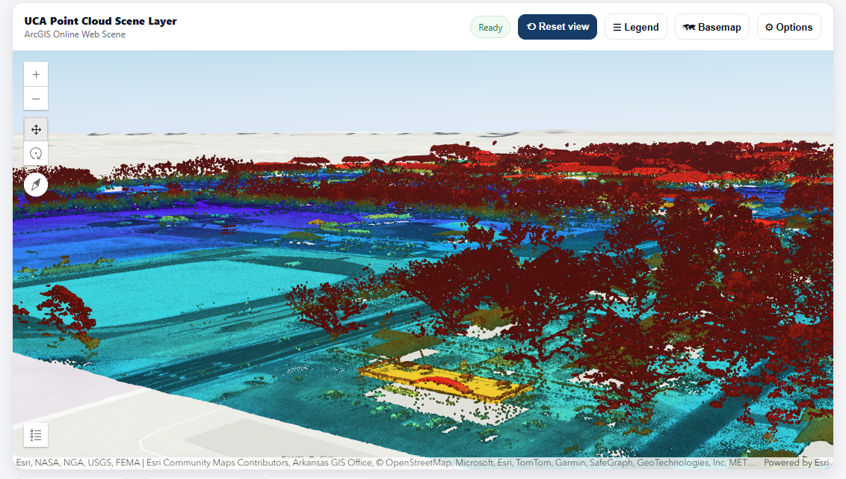
Lidar – 3D Campus

Slide 13
About you
Your background (e.g., name, major)
Share something from your summer break
What relevant experience do you have with Geographic Field Techniques?
What are your expectations for this course?

Slide 14


Course overview and expectations
Book
Getting to know Mobile GIS by Pinde Fu (ISBN: 9781589487079)
Getting to Know Web GIS, by Pinde Fu (Esri Press, 5th Edition, ISBN: 9781589487079)

Slide 15


Course overview and expectations
Book
Understanding GPS: Principles and Applications edited by Elliott D. Kaplan and Christopher J. Hegarty (ISBN-10: 1580538940; ISBN-13: 9781580538947)
Fundamentals of Capturing and Processing Drone Imagery and Data edited by Amy E. Frazier and Kunwar K. Singh (ISBN 9780367245726)

Slide 16
Software
ArcGIS online account, provided by Geography department
ArcGIS Pro 3.0, provided by Geography department

Slide 17
Course overview and expectations
Course Structure
Lecture (M: 4:00- 5:15 pm)
Interactive and inclusive environment
Feel free at any time during lecture to ask a question and make a comment
Lecture will be recorded and delivered to the students if necessary
Lab exercise (W: 4:00- 5:15 pm)
Work individually on the in-class exercise
Guidance will be provided; demonstration will be provided if necessary
When submit exercise, copy questions in the lab and provide answers in a word file
Feel free at any time to ask a question

Slide 18
Course overview and expectations
Course Structure
Final project
Select your own topic and study area, collect or obtain appropriate data, process and analyze the data, create maps and other GIS products, and communicate your findings through an engaging StoryMap.
Develop your own GIS project and prepare it as an ArcGIS StoryMap for competition submission.
Integrate appropriate course technologies, such as Survey123, Dashboards, ArcGIS Hub, Experience Builder, 3D web scenes, or other Web GIS applications, when relevant to your project.
The final product should be a published ArcGIS StoryMap that is ready for review and competition submission.

Slide 19
Course Schedule
Sep. 7
Holiday: No Class
Oct. 19
Project Showcase
Nov. 23 - 27
Project analysis
Thanksgiving Break
Nov.30 - Dec. 4
Final Presentation
Dec. 7
Competition Submission Preparation

Slide 20
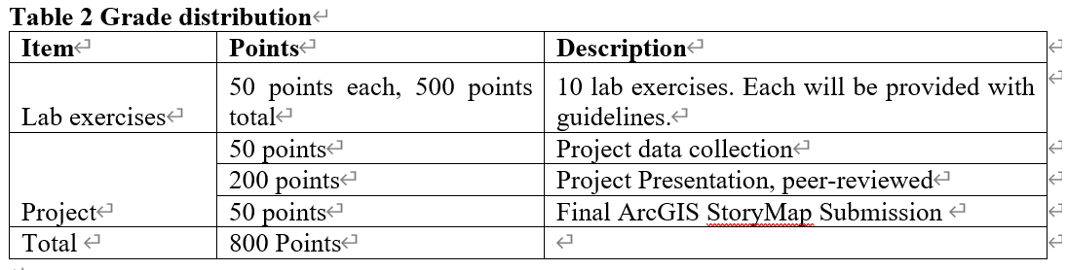
Course overview and expectations
Grading (20% later deduction)
4-credit version

Slide 21
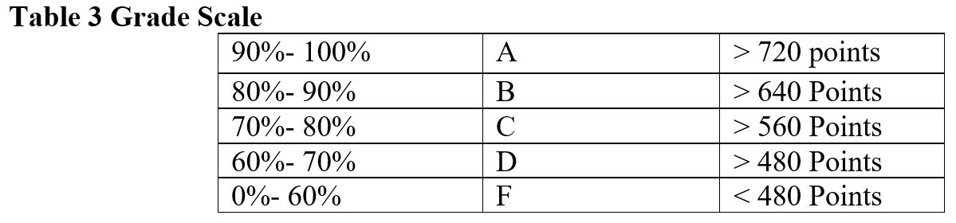
Course overview and expectations
Grading (20% later deduction)
4-credit version

Slide 22
Course overview and expectations
Late penalty for lab
Labs that are not turned in by the due date can be turned in up to 2 days late with a 20% penalty. Labs will not be accepted after this 2-day period.
Final presentation
The final presentation cannot be rescheduled. You are expected to do the final presentation at the time specified.

Slide 23
Course overview and expectations
Attendance
Prolonged absence from class will inhibit your understanding of the lecture material and prevent you from receiving help on assignments
We may do some bonus exercises during the class time. If you are not shown up, you simply lose it
Up to 3 times of absence may result in moving out from this class
If you cannot attend class, please contact me before class
Sick leave is acceptable, please contact me for re-arranging lab exercise etc.

Slide 24
Course overview and expectations
Feedback Response Time
The instructor generally replies to emails within 48 hours, except during holidays.
Often the instructor replies much more quickly, but you should not count on a same-day reply.
Please plan accordingly so that you don’t miss deadlines.

Slide 25
Course overview and expectations
Classroom Etiquette
Switch cell phones off and place them out of view. Do not use phones during class. Resist the impulse!
Computers are permitted for notetaking only.
Do not sleep in class or leave once a lecture has started.
Do not pack up and prepare to leave until the instructor has indicated that class is over
No eCigarettes permitted in the classroom.
You are encouraged to think critically and ask stimulating questions, but always respect your fellow students and your instructor.

Slide 26
Course overview and expectations
Evaluations
Student evaluations of a course and its professor are a crucial element in helping faculty achieve excellence in the classroom and the institution in demonstrating that students are gaining knowledge.
Students will receive evaluation notification from university.

Slide 27
Course overview and expectations
Structure
In-person
Lecture
Lab
Final presentation
Office hour
Preferred availability: MW, 1:00 – 4:00 pm
Office Phone: 501-450-3434
May Change!
Please regularly check your Brightspace or email

Slide 28
Course overview and expectations
After this course
explain Mobile GIS, and Web GIS principles and concepts
collect spatial data using cell phone through Suvey123
implement field data into GIS software (Esri ArcGIS)
understand the integration of technology and teamwork in Mobile GIS operations
produce maps using ArcGIS online mapping technique
understand ArcGIS Living Atlas contents
Create interactive geographic stories using ArcGIS StoryMaps and 3D web scenes.
Explain GNSS principles and concepts
Fly a UAV
Create interactive Web GIS applications using ArcGIS Hub, Dashboards, Experience Builder, and StoryMaps.

Slide 29
Course overview and expectations
Contact Info
Burdick 318
Email: ywu@uca.edu

Slide 30
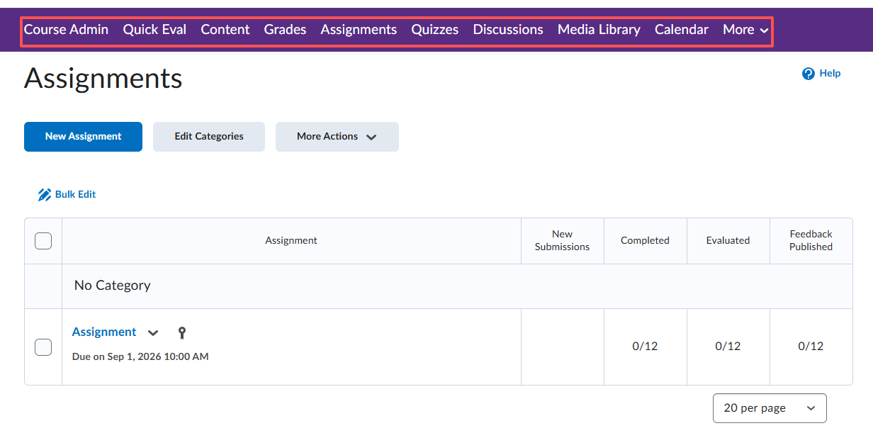
Course overview and expectations
Place for slides, and submitting lab exercise

Slide 31

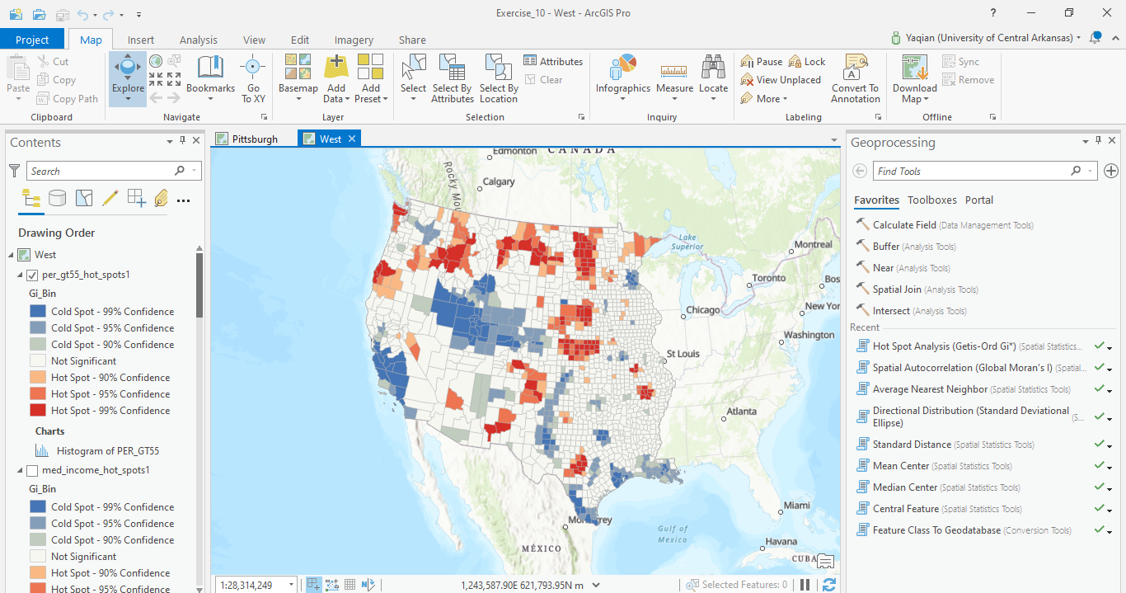
Software – ArcGIS Pro
ESRI ArcGIS Pro

Slide 32
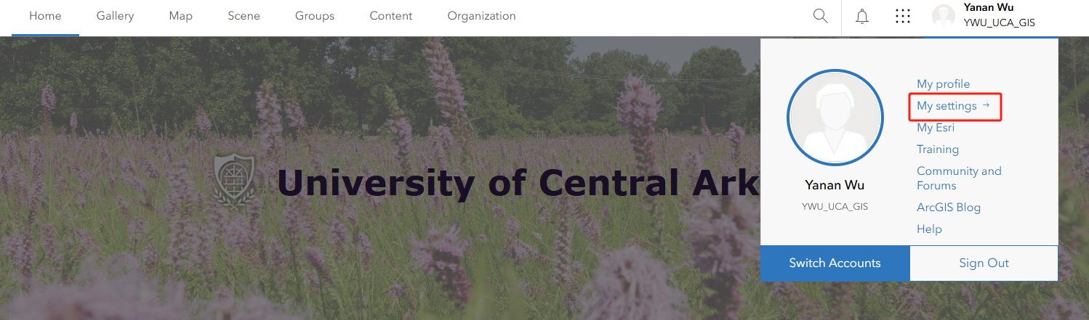
Software
ArcGIS Pro installed in your own PC

Slide 33
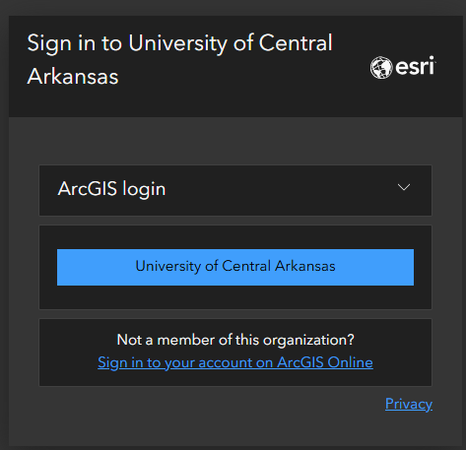
Software – ArcGIS Online
ArcGIS Online
Log in ArcGIS online
https://uca.edu/geography/gis/

Slide 34
Software – ArcGIS Pro
ESRI ArcGIS Pro

Slide 35
Software
ArcGIS Pro installed in your own PC

Slide 36
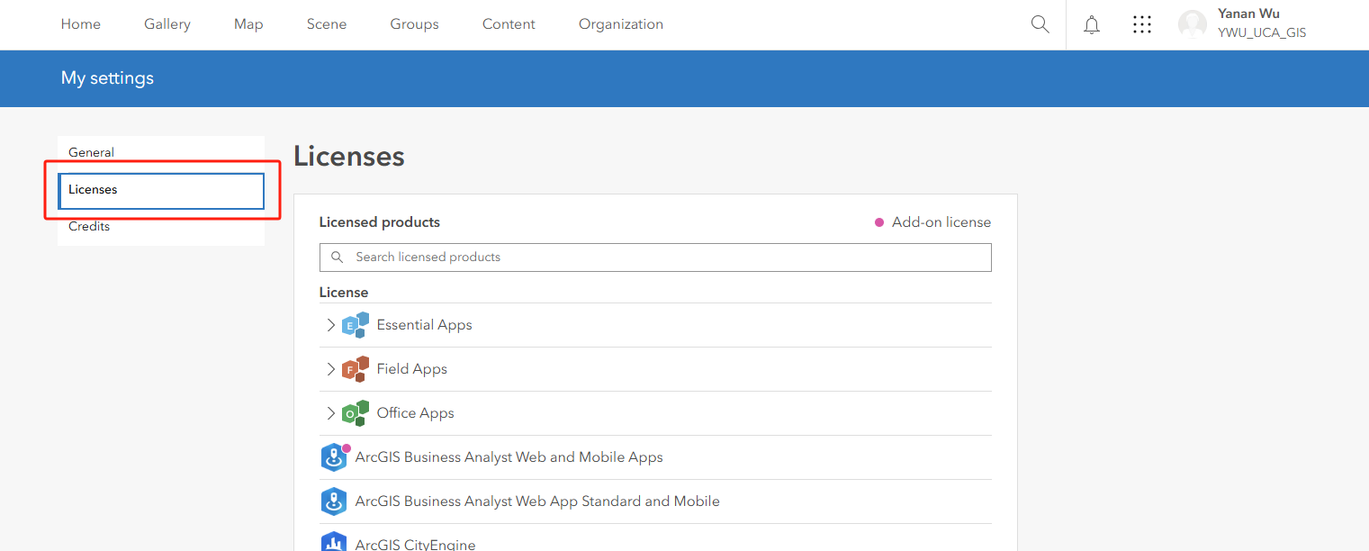
Software
ArcGIS Pro installed in your own PC

Slide 37
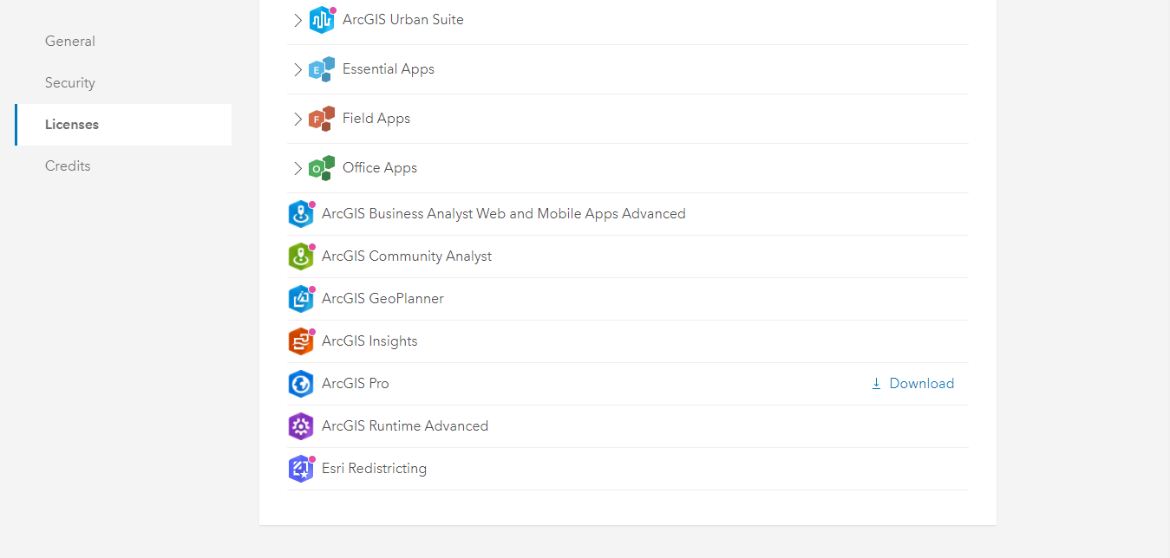
Software
ArcGIS Pro installed in your own PC

Slide 38
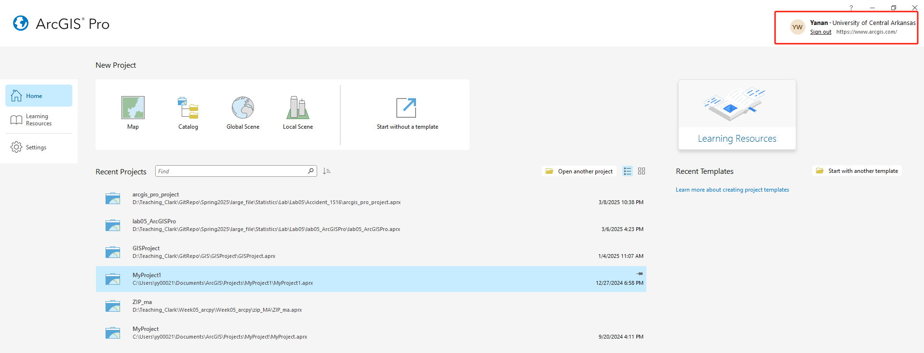
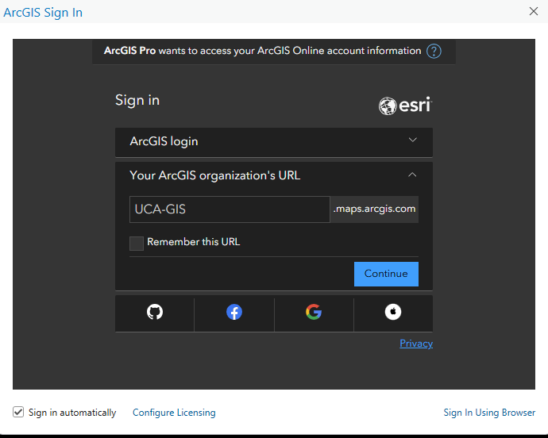
ArcGIS online account
ArcGIS Pro

Slide 39

Conference
SWAAG Conference
Student Competition
Geobowl

Slide 40
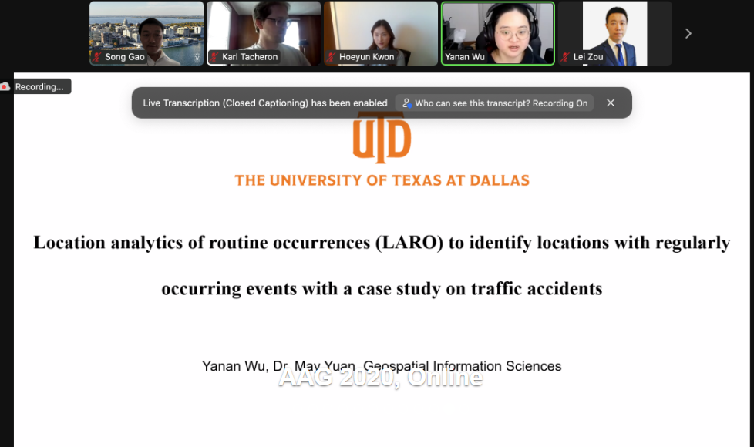
Conference
AAG Conference
Awards and grants

Slide 41

Esri Summer Internship
Notes:
These are the important geospatial skillsets for geospatial professionals. After this course, you will get some of this abilities. To get more advanced understanding and skillsets, I highly recommend to take advanced GIS and Cartography courses.
Since GIS is a fast growing field that relies heavily on technology. You will need to continue to develop your skillset throughout your professional career and you can check the professional associations.

Slide 42

2026 ArcGIS StoryMaps Competiton

Slide 43
Thank you!

