Slide 1

GEOG 3319: Geographic Field Techniques
Lecture 01 Introduction
Yanan Wu, PhD
Assistant Professor
Department of Geography

Slide 2
Overview
Introduction
  Who am I?
  Who you are?
Course overview and expectations
  Syllabus
Software
  ArcGIS Pro

Slide 3
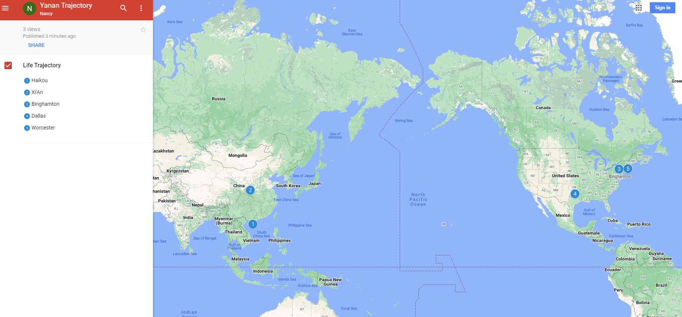
Who am I?

Slide 4


Past Teaching Experience
Python Programming
Spatial Database
Manipulating Spatial Data
Web Mapping
Processing Raster
Data Analysis
Creating Custom Tool
Data Visualization
…
Geodatabase
SQL
Proximity Analysis
Geometry processing
Raster processing
PostSQL with python
…

Slide 5





Past Teaching Experience
Web Mapping
Intermediate Statistics
Bivariate regression
Logistics regression
PCA
GWR
Spatial Autocorrelation
…
HTML
CSS
JS
Python Web Mapping
R Web Mapping
ArcGIS Maps for JavaScript
…

Slide 6

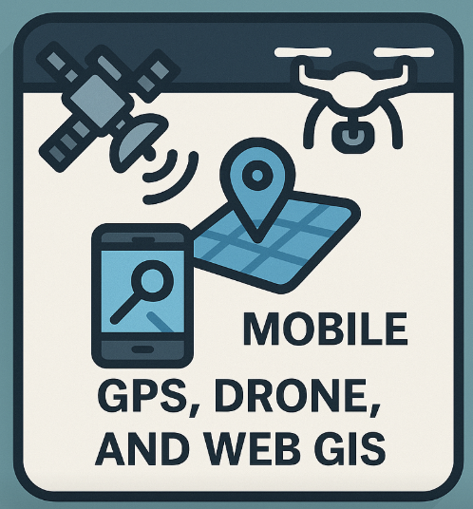
Teaching in UCA
GIS I
Geographic Field Techniques
Spatial Data
GIS software
Geodatabase
Cartography
Raster
Programming in GIS
…
GPS
Drone
Esri Mobile App
Field Map
Survey 123
ArcGIS Dashboard
…

Slide 7
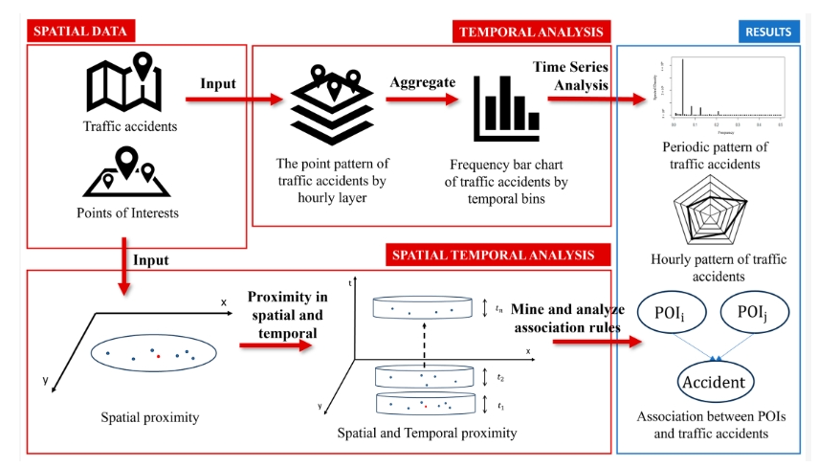
Research
Repetitive Pattern of Traffic Accidents in City of Dallas, TX
Notes:
Southwestern Energy Research Fellow

Slide 8
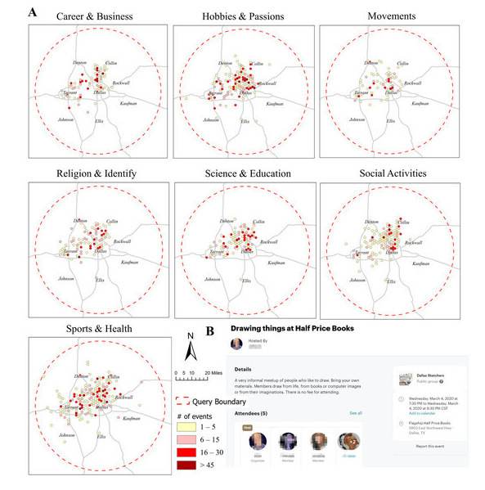
Research
What Local Environments Drive Opportunities for Social Events?
Funded by NASA EPSCoR

Slide 9
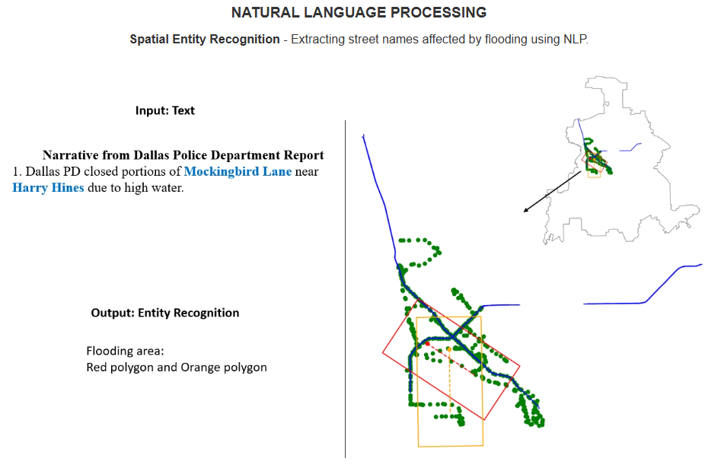
Research

Slide 10
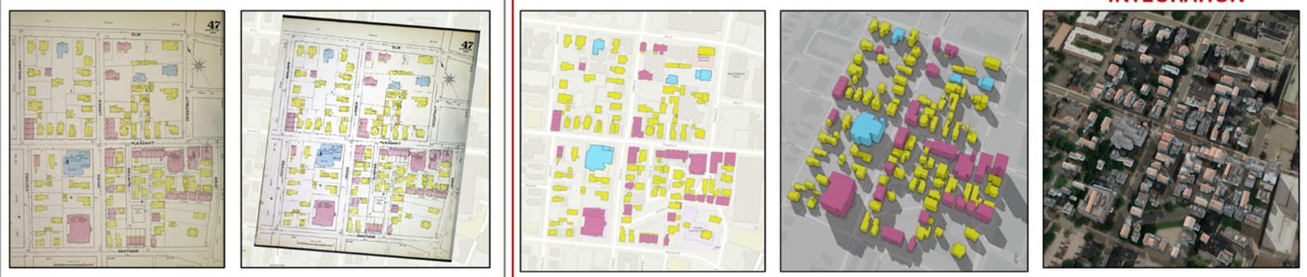
Research
Sanborn Historical Map

Slide 11
About you
Your background (e.g., name, major)
Share something from your summer break
What relevant experience do you have with Geographic Field Techniques?
What are your expectations for this course?

Slide 12


Course overview and expectations
Book
Getting to know Mobile GIS by Pinde Fu (ISBN: 9781589487079)
Getting to Know Web GIS, by Pinde Fu (Esri Press, 5th Edition, ISBN: 9781589487079)

Slide 13
Course overview and expectations
Book
Understanding GPS: Principles and Applications edited by Elliott D. Kaplan and Christopher J. Hegarty (ISBN-10: 1580538940; ISBN-13: 9781580538947)
Fundamentals of Capturing and Processing Drone Imagery and Data edited by Amy E. Frazier and Kunwar K. Singh (ISBN 9780367245726)

Slide 14
Software
ArcGIS online account, provided by Geography department
ArcGIS Pro 3.0, provided by Geography department

Slide 15
Course overview and expectations
Course Structure (4-credit)
  Lecture (T: 2:40- 3:55 pm)
    Interactive and inclusive environment
    Feel free at any time during lecture to ask a question and make a comment
    Lecture will be recorded and delivered to the students if necessary
  Lab exercise (R: 2:40 – 3:55 pm)
    Work individually on the in-class exercise
    Guidance will be provided; demonstration will be provided if necessary
    When submit exercise, copy questions in the lab and provide answers in a word file
    Feel free at any time to ask a question

Slide 16
Course overview and expectations
  Course Structure
  Final project
    For 4-credit version of this course only
    Design your own research, get your own data, process the data, generate maps, and write a final report
    You can refer to the previous exercise to get help

Slide 17
Course Schedule
Oct. 13-17
  Arkansas GIS User Forum: no class & lab
  Oct. 27-31
  SWAAG conference
  Nov. 24-28
  Thanksgiving Break
  Dec. 1-5
  Project analysis
  Dec. 8-12
  Final Presentation

Slide 18
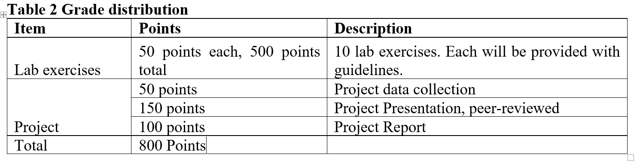
Course overview and expectations
Grading (20% later deduction)
  4-credit version

Slide 19
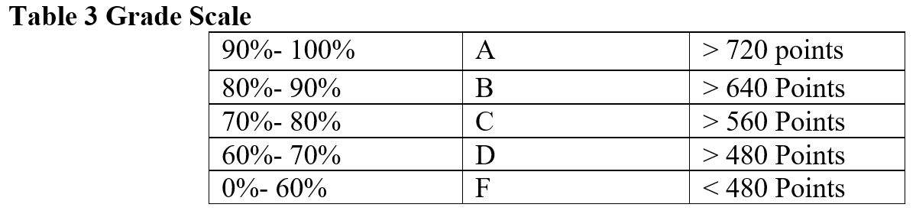
Course overview and expectations
Grading (20% later deduction)
  4-credit version

Slide 20
Course overview and expectations
Late penalty for lab
  Labs that are not turned in by the due date can be turned in up to 2 days late with a 20% penalty. Labs will not be accepted after this 2-day period.
  Final presentation
  The final presentation cannot be rescheduled. You are expected to do the final presentation at the time specified.

Slide 21
Course overview and expectations
Attendance
  Prolonged absence from class will inhibit your understanding of the lecture material and prevent you from receiving help on assignments
  We may do some bonus exercises during the class time. If you are not shown up, you simply lose it
  Up to 3 times of absence may result in moving out from this class
  If you cannot attend class, please contact me before class
  Sick leave is acceptable, please contact me for re-arranging lab exercise etc.

Slide 22
Course overview and expectations
Feedback Response Time
  The instructor generally replies to emails within 48 hours, except during holidays.
  Often the instructor replies much more quickly, but you should not count on a same-day reply.
  Please plan accordingly so that you don’t miss deadlines.

Slide 23
Course overview and expectations
Classroom Etiquette
  Switch cell phones off and place them out of view. Do not use phones during class. Resist the impulse!
  Computers are permitted for notetaking only.
  Do not sleep in class or leave once a lecture has started.
  Do not pack up and prepare to leave until the instructor has indicated that class is over
  No eCigarettes permitted in the classroom.
  You are encouraged to think critically and ask stimulating questions, but always respect your fellow students and your instructor.

Slide 24
Course overview and expectations
Evaluations
  Student evaluations of a course and its professor are a crucial element in helping faculty achieve excellence in the classroom and the institution in demonstrating that students are gaining knowledge.
  Students will receive evaluation notification from university.

Slide 25
Course overview and expectations
Structure
  In-person
    Lecture
    Lab
    Final presentation
    Office hour
      MW 10:00 am to 11:50 am
      Location: Lewis 154
  May Change!
    Please regularly check your Blackboard and or email

Slide 26
Course overview and expectations
After this course
  explain Mobile GIS, and Web GIS principles and concepts
  collect spatial data using cell phone through Field Map and Suvey123
  implement field data into GIS software (Esri ArcGIS)
  understand the integration of technology and teamwork in Mobile GIS operations
  produce maps using ArcGIS online mapping technique
  understand ArcGIS Living Atlas contents
  Create multiple dynamic maps using ArcGIS StoryMaps and 3D Web Scene
  Explain GNSS principles and concepts
  fly UAV
  process UAV image using GIS software

Slide 27
Course overview and expectations
Contact Info
  Lewis 154
  Office Hour:
    MW 10:00-11:50 am
  Email: ywu@uca.edu

Slide 28
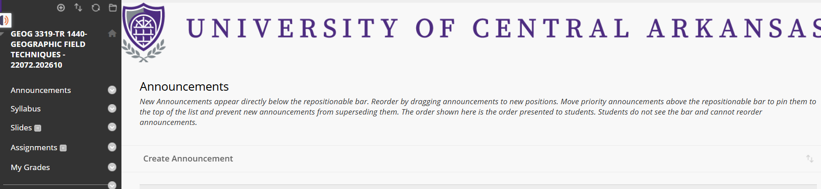
Course overview and expectations
Place for slides, and submitting lab exercise

Slide 29
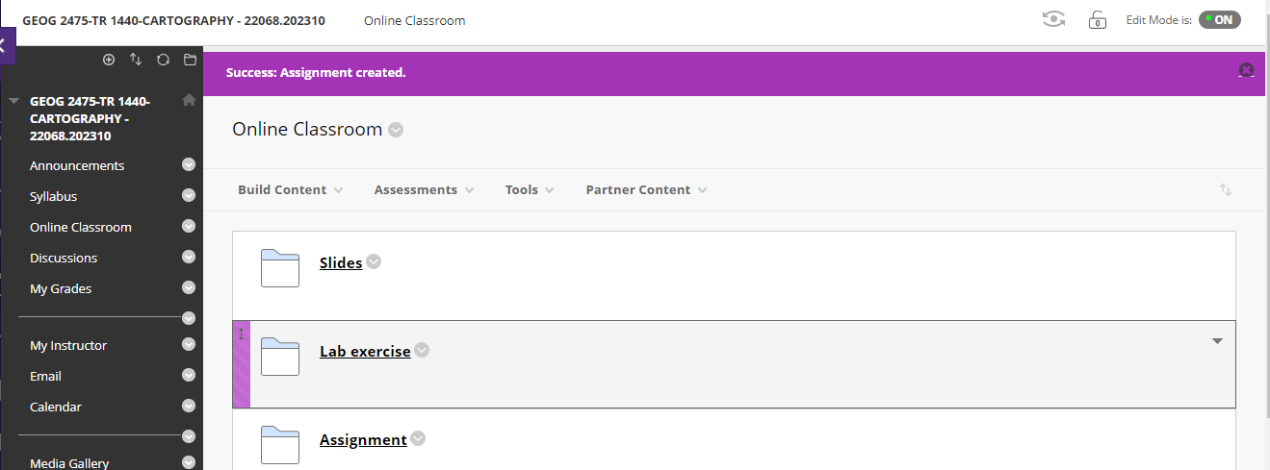
Course overview and expectations
Place for slides, and submitting lab exercise

Slide 30
ESRI https://pro.arcgis.com/en/pro-app/latest/get-started/run-pro-on-a-mac.htm
Harvard https://gis.harvard.edu/faq/how-installing-arcgis-desktop-or-pro-mac-computer
Software
ArcGIS Pro installed on Mac/other computer
Mac
Other PCs (e.g., Chromebook, Microsoft surface)
Please talk with/email to me

Slide 31
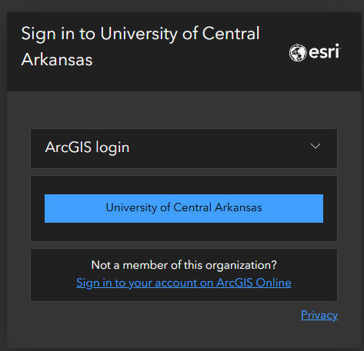
Software – ArcGIS Online
ArcGIS Online
  Log in ArcGIS online
https://uca.edu/geography/gis/

Slide 32

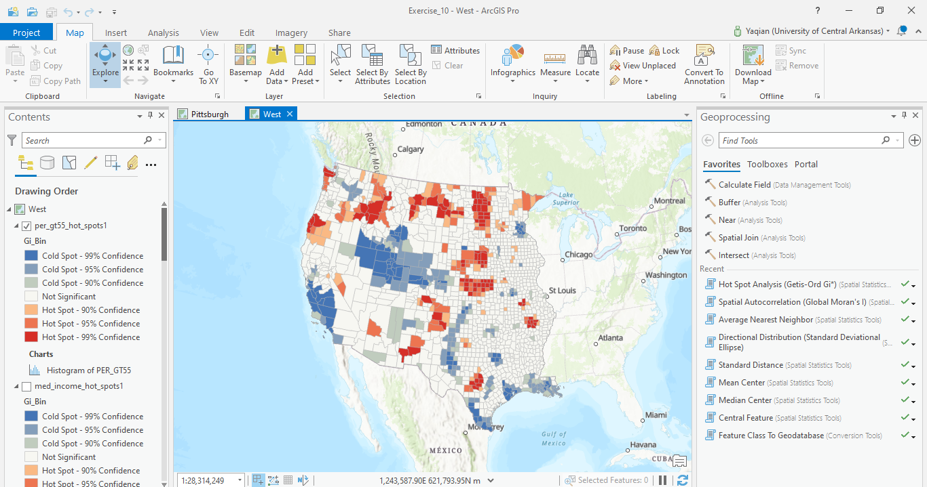
Software – ArcGIS Pro
ESRI ArcGIS Pro

Slide 33
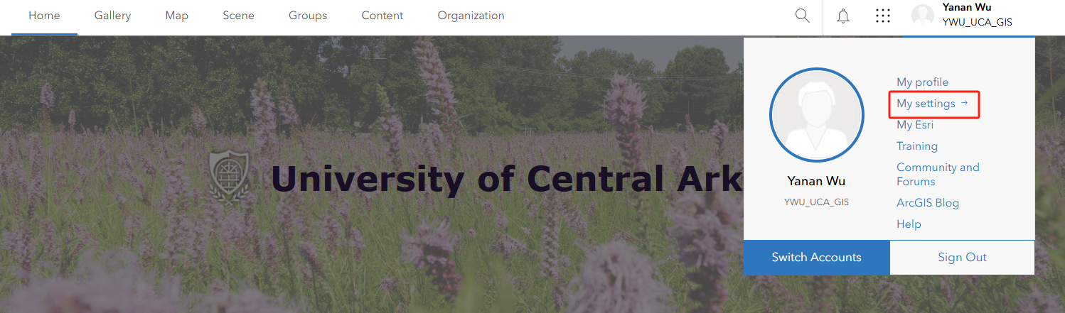
Software
ArcGIS Pro installed in your own PC

Slide 34
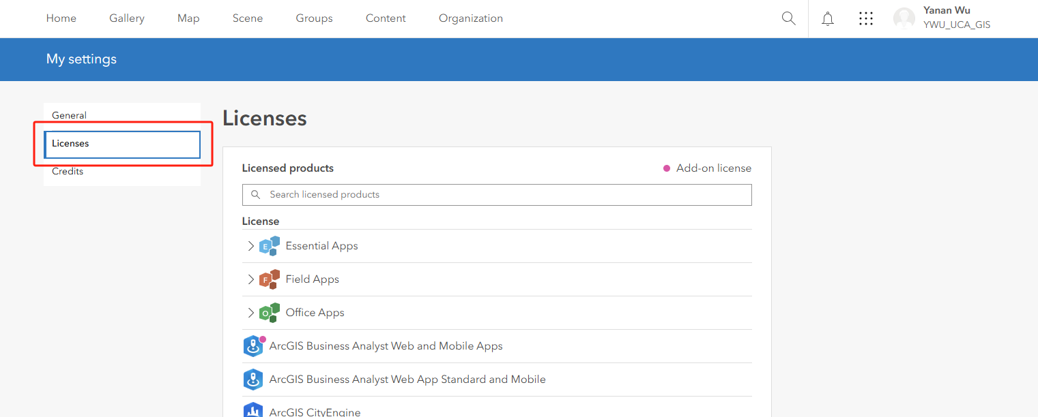
Software
ArcGIS Pro installed in your own PC

Slide 35
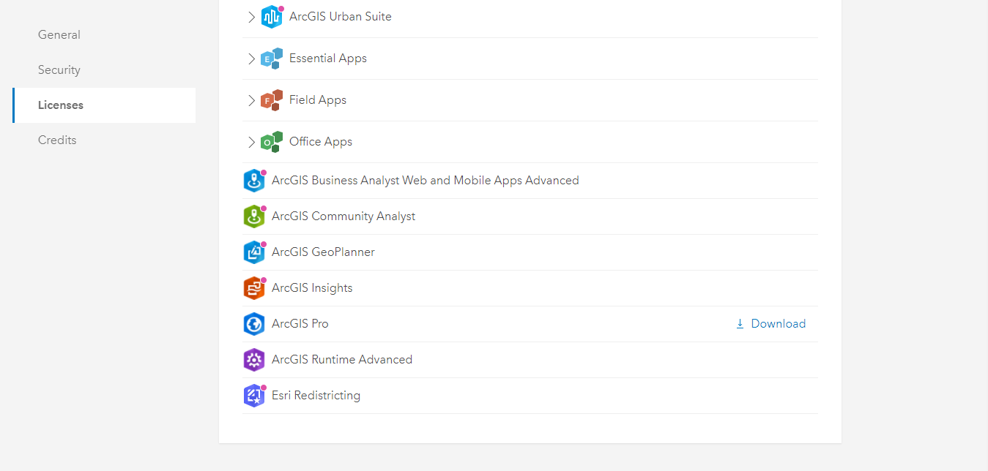
Software
ArcGIS Pro installed in your own PC

Slide 36
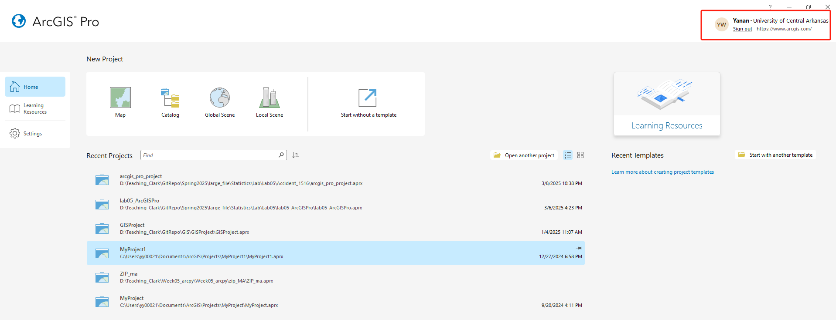
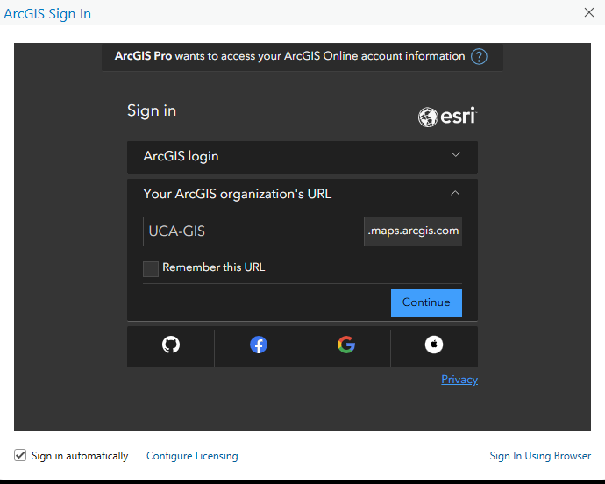
ArcGIS online account
ArcGIS Pro

Slide 37

Conference
Arkansas GIS Users Forum
SWAAG Conference
  Student Competition
  Geobowl

Slide 38
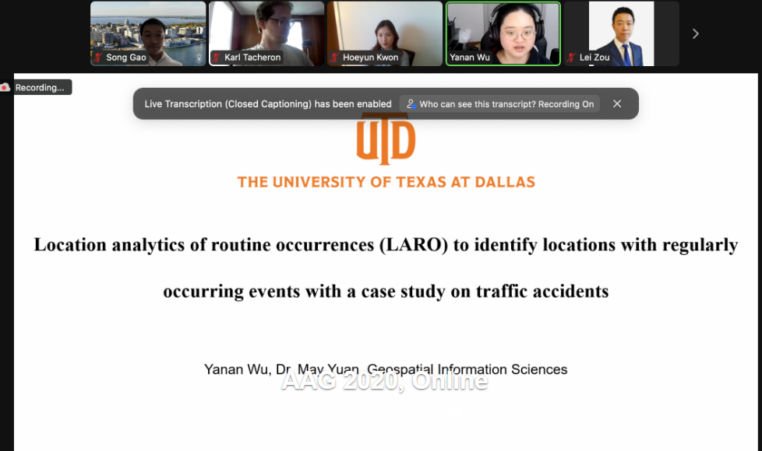
Conference
AAG Conference
  Awards and grants

Slide 39
Thank you!

