Slide 1

WEEK 05 attribute and geodatabase lecture
Instructor: Yanan Wu
fALL 2025

Slide 2
5.1 Attribute table

Slide 3
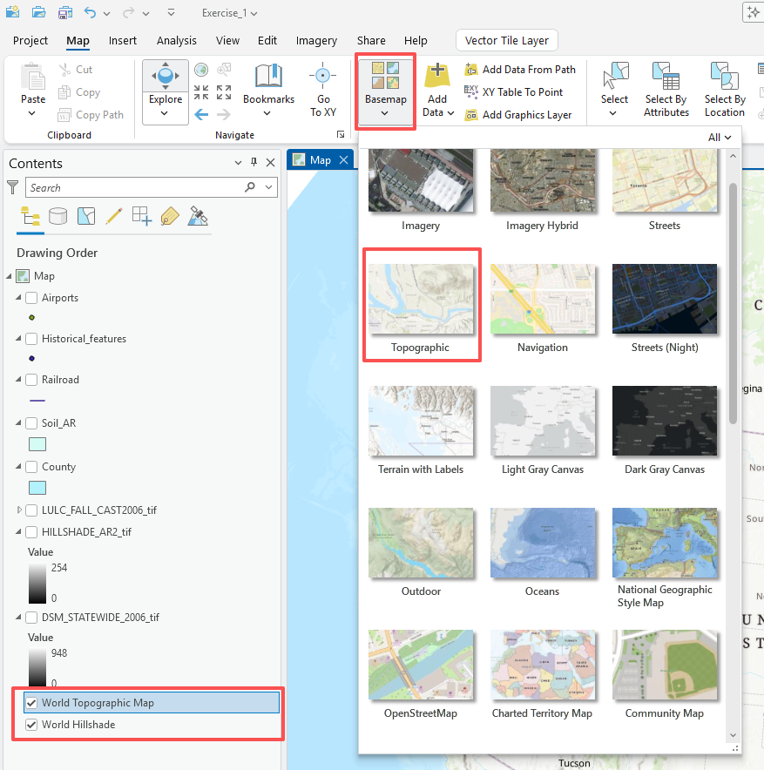
Lab 01
Question 1. How many layers are included on this map excepting the background layers of World Topographic Map and World Hillshade? (5 Points)
Answer 1: 8

Slide 4
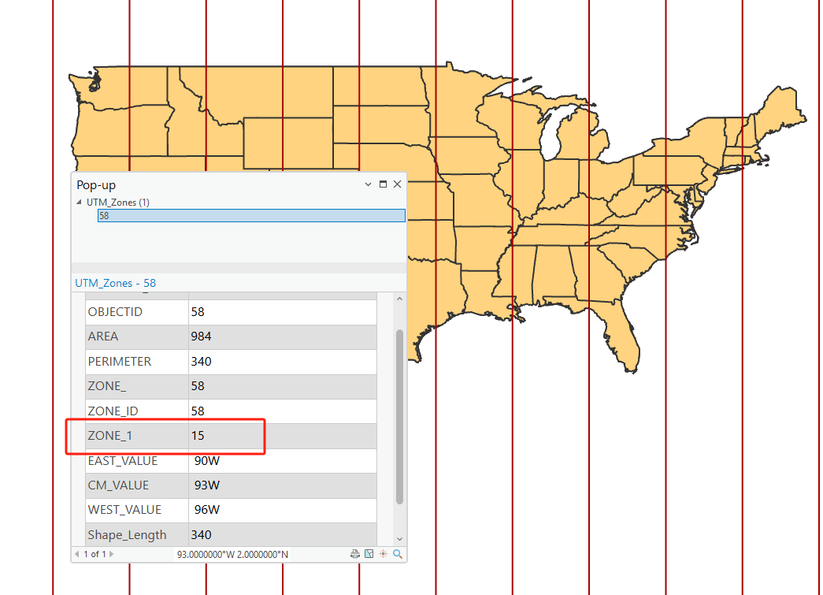
Lab 02
Question 7. What property (distance, local angels, area, shape) are conformal projections designed to maintain? (4 Points)
Answer: local angels, and shape
Question 4. In what UTM zone is Arkansas located? (4 Points)
Answer: 15 (58 is OBJECT ID, assigned by system)

Slide 5
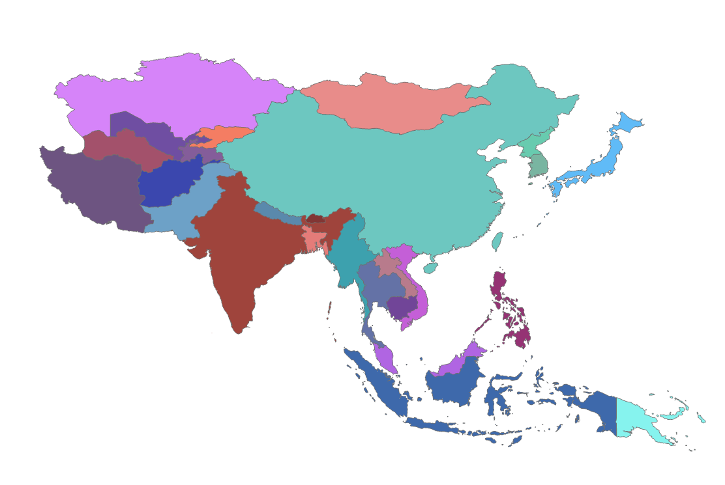
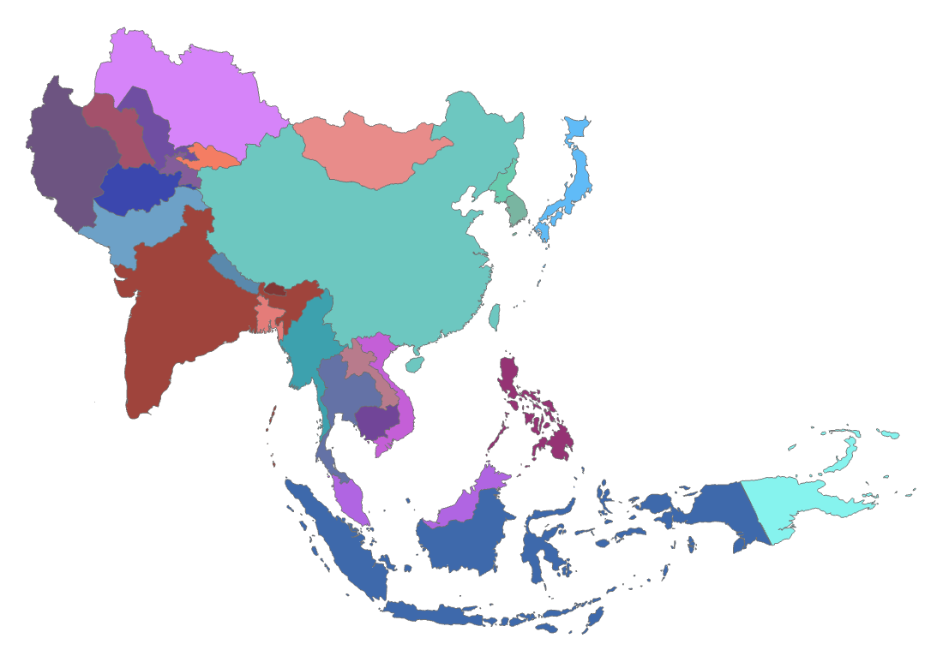
Lab 02
Deliverable 1. Provide a screenshot of Asia map using Asian Lambert Conformal Conic projection that can maintain the relative shape of the countries. (4 Points)
WGS 1984
Asian Lambert Conformal Conic projection

Slide 6
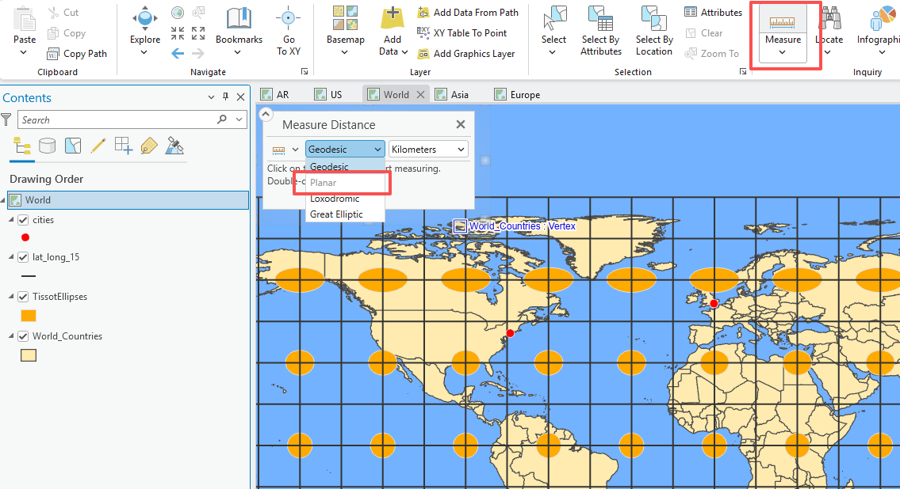
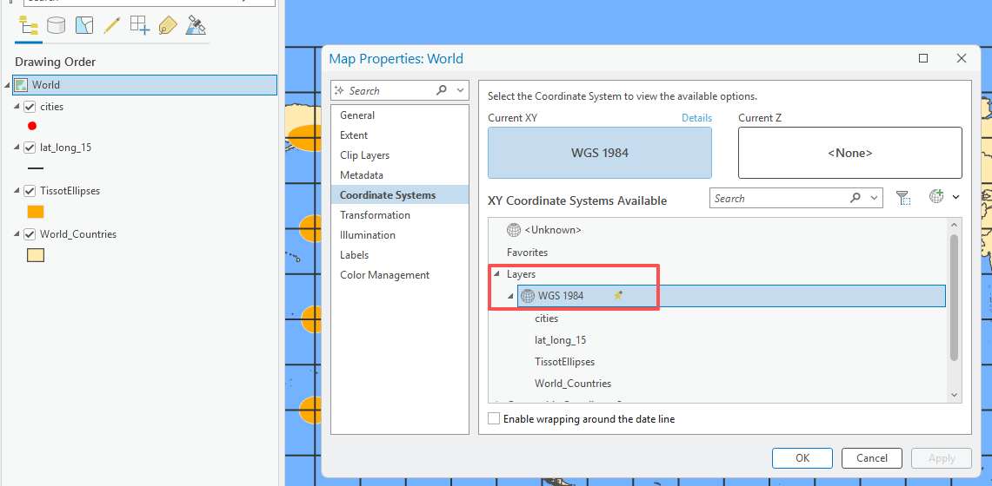
Lab 02
Question 9. What was the reported distance in kilometers between New York and London (they are red points on the map)?
A: 8379.92 km

Slide 7
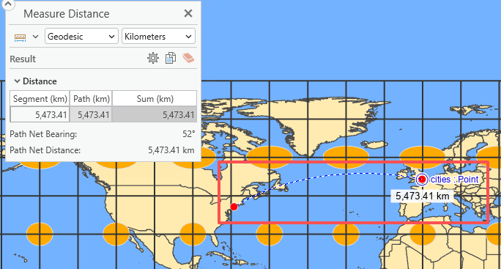
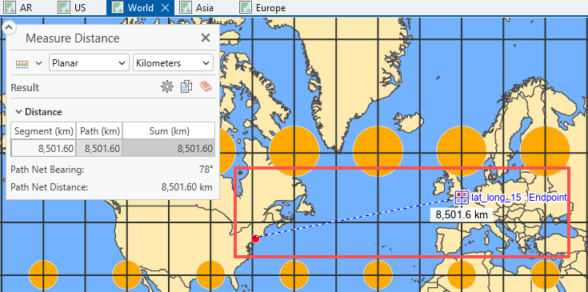
Lab 02
Question 9. What was the reported distance in kilometers between New York and London (they are red points on the map)?
Geographic Coordinate System
WGS 84
Projected Coordinate System
Mercator Projection

Slide 8
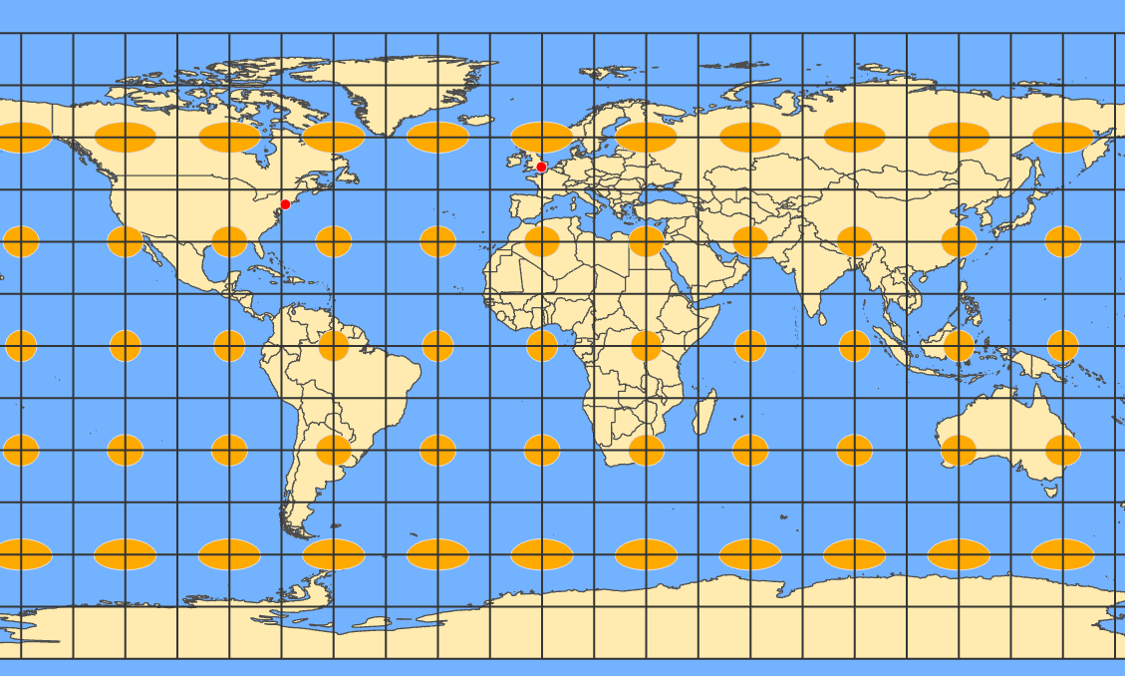
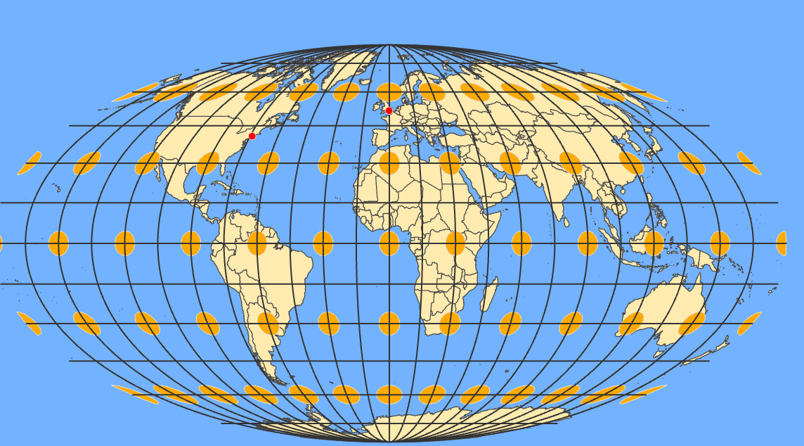
Lab 02
Q10: Does the Mollweide projection distort shape?
Yes
Geographic Coordinate System
WGS 84
Projected Coordinate System
Mollweide projection

