Slide 1

WEEK 06
Data Classification lecture
Instructor: Yanan Wu
fALL 2025

Slide 2
6.1
CLASSIFICATION

Slide 3
Overview
Data Classification
  Equal interval
  Quantiles
  Natural breaks
  Standard deviation

Slide 4
Data Classification
The act of organizing attribute values into categories, or groups
Can be qualitative or quantitative, and based on any of the four measurement scales
  Nominal
  Ordinal
  Interval
  Ratio

Slide 5
Classification Methods
One of the most interesting aspects of thematic mapping:
  One set of attribute values can yield many different maps, depending on the classification methods
  The scheme you choose can strongly influence how your map is perceived.
  Some of the most common schemes
    Equal interval, quantiles, natural breaks, standard deviation, optimal breaks, maximum breaks

Slide 6
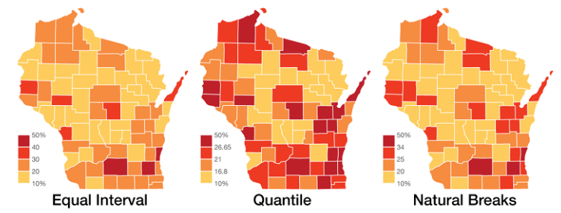
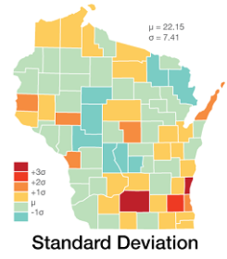
Classification Methods
Percent of residents over the age of 25 in Wisconsin that possess a Bachelor's degree or higher in 2016
https://gistbok.ucgis.org/bok-topics/statistical-mapping-enumeration-normalization-classification#:~:text=In%20Cartography%2C%20units%20by%20which,metropolitan%20areas%2C%20among%20many%20others.

Slide 7
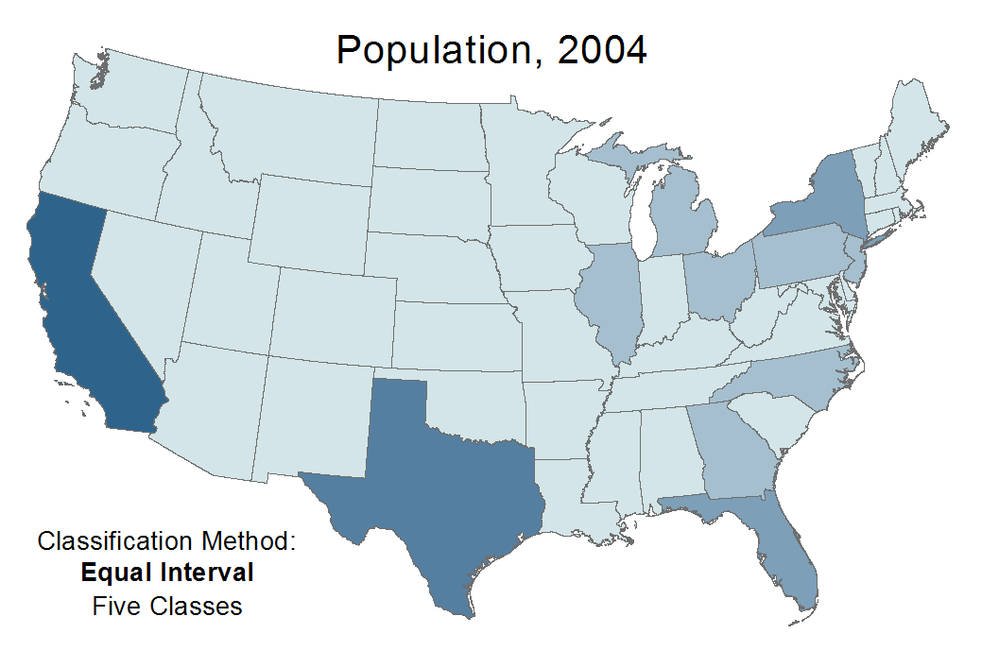
Classification Methods
Animation showing population using equal interval, quantile, and natural breaks classification methods
National Geospatial Technology Center of Excellence

Slide 8
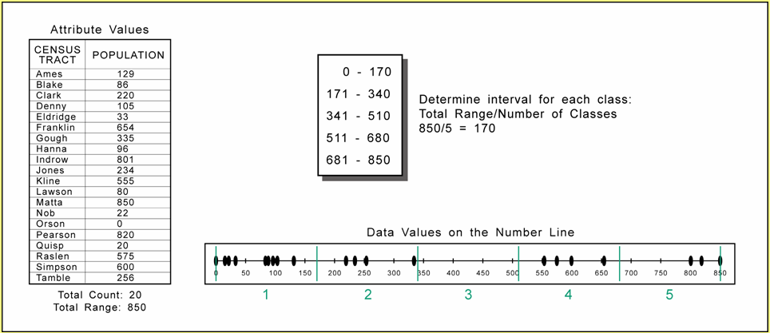
Classification Methods
Equal Interval
  Each class occupies an equal interval along the number line, or histogram
TOWN
POPULATION
No gaps between classes
National Geospatial Technology Center of Excellence
Notes:
Min 0, max is 850

Slide 9
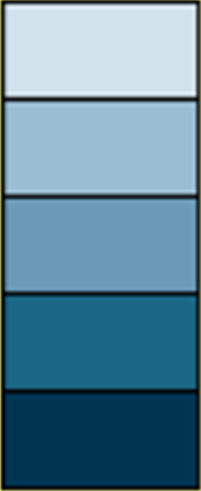
Classification Methods
Equal Interval
  Advantages
    Can be easy to understand and interpret
    Good for attributes that are normally represented using uniform classes: elevation, precipitation, percentages
0 – 20
21 – 40
41 – 60
61 – 80
81 – 100
National Geospatial Technology Center of Excellence

Slide 10
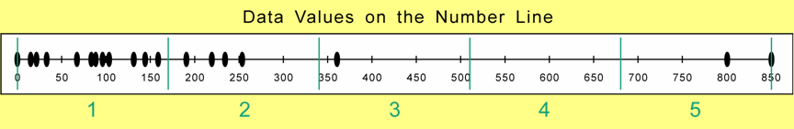
Classification Method
Equal Interval
  Disadvantages
    Poorly considers distribution of data along a number line
    Doesn’t works well with skewed distributions (can result in empty classes)
National Geospatial Technology Center of Excellence

Slide 11
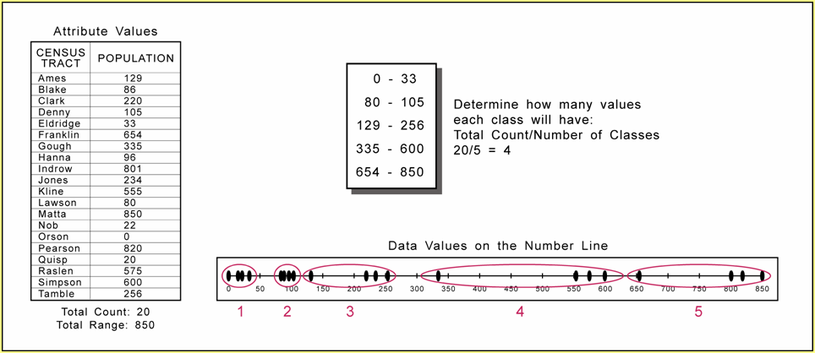
Classification Method
Quantile
  Each class contains the same (or similar) number of attribute values
4 classes: quartiles
5 classes: quintiles
6 classes: sextiles
TOWN
POPULATION
Gaps between classes
National Geospatial Technology Center of Excellence

Slide 12
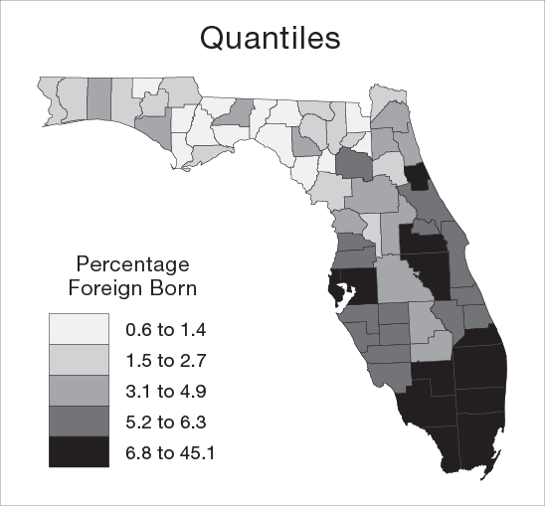
Classification Method
Quantile
  Advantages
    Ensures that a choropleth map will have the same number of darkest polygons as lightest
67 Counties
5 Classes
≈13 Counties
per Class
National Geospatial Technology Center of Excellence

Slide 13
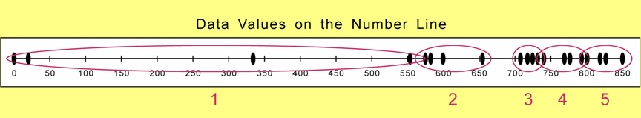
Classification Method
Quantile
  Disadvantages
    Poorly considers distribution of data along a number line
    Doesn’t works well with skewed distributions (one or two classes can occupy the majority of the range)
National Geospatial Technology Center of Excellence

Slide 14
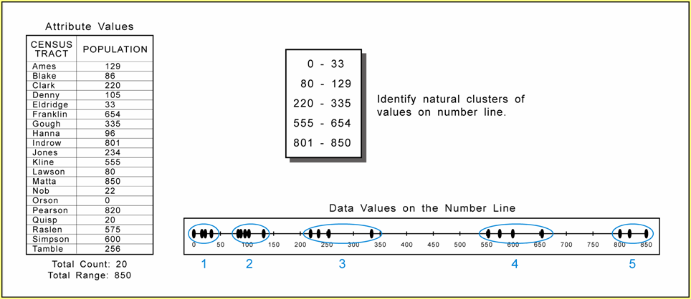
Classification Method
Natural Breaks
  Each class contains clusters of attribute values, and ‘natural’ breaks between
TOWN
POPULATION
More subjective
Gaps between classes
National Geospatial Technology Center of Excellence

Slide 15
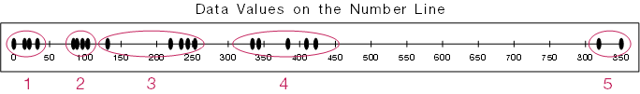
Classification Method
Natural Breaks
  Advantages
    Considers distribution of data along a number line (very good), each classification is ‘custom tailored’
    Works well with skewed data distributions
National Geospatial Technology Center of Excellence

Slide 16
Classification Method
Natural Breaks
  Disadvantages
    Subjective, and results will differ
    More difficult to compare with other maps

Slide 17
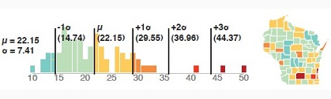
Classification Method
Mean- Standard Deviation
  Each class is determined by the standard deviation from the mean

Slide 18
Classification Method
Mean- Standard Deviation
  Advantages
    Works well with normally distributed datasets
  Disadvantages
    Does not work well with skewed or non-normally distributed data

Slide 19
Classification Method
There is no ‘best’ method
Certain methods are not well suited to particular situations

Slide 20
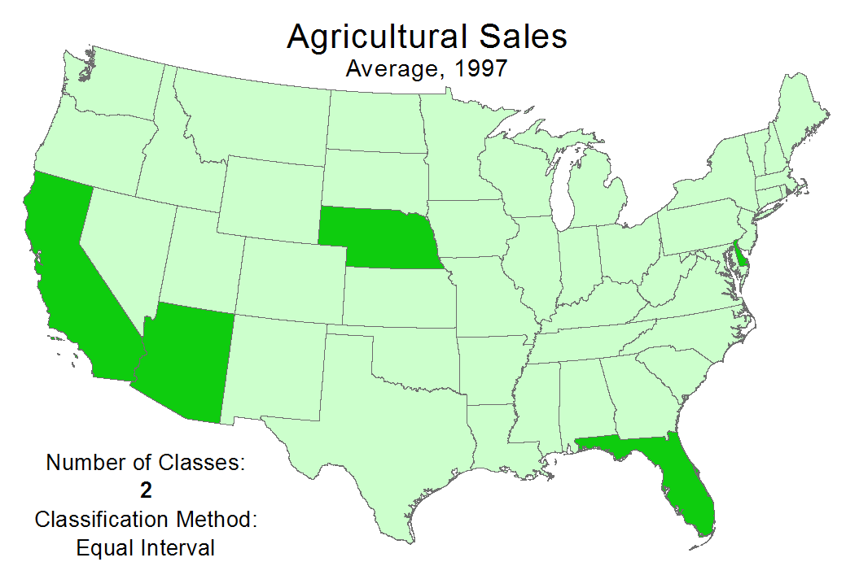
Classification Method
How many classes should you use?
Animation showing agricultural sales using 2, 4, and 6 classes
National Geospatial Technology Center of Excellence

Slide 21
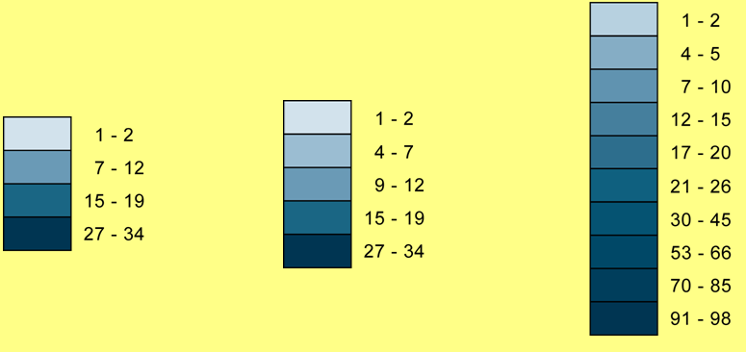
Classification Method
How many classes should you use?
  Anywhere between 3 to 7
  5 is probably optimal
  An odd # has a ‘middle’ class
Difficult to differentiate large numbers of tints
National Geospatial Technology Center of Excellence
Notes:
Tint or value

Slide 22
Classification Method
Classification for map comparison
  Use the same method for all maps
  Equal interval with identical break values often works best
  By definition, natural breaks will result in different classification on different maps, making comparison difficult

Slide 23
Group Activity
Compare two population density maps and discuss with your peers:
  Describe the spatial pattern of African-American population density? How about Hispanic?
  Are there any places with both high African-American and Hispanic population density?
  Are there any places with high African-American population density but low Hispanic population density? How about vice versa？
  Which population density is relatively higher in this region?

Slide 24
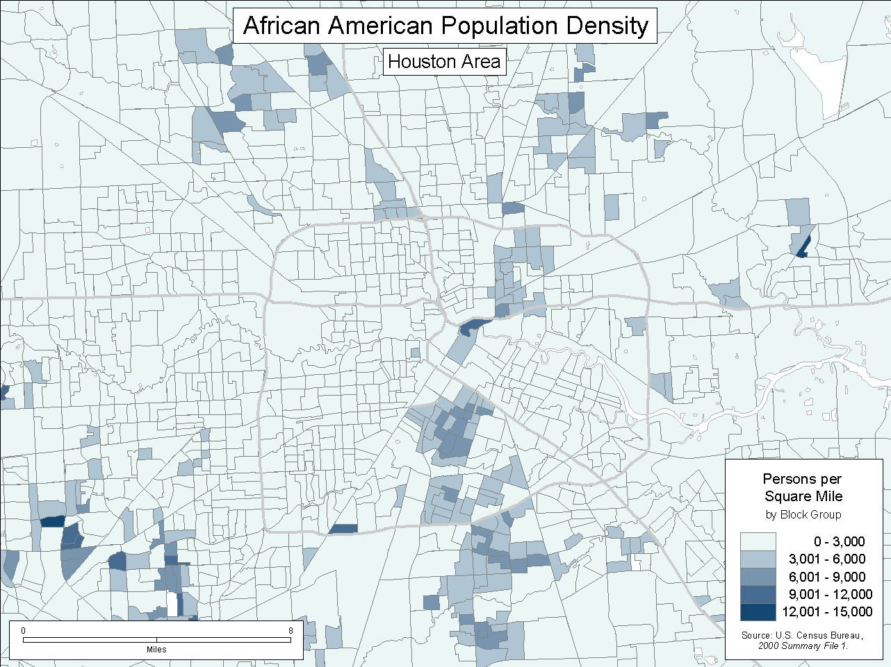
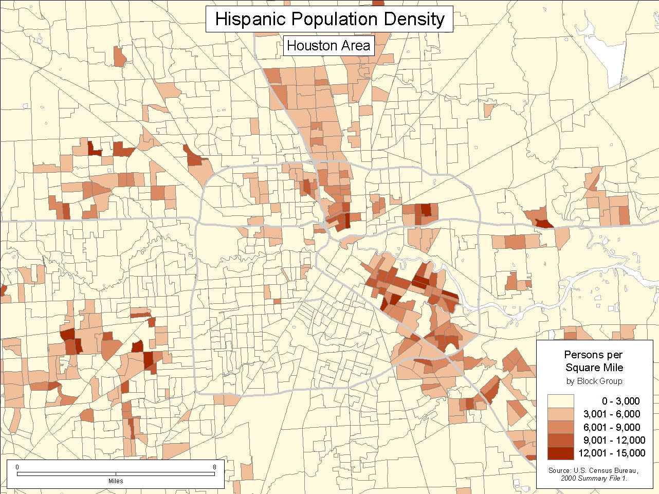
Group Activity
National Geospatial Technology Center of Excellence

Slide 25
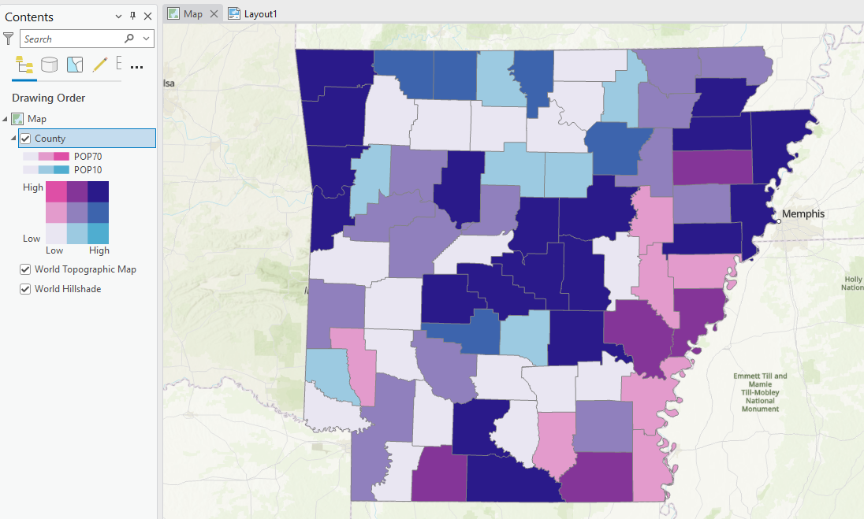
Explore bivariate colors in arcgis pro

Slide 26

Thank you!

