Slide 1

Lecture 07 Digitizing, Georeferencing, Resampling lecture
Instructor: Yanan Wu
fALL 2025

Slide 2
7.1 MAP ELEMENTS

Slide 3
Overview
Digitizing
Digitizing types
Digitizing steps
Snapping
Georeferencing
Control points
Transformation methods
Resampling
Resampling methods

Slide 4
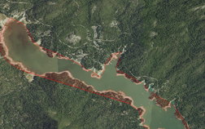
Digitizing
The process by which coordinates from a map, image, or other sources are converted into a vector layer in a GIS.
Notes:
The x, y coordinates of these features are automatically recorded and stored as spatial data.

Slide 5
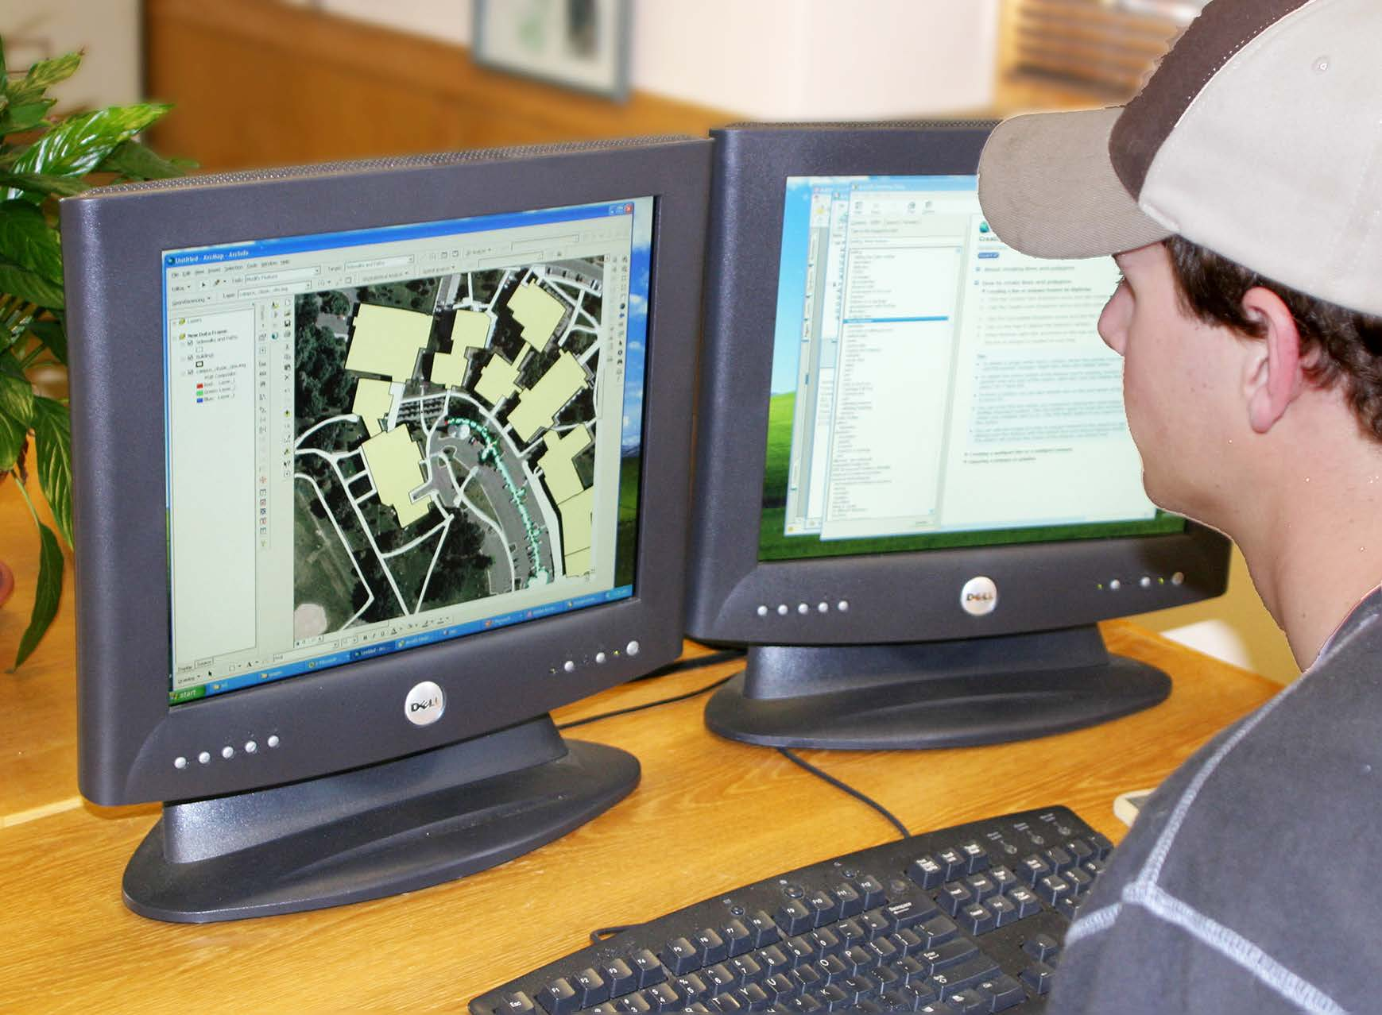
Digitizing
Manual digitization is human-guided coordinate capture from a map or image source.
On-screen digitizing
Heads-up digitizing, involves manually digitizing on a computer screen, using a digital image as a backdrop
Bolstad, 2019
Notes:
The x, y coordinates of these features are automatically recorded and stored as spatial data.

Slide 6
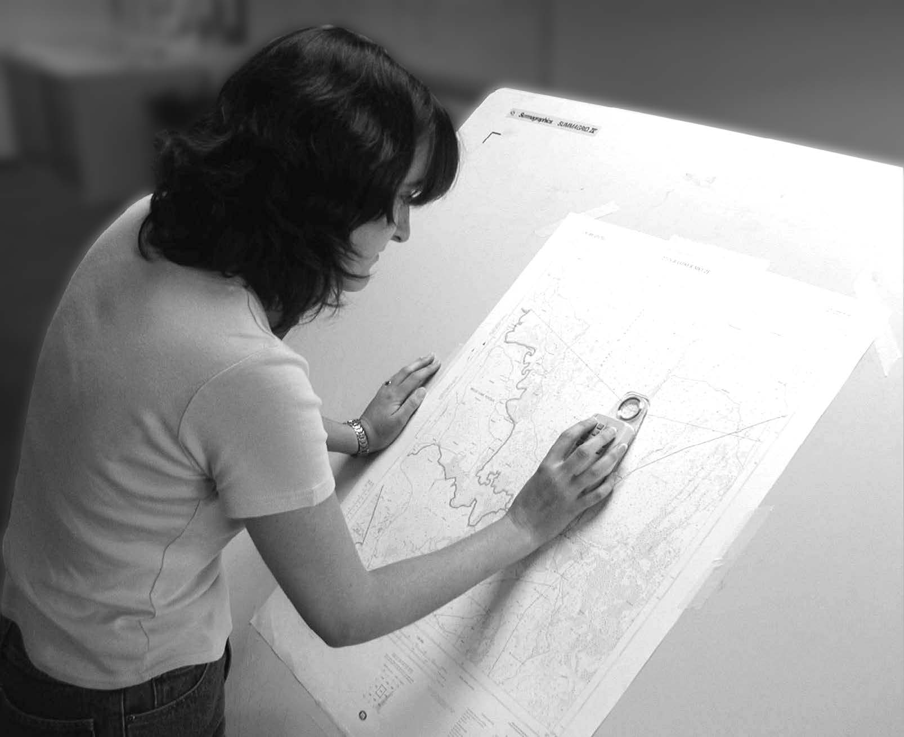
Digitizing
Manual digitization is human-guided coordinate capture from a map or image source.
Hardcopy digitizing
Human-guided coordinate capture from a paper, plastic, or other hardcopy map
Bolstad, 2019
Notes:
electrically sensitized puck. The most common digitizers are based on a wire grid embedded in or under a table

Slide 7
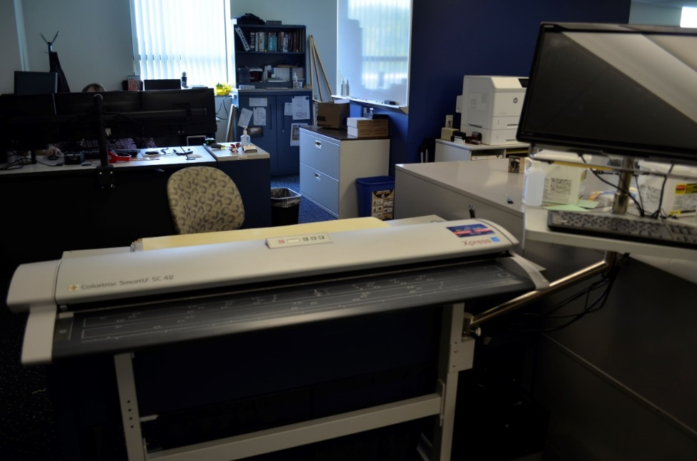
Digitizing
Manual digitization is human-guided coordinate capture from a map or image source.
Scan digitizing

Slide 8
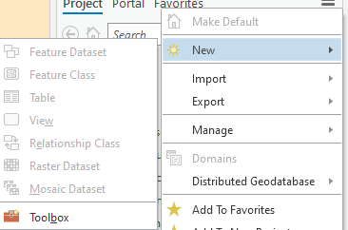
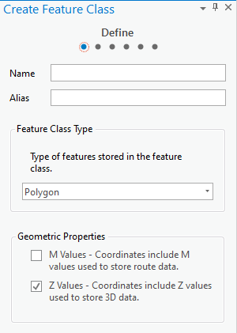
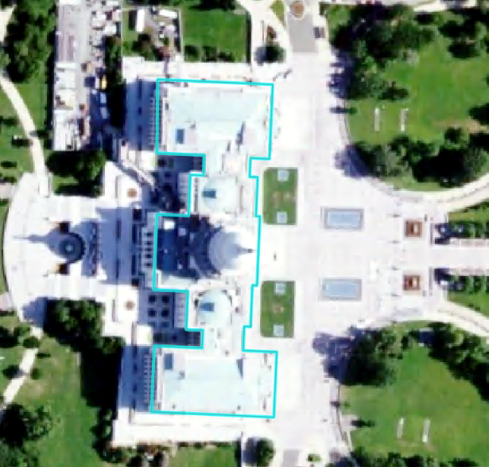
Digitizing Steps
Obtain input imagery or other reference data
Create a new file to edit into
Define geometry (point, lines, or polygon)
Define projection
Create attribute fields
Digitizing
Edit attribute information
Check and validate your results
Notes:
Before beginning to digitize, you will need to obtain some input imagery or other reference data.
You will then need to create a new shapefile or feature class to draw into. This will require defining the geometry (point, line, or polygon), setting the projection or coordinate reference system, and creating any required attribute fields.
You can then draw the new features using the reference data. You will also need to edit the attribute table.
It is always important to validate your results for quality control purposes.

Slide 9
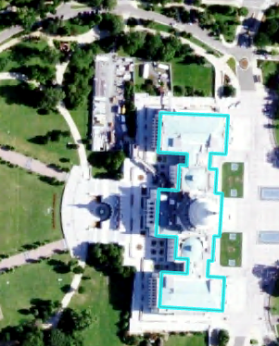
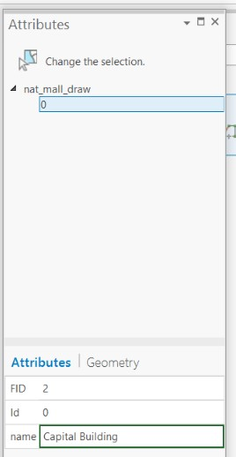
Digitizing in ArcGIS Pro
Use Edit tab
Remember to consider topology
Remember to edit attributes
Save often!!!!!!!
Notes:
Digitizing options are available in the Edit Tab.
As you edit the geometry and attributes, remember to save often so you don’t lose any work.

Slide 10
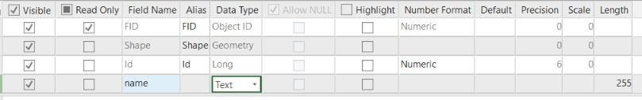
Adding Fields
Make sure to define the correct type
Data Type
Short Integer | Integer values between -32,768 and 32,767
Long Integer | Integer values between -2,147,483,648 and 2,147,483,647
Float | Decimal values with 1-6 decimal places
Double | Decimal values with more the 6 decimal places
Text | Text strings
Date | Data info (mm/dd/yyyy)
Notes:
When creating a new field, you will need to define the field type.
Short and long integer fields can only store integer or whole number values. Long integers can stored a wider range of numbers than short integers.
If you need to maintain decimal values, you cannot use a short or long integer. Instead, you must use a float or double type. Float fields can store up to 6 decimal places while double can store more than 6.
If you would like to store text or string data, you will do so in a text field. Note that numbers stored in text field will be treated like strings. They will not be treated line numbers. For example, you will not be able to perform mathematical operations on these data.
Date fields store dates and will treat the information as dates.

Slide 11
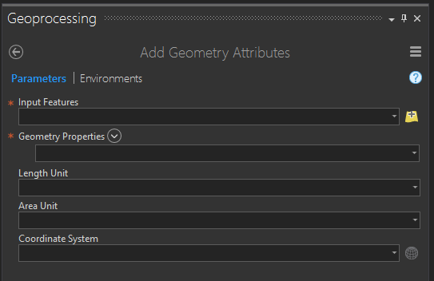
Adding Geometric Fields
Use Add/Calculate Geometry Attributes Tool
Points | Lines | Polygons
X-coordinate | Start-X | Area
Y-coordinate | Start-Y | Perimeter
Z-coordinate (if z-enabled) | End-X | Centroid-X
M-coordinate (if m-enabled) | End-Y | Centroid-Y
 | Mid-X
 | Mid-Y
 | Length
 | Bearing
Notes:
Different geometric measures can be calculated and stored in the attribute table for points, lines, and polygon data.
For point data, it is possible to store the x and y coordinate. If the feature is Z-enabled, or contains elevation or height information, this value can also be calculated. If it is M-enable, the M coordinate can be calculated. M-coordinates generally relate to positions along a network.
For lines, you can calculate the x and y coordinates for the start, end, and middle of the line segment. You can also calculate the length and bearing. The bearing is the compass direction of the line and is defined as the direction of travel from the start to the end node.
For polygons, you can calculate the area and perimeter. The perimeter is the length of all the lines that make up the polygon. You can also calculate the centroid, or geometric center, coordinates. Note that centroid coordinates can sometimes be misleading. For example, for irregular or elongated shapes, the centroid may not actually occur within the polygon. For a “C” shaped feature, the centroid would occur somewhere in the middle of the “C” as oppose to within the area that makes it up. So, be careful when using centroid measures.

Slide 12
Impacts on Digitizing Accuracy/ Precision
Factors affect accuracy of digitizing
Source data errors
The surface error caused by 1 millimeter digitizing error
Bolstad, 2019

Slide 13
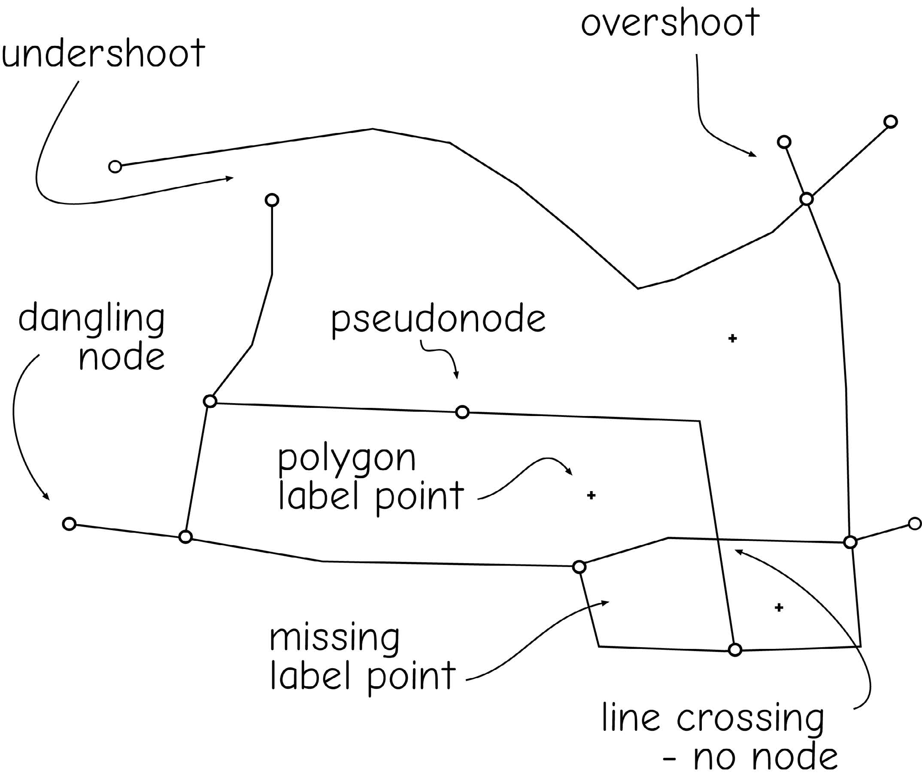
Impacts on Digitizing Accuracy/ Precision
Factors affect accuracy of digitizing
Precision of equipment
The abilities and attitude of the person digitizing affects the geometric quality of manually digitized data
Bolstad, 2019
Notes:
Dangling include overshoot and undershoot, and two lines with points not connected. Dangling node include undershoot and overshoot node.

Slide 14
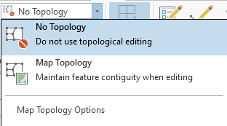
Impacts on Digitizing Accuracy/ Precision
Factors affect accuracy of digitizing
Precision of equipment
The abilities and attitude of the person digitizing affects the geometric quality of manually digitized data
Topology
Bolstad, 2019

Slide 15
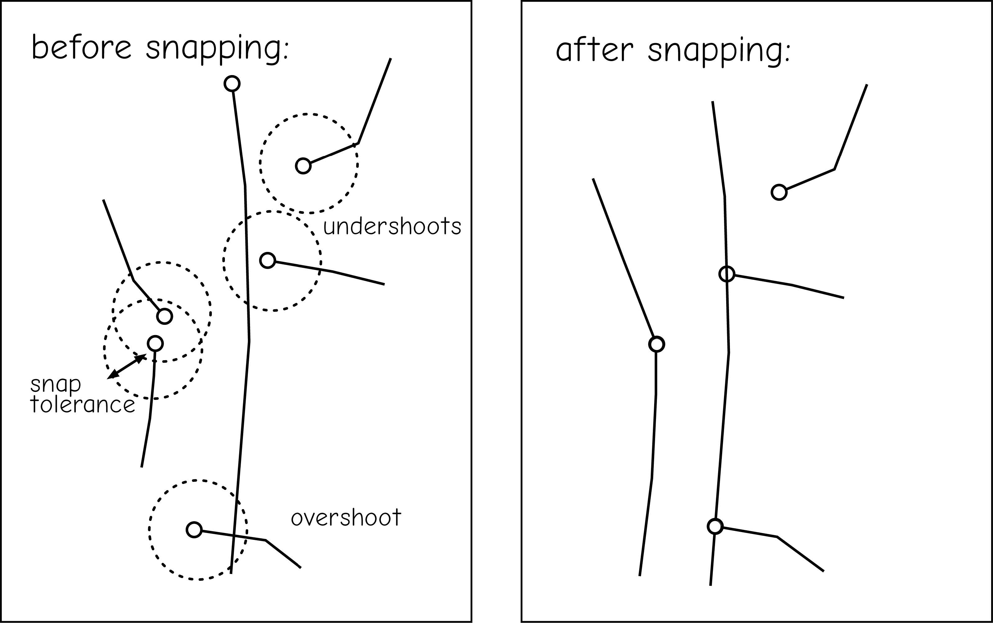
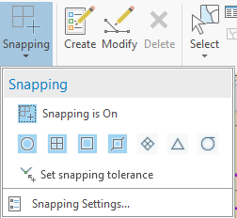
Impacts on Digitizing Accuracy/ Precision
Factors affect accuracy of digitizing
Precision of equipment
The abilities and attitude of the person digitizing affects the geometric quality of manually digitized data
Snapping
Bolstad, 2019

Slide 16
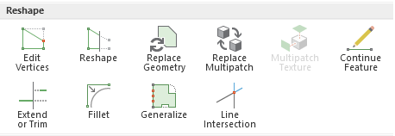
Impacts on Digitizing Accuracy/ Precision
Factors affect accuracy of digitizing
Precision of equipment
The abilities and attitude of the person digitizing affects the geometric quality of manually digitized data
Reshaping

Slide 17
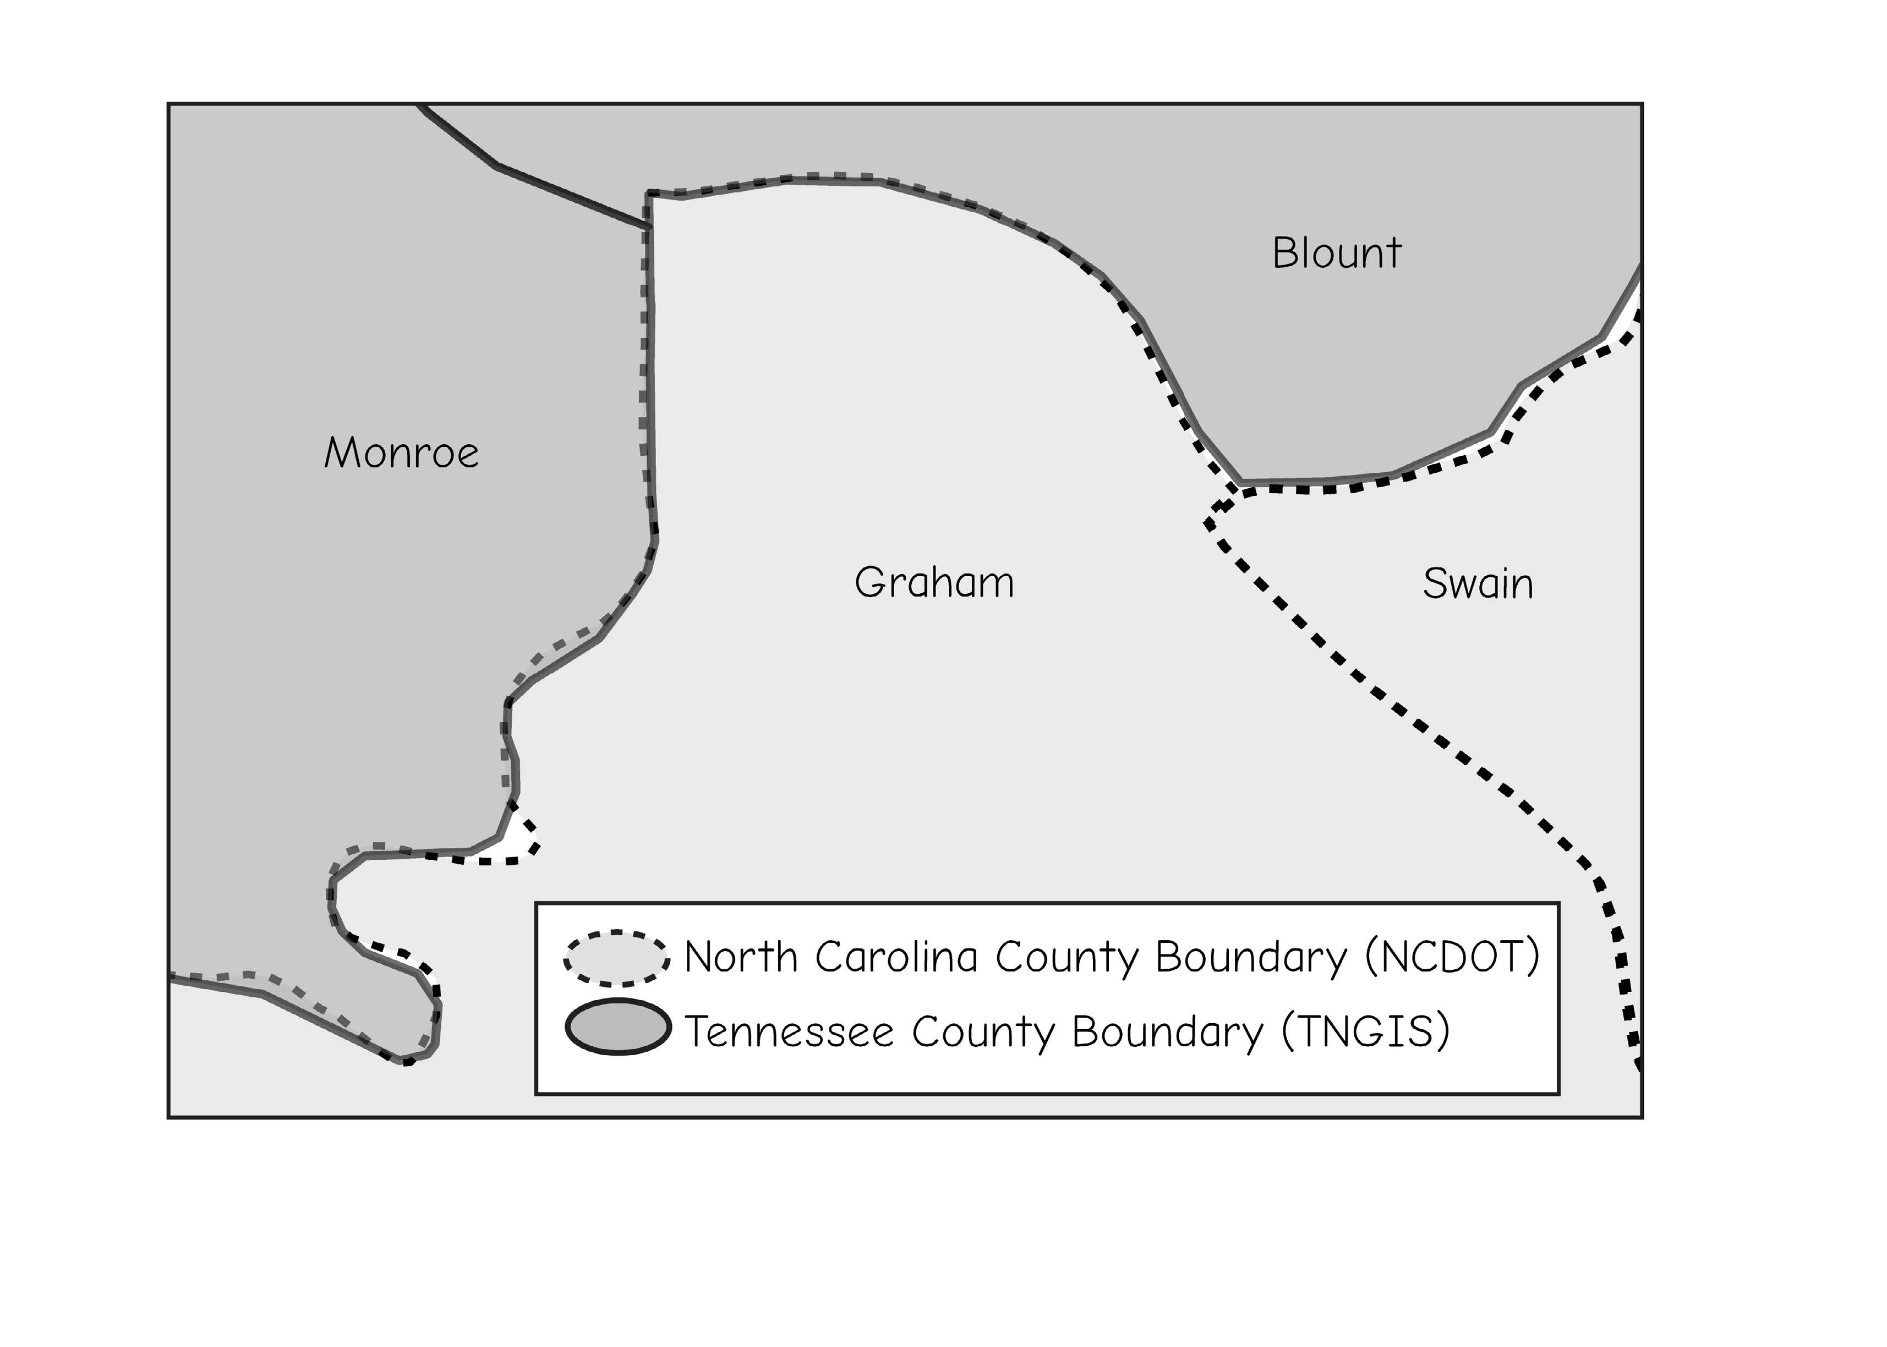
Impacts on Digitizing Accuracy/ Precision
Factors affect accuracy of digitizing
Precision of equipment
The abilities and attitude of the person digitizing affects the geometric quality of manually digitized data
Common feature inconsistency
Using a master boundary
Bolstad, 2019

Slide 18
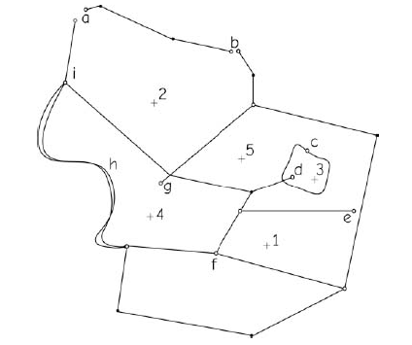
Group Activity
Identify a characteristic feature or error in digitizing at each of the labeled letter locations in the drawing below.
Bolstad, 2019
Notes:
a-undershoot; b-undershoot; c-psuedonode; d-overshoot; e-undershoot; f-missing label; g-overshoot.

Slide 19
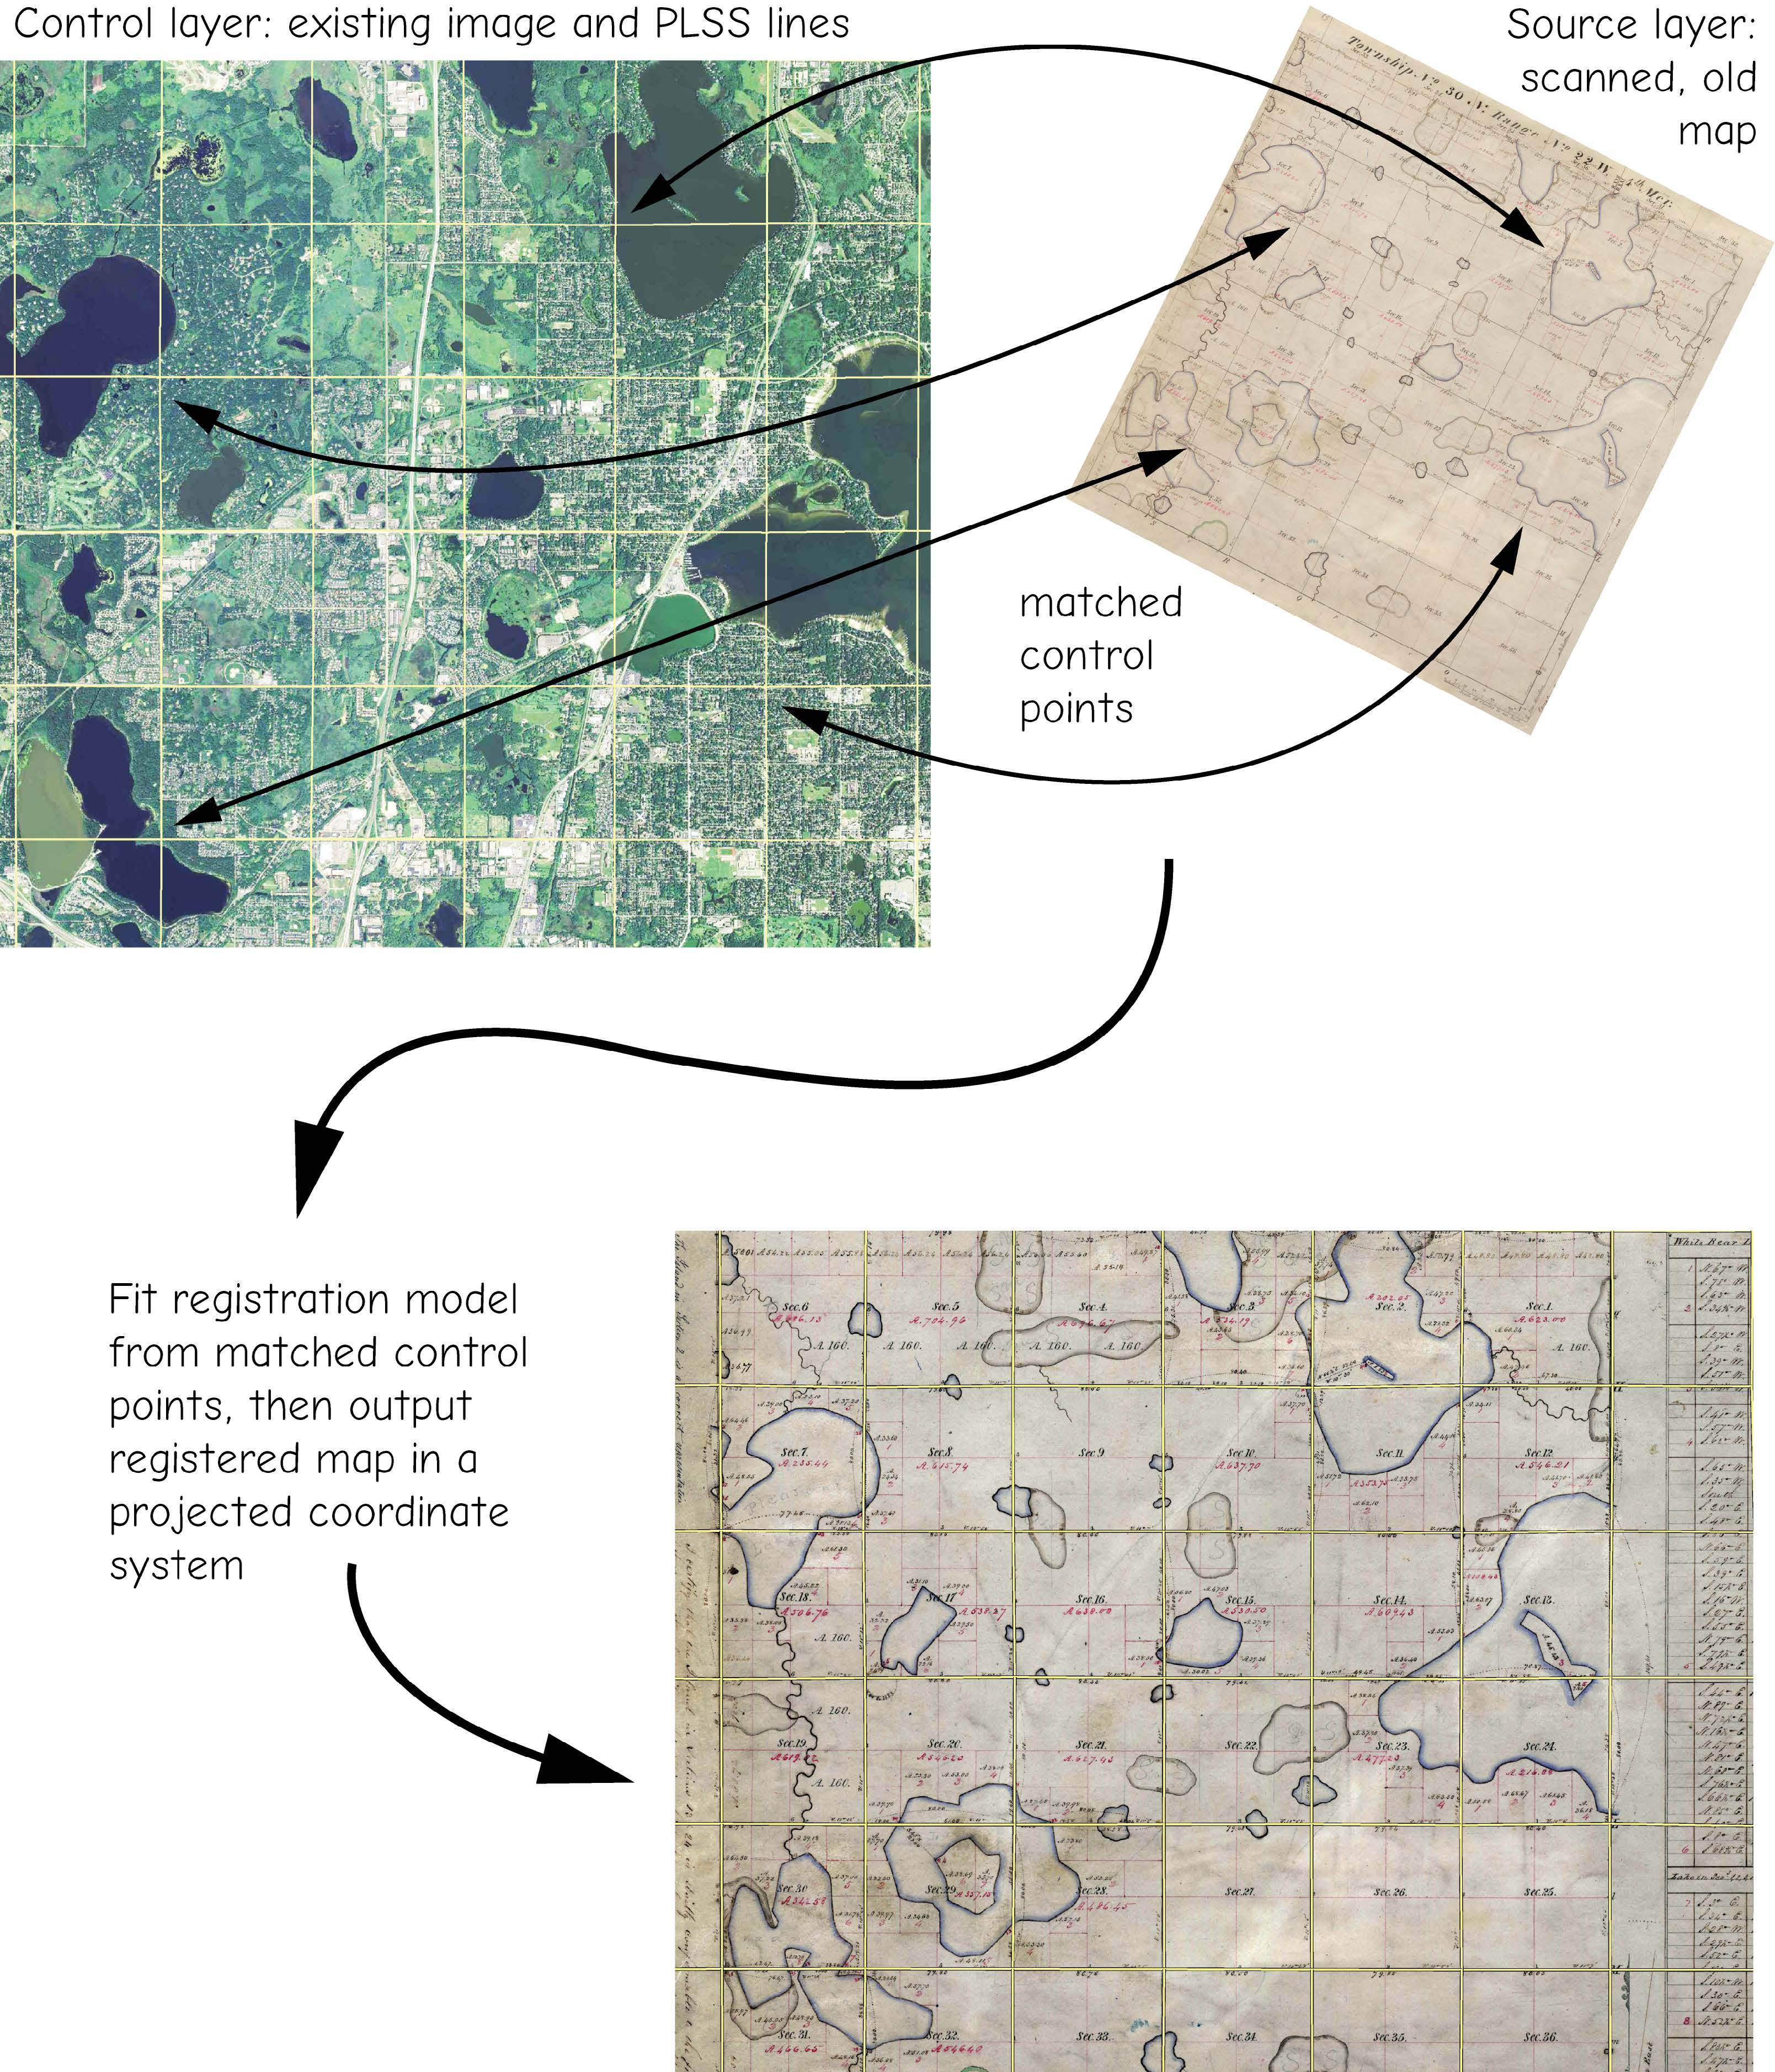
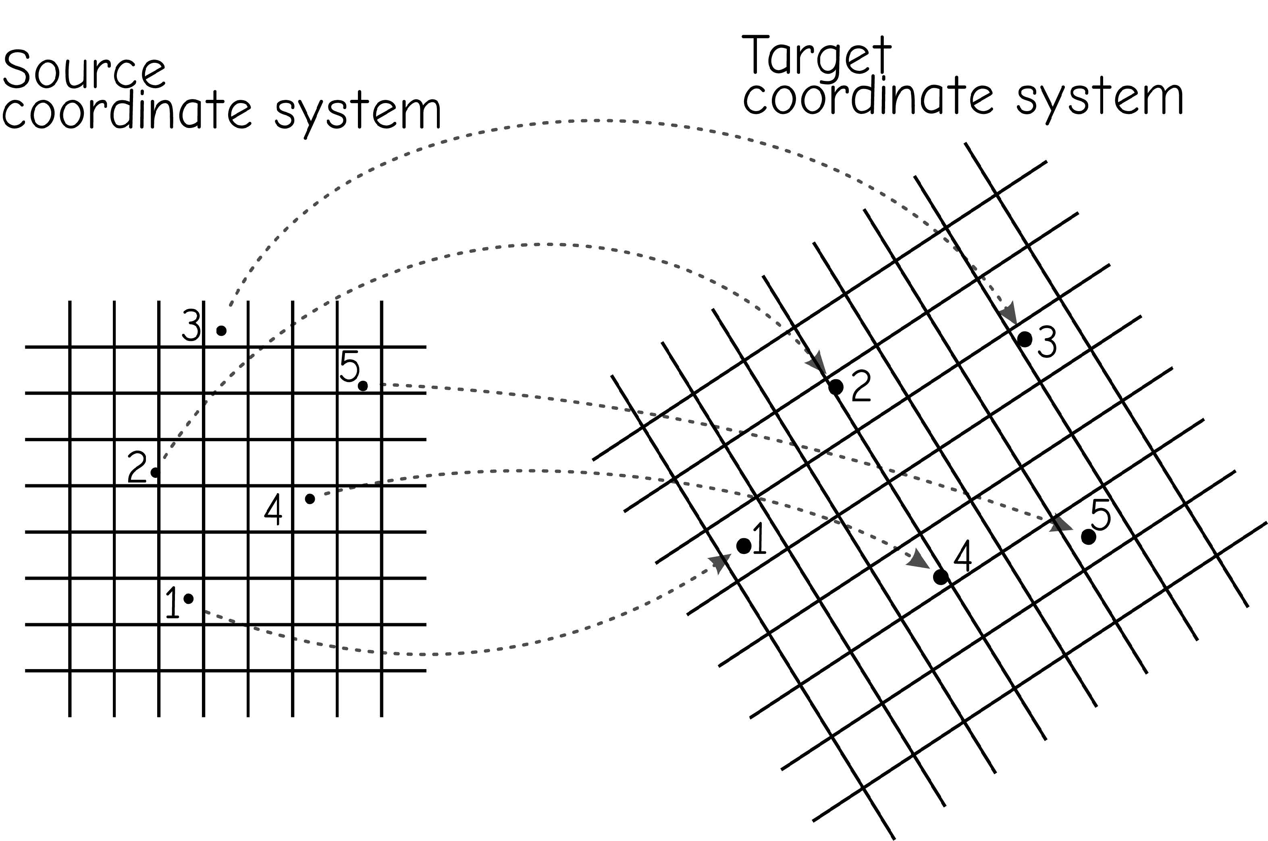
Georeferencing
Process of aligning an unreferenced dataset with one that has spatial reference information.
Bolstad, 2019
Notes:
Georeferencing is the process of aligning an unreferenced dataset with one that has spatial reference information.
As an example, you may want to use a paper map in your GIS. In order to use it effectively with other data layers, it will need to be referenced to the correct location in the map space. So, you will need to create a digital data file then apply a process to align it to other data layers in the map space. This is the process of georeferencing.
When aerial or satellite imagery are collected, they also need to be referenced to the correct location in the map space.
So, this is a common preparatory task when working with spatial data.
Many GIS and remote sensing software packages provide georeferencing tools.

Slide 20
Scanning
Convert paper map to digital raster data
Resolution and quality depends on the quality of original paper data and scanning settings (e.g., dots per inch (dpi))
Can be converted back to vector data via digitizing or tracing
Notes:
The quality of the scanned raster image will partially depend on the quality of the analog data. However, the scanning settings can also have an impact, such as the dpi used.
Make sure that you use adequate settings to scan in quality data.
Once data have been scanned in and georeferenced, vector data can be generated by digitizing or tracing over the map data.

Slide 21
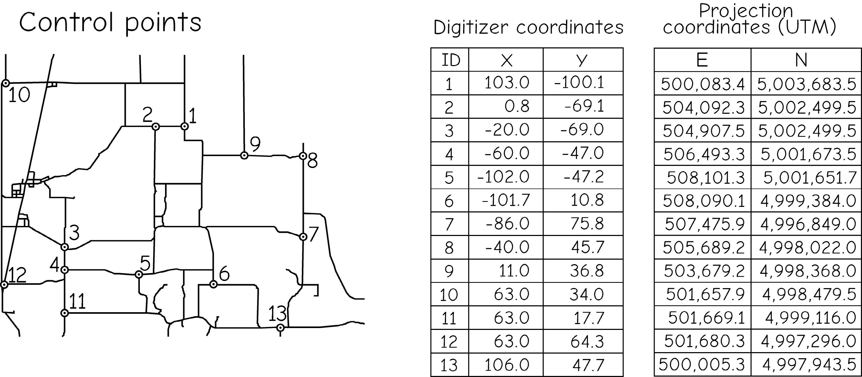
Control Points
Used to register dataset to known location
Used as reference and represent the same location in the data being referenced and reference data
Bolstad, 2019
Notes:
Control points are an important component of the georeferencing process.
Control points are used as reference and represent the same location in the data being referenced and reference data.
Control points can be created by digitizing examples on the screen.
Whenever aerial imagery is collected, it is common for ground control points to be placed on the ground prior to the data collection. These ground targets are surveyed using GPS equipment. An analyst can then use the ground targets in the image and their associated coordinates to georeference the data. This method generally produces quality results. However, this is only possible if control points can be placed in the image prior to the data collection.
So, many times were are forced to create control points on the computer screen and georeference our data relative to a dataset that has already been referenced, such as aerial imagery.

Slide 22
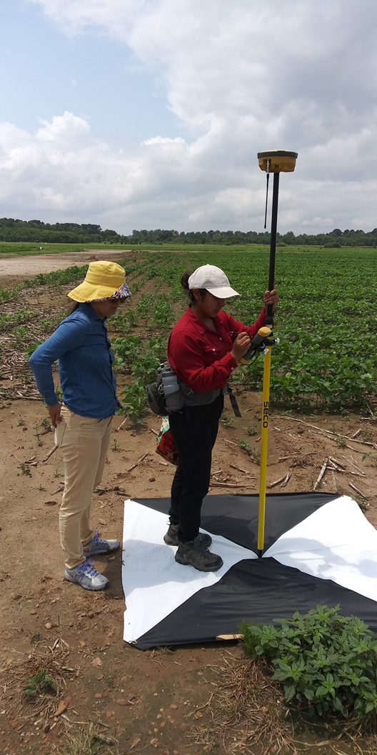
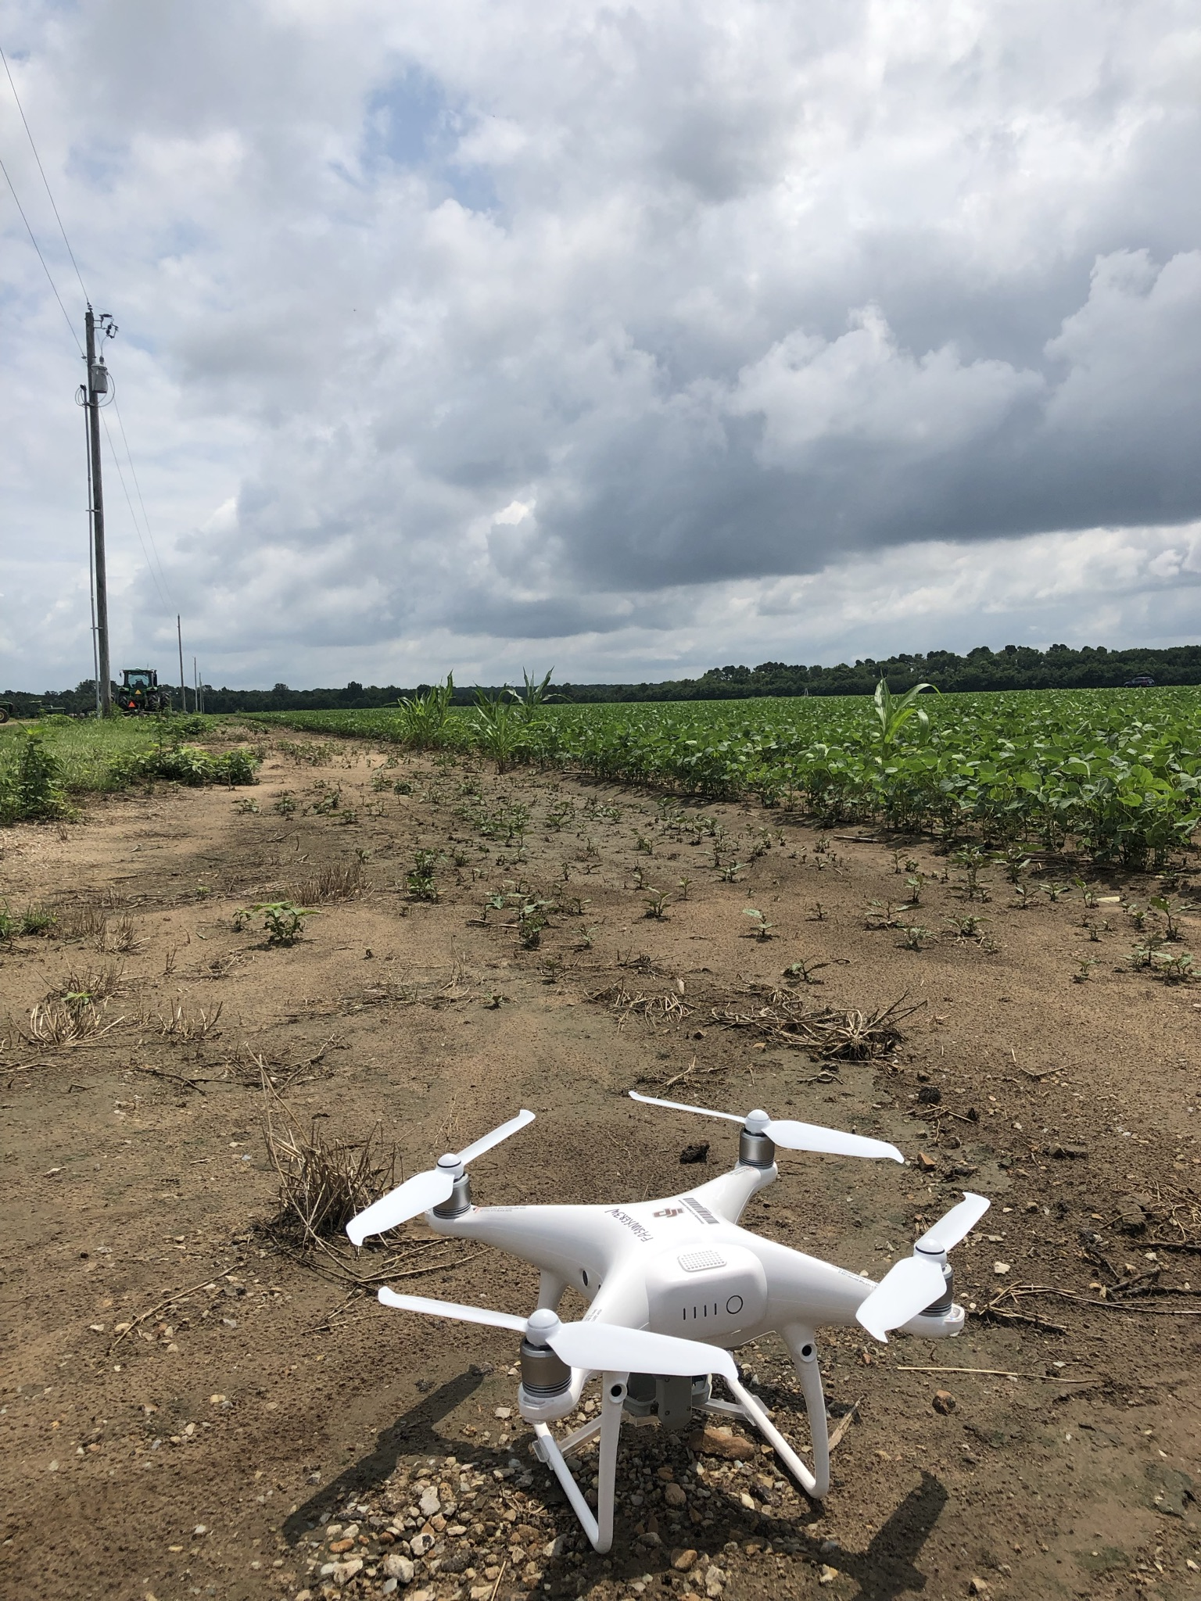
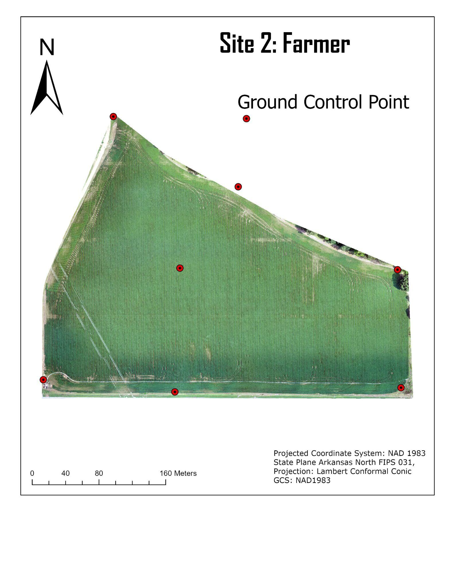
Control Points
Used to register dataset to known location
Used as reference and represent the same location in the data being referenced and reference data
Notes:
Control points are an important component of the georeferencing process.
Control points are used as reference and represent the same location in the data being referenced and reference data.
Control points can be created by digitizing examples on the screen.
Whenever aerial imagery is collected, it is common for ground control points to be placed on the ground prior to the data collection. These ground targets are surveyed using GPS equipment. An analyst can then use the ground targets in the image and their associated coordinates to georeference the data. This method generally produces quality results. However, this is only possible if control points can be placed in the image prior to the data collection.
So, many times were are forced to create control points on the computer screen and georeference our data relative to a dataset that has already been referenced, such as aerial imagery.

Slide 23
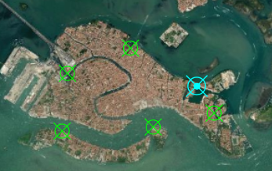
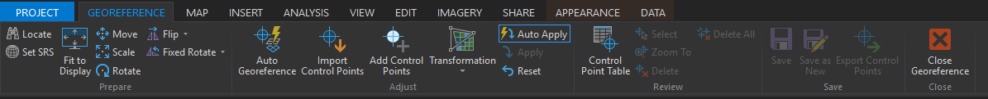
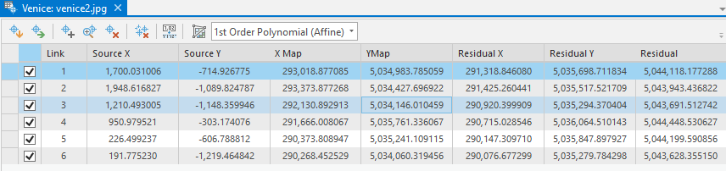
Control Points
Used to register dataset to known location
Used as reference and represent the same location in the data being referenced in reference data
Notes:
Control points are an important component of the georeferencing process.
Control points are used as reference and represent the same location in the data being referenced and reference data.
Control points can be created by digitizing examples on the screen.
Whenever aerial imagery is collected, it is common for ground control points to be placed on the ground prior to the data collection. These ground targets are surveyed using GPS equipment. An analyst can then use the ground targets in the image and their associated coordinates to georeference the data. This method generally produces quality results. However, this is only possible if control points can be placed in the image prior to the data collection.
So, many times were are forced to create control points on the computer screen and georeference our data relative to a dataset that has already been referenced, such as aerial imagery.

Slide 24
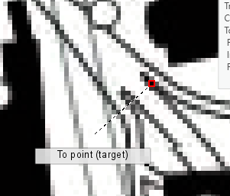
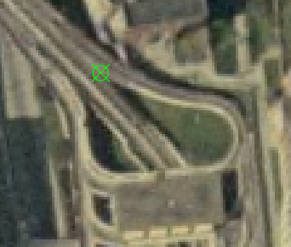
Control Points
Criteria for control points:
Spread evenly around study area
Enough points to use the algorithm of choice
Use highest accuracy dataset possible
Use locations identifiable on both datasets (known & unknown)
From Point: location on the data being referenced
To Point: same location on the reference data
Notes:
Collecting quality control points is key for successful georeferecning. Here are some suggestions for collecting quality control points.
First, the control points should be spread evenly around the study area. If the control points are only collected within the center of the image, the algorithm used will have a difficult time accurately referencing the margins of the image. So, make sure to include some points in the image margins.
You should have enough points to use the georeferecning algorithm of choice. The number of points needed depends on the algorithm, which we will discuss later.
Any positional errors in the input data will impact the georeferecning result. So, it is important to use quality reference data. Generally, we rely on high resolution imagery.
Locations must be identifiable in both datasets, the data being referenced and the reference imagery.
Generally, I try to obtain as many quality reference points as possible. However, adding more points that may be suboptimal can cause issues. So, make sure the points that you use can be accurately located in both images. Adding points that are of low quality can decrease the quality of the result.
When defining a control point, you will need to identify it in both datasets. The from point is the location on the data being referenced while the to point is the location relative to the reference data. The algorithm will attempt to move the from point location to the to point location.

Slide 25
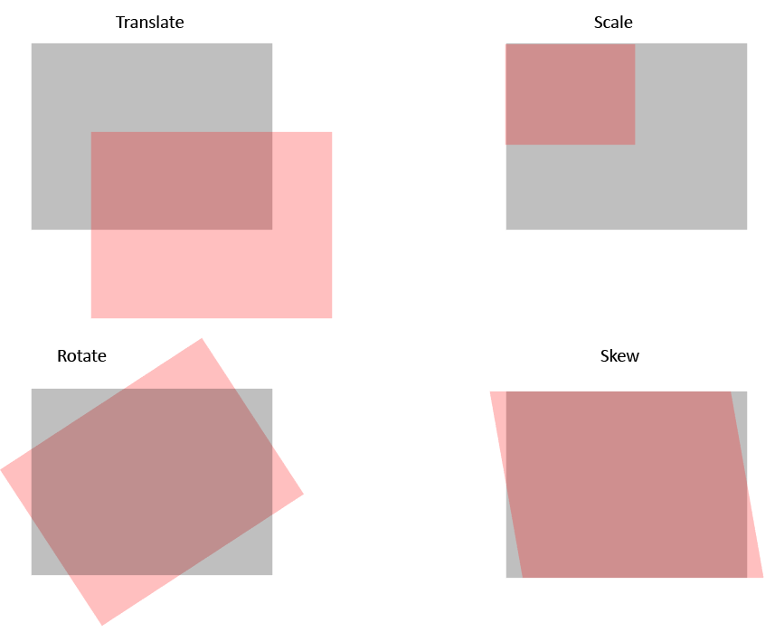
Transforming the Data
In order to georeferenced data, it may need to be:
Translate
Scale
Rotate
Skew
These transformations are applied mathematically.
Notes:
When performing georeferencing different transformations can be applied.
Translation implies moving the image without changing its shape or size.
Changing the scale means to change the size of the image but not the shape.
Rotation will reorient the scene relative to a point of rotation.
Skew is used to change or distort the shape of the data.
The transformations that can be applied depends on the algorithm used.

Slide 26
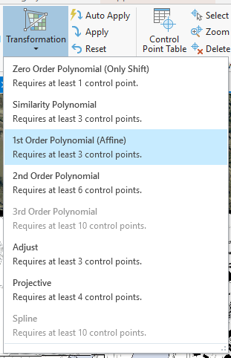
Transformation Method
Zero-Order Polynomial = just translate the data (need 1 control point)
First-Order Polynomial (Affine) = translate, scale, and rotate (need 3 control points)
Higher Order = more complex distortions can be corrected
Rarely use higher than third order
Need more control points
If raster dataset must be bent or curved, use a second- or third-order transformation
Notes:
Polynomial equations can be used for georeferencing.
Zero-order polynomials can only shift or translate the image and require only a single control point.
First-order polynomials can translate, scale, and rotate the data. However, they cannot change the shape or skew the image. Three control points are required.
Higher order polynomials can apply all four distortions and require more than three control points. We rarely use higher than third order polynomials for georeferencing.

Slide 27
First-Order Polynomial (Affine)
Transformation Method
x
X = Ax + By + C
Y = Dx + Ey + F
X = new x coordinate
Y = new y coordinate
x = original x coordinate y = original y coordinate
x
x
x
(Map) Northings (m)
x
Image Row #
Example by Dr. Tim Warner
Notes:
This slide provides an example of a first-order polynomial, also called an affine transformation.
Here, the new X and Y coordinates are predicted using the original x, and y coordinates. Note that both coordinates are used to predict each of the new coordinates.
The goal here is to determine appropriate coefficients to transform the data. Note that x and y are not raised to a power, as this in only first-order, so no square or cubed terms can be used.
The A term and D terms relate to changing the scale in the x and y directions, respectively. The B and E terms relate to rotation, and the C and F terms relate to translation. Again, this method does not allow for a skew to be applied.
The terms are determined using the control points.

Slide 28
Transformation Method
Adjust = combines polynomial and triangular irregular network (need 3 control point)
Similarity = first order transformation which tries to preserve the shape of the original raster (need 3 control points)
Projective = commonly used for image data (need 4 control points)
Spline = uses rubber sheeting (need 10 control points)
Notes:
Other methods are available that do not rely on or solely rely on polynomial equations. This slide provides some examples.
Again, different projection methods require different numbers of control points.
The optimal method will depend on the data being referenced, the control points used, and the required transformations.

Slide 29
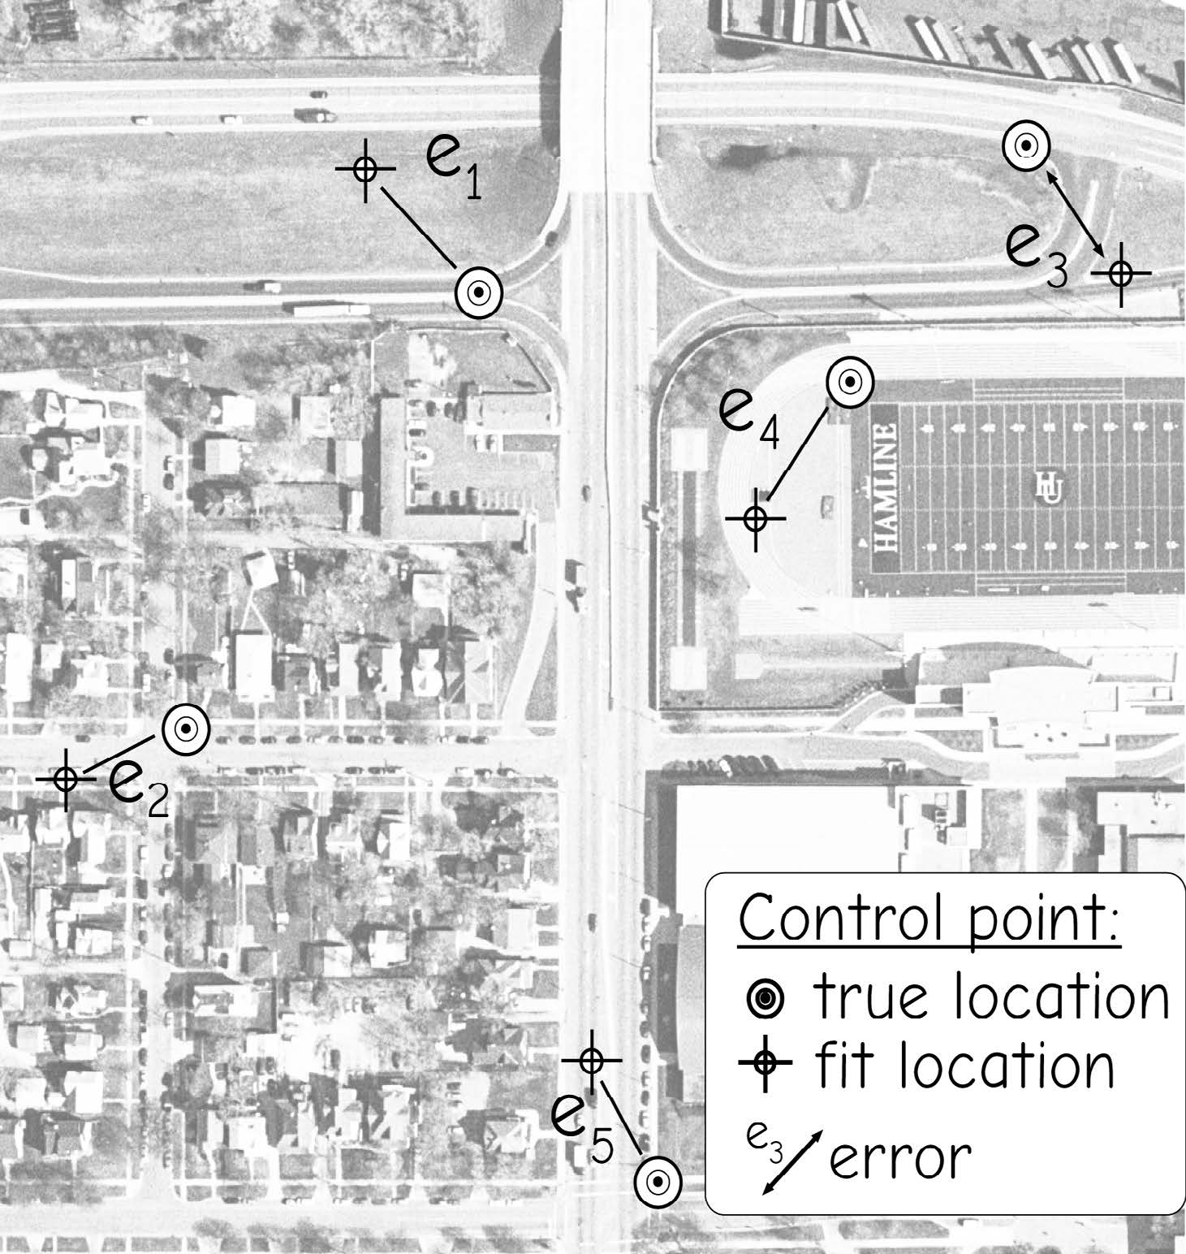
Assess the quality of georeferenced result
Root mean square error (RMSE)
Measure of how well the now-referenced data matches with the source
Obtained by comparing the known location of the control point with the computed coordinates of the control point.
RMSE_{x} = √ Σ(x_{predicted} – x_{actual})²/n
RMSE_{y} = √ Σ(y_{predicted} – y_{actual})²/n
RMSE = √ (RMSE_{x}² + RMSE_{y}²)
Bolstad, 2019
Notes:
Georeferencing is generally assessed using the root mean square error, or RMSE, statistic.
This measure provides an assessment of how well the now referenced data matches the source or reference image.
It is generally calculated by comparing the known location of the control point with the computed coordinates of the control point.
The predicted x and y coordinates are subtracted from the correct location to obtain a residual or error. The residuals are then squared, summed, then divided by the number of samples. Lastly the square root is taken. This will provide a RMSE for the x and y directions. These measures can then be combined to obtain a total RMSE.
RMSE will be reported in the map units or as number of pixels. Lower RMSE is better.

Slide 30
Assess the quality of georeferenced result
Correct X | Correct Y | Predicted X | Predicted Y | X residual | Y residual | X residual squared | Y residual squared
513,126.80 | 4,101,294.60 | 513,127.30 | 4,101,293.40 | 0.5000 | -1.2000 | 0.2500 | 1.4400
513,123.20 | 4,101,303.40 | 513,118.10 | 4,101,302.10 | -5.1000 | -1.3000 | 26.0100 | 1.6900
513,203.80 | 4,101,209.10 | 513,203.10 | 4,101,207.20 | -0.7000 | -1.9000 | 0.4900 | 3.6100
513,182.60 | 4,101,377.80 | 513,181.60 | 4,101,379.90 | -1.0000 | 2.1000 | 1.0000 | 4.4100
513,217.60 | 4,101,403.60 | 513,216.10 | 4,101,405.20 | -1.5000 | 1.6000 | 2.2500 | 2.5600
 |  |  |  |  |  | RMSE X | 2.45
 |  |  |  |  |  | RMSE Y | 1.66
 |  |  |  |  |  | RMSE | 2.96
Notes:
This slide provides an example of an RMSE calculation.
The correct and predicted x and y coordinates are differenced to obtain a residual. The residuals are then squared, summed, then divided by the number of samples. The last step is to take the square root.
Once the RMSE is obtained in the x and y directions, they can be combined to obtain a total RMSE.
In this example, the total RMSE is 2.96 meters. This suggest that each pixel is, on average, 2.96 meters from its correct location.
What is considered an acceptable RMSE? This depends on many factors. For example, coarser spatial resolution data will tend to have a larger RMSE than fine resolution data as the larger pixel or cell size will result in some spatial ambiguity.
For imagery, our goal is generally to obtain and RMSE that is smaller than the dimensions of a pixel or cell.
Some mapping tasks may require better georeferencing results than others. There will always be some georeferencing or positional error in your data.

Slide 31
Individual Activity
Calculate RMSEx, RMSEy, and RMSE using Excel sheet
Notes:
Positional uncertainty relates to differences in the position of your data relative to the correct location.
You can consider uncertainty in 2D space as x and y coordinates in a geographic or projected space.
You can also consider the uncertainty of elevation measurements.
Combining these, you can consider uncertainty in 3D space.
As an example, the image shows some uncertainty in a vector line road dataset in comparison to the orthophotography.
Positional error is generally assessed using root mean square error or RMSE, similar to how georeferencing results are assessed.
All spatial data have some positional uncertainty; however, this is only a concern if there is too much uncertainty to support your analysis or mapping needs.

Slide 32
RMSE Interpretation
The lower RMSE generally indicates a more accurate affine transformation
For imagery, we generally want the RMSE to be lower than the size of the pixel
Low RMSE can be misleading if the quality of the control points is poor
Sometimes the algorithm overfits to the control points, so the RMSE can be misleading
The RMSE is not useful when comparing among different model forms
Notes:
Here are some other notes regarding interpreting RMSE.
Note that RMSE can be misleading if the quality of the control points is suspect or poor.
Also, algorithms commonly overfit to the control points. So, if control points are used to calculate RMSE, the accuracy can be inflated.
It is best to withhold data points and calculate RMSE relative to these locations.

Slide 33
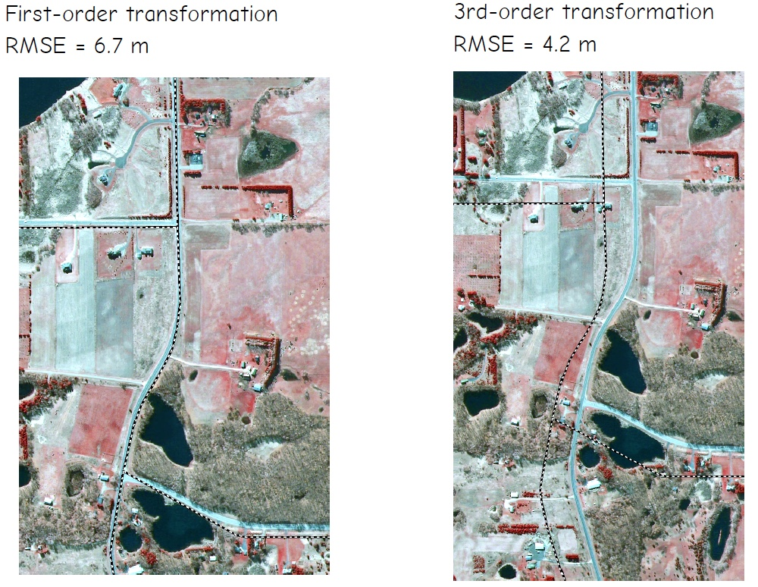
RMSE Interpretation
Bolstad, 2019
Notes:
Here are some other notes regarding interpreting RMSE.
Note that RMSE can be misleading if the quality of the control points is suspect or poor.
Also, algorithms commonly overfit to the control points. So, if control points are used to calculate RMSE, the accuracy can be inflated.
It is best to withhold data points and calculate RMSE relative to these locations.

Slide 34
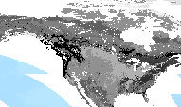
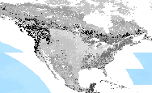
Resampling
Change the cell size
500 m cell size
Resampled 8,000 m cell size
Notes:
Resampling is used to change the cell size of raster data. Generally, cells are made larger, or the data are coarsened, since making the cells smaller will not really add information but will just duplicate existing values. You can’t increase the detail by simply resampling a coarser dataset to a finer resolution.
You may resample raster data to make it easier to process over large extents or to change the cell size to match other inputs in an analysis.
We will now talk about methods used to resample raster data.

Slide 35
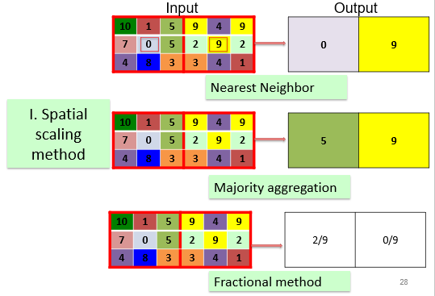
Resampling
Majority Resampling
Resamples using the most common cell value
Good for categorical data
Notes:
Majority resampling will assign the most common cell value of the original cells that fall within the new cell to the new cell.
This method is not generally used for continuous data. It is more commonly used for categorical data.
For example, if a land cover categorical raster grid was resampled using this method, each new cell would be assigned the majority land cover class from the smaller original cells that fall inside of it.

Slide 36
Resampling
Nearest Neighbor
New value will be the value of the original cell closest to the center of the new (larger) cell
Good for categorical data
Notes:
Nearest neighbor resampling assigns the closest cell value from the original raster grid to the new cell.
No averaging is performed, so this method can be used to resample both categorical and continuous data.

Slide 37
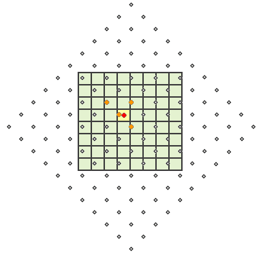
Resampling
Bilinear Interpolation
Uses the inverse distance-weighted average of the four nearest pixel values to estimate a new pixel value
The four cell centers from the input raster that are closest to the cell center for the output processing cell will be weighted based on inverse distance and then averaged
Good for continuous data
Creates a smoothed surface
http://desktop.arcgis.com/en/arcmap/latest/extensions/spatial-analyst/performing-analysis/cell-size-and-resampling-in-analysis.htm
Notes:
Bilinear interpolation uses the inverse distance-weighted average of the four nearest pixel values in the original grid to estimate the new cell value.
The four cell centers from the input raster that are closest to the cell center for the output processing cell will be weighted based on inverse distance and then averaged. So, nearer cells will have a larger weight in the calculation than cells that are further away.
Since averaging is performed, this method is not appropriate for categorical data. However, it can be used for continuous data.
This method tends to smooth the image or raster data.

Slide 38
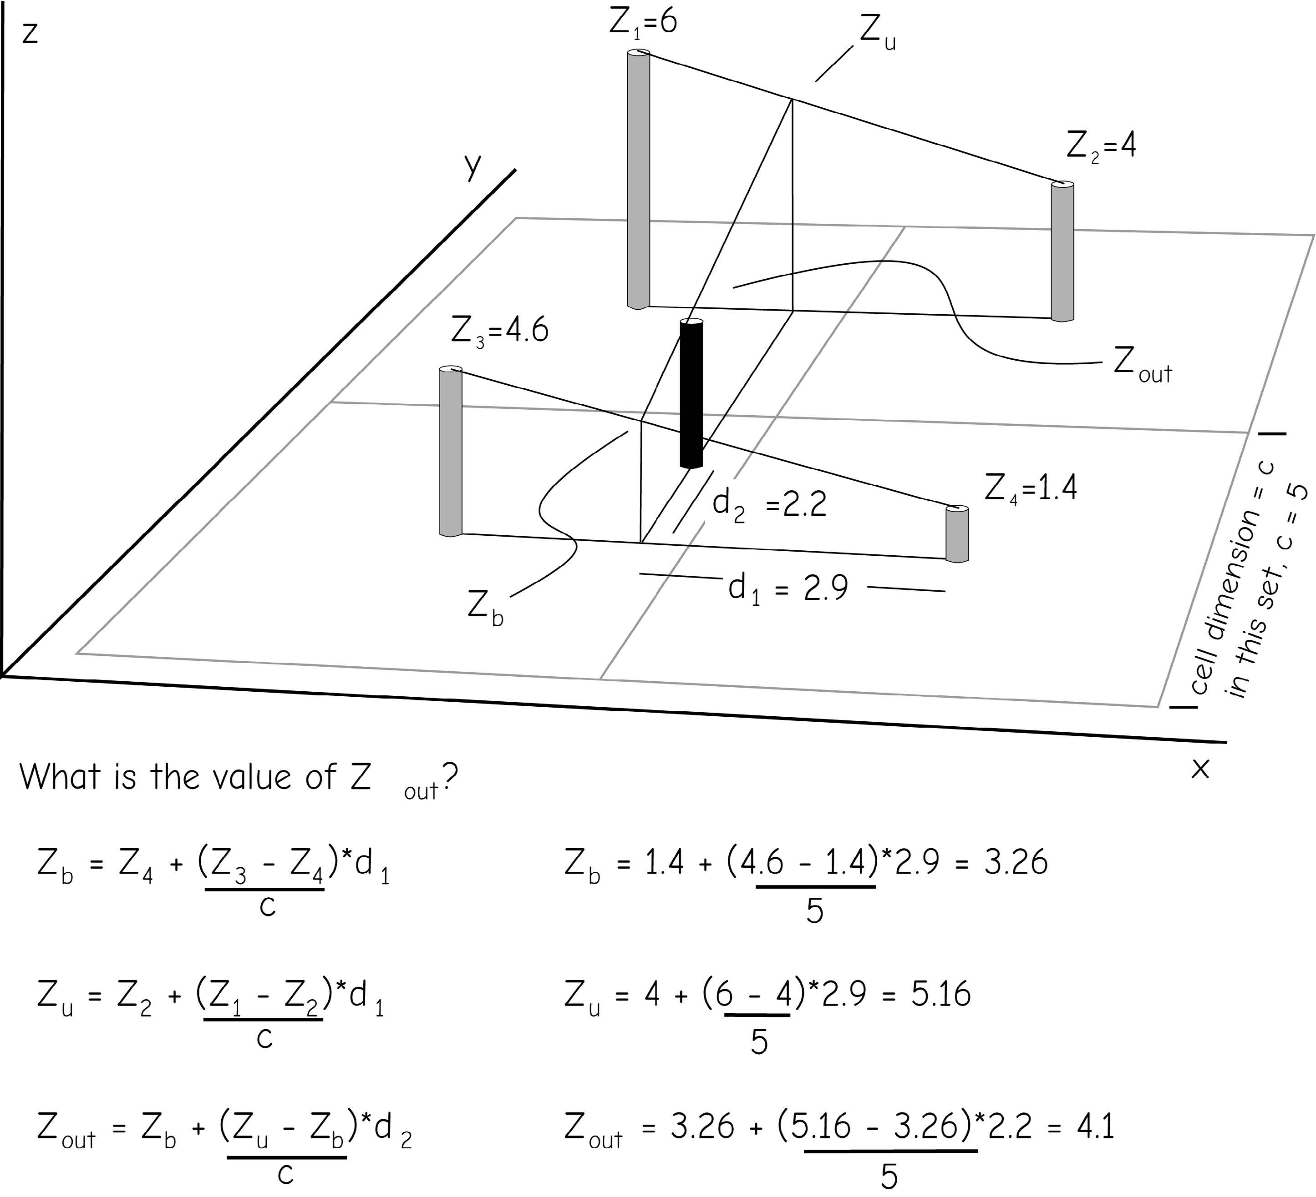
Resampling
Bilinear Interpolation
Uses the inverse distance-weighted average of the four nearest pixel values to estimate a new pixel value
The four cell centers from the input raster that are closest to the cell center for the output processing cell will be weighted based on inverse distance and then averaged
Good for continuous data
Creates a smoothed surface
Notes:
Bilinear interpolation uses the inverse distance-weighted average of the four nearest pixel values in the original grid to estimate the new cell value.
The four cell centers from the input raster that are closest to the cell center for the output processing cell will be weighted based on inverse distance and then averaged. So, nearer cells will have a larger weight in the calculation than cells that are further away.
Since averaging is performed, this method is not appropriate for categorical data. However, it can be used for continuous data.
This method tends to smooth the image or raster data.

Slide 39
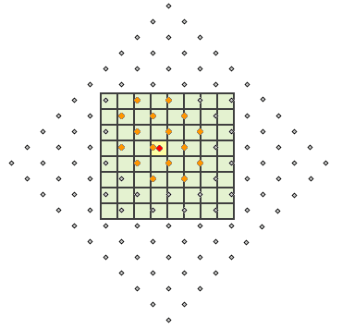
Resampling
Cubic Convolution
Similar to bilinear interpolation, except the 16 nearest input cell centers and their values are used
Good for continuous data
http://desktop.arcgis.com/en/arcmap/latest/extensions/spatial-analyst/performing-analysis/cell-size-and-resampling-in-analysis.htm
Notes:
Cubic convolution is similar to bilinear interpolation except that the nearest 16 cells are used as opposed to the nearest 4. Since it makes use of averaging, it is also not appropriate for categorical data but can be used for continuous data.
This method tends to sharpen edges more than bilinear interpolation.
Bilinear interpolation and cubic convolution are both commonly used to resample image data.

Slide 40
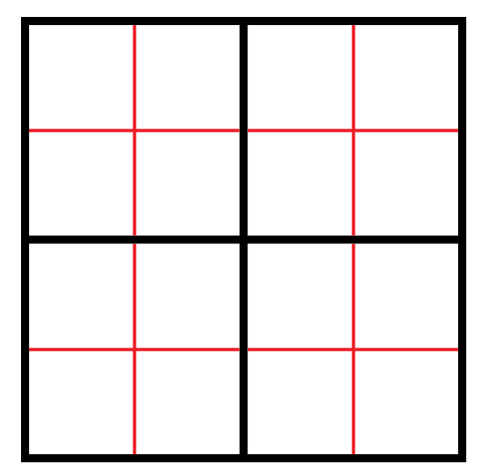
Resampling
Pixel Aggregation
Generates a reduced-resolution version of a raster grid
Each output cell contains the Sum, Minimum, Maximum, Mean, or Median of the input cells that are encompassed by the extent of that cell
Notes:
Another option to change the cell size is to use pixel aggregation. This is also sometimes refered to as image degradation.
When using this method, a statistic from the cells that fall within the new larger cell is calculated and returned to the new cell.
Examples include sum, minimum, maximum, mean, or median.
The raster data can only be reduced in resolution in such a manner that a whole number of input cells will fall perfectly within a new cell. For example, a 2 by 2 meter raster grid could be converted to a 4 by 4 meter grid but not a 3 by 3 meter output.
This method can be used for both categorical and continuous data depending on the statistic returned.

Slide 41
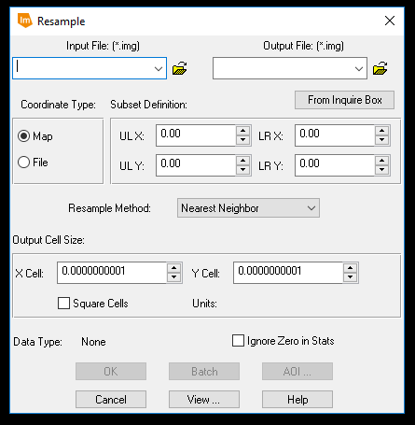
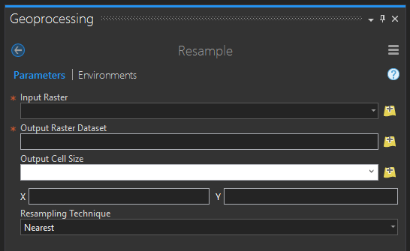
Resampling in ArcGIS Pro
A good resource:
http://desktop.arcgis.com/en/arcmap/latest/extensions/spatial-analyst/performing-analysis/cell-size-and-resampling-in-analysis.htm
Notes:
If you would like to read more about resampling, check out this ESRI link.
Note that resampling is made available in a variety of GIS and remote sensing software packages.

Slide 42

Thank you!

